Slide 1
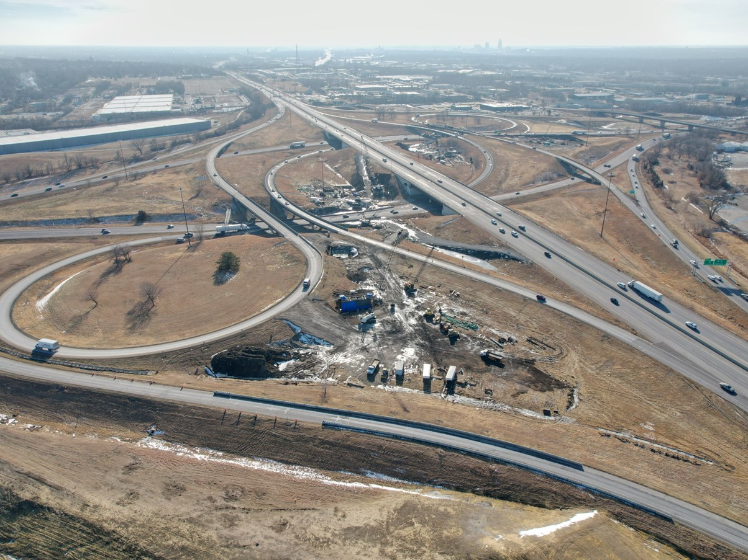


Potential 2026-2030 Highway Program Amendment
December 9, 2025
3/2/2023

Slide 2
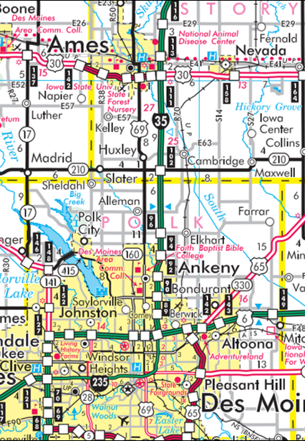
I-35 Corridor
I-35 Ankeny to Ames Capacity Improvements
0.5 mi N of E-57 to N of US 30
2028 ROW
$5.9 Million (Programmed)
2029 Grade/Pave/Signs
$ 13.5 Million (Programmed)
2030 Grade/Pave/Bridge
$22.6 Million (Programmed)
N of 315th St to 0.5 mi N of E-57 (Unprogrammed)
Ankeny to N of 315th St
2026 Grade/Pave/Lighting/Signs
$51.4 Million (Programmed)
2027 Erosion Control
$1.2 Million (Programmed)

Slide 3
Proposed FY 2026-2030 Iowa Highway Program Amendment
County | Route | Location | Estimated Project Costs x $1,000
County | Route | Location | 2026 | 2027 | 2028
Story | 35 | N of 315th St. to 0.5 mi N of Co Rd E-57 | 5,100
 |  | Total change to the highway program | 5,100

Slide 4
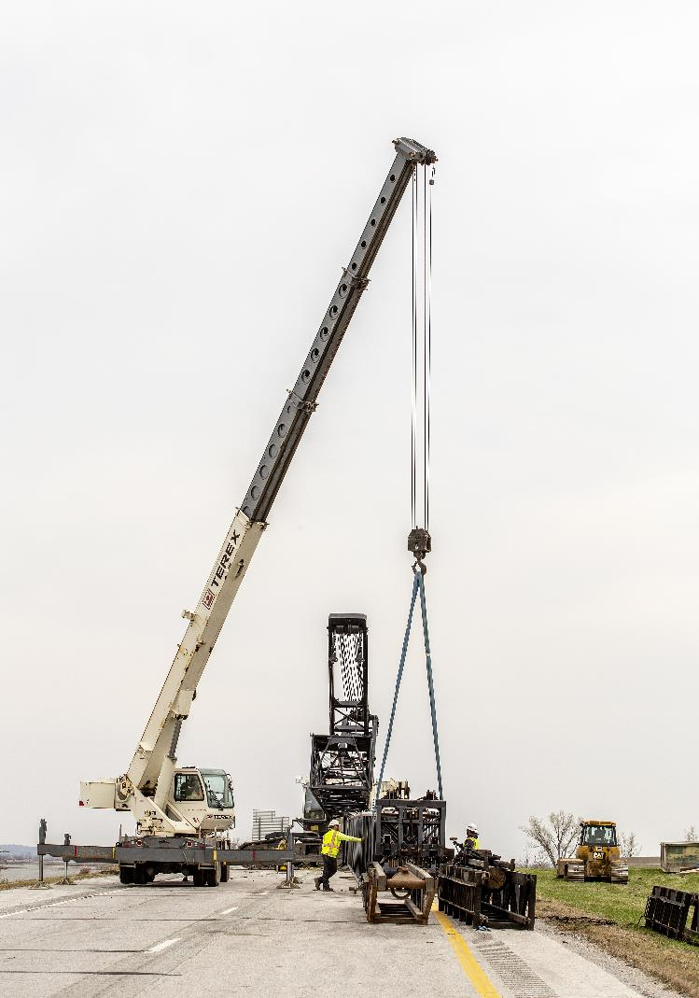
Recommendation
Approve the 2026-2030 Iowa Transportation Improvement Program Amendment.

Slide 5
Questions?

