Slide 1
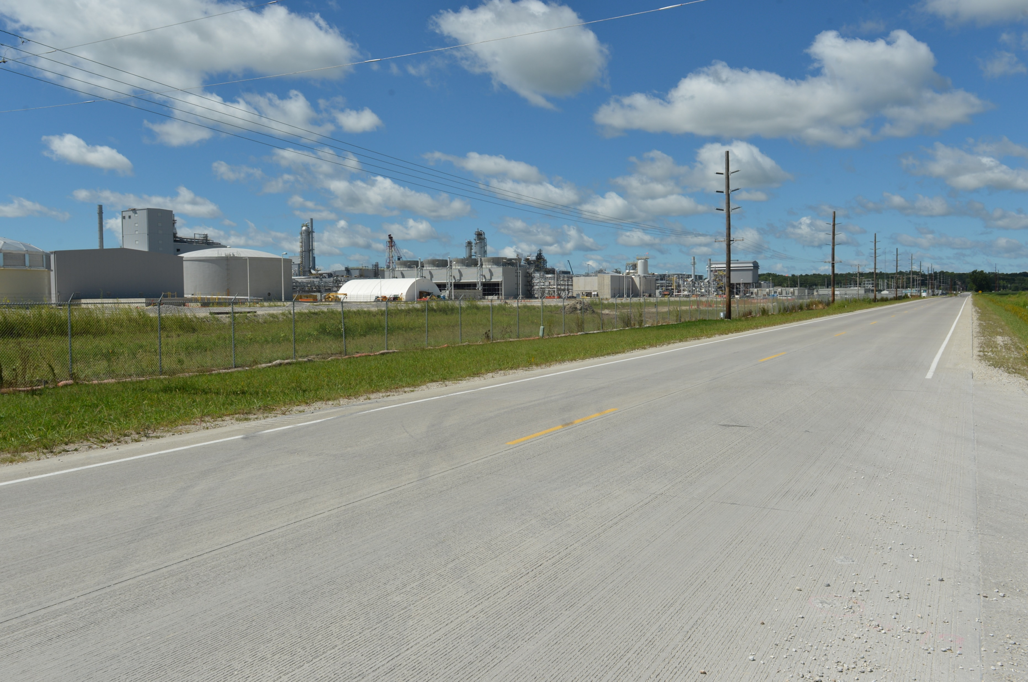

Revitalize Iowa’s Sound Economy Program
Funding Recommendation
Debra Arp
Local Systems Bureau, Grant Team Leader
12/9/2025

Slide 2
Revitalize Iowa’s Sound Economy Program
Created in 1985
Purpose: To promote economic development through roadway improvements
Eligible development shall have value-adding activities that feed new dollars into the economy
Available to cities and counties through an application program
2
2

Slide 3
Monthly Program Financial Report
Funded annually with dedicated state motor fuel and special fuel tax revenues
 | City RISE Fund | County RISE Fund
FY2026 Projected Total RISE Road Use Tax Fund (RUTF) Revenue ¹ | $12,017,805 | $6,008,902
Actual RISE Revenue Received as of 10/31/2025 ² (% of FY2026 Projected Revenue) | $4,213,975 (35.1%) | $2,078,956 (34.6%)
FY2026 RISE Funds Awarded as of 10/31/2025 (% of Projected Total RUTF committed) | $11,623,532 (96.7%) | $4,796,168 (79.8%)
Fund Balance as of 10/31/2025 | $60,885,264 | $16,247,236
Outstanding Commitments as of 10/31/2025³ | ($52,958,458) | ($18,964,448)
Uncommitted Balance as of 10/31/2025 | $7,926,806 | ($2,717,212)
¹ Calculation based on FY2025 average monthly RISE RUTF revenue of $1,001,484 to the city RISE fund and $500,742 to the county RISE fund. As of 10/31/2025, FY2026 is 33.3% complete.
² Actual RISE revenue includes RUTF revenue, loan repayments, and project settlements. These revenue sources are variable and are not included in projections.
³ Award of $2,913,196 to DeWitt in November 2025 is not reflected in the outstanding commitments of 10/31/2025.
3
3

Slide 4
Local Development Project Evaluation Criteria
Criteria | Points
Development Potential | 35
Economic Impact and Cost Effectiveness | 20
Local Commitment and Initiative | 33
Transportation Need and Justification | 4
Local Economic Need | 6
4
4

Slide 5
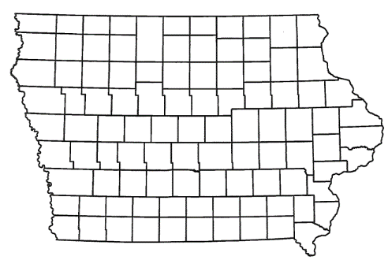
Local Development Recommendations
PROJECT NAME | SPONSOR | SCORE | TOTAL PROJECT COST | PERCENT PARTICIPATION | RECOMMENDED AMOUNT
Construction of approximately 1,085 feet of 33rd Street NW and intersection improvements including turn lanes along 34th Avenue NW at 42nd Street NW, 33rd Street NW and 25th Street NW with a traffic signal at 25th Street NW located on the northwest side of town | Altoona | 43 | $5,442,562 | 50% | $2,721,281
5
5

Slide 6
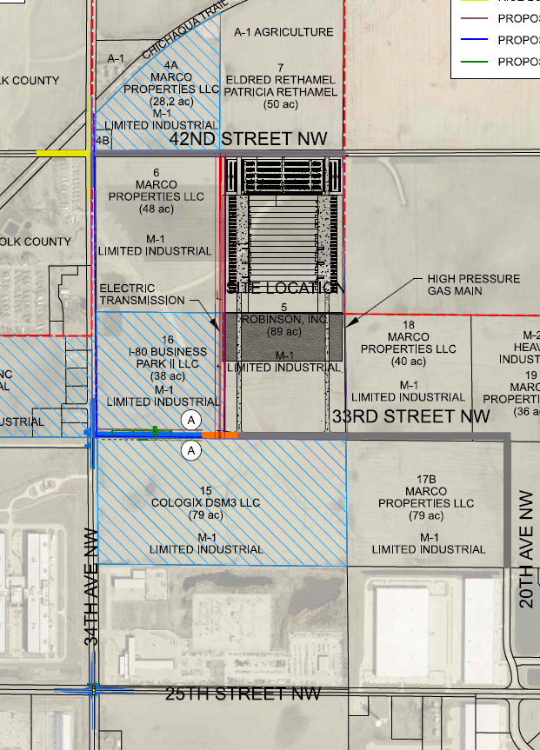
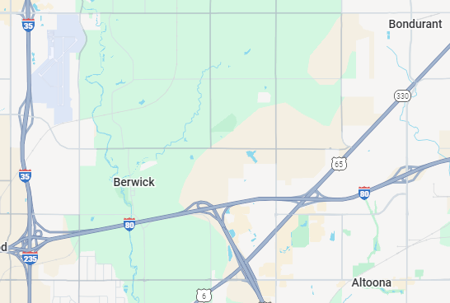
Altoona
Local Development
Construction of approximately 1,085 feet of 33rd Street NW and intersection improvements including turn lanes along 34th Avenue NW at 42nd Street NW, 33rd Street NW and 25th Street NW with a traffic signal at 25th Street NW located on the northwest side of town. This project is necessary to provide improved access to four lots totaling 216 acres for industrial purposes.
Total Cost: $5,442,562
Requested: $2,721,281 (50%)
$2,402,703 City; $318,578 County
6

Slide 7



Questions?
jennifer.kolacia@iowadot.us
515-239-1738

