Slide 1
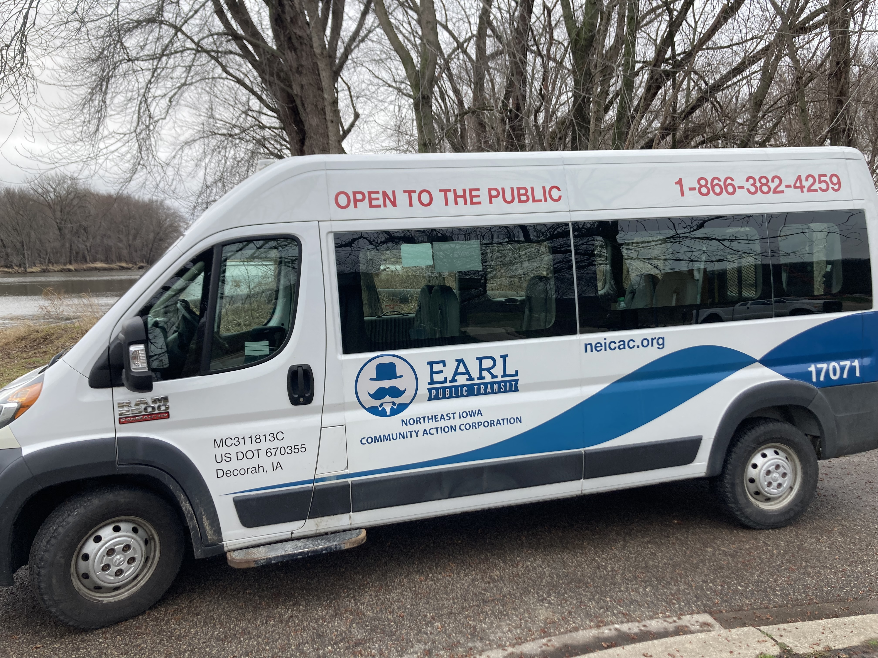
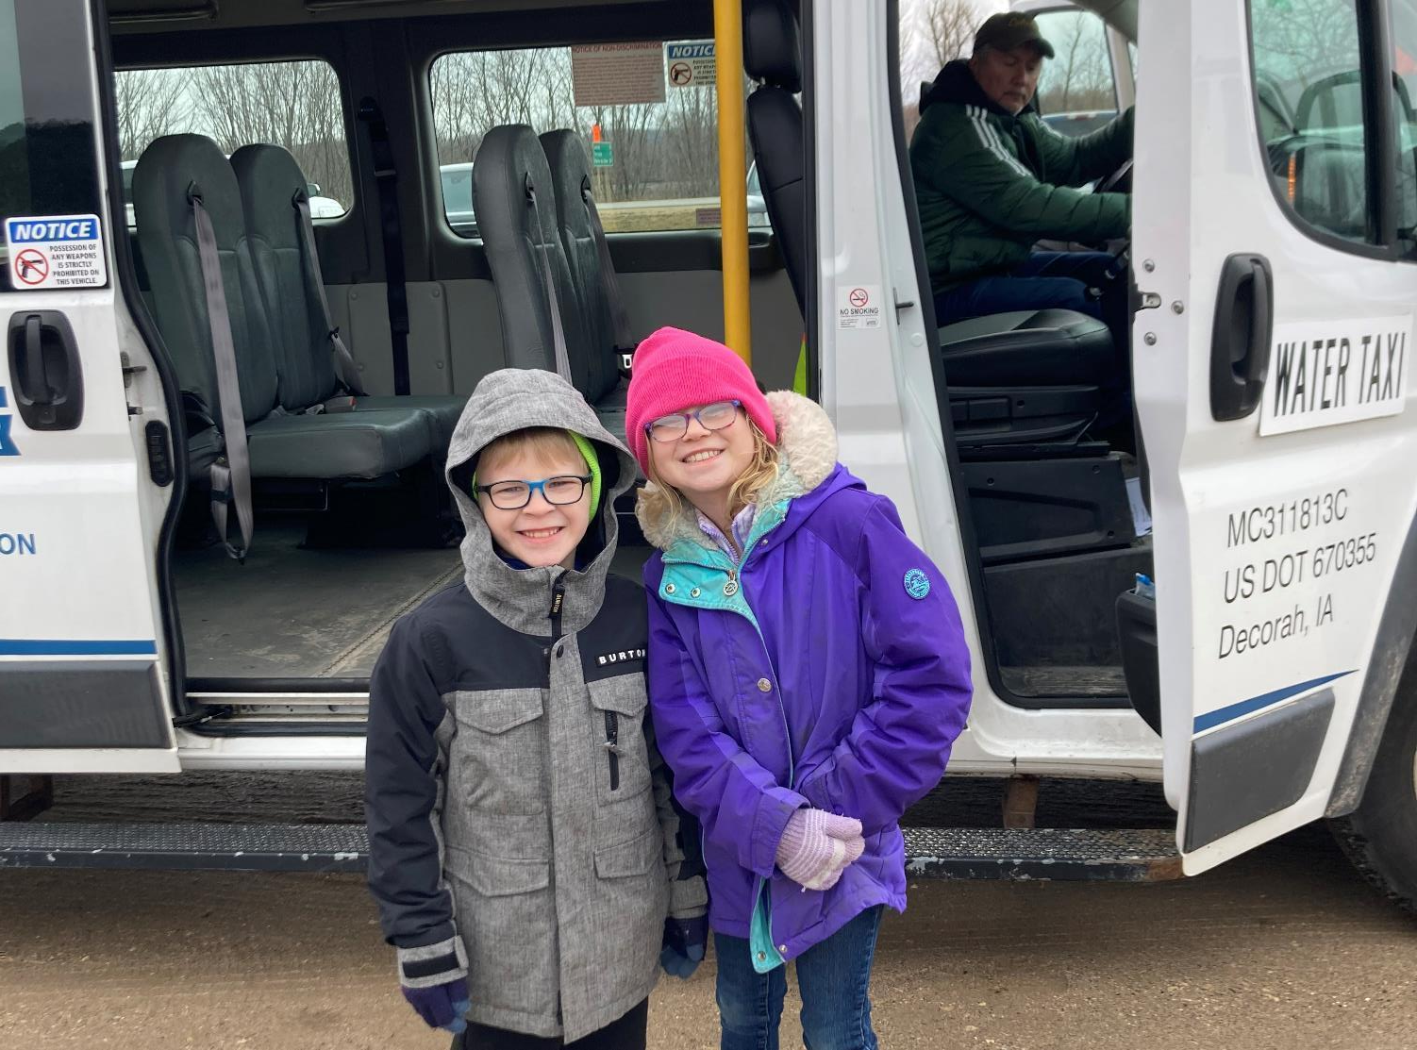


FY 2027 State Transit Assistance
Special Project Applications
3/2/2023
Tammy Nicholson
Modal Transportation Bureau Director
Commission Workshop
December 9, 2025

Slide 2
State Transit Assistance Special Project Program
$600,000 set aside from State Transit Assistance funds annually to fund training fellowships ($175,000) and special projects ($425,000).
All 35 designated Iowa public transit systems are eligible to apply. Iowa Public Transit Association also may apply for projects benefiting all public transit agencies.

Slide 3
Special Projects are extraordinary, emergency, or innovative in nature and may include but are not limited to:
Expanding the scope of planning, managerial, or technical expertise.
Increasing the public’s awareness and understanding of transit.
Enhancing the capacity for administration consolidation and service coordination.
Reducing impediments to intramodal or intermodal transfers.
Increasing the cooperation and coordination between private and public sectors.
Developing, demonstrating, or refining a technical, procedural, or mechanical innovation that may be utilized by other public transit systems in Iowa.
Responding to an emergency situation that places an extraordinary and unforeseen strain on the resources of a public transit system.

Slide 4
Program Details:
Grants can include projects which support transit services developed in conjunction with human service agencies or local community partners or statewide projects to improve public transit in Iowa.
Projects are intended to assist with start-up of new services that have been identified as needs by health, employment or human service agencies or other community partners.
Statewide projects may be used on transit marketing and projects exploring new transit technologies.
Operating and small capital projects are eligible for funding up to a maximum of 50% state participation for two years. Vehicles and facilities are not eligible under this program.

Slide 5
Program Details (continued):
One project per transit system at a time is allowed.
Priority is given to projects which include a financial contribution from human service agencies or community partners.
Applications due October 1. Projects begin July 1 of the following fiscal year. Up to two years of funding may be requested.

Slide 6
Special Project application evaluation criteria:
Financial contribution from human service agency(ies) or community partners.
Demonstration of Need.
Demonstration of Benefits.
Demonstration of Coordinated Transportation.
Addressing Long Range Public Transit Needs.

Slide 7
Available Funding and Application Summary
Annual appropriation: $425,000
FY26 Unobligated: $49,122
Funds available: $474,122
Total number of projects: 5
Total project costs: $574,056.84
Total amount requested: $269,500

Slide 8
FY 2027 Iowa DOT-sponsored Projects
Project Name | Sponsor | Total Project Cost | Requested Amount (% of Total Project Cost) | Recommended Amount (% of Total Project Cost)
General Transit Feed Specification Contractor | Iowa DOT | $77,500 | $77,500 (100%) | $77,500 (100%)
Iowarideshare.org Ridematching software | Iowa DOT | $42,000 | $42,000 (100%) | $42,000 (100%)

Slide 9
FY 2027 Competitive Applications Recommended
Project Name | Sponsor | Total Project Cost | Requested Amount (% of Total Project Cost) | Recommended Amount (% of Total Project Cost)
SWI-Ride (Hybrid demand-response service in Pottawattamie and Mills Counties) | Southwest Iowa Transit Agency, Region 13 | $254,556.84 | $50,000 (19.6%) | $50,000 (19.6%)
Making Moves with DART’s New Network (Marketing Campaign) | Des Moines Area Regional Transit Authority, DART | $150,000 | $75,000 (50%) | $75,000 (50%)
HIRTA Awareness Campaign (Marketing Campaign) | Heart of Iowa Regional Transit Agency, Region 11 | $50,000 | $25,000 (50%) | $25,000 (50%)

Slide 10
Recommended Project Funding Summary
Total number of projects: 5
Total amount requested: $269,500
Funds available: $474,122
Projects recommended for funding: 5
Recommended funding amount: $269,500
Remaining balance: $204,622

Slide 11
Questions?
Tamara Nicholson
515-239-1052
Tamara.Nicholson@iowadot.gov​
iowadot.gov
For more information on Iowa’s public transit and intercity bus programs, visit
iowadot.gov/modes-travel/transit

