Slide 1
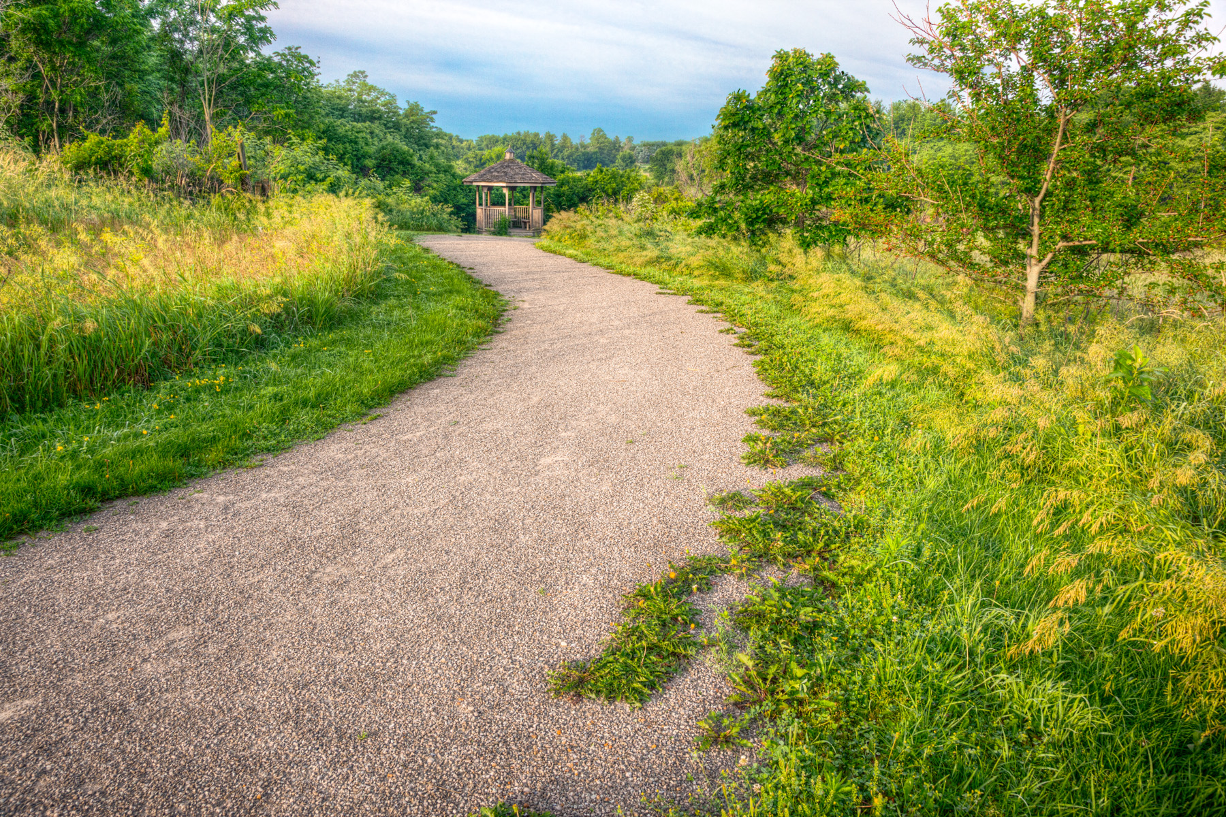

Federal Recreational Trails Program
Funding Recommendation
Debra Arp
Local Systems Bureau, Grant Team Leader
12/09/2025

Slide 2
Federal Recreational Trail Program
Created in 1991
Available to federal, state, and local government agencies. Private individuals and organizations may apply with a government co-sponsor.
Purpose is to develop and maintain recreational trails and trail related facilities for both motorized and non-motorized trail users.
Eligible projects include:
  Maintenance and restoration of existing trails, development of trailside and trailhead facilities, purchase of trail construction and maintenance equipment, construction of new trails and acquisition of land for trails.
2
2

Slide 3
Project Evaluation Criteria
Criteria | Points
Degree to which motorized and non-motorized trail use are accommodated | 10
Greatest number of compatible multi-purpose uses | 10
Access and use for persons with disabilities, older citizens, economically challenged and other special populations or groups | 10
Provides development of trail linkages | 10
Opportunities for new partnerships between trail users and private interests | 10
Identified in or furthers a specific goal of a state, regional, or local plan | 10
Leverages greater public or private investments | 10
Citizen involvement in the project’s conception and implementation. | 10
Degree to which project ties into other trails | 10
Public/private partnerships to continue operation and maintenance | 15
Trails with national designation or resulting in the cleanup of an area | 10
MAXIMUM POINTS | 115
3
3

Slide 4
Available Funding and Application Summary
Available Funding: | Column 2
Annual appropriation | $1,300,000
Underruns from closed projects | $77,833
Total available funding | $1,377,833
Application Summary:
Total number of projects | 11
Total project costs | $11,758,997
Total amount requested | $6,053,800
4
4

Slide 5
List of Motorized Applications Recommended
PROJECT NAME | SPONSOR | SCORE | TOTAL PROJECT COST | REQUESTED AMOUNT (% of Total Project Cost) | RECOMMENDED AMOUNT (% of Total Project Cost)
Snow Trail Maintenance Equipment | Iowa State Snowmobile Association | 59 | $330,000 | $264,000 (80%) | $264,000 (80%)
Off-Highway Vehicle Park Maintenance Equipment | Iowa Department of Natural Resources | 49 | $364,500 | $291,600 (80%) | $291,600 (80%)
5
Jump to Applications Not Recommended for Funding
5

Slide 6
List of Non-motorized Applications Recommended
PROJECT NAME | SPONSOR | SCORE | TOTAL PROJECT COST | REQUESTED AMOUNT (% of Total Project Cost) | RECOMMENDED AMOUNT (% of Total Project Cost)
Skunk River Bridge Repair | Polk County Conservation Board | 73 | $885,000 | $468,000 (53%) | $468,000 (53%)
Pinicon Ridge Park Wapsi Bluff Trail Connector | Linn County Conservation Department | 65 | $460,000 | $325,000 (71%) | $325,000 (71%)
6
Jump to Applications Not Recommended for Funding
6

Slide 7
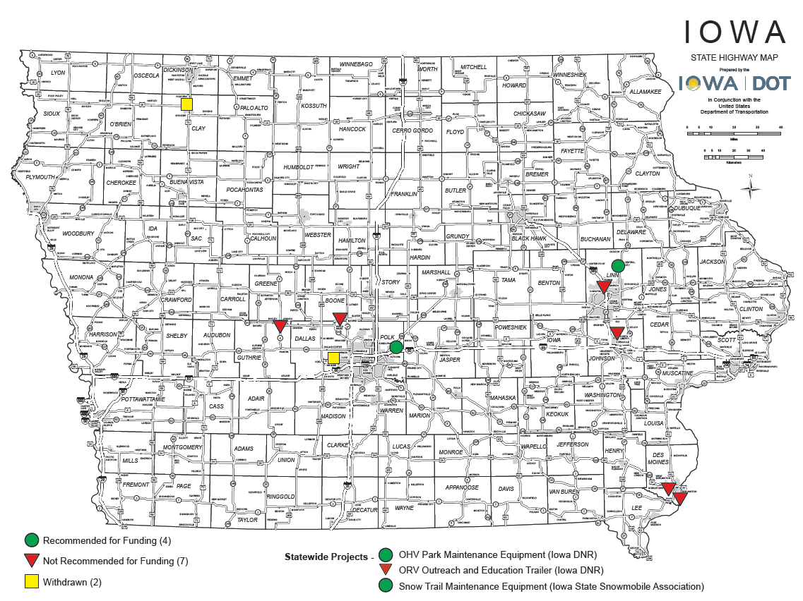
Map of Applications Received
7

Slide 8



Questions?
scott.flagg@iowadot.us
515-239-1252

Slide 9
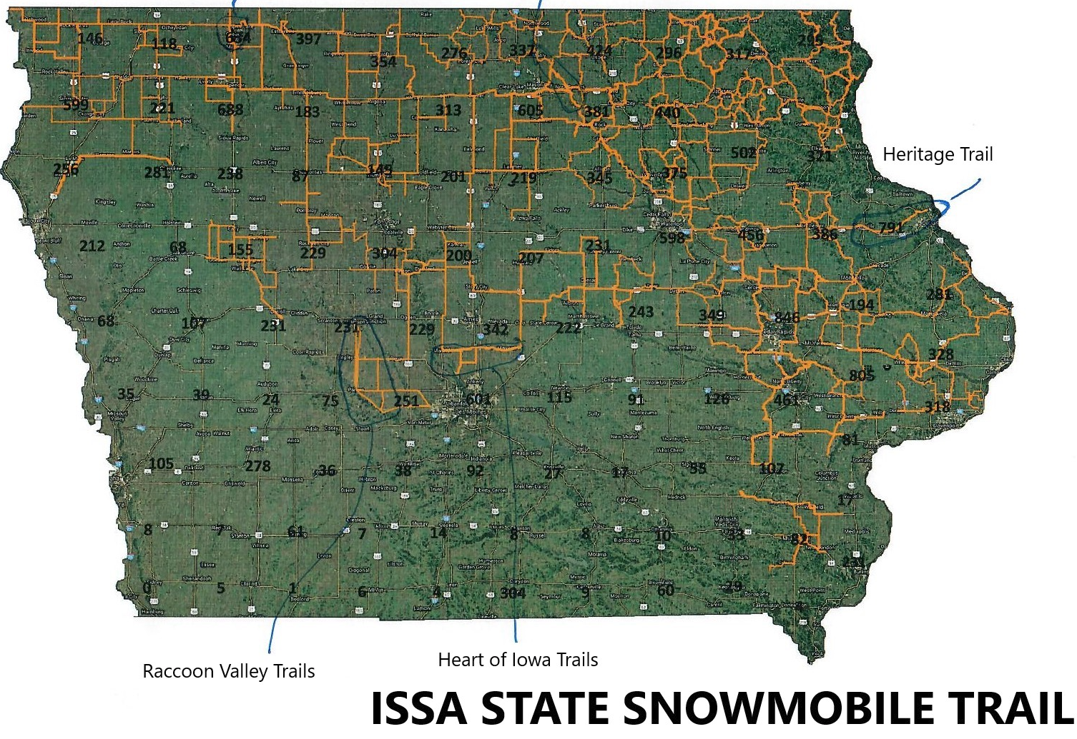
Snow Trail Maintenance Equipment
(Iowa State Snowmobile Association)
Purchase of snow cat power units and drags to maintain 8,800 miles of snowmobile trails across 63 counties.
Total Cost: $330,000
Requested: $264,000 (80%)
Return to List of Applications Recommended
9

Slide 10
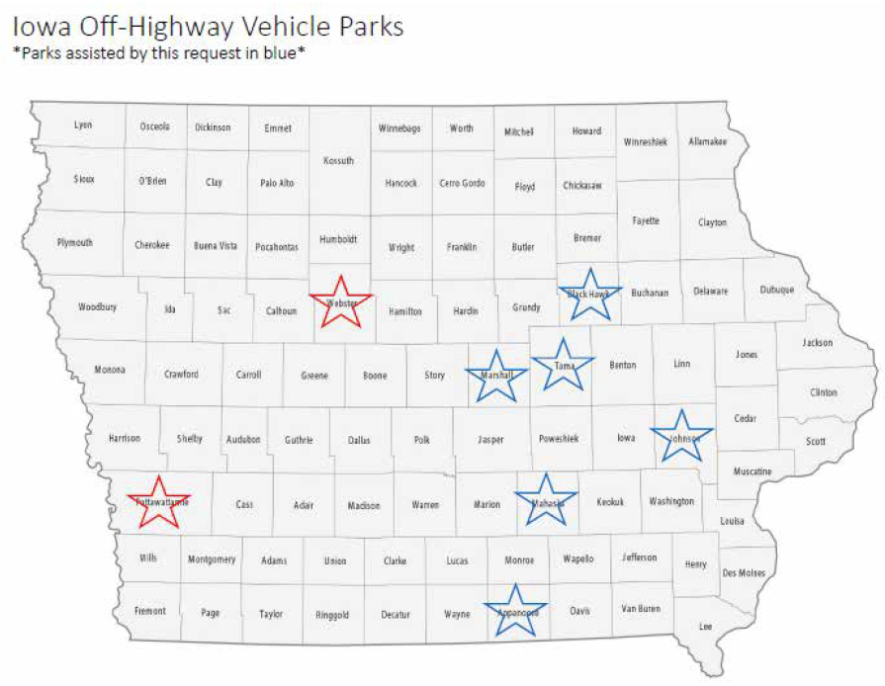
Off-Highway Vehicle Park Maintenance Equipment
(Iowa Department of Natural Resources)
Purchase 10 pieces of equipment for trail maintenance and track development at 6 designated OHV Parks across Iowa. Combined, these OHV parks offer more than 1,200 acres of public OHV recreation areas.
Total Cost: $364,500
Requested: $291,600 (80%)
Return to List of Applications Recommended
10

Slide 11
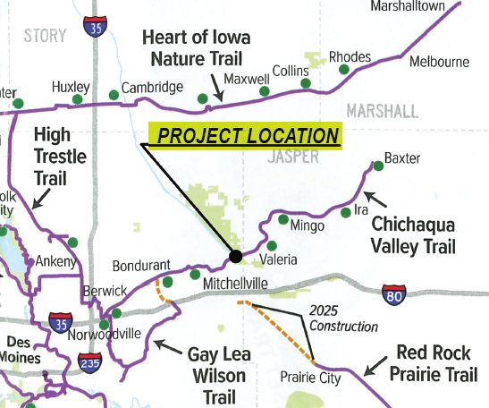
Skunk River Bridge Repair
(Polk County Conservation Board)
Provides structural repairs and replaces existing wood decking with concrete on 100-year-old, 453-foot timber bridge located northeast of Mitchellville on the Chichaqua Valley Trail. The 26-mile Chichaqua Valley Trail is located on the former Chicago Pacific Railroad corridor between Berwick and Baxter.
Total Cost: $885,000
Requested: $468,000 (53%)
Return to List of Applications Recommended
11

Slide 12
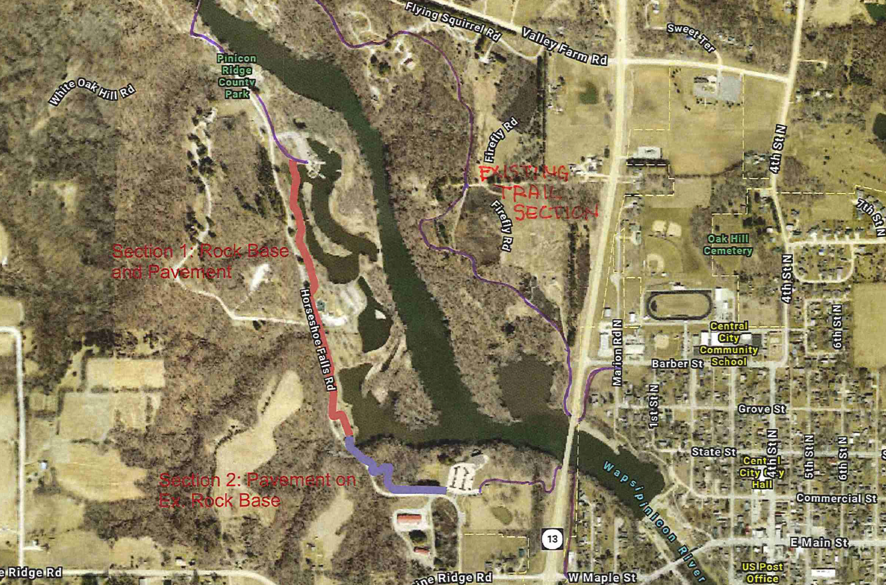
Pinicon Ridge Park Wapsi Bluff Trail Connector (Linn County Conservation Board)
Constructs 0.75 mile of paved trail in two sections within the 1,018-acre Pinicon Ridge Park and is part of a 3-mile loop trail that connects Pinicon Ridge Park with Central City.
Total Cost: $460,000
Requested: $325,000 (71%)
Return to List of Applications Recommended
12

Slide 13
List of Applications Not Recommended for Award
PROJECT NAME | SPONSOR | SCORE | TOTAL PROJECT COST | REQUESTED AMOUNT (% of Total Project Cost) | RECOMMENDED AMOUNT (% of Total Project Cost)
Trail Maintenance Equipment | Friends of Coralville Lake | 74 | $130,000 | $104,000 (80%) | $0
Swede Point Park Trail Phase IB | Boone County Conservation Board | 60 | $833,000 | $383,000 (46%) | $0
Summer Street-Dankwardt Park Connector Trail Phase I | Burlington | 59 | $4,490,000 | $800,000 (18%) | $0
Raccoon River Valley Trail Resurfacing Project | Guthrie County Conservation Board | 55 | $520,497 | $415,000 (80%) | $0
13
Return to List of Applications Recommended
13

Slide 14
List of Applications Not Recommended for Award
PROJECT NAME | SPONSOR | SCORE | TOTAL PROJECT COST | REQUESTED AMOUNT (% of Total Project Cost) | RECOMMENDED AMOUNT (% of Total Project Cost)
ITC Midwest Trail | Robins | 54 | $1,363,000 | $1,090,400 (80%) | $0
Agency Road Trail | West Burlington | 43 | $2,351,000 | $1,880,800 (80%) | $0
ORV Outreach and Education Trailer | Iowa Department of Natural Resources | 32 | $32,000 | $32,000 (100%) | $0
14
Return to List of Applications Recommended
14

