Slide 1
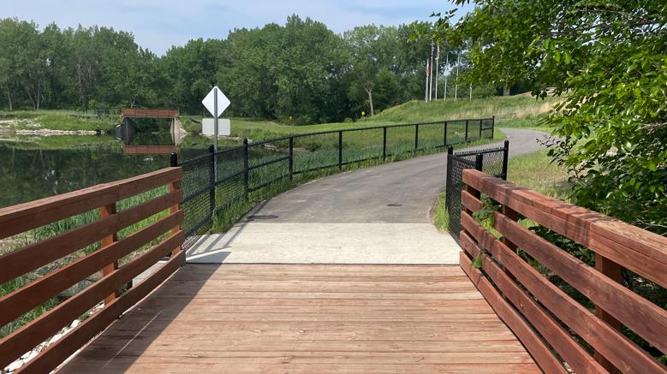

Statewide Transportation Alternatives
Set-aside Program
Funding Recommendation
Debra Arp
Local Systems Bureau, Grant Team Leader
12/09/25

Slide 2
Statewide Transportation Alternatives Set-Aside Program
Current version of program in existence since 1991
Majority of funding is distributed to Iowa’s MPOs and RPAs, but $5 million reserved for statewide projects annually with 20% target for Safe Routes to School projects
Available to a variety of project sponsors but most applicants are cities and counties
2
2

Slide 3
Eligible Activities
On-road and off-road non-motorized trail facilities, safe routes for non-drivers, conversion of abandoned rail corridors for trails, preservation/rehabilitation of historic transportation facilities among others
Federal Recreational Trails Program eligible activities
Infrastructure-related or non-infrastructure related Safe Routes to School Projects
Scenic Byways
3
3

Slide 4
Project Evaluation Criteria
Criteria | Points
Statewide or multi-regional impact of the project | 25
Connectivity and Completion of Trail Linkages | 15
Alignment with Local, Regional, or Statewide Planning Documents | 15
Federal-aid Project Development Process, Understanding & Capacity | 10
Contribution Toward Safety for All Transportation Modes | 10
Enhancement of Statewide Tourism Benefits | 10
Leverage of other funding sources | 10
Need for the proposed project | 10
Addresses high-need areas | 10
Improve accessibility | 5
Long-term maintenance plan | 5
Project readiness | 5
MAXIMUM POINTS | 130
4
4

Slide 5
Available Funding and Application Summary
Available Funding: | Column 2
Total Funding Available | $9,000,000 | $5,330,393
Target to Safe Routes to School | $1,800,000 (20%) | $1,000,000 (20%)
Target for non-Safe Routes to School | $8,000,000 | $4,000,000
Application Summary:
Total number of projects: | 14
Total project costs | $22,371,511
Total amount requested | $15,196,158
5
5

Slide 6
Safe Routes to School Applications Recommended
PROJECT NAME | SPONSOR | SCORE | TOTAL PROJECT COST | REQUESTED AMOUNT (% of Total Project Cost) | RECOMMENDED AMOUNT (% of Total Project Cost)
Central City Pedestrian Bridge | Central City | 93 | $1,750,000 | $1,400,000 (80%) | $1,400,000 (80%)
Iowa Safe Routes Partnership | Iowa Northland Regional Council of Governments | 72 | $390,002 | $312,002 (80%) | $312,002 (80%)
6
Jump to Safe Routes to School Applications not Recommended for Funding
6

Slide 7
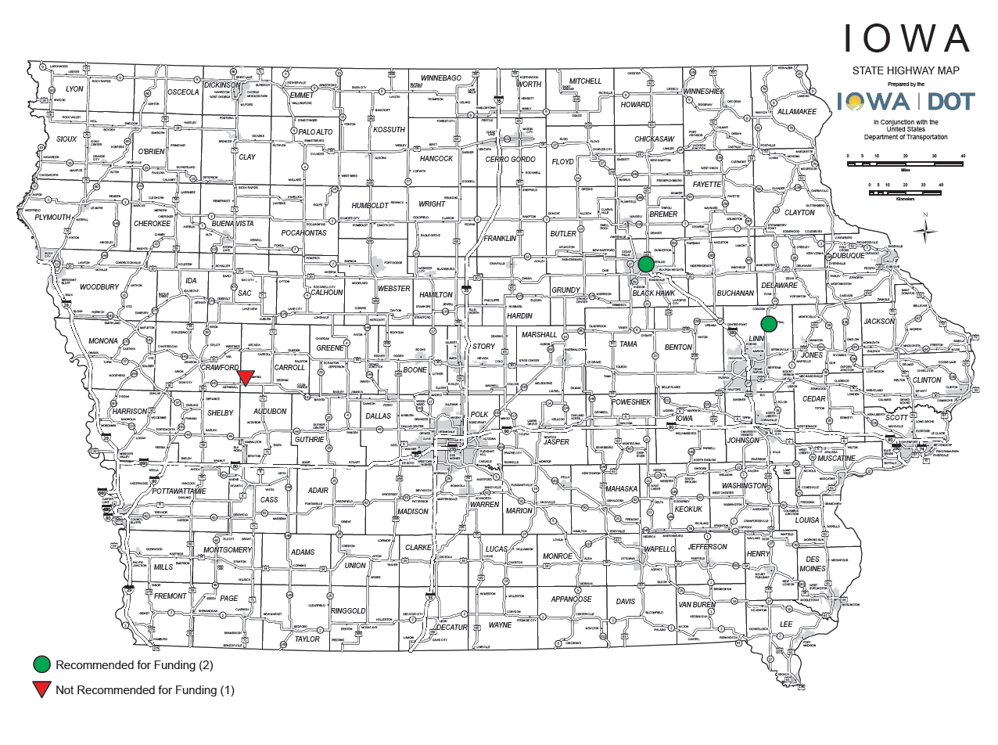
Safe Routes to School Applications Received & Recommended
7

Slide 8
All Other Applications Recommended
PROJECT NAME | SPONSOR | SCORE | TOTAL PROJECT COST | REQUESTED AMOUNT (% of Total Project Cost) | RECOMMENDED AMOUNT (% of Total Project Cost)
Great American Rail Trail: Weston to Underwood | Pottawattamie County Conservation | 106 | $4,505,000 | $3,500,000 (78%) | $1,920,435 (43%)
Summer Street-Dankwardt Park Connector Trail | Burlington | 99 | $942,000 | $750,000 (80%) | $750,000 (80%)
Camanche Trail Extensions | Camanche | 96 | $649,000 | $500,000 (77%) | $500,000 (77%)
UNI Integrated Roadside Vegetation Management | University of Northern Iowa Tallgrass Prairie Center | 94 | $1,064,386 | $447,956 (42%) | $447,956 (42%)
8
Jump to Applications Not Recommended for Funding
8

Slide 9
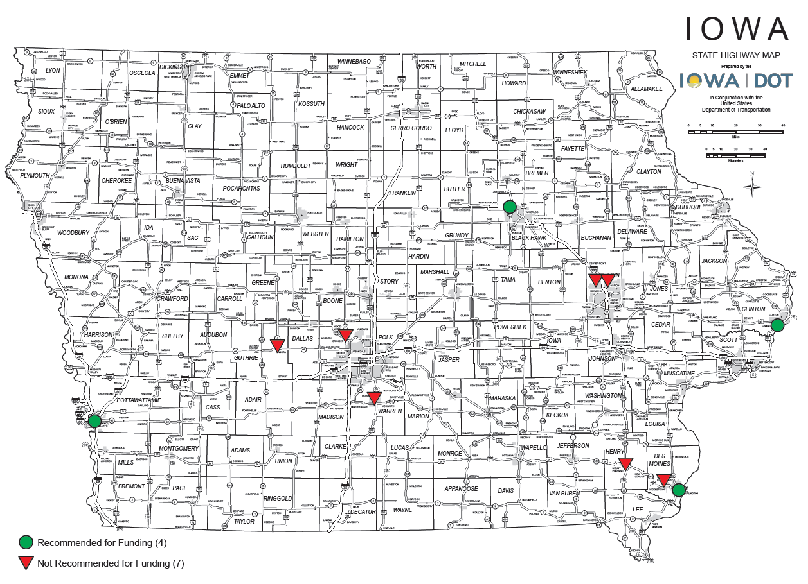
All Other Applications Received & Recommended
9

Slide 10



Questions?
susan.hollenkamp@iowadot.us
515-239-1810

Slide 11
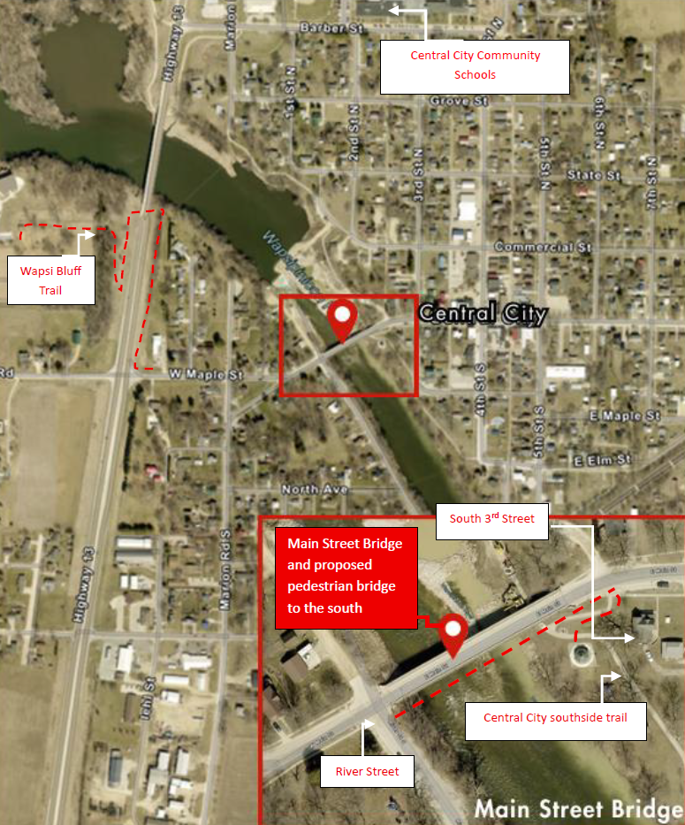
Central City Pedestrian Bridge
(Central City)
This project will replace the unrepairable pedestrian portions of the Main Street Bridge with a separated 320 feet pedestrian bridge providing a safe route for students accessing Central City Community Schools.
Total Cost: $1,750,000
Requested: $1,400,000 (80%)
Return to List of Applications Recommended
11

Slide 12
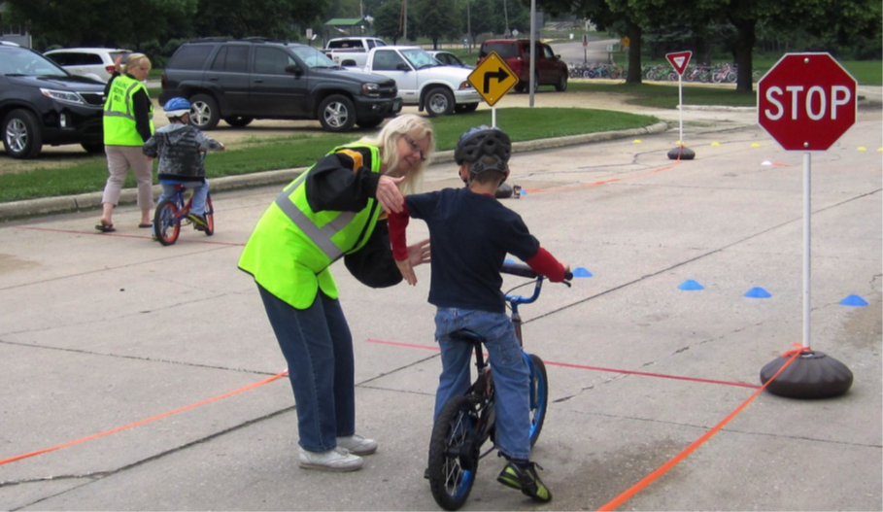
Iowa Safe Routes Partnership
(Iowa Northland Regional Council of Governments)
A comprehensive program that provides support to communities by implementing SRTS initiatives, including pedestrian and bicycle safety education through encouragement activities both inside and outside the classroom.
Total Cost: $390,002
Requested: $312,002 (80%)
Return to List of Applications Recommended
12

Slide 13
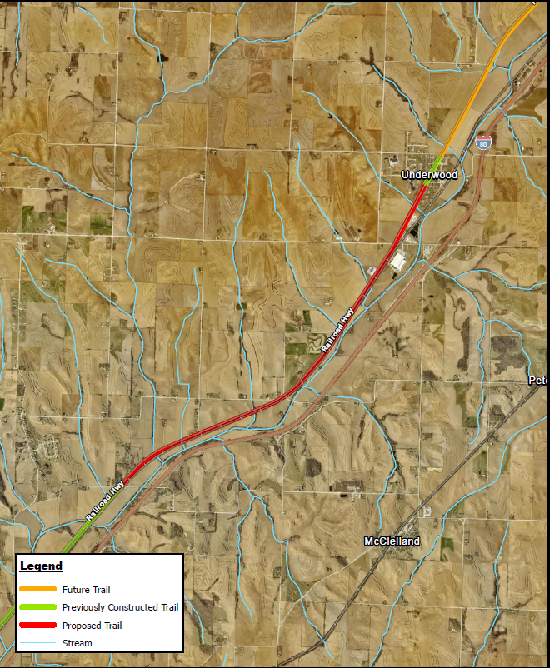
Great American Rail Trail: Weston to Underwood
(Pottawattamie County Conservation Board)
Constructs a 4.9-mile paved extension from Weston to Underwood of the 5-mile Railway Highway Trail. This project is part of the Great American Rail Trail, a planned 3,700-mile coast-to-coast trail from Washington, D.C., to Washington state.
Total Cost: $4,505,000
Requested: $3,500,000 (80%)
Recommended: $1,920,435
Return to List of Applications Recommended
13

Slide 14
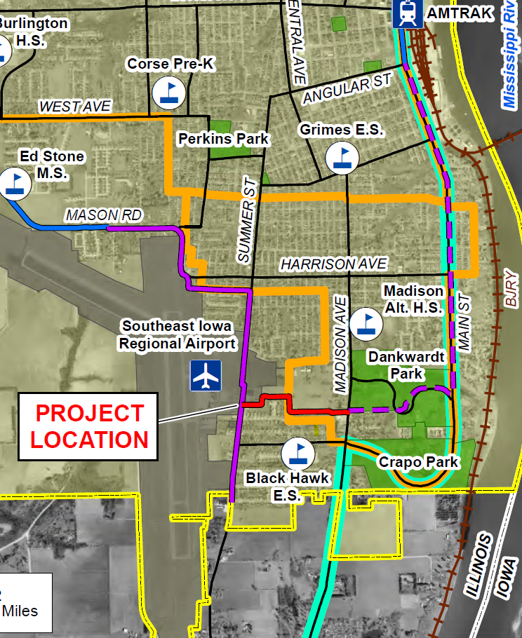
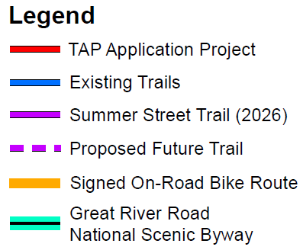
Summer Street-Dankwardt Park Connector Trail
(Burlington)
This project will construct 0.62 mile of multi-use trail connecting an existing trail at Summer Street and ending at Dankwardt Park in Burlington.
Total Cost: $942,000
Requested: $750,000 (80%)
Return to List of Applications Recommended
14

Slide 15
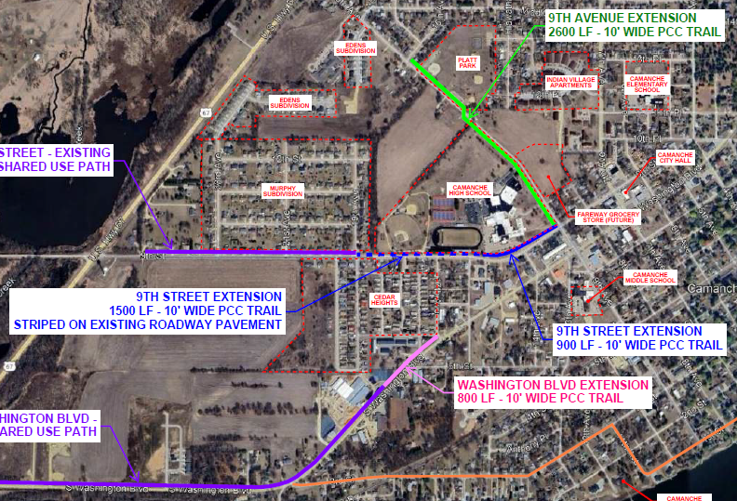
Camanche Trail Extensions
(Camanche)
This project constructs 4,300 feet of separated trail in 3 segments along portions of Washington Boulevard, 9th Street, and 9th Avenue and 1,500 feet of bike lane along 9th Street.
Total Cost: $649,000
Requested: $500,000 (77%)
Return to List of Applications Recommended
15

Slide 16
UNI Integrated Roadside Vegetation Management
(UNI Tallgrass Prairie Center)
This project result in native grass & wildflower seed being planted in road rights-of-way across the state consistent with Integrated Roadside Vegetation Management principles.
Total Cost: $1,064,386
Requested: $447,956 (42%)
Return to List of Applications Recommended
16

Slide 17
Safe Routes to School Applications Not Recommended for Award
PROJECT NAME | SPONSOR | SCORE | TOTAL PROJECT COST | REQUESTED AMOUNT (% of Total Project Cost) | RECOMMENDED AMOUNT (% of Total Project Cost)
Independence Trail | Manning | 58 | $655,000 | $524,000 (80%) | $0 (0%)
17
Return to List of Applications Recommended
17

Slide 18
All Other Applications Not Recommended for Award
PROJECT NAME | SPONSOR | SCORE | TOTAL PROJECT COST | REQUESTED AMOUNT (% of Total Project Cost) | RECOMMENDED AMOUNT (% of Total Project Cost)
NW 94th Ave. Trail Connection to the Neal Smith Trail | Polk County Conservation Board | 93 | $831,000 | $664,800 (80%) | $0 (0%)
Wapsi Bluff Trail | Linn County Conservation Board | 93 | $782,623 | $375,000 (48%) | $0 (0%)
Washington-Grand Connector Trail | Mount Pleasant | 92 | $1,585,100 | $1,268,000 (80%) | $0 (0%)
Raccoon River Valley Trail Resurfacing | Guthrie County Conservation Board | 92 | $4,876,400 | $2,000,000 (41%) | $0 (0%)
18
Return to List of Applications Recommended
18

Slide 19
All Other Applications Not Recommended for Award
PROJECT NAME | SPONSOR | SCORE | TOTAL PROJECT COST | REQUESTED AMOUNT (% of Total Project Cost) | RECOMMENDED AMOUNT (% of Total Project Cost)
Great Western Trail Rehabilitation – Phase 2 | Warren County Conservation Board | 85 | $705,000 | $564,000 (80%) | $0 (0%)
ITC Midwest Trail | Robins | 85 | $1,363,000 | $1,090,400 (80%) | $0 (0%)
Agency Road Trail | West Burlington | 84 | $2,351,000 | $1,800,000 (77%) | $0 (0%)
19
Return to List of Applications Recommended
19

