Slide 1
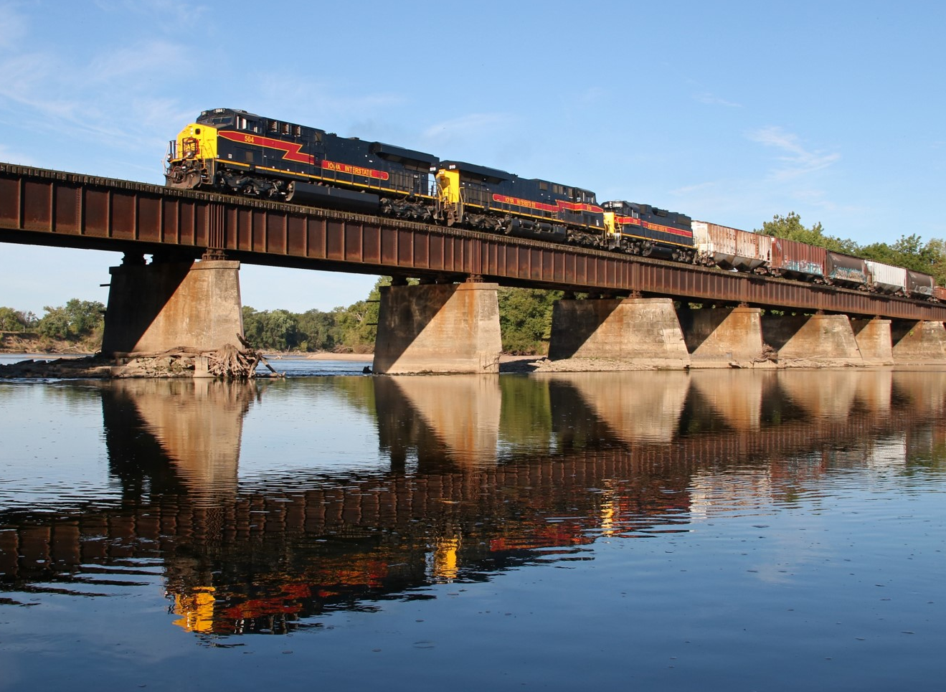


Draft State Rail Plan
Overview
3/2/2023
12/9/2025

Slide 2
Background
State Rail Plan (SRP) updated every four years
Follow SRP guidance from FRA (last updated in 2013)
Last update: January 2021 (considered a “light” update of the 2017 document completed by HDR)
2025 Draft SRP
Developed internally by Modal Transportation and Systems Planning Bureaus with some support from HDR (economic impact study)
Alternative outline approved by FRA
Less text, more graphics
Direct input from stakeholders

Slide 3
Stakeholder engagement
Railroads – needs, opportunities, facilities, chokepoints, projects
Rail Advisory Committee (RAC) – vision, goals, objectives, needs, opportunities, facilities, chokepoints, projects
Passenger Rail Advisory Committee (PRAC) – vision, goals, objectives, passenger service enhancements
Freight Advisory Council (FAC) – vision, goals, objectives, facilities
MPO/RPAs – vision, goals, objectives, safety, land use
Local officials – safety, land use, issues, needs, opportunities

Slide 4
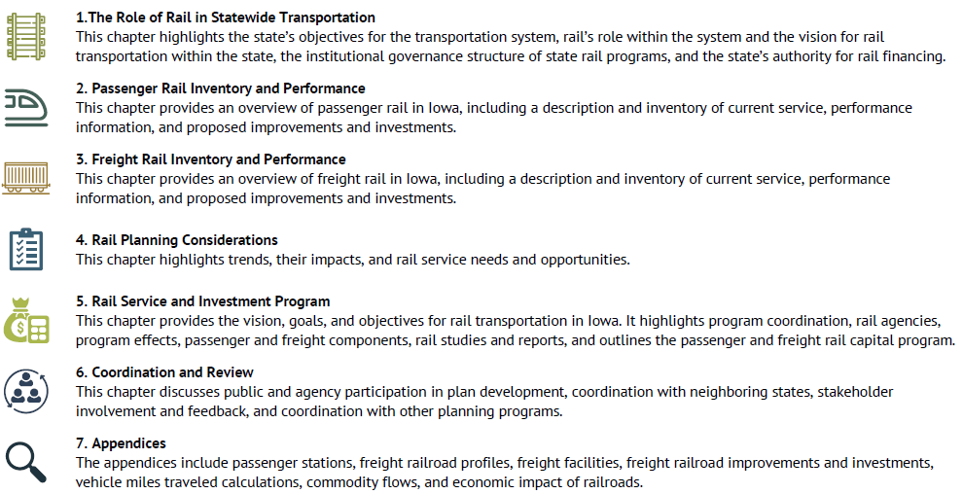
Document outline

Slide 5
Executive Summary
Notes:
The Executive Summary covers 3 pages in the plan that highlight the key elements within the document.

Slide 6
Notes:
Page 2 of the executive summary. These are some of the figures and highlights we presented to you during that first meeting.

Slide 7
Notes:
And page 3 of the executive summary highlights both freight and passenger rail short and long range projects. This is also showcasing the 4 key topics of strategies we will discuss more in a minute.

Slide 8
Vision, goals, and objectives (chapters 1 and 5)
Developed with input from the Rail Advisory Committee,
Passenger Rail Advisory Committee, Freight Advisory Council, and local officials

Slide 9
Needs and opportunities (chapter 4)
Identified using passenger and freight inventory, performance, trends, and impacts, then summarized into six categories.
Safety
Community continuity and safety
Hazardous materials
Chokepoints
Freight opportunities and growth limitations
Passenger rail service

Slide 10
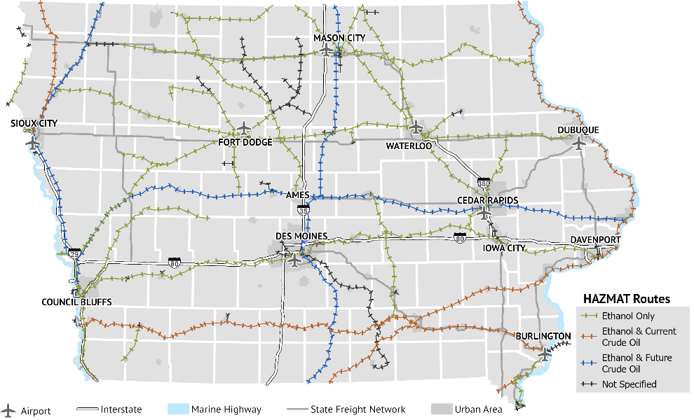
Haz Mat Routes (chapter 4)
Developed with input from the Modal Transportation Bureau

Slide 11
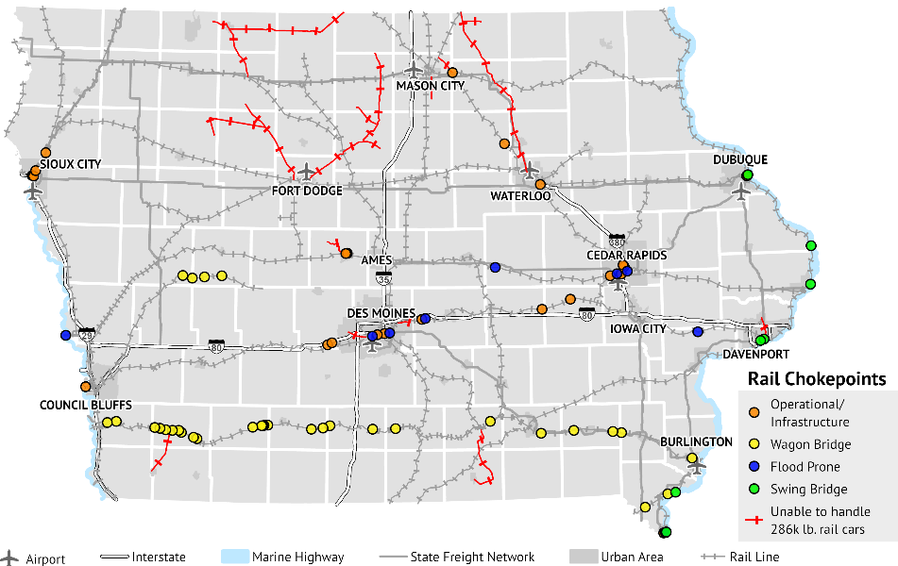
Freight rail chokepoints (chapters 3 and 4)
Developed with input from the 2017/2021 SRP, State Freight Plan, and the railroads

Slide 12
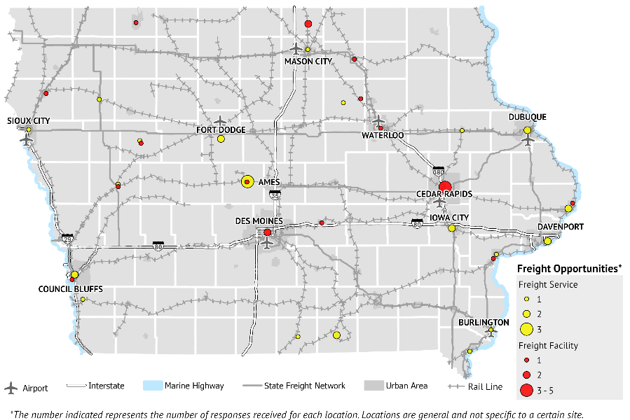
Freight opportunities (chapter 4)
Developed with input from the Rail Advisory Committee and Freight Advisory Council

Slide 13
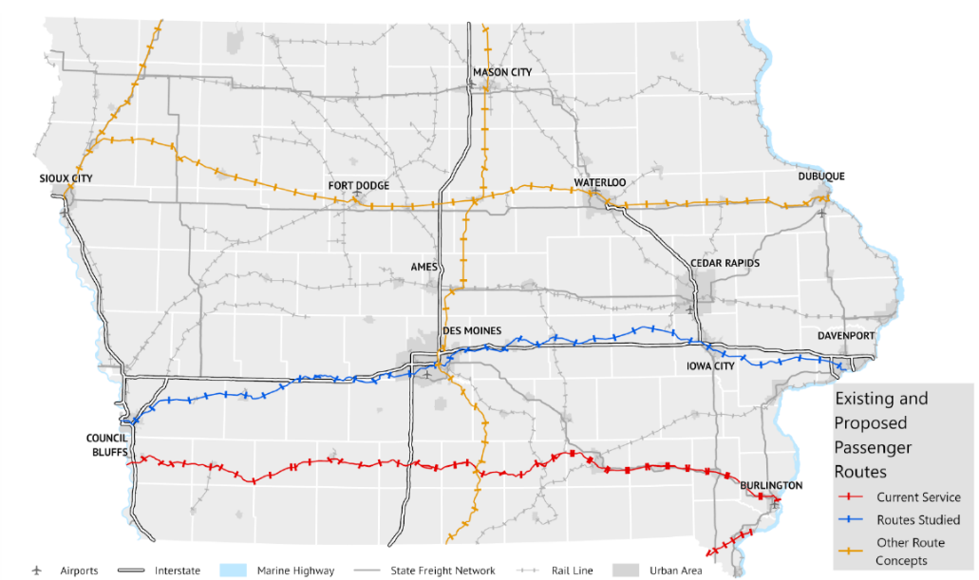
Conceptual passenger routes (chapter 2 and 4)
Developed with input from the 2017/2021 SRP, FRA Amtrak Daily Long-Distance
Service Study, and the Minnesota GO Rail Plan

Slide 14
Service and investment program (chapter 5)
Listings of passenger rail and freight rail studies and projects
Short-term (1-4 years) and long-term (5-20 years)
Descriptions, timelines, costs, and funding sources if available
Developed with input from the railroads, Amtrak, MPO/RPAs, HDR, and Iowa DOT
Long-range studies note that, “No Federal, state, or local sources have been allocated nor have timelines been established.”

Slide 15
Next steps
Present summary to Transportation Commission
FRA Approval Letter
Implement

Slide 16
Questions?

