Slide 1
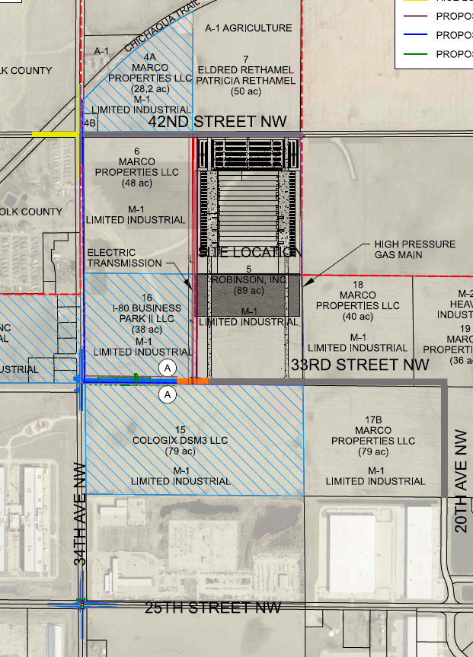
Local Development Recommendation
PROJECT NAME | SPONSOR | SCORE | TOTAL PROJECT COST | PERCENT PARTICIPATION | RECOMMENDED AMOUNT
Construction of approximately 1,085 feet of 33rd Street NW and intersection improvements including turn lanes along 34th Avenue NW at 42nd Street NW, 33rd Street NW and 25th Street NW with a traffic signal at 25th Street NW located on the northwest side of town | Altoona | 43 | $5,442,562 | 50% | $2,721,281
1
1

