Slide 1



Transportation Trends Update
December 9, 2025
3/2/2023

Slide 2
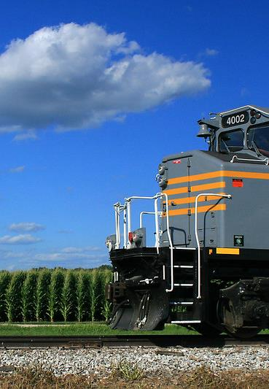

Agenda
Rail carloads
Commercial air service passenger counts
Vehicular traffic
Safety

Slide 4
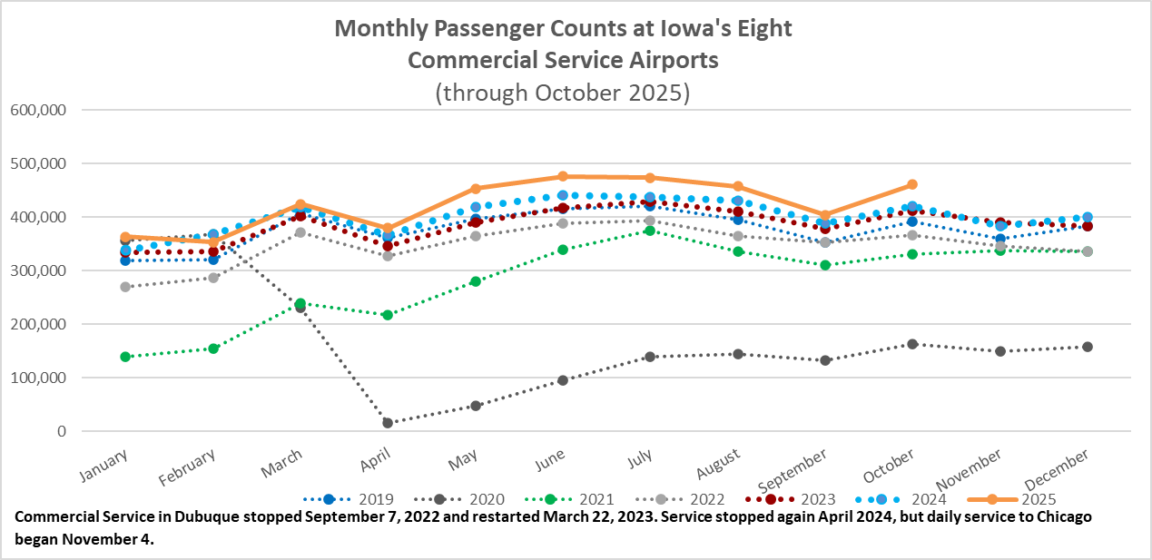

Slide 5
Monthly State Vehicle Miles of Travel
(through October 2025)
Vehicle Miles of Travel (in millions)

Slide 6
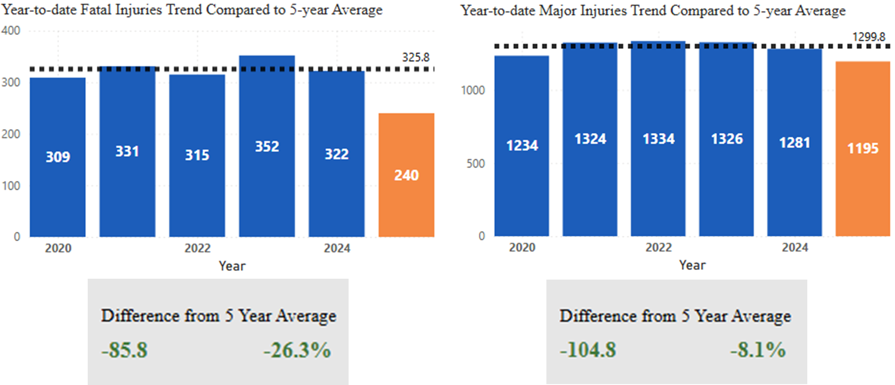
Statewide Fatalities & Major Injuries Year-to-Date
(As of December 1, 2025)

Slide 7
Questions?

