Slide 1
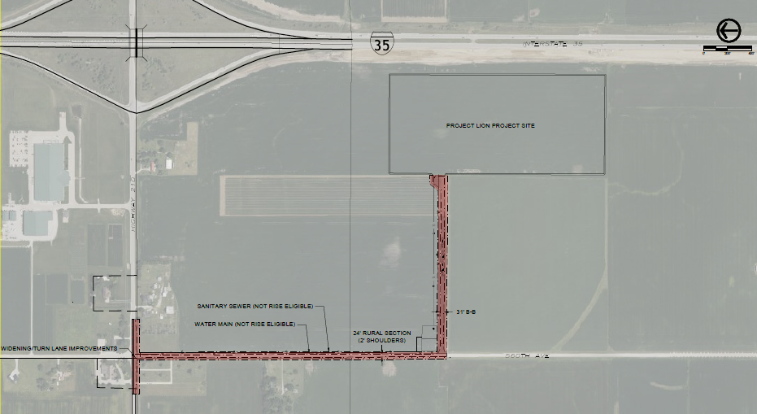
Local Development Recommendation
PROJECT NAME | SPONSOR | SCORE | TOTAL PROJECT COST | PERCENT PARTICIPATION | RECOMMENDED AMOUNT
Paving of approximately 2,650 feet of 560th Avenue and the construction of 1,500 feet of new roadway and intersection improvements at Iowa 210 and 560th Avenue located on the southeast side of town. | Huxley | 69 | $4,178,879 | 50% | $2,089,439
1
1

Slide 2
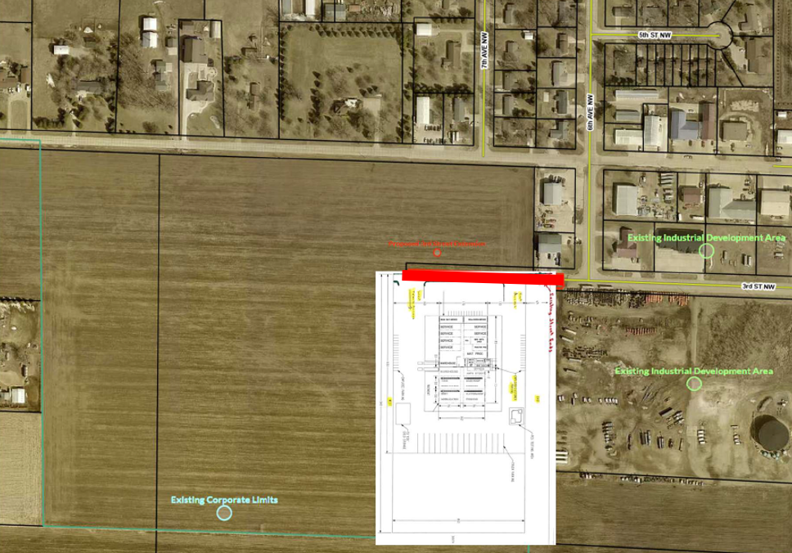
Local Development Recommendation
PROJECT NAME | SPONSOR | SCORE | TOTAL PROJECT COST | PERCENT PARTICIPATION | RECOMMENDED AMOUNT
Construction of approximately 560 feet of 3rd Street NW located on the northwest side of town. | Sioux Center | 65 | $552,940 | 50% | $276,470
2
2

Slide 3
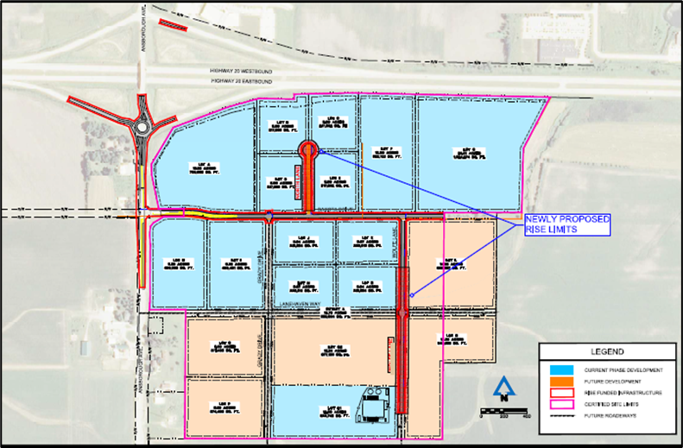
Local Development Recommendation
PROJECT NAME | SPONSOR | SCORE | TOTAL PROJECT COST | PERCENT PARTICIPATION | RECOMMENDED AMOUNT
Construct approximately 1,700 feet of Wolfe Lane and 610 feet of North Lane located on the southwest side of town (Certified Site Amendment) | Waterloo | 66 | $1,162,513 | 60% | $697,508
3
3

