Slide 1
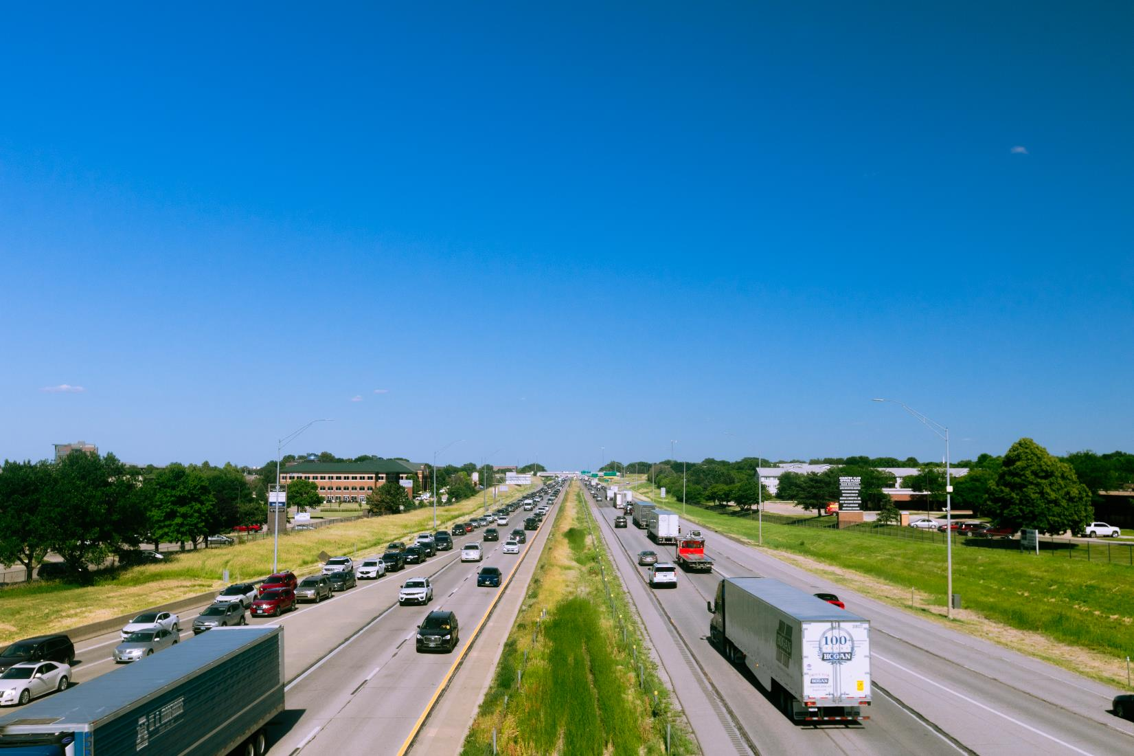


FY 2026 Highway Program Balance Report
January 13, 2026
3/2/2023

Slide 2
Receipts / Costs
Revenue
Forecast PRF Receipts (November) $400.0m
Actual PRF Receipts (November) $406.1m
Lettings
Programmed Amounts (December) $567.2m
Project Costs (December) $495.1m

Slide 3
Balance
FY 2026 Program Balance (December 2025) ($37.4m)
November PRF Receipts Difference $6.1m
December Project Letting Difference $72.1m
Program Balance (December 2025) $40.8m
Previous Balance Reported: $11.5m
FY 2026 Highway Program Balance Overview

Slide 4
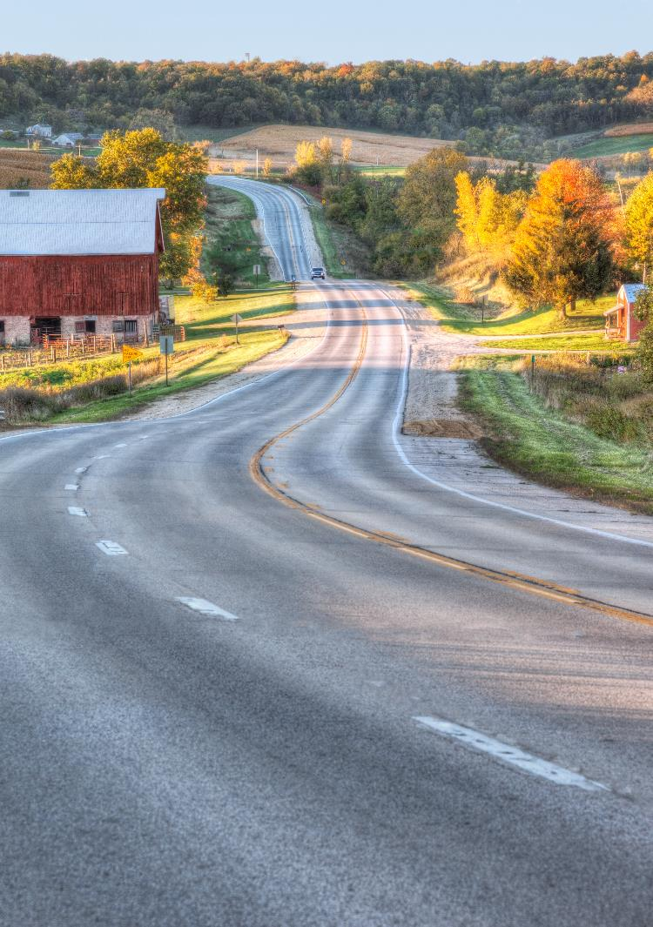





Fiscal Year 2026 Overview
Revenue: Expect monthly revenue fluctuations.
Lettings:
Sixty-five percent of the FY 2026 Program has been awarded.
The December letting was approximately $225 million.
Next letting scheduled for January 20, 2026.

Slide 5

Possible 2026 Commission Tour Locations
I O W A
STATE HIGHWAY MAP
Prepared by the
9
75
9
⁶⁰ 59
9
86
71
4
15
169
69
35
65
218
63
139
52
76
26
18
182
75
9
9
9
27
9
9
18
60
59
15
169
9
9
218
9
9
52
9
18
71
4
69
122
65
218
52
51
76
In Conjunction with
United States Department of Transportation
10
75
60
18
18
18
¹⁸ 27
14
18
63
24
18
76
10
10
71
27
346
18
150
18
18
52
18
12
75
60
59
10
4
169
17
35
65
218
63
56
13
128
52
January 1, 2015
3
10
15
14
188
188
93
56
0
10 20 30
40
3
3
3
3
3
3
3
63
3
150
187
13
0
Miles
10 20 30 40 50
12
140
7
3
65
14
27
281
3
3
52
Kilometers
29
75
140
31
59
110
143
7
169
17
69
35
218
150
187
13
38
52 ₃
61
151
77
129
75
20
20
20
20
4
7
20
57
57
281
136
32
20
71
175
20
20
20
20
14
20
58
175
27
20
20
38
20
136
20
29
31
196
169
17
65
21
380
13
151
151
52
141
175
39
175
175
175
175
63
8
218
218
150
27
61
62
52
175
141
59
30
71
4
144
169
17
69
35
330
14
96
380
13
136
64
52
175
141
30
30
65
63
21
218
64
136
64
64
67
29
37
30
169
30
69
30
30
30
30
151
1
38
61
136
136
30
183
37
30
59
141
71
141
25
144
210
330
146
63
212
151
₂₇ 218
30
30
30
30
37
4
141
141
415
160
65
14
224
6
6
220
380
1
130
61
67
29
127
44
191
44
44
44
415
330
80
117
117
6
80
63
80
151
80
38
6
130
30
30
173
25
6
163
14
146
85
21
149
27
6
61
280
67
80
80
80
80
146
22
1
218
22
70
38
67 74
29
680
80
59
83
6
83
6
25
³⁵ 28
65
69
5
316
14
163
21
22
92
22
280
6
680
192
6
6
71
148
92
92
92
163
92
92
92
92
70
92
61
6
80
92 ²⁷⁵
92
92
92
169
92
23
21
149
1
29
59
48
71
148
25
⁶⁹ 65
14
5
149
78
1 78
27
61
34
34
34
34
34
34
137
63
218
78
275
34
169
5
34
34
34
61
59
48
71
148
25
69
14
63
16
1
16
27
34
29
2
35
65
2
2
98
218
16
61
2
2
2
2
69
2
2
2
333
₂₉ 275
59
71
148
169
69
35
65
5
202
63
81
27
218
61
Interstate Highways
80
61
U.S. Highways
65
April-Fort Madison
June-Perry
August-Iowa City
October-Marquette
27
136
State Highways
Unsigned State Highways
78
61 ¹³⁶
102

Slide 6
Questions?

