Slide 1



Transportation Trends Update
January 13, 2026
3/2/2023

Slide 2
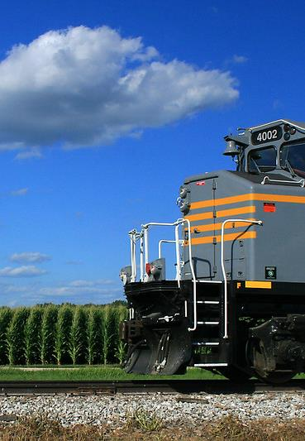

Agenda
Rail carloads
Commercial air service passenger counts
Vehicular traffic
Safety

Slide 4
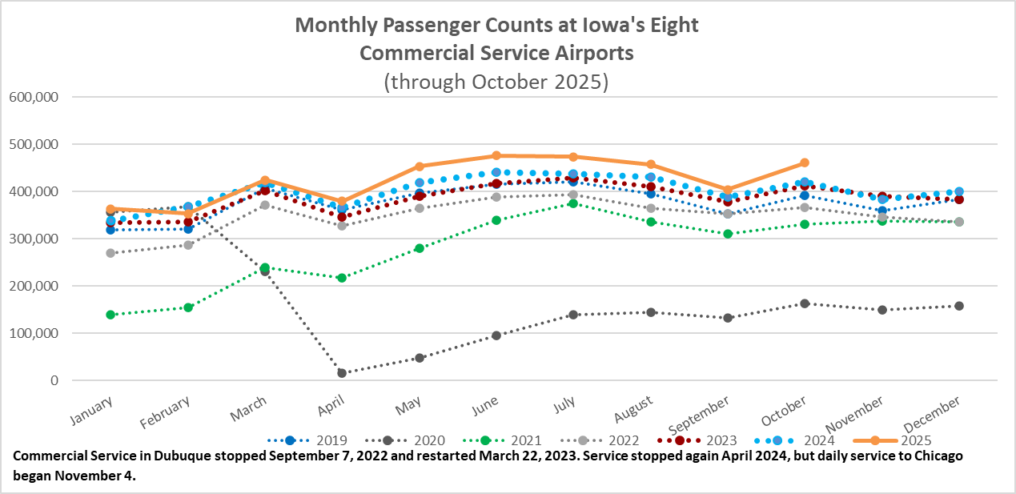

Slide 5
Monthly State Vehicle Miles of Travel
(through November 2025)
Vehicle Miles of Travel (in millions)

Slide 6
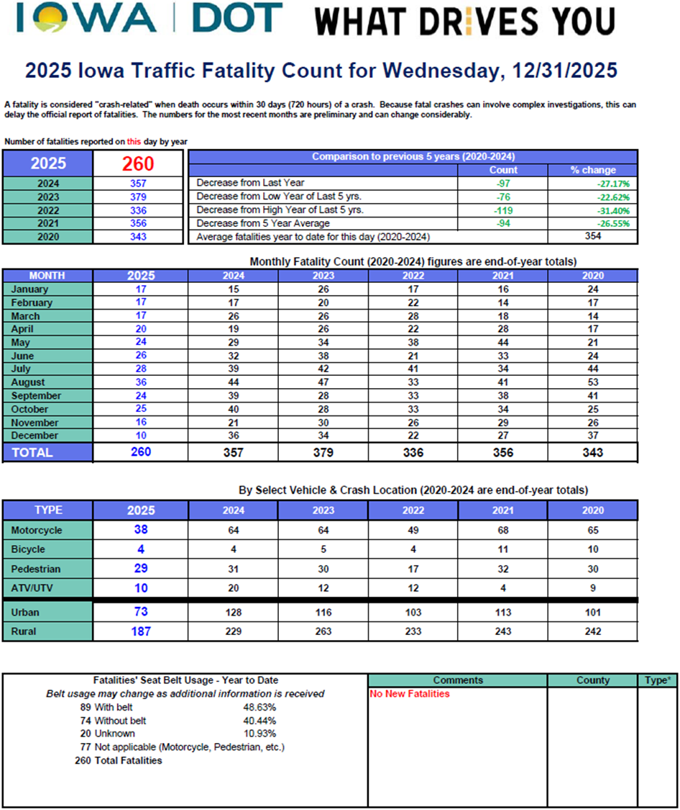

Slide 7
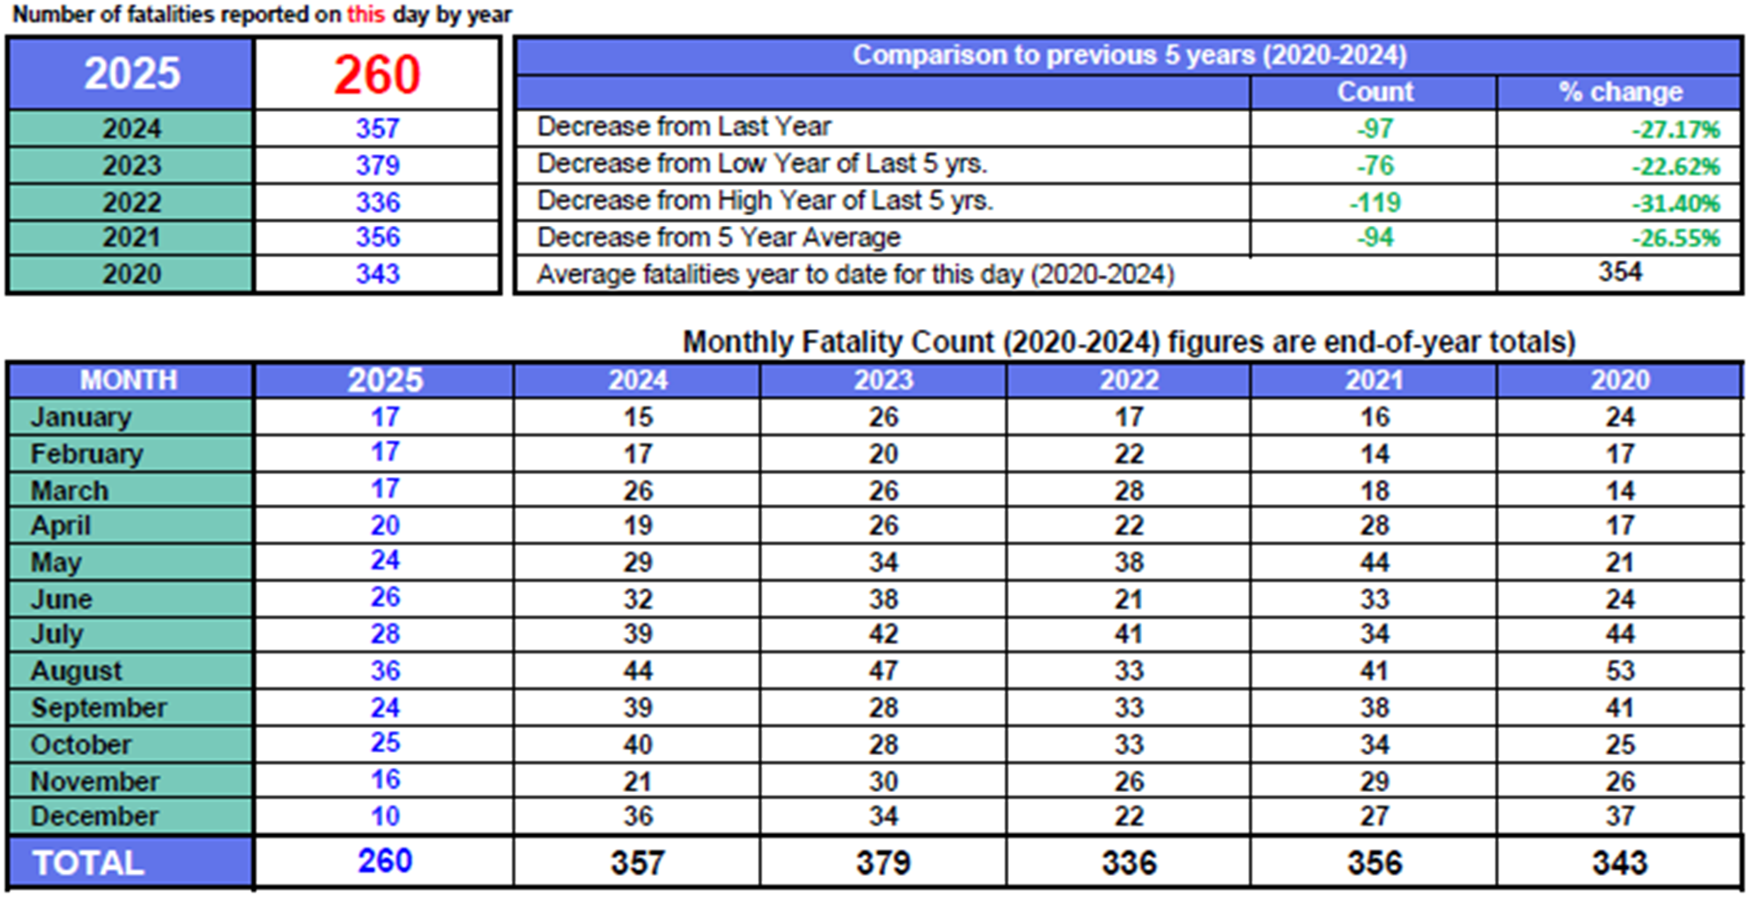

Slide 8
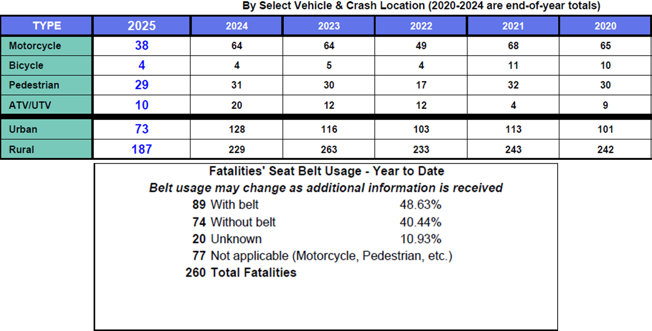

Slide 9
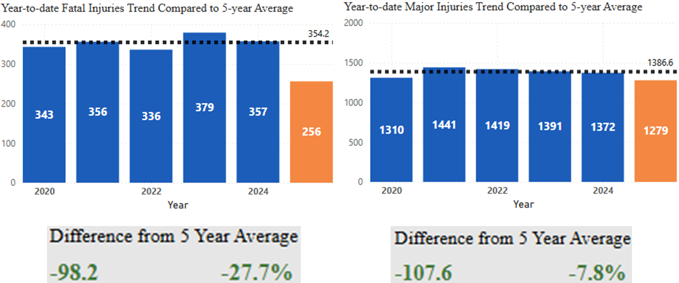
Statewide Fatalities & Major Injuries Year-to-Date
(As of December 31, 2025)

Slide 10
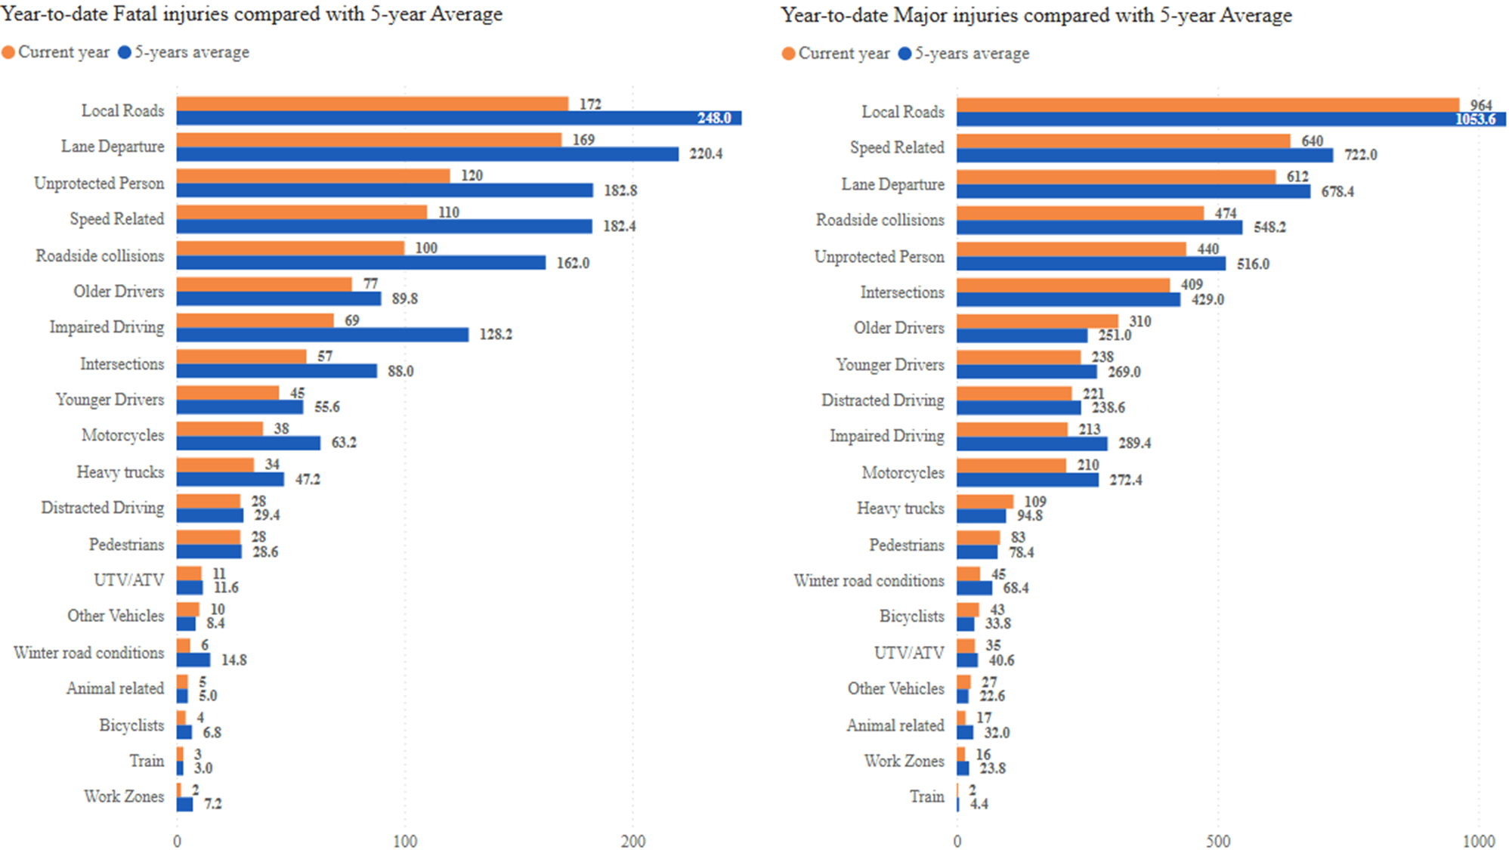

Slide 11
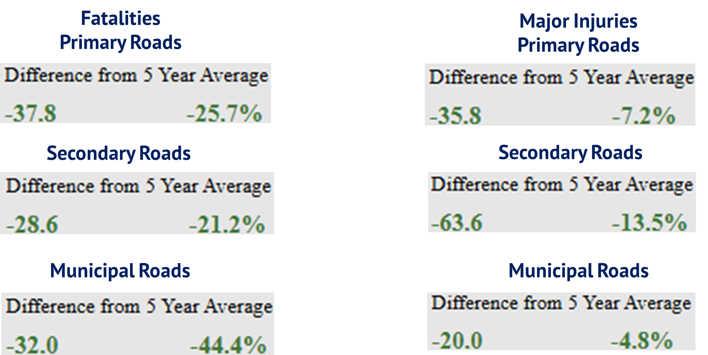
Statewide Fatalities & Major Injuries by Road Classification Year-to-Date
(As of December 31, 2025)

Slide 12
Questions?

