Slide 1
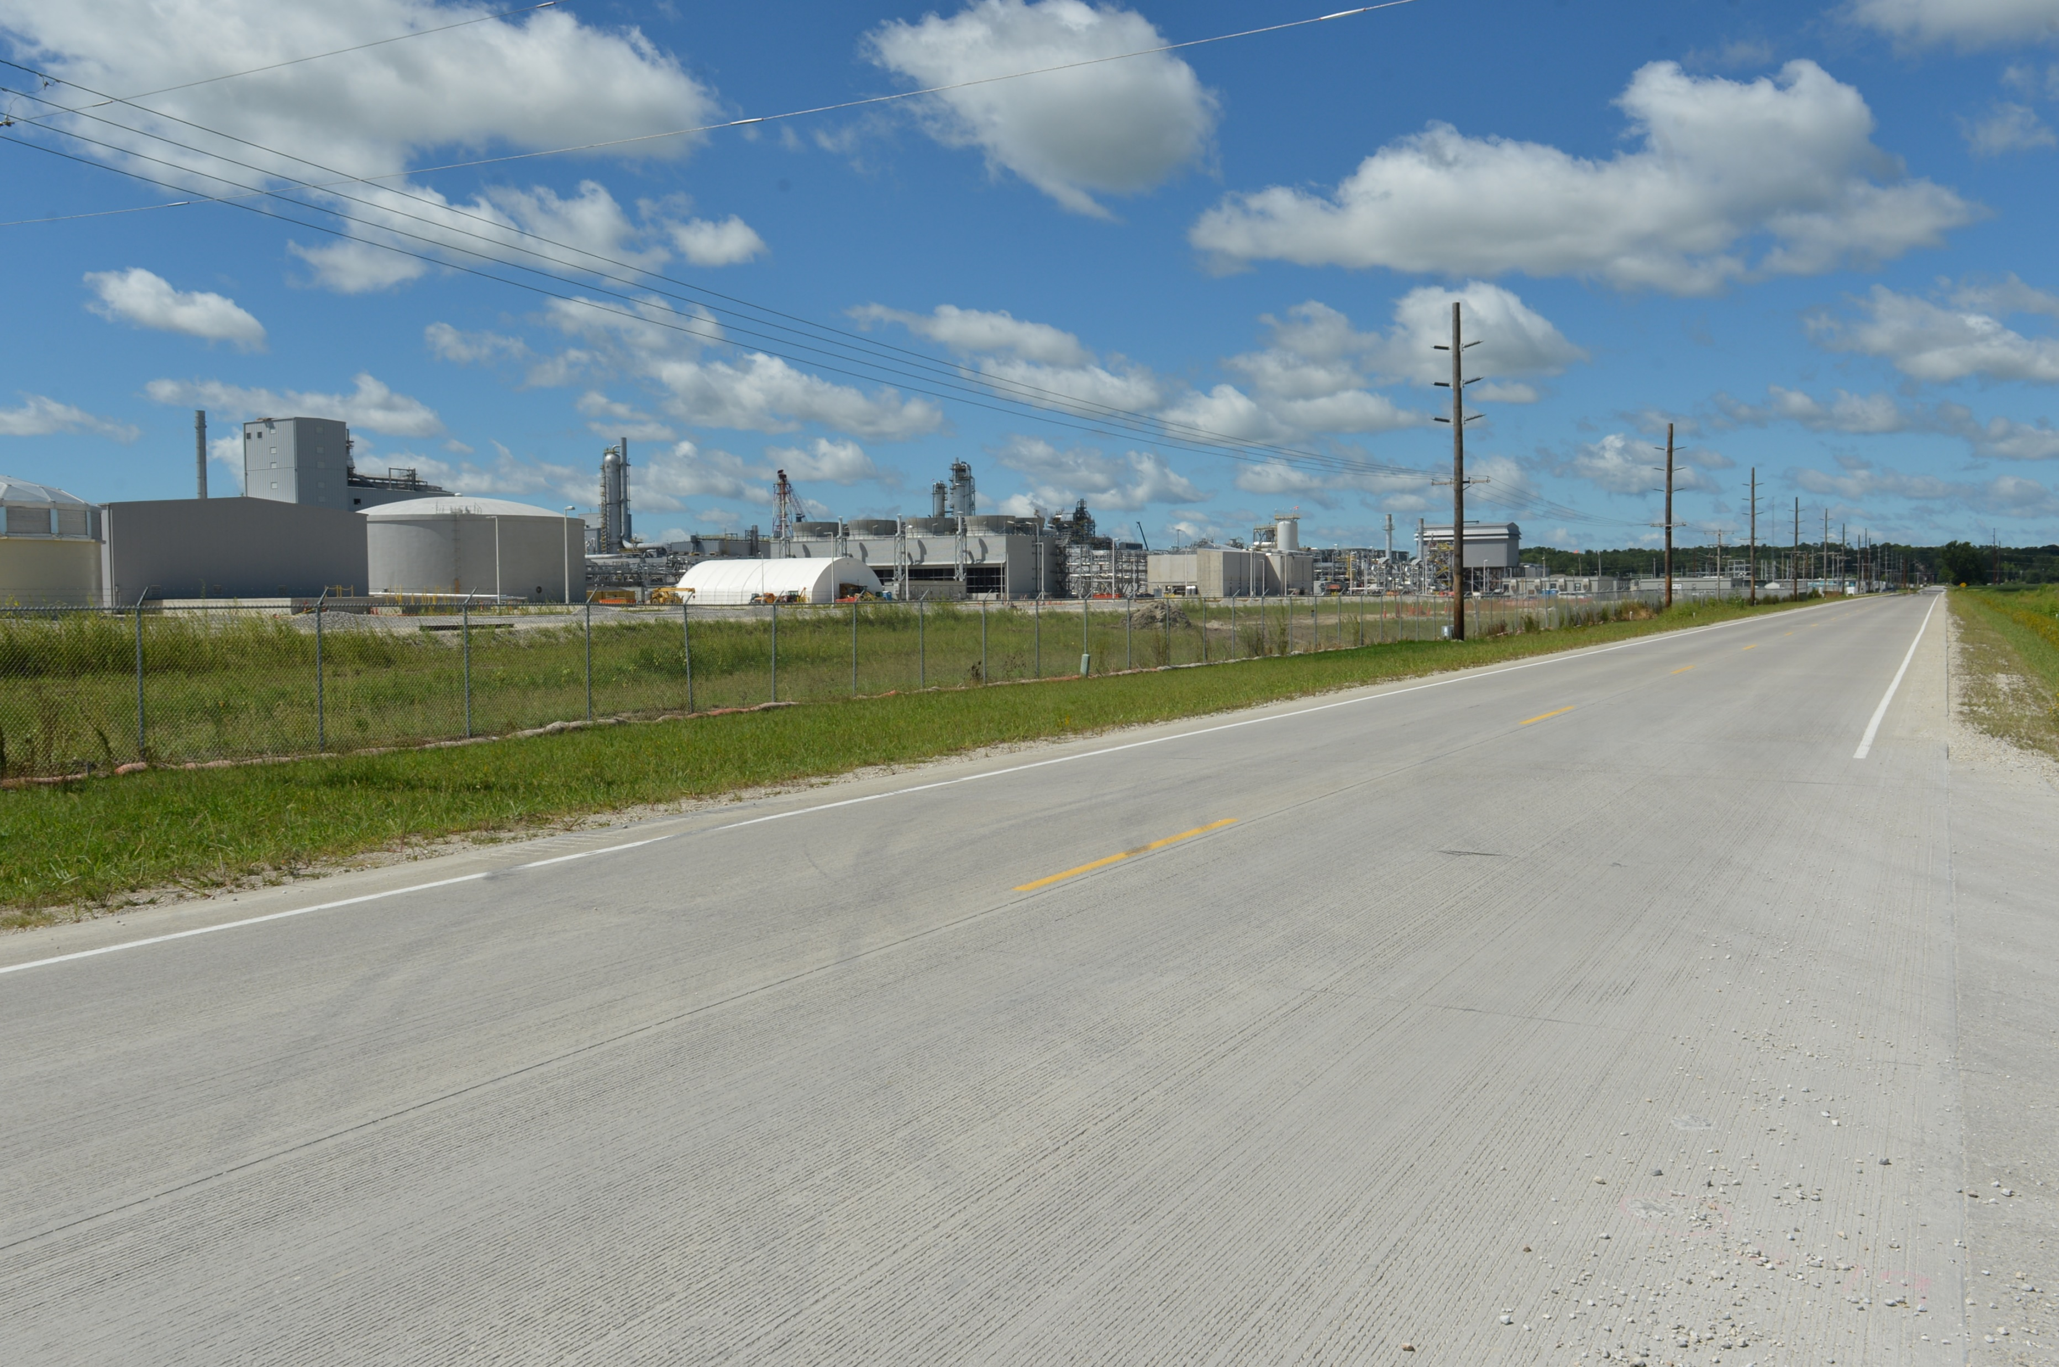

Revitalize Iowa’s Sound Economy Program
Funding Recommendation
Debra Arp
Local Systems Bureau, Grant Team Leader
1/13/2026

Slide 2
Revitalize Iowa’s Sound Economy Program
Created in 1985
Purpose: To promote economic development through roadway improvements
Eligible development shall have value-adding activities that feed new dollars into the economy
Available to cities and counties through an application program
2
2

Slide 3
Monthly Program Financial Report
Funded annually with dedicated state motor fuel and special fuel tax revenues
 | City RISE Fund | County RISE Fund
FY2026 Projected Total RISE Road Use Tax Fund (RUTF) Revenue ¹ | $12,017,805 | $6,008,902
Actual RISE Revenue Received as of 11/30/2025 ² (% of FY2026 Projected Revenue) | $5,338,239 (44.4%) | $2,641,088 (44.0%)
FY2026 RISE Funds Awarded as of 11/30/2025 (% of Projected Total RUTF committed) | $14,536,728 (121%) | $4,796,168 (79.8%)
Fund Balance as of 11/30/2025 | $61,794,658 | $16,809,368
Outstanding Commitments as of 11/30/2025³ | ($55,656,785) | ($18,964,448)
Uncommitted Balance as of 11/30/2025 | $6,137,874 | ($2,155,080)
¹ Calculation based on FY2025 average monthly RISE RUTF revenue of $1,001,484 to the city RISE fund and $500,742 to the county RISE fund. As of 11/30/2025, FY2026 is 41.7% complete.
² Actual RISE revenue includes RUTF revenue, loan repayments, and project settlements. These revenue sources are variable and are not included in projections.
³ Award of $2,721,281 to Altoona ($2,402,703 city RISE fund; $318,578 county RISE fund) in November 2025 is not reflected in the outstanding commitments of 11/30/2025.
3
3

Slide 4
Local Development Project Evaluation Criteria
Criteria | Points
Development Potential | 35
Economic Impact and Cost Effectiveness | 20
Local Commitment and Initiative | 33
Transportation Need and Justification | 4
Local Economic Need | 6
4
4

Slide 5
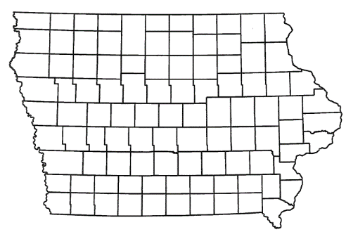
Local Development Recommendations
PROJECT NAME | SPONSOR | SCORE | TOTAL PROJECT COST | PERCENT PARTICIPATION | RECOMMENDED AMOUNT
Paving of approximately 2,650 feet of 560th Avenue and the construction of 1,500 feet of new roadway and intersection improvements at Iowa 210 and 560th Avenue located on the southeast side of town. | Huxley | 69 | $4,178,879 | 50% | $2,089,439
Construction of approximately 560 feet of 3rd Street NW located on the northwest side of town. | Sioux Center | 65 | $552,940 | 50% | $276,470
5
5

Slide 6
Local Development Recommendations
PROJECT NAME | SPONSOR | SCORE | TOTAL PROJECT COST | PERCENT PARTICIPATION | RECOMMENDED AMOUNT
Construct approximately 1,700 feet of Wolfe Lane and 610 feet of North Lane located on the southwest side of town (Certified Site Amendment) | Waterloo | 66 | $1,162,513 | 60% | $697,508
6
6

Slide 7
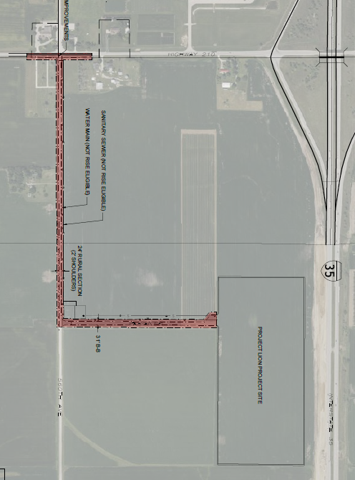
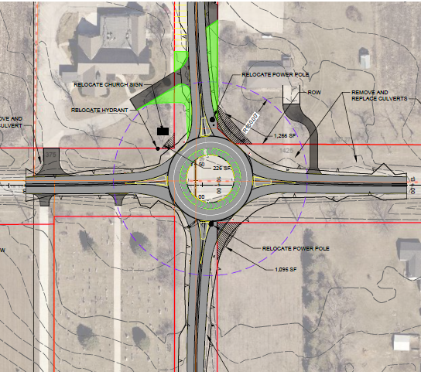
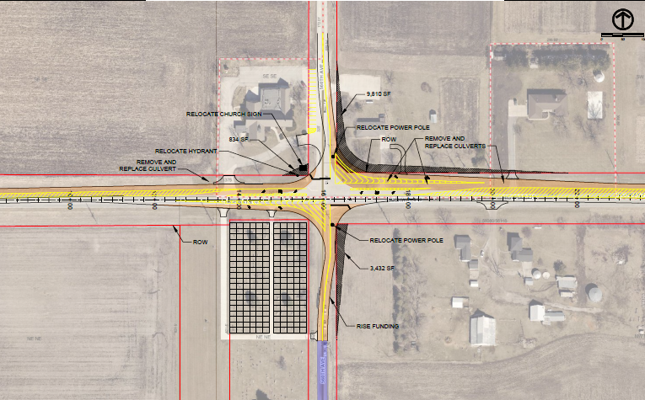
Huxley
Local Development
Roundabout Option
Paving of approximately 2,650 feet of 560th Avenue and the construction of 1,500 feet of new roadway and intersection improvements at Iowa 210 and 560th Avenue located on the southeast side of town. This project is necessary to provide access to 55 acres for warehousing and industrial purposes.
Total Cost: $4,178,879
Requested: $2,089,439 (50%)
Turn Lane Option
7

Slide 8
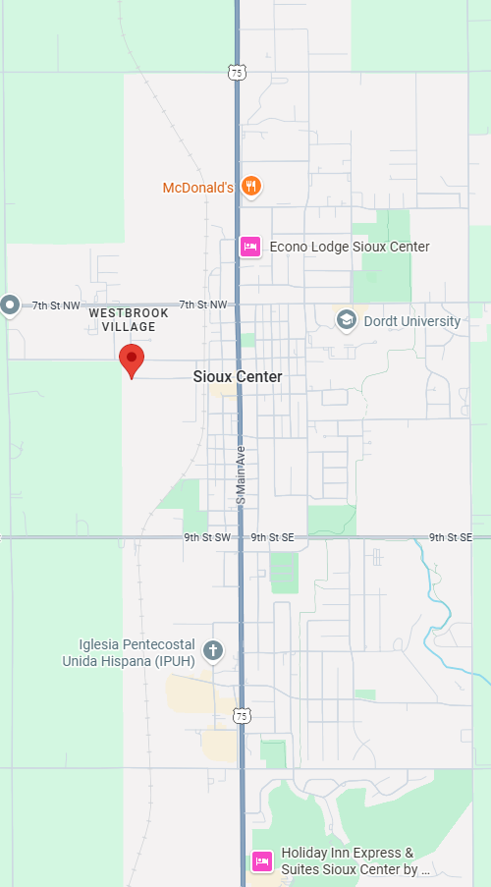
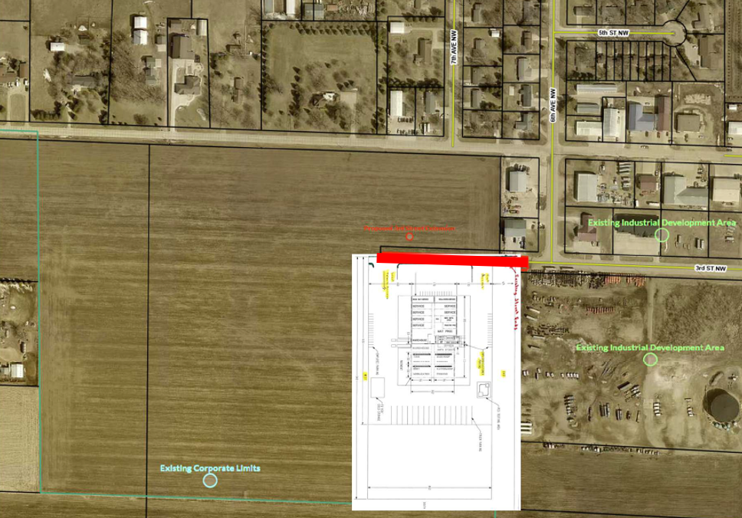
Sioux Center
Local Development
Construction of approximately 560 feet of 3rd Street NW located on the northwest side of town. This project will provide access to 12 acres for industrial purposes.
Total Cost: $552,940
Requested: $276,470 (50%)
8

Slide 9
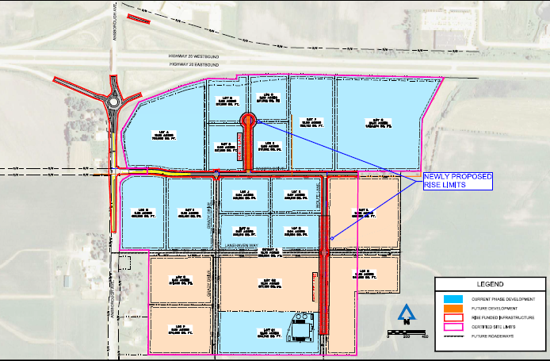
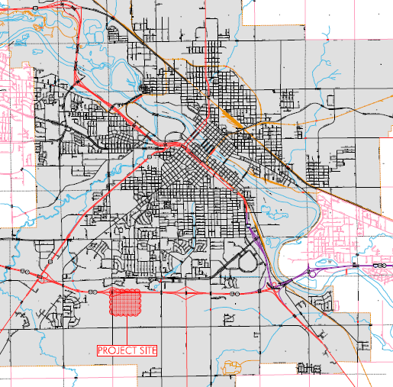
Waterloo Certified Site
Local Development
Amendment
A second amendment to the scope and grant award was requested to construct approximately 1,700 feet of Wolfe Lane and 610 feet of North Lane located on the southwest side of town
Total Cost
Previously: $6,329,663
Requested: $1,162,513
New Total: $7,492,176
RISE Funding
RISE Previously: $3,797,798 (60%)
RISE Requested: $697,508 (60%)
New Total RISE: $4,495,306 (60%)
9

Slide 10



Questions?
jennifer.kolacia@iowadot.us
515-239-1738

