Slide 1



Iowa Interstate Investment Plan
Transportation Commission Update January 2026
3/2/2023
January 13, 2026

Slide 2

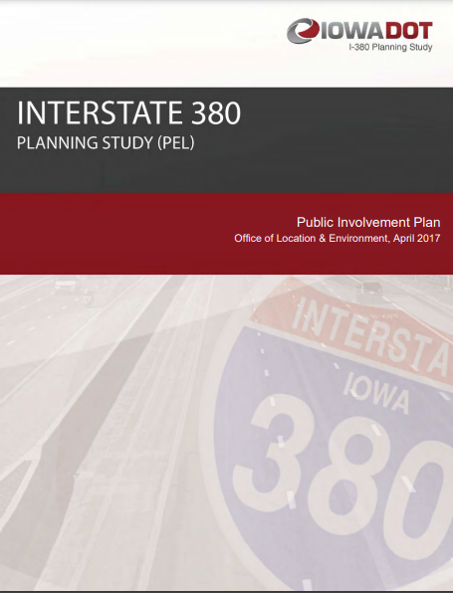

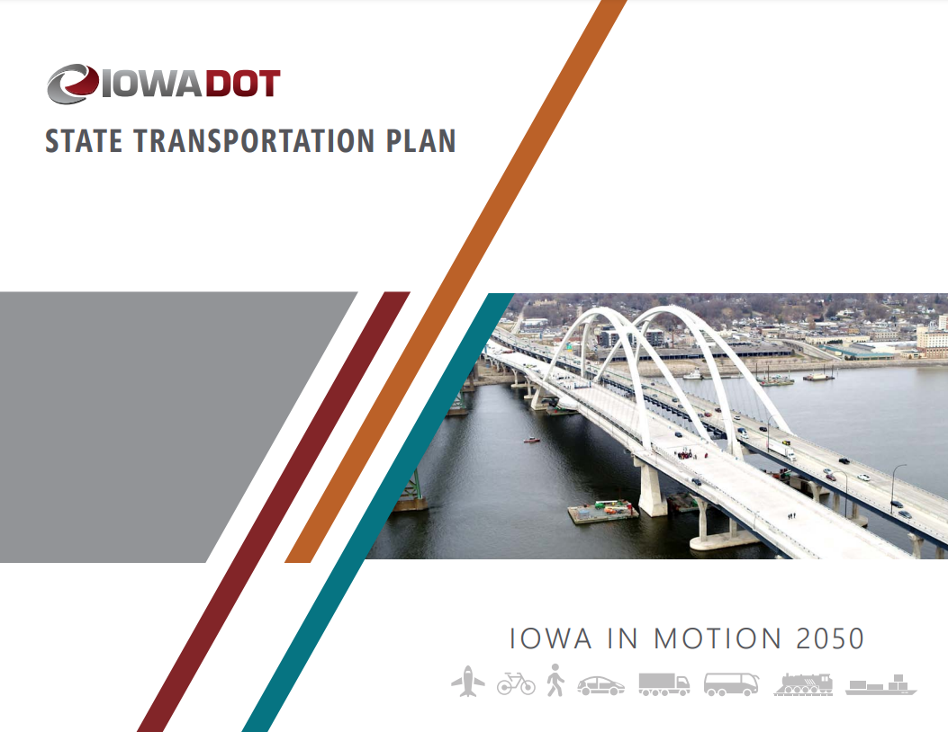

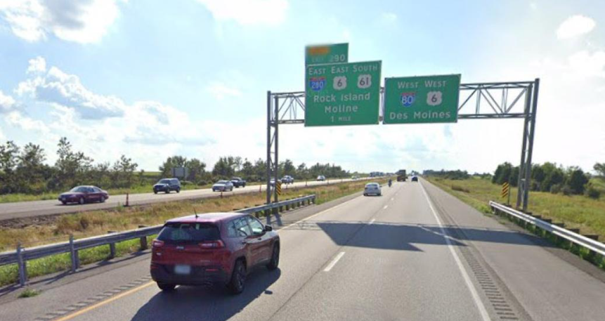
Background: Why an Interstate Plan?
Planning Efforts & Project Development Activities Highlight Iowa’s Transportation Needs Exceed Available Funding
Desired a tool that helps us identify realistic candidates for future programming based on a constrained interstate budget
Notes:
DOT does good job planning for interstate but not fiscally constrained. Why the plan – how the plan developed – what used for?

Slide 3

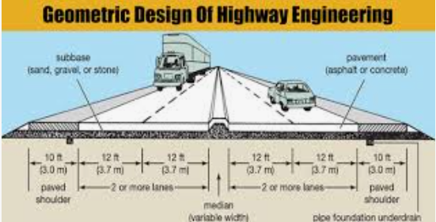
Concept of a “fiscally constrained” Plan for Iowa’s Interstate System
Initiated by a 2-day Workshop including 70 Participants in Summer of 2018
Identified Statewide Interstate Needs and Budget Estimates
Rehabilitation Needs vs. Capacity Expansion Needs
Interstate Plan Goals:
Establish priority of interstate projects
Space projects in time for increased affordability
Establish reasonable timeline of projects based on infrastructure and capacity need.
Balancing Design and $$
Notes:
Points:
Mention Initial Workshop
Rehab vs Capacity Needs
Establish priority of projects to focus on

Slide 4
Workshop Recommendations We Continue to Embrace Today
Stewardship - All participants recommended the focus should be on preservation treatments to keep the system in its current state of good repair.
Consider Technology Options First - Expansion projects in urban corridors will be limited and focus on technology solutions and other management strategies before adding lanes.
Transportation Systems Management & Operations (TSMO)
Integrated Corridor Management (ICM)
Widening Options - Many segments of Interstate have significant pavement life remaining, so adding capacity in those areas will first consider widening the existing pavement rather than a complete rebuild.
Notes:
Focus on Stewardship First
Then Consider Technology Options
Then Capacity Widening
Then Capacity Full Reconstruction

Slide 5
Initial Plan Result
$330 Million Annual Budget
Project Budgets Set Very Tight to Promote Right Sizing
Notes:
Plan results after initial workshop
Mention $330 million annual budget (1/2) program at that point in time.
Large bubble in the later years of the plan
Explain Tight Budgets to promote right sizing of projects.

Slide 6
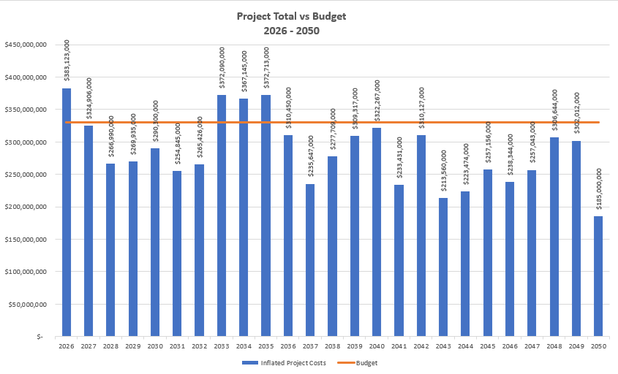
2025 Project Totals and Annual Budget
$330 Million Annual Budget
Program Years
Project Budgets Set Very Tight to Promote Right Sizing
Notes:
2025 Results of Interstate Plan
Time frame extended to 2050 (after first couple years of plan existence)
Interstate is 10% of all lane-miles
Shows Stewardship and Capacity projects

Slide 7
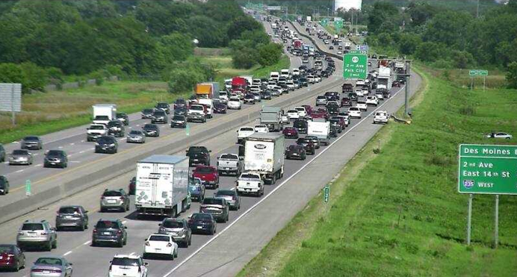
Focus for 2025 – Update of Traffic Analysis
Traffic Analysis 2025 Method:
Utilized 2050 Traffic Forecast from Systems Planning Bureau
Calculated the annual growth from current traffic counts
Most segments < 2% per year
Determined timing of when traffic levels would start to cause persistent congestion
Notes:
Briefly and in basic terms explain traffic analysis.
First traffic analysis was in 2020.

Slide 8
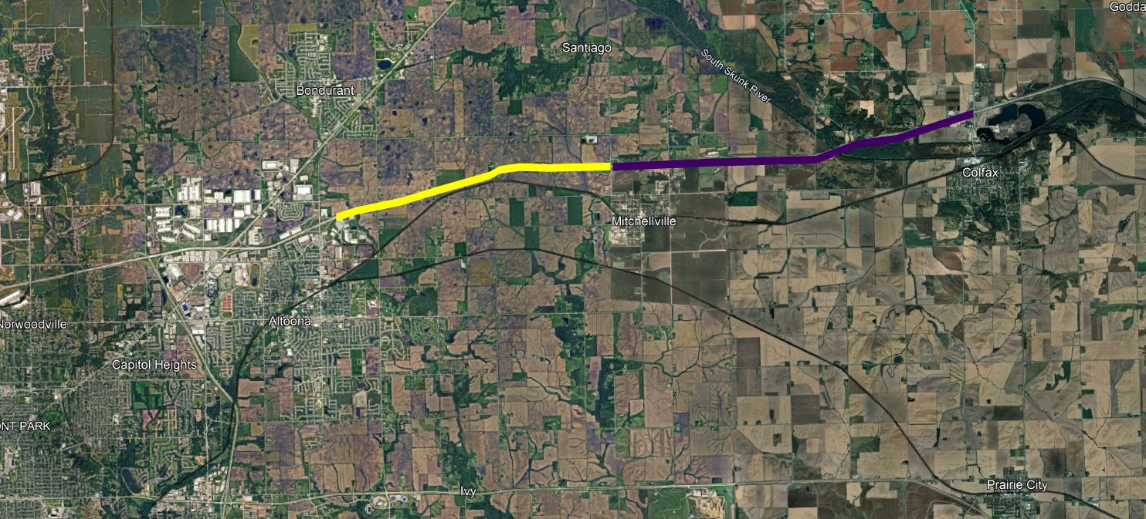

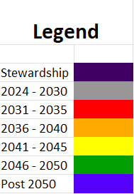
What did new traffic analysis tell us?
Need for increased capacity for many interstate sections may happen later in time.
I-80 – East of US 6/65 Interchange
US 6/65 to Mitchellville
Current Plan 2032 - Capacity Need 2043
Mitchellville to Colfax
Current Plan 2043 - Capacity Need 2057
Notes:
The analysis tells us that traffic operations may be acceptable further into the future than previously thought.
US 6/65 to Mitchellville Capacity Need in 2043 but current plan has it scheduled for 2032.
Mitchellville to Colfax post 2050 so moved to Stewardship category.

Slide 9
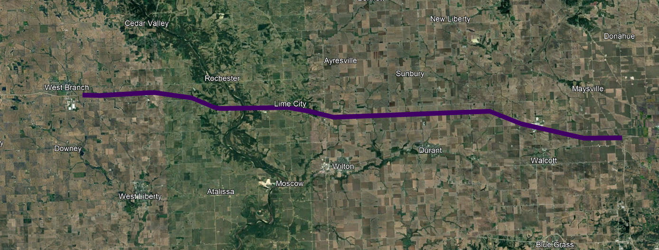
What did new traffic analysis tell us?
Need for increased capacity for many interstate sections may happen later in time.
I-80 – Cedar/Scott County
West Branch to Cedar River
Current Plan 2031 – Capacity Need 2051
Cedar River to Durant
Current Plan 2039 – Capacity Need 2057
Durant to Blue Grass
Current Plan 2047 – Capacity Need 2062
Blue Grass to I-280 Interchange
Current Plan 2047 – Capacity Need 2051
Notes:
I-80 West Branch to I-280 capacity need is post 2050 so moved to Stewardship category

Slide 10
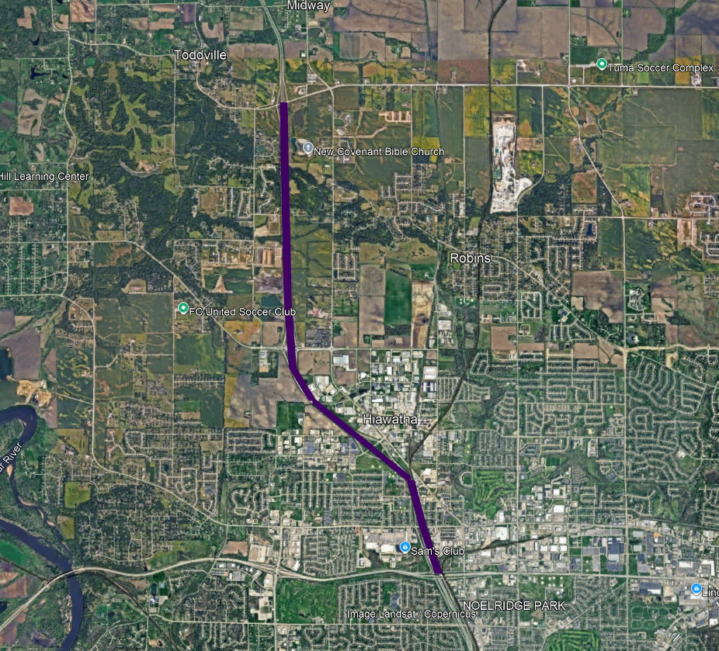

What did new traffic analysis tell us?
Need for increased capacity for many interstate sections may happen later in time.
I-380 – North of Cedar Rapids
IA 100 to Boyson Rd
Current Plan 2045 – Capacity Need 2051
Boyson Rd to County Home Rd
Current Plan 2045 – Capacity Need 2068
Notes:
I-380 North of Cedar Rapids capacity need is post 2050 so moved to Stewardship category.

Slide 11
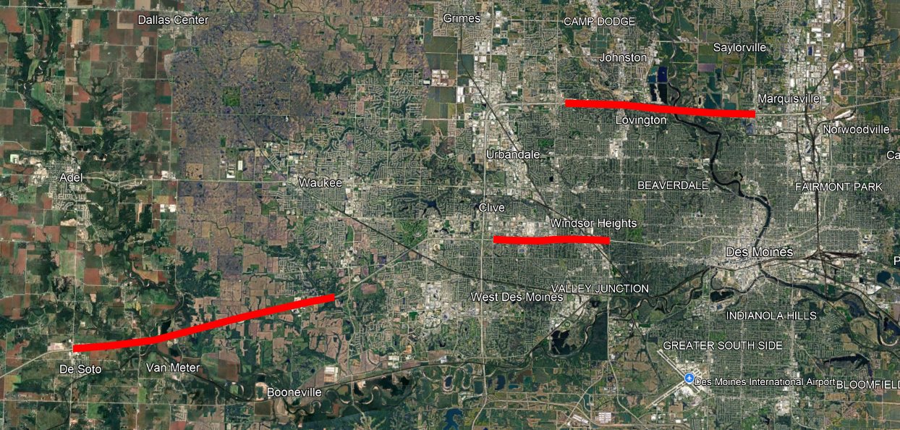


What did new traffic analysis tell us?
Some interstate segments warrant closer monitoring.
Des Moines Metro
I-80/35 – 86th St to 2nd Ave
I-80 – West of R22 Booneville
I-235 – SWMM to IA 28
Notes:
The analysis tells us that traffic operations may be unacceptable sooner than previously thought.
I-80/35 – 86th St to NEMM
86th to IA 28
Current Plan 2033 – Capacity Need 2024
IA 28 to IA 415
Current Plan 2033 – Capacity Need 2024
I-80 – West of R22 Booneville
Current Plan 2034 - Capacity Need 2056
Traffic Trends are Increasing
With Construction at I-80/US169 and East at GPP to 60th may make sense to expand capacity sooner
I-235 – SWMM to IA 28 – (Note: Auxiliary Lanes used in calculations – retain in 2031-2035 – continue monitoring)
SWMM to 35th St - Current Plan 2035 – Capacity Need 2056
35th St to 22nd St. - Current Plan 2035 - Capacity Need 2047
22nd St. to 9th St. - Current Plan 2035 - Capacity Need 2043
9th St. to IA 28 - Current Plan 2035 - Capacity Need 2066
Traffic Trends are Increasing

Slide 12
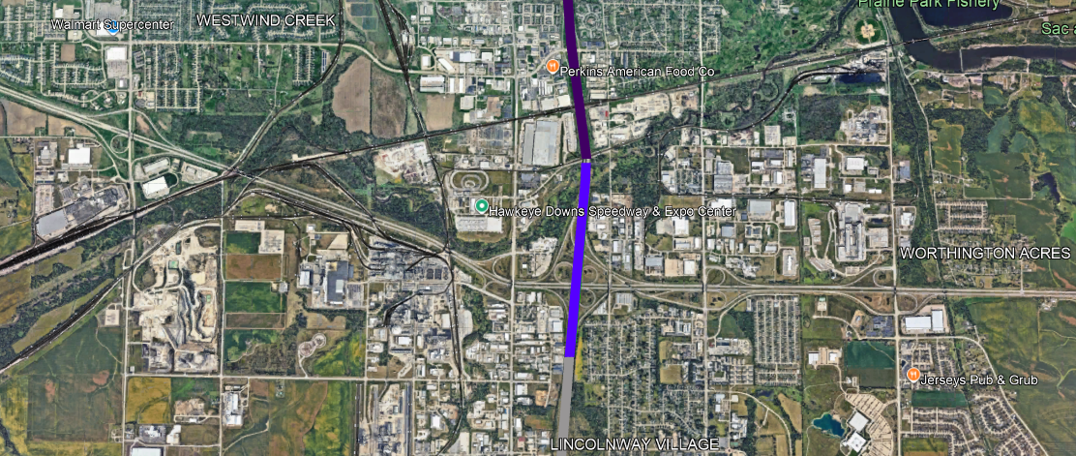
What did new traffic analysis tell us?
Some interstate segments warrant closer monitoring.
I-380/US 30 Interchange
Current Plan Post 2050 – Capacity Need 2029
Notes:
The analysis tells us that traffic operations may be unacceptable sooner than previously thought.
I-380/US 30 previously in plan for post 2050 but traffic warrants 2029.

Slide 13
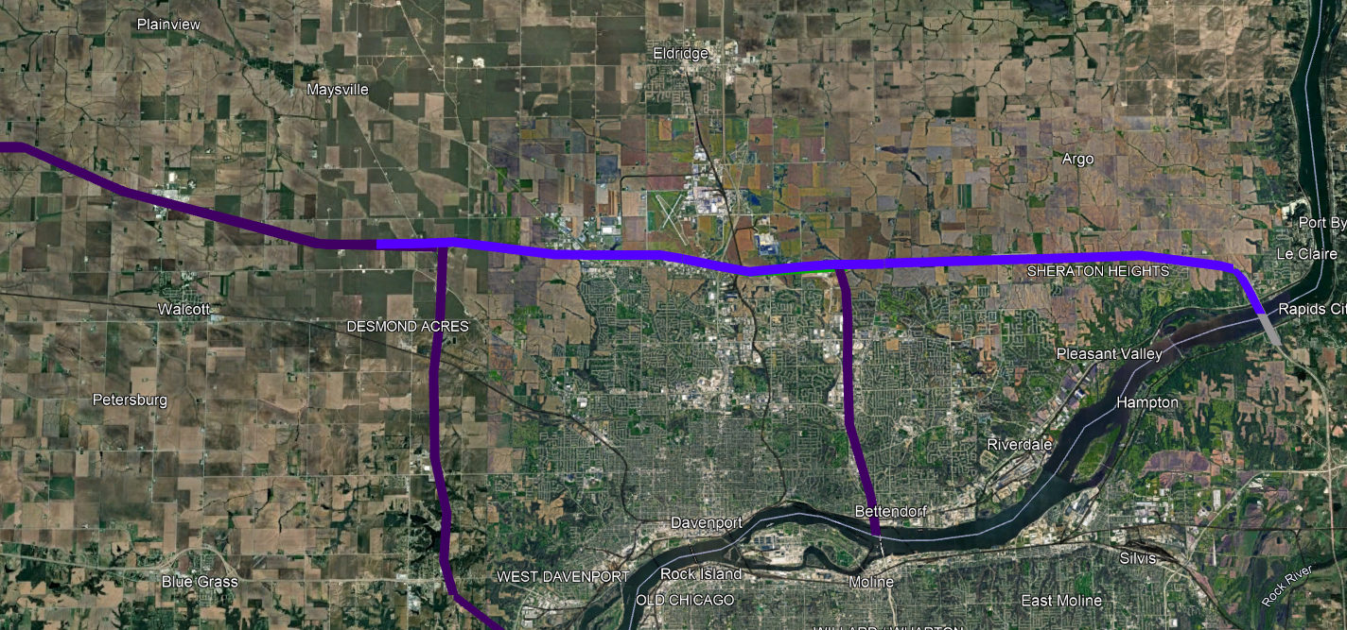


What did new traffic analysis tell us?
Some interstate segments warrant closer monitoring.
I-80 – Scott County – I-280 to Mississippi River
IA 130 to US 61
Current Plan 2050+ - Capacity Need 2042
US 61 to I74
Current Plan 2050+ - Capacity Need 2039
Spot Improvements for Operations near US 61 & I-74 Interchanges
Notes:
The analysis tells us that traffic operations may be unacceptable sooner than previously thought.
Current plan has I-80 in the Quad Cities as post 2050.
However, areas around the I-80/US 61 interchange warrant spot improvements. (Potential enhancements to ramp movements and auxiliary lanes between US 61 and I-74 interchange.)
There is a proposal from District staff to do a feasibility study in the area of the I-80/US 61 interchange.

Slide 14
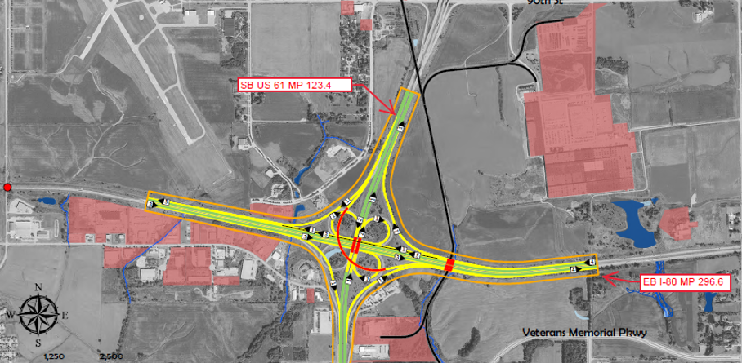
Interstate 80 – Scott County
Based on Timing of Capacity Need due to Traffic Volumes – I-80 Scott County corridor widening to 6-lanes are post 2050.
However, there are spot locations that may need to be addressed sooner than 2050. District has submitted request for feasibility study.
Below is an example of potential interchange improvements at I-80 and US 61 (southbound US 61 to eastbound I-80 flyover)
US 61
I-80
Notes:
Mention Spot Location Improvements
Business Case Received for Study around I-80/US 61 interchange

Slide 15
Steps for 2026
Continue Traffic Volume and Operations Monitoring
Analyze Construction Project Costs and Compare to Interstate Plan Budgets
Revise Interstate Plan Budgets Where Needed
Coordinate Interstate Needs with District Staff
Identify Suitable Treatments and Timing for Sections being Monitored
(Technology Solutions, Auxiliary Lanes, Widening, Reconstruction)
Report to Commission December 2026
Notes:
Interstate Plan Updates planned for 2026
More in-depth update than normal
Review Project Budgets/Suggested Treatments

Slide 16
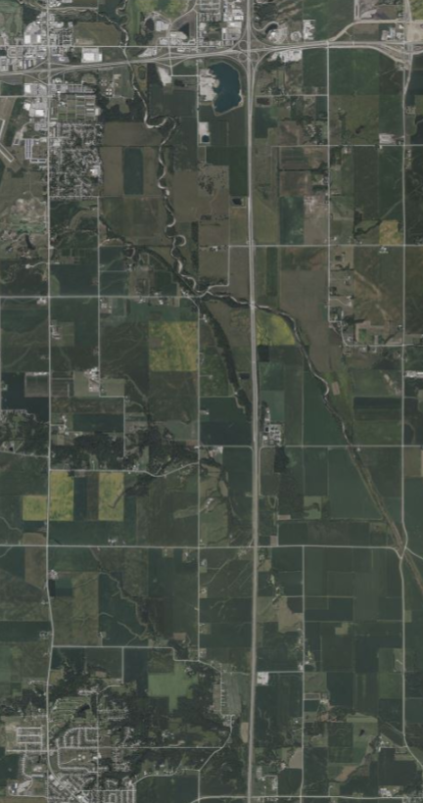
Notable Interstate Projects
Ames
Interstate 35 – Story County
Reconstruction to 6-lanes
Between Huxley to North of U.S. 30
US 30
$100 million total project cost
Construction Years 2027 - 2030
I-35
Huxley
Notes:
Notable Interstate Projects
Mention recent amendment to get ROW started.
Construction Begins 2027 and Ends 2030.

Slide 17
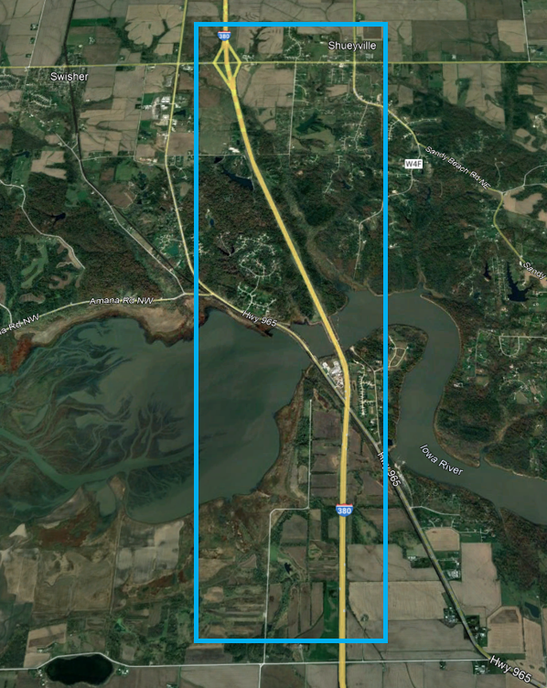
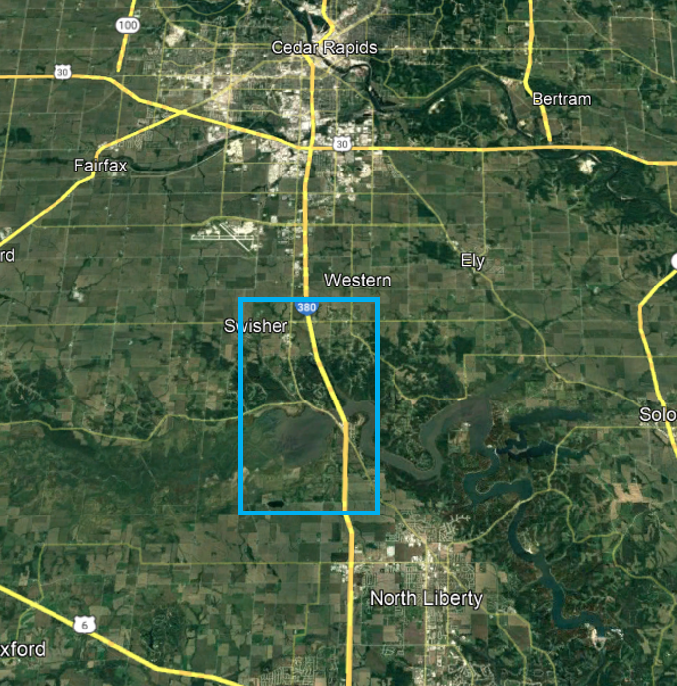
Notable Interstate Projects
Interstate 380 – Johnson/Linn County
Reconstruction to 6-lanes
North of Swan Lake Rd to North of 120th St
120th St
2029 - $1.04 million
2030 - $11.37 million
2031 - $57.8 million
2032 - $56.3 million
2033 - $27.0 million
Swan Lake Rd
Notes:
Middle segment I-380

Slide 18
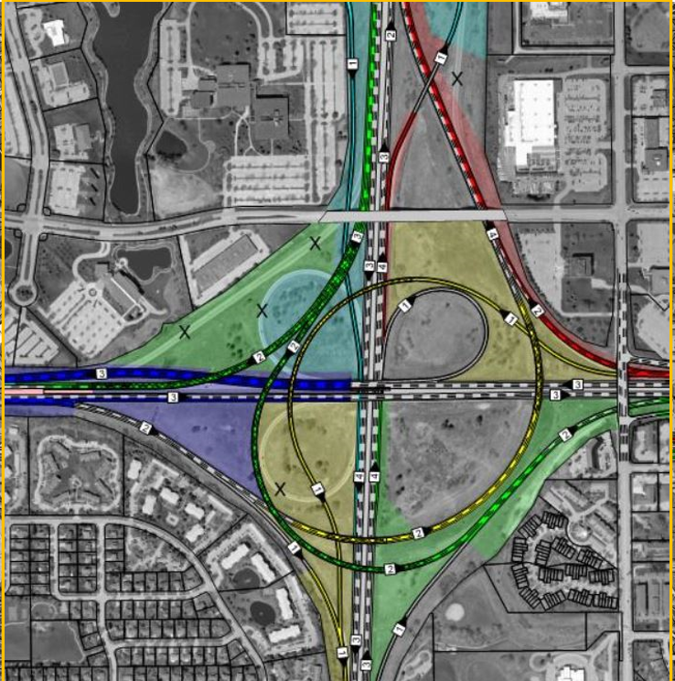
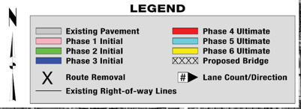
Notable Interstate Projects
Des Moines SW Mixmaster Phases
Phase Timing
Phases 1,2,3 – 2027 & 2028
ROW in 2026
Erosion Control in 2029
Phase 4 - 2038
Phase 5 - 2039
Phase 6 - 2040
Swan Lake Rd
Notes:
Mention SW Mix Construction and Future Phases

Slide 19
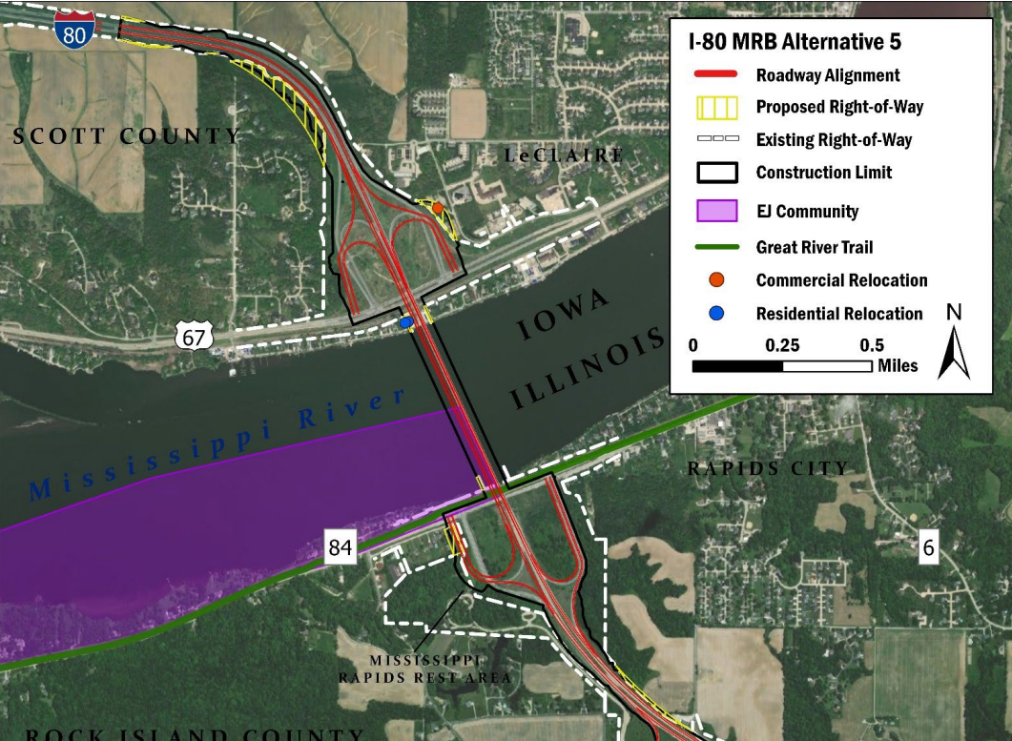
Notable Interstate Projects
Interstate 80 – Scott County
Mississippi River Bridge
Phase 2 Final Design
Preferred Alternative Chosen
Alt 5 – Companion Bridge West
Bike/Ped Facility Added
Three Years Programmed 2028/2029/2030
Total Iowa Share $210 M
Illinois DOT - lead Agency
US 61
I-80
Notes:
Brief Update on I-80 MRB Project in Final Design

Slide 20
Questions?
Phil Mescher, AICP, CPM
515-233-7969
Phil.Mescher@iowadot.us​
iowadot.gov

