Slide 1
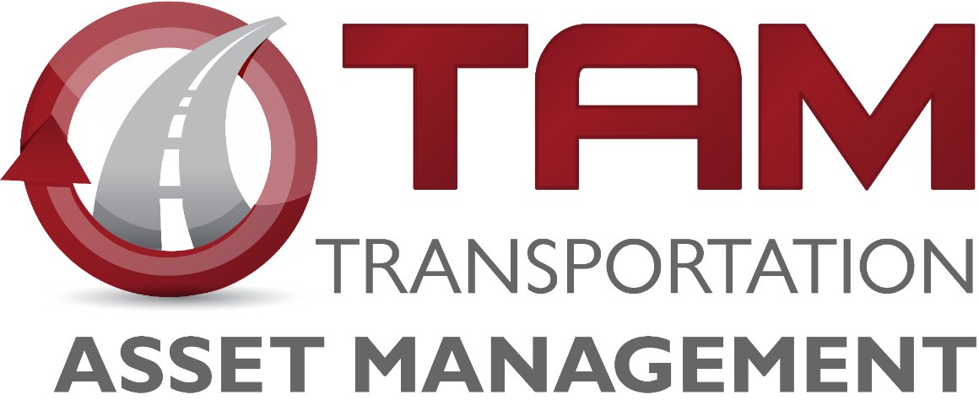


Pavement Management
Iowa Transportation Commission Workshop – January 13, 2026
3/2/2023
Notes:
“Today, we’ll explore how strategic pavement management enhances safety, efficiency, and cost-effectiveness across Iowa’s road network.”

Slide 2


Agenda
Pavement Management Team
Pavement Inventory and Age
Pavement Network Conditions
Interstate
Non-interstate
Pavement Distresses Examples
Strategic Project Selection
Notes:
“We’ll start with team introductions, review inventory and conditions, examine distress examples, and conclude with strategic project selection and key takeaways.”

Slide 3




Pavement Management Team Introduction
Jason Omundson, P.E.
Pavement Preservation Engineer
Ashley Buss, Ph.D., P.E.
Pavement Management Leader
Yen Vo,
Data Scientist 1,
Pavement Modeler and Analyst
Charchit Shukla,
Ph.D. Student at Iowa State
Iowa DOT Engineering Intern
Notes:
Our team works closely with all the districts, construction and materials, program management, project management, design, research and analytics, and systems planning.
“Our multidisciplinary team works closely with districts, design, research, and analytics to optimize pavement performance statewide.”

Slide 4
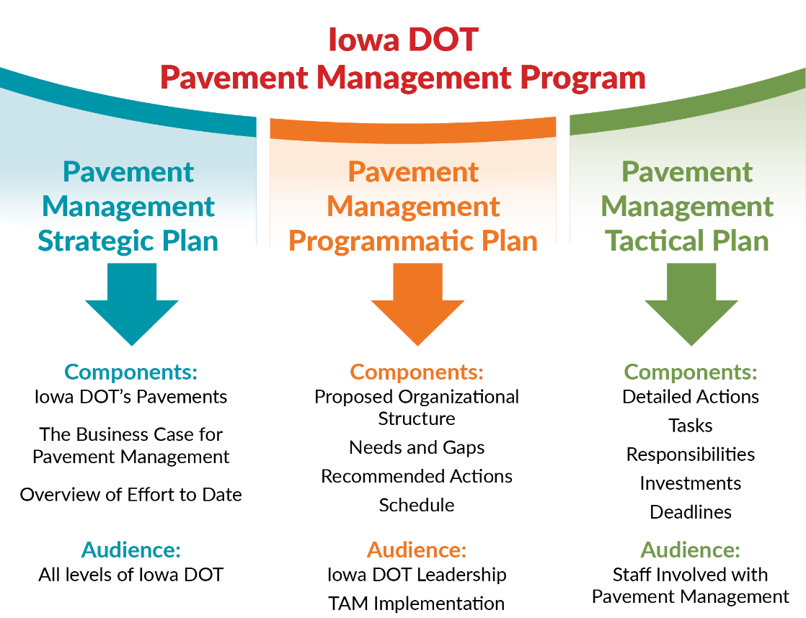
Guiding Documents
Notes:
The Pavement management strategic plan and the programmatic plan are our guiding documents that shaped the vision for creating the team.

Slide 5
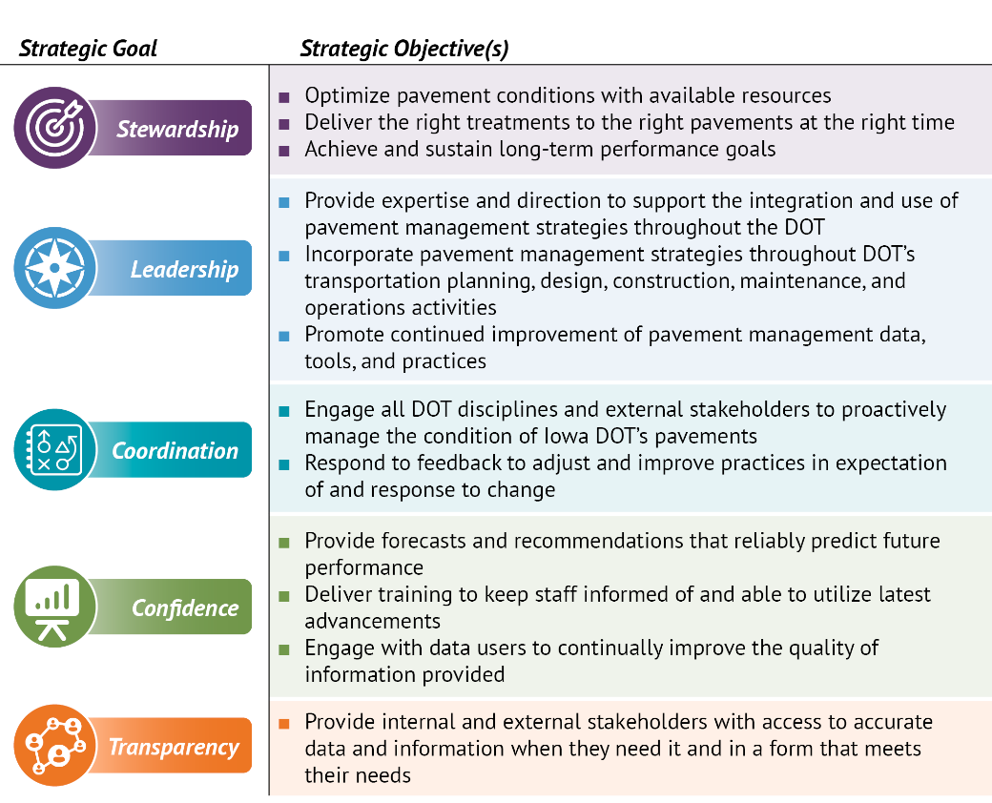
5-year Goals and Objectives
Notes:
These goals and objectives link to the Transportation Commission’s State Long-Range Transportation Plan. – particularly the emphasis on stewardship.

Slide 6
Pavement Inventory
The Primary system includes 24,657 lane miles of pavement.
3,895 or about 16% on the Interstate
806 lane miles of ramps
Our Investment
If we had to replace the pavement on all these roads today, the cost would exceed $30 billion.
Notes:
“Replacing all pavements today would exceed $30 billion—underscoring why proactive management is critical.”
One mile of four-lane roadway is four lane-miles.
These mileages are based on the LRS data, not PMIS.
(Documentation: Research & Analytics Bureau report generated 5/22/25. )
Estimated range is between $29 Billion to $36 Billion

Slide 7
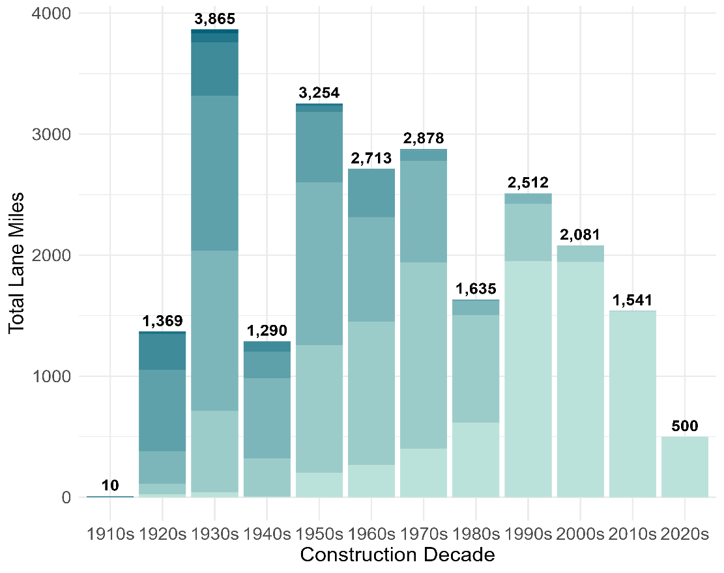
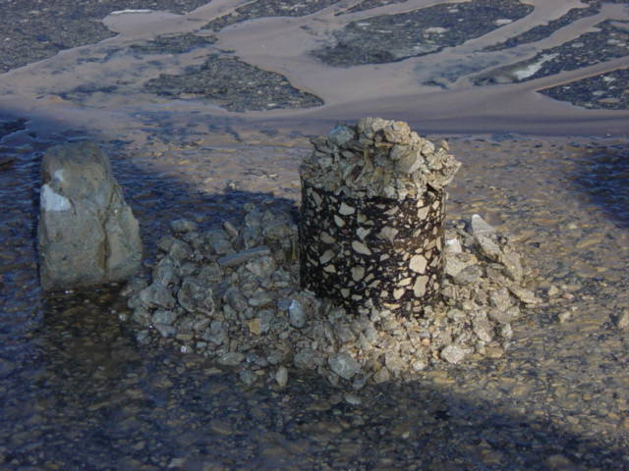
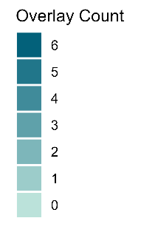
Lane Miles by Decade of Original Construction
Aggregate Durability Specifications Implemented in1971
Notes:
Aggregate Durability Classification started in 1971.

Slide 8
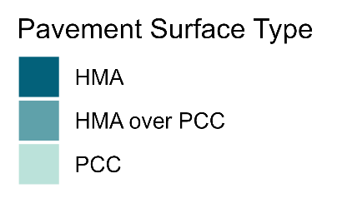
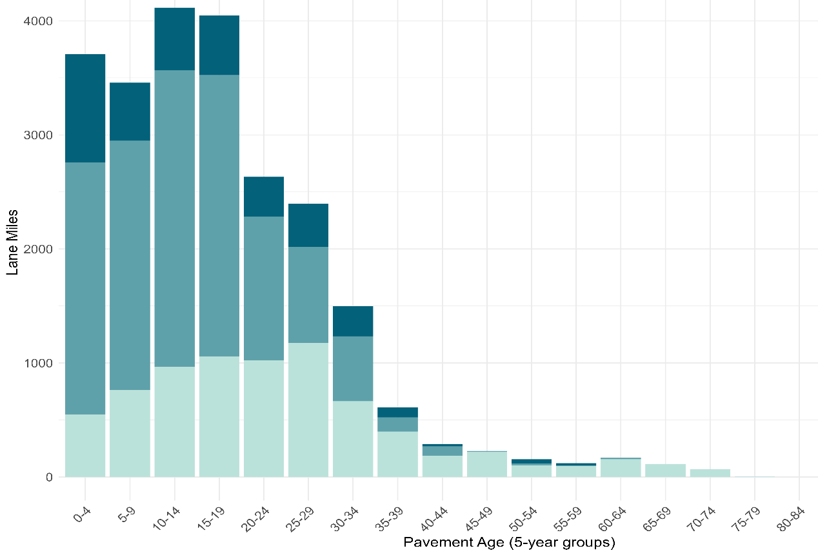
Lane Miles by Surface Type and Surface Age
5,040 Lane Miles have reached or exceeded typical design age
21% of Mainline Lane Miles
Notes:
“Over 5,000 lane miles have reached or exceeded design age—these aren’t failing yet, but they carry higher risk.”

Slide 9
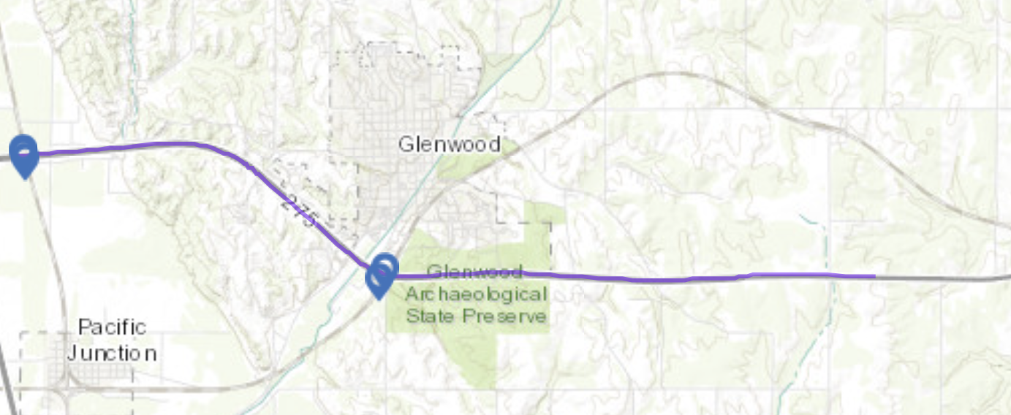
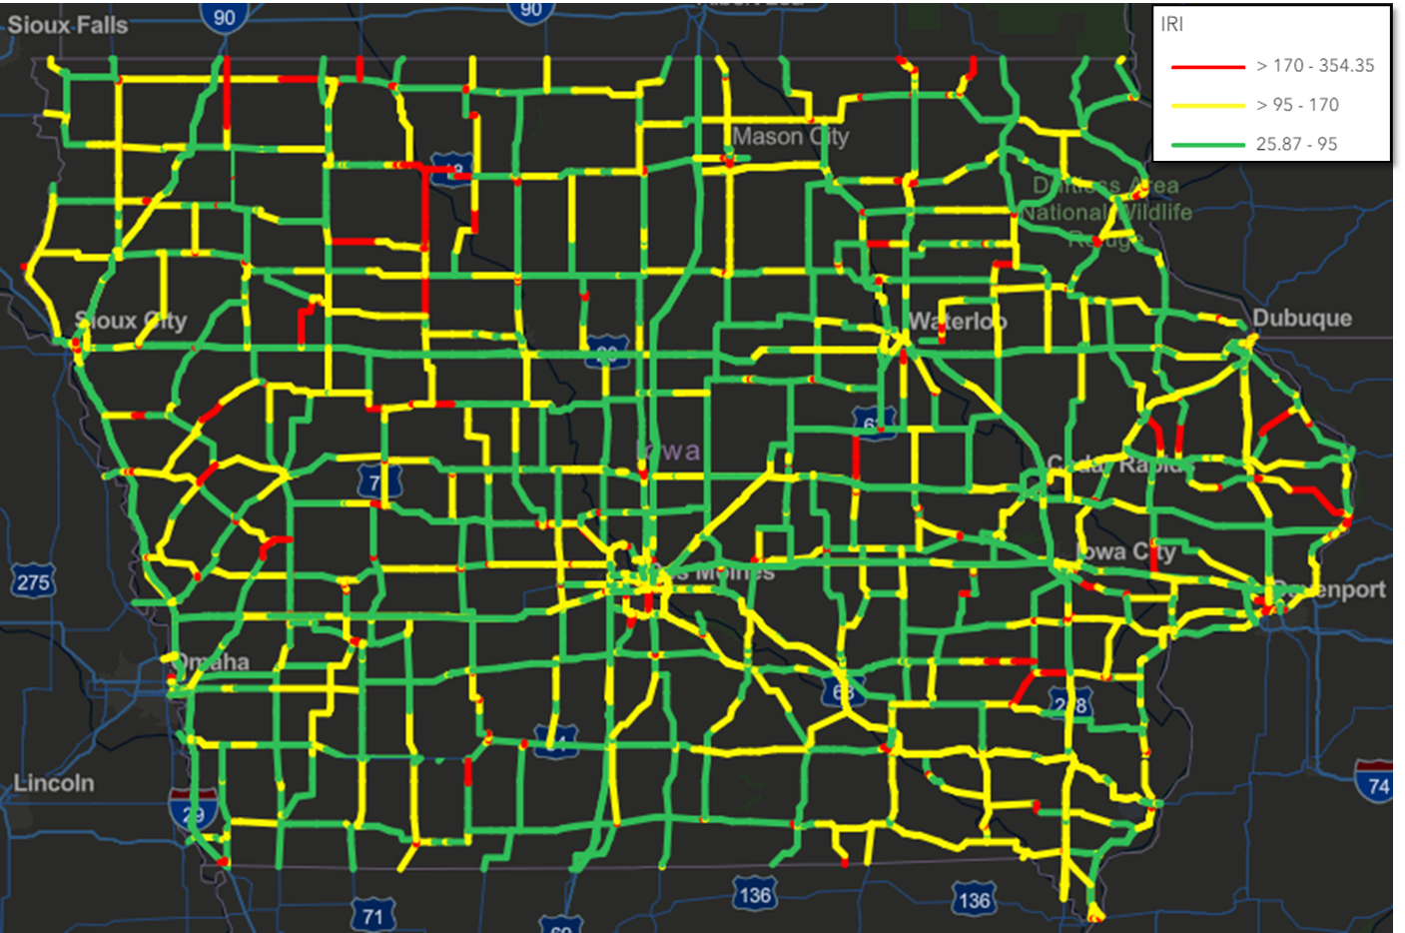
Pavement Management:
Network vs. Project Perspectives
Project-Level
Network-Level
Best treatment for a specific section
Localized cost-benefit analysis
Pavement Forensics, Coring, Ground Penetrating Radar
Condition Forecast of Specific Locations
System-level analysis of where to invest to optimize network performance
System-wide Targets
Pavement Condition Index (PCI)
80 average target on Interstate
75 average target on primary non-interstate.
Notes:
“Our goal is to maintain PCI 80 for interstates and 75 for non-interstates—balancing performance and budget constraints.”

Slide 10
Pavement Network Condition Targets
Iowa’s Pavement Condition Index (PCI)
Interstate Network
Non-Interstate Primary
100 | Excellent
85 | Good
75 | Fair
60 | Poor
50 | Very Poor
100 | Excellent
85 | Good
70 | Fair
55 | Poor
40 | Very Poor
Target = 80
Target = 75
Notes:
“The scales shown represent generalized pavement condition categories. While PCI (Pavement Condition Index) isn’t a perfect measure of every performance factor, it provides a reliable, standardized indicator for assessing overall network health. From a system-level perspective, PCI helps us prioritize investments and track long-term trends effectively. Our target is to maintain an average PCI of 80 on interstates and 75 on non-interstate primary routes—striking a balance between performance goals and available funding.”
“Our goal is to maintain PCI 80 for interstates and 75 for non-interstates—balancing performance and budget constraints.”

Slide 11
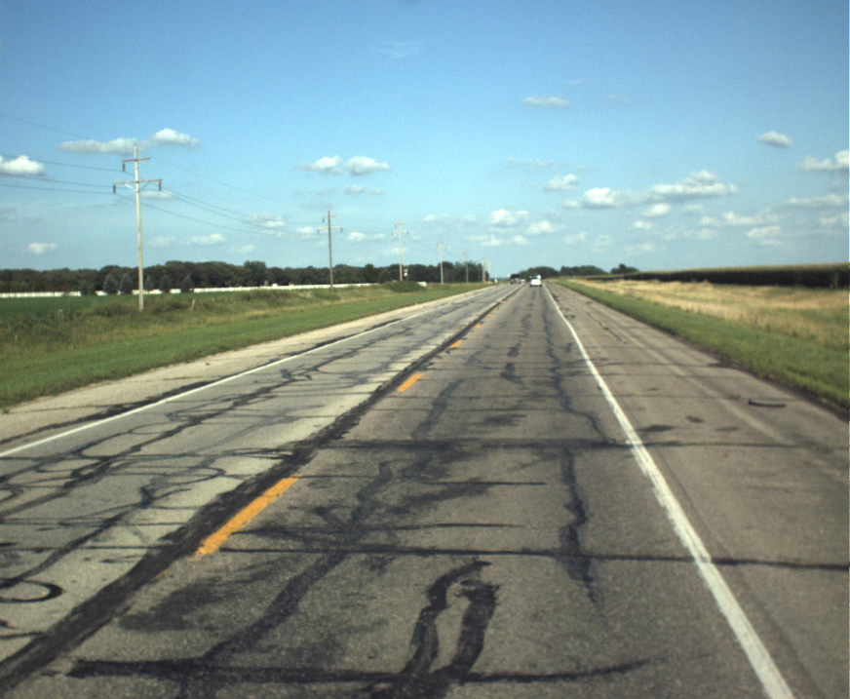
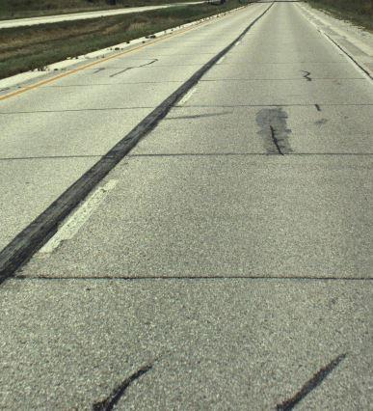
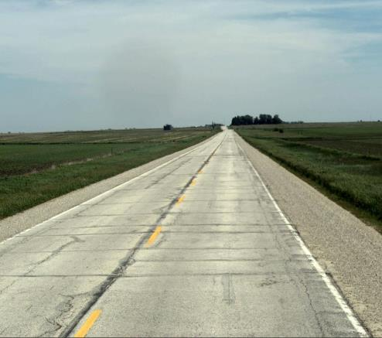
PCI = 33
PCI = 50
PCI = 75
Notes:
PCI stands for pavement condition index. Iowa DOT uses a numerical scale to assess the condition of a roadway’s surface, ranging from 0 to 100 (excellent). It is based on the severity and extent of cracking, roughness, and rutting for HMA) or faulting for PCC. The condition index is used to guide maintenance and repair decisions. Over time, PCI is not generally a steady decline. Cracking in the roadway causes significant increases in roughness and the combination of issues leads to an accelerated decrease in the condition index.

Slide 12
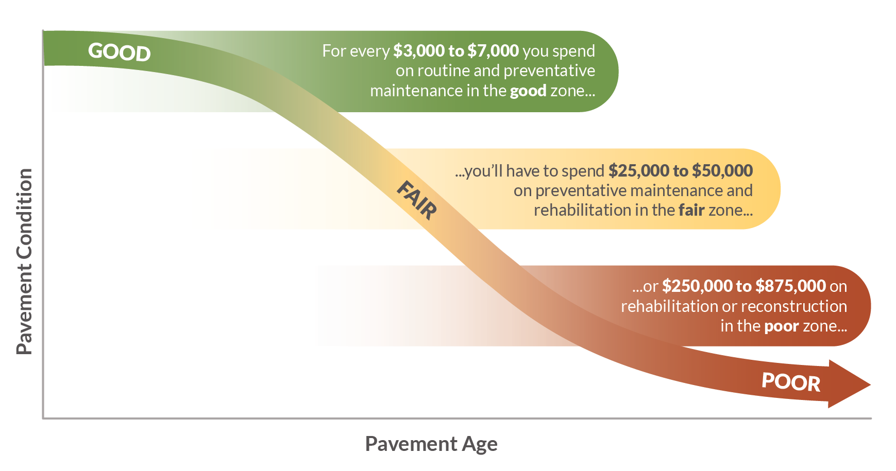
Pavement
Notes:
“Preservation is like sealing your deck—cost-effective early, but eventually full rehab is inevitable.”
The Pavement management strategic plan and the programmatic plan are our guiding documents that shaped the vision for creating the team.
Link investment decisions to this slide – Investing when we are still in the “good” condition
Slowing down the deterioration
Preventive Maintenance/Preservation
Treatments applied to pavements in relatively good condition to extend pavement life and/or improve performance.
Begin early in pavement life
Very cost effective
Treatments may be repeated on a schedule
Maintaining Good Condition Costs Less
Just like your car or home, routine and preventative maintenance can help extend the life.
Eventually things wear out and more extensive rehabilitation or replacement is required.
Over the life of a pavement, preservation treatments are like sealing the deck on your house – it can help extend the life, but eventually it will need rehabilitation or replacement.
We use pavement management data and tools to help us determine the optimal mix of treatments to get the most life at the least cost.

Slide 13
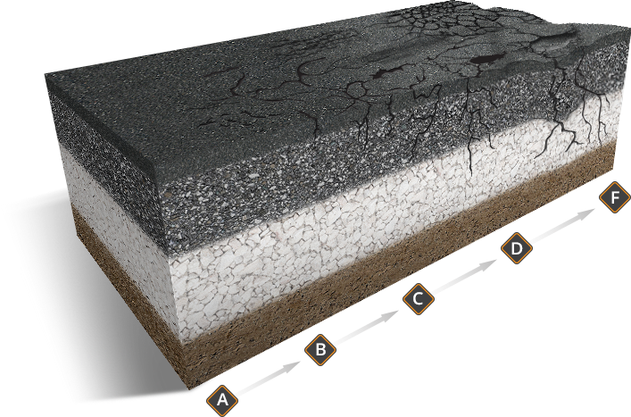
Pavement
Good Pavements Cost Less To Rehabilitate
Graphic from RoadResource.org
Notes:
Slowing down the deterioration
Preventive Maintenance/Preservation
Treatments applied to pavements in relatively good condition to extend pavement life and/or improve performance.
Begin early in pavement life
Very cost effective
Treatments may be repeated on a schedule
Maintaining Good Condition Costs Less
Just like your car or home, routine and preventative maintenance can help extend the life.
Eventually things wear out and more extensive rehabilitation or replacement is required.
Over the life of a pavement, preservation treatments are like sealing the deck on your house – it can help extend the life, but eventually it will need rehabilitation or replacement.
We use pavement management data and tools to help us determine the optimal mix of treatments to get the most life at the least cost.

Slide 14
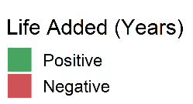
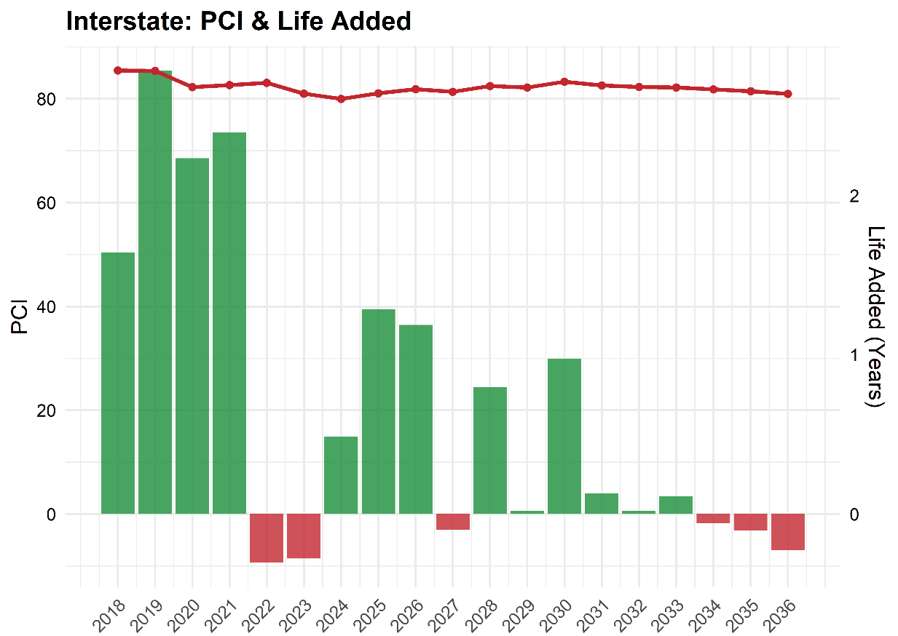

Historical PCI and Added Life Each Year
Target = 80
Notes:
“Notice how PCI improved with higher investments and dipped when funding lagged—budget directly influences pavement life.”

Slide 15

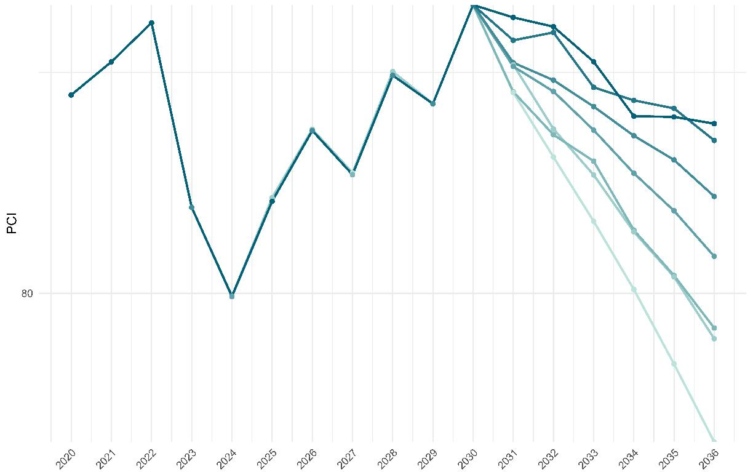
Historical PCI and Added Life Each Year
85
80
Target = 80

Slide 16
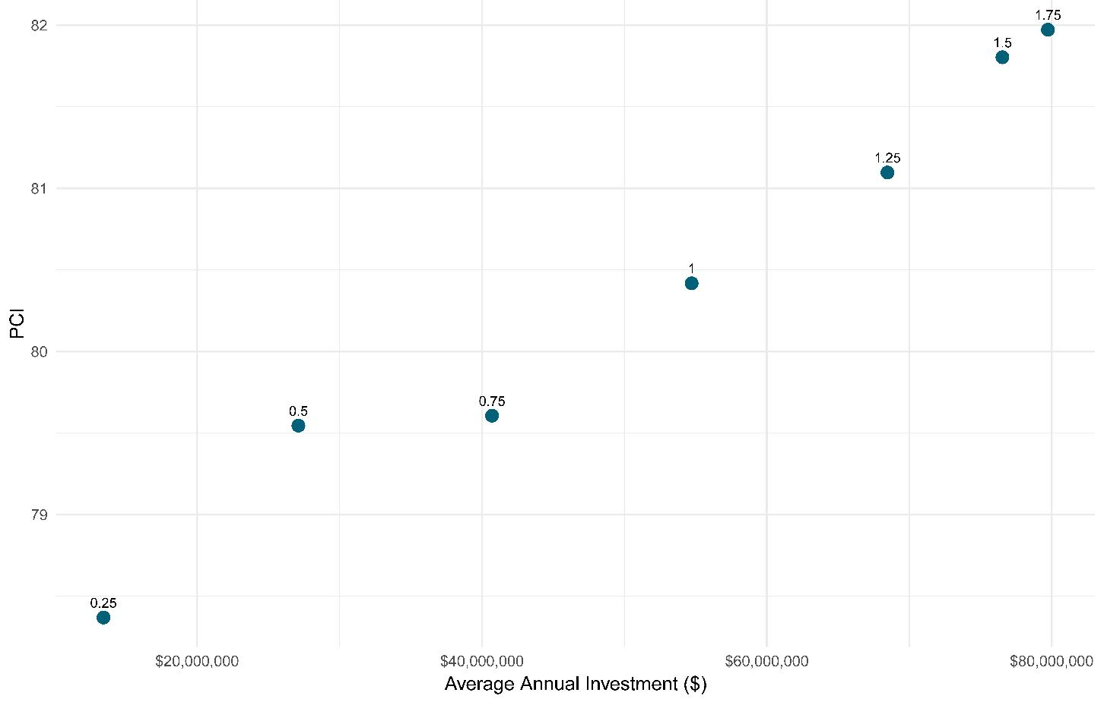
Historical PCI and Added Life Each Year
Target = 80
~$18 M to increase 1 PCI
3,895 Lane Miles
~$47M

Slide 17
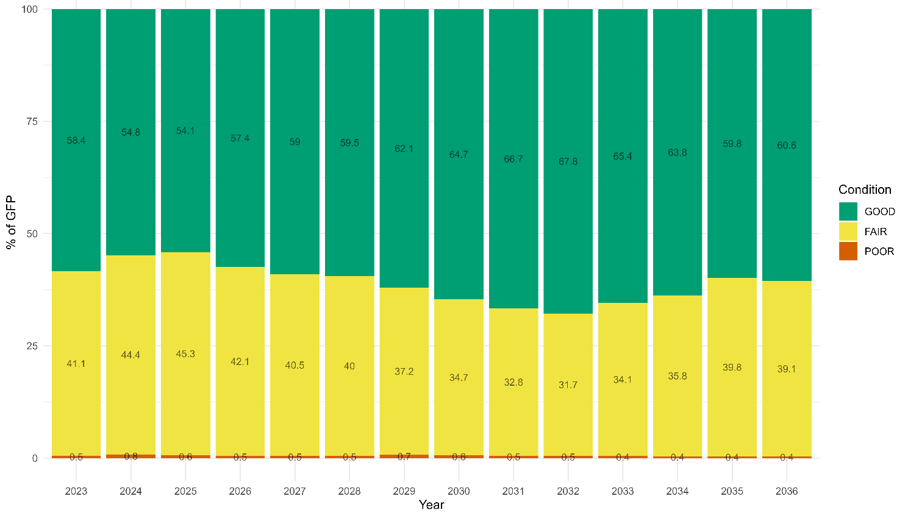
Interstate Pavement Condition and Future Performance Estimates (Federal Reporting)
Notes:
(2024 PMIS Data)

Slide 18
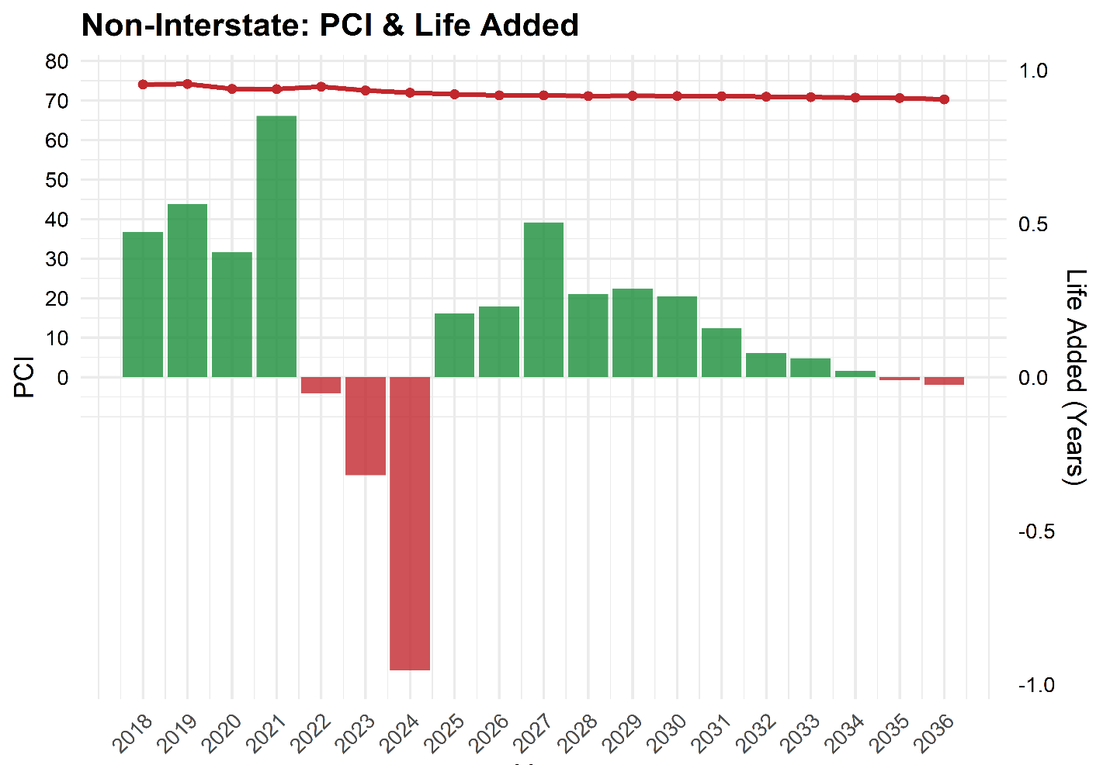
Historical PCI and Added Life Each Year
Target = 75

Slide 19
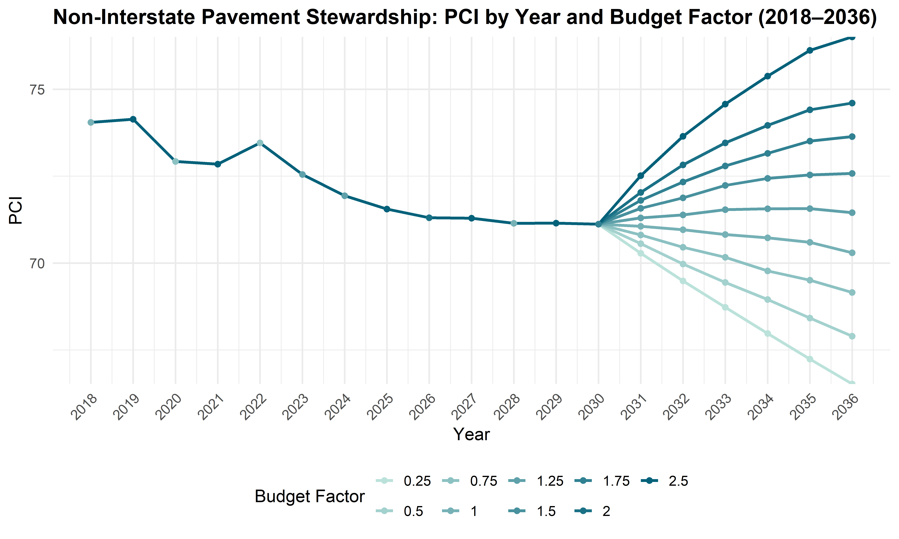
Historical PCI and Added Life Each Year
Target = 75

Slide 20
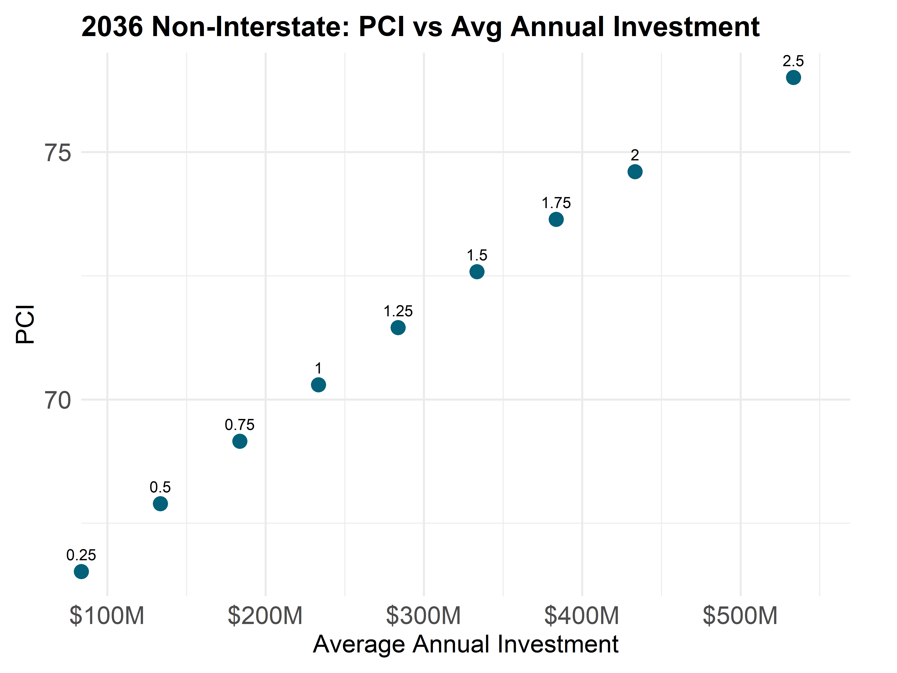
Historical PCI and Added Life Each Year
Target = 75
~$50 M to increase 1 PCI
Approx. 20,200 Lane Miles
~$450M

Slide 21
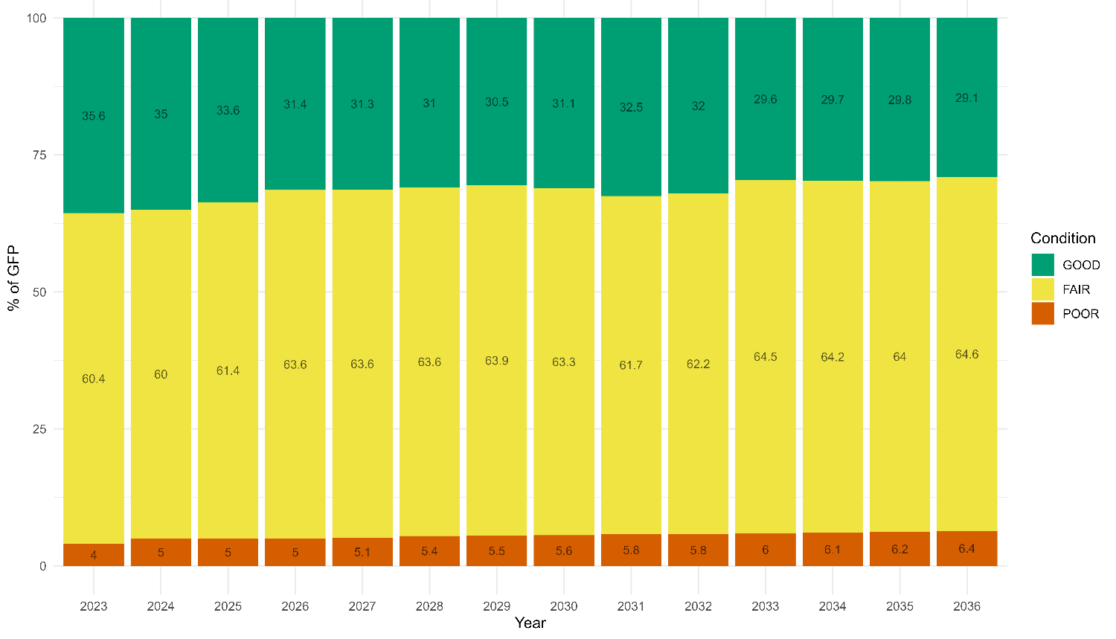
Non-Interstate Pavement Condition and
Future Performance Estimates (Federal Reporting)

Slide 22

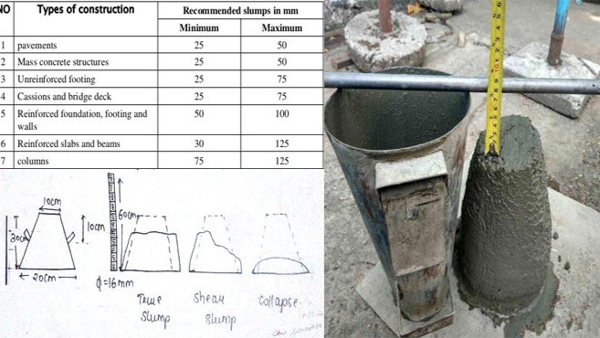
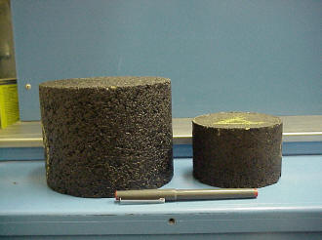
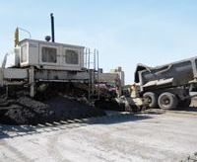

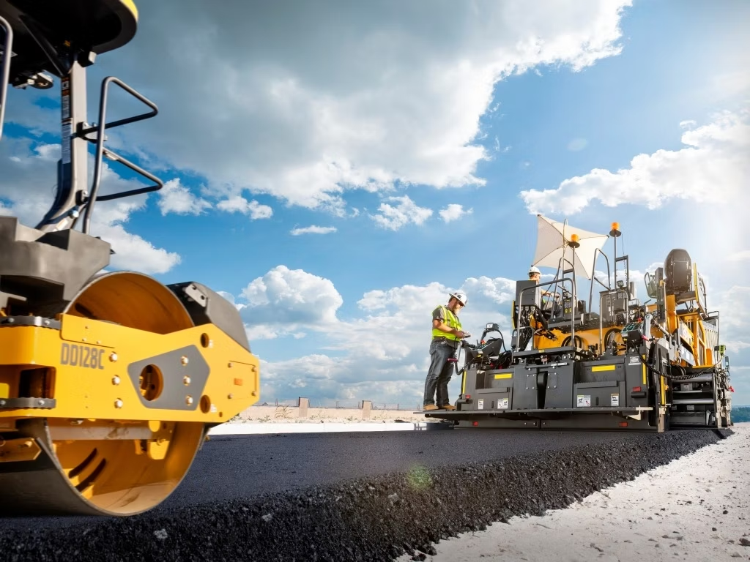


Causes of Pavement Distresses
Load (Trucks)
Material
Climate
Construction

Slide 23
Pavement Distresses and Causes
Load (Trucks)
Fatigue Cracking
Material
Stripping
Climate
Rutting
Construction
Roller marks
Bleeding
Durability Cracking
Oxidation
Blowups
Thermal Cracks
Pot holes (freeze thaw)
Longitudinal Joint
Polishing
Mat Tearing
Segregation
Corner Breaks
Faulting
Rutting

Slide 24
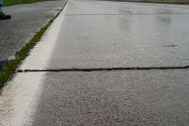
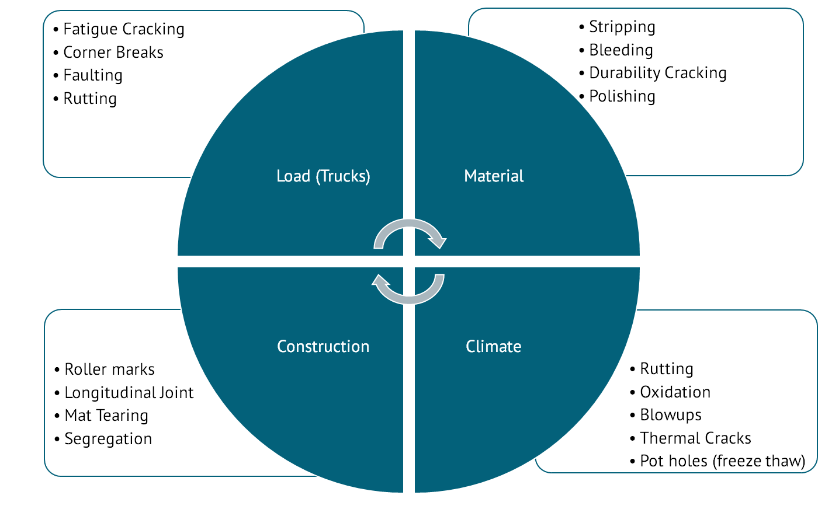
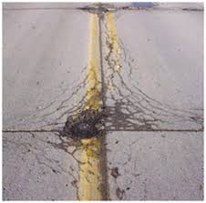
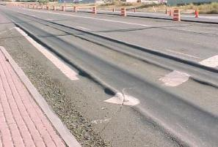
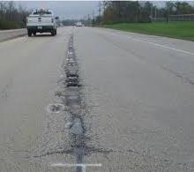
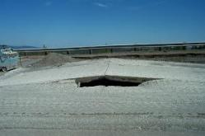
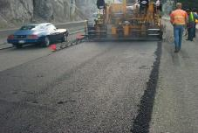
Pavement Distresses and Causes

Slide 25
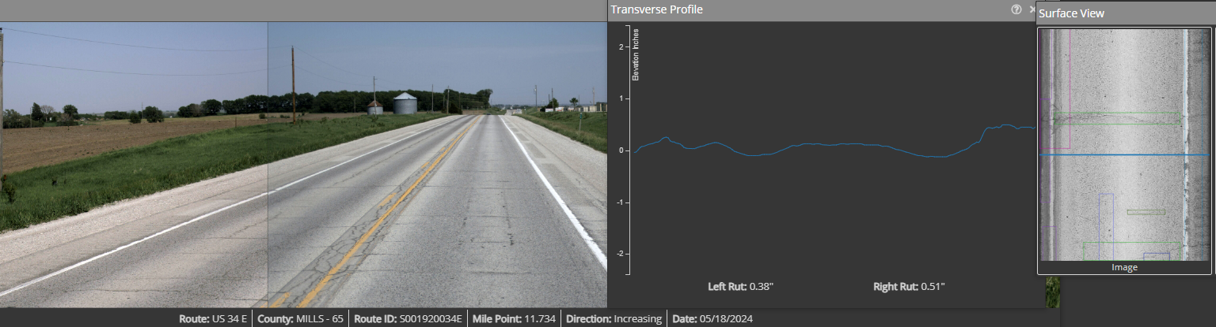
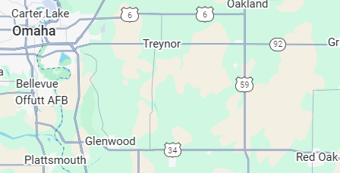
Pavement Distress Example
Rutting
Primary Causes:
Load
Materials
Climate
Prevented By:
Adequate Pavement Structure Design and
Materials Specification
PCI = 49
Example:
FY 2027 3R Proposed
Treatment: 2” Mill with
3” HMA Overlay
Notes for US 34 @ MP 11.73
Constructed | 1966
Resurfaced (Preserved) | 2006 (2018)

Slide 26
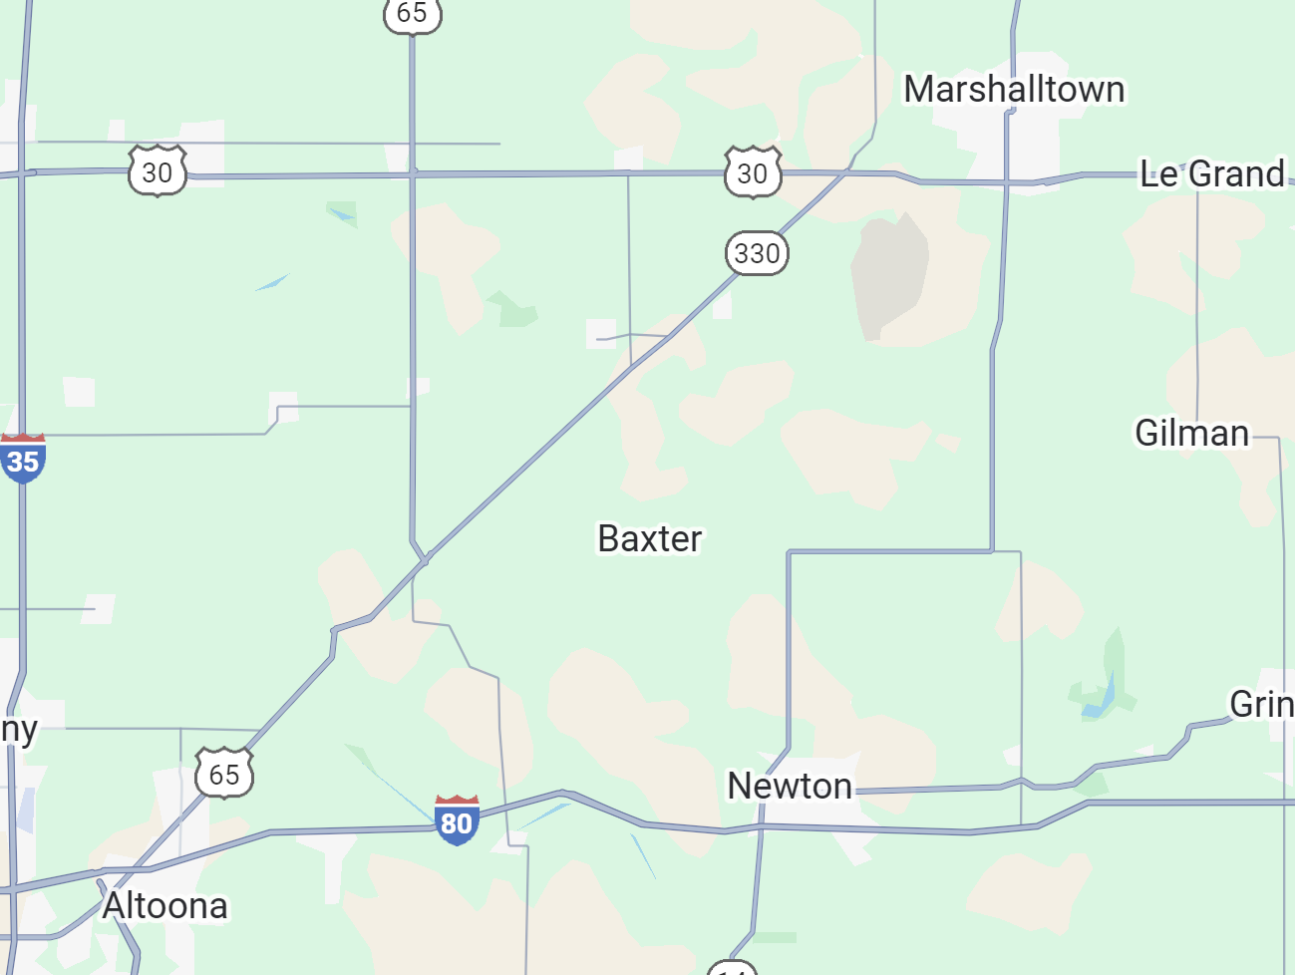
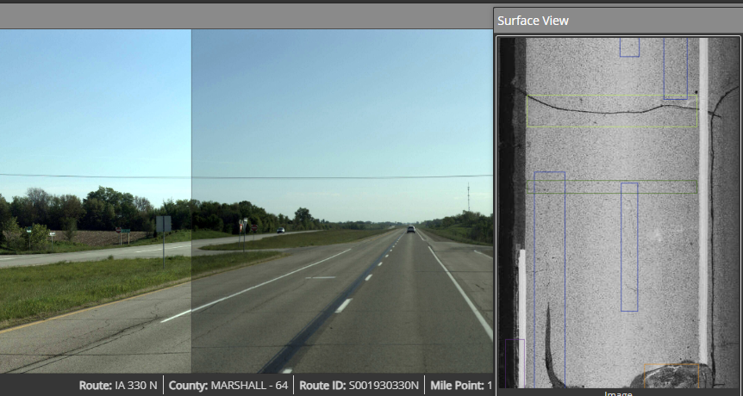
Pavement Distress Examples
Cracking
IA 330 NB
MP 5.51-20.29
Primary Causes:
Load
Materials
Climate
Construction
PCI = 56
Prevented By:
Adequate Pavement Structure Design and
Materials Specification
Mixture Desing
High-Quality Construction
FY 2026 3R Cold in-place recycling with HMA Overlay
Crack Ratio: 48%
Example:
Notes for US 330 @ MP 20.1
Constructed | 1983
Resurfaced | 2006
Notes:
=HYPERLINK("http://rams.iowadot.gov/pathweb/?cycle='Current'&nlfid=S001930330N&logpoint=19.95","Pathweb")
Final turn-in estimate: $4,690,197

Slide 27
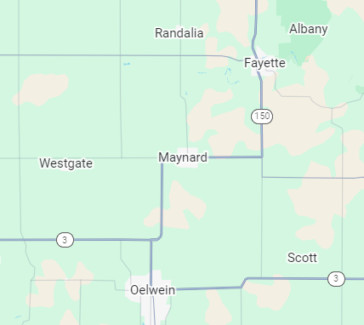
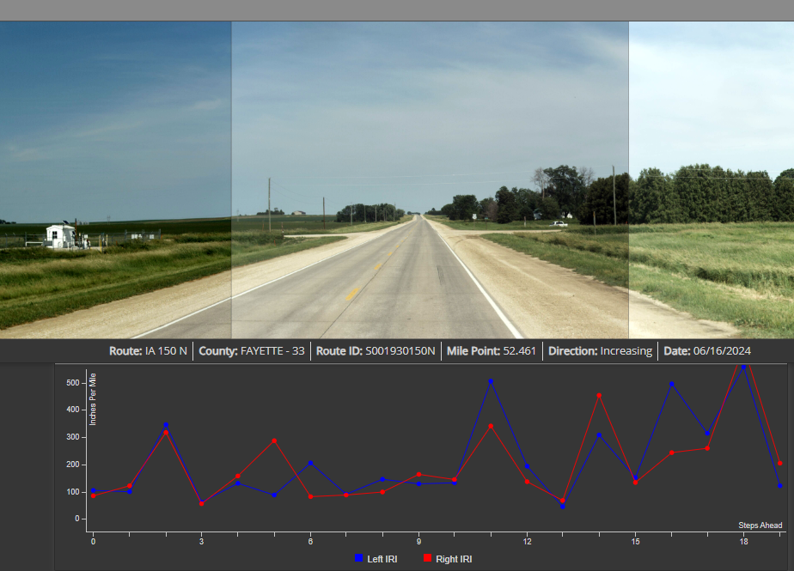
Pavement Distress Examples
Iowa 150
MP 58.78-68.03
Faulting
PCI = 35
Primary Causes:
Poor Load Transfer
Materials and Placement
Climate
Prevented By:
Adequate Pavement Structure Design and
Materials Specification
Proposed Treatment:
Dowel Bar Retrofit and Diamond Grind
Example:
Notes for US 150 @ MP 20.1
Constructed | 1971
IRI = 225

Slide 28
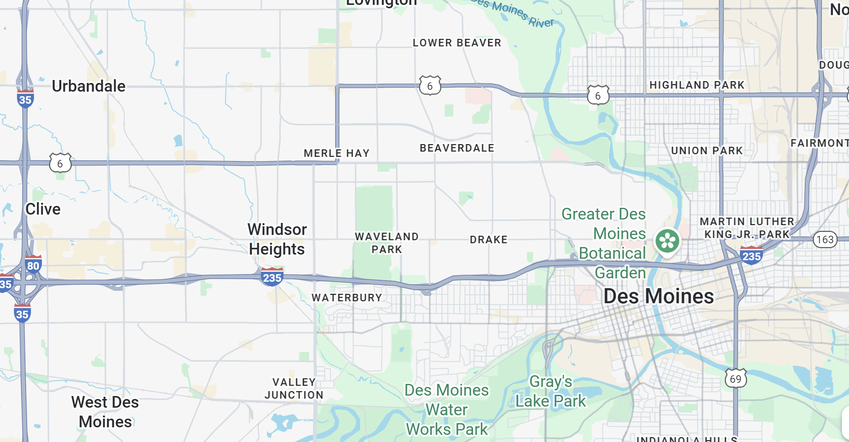
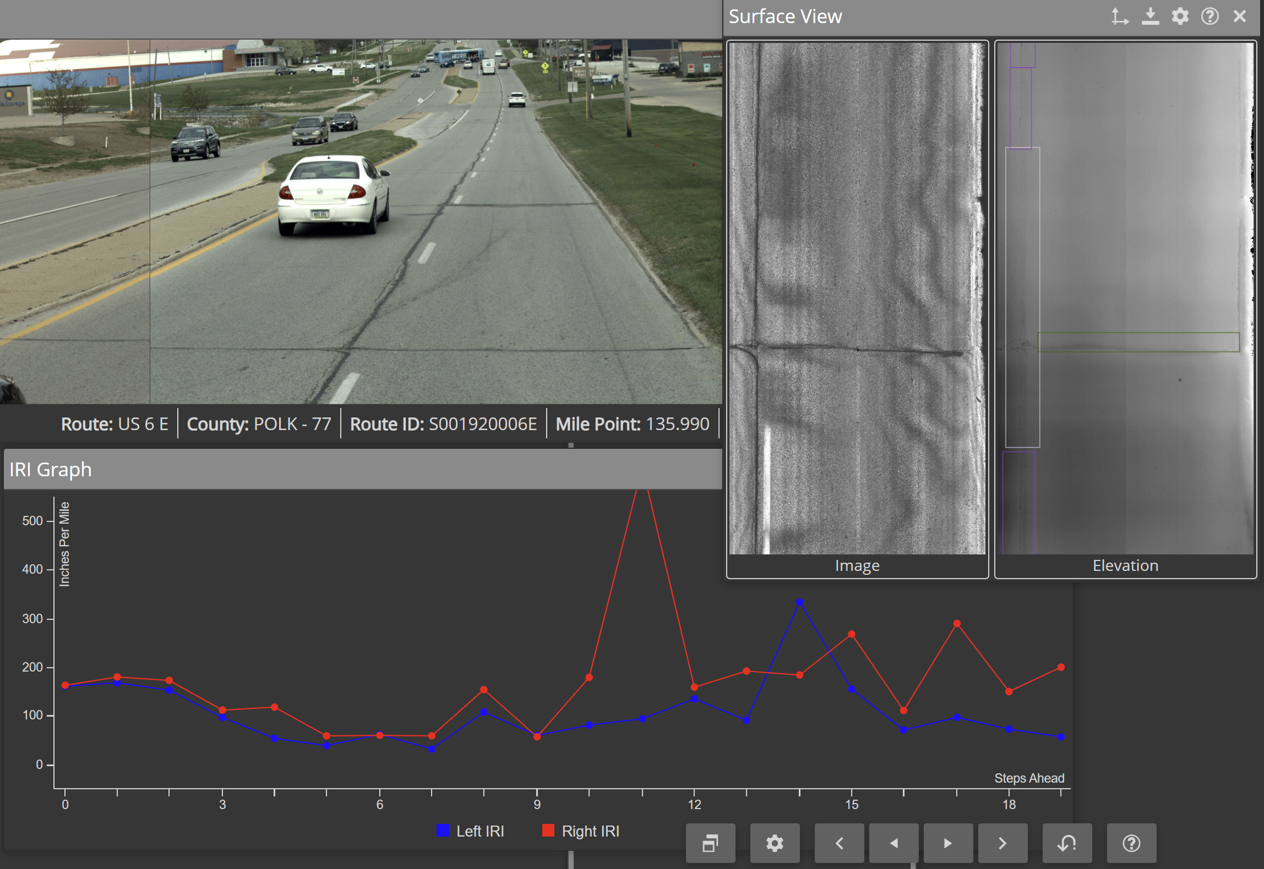
Pavement Distress Examples
Poor Ride Quality
US 6 EB
MP 135.25-137.37
Primary Causes:
Combination of Distresses, especially Cracking
PCI = 55
FY 2026 3R HMA Overlay
Corrected By:
Rehabilitation (Mill & Overlay)
Diamond Grinding (mainly PCC)
Example: US 6 MP 136
Notes for US 6 E @ MP 136
Constructed | 1930
Resurfaced | 2007
IRI = 142.8

Slide 29
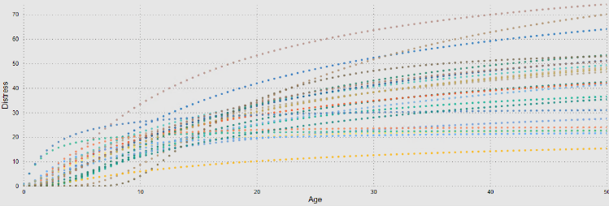
Pavement Modeling
Pavement Performance Models
Network Structural Testing
~20% Annually
Friction Data Collection
20% Annually
Pavement Performance Data
Special Investigations Team
Vendor Collected Data

Slide 30
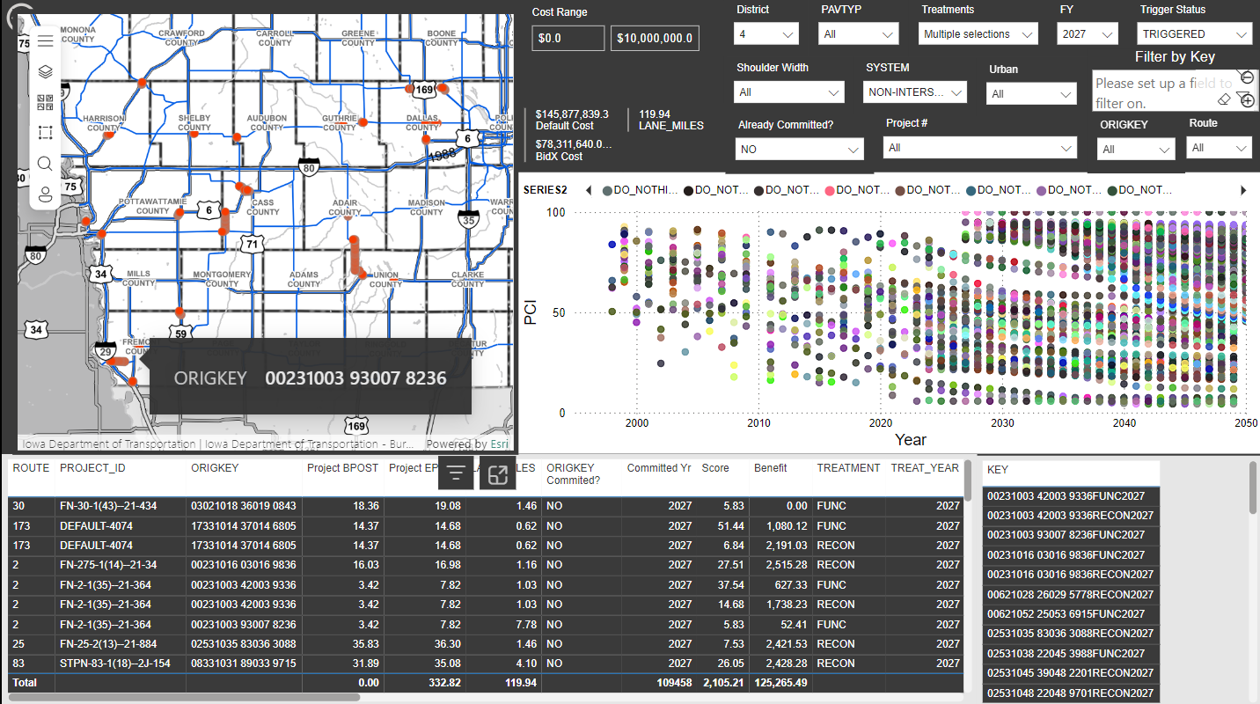
Identify Candidates Based on Decision Trees
Finding Candidates based on:
Pavement Management Decision Tree
Cost
Additional filters
Shoulder Type
Urban/Rural
Route

Slide 31
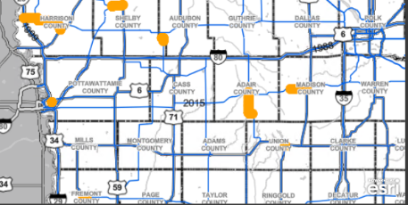
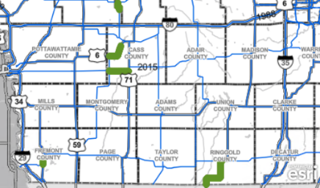
Project Selection Optimization (Non-Interstate)
Optimization Software Makes Recommendations
Engineers Make Adjustments
Traffic
Field Staff Reviews
Safety
Compare and Finalize
Life Added vs Life Lost
Lane Miles Treated
PCI Impact
Notes:
“Optimization tools guide decisions, but engineers balance local needs and safety considerations.”
We have tools that tell us the most economical way to invest. Engineers take these recommendations and make adjustments based on local feedback and other non-pavement considerations (ie safety). We quantify the impacts of the Engineer’s decisions compared to the optimization tools so we can balance the trade-offs. We make sure we put as much life back as we take out each year through normal deterioration. We make sure our selections offer a similar impact to PCI as the optimization’s recommendations do.

Slide 32
Pavement Management Key Takeaways
Analytics and Models to Support Investment Priorities
Pavement Preservation Helps Maximizes Pavement Life
Interstate System
Operating just above the 80 PCI condition target
Non-Interstate System
Operating below the 75 PCI condition target
Decreasing PCI trends are expected to continue based on current allocations
Delayed treatments are more costly
Notes:
Data-Driven Decisions: Analytics and models guide investment priorities for maximum impact.
Preservation Pays Off: Timely pavement preservation extends life and reduces long-term costs.
Interstate System: Currently operating just above the PCI target of 80.
Non-Interstate System: Operating below the PCI target of 75, signaling higher risk.
Trend Alert: PCI decline is expected to continue under current funding levels.
Cost of Delay: Postponing treatments significantly increases rehabilitation costs.

Slide 33
Thank you!
Questions?
ashley.buss@iowadot.us

