Slide 1
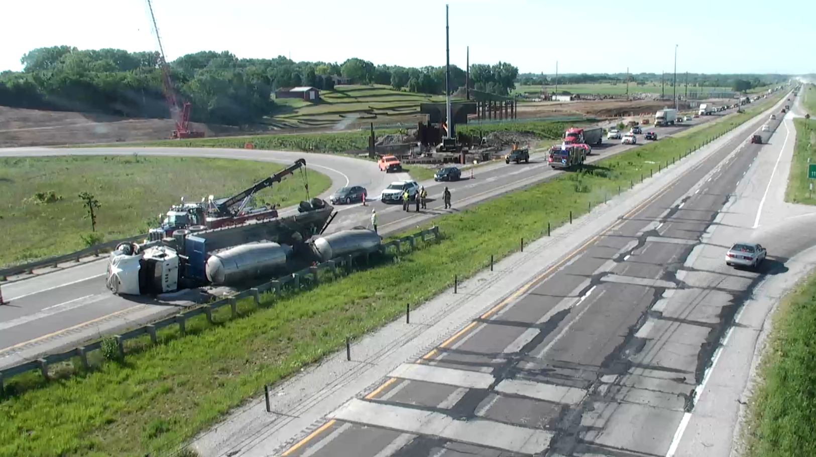


Statewide Operations & Intelligent Transportation Systems
Systems Operations Division
January 13, 2026
Notes:
Thank you, Madam Chair and Members of the Commission.

Slide 2
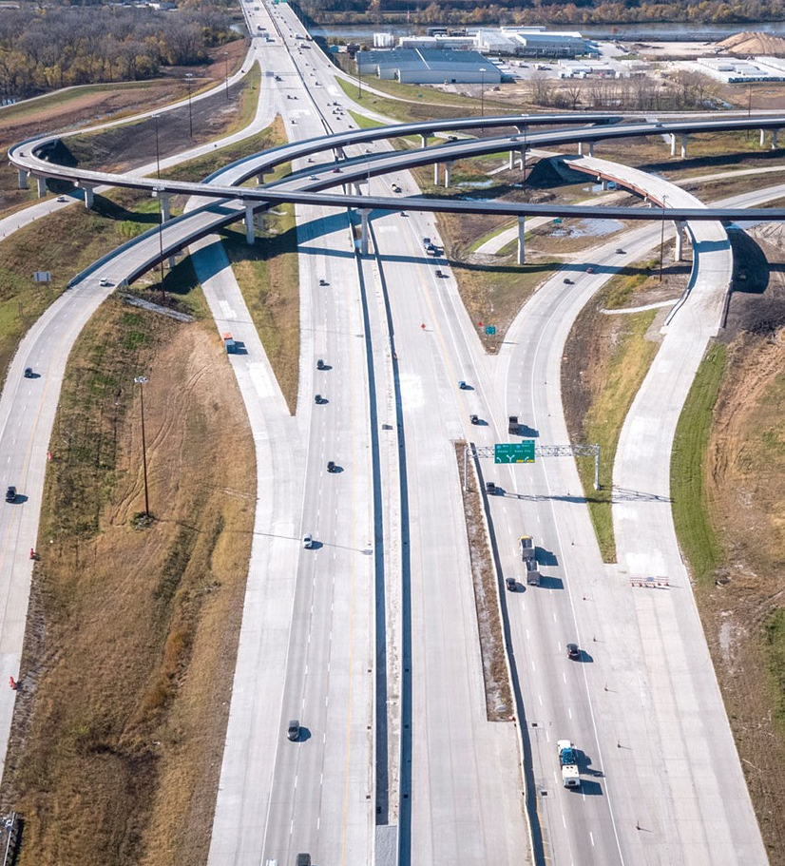
Highlights
Traffic Operations Overview
ITS Overview
New Activities
“Statewide Operations” (16$M)
“Statewide ITS” (8$M)
Traffic Operations & ITS
Notes:
I will be highlighting several of the functions that are funded from the “Statewide” Lines in the Back the 5-Year Highway Program,

Slide 3
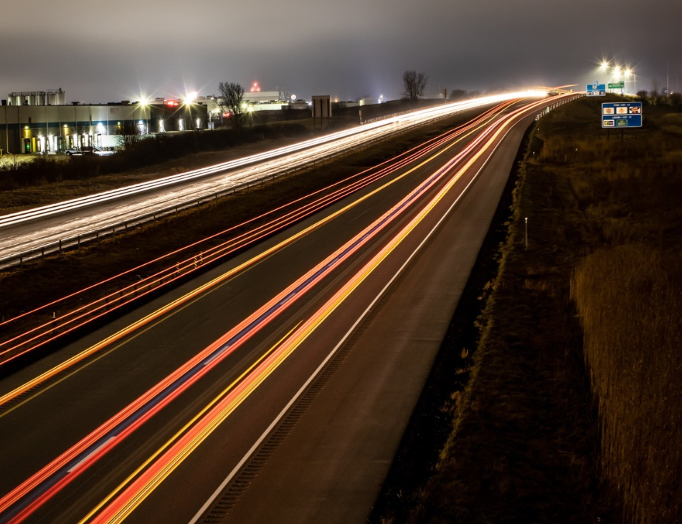
Transportation Systems Management & Operations “TSMO”
System-wide approach to get people and goods to their destinations safely and efficiently
More holistic
Maximizing the efficiency of existing infrastructure
Alternatives to building new infrastructure
Making Lives Better
Through Transportation
Traffic Operations & ITS
Notes:
TSMO is a National term; the recognition the even if we could have the very best roads and bridges, we wouldn’t obtain our Agency Mission “Making Lives Better Through Transportation”
There is still a lot we need to do to make sure people get where they are going safely and efficiently.
Everything I will be talking about falls under the TSMO ubrella.
Yes, but this emphasis has helped us collaborate and focus on key areas that can have a big impact…

Slide 4
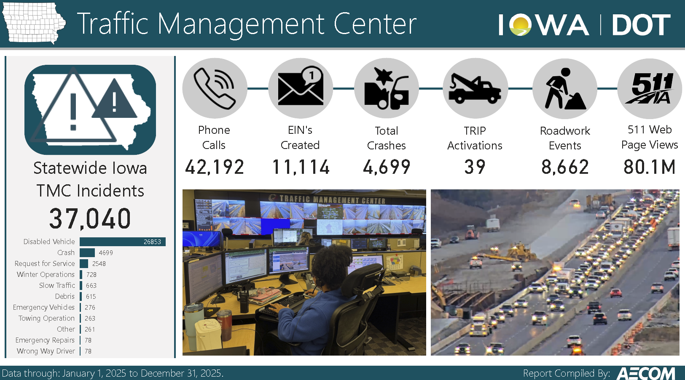
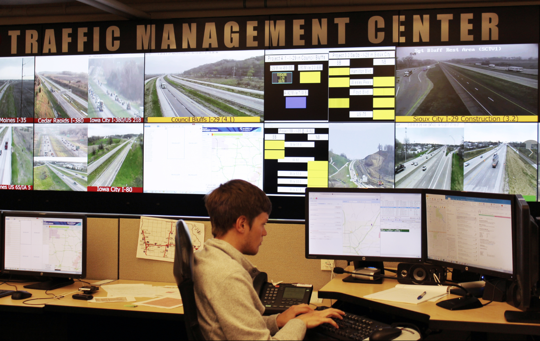
Traffic Management Center
2025
Traffic Operations & ITS
Notes:
Start with the Nerve Center for Traffic Operations: our TMC
24/7 operation; Motor Vehicle Building in Ankeny; Where you visited in June 2025.
Manage 3000-4000 Incidents per month; Post messages to DMS; Dispatch Highway Helper motorist assist; Coordinate DOT responses with other agencies; populate 511; generate data feeds

Slide 5
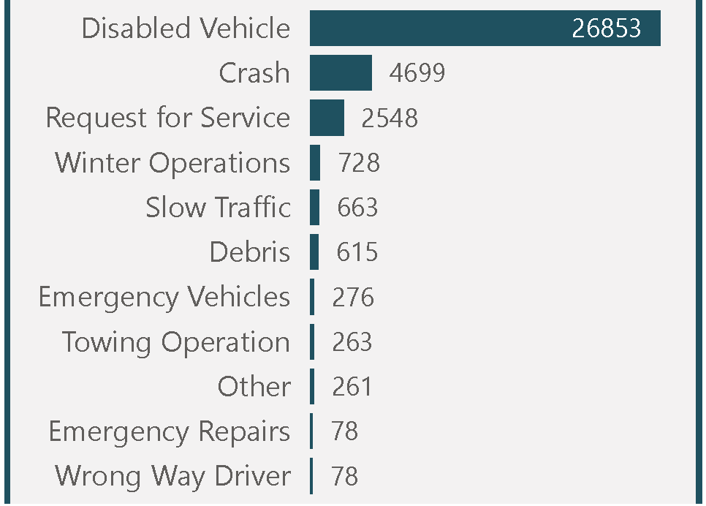
Traffic Management Center
37,040 Incidents Managed
by TMC in 2025
24/7 Operation
Ankeny, Motor Vehicle Division Building
3,000-4,000 Incidents Managed/month
Notes:
Commission Visited in June 2025

Slide 6
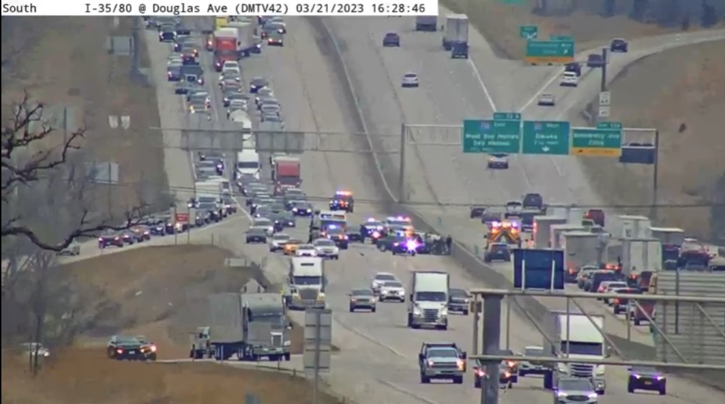
Traffic Incident Management
Training
T.I.M. Plans
Statewide T.I.M.
Local Multi-Disciplinary Groups
1029
TIM Plans
73
Certified TIM Trainers
13,572
Responders Trained
Traffic Operations & ITS
Notes:
Collaboration with emergency responders; paradigm shift away from using bright lights and big trucks to “Secure the Scene,” toward quick-clearance.
Statewide TIM Committee; TIM Training; TIM Plans;

Slide 7
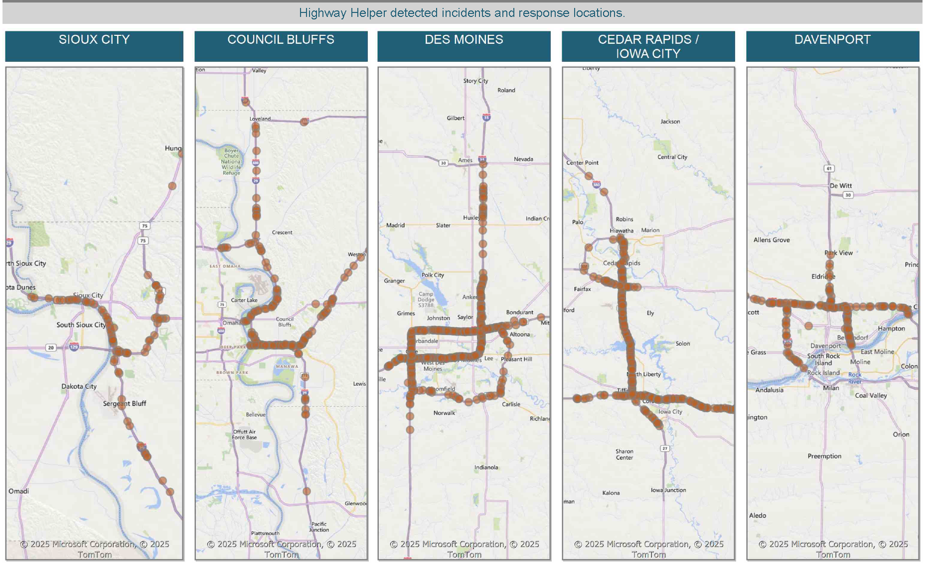
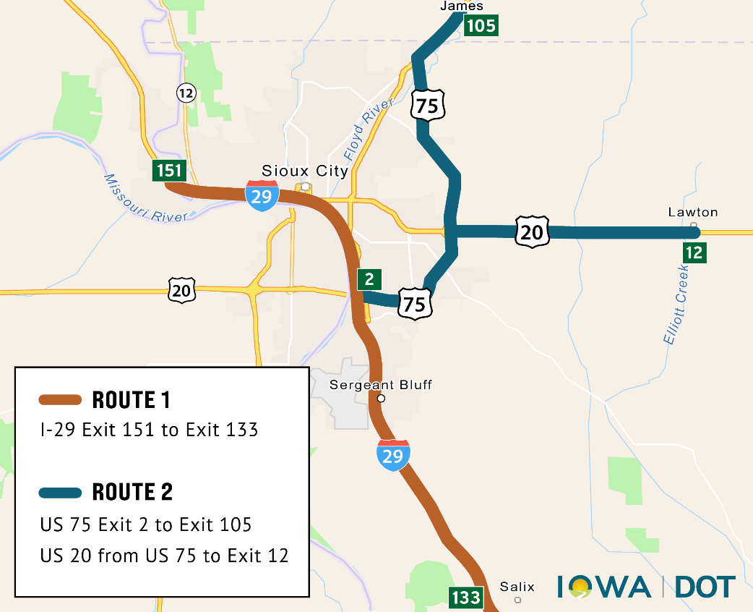
Highway Helper Locations
Sioux City
Traffic Operations & ITS
Notes:
Sioux City added in 2025 with new contract.

Slide 8
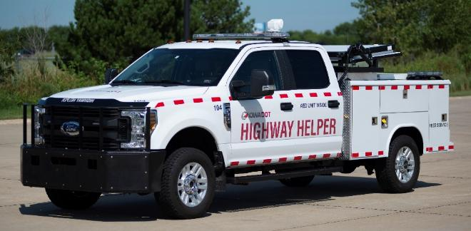
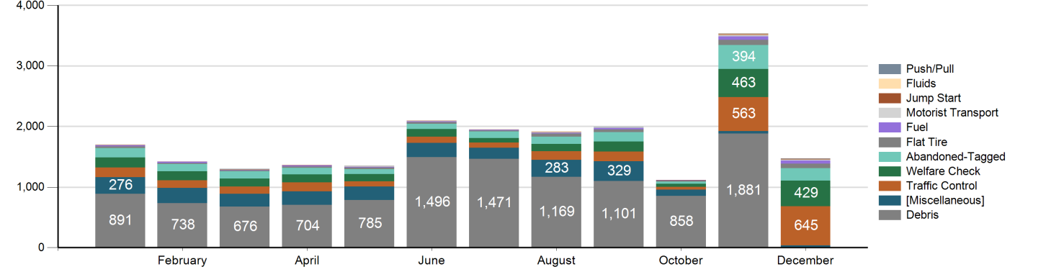
Highway Helper
2025 Responses by Month
Notes:
Highway Helper handles to 1300-2200 responses per month; You can see the variety here;
Unanimously popular with the public and emergency responders; Have added minor towing capabilities in the Des Moines area—not competing with private towing companies.

Slide 9
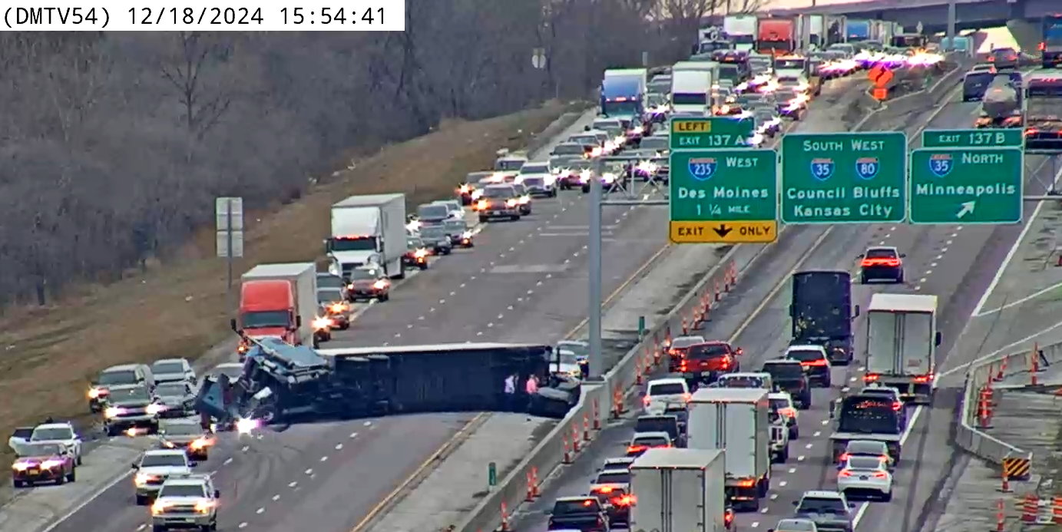
Towing Recovery Incentive Program (TRIP)
Quick clearance of commercial vehicles
Iowa City I-80 & I-380 interchange project
Des Moines
Traffic Operations & ITS
Notes:
Pre-qualified towing companies;
PHOTO: Eastbound I-80 crash near 38th Street, east of NE MM, 12/18/2024.

Slide 10
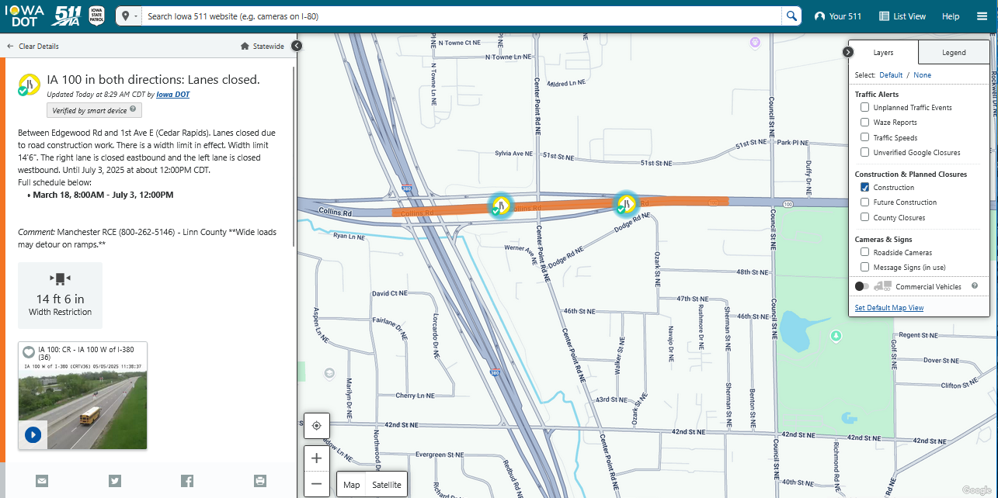
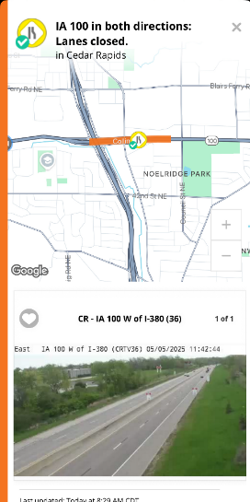
Traveler Information
511ia.org: web, mobile, phone
Data sharing
Notes:
Most people are used to checking winter road conditions and camera images (permanent cameras and snowplow cameras).
Incredible amount of information, display layers, and options: Traffic speeds, construction, future construction, incidents, message signs, rest area amenities; ALSO includes subscription/alert services, data feeds for 3rd parties and Connected Vehicles, recorded video requests, etc.
We recognize that not everyone will use our website or app, so we also provide our information to other navigation systems via data feeds.
We also receive information from crowd sourced data, E.G., Waze users.

Slide 11
Iowa 511 Usage
Traveler Information
Notes:
511 usage during November and December 2025 Winter Storms

Slide 12
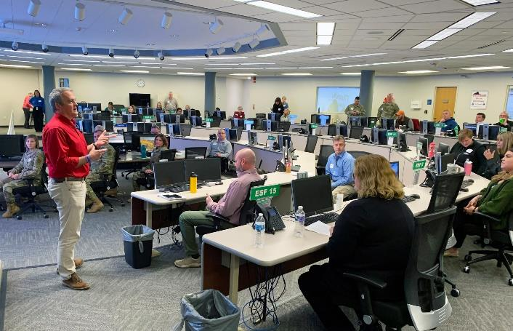
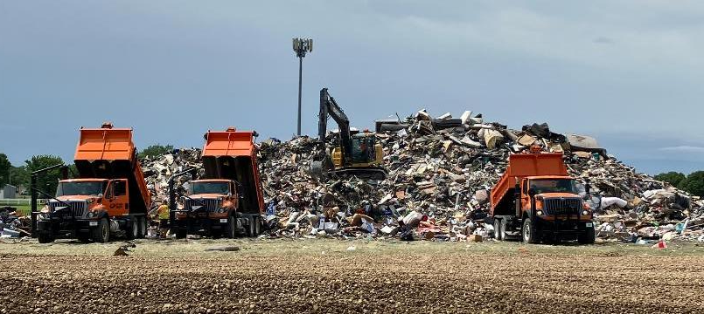
Emergency Management
Planning
Response
Recovery
Resource Tracking
Continuity of Operations
Notes:
Prepared for the unthinkable, as well as what seems to have become “routine.”
Much collaboration with other agencies: FEMA, Homeland Security, Dept. of Public Safety, Cities, Counties

Slide 13
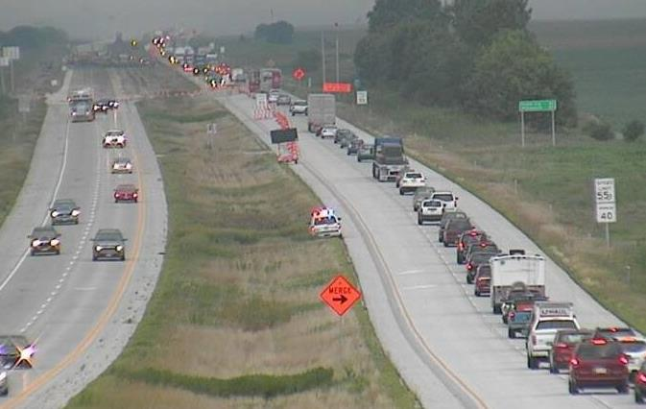
Work Zone Management
Collaboration
Resources
Innovative Contracting & Staging
Public Information
Intelligent Work Zones
Enhanced Monitoring
Extra Enforcement
Lane Closure System

Slide 14

Cooperative/ Automated Transportation
Statewide Advisory Council
Roadway Readiness
Collaboration with multi-state corridors: “I-80 Coalition”
Slow Moving Vehicle detection & warning

Slide 15
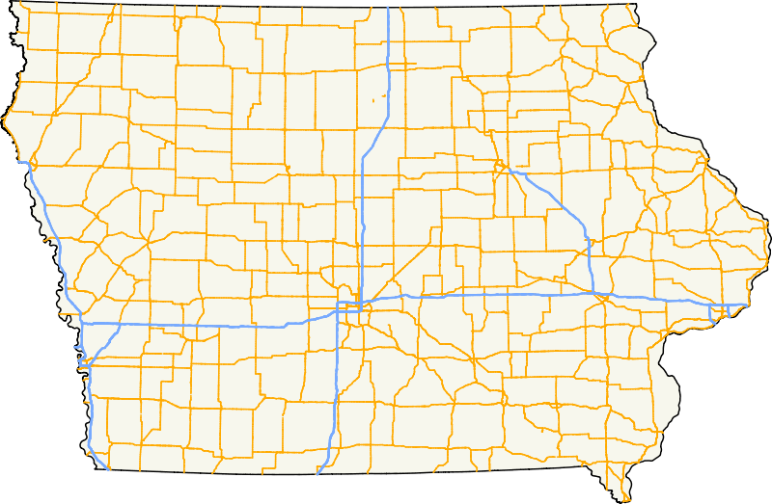
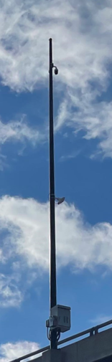



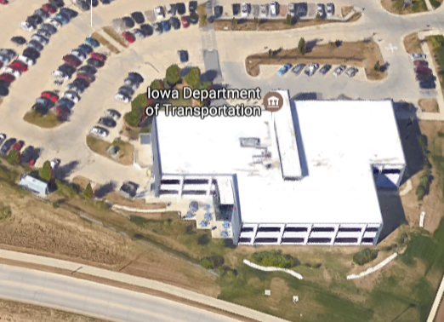
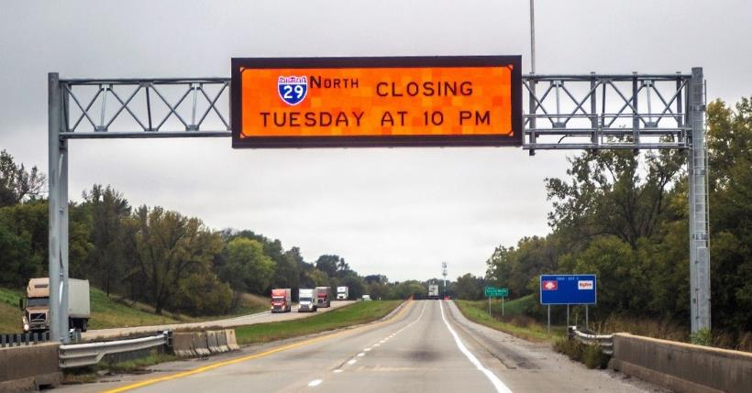
Intelligent Transportation Systems (ITS)
Sioux City
Waterloo
Dubuque
Fiber Optic Network
Dynamic Message Signs
Cameras: ~650
Sensors: ~400
Intersection Conflict Warning Systems
Wrong Way Detection
Ames
Cedar Rapids
Des Moines
Iowa City
Quad
Cities
Council Bluffs
Traffic Mgmt. Center, Ankeny
Notes:
Fiber Optic network is the backbone of our ITS Network to provide communications to our field equipment—most important: Cameras. If you look at 511 and see our camera locations, that gives you a good idea of where we have fiber. Our next big void is the Iowa City to Quad Cities segment of I-80, which happened to be where we had a major snow-related pile-up. Fortunately, we have a couple strands of fiber along that segment dedicated to us from the Iowa Communications Network and are optimistic about getting funding soon for a project to access that fiber and install cameras.
ICWS – at rural expressway two-way stops: Scotch Ridge; New London; Springville; (former: Dyersville, Mingo, Granger, Anamosa)
Wrong Way Detection – part of a comprehensive approach to wrong way driving analysis and prevention

Slide 16
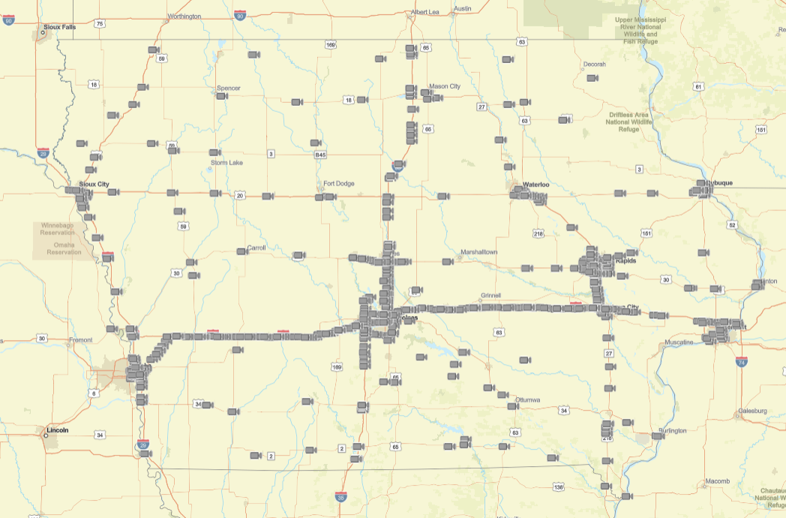
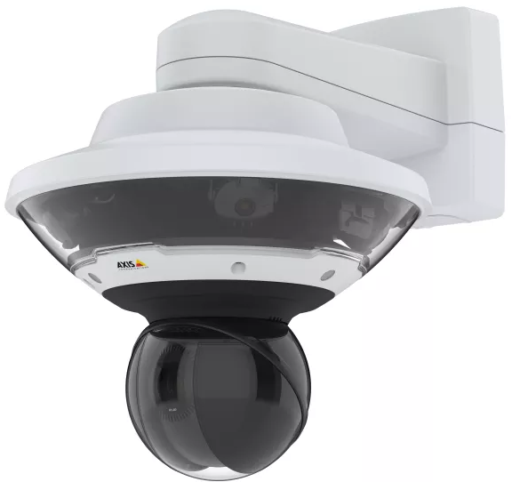
Cameras (650)
Pan-Tilt-Zoom
Wrong Way Detection
Rural (still images)
Portable (work zone)
7-Day Recording
Traffic Operations & ITS
Notes:
Video or still images on 511ia.org
Primarily focused on where we have the most traffic, but also Road Weather Information Systems, Rural Work Zones, Wrong Way Detection, or Safety Concerns. SEE gap from Iowa City to Quad Cities

Slide 17
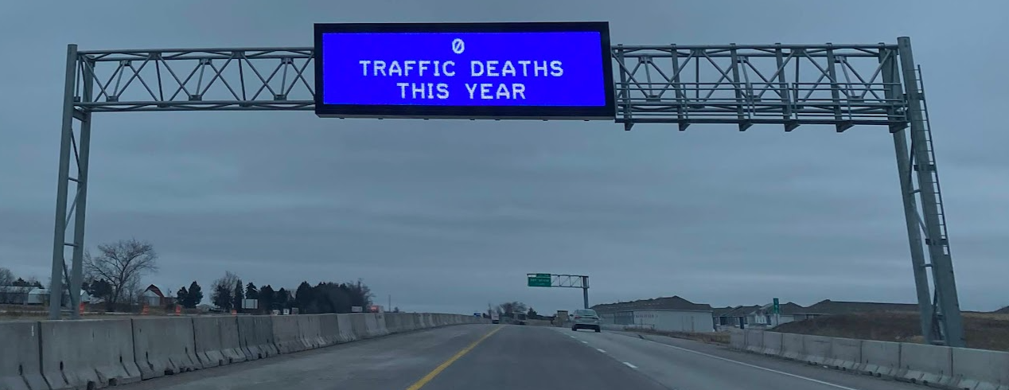
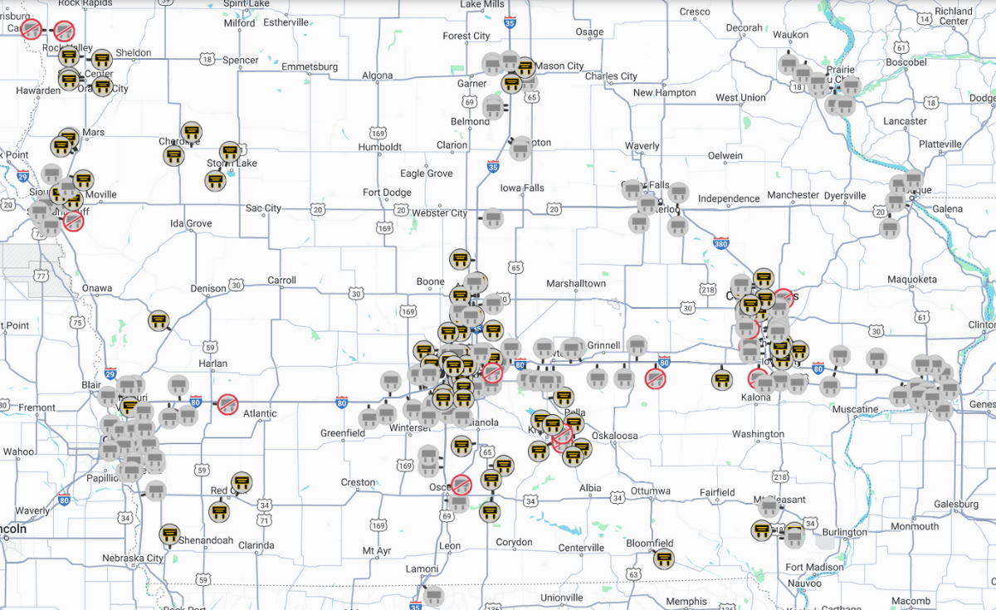
Dynamic Message Signs (DMS)
Permanent DMS
85 Overhead
50 Side-mount
Portable DMS
Mix of DOT & Contractor’s
TMC controls all contractor portable signs
Traffic Operations & ITS
Notes:
Primary method of conveying information to drivers.
Moving away from DOT-owned portable DMS toward rented PDMS.

Slide 18
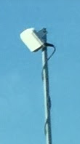
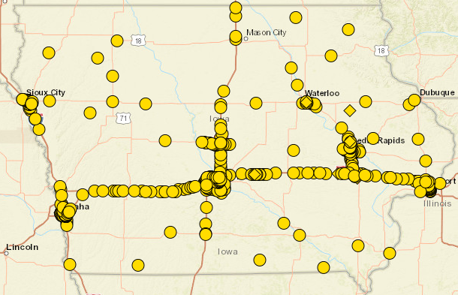
Traffic Sensors (400 )
Speeds, Volumes, Veh. Class, by lane, every 60 seconds. Uses: Lane closure planning, queue detection, and Federal reporting
Traffic Operations & ITS
Notes:
Primarily used for Lane Closure Planning. …also automated queue detection & warning.
Not needed for monitoring system speeds because of… (next slide)

Slide 19
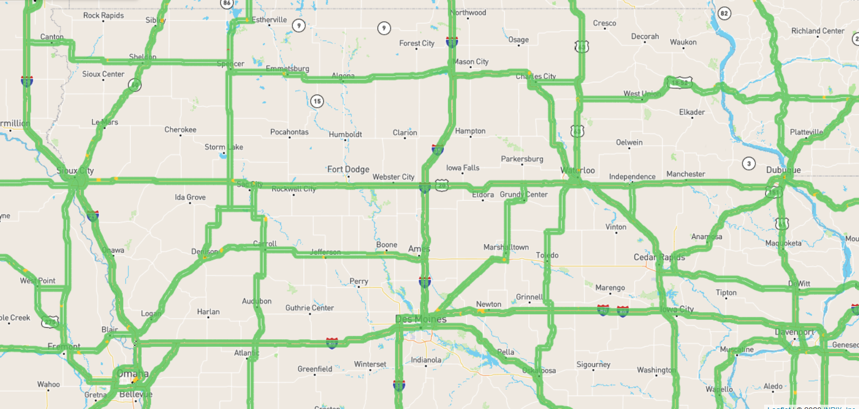
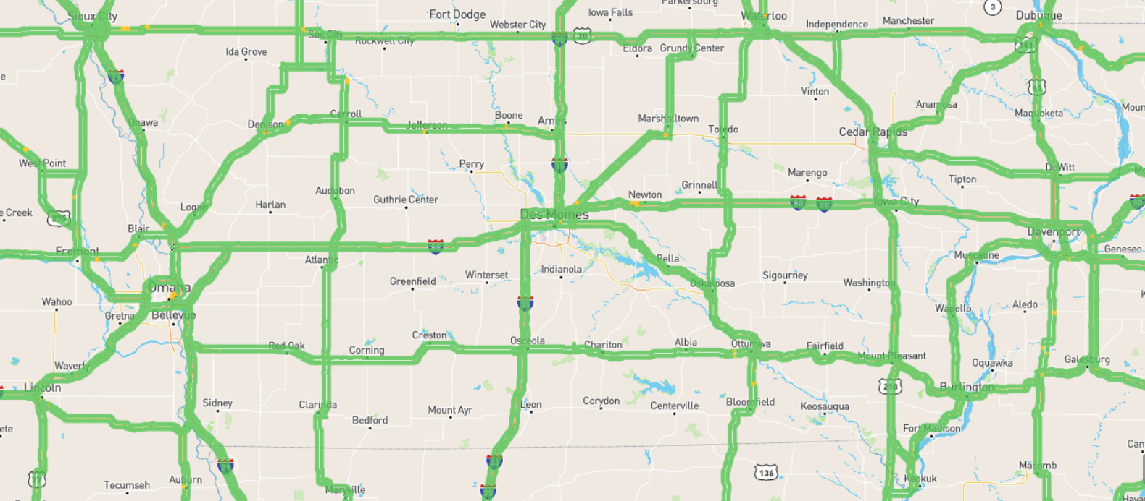
Statewide INRIX Probe Data
Next: Connected Vehicle Data
Near real-time
Trace Vehicle Speeds and Locations
Slow-down detection and Traffic Signal analytics
Both Primary and city/county roads
No equipment to deploy or maintain
Speeds but not volumes
Notes:
No field equipment needed! (power, communications, maintenance, etc.)
Used for travel time calculations on DMS.
Connected Vehicle Data being tested by Institute for Transportation at Iowa State Univ. (Dr. Shauna Hallmark presented in November)
Especially skilled and equipped to manage massive amounts of data and turn it into useful information.

Slide 20
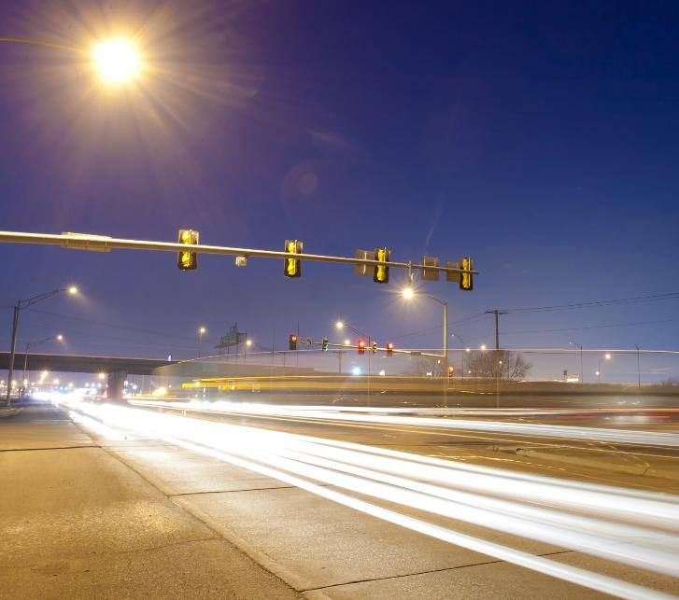
TSMO Self-Evaluation from December
Successes
Culture & Collaboration
District Traffic Operations Engineers
Dedicated Operations & ITS Funding
Work Zone Collaboration
Opportunities
Work Zone Training
Systems Engineering & ITS Architecture
Traffic Signals
Traffic Operations & ITS
Notes:
About 25 attendees from across the Dept.
Not just WHAT are we doing, but HOW are we doing it?
Two “Back of Program” funding lines have been a source of consistent security; Many states install with grants, but cannot maintain.
Systems Engineering will help with new endeavors that reach beyond the DOT TMC: Using and collaborating with new data sources; Ramp Metering; FINALLY: some of our new technologies and new resources are opening the door to looking beyond our traditional responsibilities, including Traffic Signals: especially on our Primary Highways.

Slide 21
Key Takeaway
Making Lives Better Through Transportation relies on both infrastructure and how we operate the system
“…and the next, great solutions will come from within the DOT.”
-Scott Marler, Director
Traffic Operations & ITS
Notes:
I give a brief version of this presentation every month to all New Employees
Here at the DOT we are all not just employees, but we are also users of our Transportation System. We see things that frustrate us as drivers AND we have the opportunity to do something about it.
One of the great things about Iowa DOT is that from our Director on down we are all encouraged to contribute to “Making Lives Better Through Transportation”
(quote from Director, Scott Marler, “The next solutions to our problems are already here in the room.”)

