Slide 1
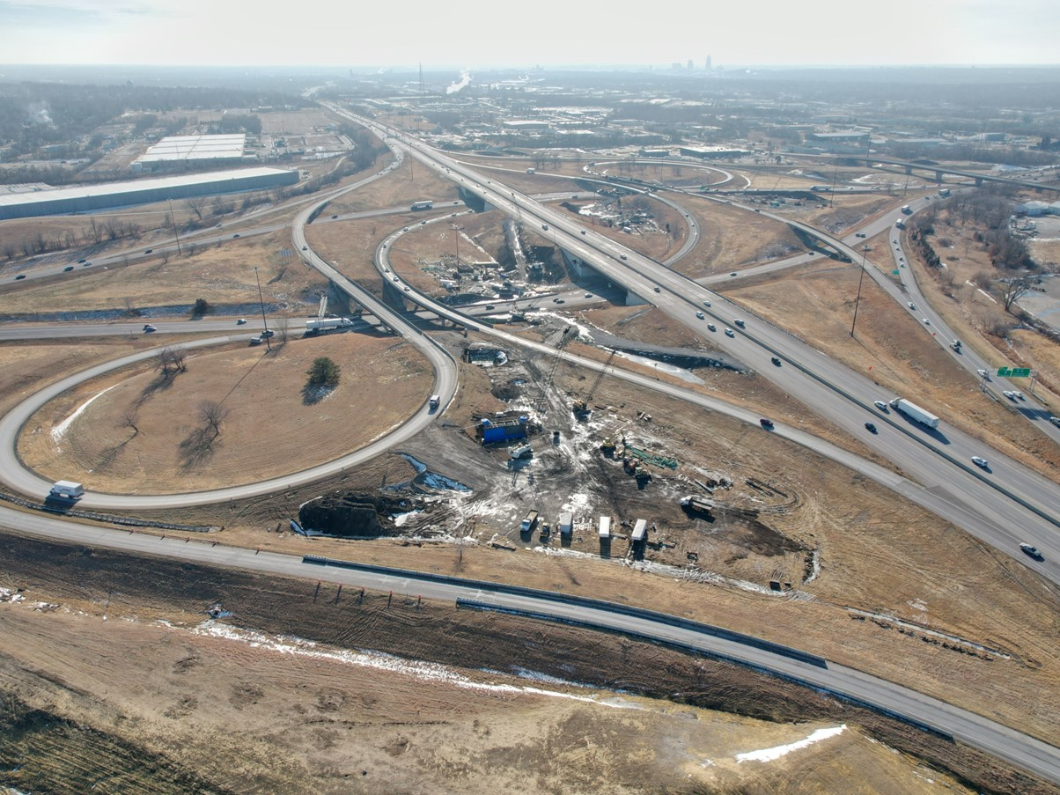


2027-2031 Highway Program Development
January 28, 2026
3/2/2023

Slide 2
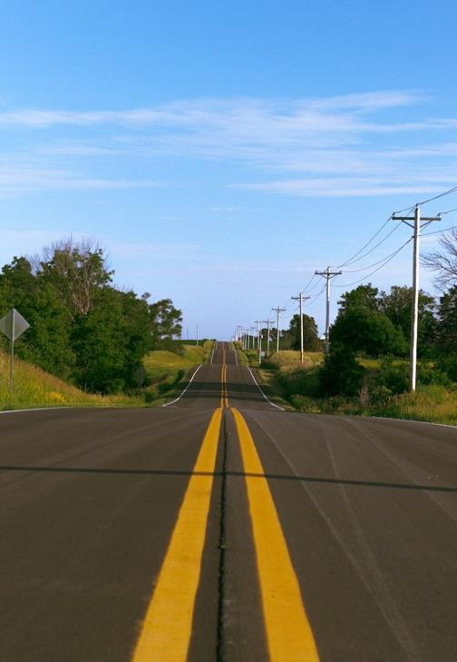

Agenda
TOPIC 1
Highway Program Development Process
TOPIC 2
2027-2031 Highway Program Development Schedule
TOPIC 3
2026-2030 Highway Program Recap
TOPIC 4
Funding Categories
TOPIC 5
Federal Funding Status
TOPIC 6
Program Development Considerations
TOPIC 7
Next Steps

Slide 3
Topic 1
Highway Program Development Process

Slide 4

Highway Program Development Process
Public Policy and Input
What direction do we have?
Transportation Plans
What type of system do we need?
Performance Monitoring
Are we successful?
Five-Year Program
What projects will be done and when?

Slide 5
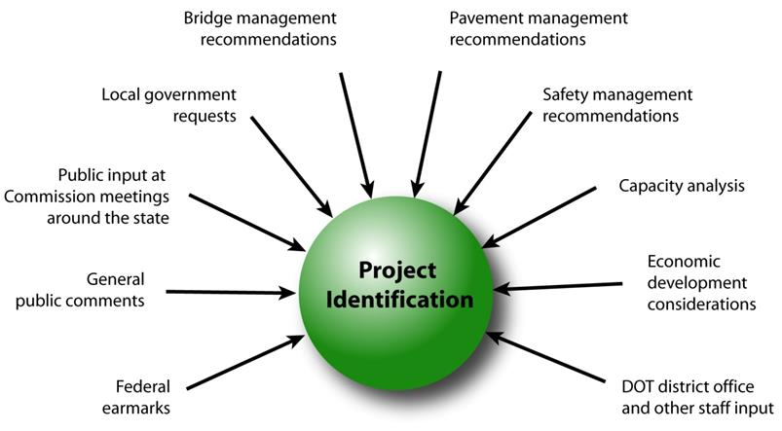
Step 1: Project Identification

Slide 6
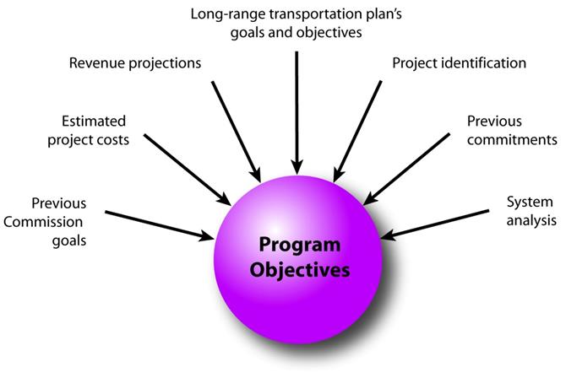
Step 2: Establishing the Transportation Commission’s Annual Programming Objectives

Slide 7
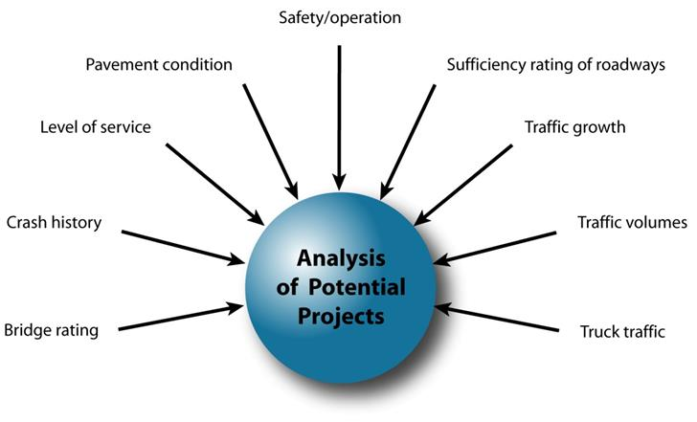
Step 3: Evaluating Potential Project Candidates

Slide 8
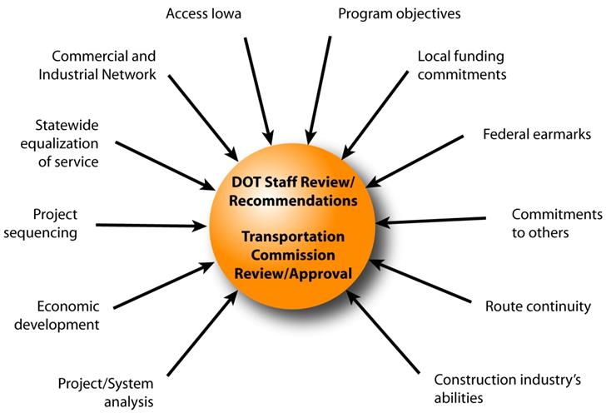
Step 4: Developing The Final Program

Slide 9
Topic 2
2027-2031 Highway Program Development Schedule

Slide 10
Highway Program Development Schedule (2027-2031)
January 2026
Discuss Highway Program Development Process
Discuss 2027-2031 Highway Program Development Schedule
February 2026
Discuss Extended Highway Program Analysis
Discuss Statewide Line Items
At what levels should the line-item targets be programmed?
March 2026
Discuss 2027-2031 available Highway Program funding
Discuss 2027-2031 Highway Program options
Determine 2027-2031 Highway Program Objectives
Action Item: Line-Item Targets for Programming
April 2026
Develop the Draft 2027-2031 Highway Program
Action Item: 2027-2031 Highway Program Objectives
May 2026
Present the Draft 2027-2031 Iowa Transportation Improvement Program to the public (including all previous program approvals and Draft 2027-2031 Highway Program)
June 2026
Action Item: Approve the 2027-2031 Iowa Transportation improvement Program

Slide 11
Topic 3
2026-2030 Highway Program Recap

Slide 12
2026-2030 Highway Program Recap
Challenges
No additional funding
Uncertainty in last four years of Program due to expiration of federal transportation bill
Actions
Prioritized stewardship
Project underfunding
Reschedule some non-stewardship projects in Program
Modify Stewardship Targets in 2028-2030

Slide 14
Topic 4
Program Funding Categories

Slide 15
Stewardship Funding Categories
Category
Interstate Stewardship
Non-Interstate Pavement Modernization
Non-Interstate Bridge Modernization
Safety Specific
Commission defines targets for these categories for a ten-year period
Commission has focused on increasing these targets
Asset Management presentations are intended to support this process

Slide 16
Interstate Stewardship (4R)
Funds available based on stewardship target.
Off-the-top allocations for rest areas, lighting, guardrail repair, signing, and pavement maintenance.
Remaining funds generally targeted to pavements (2/3) and bridges (1/3).
Requires coordination with multiple bureaus and Districts.

Slide 17
Non-Interstate Pavement Modernization (3R)
Funding available based on stewardship target.
Allocation to each District based on formula.
Starting in 2027 an additional $35 m in 3R funding is available for reconstruction projects.

Slide 18
Non-Interstate Bridge Modernization (BR)
Funding available based on stewardship target.
Significant increase in target over past several years.
Recommended projects determined by Bridges and Structures Bureau.

Slide 19
Safety Specific (SR)
Funds available based on stewardship targets.
Recommended projects selected by Traffic and Safety Bureau.
Some funding used on 3R projects (paved shoulders).

Slide 20
Non-Interstate Capacity/System Enhancement (NR)
Non-stewardship funding category.
Capacity to add projects based on overall funding available after deduction for stewardship targets and consideration of Major Interstate project additions.
Recommended projects selected from Highway Candidates list.

Slide 21
Major Interstate Capacity/System Enhancement (MI)
Non-stewardship funding category.
While not a stewardship category, projects do include stewardship benefits.
Primarily driven by Interstate Plan (I3P).

Slide 22
Topic 5
Federal Funding Status

Slide 23
Federal Funding Status
FFY 2026 Appropriation: Continuing resolution expires January 30.
Infrastructure Bill authorizes federal funding through September 30, 2026, leaving some funding uncertainty for the entirety of this Program.
Infrastructure Bill funding allocations based on Commission action in June 2022.
The next Highway Trust Fund cliff is in 2028.

Slide 24
Underfunded Project Summary/Status
Starting in the 2024-2028 Program several projects were identified as grant application candidates/Underfunded.
Recent awards:
SW Mixmaster Interchange in Polk Co. ($68.7 m)
I-380 Wright Brothers Blvd. in Linn Co. ($50.0 m)
Unsuccessful applications:
I-80 Middle Rd. Interchange in Scott Co.-construction proceeding without grant funding.
IA 58 Greenhill Rd. Interchange in Black Hawk Co.-planning to resubmit
Pending applications:
IA 12 Gordon Dr. Viaduct in Woodbury Co.
Due to uncertainty of grant programs in the next federal reauthorization, not recommending any additional grant applications be considered in this program cycle.

Slide 25
Underfunded Projects in 2026-2030 Program

Slide 26
Topic 6
Program Development Considerations

Slide 27
Program Development Considerations
Construction costs have increased this calendar year.
State road funding continues to come in higher than forecast.
All federal funding in this Program is beyond the life of the current authorization bill.
Continue to prioritize bridge and pavement stewardship investments on existing highway system.
Pursue grant funding opportunities.
Assess balance of pavement and bridge stewardship investments.
Balance capacity improvements with stewardship needs.
Address major river crossing needs.

Slide 28
Topic 7
Next Steps

Slide 29
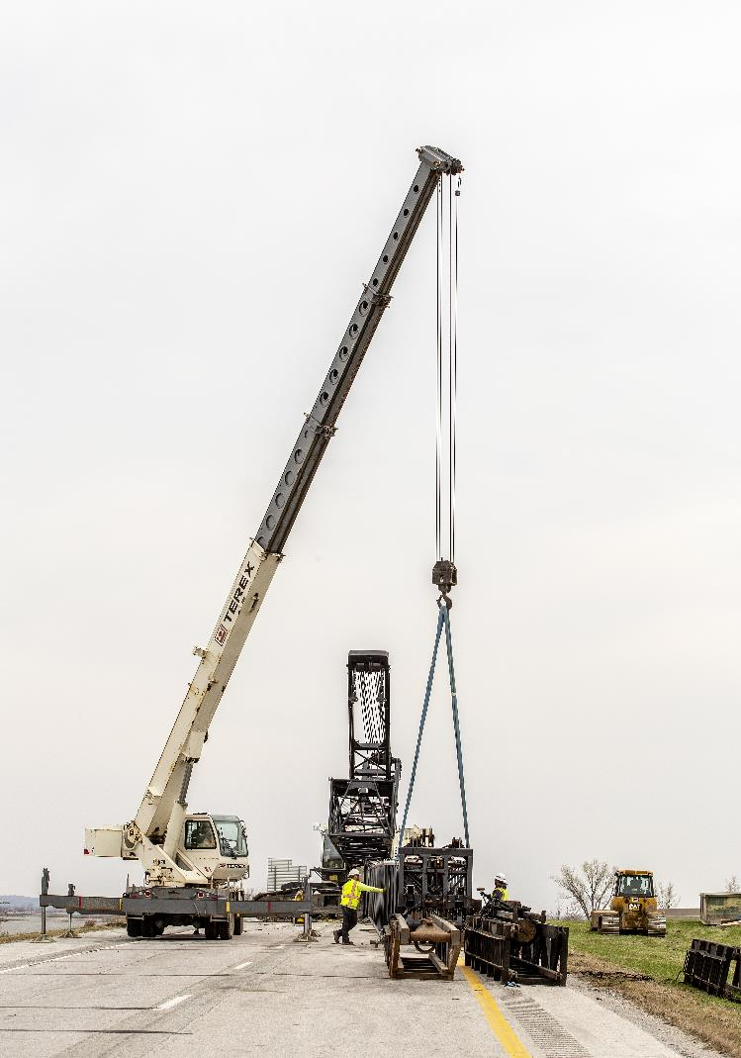
Next Steps
Discuss Extended Highway Program Analysis
Discuss Statewide Line Items
At what levels should the line-item targets be programmed?

Slide 30
Questions?

