Slide 1



State Long Range Transportation Plan
Iowa Transportation Commission Workshop
Kyle Durant
Statewide Planning Coordinator
January 28, 2026

Slide 2
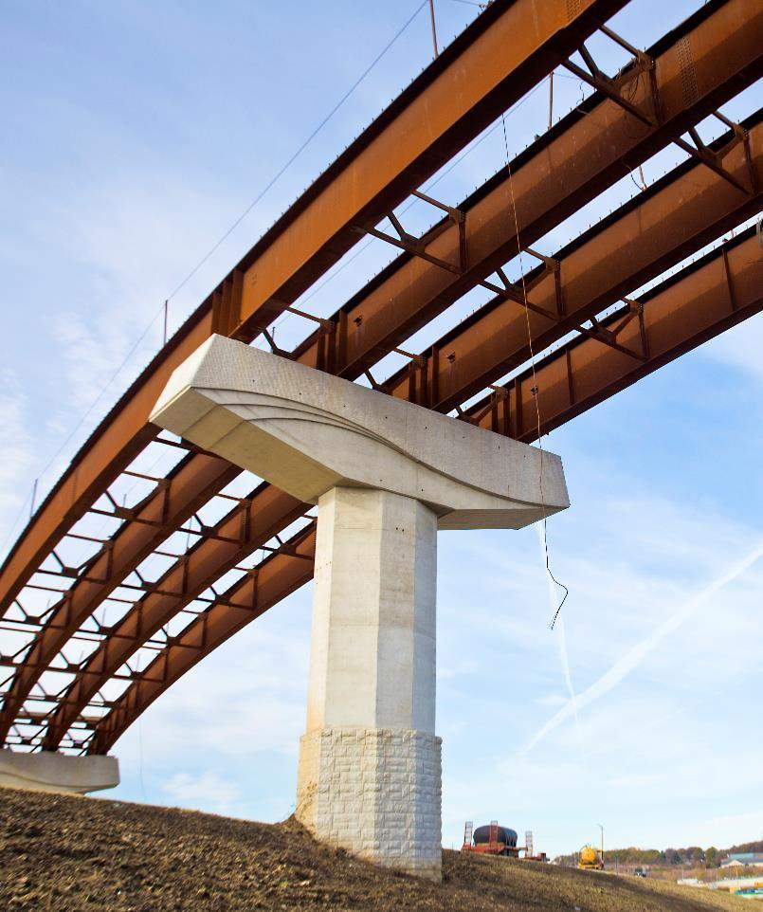

Agenda
BACKGROUND & EVOLUTION
Overview, purpose, and progression of the Plan over the years
WHAT WE HEARD
Key Insights from Staff and Public
INPUT OPPORTUNITIES
System Objectives & additional enhancements
WRAP UP & NEXT STEPS

Slide 3

Background & Evolution
Overview, purpose, and progression of the Plan over the years

Slide 4
Background
Comprehensive long-range plan for all modes
Federally required per Title 23 of United States Code
Also required per Iowa Code chapter 307A; formally adopted by the Iowa Transportation Commission
Updated every five years

Slide 5
Role of the Plan
Serve as a comprehensive, multimodal statewide plan addressing transportation needs in both rural and urban Iowa.
Consider public policy & stakeholder input
Evaluate trends & needs
Document long-range vision & objectives for the transportation system
Provide a framework to support decision making & performance monitoring
Guide the Iowa Transportation Commission’s development of the Five-Year Program

Slide 6
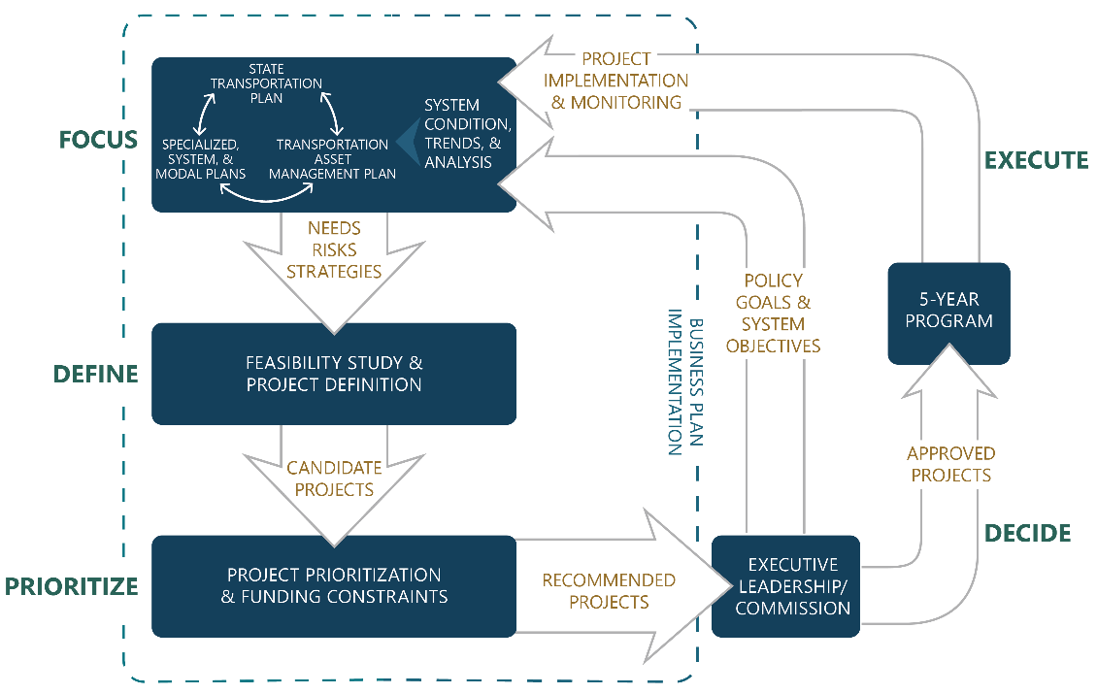
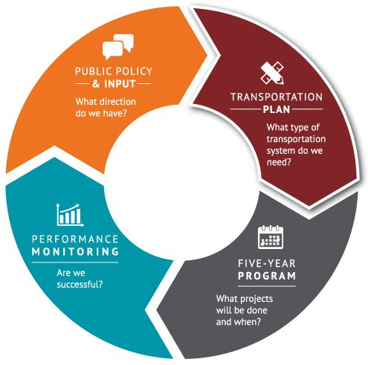
How the Plan is Used
Notes:
Guides investment decisions by the Iowa Transportation Commission through policy direction, strategic priorities, and corridor-level needs and risks
Provides a long-term vision for multimodal transportation
Connects to the Five-Year Program, which implements the SLRTP
Establishes a performance framework, documenting federally required targets and defining objectives to monitor system performance over time.
Aligns with public policy and legislation, incorporating federal and state requirements, public input, and guidance from the governor and legislature
Supports local planning by informing MPOs and RPAs of Iowa DOT’s statewide perspective to help align local transportation plans and investment decisions

Slide 7


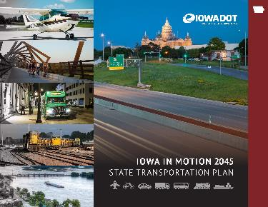
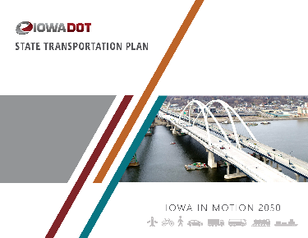
Evolution
1997
Investment plans across modes
Plans for CIN expansion (4-lane and Super-2)
Recognized the cost and need to transition to stewardship by end of planning period
2012
Policy-focused plan that included guiding principle and goals
Included investment actions by mode and goal
2017
Identified primary investment areas; focus on stewardship
Included needs and strategies across modes
Corridor-level highway needs analysis
2022
Established system objectives
Expanded highway needs and risks analysis
New implementation strategies, including rightsizing policy

Slide 8

Current Plan
Adopted by the Commission on May 10, 2022
Administrative modification completed in April 2024
Key components
Trends: Demographic, economic, passenger, and freight
System condition: An overview of each mode
Planning considerations: Issues that influence transportation planning
Vision and system objectives: Vision for Iowa’s future transportation system and system objectives to help achieve it
Needs and risks: Analysis of current and future needs and risks by mode
Strategies: Actions and initiatives to help implement the plan
Financial analysis: Projected annual costs and revenues by mode; ways to address any shortfalls
Implementation: Programming and performance monitoring

Slide 9
Implementation update
Long range plans
2025
2026
2027
Q1
Q2
Q3
Q4
Q1
Q2
Q3
Q4
Q1
Q2
Q3
Q4
Bicycle and Pedestrian Plan
Rail Plan
Freight Plan
State Transportation Plan
Public Transit Plan
Transportation Asset Management Plan
Analyses
Recently updated
Soon to be updated
Bicyclists
Bridge Condition
Bottlenecks
Capacity
Flood Resiliency
Winter Weather
Operations
Pavement Condition
Safety
Pedestrians
Notes:
Long range plan updates
Analyses updates for highway needs and risks matrix
Project prioritization

Slide 10
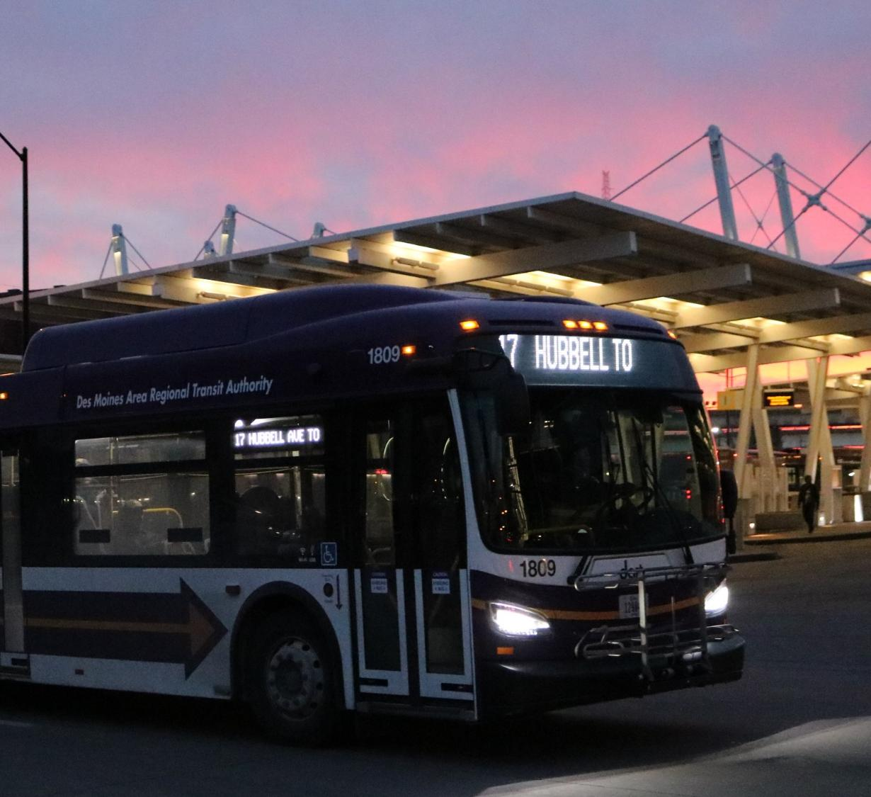
What We Heard
Key Insights from
Staff & Public

Slide 11
Trends Shaping Iowa’s Transportation Future
Demographic shifts
Aging population & changing driver base
Urban-rural population shifts & city growth patterns
Technology Adoption
Emerging transportation technologies
Digital infrastructure & data integration needs
ends
Climate & Resiliency
Infrastructure vulnerability to extreme weather
Need for resilient design & investment strategies
Economic & Freight Growth
Increased freight movement & logistics demands
Economic development in high-growth corridors

Slide 12
Strategic Planning Focus Areas
Multimodal Access & Equity
Address rural transit gaps & car dependency
Improve access for underserved & non-driving populations
Safety & System Design
Reduce high-crash locations
Incorporate systemic safety strategies into design standards
Public Engagement & Communication
Clearly communicate plan evolution, priorities, and safety strategies
Integration & Governance
Strengthen alignment between Plan, Five-Year Program, and MPO/RPA plans
Improve coordination across DOT bureaus, Districts, and local partners
Growth & Investment Balance
Evaluate growth/decline patterns & their impact on service levels
Ensure equitable investment across urban & rural areas

Slide 13
Opportunities to Strengthen the Plan
Safety Strategies
Systemic safety improvements (e.g., rumble strips, intersection design)
Align SLRTP with the DOT’s Safety Portfolio
Stewardship & Asset Management
Interchange rightsizing guidance
Proactive property management strategies
ROW Improvements
Early environmental screening tool(s)
Explore cost recovery through leasing/sales
Funding Guidance
Clarify internal guidance on funding sources & project eligibility
Modal Integration
Enhance Complete Streets Policy
Improve intermodal coordination, especially for emergency/border projects
Technology, Data, & Interactive Tools
Interactive map of planning studies
Standardize tools & datasets
Prioritization Framework
Graduated scale for highway needs & risks (beyond Yes/No)
Align Project Prioritization (IPASS) & Five-Year Program with SLRTP priorities
Goal = more useful and user-friendly document

Slide 14
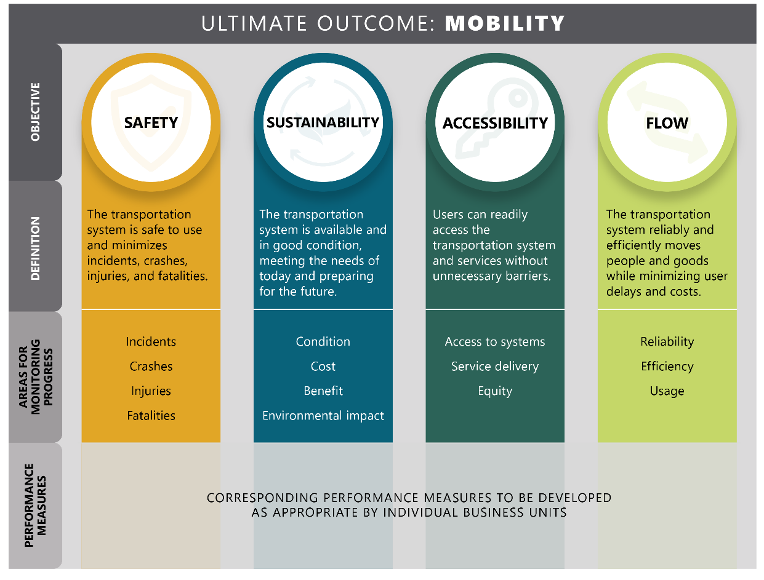
Current System Objectives

Slide 15
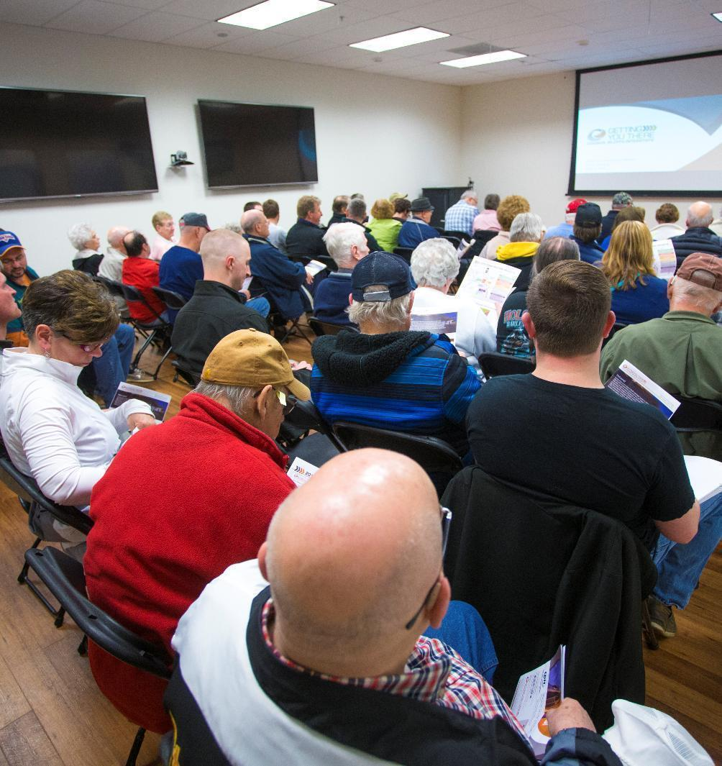
Input Opportunity
Are the current system objectives still appropriate?
Staff feedback was to continue with current objectives – Safety, Sustainability, Accessibility, & Flow

Slide 16

Input Opportunity – Mentimeter
How to Participate
Go to menti.com on your phone or computer
Enter 8-digit code
Submit responses as prompted
Tips for Using
Responses are anonymous
No right or wrong answers
Short phrases work best
Think statewide & long-term (to 2055)
If you’re not seeing the same question, click on Skip ahead
9521 7622

Slide 17
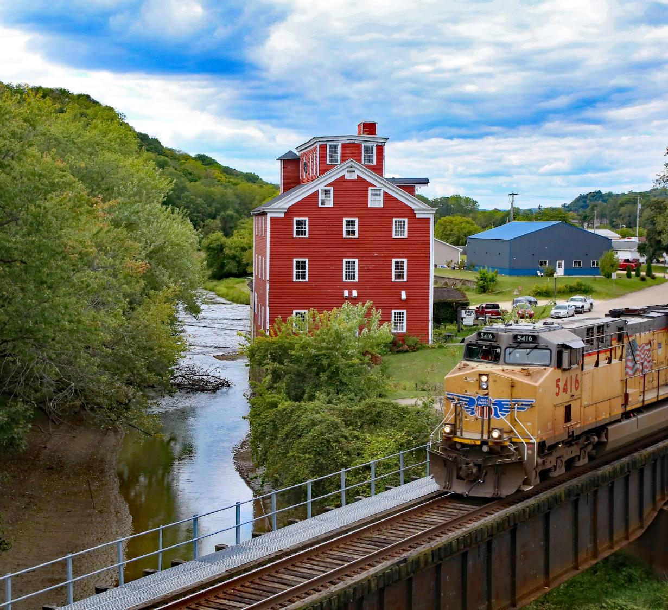
Wrap Up and Next Steps
Internal Planning Steering Committee
Finalize Enhancements
Document development
Future update to Commission

Slide 18
Timeline
Present Draft Material to Commission (months TBD)
Commission Workshop
Start IPSC
ELT
District Planners
Full Draft
Plan Adoption
2025
Jul
Nov
Mar
Jul
Nov
Mar
2027
Feb
Feb
Sep
Jan
May
Sep
Jan
May
Bureau Meetings
Public Input Survey #1
TAMIT
Highway Needs & Risks Analysis
Public Survey #2
Public Comment Period (Late Feb)
MPO/RPA input

Slide 19
Questions?
Kyle Durant
515-233-7950
Kyle.Durant@iowadot.us​
iowadot.gov

Slide 20

Infrastructure Prioritization and Scoring System IPASS
Iowa Transportation Commission Workshop
Samuel Sturtz
LEB Support Team Lead
January 28, 2026

Slide 21
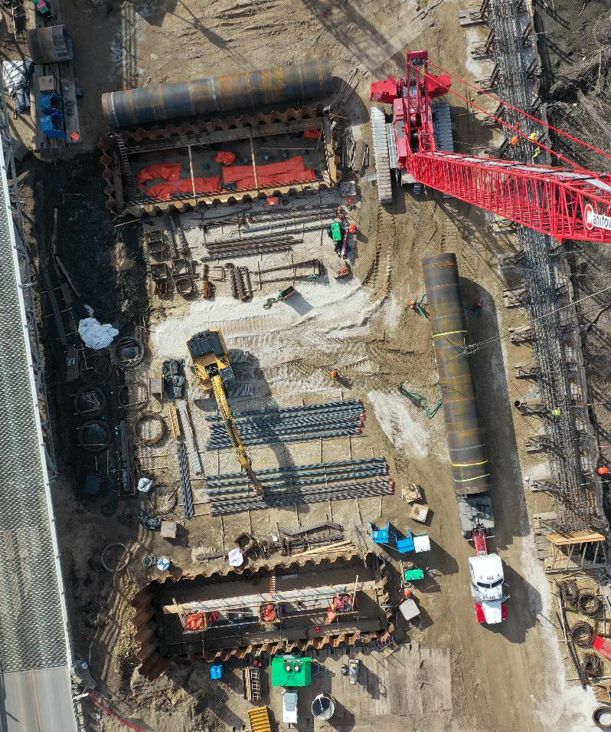
Agenda
Background
Tool structure and scoring
Approach prioritization
Input into project weighting
Wrap up & next steps

Slide 22
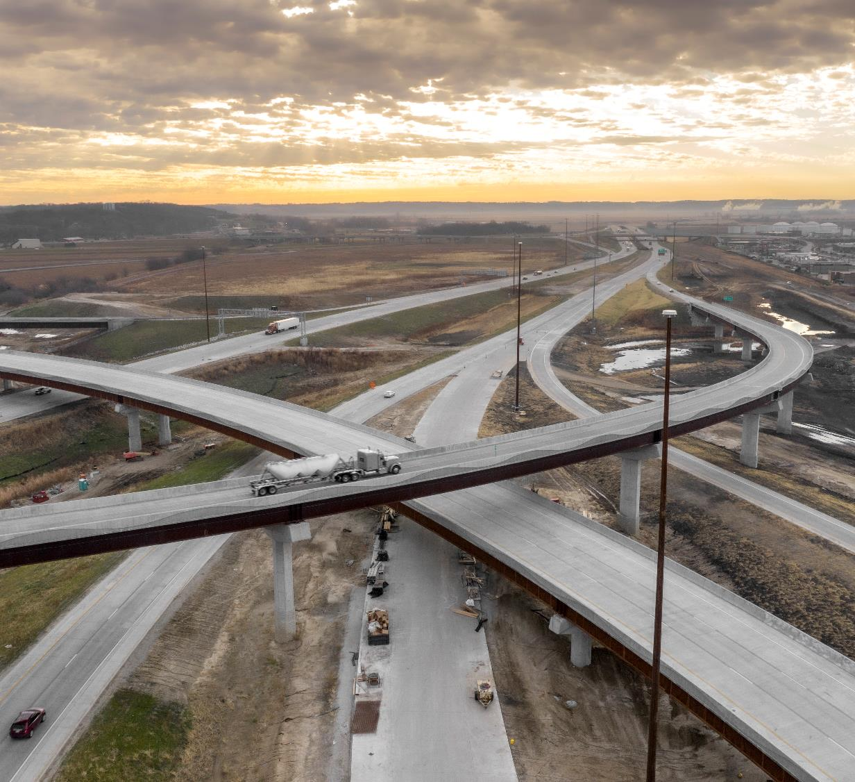
Background

Slide 23
Background
November 2025 Commission meeting
Provided an overview of the new approach to project prioritization.
New approach to project prioritization will better align with department objectives.
Future process will integrate with application process of business plans
Initial scores will be used in this year's evaluation of business case applications.

Slide 24

Tool Structure and Scoring

Slide 25
Tool Structure
Define Project
Project Location defined
Needs Evaluation
Assess needs of proposed project (aligned with SLRTP).
Outcome scoring
User assessment of project outcomes
Additional info provided by applicant
Submission
Project scored for review
Review committee and ELT provide final recommendations for programming
Application saved for future reference and resubmittal

Slide 26

Safety
Sustainability
Accessibility
Flow
Subject Matter Experts
Subject Matter Experts
Subject Matter Experts
Subject Matter Experts
Potential Crash Reduction (PCR)
Bicyclists and Pedestrian Risk
Pavement Condition
Bridge Priority of Work
Flood Resiliency
SLRTP accessibility analysis
Volume over capacity
Bottleneck locations
Super 2

Slide 27
Tool Structure
Define Project
Project Location defined
Needs Evaluation
Assess needs of proposed project (aligned with SLRTP).
Outcome scoring
User assessment of project outcomes
Additional info provided by applicant
Submission
Project scored for review
Review committee and ELT provide final recommendations for programming
Application saved for future reference and resubmittal

Slide 28
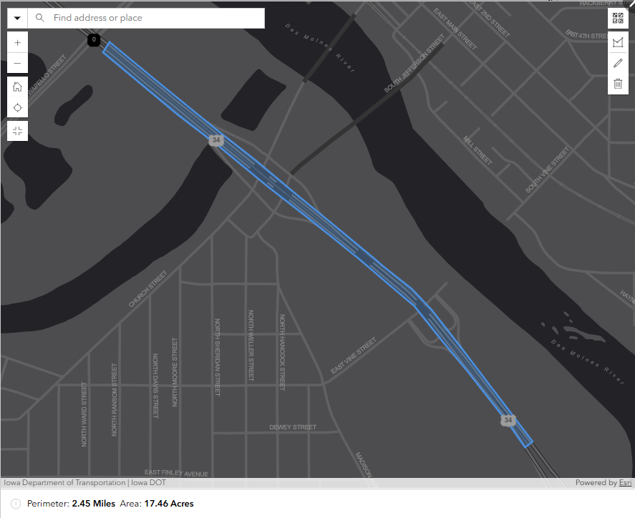
Scoring Approach
When the project area is identified. Our tool will identify the amount of need within the project limits.
These needs are represented by segments and intersections.
Steps to calculating a score
1. summarize amount of need
2. Applicants will respond how much of the need will be addressed by their proposed project.
3. The applicants responses serve as multipliers for the score depending on how much of the need is being addressed.

Slide 29
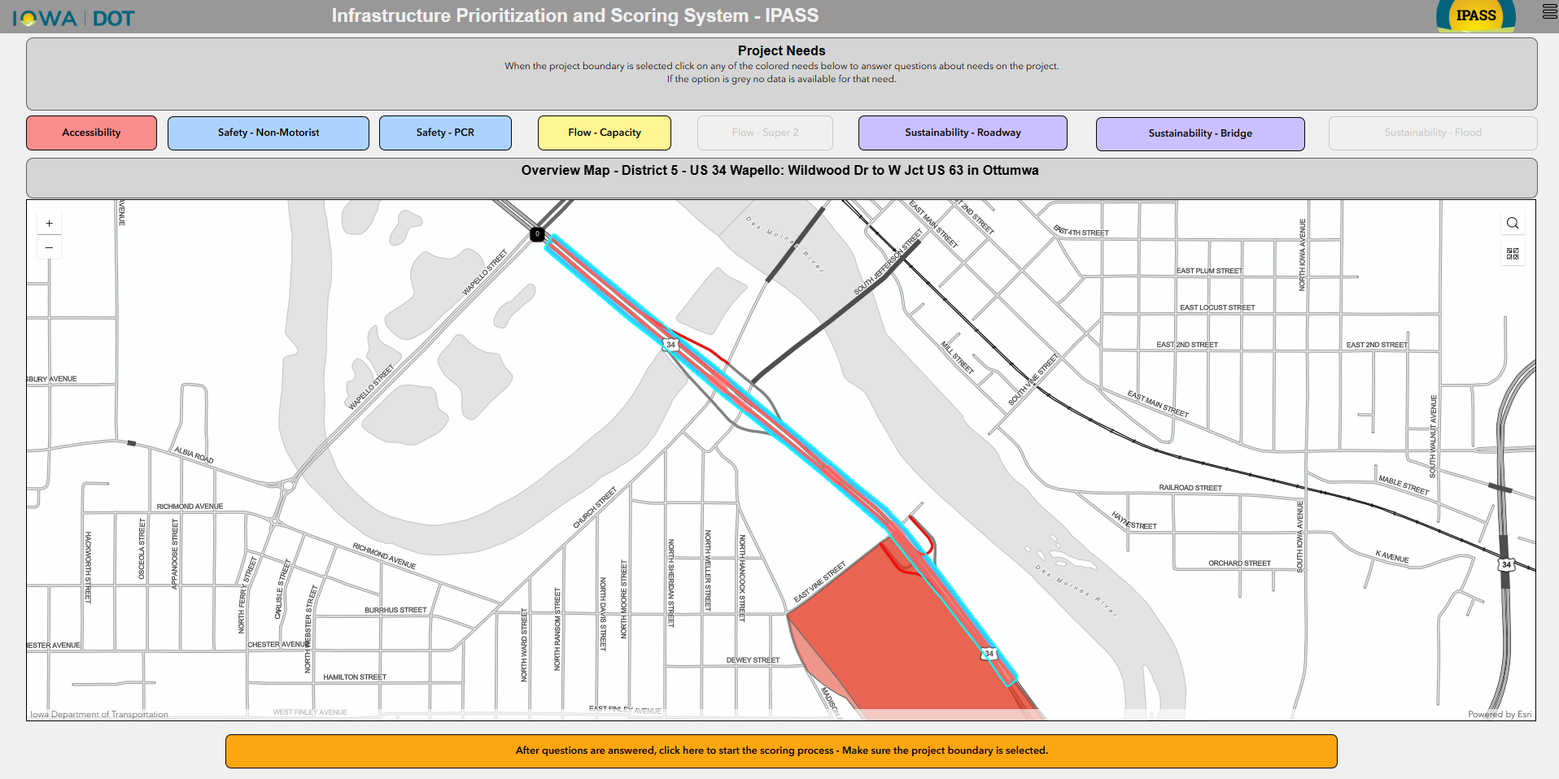

Slide 30
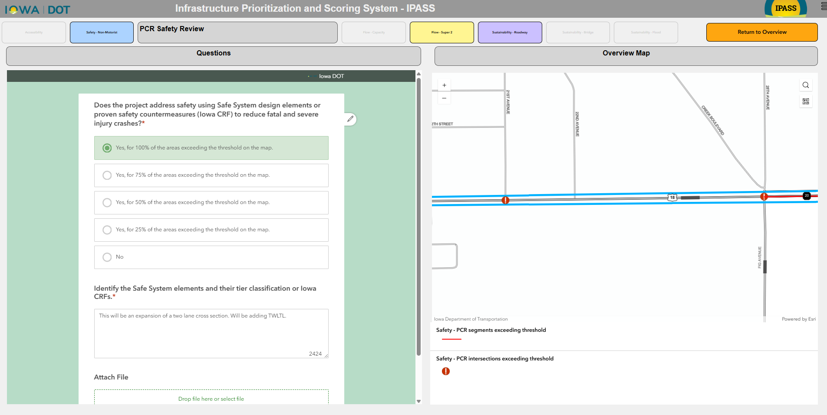

Slide 31
Project Scoring
Intended results of this scoring approach
More needs addressed = better score
Applicants will need to provide a description of how they are addressing the needs (essentially what are they doing).
Scoring from this approach can be used in conjunction with other metrics to evaluate proposed projects.

Slide 32
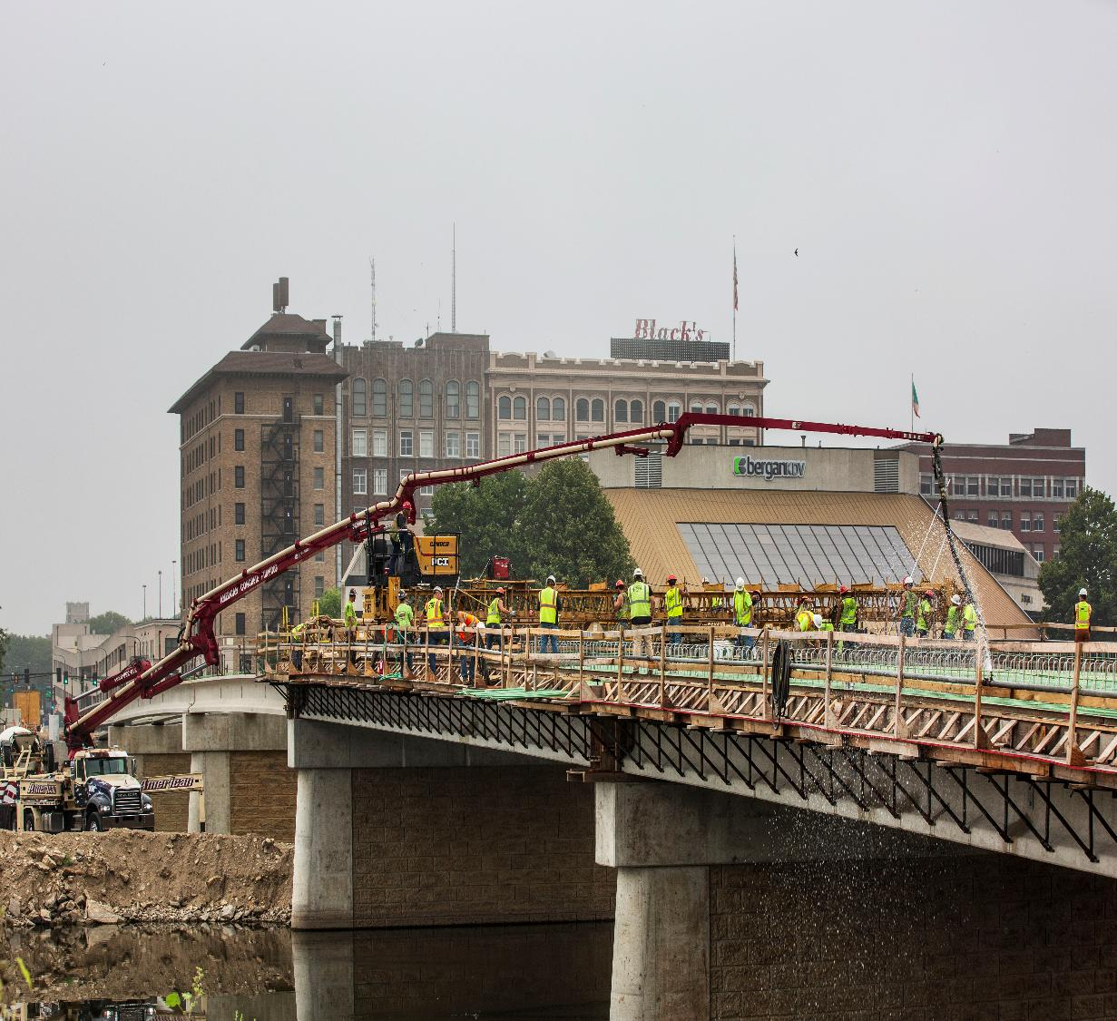
Approach to weighting

Slide 33

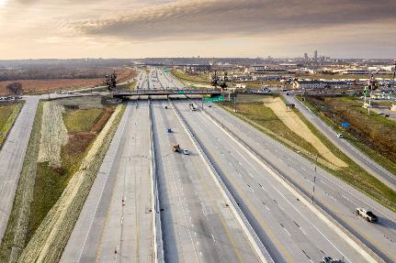
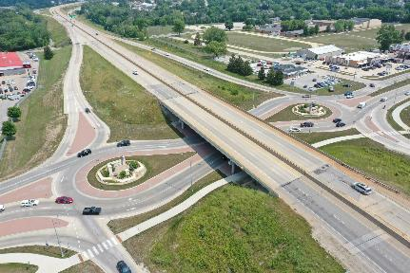
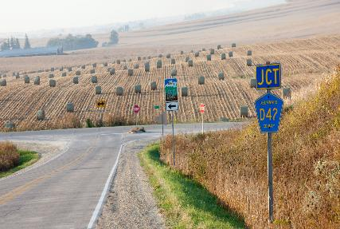
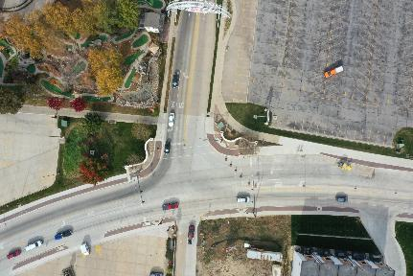
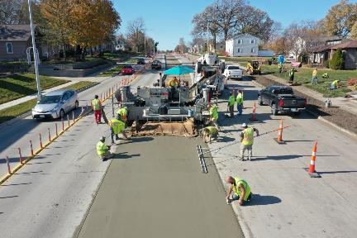

Project types
Image © Kenneth G. West Jr., all rights reserved, www.sweetlightgallery.com
Image © Kenneth G. West Jr., all rights reserved, www.sweetlightgallery.com

Slide 34
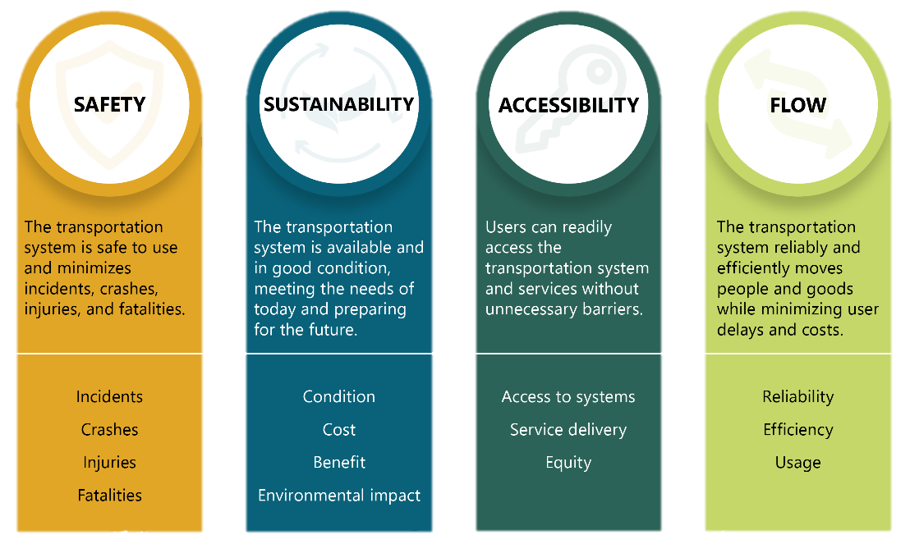
Project types
Comparing projects

Slide 35

Weighting
Initial weighting scenarios & input
Project Types | Accessibility | Flow | Sustainability | Safety | Total
Urban Intersection
Rural Intersection
Urban Interstate
Rural Interstate
Urban Highway/ Arterial
Rural Highway
Rural Interchanges

Slide 36

Input into
Project weighting

Slide 37
Input Opportunity – Mentimeter
How to Participate
Go to menti.com on your phone or computer
Enter 8-digit code
Submit responses as prompted
Tips for Using
Responses are anonymous
No right or wrong answers
If you’re not seeing the same question, click on Skip ahead
9521 7622

Slide 38
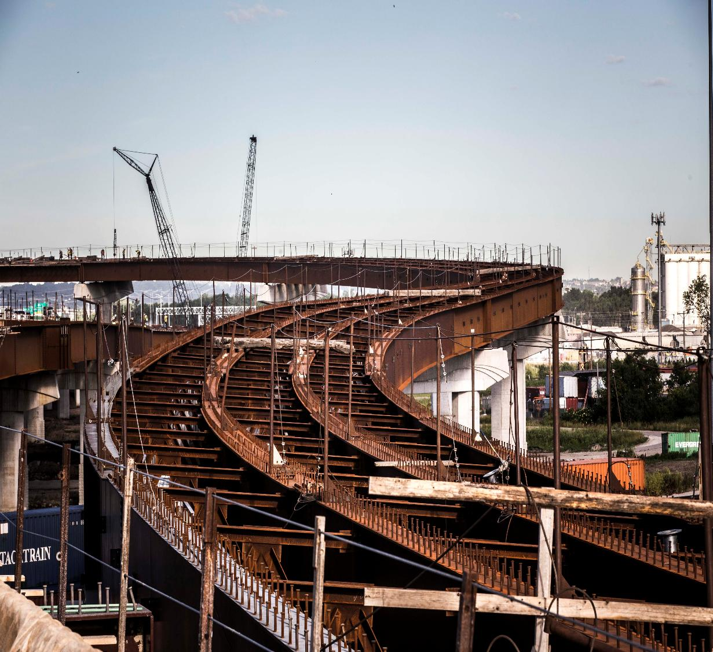
Wrap up &
Next steps

Slide 39
Next steps
Timeline of implementation
Winter 2025-2026
Form “Business Case Review Committee”
Business case review by staff and management.
Program team recommends projects to be added to candidate list.
Spring 2026
Commission input/ direction on highway candidate list and programming recommendations.
Finalize business case decisions and notify staff of selected projects.

Slide 40
Questions?
Samuel Sturtz
515-239-7988
Samuel.sturtz@iowadot.us​
iowadot.gov

