Slide 1
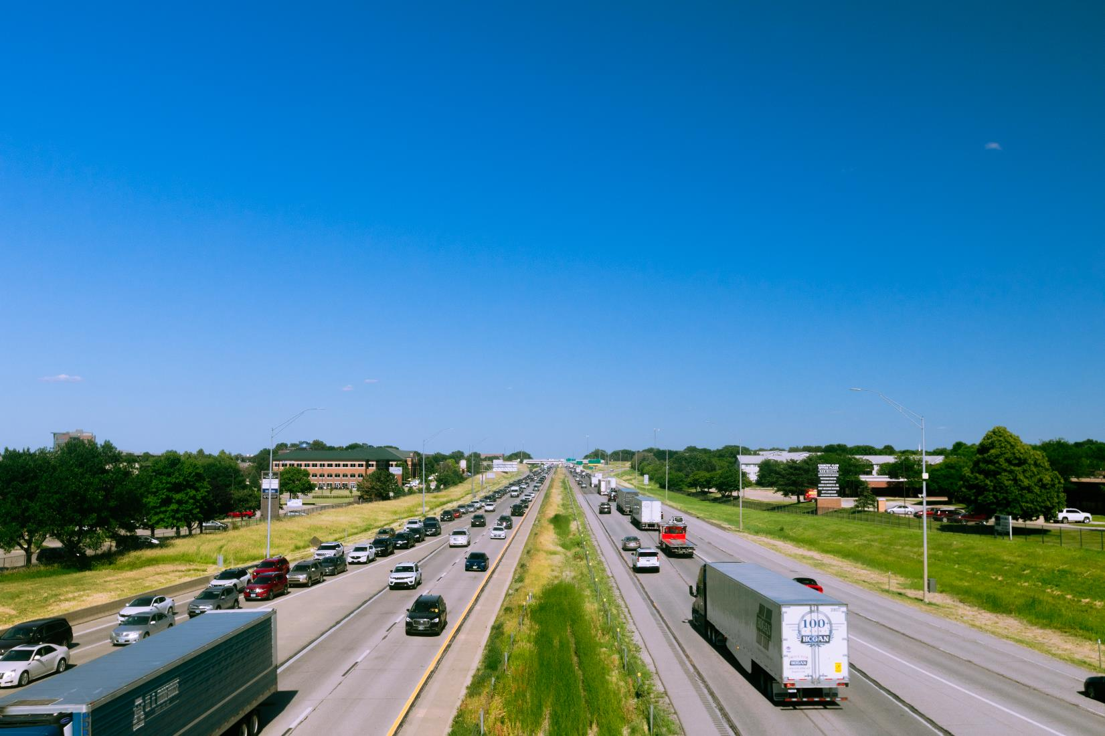


FY 2026 Highway Program Balance Report
February 10, 2026
3/2/2023

Slide 2
Receipts / Costs
Revenue
Forecast PRF Receipts (December) $476.3m
Actual PRF Receipts (December) $482.2m
Lettings
Programmed Amounts (January) $687.6m
Project Costs (January) $603.5m

Slide 3
Balance
FY 2026 Program Balance (December 2025) ($37.4m)
December PRF Receipts Difference $5.9m
January Project Letting Difference $84.1m
Program Balance (January 2026) $52.6m
Previous Balance Reported: $40.8m
FY 2026 Highway Program Balance Overview

Slide 4






Fiscal Year 2026 Overview
Revenue: Expect monthly revenue fluctuations.
Lettings:
Seventy eight percent (78%) of the FY 2026 Program has been awarded.
The January letting was approximately $120 million.
Next letting scheduled for February 17, 2026.

Slide 5
Questions?

