Slide 1

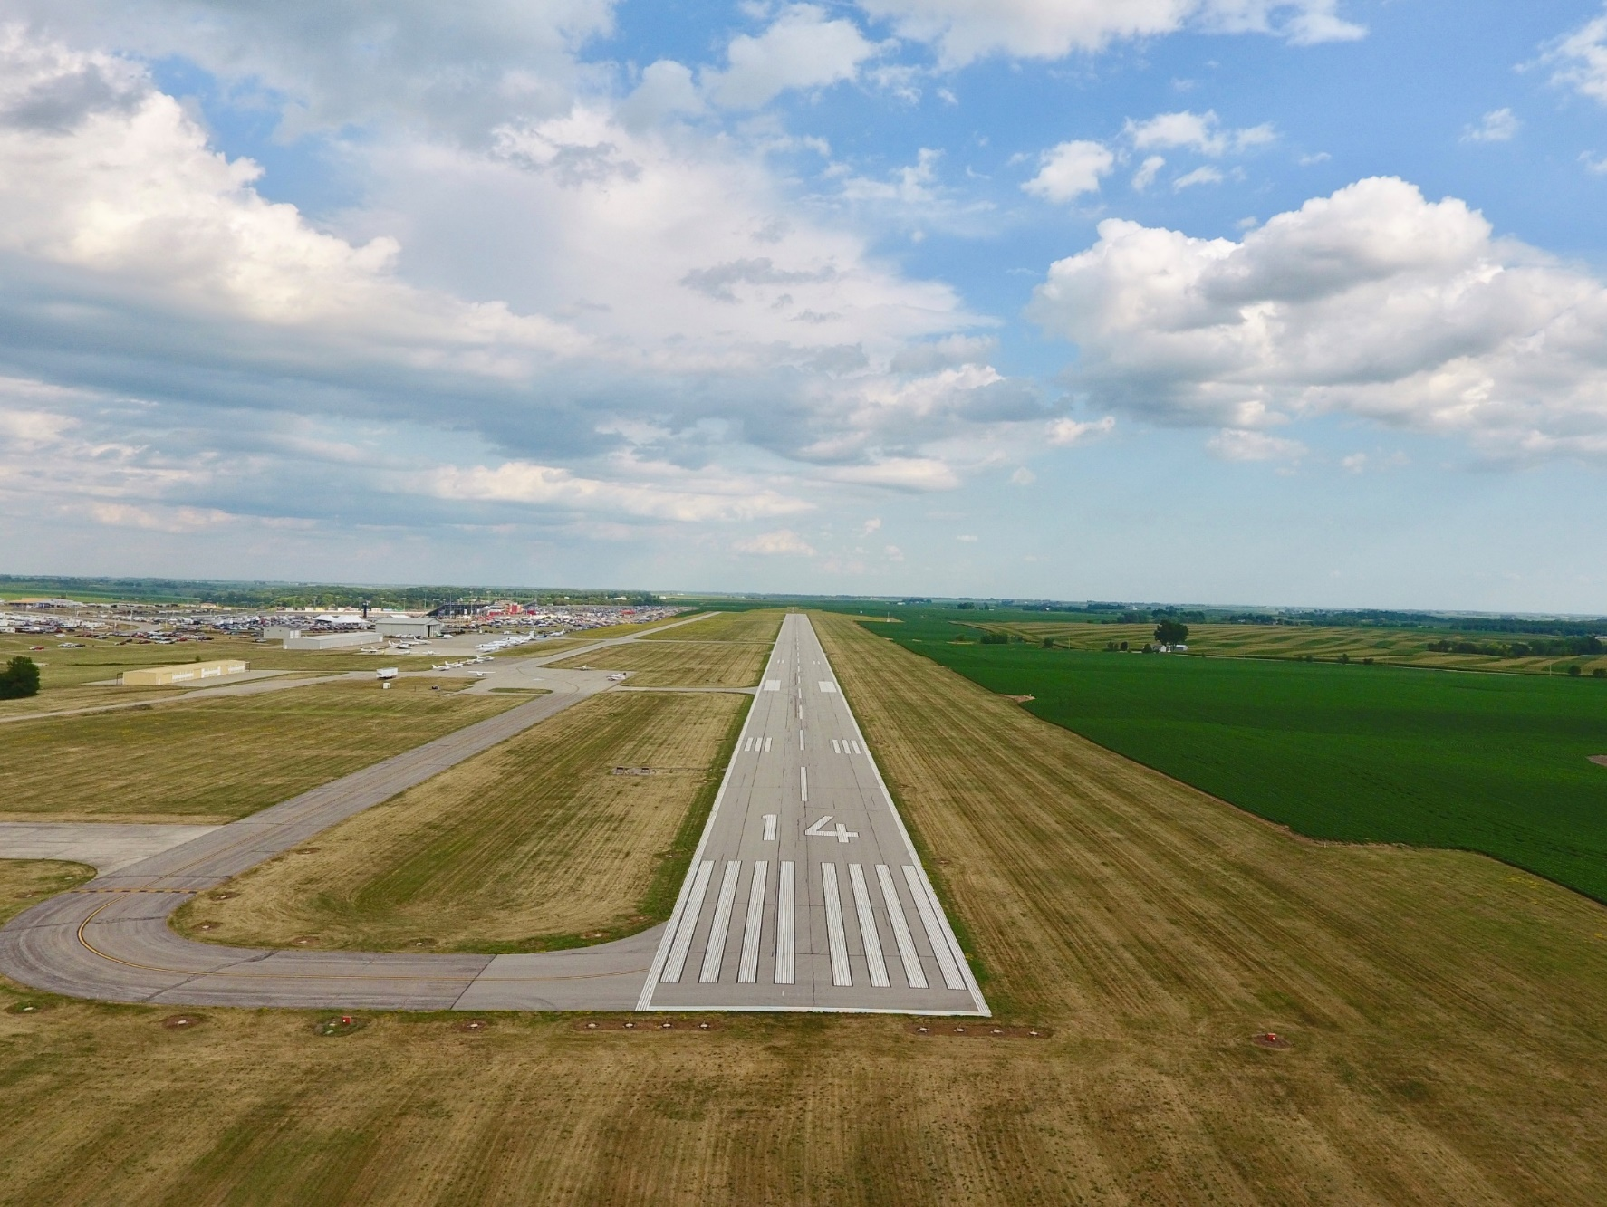
FFY 2027
Federal Aviation Administration
Funding Preapplications
Shane Wright
Modal Transportation Bureau - Aviation
February 10, 2026

Slide 2
Notes:
70 general aviation airports and 3 non-primary commercial service airports – Burlington, Fort Dodge and Mason City
DSM, CID, DBQ, SUX, ALO primary airports (more than 10,000 enplanements) go directly to FAA
30 general aviation airports not eligible for federal funds

Slide 3
Federal Aviation Administration Funding
Channeling Act of 1993 - Applies to all general aviation (GA) airports and commercial service airports that do not receive primary entitlement funds – Iowa Code Section 330.13
  Must submit federal preapplication to the Iowa DOT prior to submittal to FAA
Transportation Commission approves submittal of applications to FAA
Final approval and programming of projects responsibility of the FAA

Slide 4
Federal Aviation Administration Funding
FAA Reauthorization Act of 2024
  $4.0 billion for through FY2028
  90% federal share
Total available dollars remain subject to annual appropriations
Federal Airport Improvement Program (AIP)
  Nonprimary entitlement – Airports receive up to $150,000 each year, based on 5-year capital improvement plan included in the NPIAS (can accumulate 4 years)
  State apportionment – Based on population and land area
  Discretionary – Airport projects compete for funds based on FAA priority of project.
  Entitlement funds are available to airports for any qualifying project. If a grant request exceeds the entitlement available, the FAA may apply apportionment or discretionary to fund the difference.
Notes:
Passed February 2012 after 24 continuing resolutions
FY 2013 funding approp thru March 27

Slide 5
Federal Aviation Administration Funding
Infrastructure Investment and Jobs Act of 2021
  $20 Billion for NPIAS airport infrastructure grants over 5 years
    Two categories of airport funds
      Airport Infrastructure Grants(AIG) - $15B – formula allocations to each airport
        90% Federal share
      Airport Terminal Program(ATP) - $5B – competitive grants dedicated to airport terminal infrastructure
        95% Federal share for Iowa airports
        Projects shown for this program have an ATP in the description.
Notes:
Passed February 2012 after 24 continuing resolutions
FY 2013 funding approp thru March 27

Slide 6
Summary of Federal Funding
Nonprimary Airports in Iowa
 | 2022 | 2023 | 2024 | 2025 | 2026*
Entitlement | $16,231,042 | $19,956,793 | $12,751,903 | $10,109,486 | $14,182,183
Apportionment | $2,956,049 | $2,960,370 | $2,846,389 | $3,100,000 | $3,037,500
Discretionary | $11,761,702** | $2,472,386** | $6,331,955** | $15,671,025** | $18,323,000
IIJA | $405,000 | $6,469,229 | $7,430,975 | $14,941,512 | $16,231,737
 | $31,353,793 | $31,858,778 | $34,963,113 | $43,822,023 | $51,774,420
*Preliminary ** Includes Supplemental Discretionary
Notes:
2013 – Land purchases (Iowa City, Sioux County))
Washington rwy reconstructon
2014 – fewer projects requested that needed discretionary funding

Slide 7
FFY 2027 Federal Funding
Project Categories
Safety and Planning
  Projects that are safety or planning related
  These projects are a high priority as they help to ensure the immediate safety and long-term viability of the Iowa air transportation system
Maintenance and Development Projects
  Projects that are to replace, repair, or expand airport infrastructure.
  Also include acquisition of snow removal equipment, fueling facilities, and buildings
Land acquisition
  All conditions must be satisfied for FAA to program a project that must compete for discretionary funding
  Justified, eligible project and shown on an airport layout plan
  Environmental process complete
  Must have purchased the land or have a formal negotiated agreement

Slide 8
FFY 2027 Federal Funding
Safety and planning projects
Airport | Project description | Federal AIP | Federal IIJA | Total Project Cost*
Creston Municipal | Environmental Assessment for Full Parallel Taxiway | $162,000 |  | $180,000
Emmetsburg Municipal | Environmental Assessment for Realigned Turf Runway | $71,000 | $109,000 | $200,000
Fort Dodge Regional | Update Airport Master Plan and AGIS | $450,000 |  | $500,000
Iowa DOT | Pavement Condition Study | $198,000 |  | $220,000
Iowa DOT | Land Use Study Update | $315,000 |  | $350,000
Osceola Municipal | Parallel Taxiway Design | $105,750 |  | $117,500
Ottumwa Regional | Taxiway Rehabilitation Design | $90,250 |  | $95,000
Sheldon Regional | Runway 33 Safety Area Environmental | $84,238 | $77,762 | $180,000
Vinton Veterans | Runway 09-27 Reconstruction Design | $135,000 | $315,000 | $500,000
 | Total planning projects | $1,611,238 | $501,762 | $2,342,500
* Total Project Cost includes local, state, and other sources of funds not included on this summary
Notes:
The Iowa Aviation System Plan provides a detailed overview of the Iowa Aviation System. It evaluates existing conditions and makes recommendations for future development of the air transportation system.
Last Aviation System Plan was published in 2010.
Originally scheduled to receive FAA funding in FY2018, but FY2017 funds became available and offered to us to begin this effort early.
Estimated cost of $350,000 requiring a $35,000 state share.
Because this is a FAA FY2017 project, it does not appear on the list of projects, but we are requesting commission approval to move ahead with the project.

Slide 9
FFY 2027 Federal Funding
Maintenance and development projects
Airport | Project description | Federal AIP | Federal IIJA | Total Project Cost*
Algona Municipal | Runway Rehabilitation | $150,000 |  | $166,667
Ames Municipal | Reconstruct Runway 01-19 | $14,085,000 |  | $15,650,000
Arthur N New | Construct Hangar | $351,000 | $399,000 | $1,200,000
Belle Plaine | Automated Fuel Terminal | $76,500 |  | $85,000
Boone Municipal | Runway, Taxiway, and Apron Rehabilitation | $450,000 | $181,481 | $701,645
Clarinda Municipal | Rehabilitate Taxilanes and Approach Pavement | $163,697 | $151,303 | $350,000
Decorah Municipal | Runway Pavement Maintenance | $315,050 | $274,000 | $654,500
Denison Municipal | Construct Runway 18-36 | $4,306,100 | $94,000 | $4,889,000
Estherville Municipal | Construct Grass Pathway | $330,000 | $300,000 | $700,000
Fort Madison Municipal | Construct Wildlife Fence | $416,625 | $393,375 | $900,000
Greenfield Municipal | Construct Hangar | $150,210 |  | $166,900
Harlan Municipal | Install Jet A Fuel System |  | $140,000 | $200,000
Humboldt Municipal | Apron, Taxiway, and Access Road Rehabilitation | $810,000 |  | $900,000
Iowa City Municipal | Construct T-Hangar |  | $577,122 | $902,750
Marshalltown Municipal | Reconstruct Runway 13-31 and Lighting System | $14,369,531 | $379,943 | $16,388,304
Muscatine Municipal | Snow Removal Equipment Building | $254,500 | $137,000 | $686,750
Newton Municipal | Snow Removal Equipment | $66,427 | $226,073 | $325,000
Oelwein Municipal | Install Precision Approach Path Indicator |  | $198,900 | $221,000
Oskaloosa Municipal | Install Runway 13-31 Edge Lighting and Visual Guidance | $792,000 |  | $880,000
Ottumwa Regional | T-Hangar and Taxilane Improvements | $300,000 | $214,518 | $1,194,009
Perry Municipal | Construct Taxilanes |  | $300,200 | $333,555
Shenandoah Municipal | Reconstruct Runway 12-30 Lighting and NAVAIDs | $391,146 | $240,654 | $702,000
Southeast Iowa Regional | Aircraft Hangar and Apron Expansion | $1,895,343 | $408,915 | $2,699,176
Vinton Veterans | Wetland Mitigation and Grading | $450,000 |  | $500,000
Washington Municipal | Runway 18-36 Pavement Rehabilitation | $90,000 |  | $100,000
 | Total maintenance and development projects | $40,213,129 | $4,616,484 | $51,496,256
* Total Project Cost includes local, state, and other sources of funds not included on this summary

Slide 10
FFY 2027 Federal Funding
Land acquisition projects
Airport | Project description | Federal AIP | Federal IIJA | Total Project Cost*
Grinnell Regional | Land Acquisition for Parallel Taxiway | $90,000 |  | $100,000
Mathews Memorial | Land Acquisition | $250,332 |  | $263,507
Monticello Regional | Land Acquisition | $47,300 | $47,300 | $99,580
Northeast Iowa Regional | Acquire Land for RPZ and Extension | $1,154,250 |  | $1,282,500
 | Total land acquisition projects | $1,541,882 | $47,300 | $1,745,587

Slide 11
FFY 2027 Federal Funding
Preapplications Summary
 | Projects | Airports | Federal Share | Total Applications
Safety and Planning | 9 | 8 | $2,113,000 | $2,342,500
Maintenance and Development | 25 | 25 | $44,829,613 | $51,496,256
Land Acquisition | 4 | 4 | $1,589,182 | $1,745,587
Total Preapplications | 38 | 37 | $48,531,795 | $55,584,343
Notes:
Total eligible airports: 73 plus 2 new/replacement
No projects: 21 airports

Slide 12
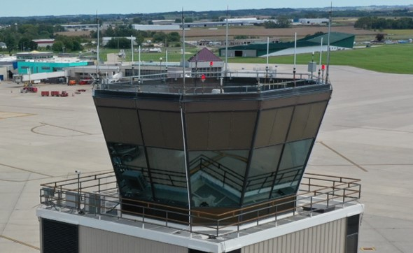
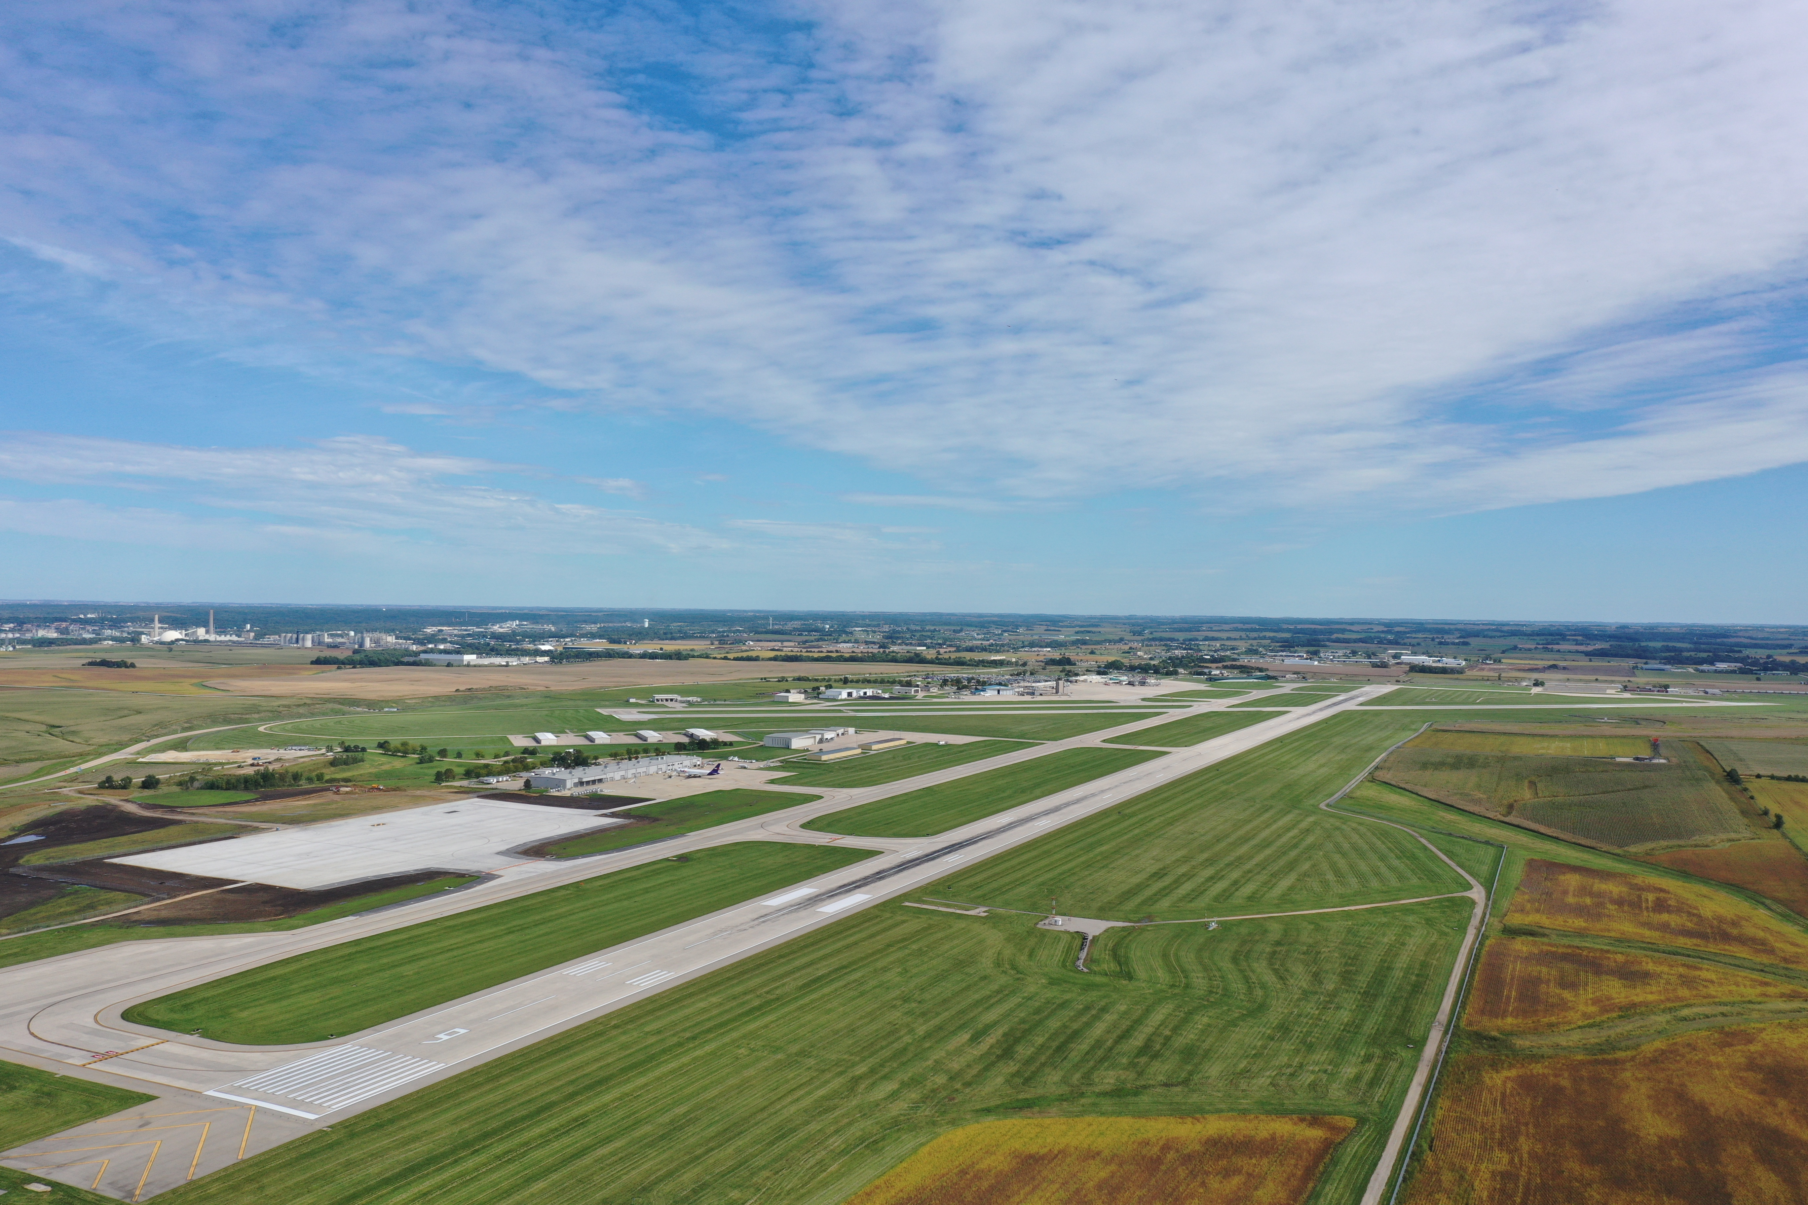
Summary
38 Projects totaling $55.5M
All projects fall within the Iowa Aviation System Plan
Modal Transportation Bureau offers no objections
Recommend approving submittal of applications, as presented, to the FAA

Slide 14
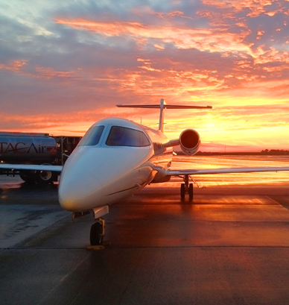
FFY 2027
Federal Aviation Administration
Funding Preapplications
Questions??

