Slide 1
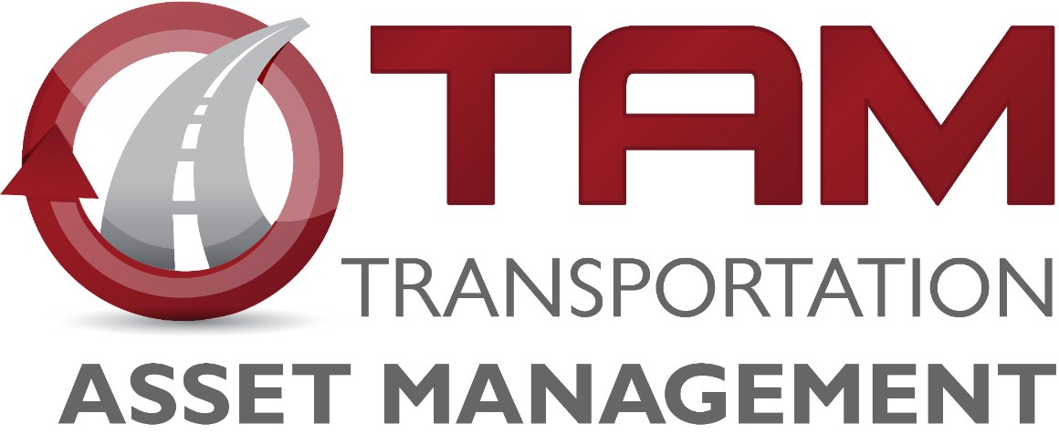


Bridge Management
Iowa Transportation Commission Workshop – February 11, 2026

Slide 2
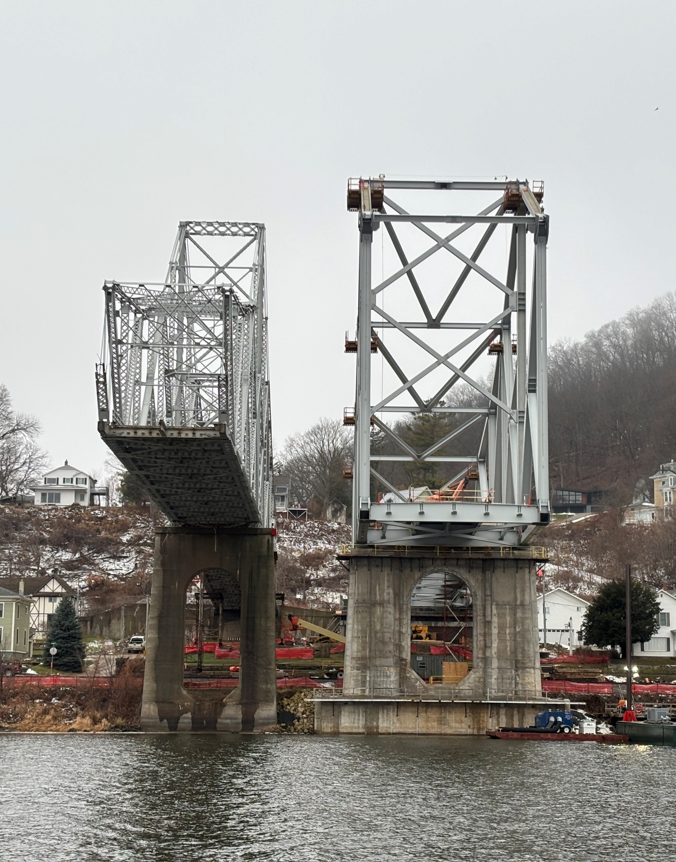

Agenda
Bridge Preservation & Maintenance Activities
Bridge Design for Service Life
Non-Destructive Evaluation Techniques
Bridge Inventory
Iowa’s Interstate Bridges
Condition Summary
Funding Scenarios
Conclusion

Slide 3
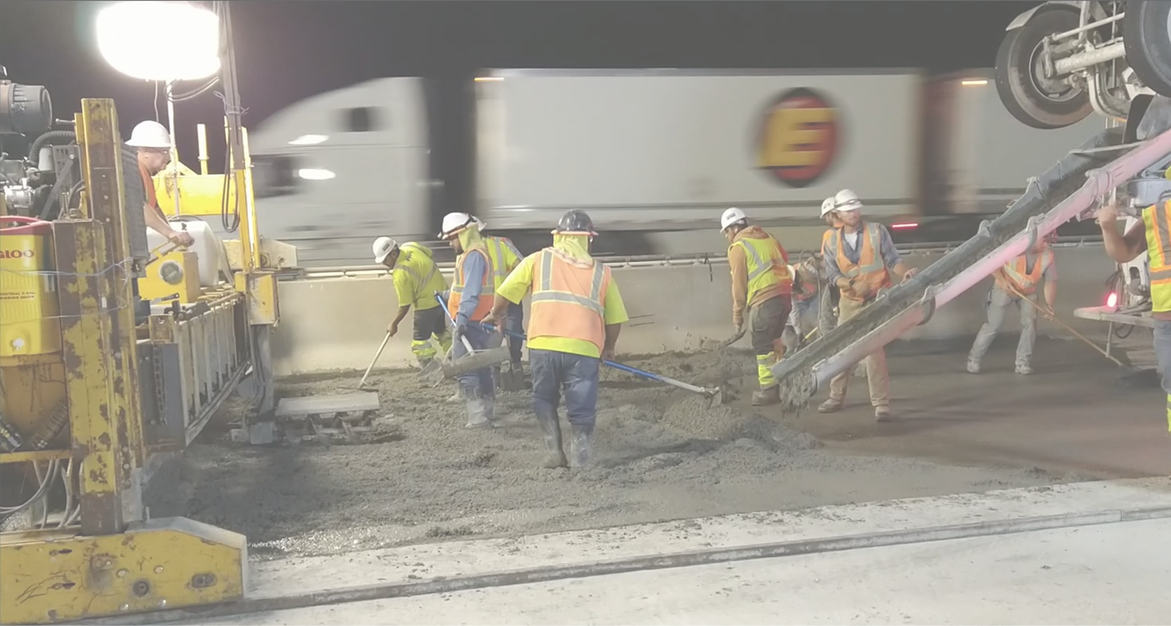
Typical Bridge Preservation and Maintenance Activities
Replace aging deck expansion joints
Overlay bridge decks with new wearing surface
Dense Portland cement concrete overlay
Polyester Polymer concrete overlay
Repair beams ends
Epoxy inject or patch deteriorated bridge deck areas
Apply concrete sealers
Paint steel girders
Install berm and bank protection

Slide 4
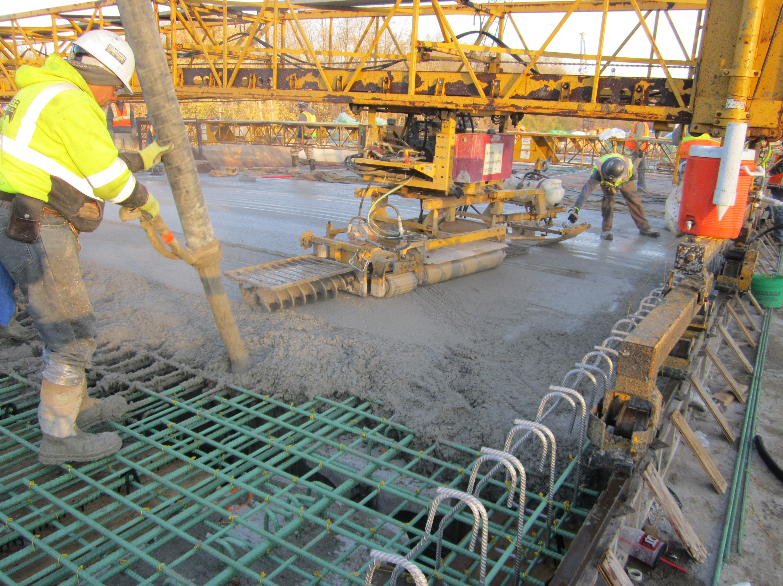
Bridge design for service life
Use stainless steel in areas with high potential for corrosion.
Use High Performance concrete (HPC) in new bridge decks.
Eliminate expansion joints wherever feasible.
Design for enhanced service life for major capital projects such as border bridges.
Notes:
Photo – 2022 IA 28 over Raccoon River bridge deck casting

Slide 5
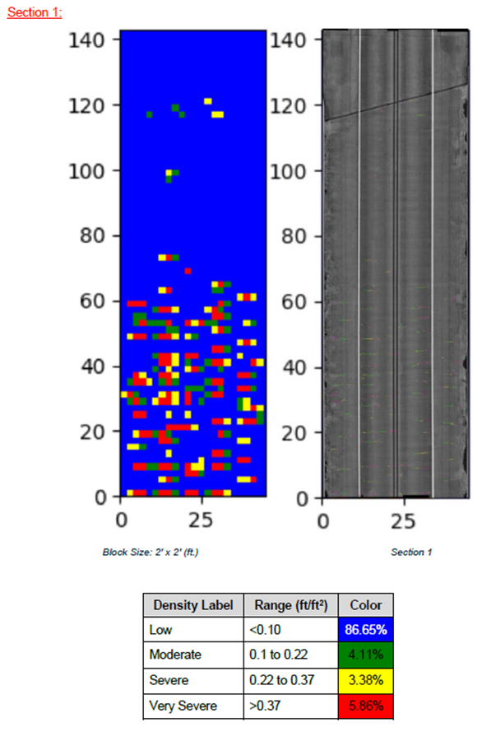
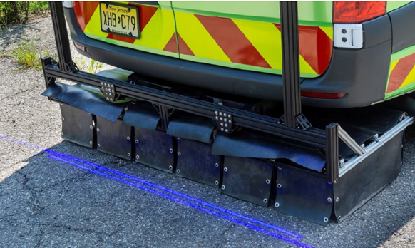
Non-destructive evaluation techniques
Bridge deck sounding
Automated acoustic sounding
High-speed, high-resolution imaging with AI crack mapping
Phased-array ultrasonic testing (PAUT)
Ultrasonic testing (UT)
Magnetic Particle Testing (MT)
UAS imagery
Notes:
Photos – Laser light illuminating the surface for high resolution cameras and a sample of a deck crack density and crack map report.

Slide 6
Bridge Inventory
State Owned Inventory
The primary system includes 4,214 bridges and bridge-sized culverts
The deck area of all primary system bridges is over 47.4 million square feet – that’s approximately 1.7 square miles. (over 820 football fields)
If we had to replace these bridges today, the cost would exceed $20 billion.
Average vehicles per day (VPD) 6472.
Median VPD 3495.
Notes:
This data is updated based on 2025 Annual Bridge Report published in July 2025 and 2025 NBI Submittal
4214 total state owned bridges (727 interstate bridges, 3487 non-interstate bridges)
2,659 bridges on the NHS. 28 total Poor. 15 Poor on NHS (8 state owned bridges and 7 city bridges)
Make comment that there are 23,685 bridges statewide (23,716 if private, federal, etc., owned is included). Iowa’s status as number one state with the most Poor/SD bridges (4418) due to local bridges.
17.2% of state owned bridges are on the interstate. 26.4% of the total deck area on the interstate.
The Des Moines River bridge on I-235 has the highest VPD at 89,000.
Football field is 57,600ft^2

Slide 7
Bridge Inventory
Local Agency Owned Inventory
The secondary system includes 19,471 bridges and bridge-sized culverts
County owned = 18,196
City owned = 1,275
Others = 31
The deck area of all secondary system bridges is over 50.0 million square feet – That is approximately 1.8 square miles.
Average county vehicles per day (VPD) 199. Median VPD 46
Average city VPD 3066. Median VPD 1488
Notes:
This data is updated based on 2025 Annual Bridge Report published in July 2025 and 2025 NBI Submittal
4214 total state owned bridges (727 interstate bridges, 3487 non-interstate bridges)
2,659 bridges on the NHS. 28 total Poor. 15 Poor on NHS (8 state owned bridges and 7 city bridges)
Make comment that there are 23,685 bridges statewide (23,716 if private, federal, etc., owned is included). Iowa’s status as number one state with the most Poor/SD bridges (4418) due to local bridges.
17.2% of state owned bridges are on the interstate. 26.4% of the total deck area on the interstate.
The Des Moines River bridge on I-235 has the highest VPD at 89,000.
Football field is 57,600ft^2

Slide 8
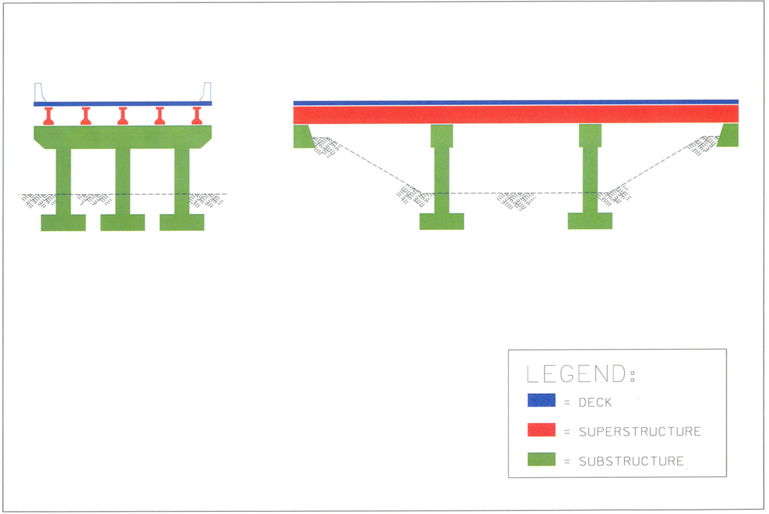
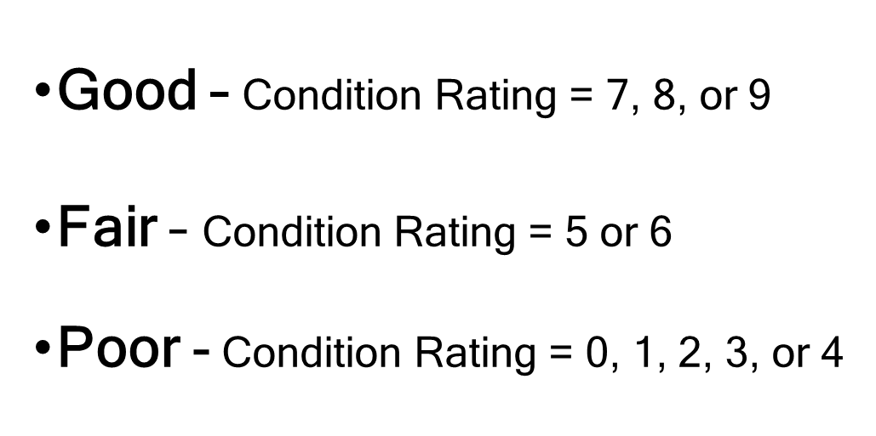
Bridge Condition
Notes:
Discuss inspection and how we arrive at Good, Fair, and Poor.
Bridge inspectors assign a general condition rating to the components of the deck, superstructure and substructure in accordance with the National Bridge Inspection Standards (NBIS) and the FHWA Recording and Coding Guide and the AASHTO Manual for Bridge Evaluation. We are in a transition period of implementing new NBIS requirements and the new Specifications for the National Bridge Inventory (SNBI). April 2024, we started collecting SNBI data.
SNBI replaces the Recording and Coding Guide. Component Condition Rating replaces General Condition Rating.

Slide 9
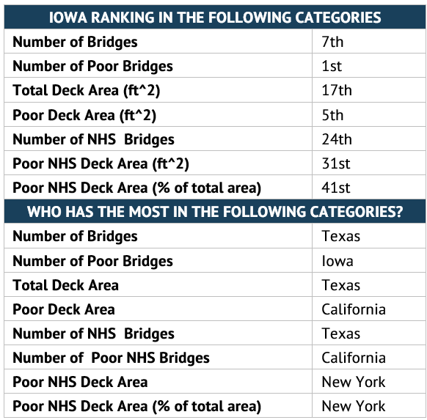
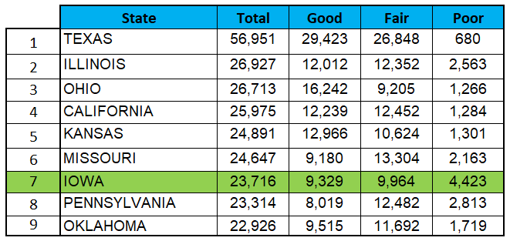
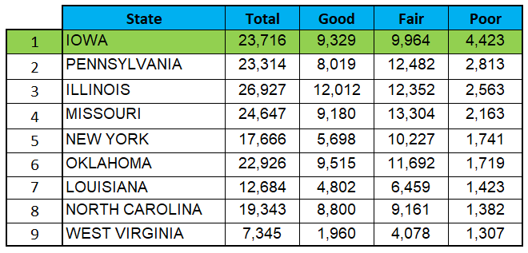
Iowa’s Comparison to Other States
Highest Bridge Counts per State
Highest Count of Poor Bridges per State
Notes:
Rhode Island only has 787 bridges and 110 are Poor. The fewest total number of bridges in the country.
Top 12 states own half the bridges in the US.
Poor deck area in California is twice as much as Iowa.
Iowa 49 in % interstate poor, 45 in % NHS poor

Slide 10
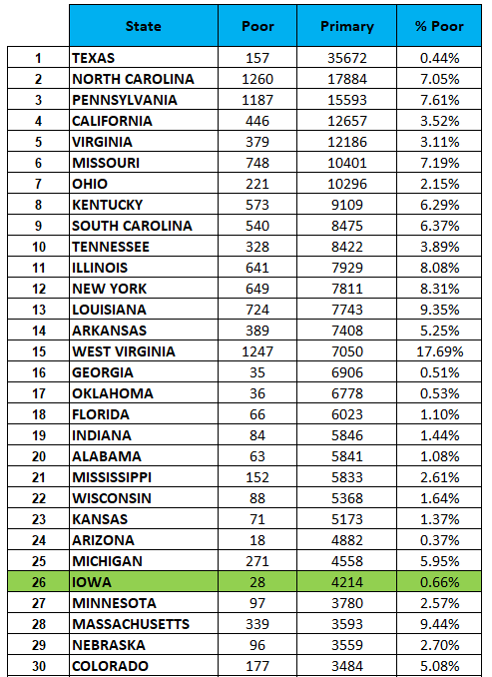
Iowa’s Primary Highway Bridges Compared to Other States
Notes:
IA has state-owned (primary highway) bridges of 4,214 ranked 26th. 28 poor bridges -> 0.66%

Slide 11
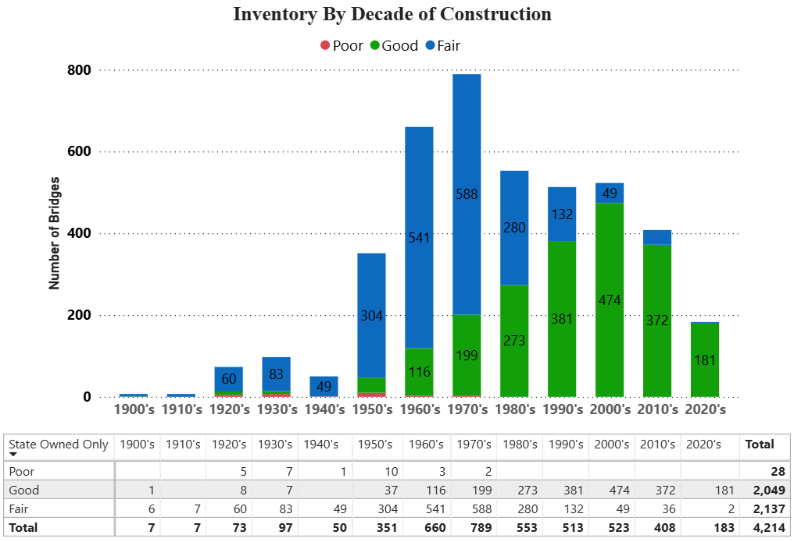
Notes:
Updated from 2024 submittal

Slide 12
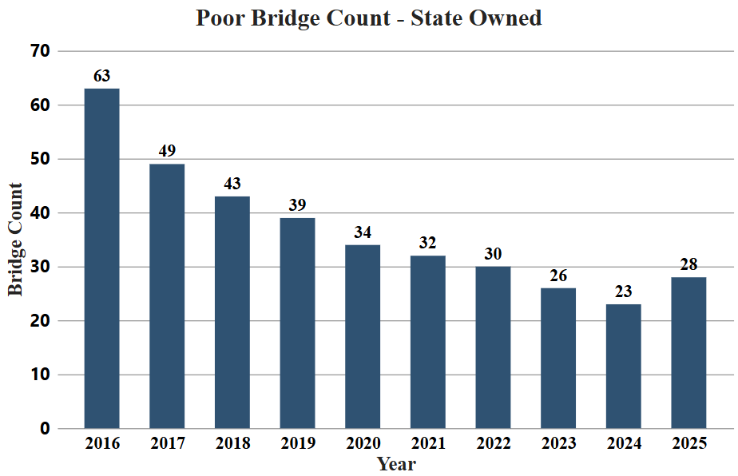
Poor bridges over time
Notes:
28 Poor bridges in 2025.

Slide 13
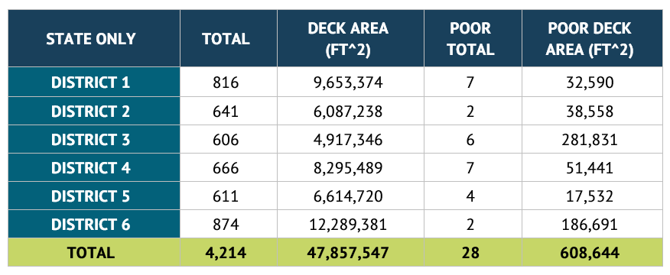
Bridges Per District
Notes:
28 Poor bridges in 2025.

Slide 14
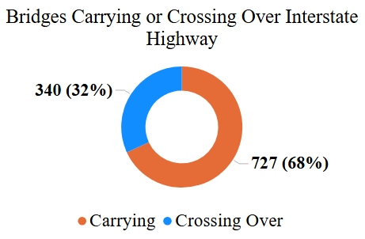
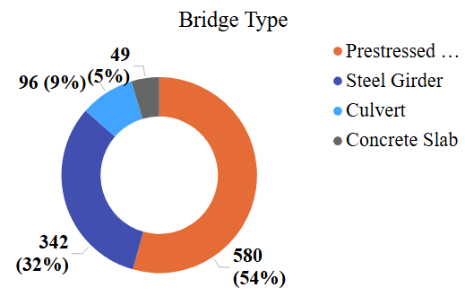
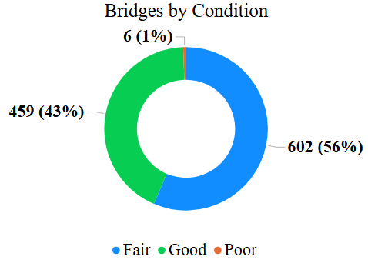
Interstate Bridges Overview
Notes:
Overview of Interstate Bridges: please note that interstate bridges here include both bridges carrying interstate and bridges crossing over interstate

Slide 15
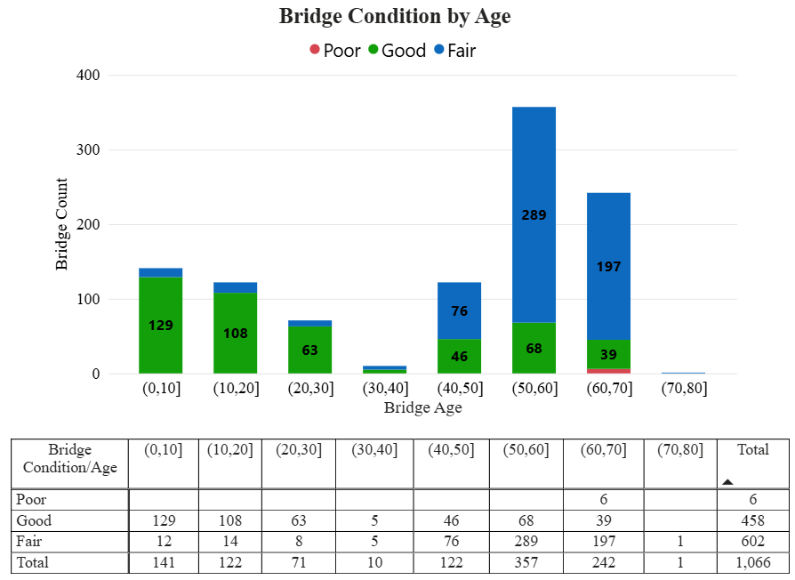
Interstate Bridges By Age
Note: (0,10] means 0 to 10 years old
Notes:
One interstate bridge misses its age data in the inventory, probably due to no active inspection data on this new bridge

Slide 16
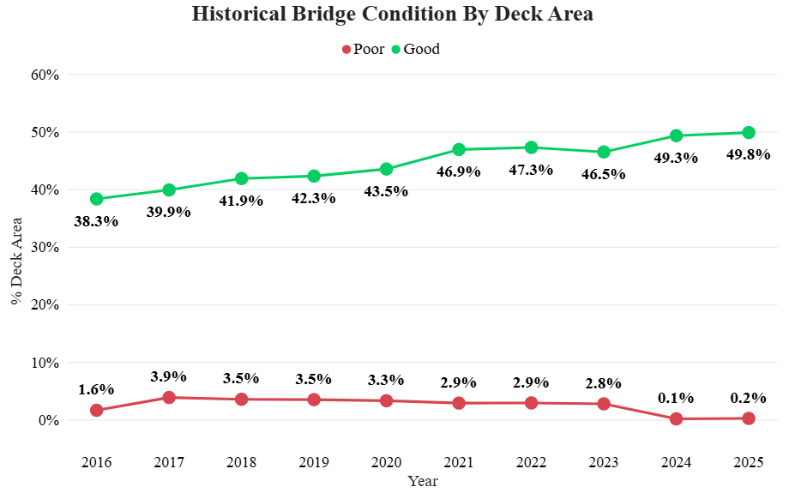
Interstate Bridges: Historical Condition

Slide 17
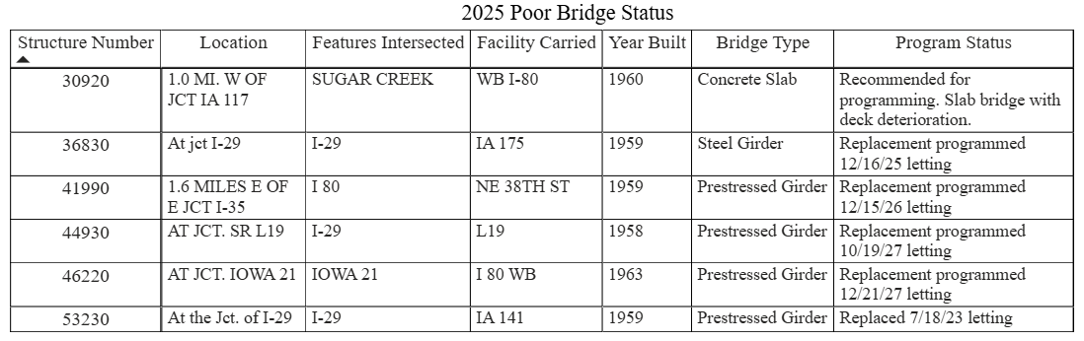
Poor Interstate Bridges

Slide 18
Typical Bridge Costs
Project Type | 2025 Present Day Cost Per Square Foot of Deck Area
Bridge Deck Overlay | $82.80
Bridge Deck Replacement | $150.27
Bridge Replacement | $616.71

Slide 19
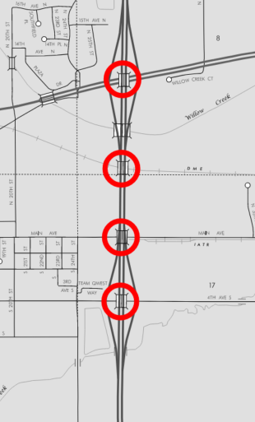
Bridge Project Example: Deck Overlay
I-35 NB/SB in Cerro Gordo County
Eight bridge overlays tied into one project
4th Ave. S.
Main Ave.
DM&E RR
US 18
$4.88M total bid
Average cost $54/SF
Note: Letting costs shown

Slide 20
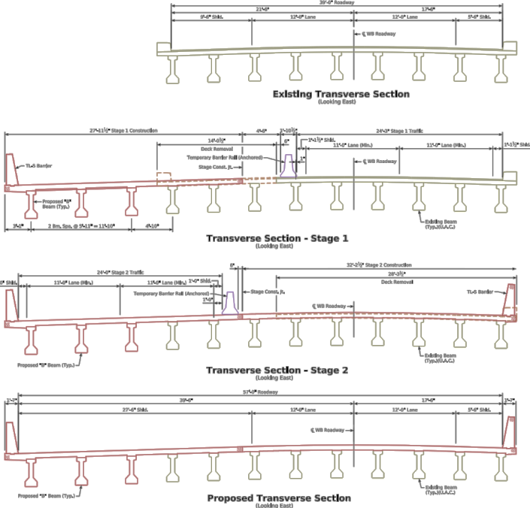
Bridge Project Example: Deck Replacement
I-80 EB/WB over Keg Creek near Minden
Deck replacement with widening to maintain 2 lanes
Existing bridge 200’ x 39’ PPBC Bridge
New size 200’ x 57’ PPCB Bridge
Deck replacement cost $2.45M
Widening costs $2.74M
Roadway Items $3.29M
Project cost $8.48M
Note: Letting cost shown
Notes:
Project $1087/sf based on original bridge size

Slide 21
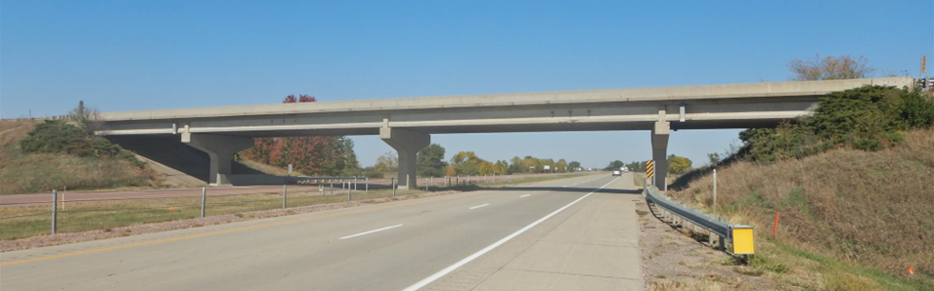
Bridge Project Example: Bridge Replacement
IA 141 over I-29 near Sloan
Existing bridge 210’ x 30’ PPCB Bridge
New bridge 222’ x 40’ PPCB Bridge
Bridge cost $1.86M
Project cost $16.3M
Grade and pave $13.7M
Traffic signs $321k
Lighting $198k
Erosion control $38k
Fencing $150k
Note – ROW costs not included, vertical clearance increased from 15’ to 16’9”
Letting cost shown
Square foot cost based on existing bridge size
Bridge only - $300/SF
Total project - $2,600/SF
Notes:
Original bridge had 15’ vertical clearance
New bridge has 16’9 vertical clearance
Bridge was in poor condition due to the deck and beam ends

Slide 22
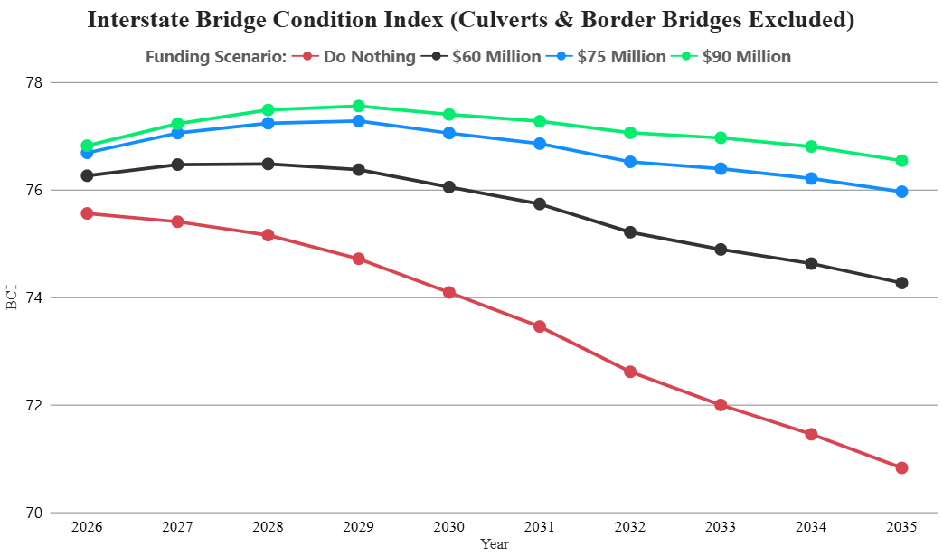
Condition Forecast – Interstate Bridge Condition Index

Slide 23
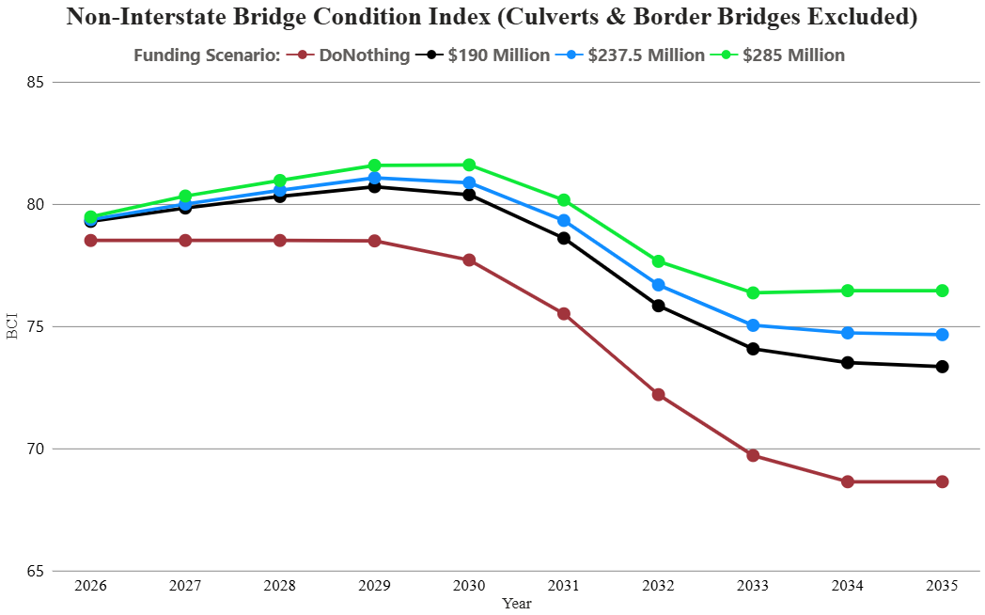
Condition Forecast – Non-Interstate Bridge Condition Index

Slide 24
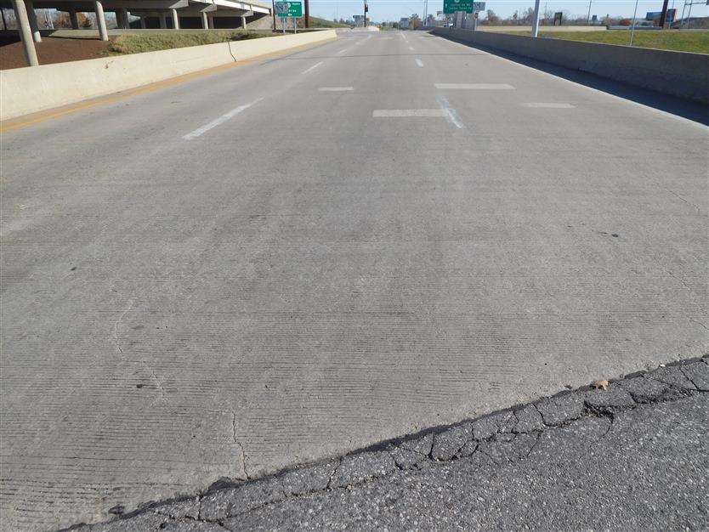
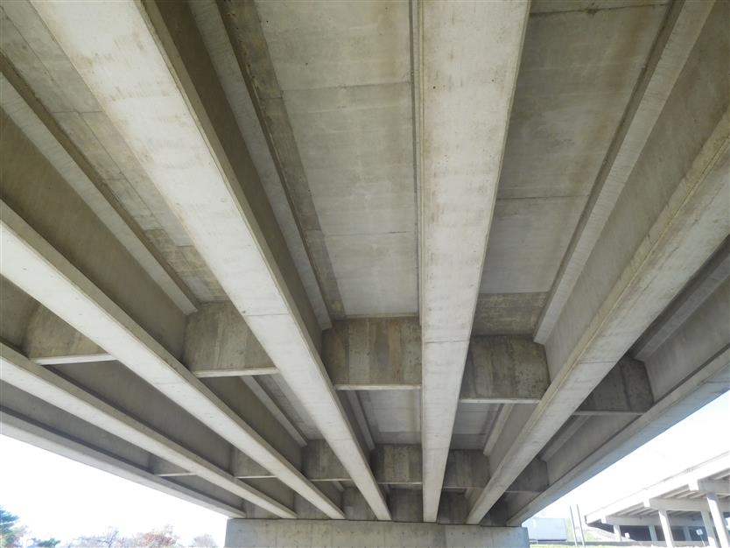
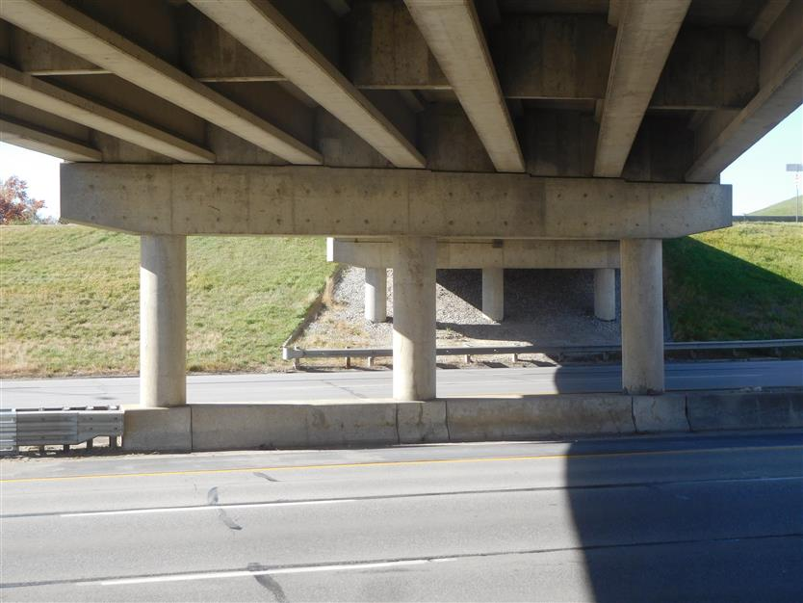
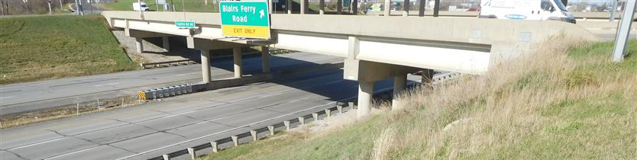
Example of Bridge in Fair Condition
Deck: Fair
Superstructure: Fair
Substructure: Fair
A bridge on IA 100, built in 1982 with routine maintenance
Notes:
Bridge example of condition index of 76: 268’x42’ prestressed bridge on NHS, FHWA #604710, EB Coll IA 100, district 6, crossing I-380, ADT: 2670
In Cedar Rapids – just west of Collins Aerospace.

Slide 25



Major Capital Bridge Projects
There is a need to replace or rehabilitate several large bridges over the next 20 years.
I-80: Le Claire (Fred Schwengel) over the Mississippi River (replace in FY2028, $241 million)
IA-149: Ottumwa Viaduct over Des Moines River (deck replacement in FY2029- $34 million)
IA-12: Sioux City (Gordon Drive Viaduct) (replace in FY2029, $75 million)
IA-175: Decatur over the Missouri River (replace - $74 million )
US-67: Davenport (Centennial) over the Mississippi River (replace beyond 2030, $180 million)
US-20: Dubuque (Julien-Dubuque) over the Mississippi River (replace - $175 million )
US-30: Clinton (Gateway) over the Mississippi River (replace - $125 million )
IA-926: Fort Dodge (Karl King Viaduct) over Des Moines River (replace - $30 million)
Note: the costs shown above for border bridges represent Iowa’s estimated share.
In 5 Years
In 10 Years
In 20 Years
Notes:
15 bridges over Mississippi River, 12 bridges over Missouri River, 1 owned by the city of Akron and South Dakota, and 11 bridges over other waterways
Nebraska is applying for a grant to replace IA-175. Note that the total project costs for IA 12 is $260M, $213M DOT share, $75M bridge only.

Slide 26
Key Take-Aways
There is a large inventory of bridges built in the 1950’s, 1960’s and 1970’s.
Good progress has been made reducing the number of bridges classified as poor. This trend is likely to reverse due to the large number of aging bridges.
Border bridges represent large capital improvement projects that need to be planned for far in advance.
A sustained focus on stewardship is critical.

