Slide 1
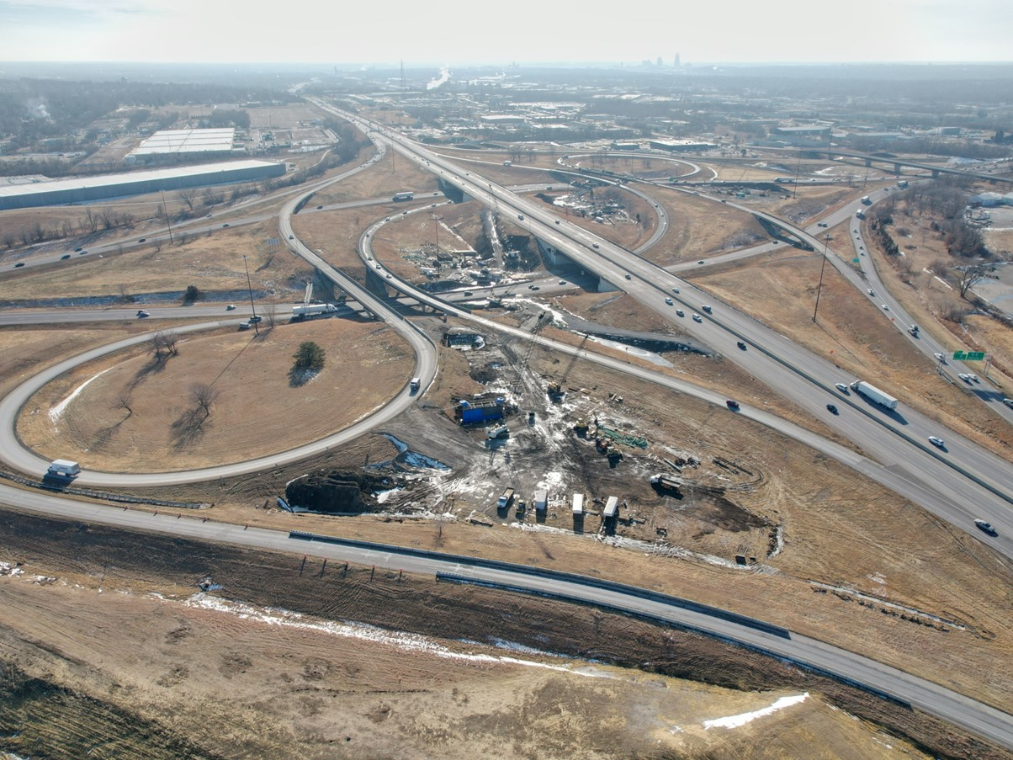


2027-2031 Highway Program Development
February 10, 2026
3/2/2023

Slide 2
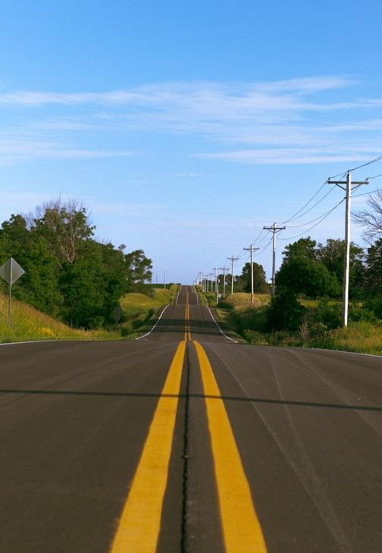

Agenda
TOPIC 1
2027-2031 Highway Program Development Schedule
TOPIC 2
Extended Highway Program Analysis
TOPIC 3
Statewide Line Items
  At what levels should the line item targets be programmed?
TOPIC 4
Federal Funding Status
Program Development Considerations
Next Steps

Slide 3
Topic 1
2027-2031 Highway Program Development Schedule

Slide 4
February 10, 2026
Highway Program Development Schedule (2027-2031)
February 2026
  Discuss Extended Highway Program Analysis
  Discuss Statewide Line Items
    At what levels should the Line Item targets be programmed?
March 2026
  Discuss 2027-2031 available Highway Program funding
  Discuss 2027-2031 Highway Program options
  Determine 2027-2031 Highway Program Objectives
  Action Item: Line Item Targets for Programming
April 2026
  Develop the Draft 2027-2031 Highway Program
  Action Item: 2027-2031 Highway Program Objectives
May 2026
  Present the Draft 2027-2031 Iowa Transportation Improvement Program to the public (including all previous program approvals and Draft 2027-2031 Highway Program)
June 2026
  Action Item: Approve the 2027-2031 Iowa Transportation Improvement Program

Slide 5
Topic 2
Extended Highway Program Analysis

Slide 6
February 10, 2026 as presented on January 13, 2026
2026-2035 Highway Program Analysis
For Highway Planning Purposes Only (x $1,000,000)
 |  | Proposed Highway Program |  |  |  |  |  |  |  |  |  |  | Extended Highway Program
 |  | 2026 |  | 2027 |  | 2028 |  | 2029 |  | 2030 |  |  | 2031 |  | 2032 |  | 2033 |  | 2034 |  | 2035
Projected Funds as of March 2025 |  | 908.7 |  | 912.8 |  | 830.2 |  | 822.7 |  | 816.6 |  |  | 816.6 |  | 816.6 |  | 816.6 |  | 816.6 |  | 816.6
Highway Program Components
Interstate Stewardship |  | 257.5 |  | 188.9 |  | 225.9 |  | 145.0 |  | 190.0 |  |  | 195.0 |  | 195.0 |  | 195.0 |  | 195.0 |  | 195.0
Non-Interstate Pavement Modernization |  | 175.3 |  | 205.0 |  | 195.5 |  | 225.0 |  | 230.0 |  |  | 235.0 |  | 235.0 |  | 235.0 |  | 235.0 |  | 235.0
Non-Interstate Bridge Modernization |  | 146.3 |  | 171.9 |  | 176.2 |  | 192.2 |  | 195.0 |  |  | 200.0 |  | 200.0 |  | 200.0 |  | 200.0 |  | 200.0
Safety Specific |  | 34.0 |  | 35.0 |  | 36.0 |  | 37.0 |  | 38.0 |  |  | 38.0 |  | 38.0 |  | 38.0 |  | 38.0 |  | 38.0
Non-Interstate Capacity/System Enhancement |  | 173.3 |  | 222.8 |  | 176.5 |  | 205.6 |  | 107.4 |  |  | 12.3 |  | 37.6 |  | 2.3 |  | 0.0 |  | 0.0
Major Interstate Capacity/System Enhancement |  | 159.7 |  | 111.0 |  | 81.7 |  | 84.9 |  | 103.9 |  |  | 59.8 |  | 59.3 |  | 61.4 |  | 0.0 |  | 0.0
Highway Program Balance |  | (37.4) |  | (21.8) |  | (61.5) |  | (67.1) |  | (47.7) |  |  | 76.5 |  | 51.7 |  | 84.9 |  | 148.6 |  | 148.6
Underfunded Projects |  | 0.0 |  | 0.0 |  | 42.3 |  | 26.3 |  | 23.6 |  |  | 0.0 |  | 0.0 |  | 0.0 |  | 0.0 |  | 0.0
Highway Program Balance |  | (37.4) |  | (21.8) |  | (19.2) |  | (40.8) |  | (24.1) |  |  | 76.5 |  | 51.7 |  | 84.9 |  | 148.6 |  | 148.6
Black: Previous discussion
( ): Indicates Highway Program is over-programmed
Green: Changes since previous discussion

Slide 7
February 10, 2026
2027-2036 Highway Program Analysis
For Highway Planning Purposes Only (x $1,000,000)
 |  | Proposed Highway Program |  |  |  |  |  |  |  |  |  |  | Extended Highway Program
 |  | 2027 |  | 2028 |  | 2029 |  | 2030 |  | 2031 |  |  | 2032 |  | 2033 |  | 2034 |  | 2035 |  | 2036
Projected Funds as of March 2025 |  | 912.8 |  | 830.2 |  | 822.7 |  | 816.6 |  | 816.6 |  |  | 816.6 |  | 816.6 |  | 816.6 |  | 816.6 |  | 816.6
Highway Program Components
Interstate Stewardship |  | 188.9 |  | 225.9 |  | 145.0 |  | 190.0 |  | 195.0 |  |  | 195.0 |  | 195.0 |  | 195.0 |  | 195.0 |  | 195.0
Non-Interstate Pavement Modernization |  | 205.0 |  | 195.5 |  | 225.0 |  | 230.0 |  | 235.0 |  |  | 235.0 |  | 235.0 |  | 235.0 |  | 235.0 |  | 235.0
Non-Interstate Bridge Modernization |  | 171.9 |  | 176.2 |  | 192.2 |  | 195.0 |  | 200.0 |  |  | 200.0 |  | 200.0 |  | 200.0 |  | 200.0 |  | 200.0
Safety Specific |  | 35.0 |  | 36.0 |  | 37.0 |  | 38.0 |  | 38.0 |  |  | 38.0 |  | 38.0 |  | 38.0 |  | 38.0 |  | 38.0
Non-Interstate Capacity/System Enhancement |  | 222.8 |  | 176.4 |  | 205.6 |  | 107.4 |  | 12.3 |  |  | 37.6 |  | 2.3 |  | 0.0 |  | 0.0 |  | 0.0
Major Interstate Capacity/System Enhancement |  | 111.0 |  | 81.7 |  | 84.9 |  | 103.9 |  | 59.8 |  |  | 59.3 |  | 61.4 |  | 0.0 |  | 0.0 |  | 0.0
Highway Program Balance |  | (21.8) |  | (61.5) |  | (67.1) |  | (47.7) |  | 76.5 |  |  | 51.7 |  | 84.9 |  | 148.6 |  | 148.6 |  | 148.6
Underfunded Projects |  | 0.0 |  | 42.3 |  | 26.3 |  | 23.6 |  | 0.0 |  |  | 0.0 |  | 0.0 |  | 0.0 |  | 0.0 |  | 0.0
Highway Program Balance |  | (21.8) |  | (19.2) |  | (40.8) |  | (24.1) |  | 76.5 |  |  | 51.7 |  | 84.9 |  | 148.6 |  | 148.6 |  | 148.6
Black: Previous discussion
( ): Indicates Highway Program is over-programmed
Green: Changes since previous discussion

Slide 8
Topic 3
Statewide Line Items

Slide 9
February 10, 2026
Draft 2027-2031 Iowa Highway Program Line Items
Last year the department discussed re-evaluating line items prior to the 2027 Program Development cycle.
This effort included review of funding levels, alignment with current business practices and identifying efficiencies in managing each line item.
The result of these efforts is a recommendation to reduce the overall number of line items by combining like initiatives and a reduction in overall funding amounts.

Slide 10
February 10, 2026
Draft 2027-2031 Iowa Highway Program Line Items
Construction Industry Training Program
 |  | Project Estimated Costs X $1000
Location | Type Of Work | 2027 | 2028 | 2029 | 2030 | 2031
Construction Industry Training Program | Training | 1,300 | 1,300 | 1,300 | 1,300 | 1,300
Deleted the word “Industry” to be more reflective of the broad nature of construction training supported by this line item.

Slide 11
February 10, 2026
Draft 2027-2031 Iowa Highway Program Line Items
Statewide Interstate Lighting
 |  | Project Estimated Costs X $1000
Location | Type Of Work | 2027 | 2028 | 2029 | 2030 | 2031
Statewide Interstate Lighting | Lighting | 1,800 | 1,800 | 1,800 | 1,800 | 1,800
 |  | 200 | 200 | 200 | 200 | 200
Merged non-interstate and interstate lighting into one inclusive statewide lighting line item.
Allows flexibility to utilize funds across the Primary system based on asset needs.
Moved non-interstate lighting funds into this line item.
Program-neutral cost change

Slide 12
February 10, 2026
Draft 2027-2031 Iowa Highway Program Line Items
Pavement Markings Materials
 |  | Project Estimated Costs X $1000
Location | Type Of Work | 2027 | 2028 | 2029 | 2030 | 2031
Pavement Markings Materials | Paint | 7,700 | 7,700 | 7,700 | 7,700 | 7,700
 |  | 5,000 | 5,000 | 5,000 | 5,000 | 5,000
Moved interstate pavement markings from statewide interstate pavement maintenance into this line item.
Improves cost tracking efficiency.
Allows flexibility to utilize funds across the Primary system based on asset needs.
Program-neutral cost change

Slide 13
February 10, 2026
Draft 2027-2031 Iowa Highway Program Line Items
Statewide Contract Maintenance
 |  | Project Estimated Costs X $1000
Location | Type Of Work | 2027 | 2028 | 2029 | 2030 | 2031
Statewide Contract Maintenance | Construction | 43,350 | 48,500 | 49,000 | 49,500 | 50,000
 |  | 9,950 | 9,500 | 9,500 | 9,500 | 9,500
Consolidated statewide interstate pavement maintenance (9.5M annually) into this line item.
Additional funding in 2027 to support costs associated with weigh scale ramp patching.

Slide 14
February 10, 2026
Draft 2027-2031 Iowa Highway Program Line Items
Statewide Traffic Control Devices/Signs/Lighting
 |  | Project Estimated Costs X $1000
Location | Type Of Work | 2027 | 2028 | 2029 | 2030 | 2031
Statewide Traffic Control | Traffic Signs and Lighting | 5,000 | 5,000 | 5,000 | 5,000 | 5,000
Devices/Signs/Lighting |  | 800 | 800 | 800 | 800 | 800
Consolidated interstate signs and statewide traffic control devices into one line item to allow flexibility to utilize funds across the Primary system based on asset needs.
Moved lighting to statewide lighting line item.
Modify description to more accurately reflect the updated use of funds.
Moved statewide interstate signing funds into this line item.
Program-neutral cost change

Slide 15
February 10, 2026
Draft 2027-2031 Iowa Highway Program Line Items
Engineering Consultant Services
 |  | Project Estimated Costs X $1000
Location | Type Of Work | 2027 | 2028 | 2029 | 2030 | 2031
Statewide Consultant Services | Outside Services Engineering | 74,000 | 74,000 | 74,000 | 74,000 | 74,000
 |  | 1,000 | 1,000 | 1,000 | 1,000 | 1,000
Consultant costs have increased with inflation. Further refinement from changes in last Program.
With an increasing program there are additional projects which need to be developed with consultant services.
This program includes several large and complex projects (e.g., Gordon Dr Viaduct and SW Mixmaster) that require consultant support.

Slide 16
February 10, 2026
Draft 2027-2031 Iowa Highway Program Line Items
Statewide Interstate Rest Area and Scale Contract Support and Building Repair
 |  | Project Estimated Costs X $1000
Location | Type Of Work | 2027 | 2028 | 2029 | 2030 | 2031
Statewide Interstate Rest Area and Scale | Rest Area Improvement | 10,000 | 10,100 | 10,200 | 10,300 | 10,400
Contract Support and Building Repair |  | 600 | 600 | 600 | 600 | 600
Cost increase to support additional rest area building maintenance.

Slide 17
February 10, 2026
Draft 2027-2031 Iowa Highway Program Line Items
Winter Operations Materials
 |  | Project Estimated Costs X $1000
Location | Type Of Work | 2027 | 2028 | 2029 | 2030 | 2031
Winter Operations Materials | Materials | 15,000 | 15,000 | 15,000 | 15,000 | 15,000
 |  | (3,000) | (3,000) | (3,000) | (3,000) | (3,000)
Reduced to better align with recent actual costs.
Includes funding to enhance brine production/application.

Slide 18
February 10, 2026
Draft 2027-2031 Iowa Highway Program Line Items
Americans with Disabilities Act
 |  | Project Estimated Costs X $1000
Location | Type Of Work | 2027 | 2028 | 2029 | 2030 | 2031
Americans with Disabilities Act | Pedestrian Improvement | 5,500 | 6,000 | 6,500 | 7,000 | 7,500
 |  |  | (500) | (1,000) | (1,500) | (2,000)
Significant progress has been accomplished in addressing ADA needs.
Will reassess the program in the coming year and consider recommending further adjustments with the next Program.

Slide 19
February 10, 2026
Draft 2027-2031 Iowa Highway Program Line Items
Line Items
Project Estimated Costs X $1000
County | Line Item | Type Of Work | 2027 | 2028 | 2029 | 2030 | 2031
Statewide | Statewide Interstate Guardrail Repair | Guardrail Repair | 2,000 | 2,000 | 2,000 | 2,000 | 2,000
Statewide | Statewide Lighting | Lighting | 2,000 | 2,000 | 2,000 | 2,000 | 2,000
Statewide | Statewide Rest Area and Scale Contract Support and Building Repair | Rest Area Improvement | 10,600 | 10,700 | 10,800 | 10,900 | 11,000
Statewide | Americans with Disabilities Act | Pedestrian Improvement | 5,500 | 5,500 | 5,500 | 5,500 | 5,500
Statewide | Construction Training Program | Training | 1,300 | 1,300 | 1,300 | 1,300 | 1,300
Statewide | Cooperative City/County/State Highway Research | Research | 2,500 | 2,500 | 2,500 | 2,500 | 2,500
Statewide | Emergency & Contingency (U-STEP/C-STEP) | Construction | 6,000 | 6,000 | 6,000 | 6,000 | 6,000
Statewide | Post Letting Project Cost | Construction | 30,000 | 30,000 | 30,000 | 30,000 | 30,000
Statewide | Prevocational Training and DBE Support Services | Training | 360 | 360 | 360 | 360 | 360
Statewide | Scenic Byway Program | Signs | 500 | 500 | 500 | 500 | 500
Statewide | Statewide Consultant Services | Outside Services Engineering | 75,000 | 75,000 | 75,000 | 75,000 | 75,000
Statewide | Statewide Contract Maintenance | Construction | 53,300 | 58,000 | 58,500 | 59,000 | 59,500
Statewide | Statewide Railroad Crossings | Construction | 500 | 500 | 500 | 500 | 500
Statewide | Statewide Roadside Improvement | Landscaping | 2,500 | 2,500 | 2,500 | 2,500 | 2,500
Statewide | Statewide Traffic Control Devices | Traffic Signs | 5,800 | 5,800 | 5,800 | 5,800 | 5,800
Statewide | Statewide Operations | Outside Services Engineering | 16,000 | 16,000 | 16,000 | 16,000 | 16,000
Statewide | Statewide ITS | Equipment | 8,000 | 8,000 | 8,000 | 8,000 | 8,000
Statewide | Winter Operations Materials | Materials | 12,000 | 12,000 | 12,000 | 12,000 | 12,000
Statewide | Summer Infrastructure Rehabilitation Materials | Materials | 1,500 | 1,500 | 1,500 | 1,500 | 1,500
Statewide | Pavement Markings | Paint | 12,700 | 12,700 | 12,700 | 12,700 | 12,700
  At what levels should the line item targets be programmed?
  March Action Item:
  Line Item Targets for Programming

Slide 20
Topic 4
Federal Funding Status
Program Development Considerations
Next Steps

Slide 21
February 10, 2026
Federal Funding Status
  FFY 2026 Transportation Appropriation Bill has been passed and signed into law.
  Infrastructure Bill authorizes federal funding through September 30, 2026, leaving some funding uncertainty for the entirety of this Program.
  Infrastructure Bill funding allocations based on Commission action in June 2022.
  The next Highway Trust Fund cliff is in 2028. This is the point where funding outlays exceed the amount of revenue deposited into the fund.

Slide 22
February 10, 2026
Program Development Considerations
  Construction costs have increased this calendar year.
  State road funding continues to come in higher than forecast.
  All federal funding in this Program is beyond the life of the current authorization bill.
  Continue to prioritize bridge and pavement stewardship investments on existing highway system.
  Pursue grant funding opportunities.
  Assess balance of pavement and bridge stewardship investments.
  Balance capacity improvements with stewardship needs.
  Address major river crossing needs.

Slide 23
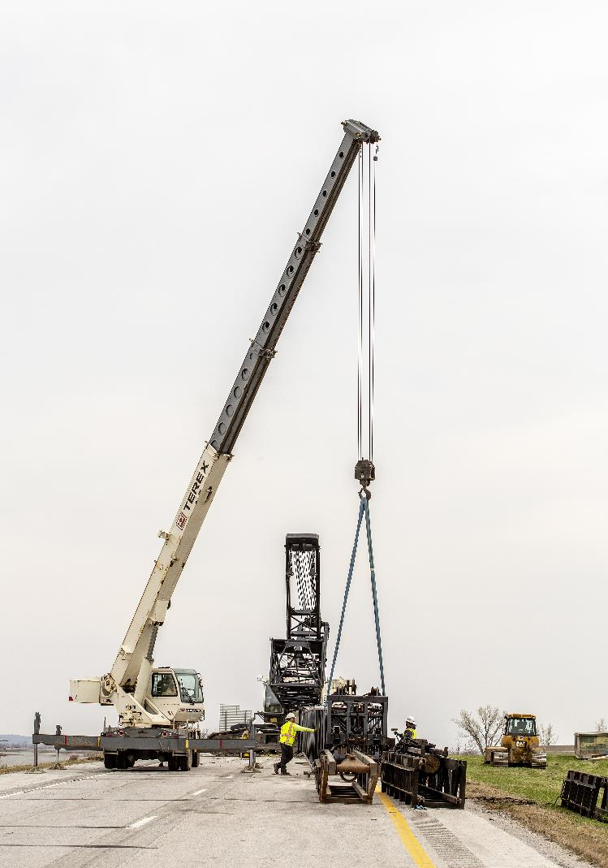
Next Steps
Discuss 2027-2031 available Highway Program funding
Discuss 2027-2031 Highway Program Options
Determine 2027-2031 Highway Program Objectives
Action Item: Line-Item Targets for Programming

Slide 24
Questions?

