Slide 1



Transportation Trends Update
March 10, 2026
3/2/2023

Slide 2
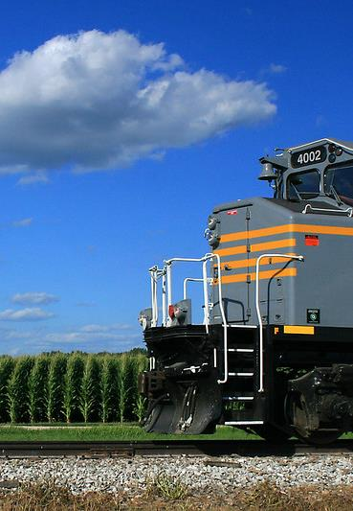

Agenda
Rail carloads
Commercial air service passenger counts
Vehicular traffic
Safety

Slide 4
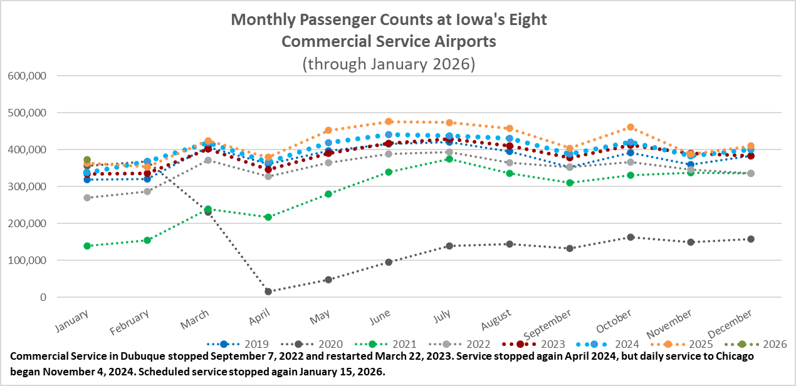

Slide 5
Monthly State Vehicle Miles of Travel
(through January 2026)
Vehicle Miles of Travel (in millions)

Slide 6
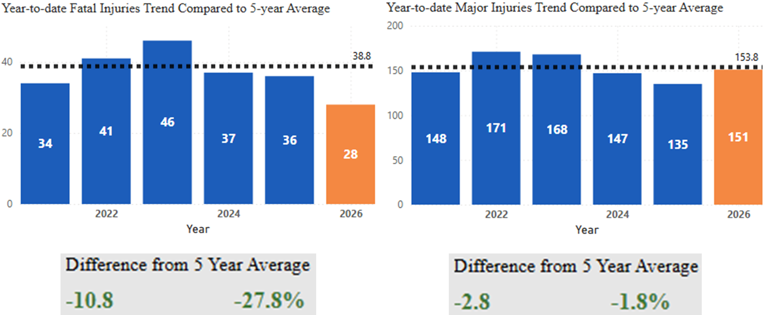
Statewide Fatalities & Major Injuries Year-to-Date
(As of March 3, 2026)

Slide 7
Questions?

