Slide 1


April Commission Tour Preview
March 10, 2026
3/2/2023

Slide 2
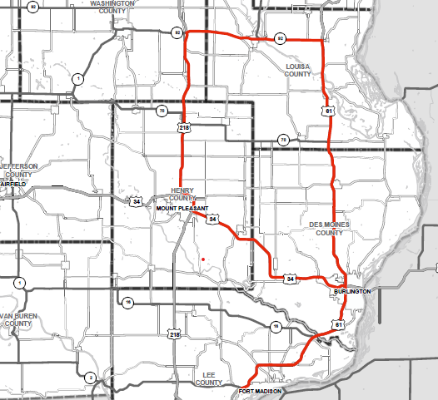
April Commission Tour Preview

Slide 3
April Commission Tour Preview
Begin tour at the Quality Inn and Suites in Fort Madison
US 61 (Roosevelt Avenue in Burlington)
US 61 Corridor - Segments 2-4 in Des Moines and Louisa County
IA 92 Corridor bridges (Louisa County)
US 218 resurfacing project (IA 92 to Henry County)
Lunch in Mt. Pleasant
US 34 Corridor bridge projects (Des Moines County)
Visit Southeast Iowa Regional Airport-Burlington
US 61 bridge projects (Lee County)
Meetings to be held at Quality Inn and Suites

Slide 4
April Commission Tour Preview
Questions?
Zac Bitting
Zachary.Bitting@iowadot.gov​
iowadot.gov

