Slide 1


Transportation Asset Management Summary
March 10, 2026
Charlie Purcell
Deputy Director, Transportation Development Division
3/2/2023
Notes:
Thank chair and members of the commission
Today’s presentation will provide a summary of the key points from previous presentations and recommendations for future investment strategies

Slide 2
Asset Type | How Many? | How Much?
Roads (lane miles) | 24,657 | $31 billion
Bridges | 4,214 | $20 billion
Total |  | $51 billion
Why is asset management important?
TRANSPORTATION ASSET MANAGEMENT SUMMARY
Notes:
We’ve made a tremendous investments in our transportation system over a long period of time
Even a 1% increase in efficiency yields $510M in savings over the entire asset lifecycle
Small incremental steps when applied to our entire system of asset can have very large impacts

Slide 3
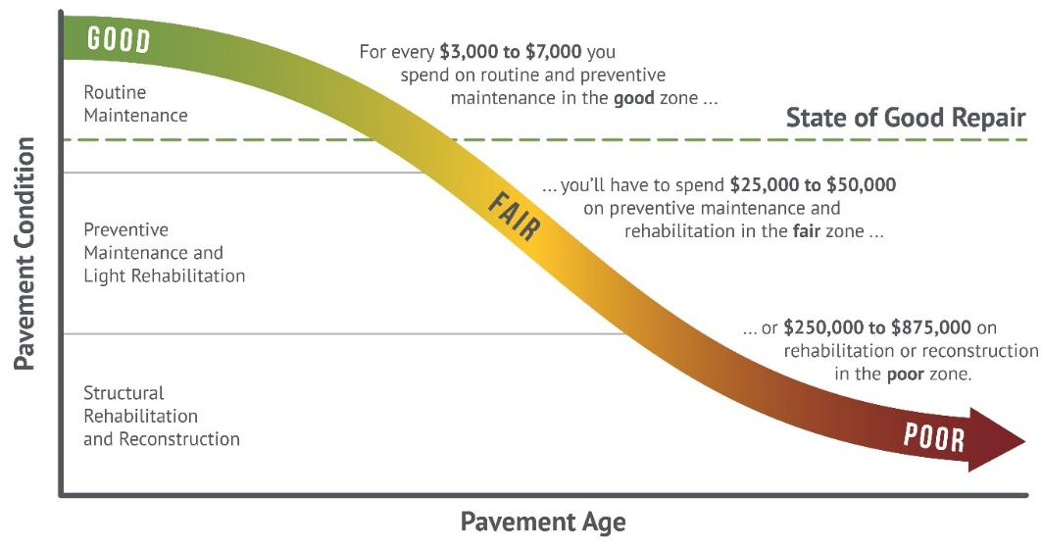
How we set targets
Targets are set to maintain a state of good repair
Maintaining assets in a state of good repair minimizes overall lifecycle costs (good roads cost less)
Notes:
Targets are set strategically

Slide 4
Cost Comparisons – what does $10 million buy?
1 mile of new 4-lane expressway, or
3 miles of 2-lane pavement reconstruction, or
18 miles of pavement resurfacing, or
3 bridge replacements
Notes:
Asset management is about trade-offs
This chart illustrates the relative amount of work that can be done for $10M for various types of assets

Slide 5
Previous presentations
Sep 2025 – Highway Planning Overview
Oct 2025 – Asset Management Overview
Nov 2025 – Project Prioritization Update
Jan 2026
Interstate Plan Update
Pavement Management
Feb 2026 – Bridge Management
Notes:
Will

Slide 6
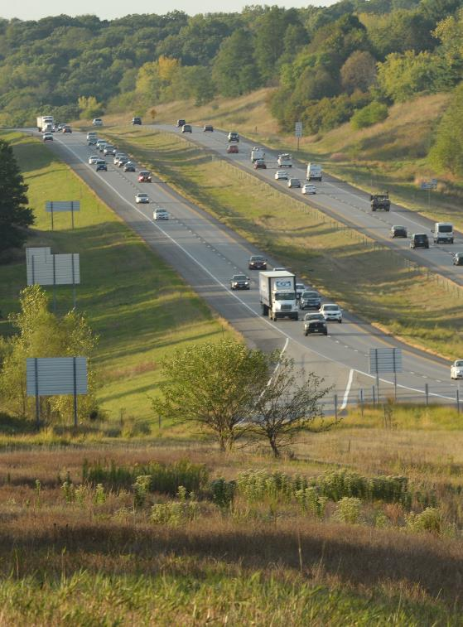
Key takeaways – Interstate Plan
Near term priorities for future capacity expansion remain mostly the same
Updated traffic projections to better identify when and where capacity improvements will be needed
Notes:
Capacity expansion areas in the near term:
I-380 from Iowa City to Cedar Rapids
I-35 from Ankeny to Ames
DSM Metro
SWMM
I-80/35 and Hickman Interchange
NEMM to US 65 / Altoona
Don’t do details unless asked:
Segments proposed to be later
I-80 from Altoona to Mitchellville
I-80 from West Branch to Cedar River
I-380 from IA 100 to County Home Road
Segments that are being monitored that may need to be earlier
I-80/35 – 86th St to 2nd Ave (just west of NEMM)
I-80 – West of R22 (Booneville exit)
I-235 – SWMM to IA 28
I-380/US 30 Interchange
I-80 – Scott County – I-280 to Mississippi River

Slide 7
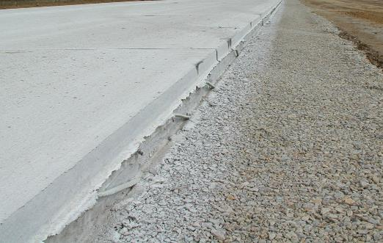
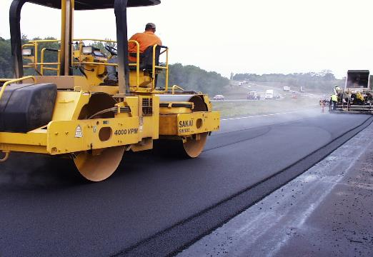
Key takeaways – Pavements
We continue to make better use of models and analytics and improve project selection methods
Decreasing buying power is reducing our ability add more pavement life than is lost each year
Need to increase our investments in both pavement rehabilitation and pavement replacement to reach our pavement condition targets
Interstate pavement conditions are improving, but non-Interstate pavement condition continues to show a growing funding shortfall

Slide 8
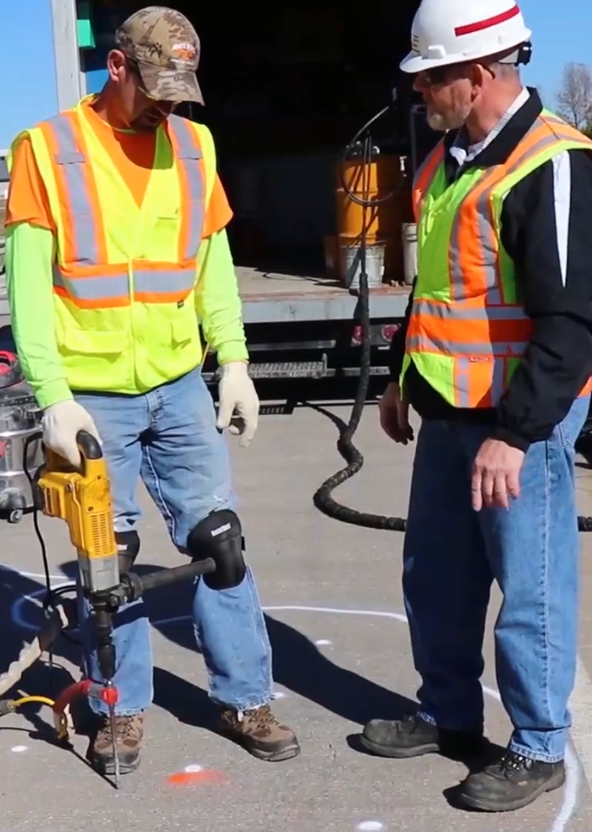
Key takeaways – Bridges
Good progress has been made reducing the number of poor bridges on the primary system
However, without continued increases to stewardship investments, this trend is likely to reverse due to the large number of aging bridges built in the 50’s, 60’s and 70’s
Preventative maintenance investments are extending the life of our structures
Large bridges represent major capital investments that need to be planned far in advance
Notes:
Only 26 poor bridges on the state system, or about 0.6% of the total
Wave of bridge is coming but strong preventative maintenance and rehabilitation strategies are increasing the life of our structures

Slide 9
Steps towards a stewardship focus
2017
Started current series of Asset Management workshop presentations connected to the 5-year program development process
2018
Began steady increases to Non-Interstate Bridge Modernization targets
Began steady increases to Non-Interstate Pavement Modernization targets
2021
Added 500k/year to Statewide Contract Maintenance line item starting in FY21 and continuing

Slide 10
Steps towards a stewardship focus
2022
Increased Non-Interstate Pavement Modernization target by $35M/year for pavement replacements starting FY27 and continuing
Increased Non-Interstate Bridge Modernization target by $20M/year starting in FY27 and continuing
Increased Safety Specific target by $5M/year starting in FY27 and continuing
2023
Increased Statewide Interstate Rest Area maintenance target by 100k/year starting in FY25 and continuing
2024
Dedicate $55M annually for pavements within the Interstate Stewardship program target

Slide 11
Evidence of a stewardship focus
The percentage of the program devoted to stewardship has continued to increase

Slide 12
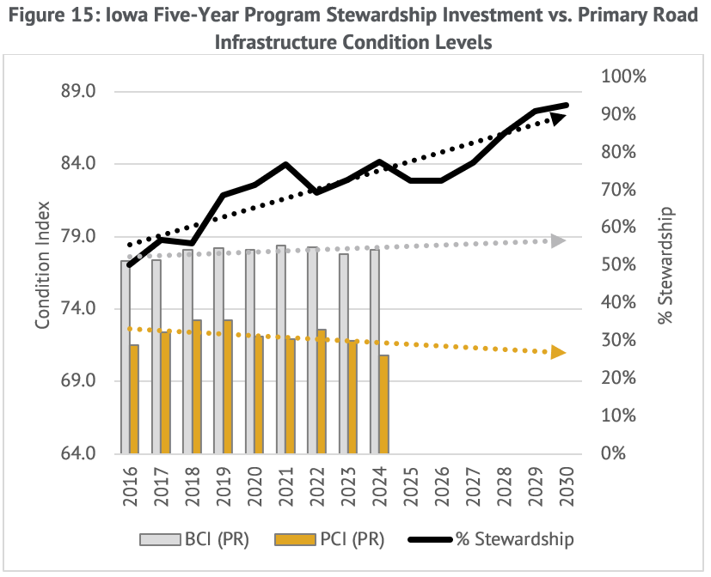
Loss of buying power remains a challenge

Slide 13

Summary recommendations
Maintain a focus on stewardship investments
Continuously evaluate the balance between pavement and bridge investments
Limit capacity expansions to a few prioritized interstate corridors

Slide 14
Questions?

