Slide 1
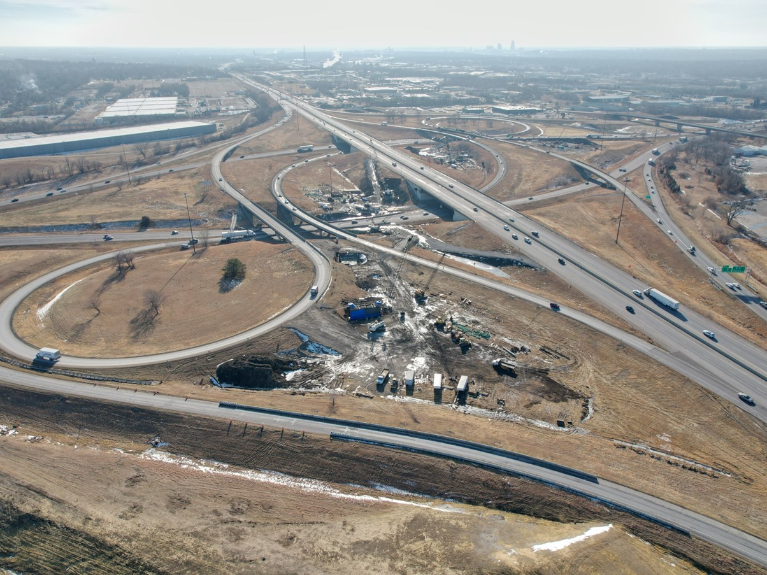


2027-2031 Highway Program Development
March 10, 2026
3/2/2023

Slide 2
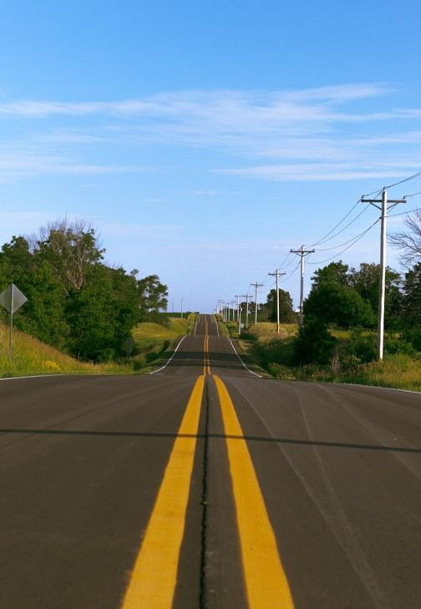

Agenda
TOPIC 1
Statewide Line Items
TOPIC 2
2027-2031 Highway Program Funding
TOPIC 3
Highway Program Analysis
TOPIC 4
Program Development Considerations
TOPIC 5
Determine Highway Program Objectives
TOPIC 6
Next Steps

Slide 3
March 10, 2026
Highway Program Development Schedule (2027-2031)
March 2026
Discuss 2027-2031 available Highway Program funding
Discuss 2027-2031 Highway Program options
Determine 2027-2031 Highway Program Objectives
Action Item: Line Item Targets for Programming
April 2026
Develop the Draft 2027-2031 Highway Program
Action Item: 2027-2031 Highway Program Objectives
May 2026
Present the Draft 2027-2031 Iowa Transportation Improvement Program to the public (including all previous program approvals and Draft 2027-2031 Highway Program)
June 2026
Action Item: Approve the 2027-2031 Iowa Transportation Improvement Program

Slide 4
March 10, 2026
2027-2031 Iowa Highway Program
Decision Points
Should projects in the 2027-2030 Program continue to be programmed with cost/schedule updates?
What modifications to the Program should be considered?
3. How should Program be balanced?

Slide 5
Topic 1
Statewide Line Items

Slide 6
March 10, 2026 as presented on February 10, 2026
Draft 2027-2031 Iowa Highway Program Line Items
($ in thousands)
At what levels should the line item targets be programmed?
March Action Item:
Line Item Targets for Programming

Slide 7
Topic 2
2027-2031 Highway Program Funding

Slide 8
March 10, 2026

Slide 9
March 10, 2026
2027-2031 Iowa Highway Program Funding Assumptions
RUTF/TIME-21
(For Highway Planning Purposes Only)
Overall forecast is conservative
Forecast continues to reflect expected reduction in fuel tax revenue
TIME-21 funding cap of $225 million has been met
Average combined RUTF/TIME-21 growth of 0.8% annually

Slide 10
March 10, 2026
Federal Funding Status
FFY 2026 Transportation Appropriation Bill has been passed and signed into law.
Infrastructure Bill authorizes federal funding through September 30, 2026, leaving some funding uncertainty for the entirety of this Program.
Infrastructure Bill funding allocations based on Commission action in June 2022.
The next Highway Trust Fund cliff is in 2028. This is the point where funding outlays exceed the amount of revenue deposited into the fund.

Slide 11
March 10, 2026
2027-2031 Forecast of Iowa Federal-Aid Formula Transportation Authorized Funds
(x $1,000)
(For Highway Planning Purposes Only)
 | 2027 | 2028 | 2029 | 2030 | 2031
National Highway Performance Program | $ 388,000 | $ 388,000 | $ 388,000 | $ 388,000 | $ 388,000
Surface Transportation Block Grant Program | $ 188,800 | $ 188,800 | $ 188,800 | $ 188,800 | $ 188,800
Highway Safety Improvement Program | $ 38,400 | $ 38,400 | $ 38,400 | $ 38,400 | $ 38,400
Rail-Highway Crossings Program | $ 5,700 | $ 5,700 | $ 5,700 | $ 5,700 | $ 5,700
Congestion Mitigation and Air Quality Program | $ 13,100 | $ 13,100 | $ 13,100 | $ 13,100 | $ 13,100
Metropolitan Planning | $ 2,800 | $ 2,800 | $ 2,800 | $ 2,800 | $ 2,800
National Highway Freight Program | $ 18,100 | $ 18,100 | $ 18,100 | $ 18,100 | $ 18,100
State Planning and Research | $ 13,200 | $ 13,200 | $ 13,200 | $ 13,200 | $ 13,200
Carbon Reduction Program | $ 17,200 | $ 17,200 | $ 17,200 | $ 17,200 | $ 17,200
PROTECT Formula Program | $ 19,500 | $ 19,500 | $ 19,500 | $ 19,500 | $ 19,500
Bridge Replacement Program | $ 93,400 | $ 93,400 | $ 93,400 | $ 93,400 | $ 93,400
Redistribution of Certain Authorized Funds | $ 4,900 | $ 4,900 | $ 4,900 | $ 4,900 | $ 4,900
 | $ 803,100 | $ 803,100 | $ 803,100 | $ 803,100 | $ 803,100
Iowa DOT Share (66.4%) | $ 533,300 | $ 533,300 | $ 533,300 | $ 533,300 | $ 533,300
Total Federal-Aid Formula Funds Forecast to DOT Programs
(x $1,000,000)
2027 - ($533.3 @ 87.0% Obligation Authority = $464.0) + (August Redistribution $60.0) = $524.0
2028 - ($533.3 @ 91.0% Obligation Authority = $485.3) + (August Redistribution $30.0) = $515.3
2029 - ($533.3 @ 91.0% Obligation Authority = $485.3) + (August Redistribution $30.0) = $515.3
2030 - ($533.3 @ 91.0% Obligation Authority = $485.3) + (August Redistribution $30.0) = $515.3
2031 - ($533.3 @ 91.0% Obligation Authority = $485.3) + (August Redistribution $30.0) = $515.3

Slide 12
March 10, 2026
2027-2030 Highway Program Funding with Possible Changes That Could Impact Funds Available for ROW/Construction
($ in millions)
(For Highway Planning Purposes Only)

Slide 13
March 10, 2026
2027-2031 Highway Program Funding Available for ROW/Construction
($ in millions)
(For Highway Planning Purposes Only)

Slide 14
Topic 3
Highway Program Analysis

Slide 15
March 10, 2026
2027-2036 Highway Program Analysis
($ in millions)
(For Highway Planning Purposes Only)

Slide 16
March 10, 2026
Underfunded Projects with Possible Changes
($ in millions)
(For Highway Planning Purposes Only)

Slide 17
March 10, 2026
Underfunded Projects
($ in millions)
(For Highway Planning Purposes Only)

Slide 18
March 10, 2026
2027-2036 Highway Program Analysis
($ in millions)
(For Highway Planning Purposes Only)

Slide 19
March 10, 2026
Notable 2026-2029 Iowa Highway Program Changes
IA 58 Black Hawk County Greenhill Road Interchange
Project letting moved from 2028 to 2029
US 30 Harrison County Missouri Valley Bypass
Grading and bridge work moved from 2027 to 2028
Paving work moved from 2029 to 2031
I-80 Scott County Mississippi River Bridge Replacement
Cost estimate adjusted from $210m to $241m (Iowa Share)

Slide 20
March 10, 2026
2027-2036 Highway Program Analysis
($ in millions)
(For Highway Planning Purposes Only)

Slide 21
March 10, 2026
2027-2036 Highway Program Analysis
($ in millions)
(For Highway Planning Purposes Only)

Slide 22
March 10, 2026
2027-2036 Highway Program Analysis
($ in millions)
(For Highway Planning Purposes Only)

Slide 23
March 10, 2026
2027-2036 Highway Program Analysis
($ in millions)
(For Highway Planning Purposes Only)

Slide 24
March 10, 2026
2027-2036 Highway Program Analysis
($ in millions)
(For Highway Planning Purposes Only)

Slide 25
March 10, 2026
Highway Program Studies/Requests

Slide 26
March 10, 2026
Highway Program Studies/Requests

Slide 27
March 10, 2026
Highway Program Studies/Requests

Slide 28
March 10, 2026
Highway Program Studies/Requests

Slide 29
March 10, 2026
Highway Program Studies/Requests

Slide 30
March 10, 2026
2027-2036 Highway Program Candidates
($ in millions)
(For Highway Planning Purposes Only)

Slide 31
March 10, 2026
2027-2036 Highway Program Candidates
($ in millions)
(For Highway Planning Purposes Only)

Slide 32
March 10, 2026
2027-2036 Highway Program Candidates
($ in millions)
(For Highway Planning Purposes Only)

Slide 33
March 10, 2026
2027-2031 Iowa Highway Program
Decision Points
Should projects in the 2027-2030 Program continue to be programmed with cost/schedule updates?
What modifications to the Program should be considered?
Adjust Stewardship Targets in the extended highway program?
Add projects to the Program from the Highway Program Candidates list?
How should Program be balanced?
Program balances will need to be addressed, specifically 2027, 2028 and 2031.
Options include project rescheduling, adding projects from the Highway Program Candidates list and stewardship target adjustments.
What additional information would be helpful?
Come back with scenario(s) for March 19 Workshop

Slide 34
March 10, 2026
Potential Balancing Scenario Summary
Advance 2028 Non-Interstate Pavement Modernization projects into 2027.
Add Non-Interstate and Major Interstate Capacity/System Enhancement projects where feasible.
Include upcoming border bridge replacements

Slide 35
Topic 4
Program Development Considerations

Slide 36
March 10, 2026
Program Development Considerations
Construction costs have increased this calendar year.
State road funding continues to come in higher than forecast.
All federal funding in this Program is beyond the life of the current authorization bill.
Continue to prioritize bridge and pavement stewardship investments on existing highway system.
Pursue grant funding opportunities.
Assess balance of pavement and bridge stewardship investments.
Balance capacity improvements with stewardship needs.
Address major river crossing needs.

Slide 37
Topic 5
Determine Highway Program Objectives

Slide 38
March 10, 2026
Potential 2027-2031 Highway Program Objectives
Safety
Maintain increasing funding levels for safety
Complete statewide centerline rumble strip implementation
Continue enhanced pavement markings to non-interstate highways
Sustainability
Maintain Interstate funding levels for pavement reconstruction, modernization, bridges, pavement patching/maintenance, rest areas, and other miscellaneous projects
Maintain funding levels for non-interstate pavement modernization
Maintain funding levels for non-interstate bridge modernization
Invest in additional stewardship projects
Transfer jurisdiction of portions of primary roadways to cities and counties
Invest in border bridge replacements
Accessibility
Invest in truck parking at Interstate Rest Areas
Continue to invest in vault toilets at parking only sites
Complete installation of adult changing stations at modernized rest areas
Invest in corridor improvements
Flow
Invest in intelligent transportation systems infrastructure
Invest in Super-2 improvements
Invest in operational and Integrated Corridor Management improvements

Slide 39
Topic 6
Next Steps

Slide 40
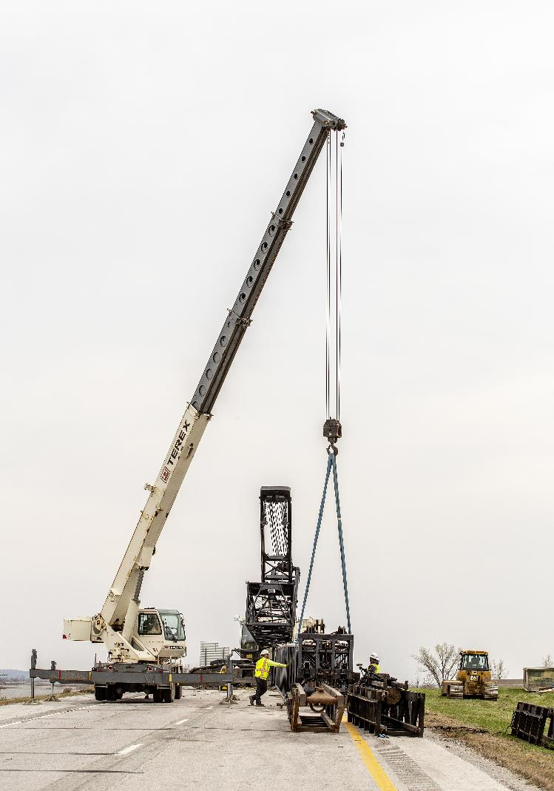
Next Steps
March Business Meeting - Action Item: Line-Item Targets for Programming
March 19 Workshop - Discuss 2027-2031 Highway Program Options
March 19 Workshop - Determine 2027-2031 Highway Program Objectives

Slide 41
Questions?

