Slide 1
Railroad Revolving Loan and Grant Program Planning Study recommendation
December 13, 2022
Commission Workshop

Slide 2
FY 23 Program Modification Recommendation
TOTAL RAIL PROJECT COST
REQUESTED AMOUNT
(% of Total Project Cost)
RECOMMENDED AMOUNT
(% of Total Project Cost)
PROJECT NAME
SPONSOR
SCORE
Iowa Crossroads of Global Innovation Dual Rail and Transload Study | Webster County | Not Applicable | $200,000 | Grant: $100,000 (50%) | Grant: $100,000 (50%)
Notes:
The Commission approved the FY 23 RRLG projects on October 11, 2022. Webster County submitted a planning study application in September, after project recommendations for FY 23 had been considered. With the change in accepting and funding planning studies at anytime during the year, we are recommending funding this planning study.
Total study cost $200,000
Grant Requested: $100,000 (50%)
Staff recommends a full grant award of $100,000(50%)

Slide 3
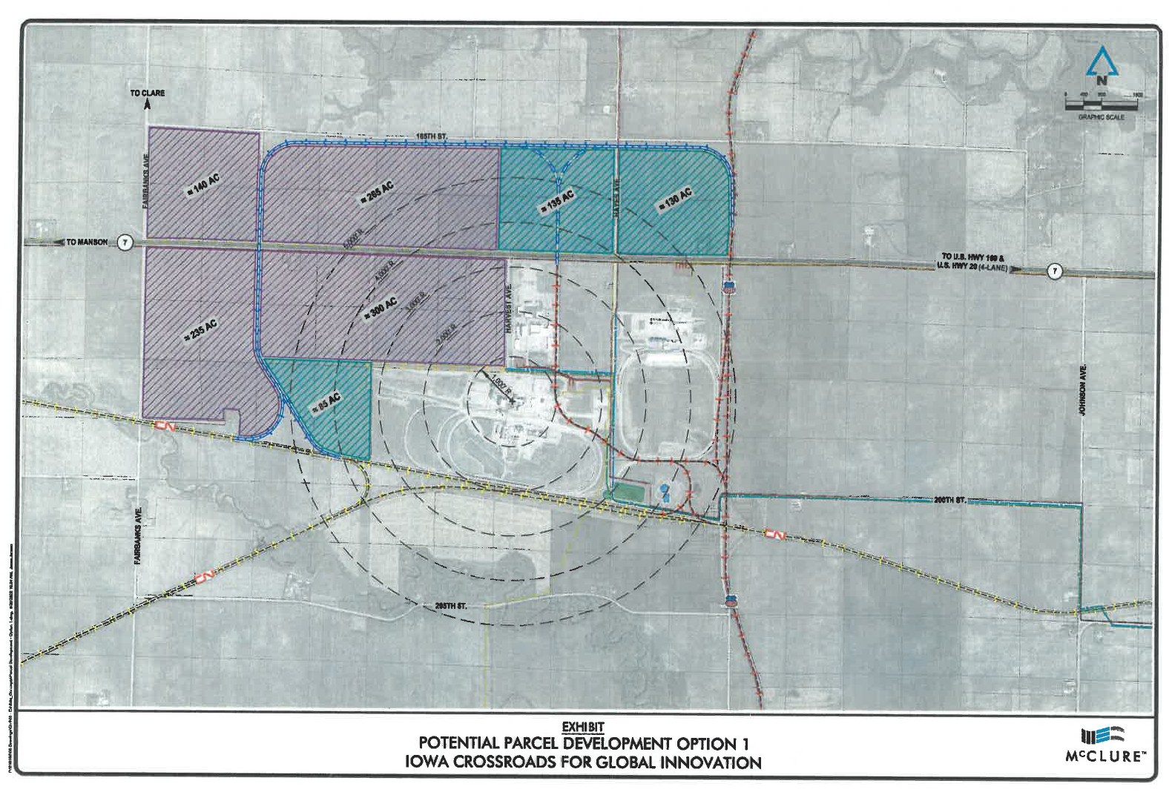
Iowa Crossroads of Global Innovation Dual Rail and Transload Study
The purpose of the study is to determine the feasibility of a transload facility to serve Webster County. The study will determine the current and future needs of the area and prepare a plan for an efficient rail transportation to meet those needs.
Total Cost: $200,000
Requested: $100,000 Recommended: $100,000
Return to Recommendation Summary
Notes:
The project area includes two Class 1 RR’s, UPRR and CN. The area is primed with industrial agricultural companies and existing rail facilities. The study will review the potential for expanding the rail capabilities of the area and add benefit by constructing a rail port transload facility to transfer products between truck and train freight movement systems and provide dual rail service to companies served.

Slide 4
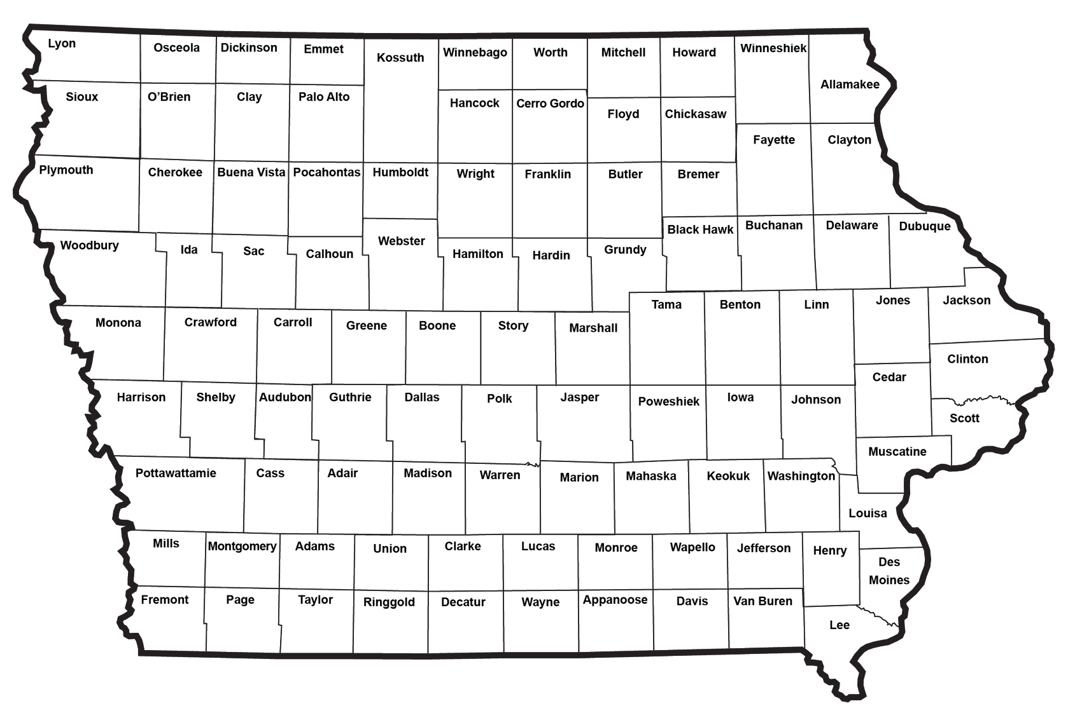
Iowa Crossroads of Global Innovation Dual Rail and Transload Study
Return to Recommendation Summary

Slide 5
QUESTIONS?
Tammy Nicholson,
Modal Transportation Bureau
Tamara.nicholson@iowadot.us
515-239-1052

