Slide 1
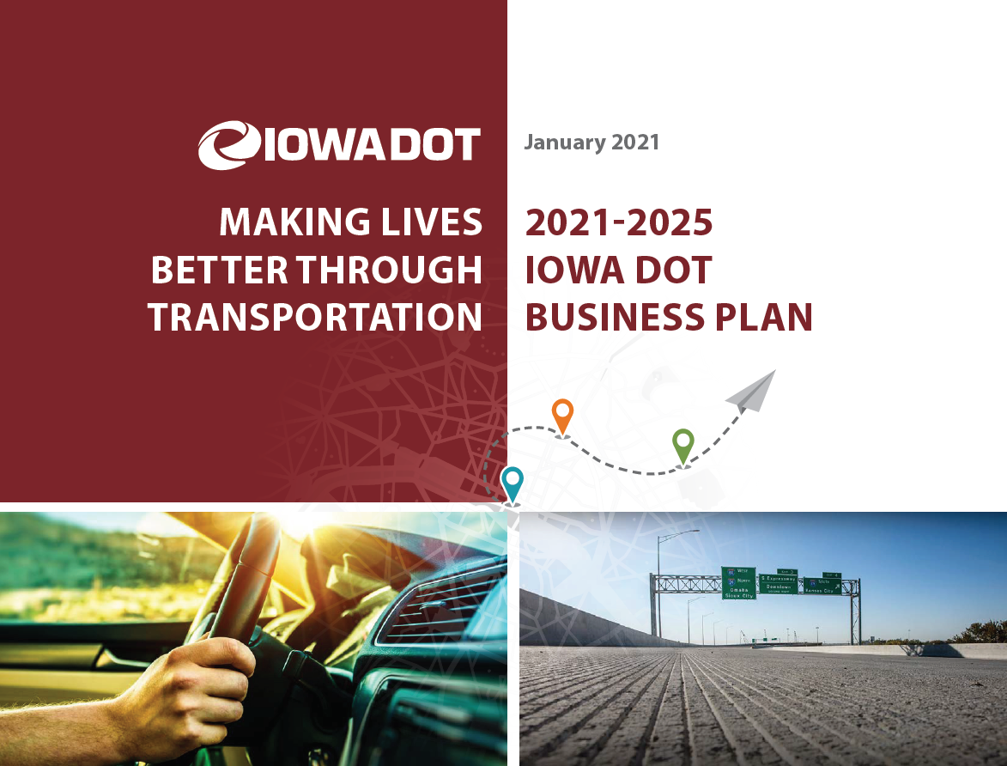

Slide 2

Why are we embarking on this process?

Slide 3

The process started in
February 2020
    Director Marler’s Primary Focus –
    help grow and modernize the agency
    and prepare for the future.
    One of the first actions - interviewed each member of DOT’s senior leadership to discuss agency priorities and strategies.

Slide 4

What was learned?
We have a strong foundation
    In 1913 we started out as the Iowa State Highway Commission.
    In 1974 all modes of transportation were brought together to form the Iowa Department of Transportation.
    Since then we have continued developing a multi-modal transportation system. We’ve had a focus on providing mobility and access to that system.
    We must use the strong foundation of our past to
    continue to prepare for the future of transportation.

Slide 5
What was learned?
Future considerations
    We face many challenges.
      We will discuss more as we explore
      “where we are” as an agency.
    We have too many priorities to be able to
    effectively bring about strategic change.
    Unprecedented challenges of 2020 demonstrated that we are willing and able to adapt.
    Change will bring us opportunity.

Slide 6
How do we begin shaping our future?
  Fall/Winter 2020 - Senior leadership engaged in a series of workshops to reimagine our strategic direction.
  Focused on where we are, where we are going, and how we get there as an organization.

Slide 7

What is
our plan and how do we hold ourselves accountable?

Slide 8
The plan comprises three sections
Where we are
Where we are going
How we get there

Slide 9
Where we are
  We face significant challenges:
    Employee recruitment/retention and retirements
    Employee injuries and fatalities
    Outdated systems/processes
    Fewer staff
    Limited budgets and funding
    Disasters – Pandemic, Derecho, Flooding/Droughts
  Need to prepare for future:
    New federal transportation bill in 2021
    More highly automated vehicles
    Resiliency and climate change
    Commitment to take safety to next level

Slide 10
Where we are going – 25-Year Vision
  The State Long Range Transportation Plan provides a 25-Year vision for the Iowa DOT. This vision guides the direction of the business plan.
  Our 25-Year Vision:
  A safe and efficient multimodal transportation system that enables the social and economic wellbeing of all Iowans, provides enhanced access and mobility for people and freight, and accommodates the unique needs of urban and rural areas in an environmentally conscious manner.

Slide 11
Where we are going – Core Values
  Guiding principles that define our culture and the behaviors we expect from one another.
  Have been reassessed to reflect our current values and to position us for the future.
  Our Core Values:
    Safety First
    People Matter
    Customer Focused
    Servant Leadership
    Integrity Without Exception

Slide 12
Where we are going – Core Focus
  Why we exist and what we do in the world.
  Formerly known as our Mission.
  Our Core Focus:
  Making Lives Better
  Through Transportation
  The reason for Iowa DOT existing is to make lives better through transportation. Serving the people and businesses of Iowa, the DOT has the unique niche as Stewards of Iowa’s Transportation System.

Slide 13
Where we are going – 10-Year Target
  The preferred future of the DOT 10 years out, looks beyond the Business Plan, but not as far as the State Long Range Transportation Plan.
  Our 10-Year Target:
  Safest – Smartest – Made to Last
  Iowa has the most customer-focused, safe, reliable, and efficient transportation system and services in the nation through agility and innovation.

Slide 14
Where we are going – 5-Year Priority Goals
  Outline our direction for focused effort over the next five years and serve as building blocks for our preferred future.
  Our 5-Year Priority Goals:
    Improve transportation system safety and performance
    Improve customer service
    Advance workforce for future challenges and opportunities
    Secure stable and sustainable funding
    Grow innovation

Slide 15
How we get there – 1-Year Objectives
  Annually we will set objectives for that calendar year that align to our 5-Year Priority Goals.
  In 2021 we will prioritize the following (Our 1-Year Objectives):
    Reduce fatalities to under 300
    Update organizational structure and HR business practices to align with organizational strategies
    Implement new customer feedback programs
    Reimagine how we invest in technology
    Implement business measures to move us forward
  Divisions/Districts and subsequent business units are encouraged to set their own 1-Year Objectives that
  align to the business plan and agency priority goals.

Slide 16
How we get there – 90-Day Rocks
  Rocks are the highest priority items we need to work on in the next 90 days to meet our 1-Year Objectives.
  Each quarter we will set new Rocks
  Progress on Rocks are reviewed regularly to keep them on track.
    At the Executive Leadership Level, Rocks are reviewed
    bi-weekly, along with key business metrics.
  Divisions/Districts and subsequent business units are encouraged to set and track their own 90-Day Rocks
  that align to their 1-Year Goals, the business plan, and agency priority goals.

Slide 17
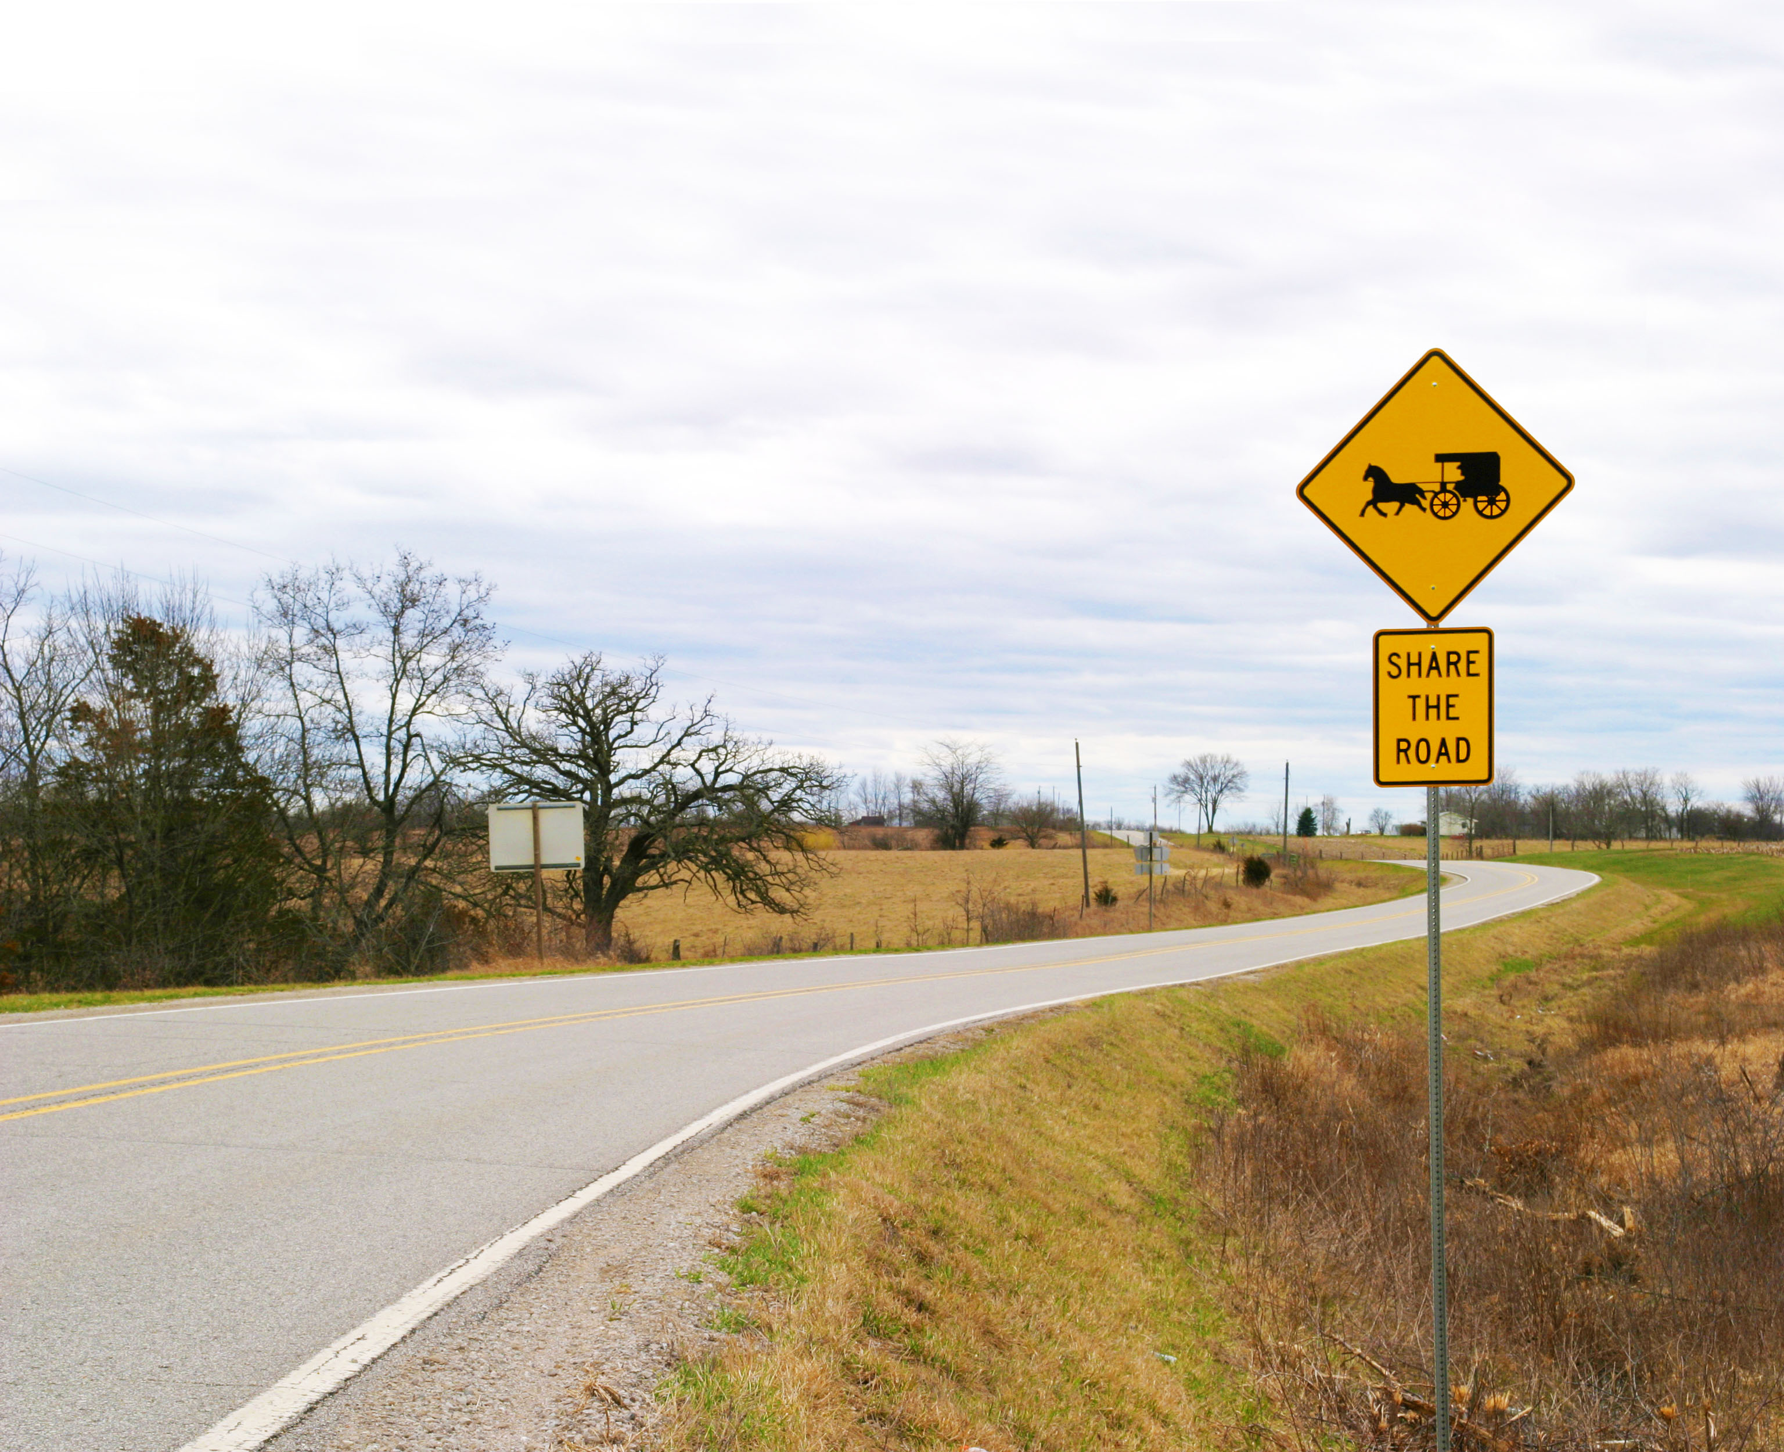
How is the
plan being rolled out?

Slide 18
Cascading rollout
  Everyone has a role in the plan and its success!
  The Director announced the business plan to
  all employees via email on March 1.
  Division Directors and District Engineers will share this presentation with their Bureau Directors and District Management.
  Bureau Directors and District Management will share with their management and direct reports.
  Process will “cascade” until everyone in the agency has been made aware – targeting the end of March.

Slide 19

What’s next?
Work the plan!

Slide 20
Set 1-Year Objectives
  As the plan is rolled out, business units should consider how their work aligns with the plan.
  Determine the agency 1-Year Objectives most applicable to your work unit and consider other business unit priorities that align with the business plan.
    Set the 1-Year Objectives that your business unit will focus on in 2021.

Slide 21
Set 90-Day Rocks
  Determine the highest priority items or “Rocks” your team should be working on in the next 90 days.
  Most of your Rocks should align to your 1-Year Objectives.
  Focus on items that bring about change and forward progress, not the day-to-day tasks you are required to complete. These should be business goals.

Slide 22
Track your progress
  As a business unit, establish a rhythm to review the progress of your Rocks and other key metrics important to your team on a regular basis.
  It is suggested that you check progress at least every-other week.
    It can be as simple as assessing if the Rock is
    “on-track” or “off-track.”
    For accountability, your supervisor should report the number of on-track and off-track items regularly to their supervisor.

Slide 23
What if a Rock is off-track?
  It’s okay!
  Your business unit should have more items on-track
  than off-track.
  Following your assessment of progress, discuss ways to continue to move off-track items forward.
  Continue to “work the plan” and track your progress on a regular basis.

Slide 24
Repeat, repeat, repeat
  Every 90 days your business unit should
  set new Rocks.
    If a rock did not get completed
    in the last 90 days – Assess it.
      Is it still a priority?
        If so, should it be a Rock in the next 90 days?
      Is it too big to tackle in 90 days?
        If so, should it be moved to a 1-Year Objective?

Slide 25
Looking ahead
  As we go through this first year of the business plan and the new tools become more familiar, look for opportunities to establish your business unit objectives for next year, 2022.
    Executive leadership will be establishing annual objectives for the agency and will be seeking your input.

Slide 26
Working the plan is our responsibility
As Stewards of Iowa’s Transportation System, we are in a unique and privileged position to connect communities, people, services, and goods to advance our state.
We have the opportunity to truly
make lives better through transportation.

Slide 27
What if I have questions?
  This is your plan! While an agency framework and goals are in place, each business unit should align with the plan by forming your own team business goals.
  But if you still have questions it’s okay!
  Questions should start with your supervisor.
    If they don’t have the answer, the supervisor should submit questions to Sofia Ingersoll, Assistant to the Director/COO
      Sofia.Ingersoll@iowadot.us
  Questions will be answered and communicated to all employees.

Slide 28

MAKING LIVES BETTER THROUGH TRANSPORTATION

