Slide 1
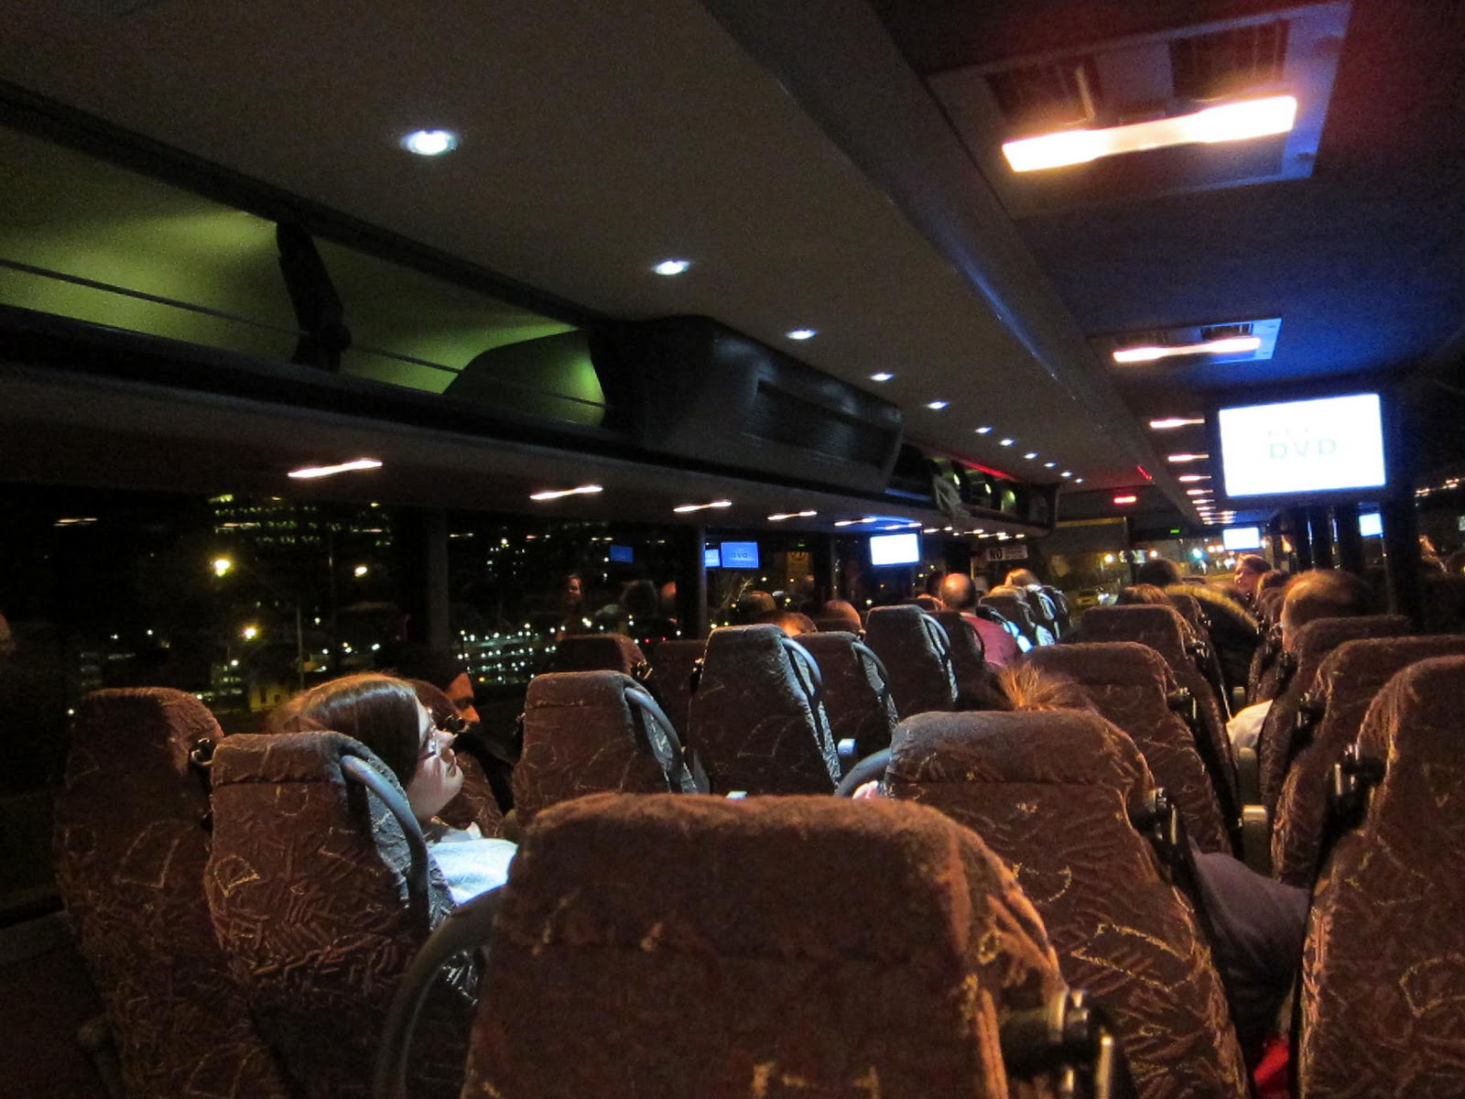

CY 23 Intercity Bus Program
Transportation Commission Workshop
November 8, 2022

Slide 2

Intercity Bus Program
CY23 Intercity Bus Program
Purpose: Support intercity bus services that includes stops at non-urbanized locations and makes meaningful connections to nationwide network
Available to private intercity bus companies, companies wishing to start bus service, public transit agencies either operating of proposing to operate bus service, and local communities wishing to support intercity connections to their community
Notes:
The intercity bus assistance program is a federally funded grant program that provides financial assistance to support intercity bus services that includes stops at non-urbanized locations and makes meaningful connections to nationwide network. Funding is available for private bus companies, public transit agencies, and local communities wishing to support intercity connections to their community to maintain the viability of intercity bus service in Iowa.

Slide 3
Funding Priorities
CY23 Intercity Bus Program
Iowa’s program has four components in priority order:
Base level support of existing services ($0.20 per revenue mile)
Start-up support for new services (three years at $0.50 per revenue mile)
Support for marketing of intercity bus services and interlined services (maximum $7,500 for existing routes per agency and $12,000 per each new route with 20% local match required)
Support for intercity bus capital improvements (over the road coaches, vertical infrastructure, vehicle renovations/improvements, ADA improvements to vehicles and facilities). Vehicles require a 15% local match while all other capital projects require 20% local match.
Notes:
The intercity bus program has four funding components under which eligible applicants may apply, in priority order:
Priority 1 is for base level support of existing services at 20 cents per revenue mile.
Second priority is Start-up support for new services at three years at 50 cents per revenue mile.
Third is support for marketing of intercity bus services and interlined services, with a maximum seventy-five hundred dollars for existing routes per agency and twelve thousand dollars per each new route established.
The fourth priority is support for intercity bus capital improvements, which includes vehicles and facilities.

Slide 4
Available Funding and Application Summary
CY23 Intercity Bus Program
Available Funding
  Total Intercity Bus Funds Available: $2,691,994
    15% of federal non-urbanized (FTA Section 5311) transit funding
Application Summary
  Total number of projects: 8
  Total number of projects funded: 8
  Total project costs: $2,684,220
  Total amount requested: $2,267,375
  Contingency: $424,619
Notes:
The program is funded by utilizing 15% of federal non-urbanized FTA Section 5311 transit funding. This year, we have two million, six hundred ninety-one thousand, nine hundred ninety-four dollars in available funds.
We received eight project applications we are recommending for funding. The total project costs on the eight applications totaled $2,684,220. The total amount of the eight requested projects was $2,267,375.
This leaves us with $424,619 in contingency funds for future projects. We are currently working with FTA to determine how best to utilize the funding.

Slide 5
CY23 Intercity Bus Program
List of Recommended Projects
PROJECT NAME | SPONSOR | TOTAL PROJECT COST | REQUESTED AMOUNT (% of Total Project Cost) | RECOMMENDED AMOUNT (% of Total Project Cost)2 -
2 – Over the Road Motor Coaches | Burlington Trailways | $1,220,000 | $1,037,000 (85%) | $1,037,000 (85%)
Digital Repeater – aid in communication with drivers | Burlington Trailways | $11,000 | $9,350 (85%) | $ 8,800 (80%)
Driving Stimulator | Burlington Trailways | $222,781 | $178,224 (85%) | $178,224 (80%)
Notes:
Burlington Trailways has requested funding for three projects. The first, the purchase of two replacement over the road motor coaches for $1,037,000. Second, the purchase of a digital repeater to aid in the communication with drivers for $9,350, they requested 85% but eligibility is 80%, thus the recommended amount is reduced to $8,800. The third, purchase of a driving stimulator for $178,224. These three projects are being recommended for funding at the requested amount next month.

Slide 6
CY23 Intercity Bus Program
List of Recommended Projects,
continued
PROJECT NAME | SPONSOR | TOTAL PROJECT COST | REQUESTED AMOUNT (% of Total Project Cost) | RECOMMENDED AMOUNT (% of Total Project Cost)
2 – Over the Road Motor Coaches | Jefferson Lines | $1,180,000 | $1,003,000 (85%) | $1,003,000 (85%)
Travel Information Center | Jefferson Lines | $22,689 | $18,151 (80%) | $18,151 (80%)
Lease payments | Jefferson Lines | $9,000 | $7,200 (80%) | $7,200 (80%)
Marketing | Jefferson Lines | $9,375 | $7,500 (80%) | $7,500 (80%)
Notes:
Jefferson Lines has requested funding for four projects. The application was for the purchase of two replacement over the road motor coaches for $1,003,000. The second project was for the travel information center for $18,151, third operating assistance for lease payments on the Des Moines facility $7,200 and fourth, marketing assistance for $7,500. These projects is being recommended for funding at the requested amount next month.

Slide 7
CY23 Intercity Bus Program
List of Recommended Projects
continued
PROJECT NAME | SPONSOR | TOTAL PROJECT COST | REQUESTED AMOUNT (% of Total Project Cost) | RECOMMENDED AMOUNT (% of Total Project Cost)
Marketing | Fort Dodge | $9,375 | $7,500 (80%) | $7,500 (80%)
Notes:
Fort Dodge has requested funding for marketing assistance for seven thousand five hundred dollars. We will be recommending funding next month at their requested amount.

Slide 8
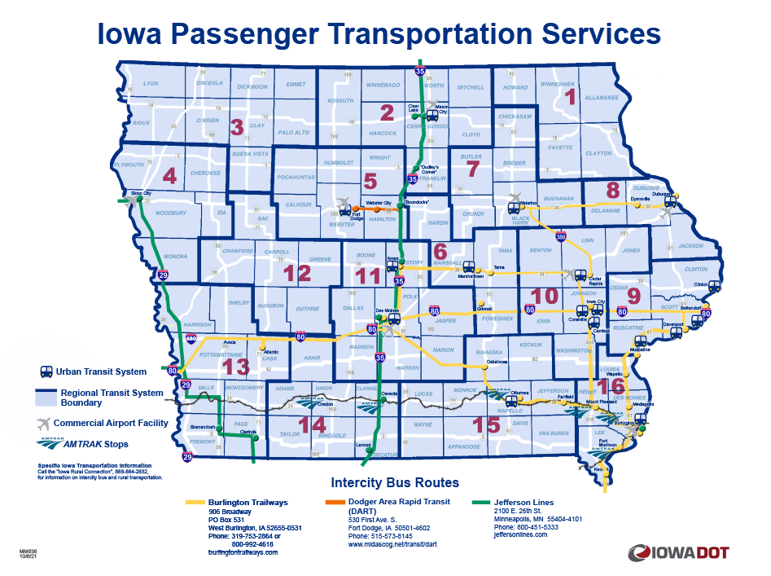
Intercity Bus Map
CY23 Intercity Bus Program
Notes:
This map provides the most recent and accurate Intercity Bus program transportation services.

Slide 9

QUESTIONS?
For more information on Iowa’s public transit and intercity bus programs, visit
www.iowadot.gov/transit
Notes:
Any questions?

