Slide 1

Integral Abutments
Design and Construction Considerations
Mahmoud Hailat, PE
INDOT-Bridge Division
May 1, 2014

Slide 2
Integral Abutments – Outline
History & Updates
Advantages and Disadvantages
Types
Research Update – Purdue University
Design Criteria/ Considerations
Details – INDOT Method A
Construction Considerations – INDOT Method A
ABC Considerations – INDOT Method A

Slide 3
History
Started by a memo dated March 1989
The memo revised in November 1992
Details included in Indiana Design Manual in 2005 – Metric Version
Updated in 2008 – English Version
Updated then published in 2013 (LRFD and Research updates included)
  Chapter 409 “Abutments, Piers, and Bearings”
  Chapter 408 “Foundations”

Slide 4
Advantages
  Lower construction & Maintenance cost due elimination of expansion joints
  No bearings to maintain
  Beam ends are protected
  Design efficiency, increased structural redundancy, & enhanced load distribution
  Greater end span ratio
  Construction is simple and rapid
  Seismic performance
  Fewer piles and no battered piles required
  Improves vehicular ridding quality

Slide 5
Disadvantages
Settlement of the approach roadway
Deterioration of the terminal joint (pavement relief joint) between approach slab and roadway pavement
Insufficient thermal movement if backfill is over compacted (INDOT is using aggregate for backfill)

Slide 6
Types Of End Abutments
Integral Abutments (Preferred)
  Method A: Beam attached directly to the Pile (Preferred Method; Reaction acts directly on top of the pile, less induced stresses to the end bent )
  Method B: Beam attached to the concrete cap w/bearing assembly
Semi Integral Abutment
  Method 1: Beam attached to anchor steel plate
  Method 2: Beam attached to elastomeric bearing

Slide 7
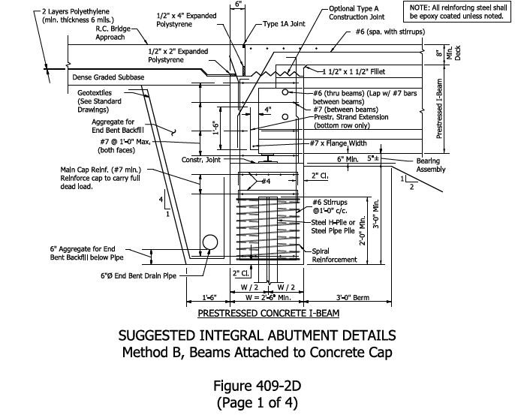

Int. Abutment – Method B
Load
Path

Slide 8
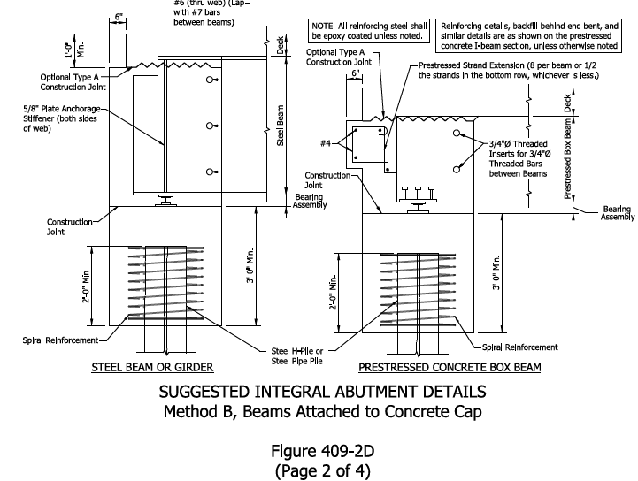
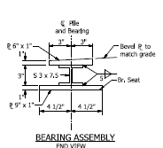
Int. Abutment – Method B

Slide 9
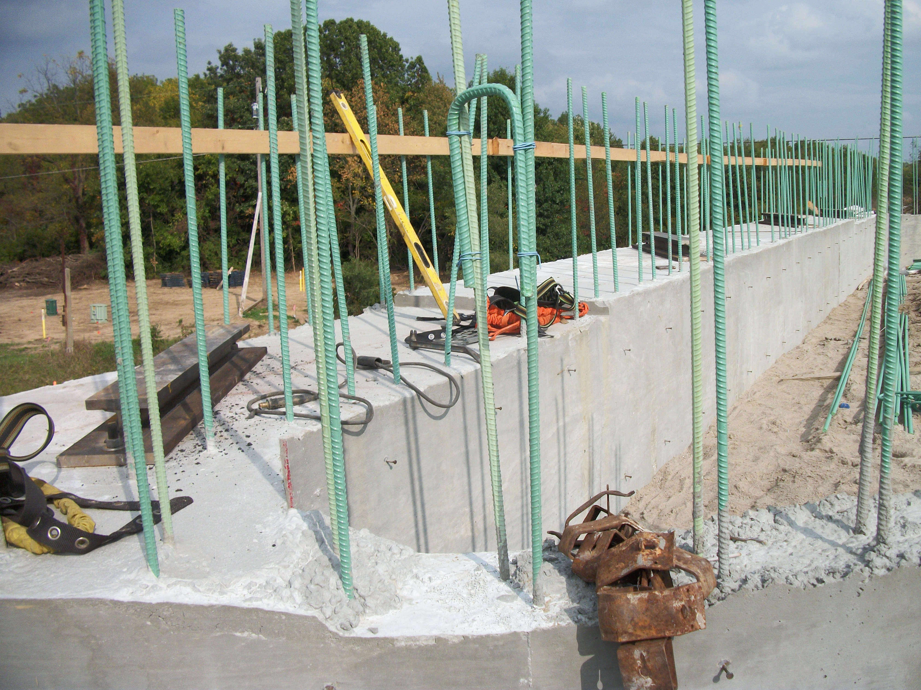
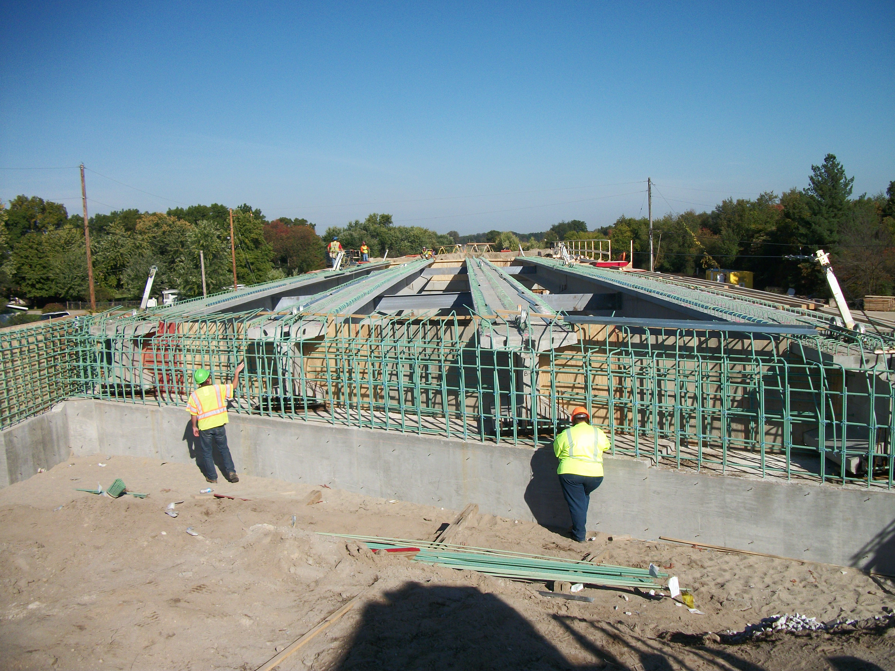
Int. Abutment – Method B

Slide 10
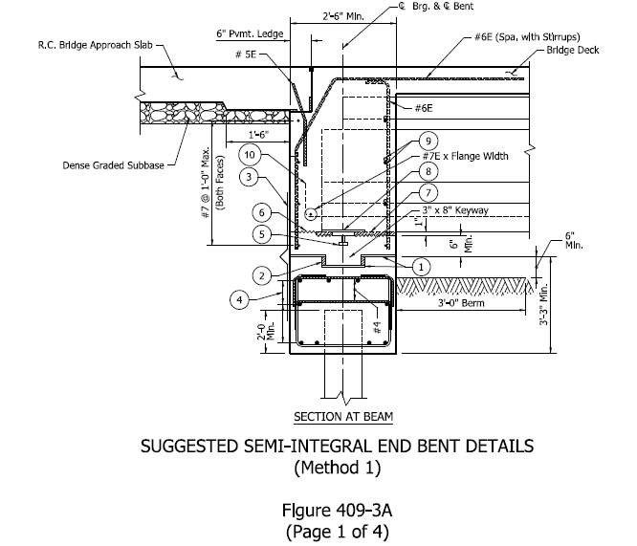
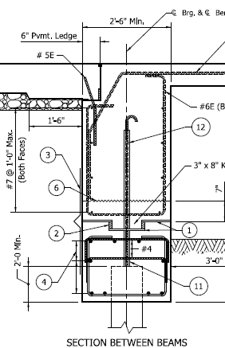
Semi Int. Abutment – Method 1
3 Layers of Medium Weight Roofing Felt with Grease between Layers over 1/8” High Density plastic Strip

Slide 11
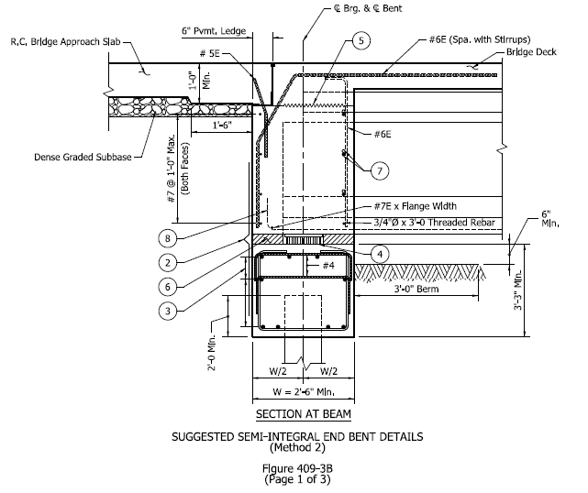
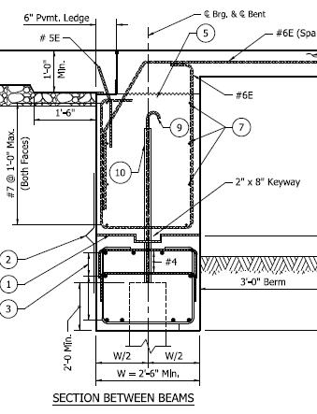
Semi Int. Abutment – Method 2

Slide 12
Research
Research on Integral Abutment:
  FHWA/IN/JTRP – 2004/24 – INDOT & Purdue Jointless and Smoother Bridges: Behavior and Design of Piles
  FHWA/IN/JTRP – 2008/11 – INDOT & Purdue Earthquake Resistance of Integral Abutment Bridges
  JTRP – INDOT & Purdue
Long-Term Behavior of Integral Abutment Bridges

Slide 13
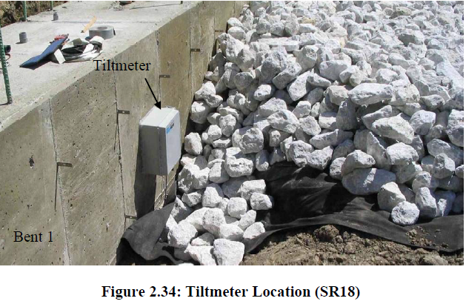
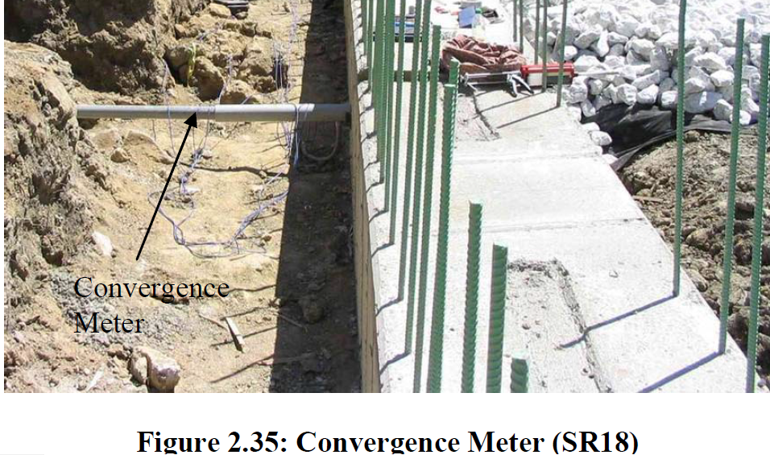
Research
INDOT & Purdue: Jointless and Smoother Bridges: Behavior and Design of Piles
`
Pictures Taken From FHWA/IN/JTRP-2004/24 - INDOT & Purdue

Slide 14

Research
Jointless and Smoother Bridges: Behavior and Design of Piles.
Piles sizes should be selected to provide
adequate axial capacity while minimizing their bending resistance along the longitudinal axis of the bridge.
Piles should be oriented about their weak axis perpendicular to the beam.
Axial load should be limited to:
0.25fyAs for H piles (ASD).
0.25fyAs + 0.4 f’c Ac for CFT piles (ASD).

Slide 15
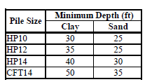
Research
Recommendations (cont.):
  4. The pile minimum embedment length should be increased to 24 in. (was 15 in.) and/or confinement steel should be provided.
5. A minimum pile length below ground is required to prevent displacement at the pile base.
Fig 408-3B

Slide 16
Research
Recommendations (cont.):
6. Bridges designed considering the above recommendations can be constructed up to a
maximum total length of 500 ft for both steel and concrete superstructures with less than 30 degrees skew.

Slide 17
Research
Earthquake Resistance of Integral Abutment Bridges
A pile embedment length of 24 in. (was 15 in.) Piles should be oriented about their weak axis.
2. Integral Abutment bridges can be used for lengths up to 1,000 ft for bridge lengths greater than 500 ft, confining reinforcement must be provided around the pile head. As a minimum, it is recommended that a #4 spiral with a 2.5 in. pitch be specified.
3. The use of a “pin” detail is not recommended for seismic applications. Although this detail performed adequately in laboratory tests, its performance under dynamic loading is uncertain.

Slide 18
Research
Long Term Behavior of Integral Abutment Bridges
For Standard Integral Abutment Details, provide designers with geometric limitations (length and skew), Section 6.4 of the study, Fig 6.8.
For Integral Abutment outside these limitations, provide designers with recommended geometric limitations and modeling guidelines, Section 6.4 & 6.5 of the Study (Piles, Loading, Structural Model, and Soil)

Slide 19
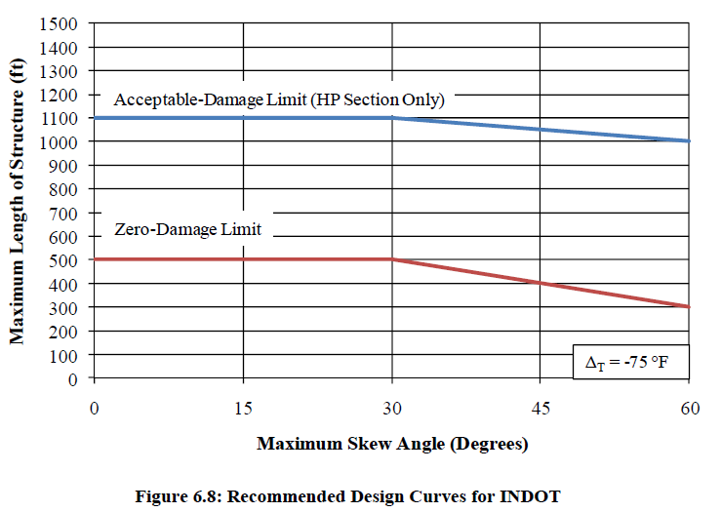
Research
Long Term Behavior of Integral Abutment Bridges

Slide 20
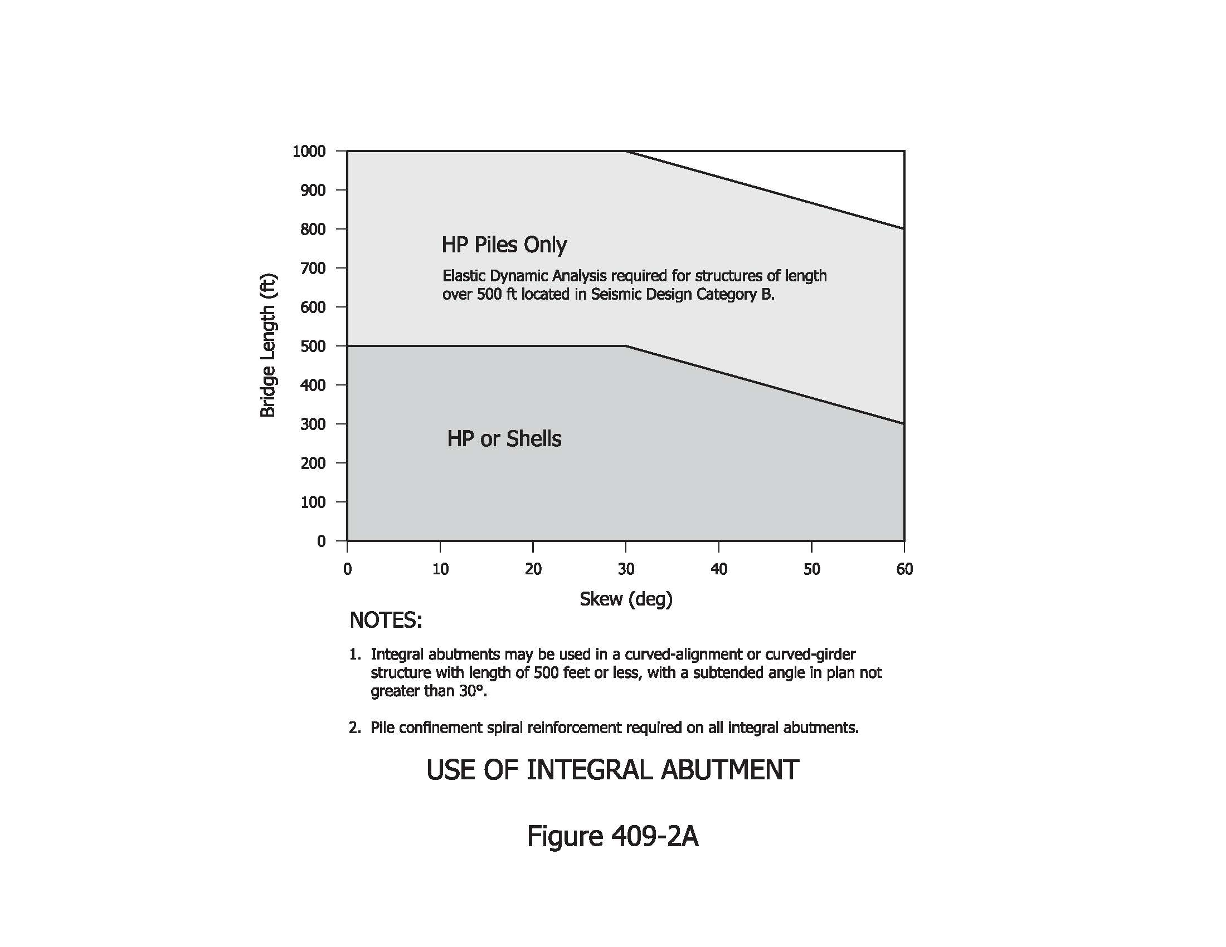
Design Criteria/Requirements
2013 Selection Table

Slide 21
Design Criteria/Requirements
Material:
  Class C (4 Ksi) concrete and epoxy-coated reinforcing bars (60 Ksi) (including Wingwalls)
End Condition:
  Pinned-end condition is assumed, ends are free to rotate and translate longitudinally
Longitudinal Force Distribution:
  Restraining effect of passive earth pressure is neglected when distributing superstructure longitudinal force to the interior supports

Slide 22
Design Criteria/Requirements
Passive Earth Pressure:
  May be considered by distributing to the interior supports, abutments, and soil behind the abutments
Interior Pile Bent or Thin Wall Pier:
  All longitudinal forces to be distributed among interior supports (pile bent or thin wall pier on single row of piles), end bents, and soil behind the end bents based on relative stiffnes
Structural Model:
  The cap shall be treated as a continuous structural beam

Slide 23
Design Criteria/Requirements
Backfill:
  Aggregate for end bent backfill for girder type superstructures
  Flowable backfill for slab bridges
Bridge Approach Slab:
  10” or 12” Thick, 20’-6” long Approach Slab
  RCBA is anchored to the superstructure with #5 threaded epoxy coated bars @ 2’-0” C-C
  Type 1-A Joint between approach slab and bridge deck

Slide 24
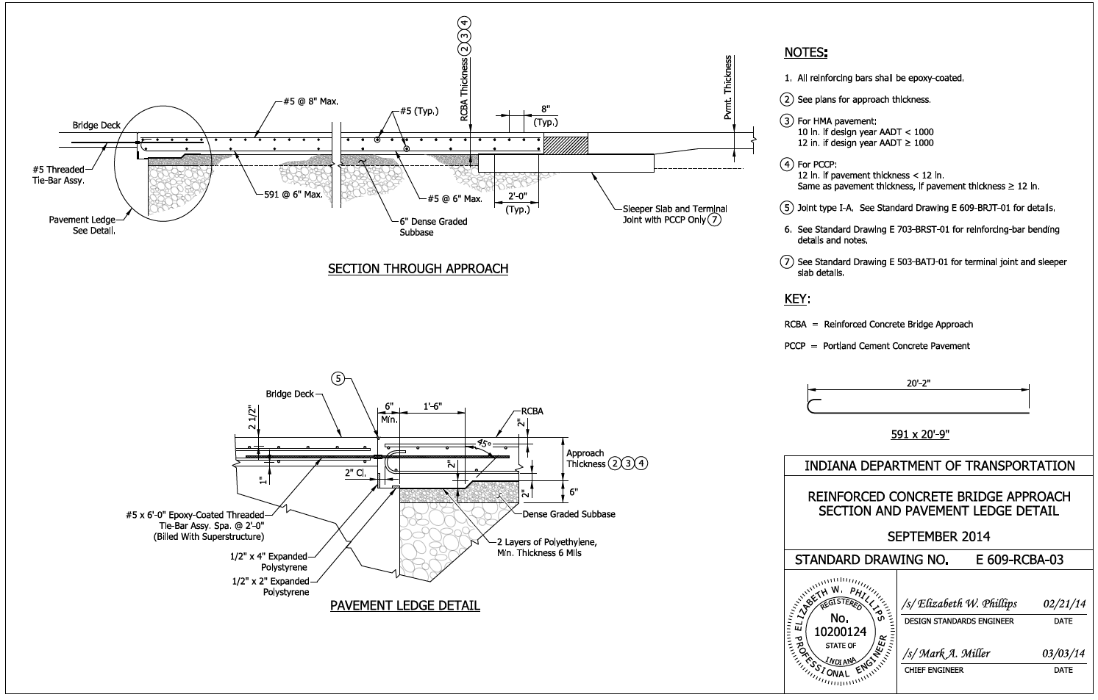
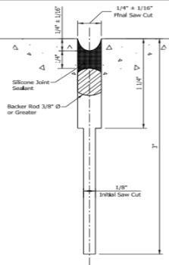
Design Criteria/Requirements
Bridge Approach Joint:
1-a) Str. Length< 300 ft → use 2 ft terminal Joint for PCCP
Terminal Joint

Slide 25
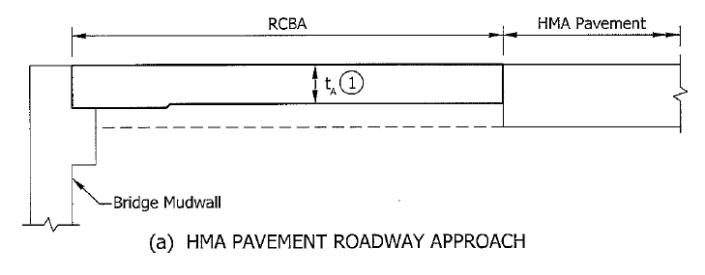
Design Criteria/Requirements
Bridge Approach Joint:
1-b) Str. Length< 300 ft → No Need for a Joint for HMA Pavement
  2- 300 ft < Str. Length< 500 ft → Exp. Joint should be considered
  3- Str. Length ≥ 500 Ft Exp. Joint is required (Tooth Expansion Joint)

Slide 26
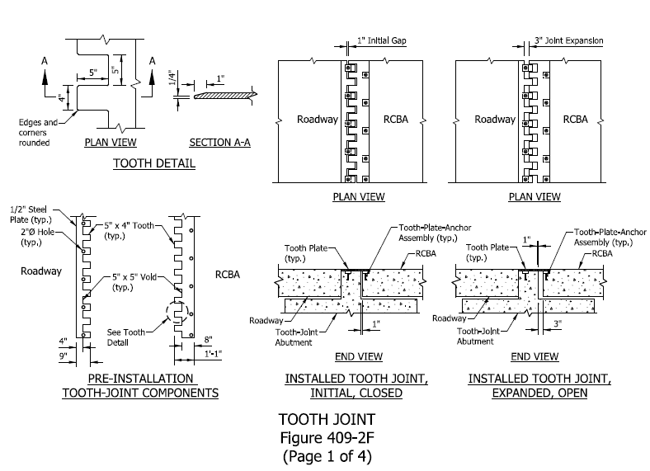
Design Criteria/Requirements
Tooth Expansion Joint

Slide 27
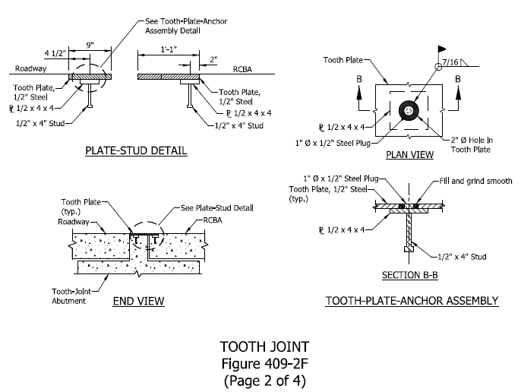
Design Criteria/Requirements
Tooth Expansion Joint (Cont.)

Slide 28
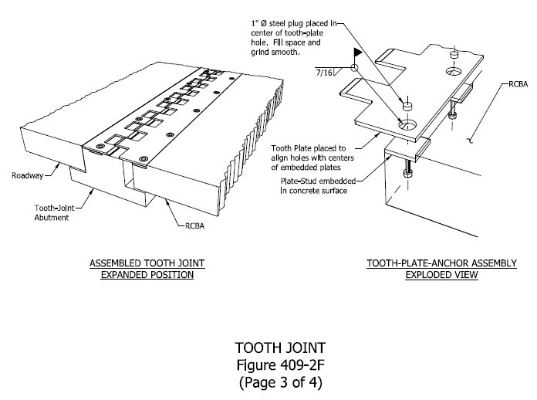
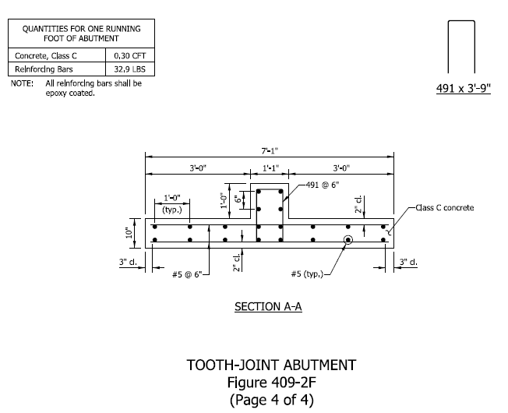
Design Criteria/Requirements
Tooth Expansion Joint (Cont.)

Slide 29
Design Criteria/Requirements
Min. Cap Width ≥ 2.5 ft.
Pile to cap embedment = 2 ft.
Spiral reinforcement (Figure 409-2D)
Beam extension into the end bent ≥ 1.75 ft.
4” Cover beyond farther –most edge of the beam
Provide stiffener plate for steel beam
#6 Bars through the web near the front face of the bent
:

Slide 30
Design Criteria/Requirements
End bent reinforcement:
  Min. #6 @ 1’-0” Max. stirrups
  Min. #7 @ 1’-0” Max. vertical spacing longitudinal bars
Corner Bars:
  #6 extended from the rear face into the top of the deck.
Wingwalls Configurations:
  Min. 1’-0” thick wall parallel to centerline of roadway. Greater than 10 ft wall requires additional analysis (may be supported by piles).

Slide 31
Design Criteria/Requirements
Wingwall Connection:
  1’ x 1’ Chamfer at interior connection angle
  U-shape bars & hooked corners bars
Interior Diaphragms for Steel Structure:
  Where steel Beam is used, an interior diaphragm shall be placed within 10 ft. of the end bent to provide stability during construction.

Slide 32
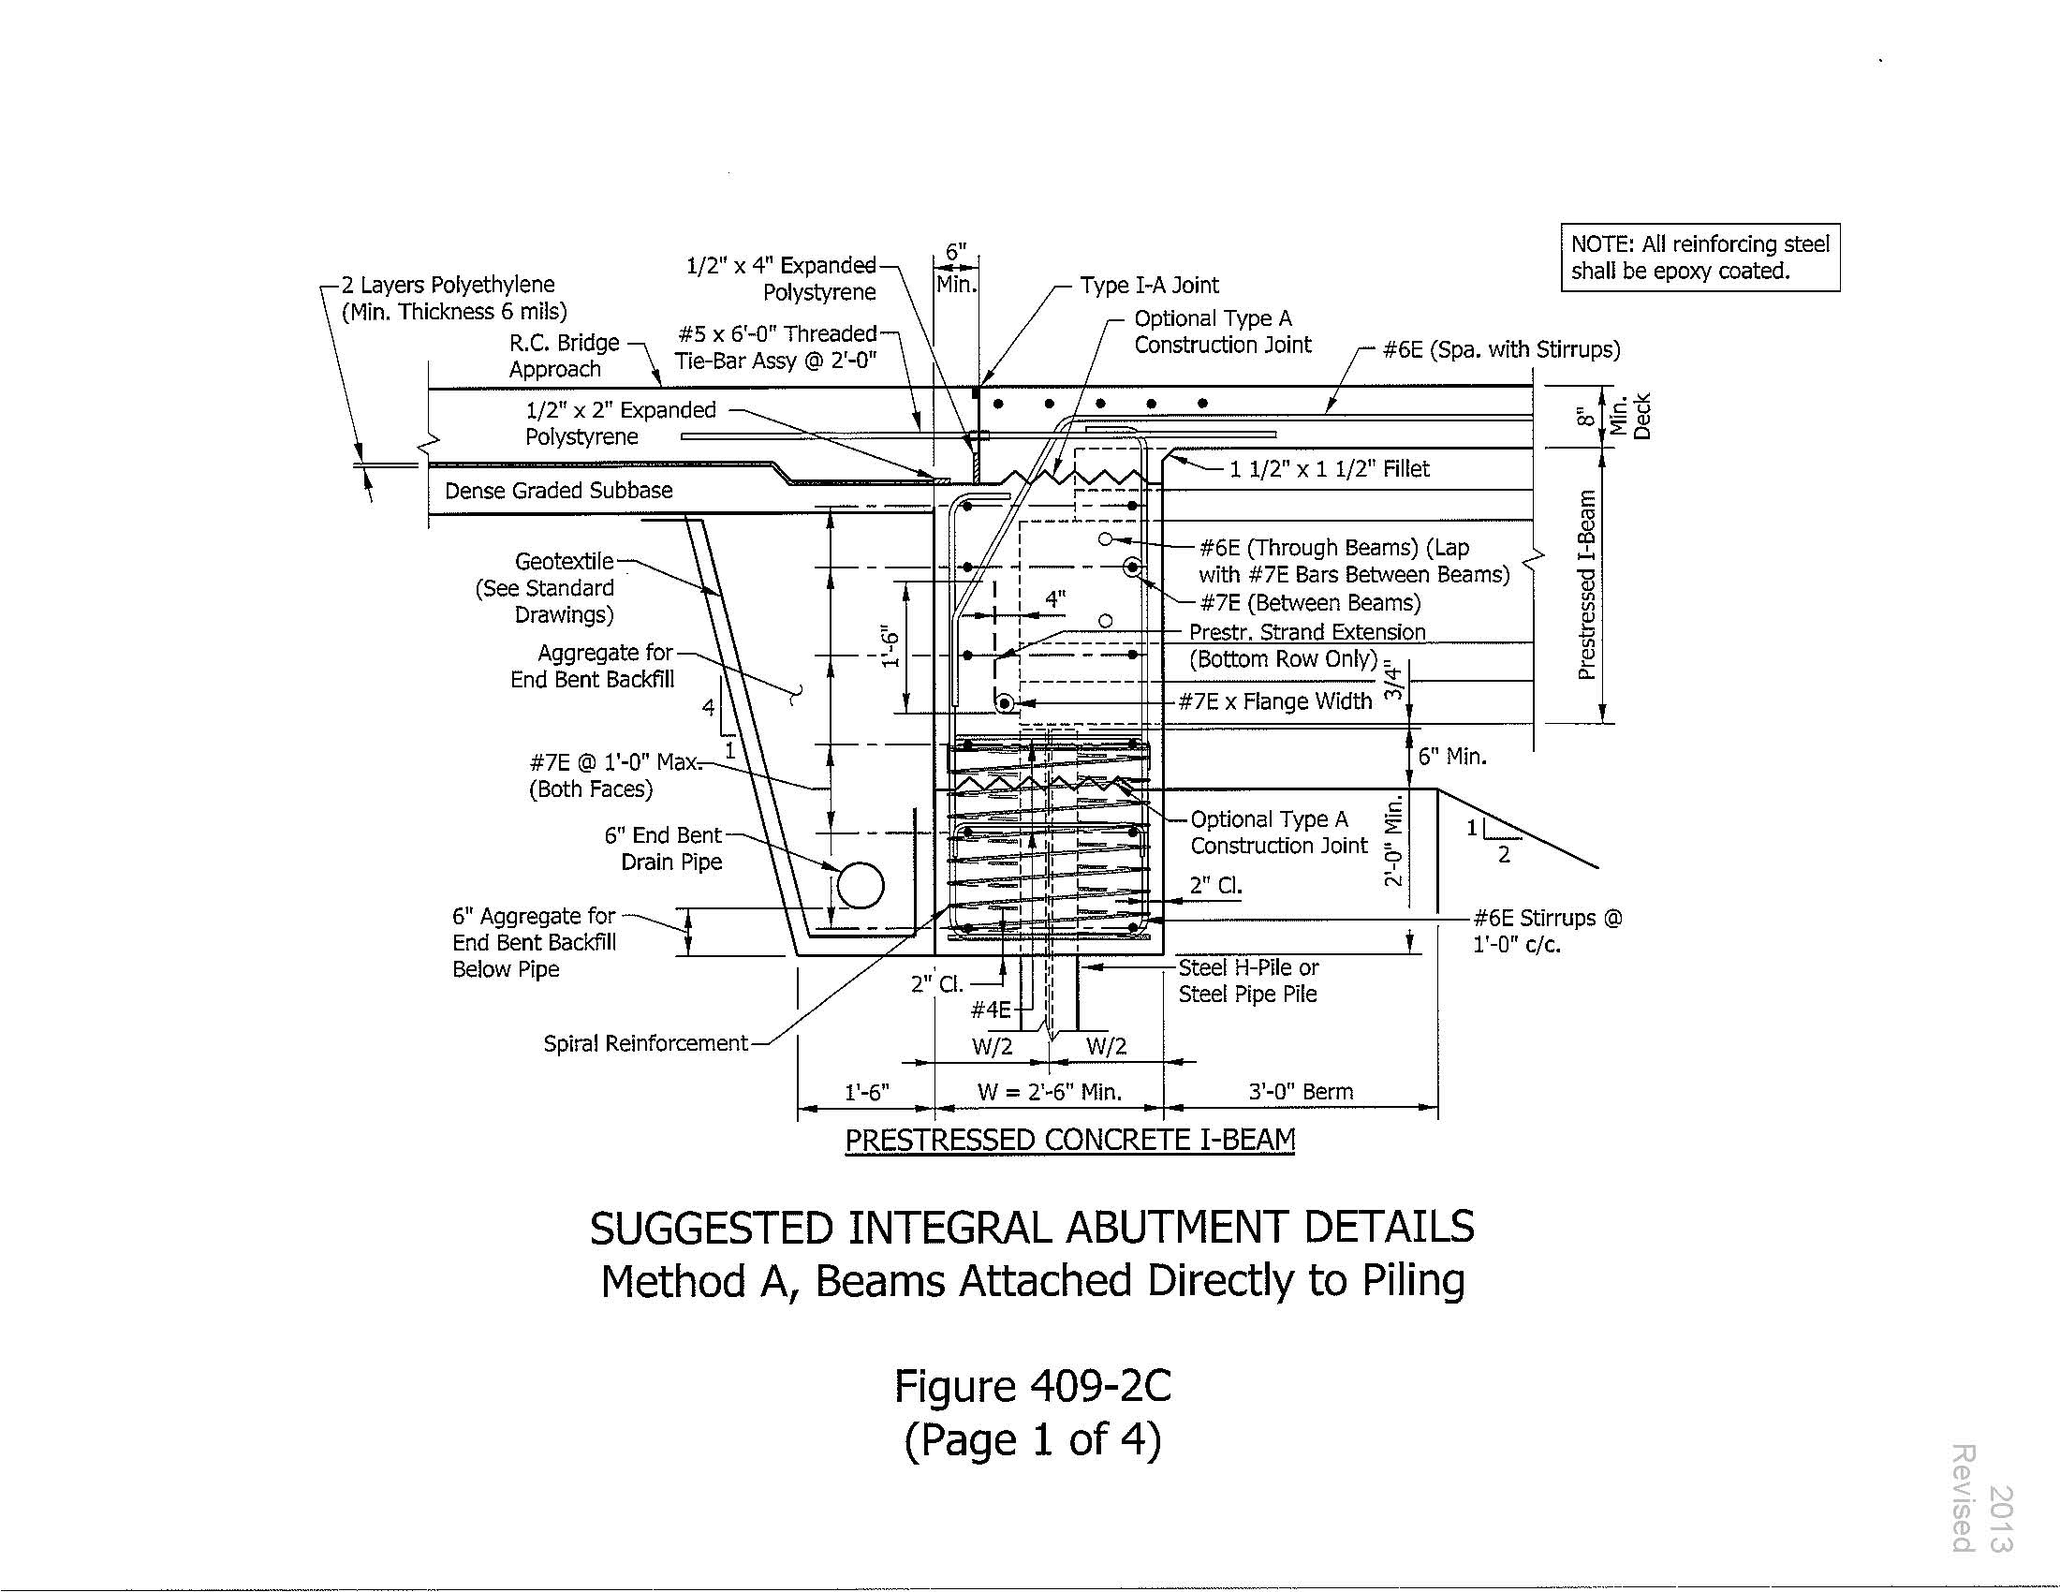
Details – Method A
HL-93
Loads
Load Path Through Deck, Beams, to End Bent Concrete Cap.
Loads Carrying
Element

Slide 33
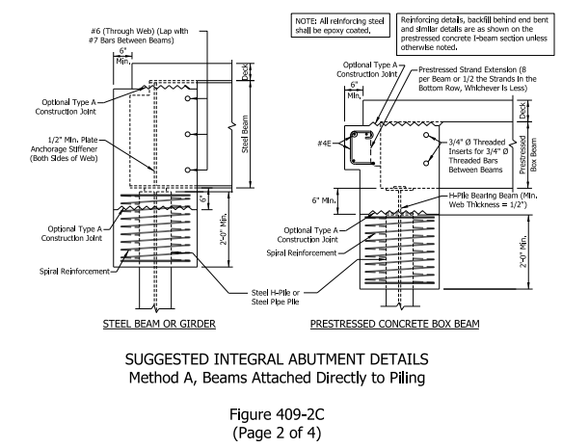
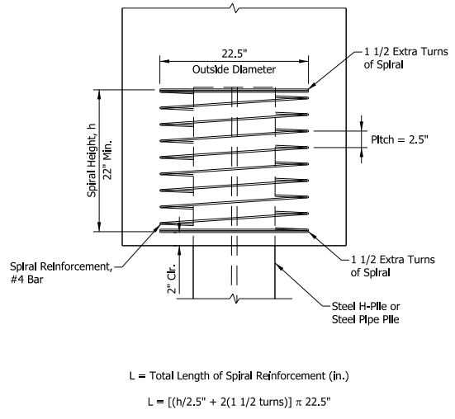
Details – Method A

Slide 34
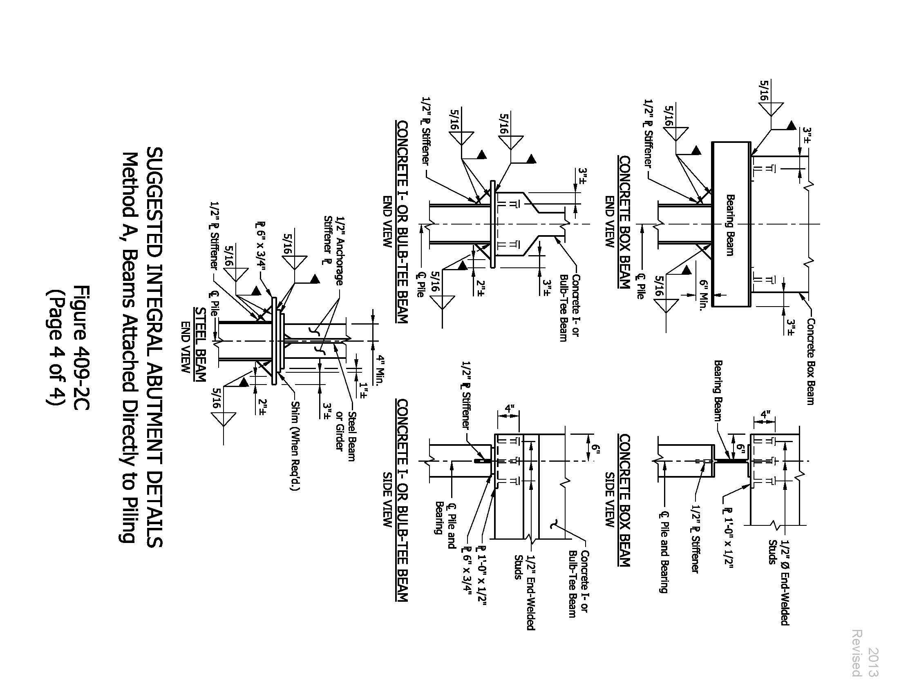
Details – Method A
Concrete Box Beam Connection
Figure 409-2C

Slide 35
Details – Method A
Concrete I-Beam Connection
Figure 409-2C

Slide 36
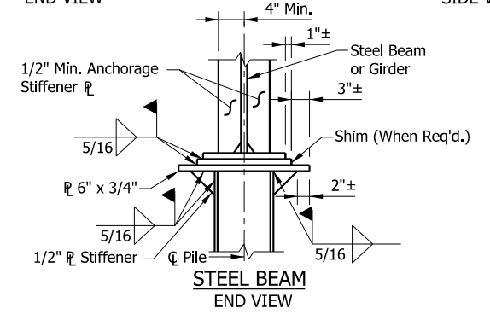
Details – Method A
Steel Beam Connection
Figure 409-2C

Slide 37
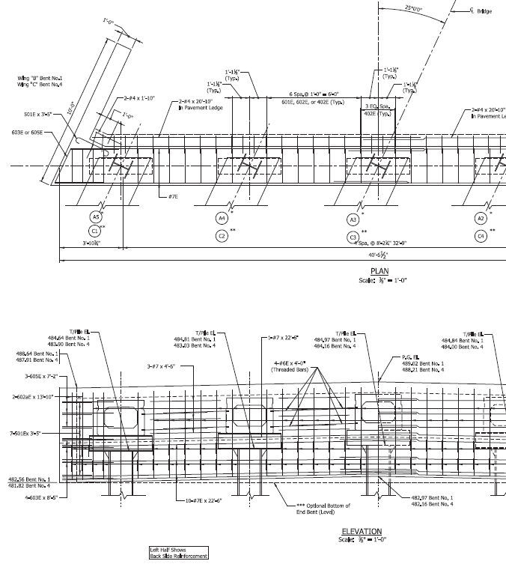
Details – Method A
Pile Oriented about weak Axis
Prestressed Concrete Box Beam
Horizontal Supporting Steel Beam
Pile

Slide 38
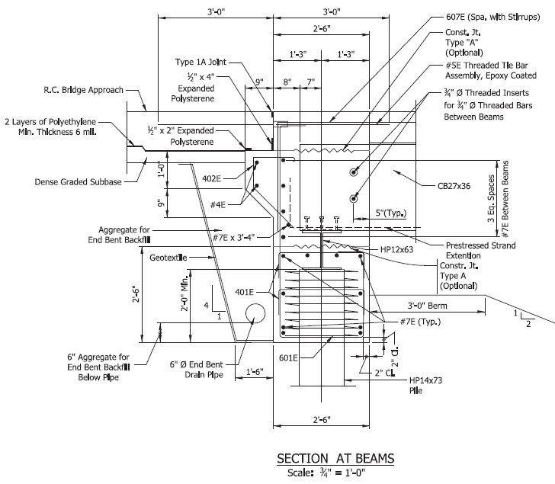
Details – Method A

Slide 39
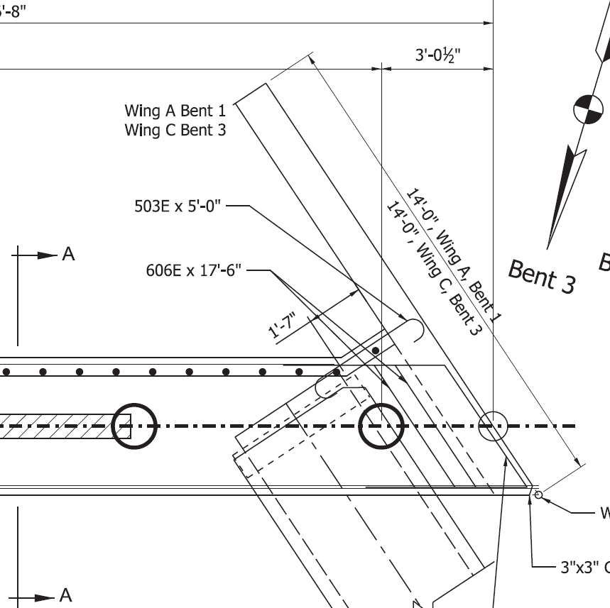
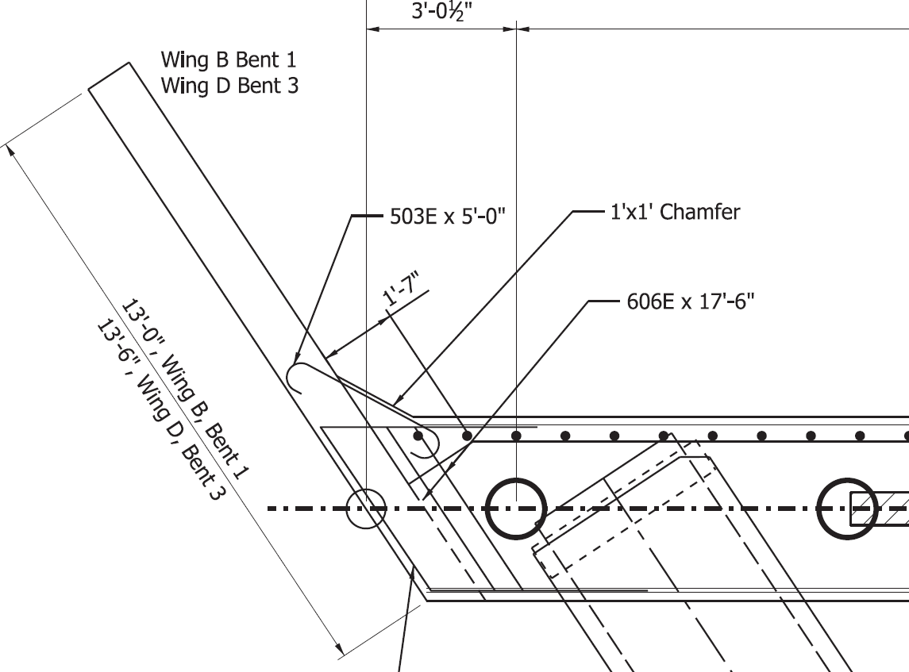
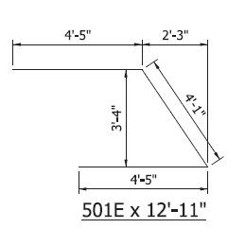
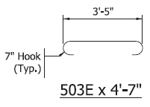
Design – Wingwall Connection

Slide 40
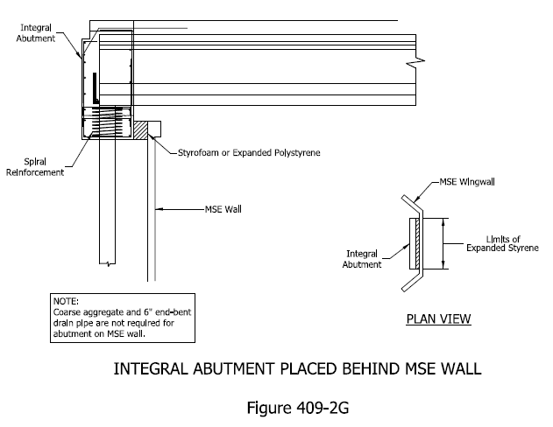
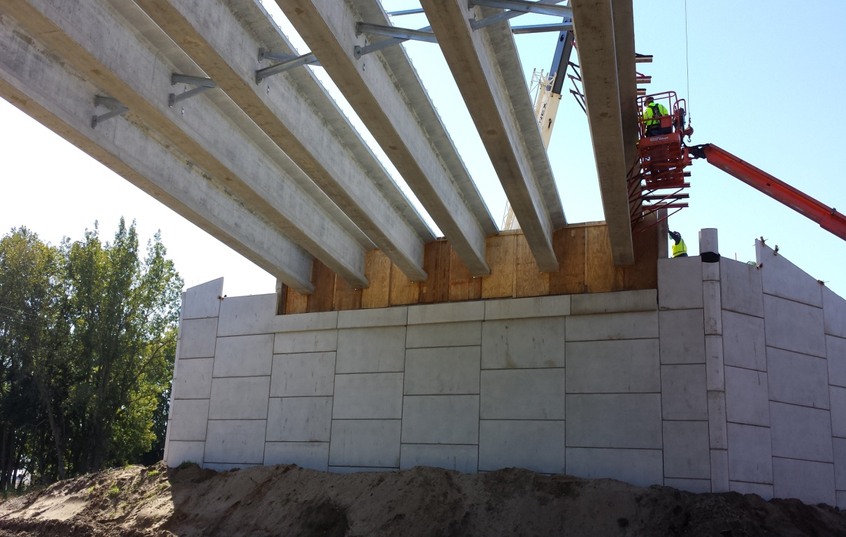
Details – MSE Walls Requirements
When placed behind MSE wall:

Slide 41
Design Considerations – Loading
Loads and forces for end bent piling satisfies requirements in Fig 409-2A:
  1- Only vertical forces to be considered (except for pile bent and thin wall pier on single row of piles)
  2- Forces due to temperature, shrinkage, and creep may be neglected (Integral Abutment should absorb these forces)
DL+FWS+LL
Hand Calculations
Computer Program (Ex. RC-PIER)

Slide 42
Design Considerations – Loading
Alternative analysis for end bent piling that does not satisfy requirements in
Fig. 409-2A:
  Point of Zero Movement shall be established.
  Forces due to temperature, shrinkage, and creep shall be considered.
  Movement at a point on the superstructure shall be proportioned to the Point of Zero Movement

Slide 43
Design Considerations – Loading
Alternative analysis for end bent piling that does not satisfy requirements in Fig. 409-2A:
  Lateral curvature may be neglected if it satisfies LRFD 4.6.1.2 “Structures Curved in Plan”
  Lateral soil resistance shall be considered in establishing force effects and buckling resistance of piles

Slide 44
Design Considerations – Loading
Lateral Analysis (Investigate Geotechnical & Str. Capacity)
Parameters Affecting Lateral Analysis:
  1- Soil Parameters:
  Type and physical properties, coefficient of subgrade reaction
  2- Pile Parameters:
  Physical properties, head condition (free or fixed), method of placement, group action
  3- Load Parameters:
  Type of loading (static or dynamic), load magnitude, eccentricity
(More details available in INDOT Geotechnical Manual)

Slide 45
Design Considerations – Loading
Lateral Analysis
Design for Laterally Loaded Piles:
  1- Lateral load test ( full scale test, time consuming and costly)
  2- Arbitrary value for lateral capacity (assume Fh ~ 10% of Fv)
  3- Analytical method (based on theory and empirical data)
  4- Structural analysis (when required):
  Lateral load analysis (breaking, seismic, wind, water….)
  Load distribution based on relative stiffens of substructure elements (optimize end span ratio)
  Establish fixity point (LRFD Section 10)
  Design as a column above fixity point (LRFD Section 6)
  L-Pile analysis (can be performed by geotechnical Eng.)

Slide 46
Design Considerations – Seismic
Min. support length need not to be investigated
Integral structure ≤ 500 ft. does not require seismic analysis (damping effect)
Integral Structure > 500 ft. in area of seismic category greater than A, will be analyzed using elastic dynamic analysis.

Slide 47
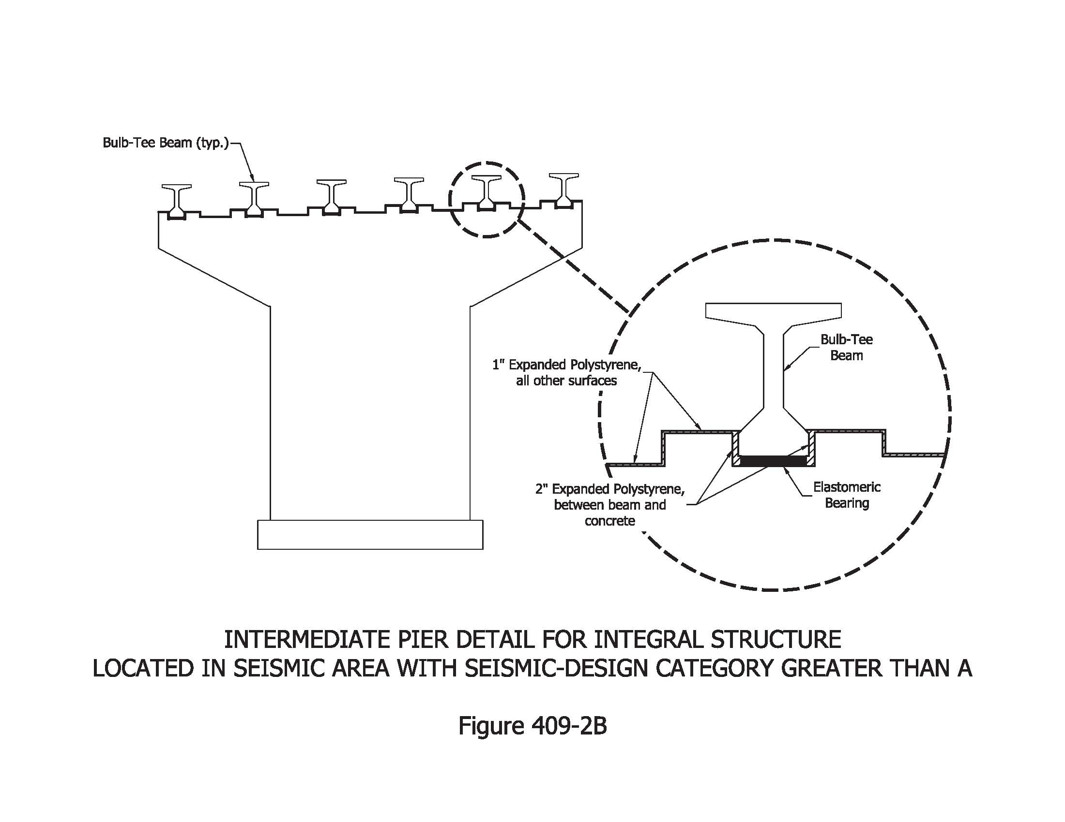
Design Considerations – Seismic
Intermediate pier details in seismic design category greater than A:
To prevent Lateral Movement due to Lateral Seismic Forces
Seismic Force

Slide 48
Design Considerations – Piling
  Type and configuration:
    H-piles or Pipe Piles
    Piles driven vertically (no battered piles)
    One row of piling is permitted
    Pile tip or Pile Show as recommended by Geotechnical Report
  Pile spacing:
    Max. pile spacing is 10 ft.
    Min. pile spacing 3 ft or 3 x pile width for H-piles
    Min. pile spacing 3.5 ft or 3 x pile width for pipe piles
    Min. pile spacing in Shale is 6 ft.

Slide 49
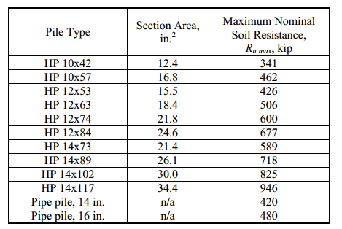
Design Considerations – Piling
  Maximum Nominal Geotechnical Resistance
  Figure 408-3A
  A- For Piles in Soil,
  Soft Rock, or Shale
  B- For Piles in Hard Rock (Limestone)
  Max. Nominal Geotechnical Resistance = 0.65 As Fy
  Max. Factored Geotechnical Resistance = 0.46 As Fy

Slide 50
Design Considerations – Piling
  H-Pile:
    HP10, HP12, or HP14, Web perpendicular to the centerline of the structure
    Best for end bearing
    Min. yield strength 50 Ksi
  Steel Pipe Pile:
    14” or 16” dia. with 0.25 in & 0.312 in min. wall thickness respectively
    Best for skin friction
    Filled with Class A Concrete (3500 Psi)
    Min. yield strength 45 Ksi

Slide 51
Design Considerations – Piling
  Pile Pilot Holes:
    Preboring:
      Hole is 2” smaller than the diameter or diagonal of the pile cross section
      Predrilling:
      Hole minimum diameter is not less than the greatest dimension plus 4”.
      Cored in Rock:
        Diameter as shown on the plans, piles driven to practical refusal, then holes filled with concrete.
  Pile Testing:
        Pile testing per INDOT Std. Specs (Dynamic or static)

Slide 52
Design Considerations - Piling
  Alignment Tolerances (Std. Specs):
    2% of the axial alignment of the top 10 ft (2.4”)
    Pile shall not be less than 4” from the edge of the cap
    If alignment tolerances are exceeded, the extent of overloading shall be investigated. Corrective measures to be designed and constructed by the contractor.

Slide 53




Construction Sequence
  Optional Construction Joints
Optional Construction Joints

Slide 54
Construction Sequence
  Without Optional Construction Joint

Slide 55
ABC Considerations
  Two options were considered:
    Option A:
    Total Cast-in-place concrete End Bent
    Cast-in-place concrete wingwalls
    Option B:
    Precast concrete Cap
    Cast-in-place concrete above precast concrete cap and between beams
    Precast concrete wingwall with a closure pour

Slide 56

ABC Considerations
Cast-in-Place
Precast
  Option A- Cast-in-Place End Abutment

Slide 57
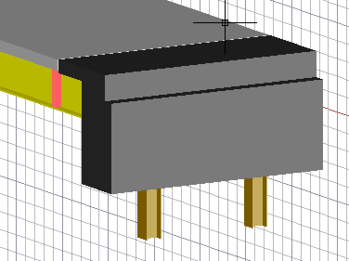
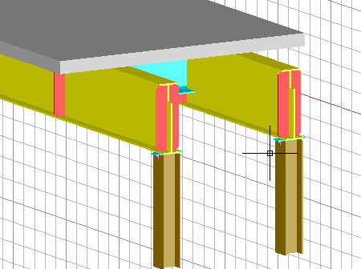

ABC Considerations
  Option A- Cast-in-Place End Abutment

Slide 58
ABC Considerations
Cast-in-Place
Precast
  Option B- Partial Precast End Abutment

Slide 59
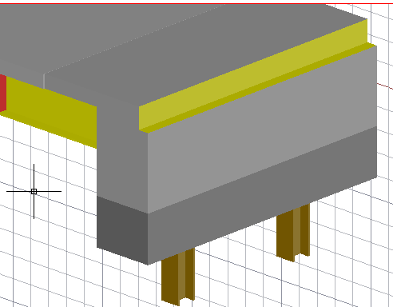
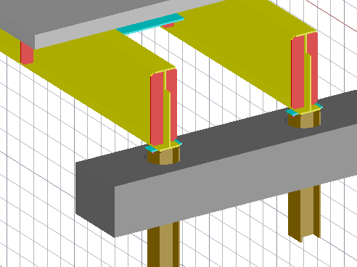
ABC Considerations
Superstructure Unit
Precast Cap
Precast Cap
  Option B- Partial Precast End Abutment

Slide 60
ABC Considerations
  Piling:
    Geotechnical report recommendations
    Specifications for pile deviation (tolerances), establish acceptance criteria
    Pile testing and restricking criteria (24 to 72 hours)
    Consider reduced resistance factors if restricking criteria is removed
    Consider preboring, predrilling, & precoring

Slide 61
ABC Considerations
  Precast Cap:
    Weight of the cap / load limits during transportation
    Segmental cap/ do we need post tension
    Cap height/ Piles extension above the cap
    Pile/ cap tolerances (hole size)
    Consider shear keys
    Reinforcement details at precast / Cast-in-place interface (mechanical splice or bars extended above precast cap)
    Concrete mix design / accelerator admixtures (concrete strength when service starts)

Slide 62
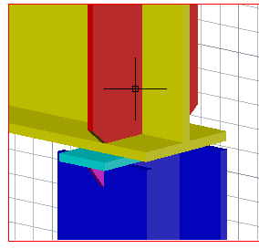
ABC Considerations
  Beam Pile Connection:
    Cut the pile, grind and weld top plate and angle stiffener
    Account for welding time (~ 2 hours per connection)
    Provide shim only if needed (avoid if you can)
    Provide clearance for welding
    (1’ to 1.5’, consult with welders ).

Slide 63
ABC Considerations
  Wingwall installation and connection:
    Investigate Precast vs cast-in-place wingwall (time, cost, post tension)
    Investigate wingwall orientation (Parallel to roadway centerline or parallel to End Bent)
    For precast wingwall parallel to roadway centerline you will need a closure pour
    Consider Piling if needed by design
    Consider reinforcing detail for wingwall connection

Slide 64

Design Considerations – Wingwall
Precast Wingwall
Post Tension Bars

Slide 65
Design Considerations – Wingwall
Precast
Cast-in-place

Slide 66
ABC Considerations
  Comparison between Option A & B :
Item of Comparison | Option A (Cast-in-Place End Bent) | Option B (Partial Precast End Bent)
Rebar and Form work | All reinforcing and form work Done on-Site | Less on-site reinforcing & forming work
Cast-in-Place vs Precast | All concrete in end bent is Cast-in-Place | Less Cast-in Place concrete
Fill and Grading | Partial fill at the front | Complete fill at the front
Field work time | More field work time | Less time for field work
Piling Tolerances | Higher values are acceptable | Small Margin of Tolerance is required
Cost (Economy) | Cost less, No precast element in end bent | Precast element cost more
Joints | No joints (except Optional Joints for Cast-in-Place Concrete) | Cold Joint Between Precast Element and Cast-in-Place Concrete
Beam-Pile Connection | No constraints | Precast element Can be an obstacle for welding
Wingwall | Cast-in-Place with the end bent | Precast with Closure Pour

Slide 67
Refrences
    INDOT Design Manual Chapter 408 “Foundations”
    http://www.in.gov/indot/design_manual/files/Ch408_2013.pdf
    INDOT Design Manual Chapter 409 “Abutments, Piers, & Bearings)
    http://www.in.gov/indot/design_manual/files/Ch409_2013.pdf
    INDOT Standard Specifications
    http://www.in.gov/dot/div/contracts/standards/book/index.html
    INDOT Standard Drawings http://www.in.gov/dot/div/contracts/standards/drawings /index.html
    INDOT Geotechnical Manual
    http://www.in.gov/indot/files/GTS_2010GTSManual_2012.pdf
    AASHTO LRFD-Bridge Design Specification

Slide 68
Contact Information
    Mahmoud Hailat, PE
    100 N. Senate Ave, Rm 642
    Indianapolis, IN 46204
    Ph. No. (317) 234-5299
    Email: mhailat@indot.in.gov

Slide 69

Thank you!

