Slide 1
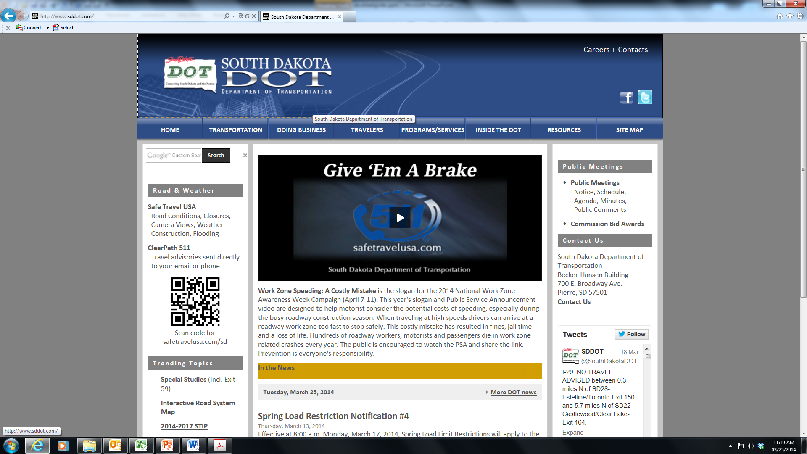
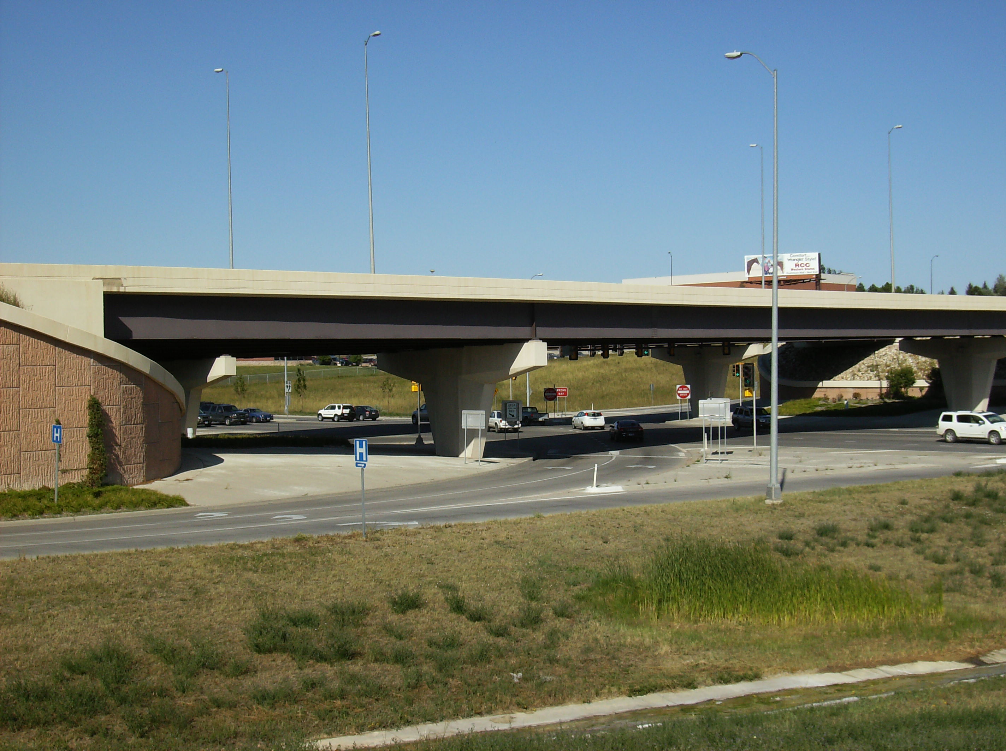
South Dakota’s
Integral Abutment Bridges
Steve Johnson
Bridge Design Engineer

Slide 2

HISTORY:
1967: Research began
Integral abutment construction begins in 1971
1973: The SD Research Report “Analysis of Integral Abutment Bridges” published
Currently 135 steel girder bridges and 130 prestressed girder bridges on the inventory with integral abutments

Slide 3


Slide 4
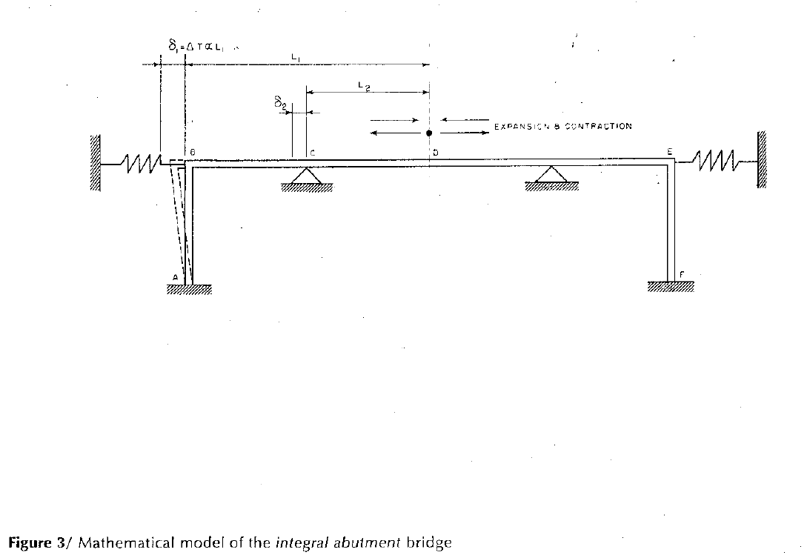
Study Model:

Slide 5
Limitations:
Steel Superstructure, Max. structure length = 350 Ft.
Concrete Superstructure, Max. structure length = 700 ft.
Max. Skew = 30 degrees regardless of superstructure material.
Bottom of abutment approximately 3 ft below bottom of low girder.

Slide 6
Pile Req’s.
Steel girders set directly on steel piling
Prestressed girders set on concrete pile cap
Prebore at each pile for depth of 10 ft. or to natural ground (for new embankments)
Prebore filled with dry sand.
Piling thru MSE backfill are cased with CMP.
    Prebore filled with Bentonite slurry.
2” driving tolerance for piling.

Slide 7
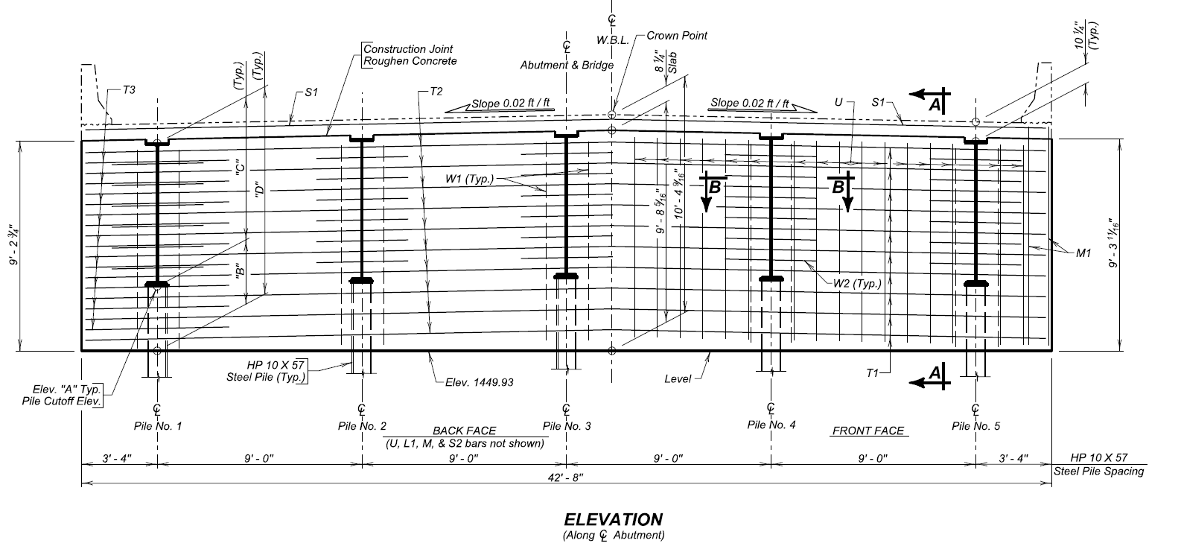
Steel Girder

Slide 8
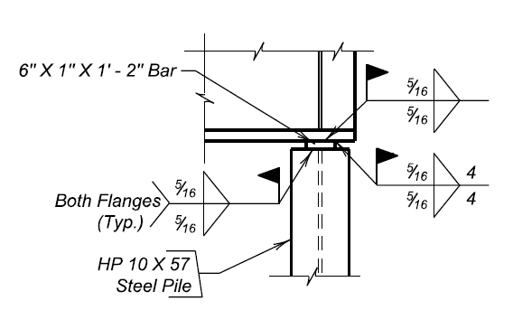
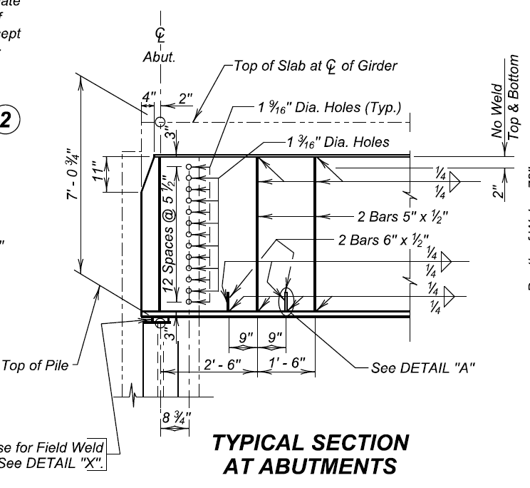
Typical Details

Slide 9
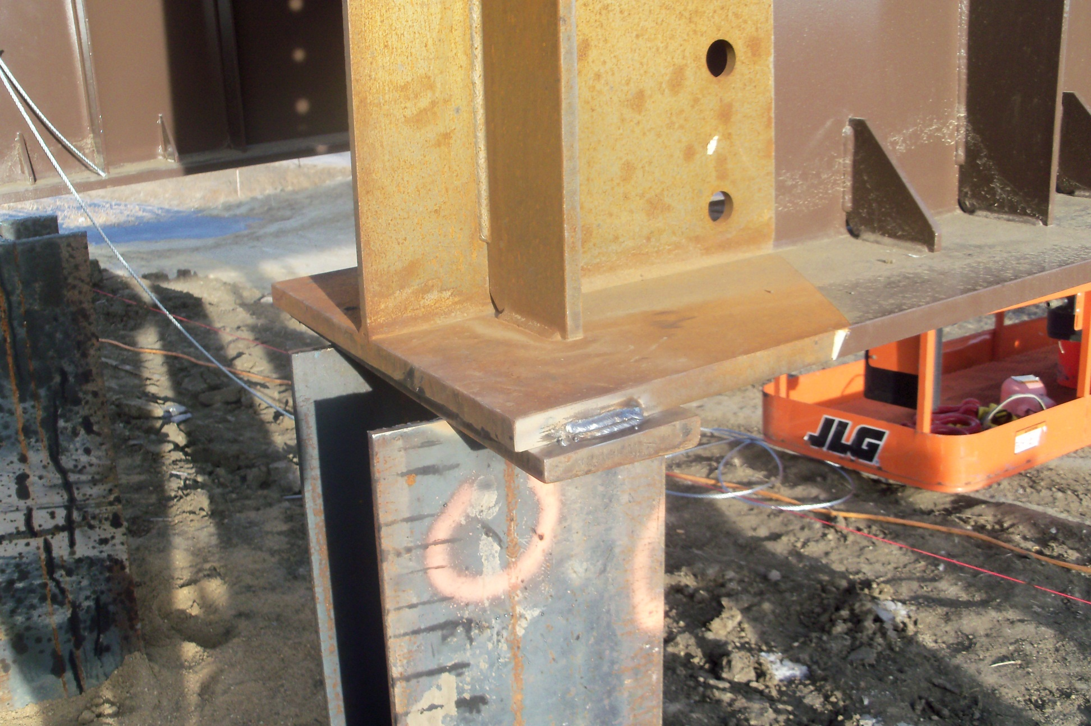
Weld Details

Slide 10
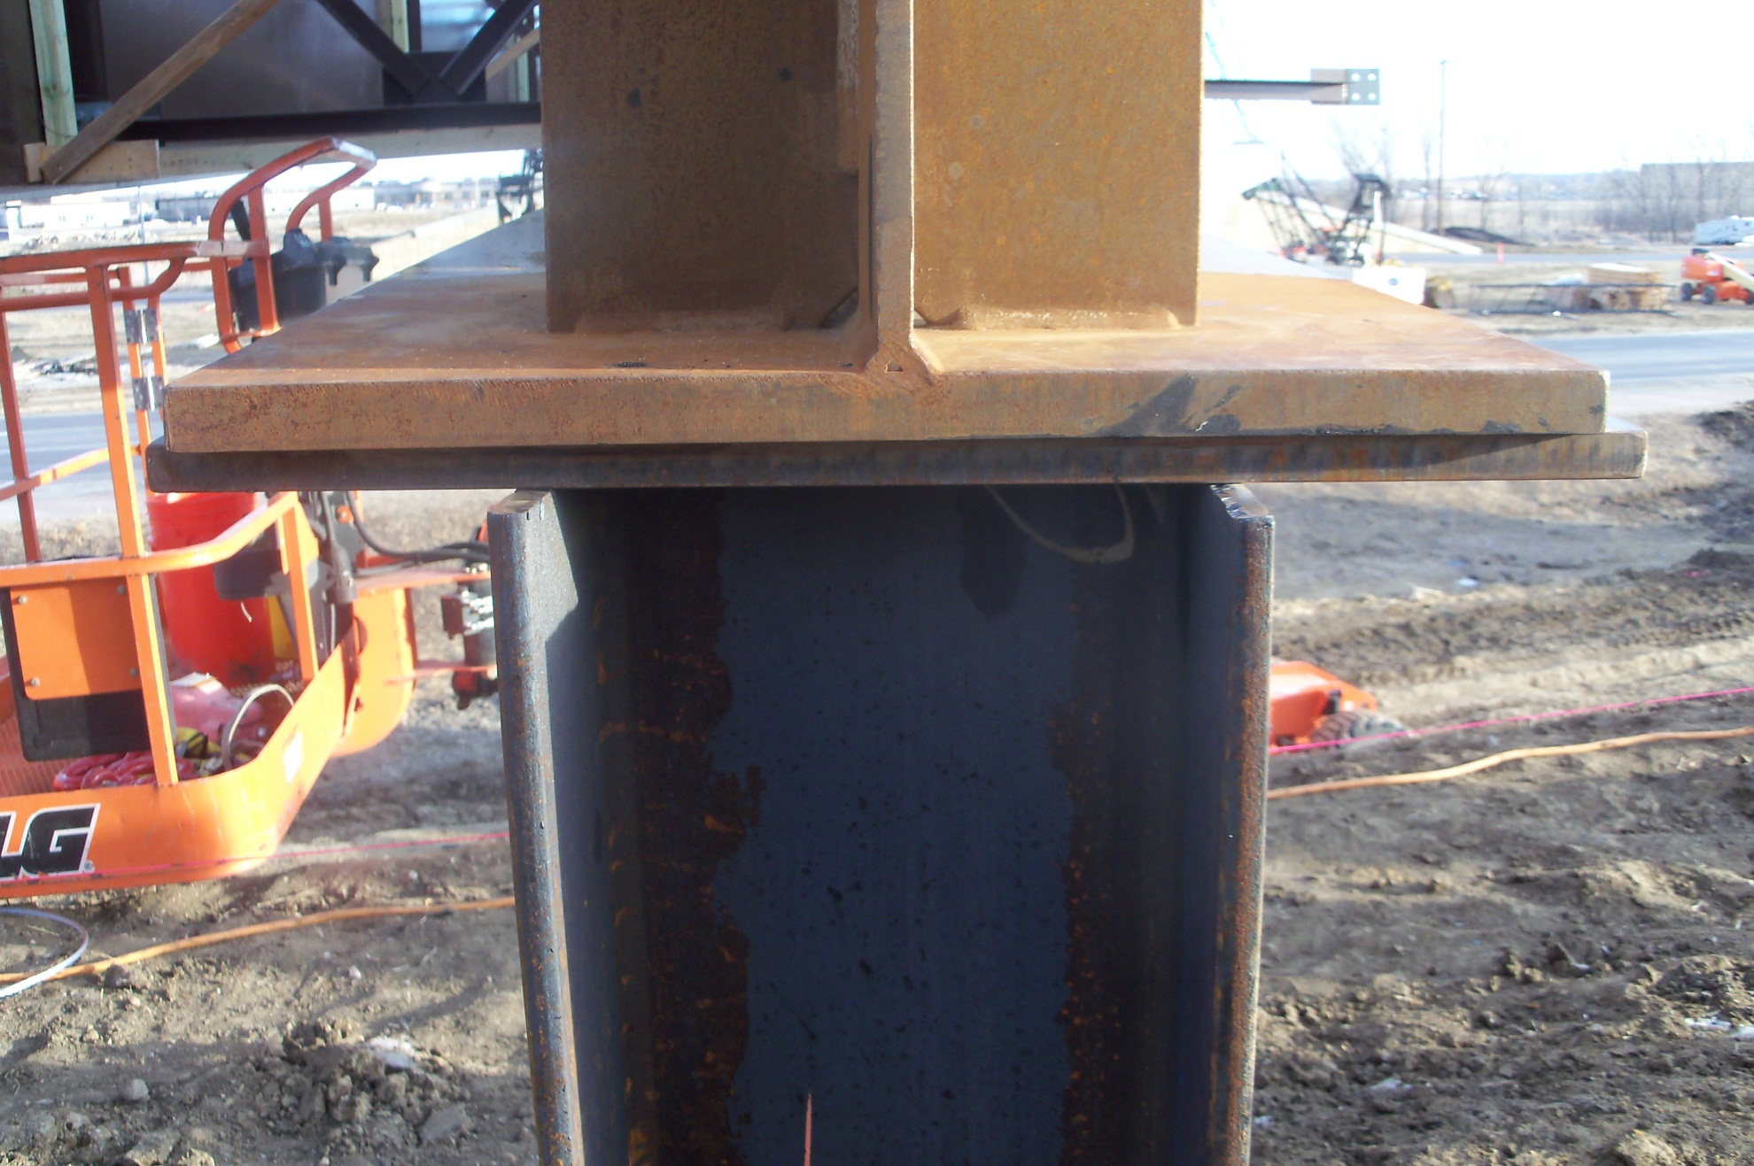
End View

Slide 11
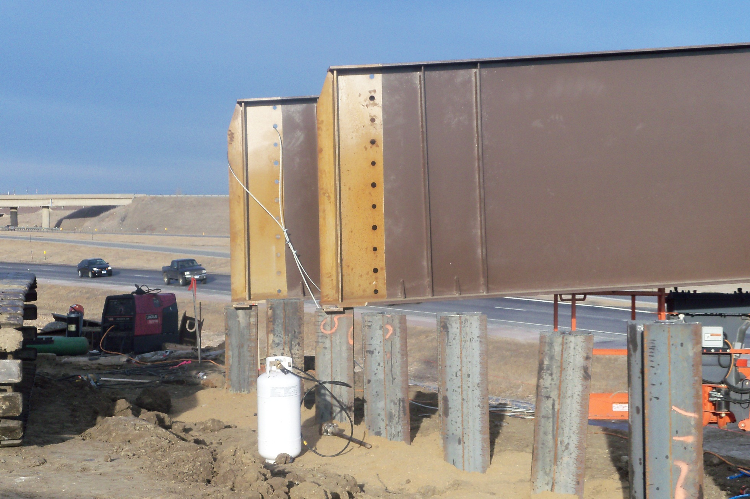
Grdrs in Place

Slide 12
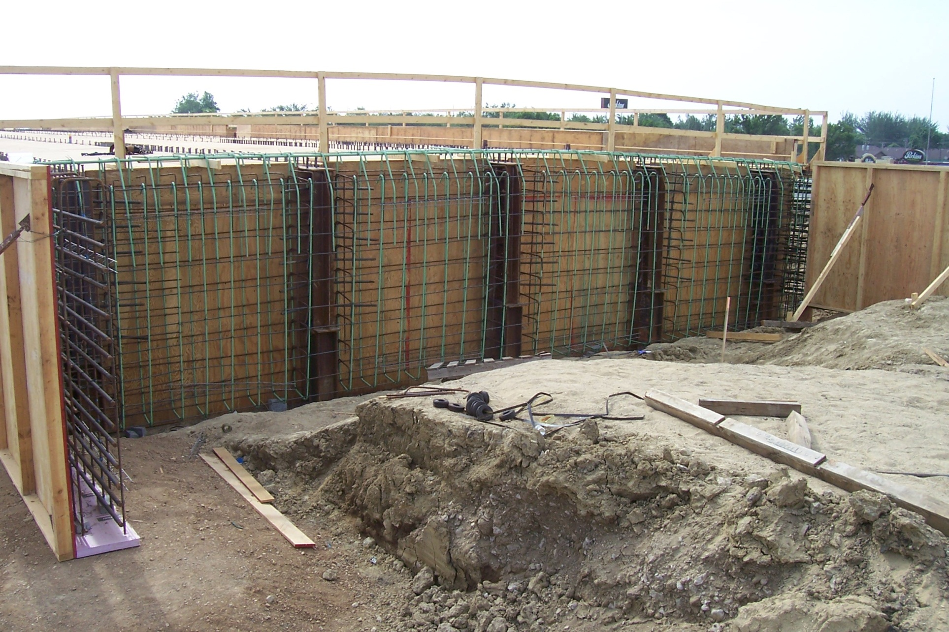
Typ. Reinforcing

Slide 13
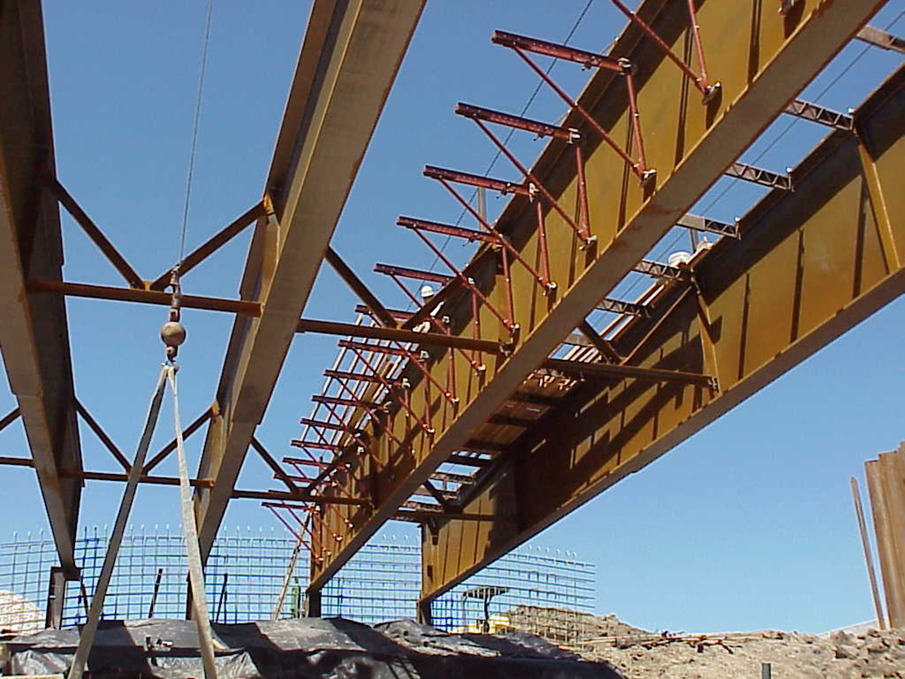
Not So Good!

Slide 14
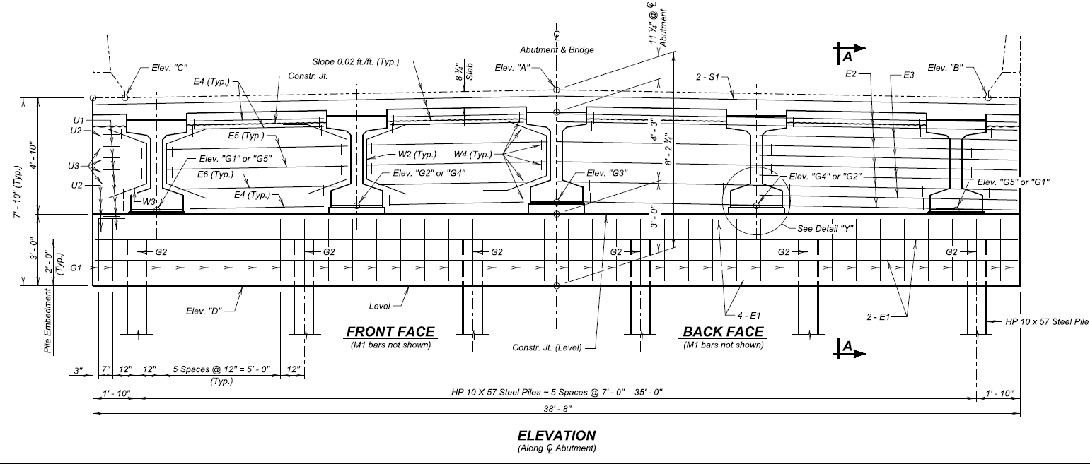
Prestressed Girder

Slide 15
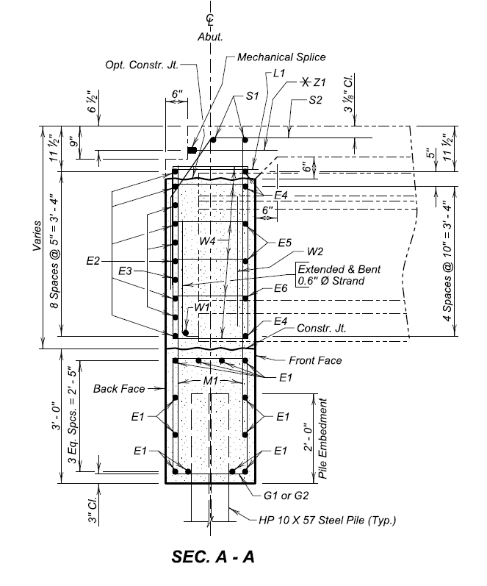
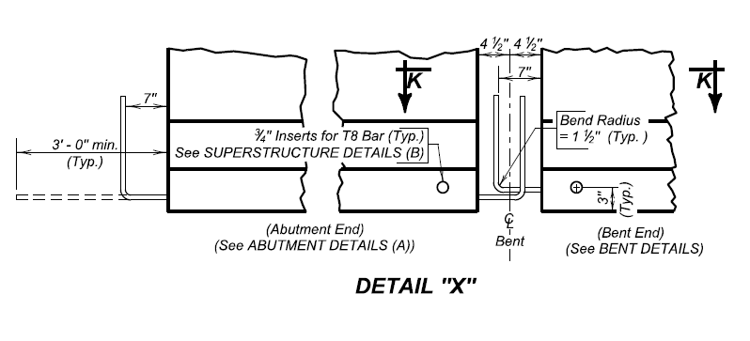
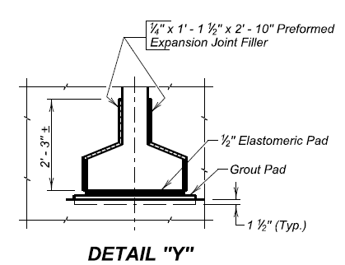
Typical Details

Slide 16
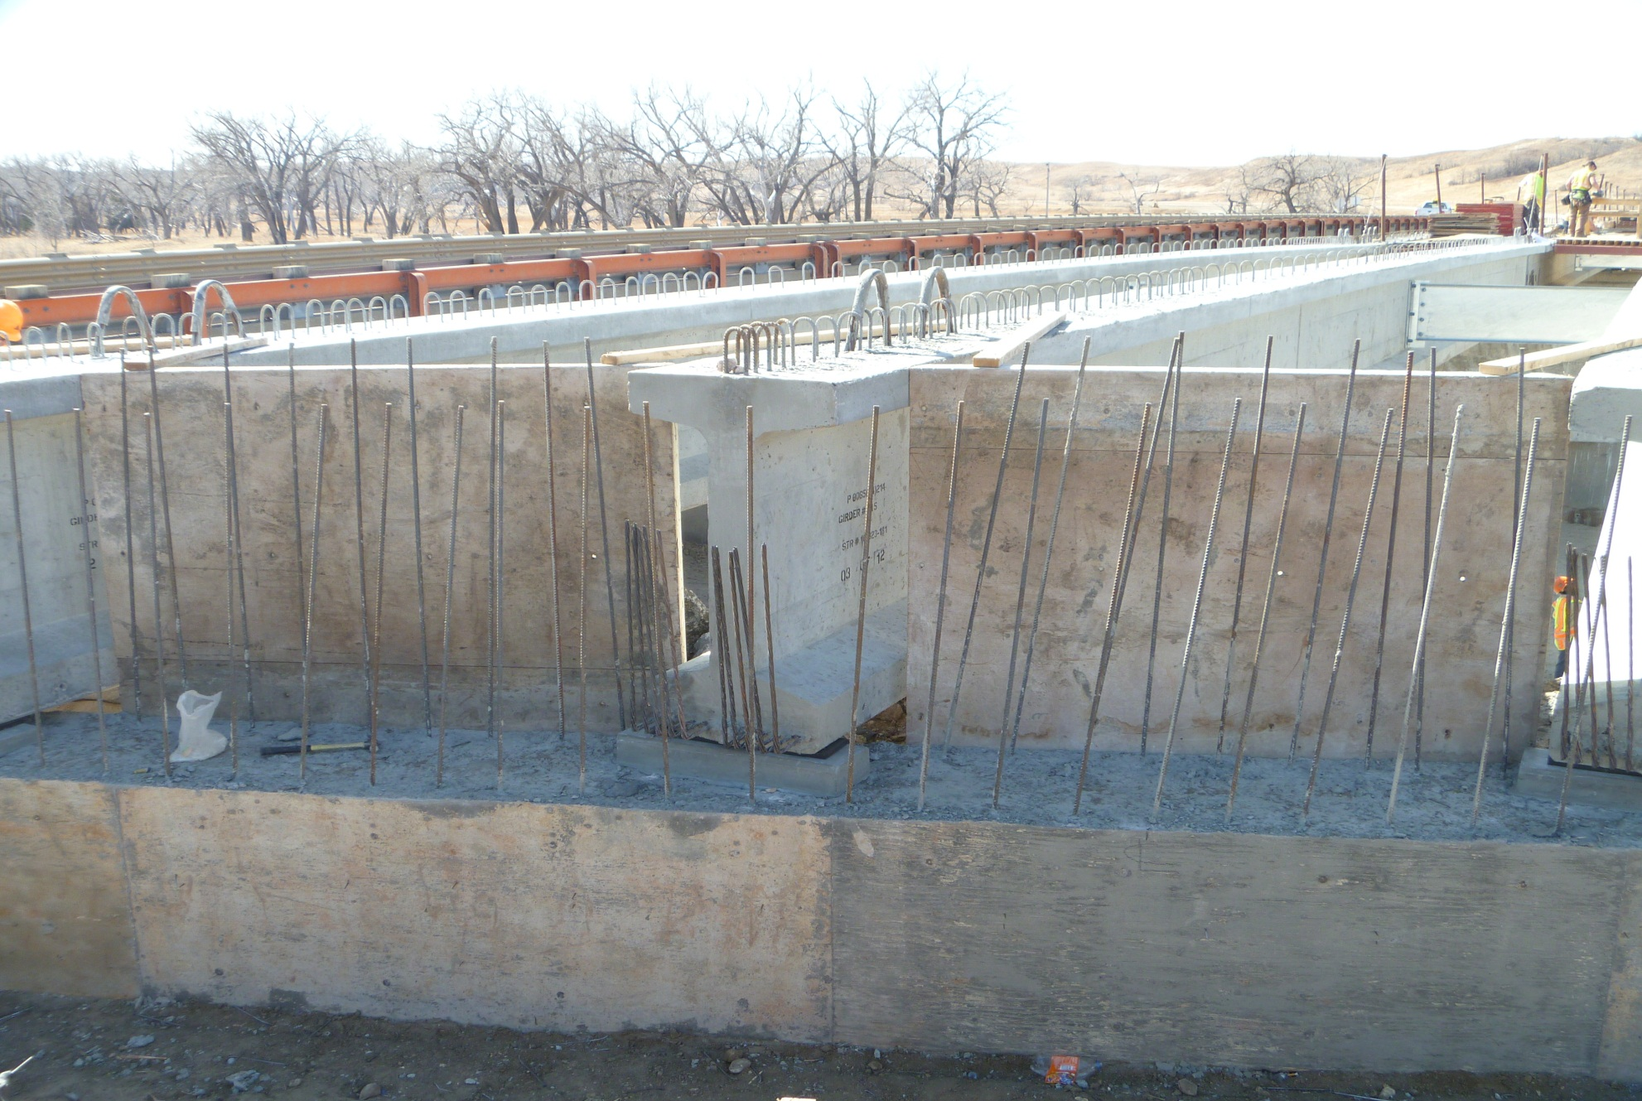
Girders in Place

Slide 17
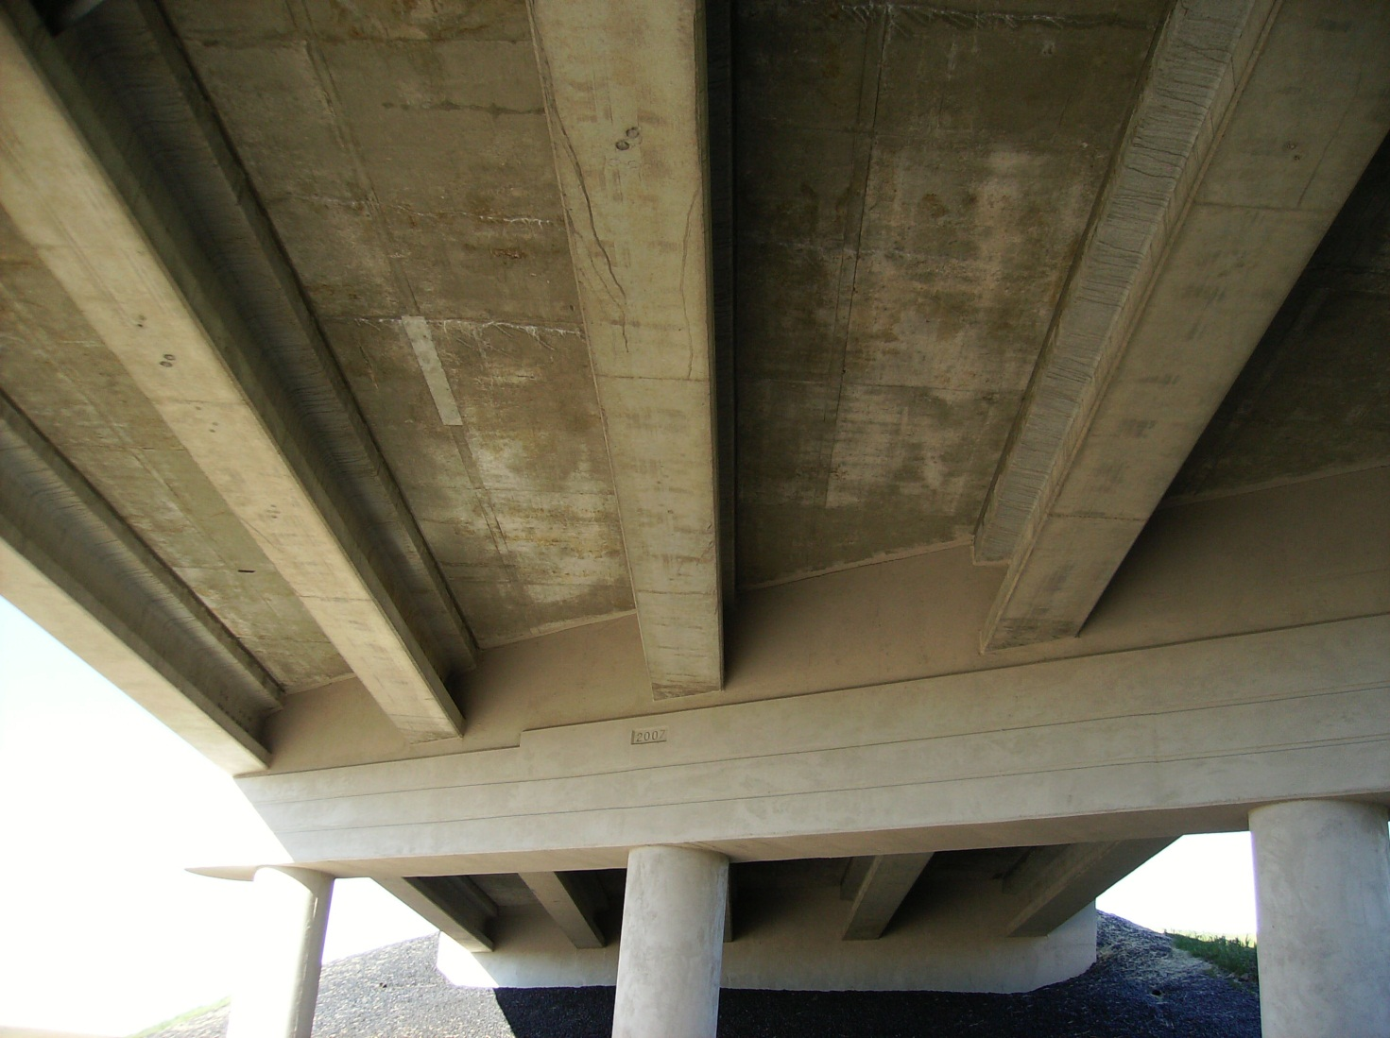
Encased Grdr Ends

Slide 18
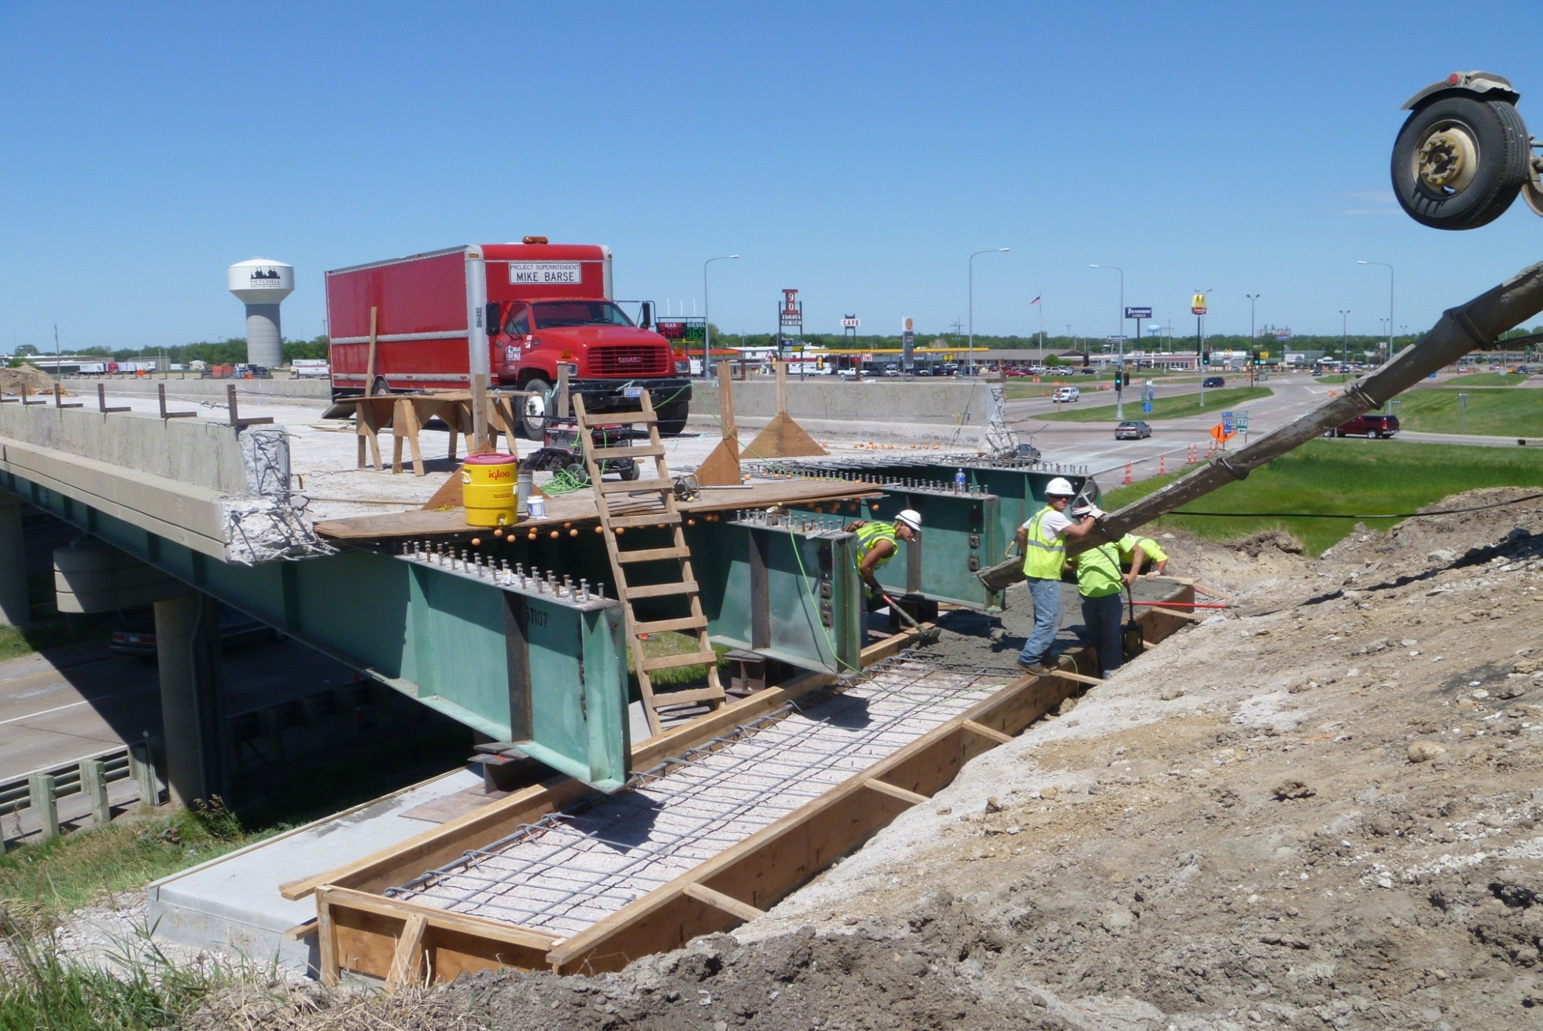
Semi-Integral

Slide 19
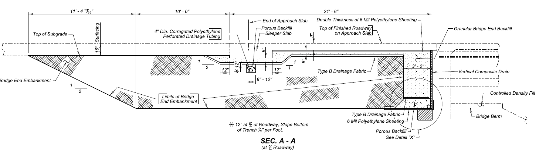
Backfill

Slide 20
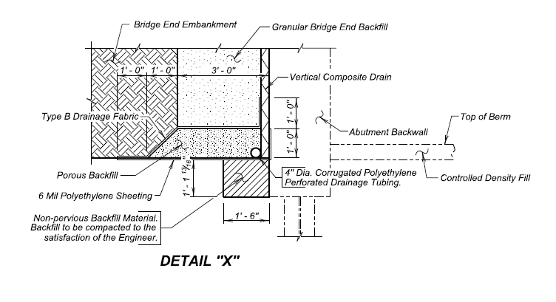
Drainage Detail

Slide 21
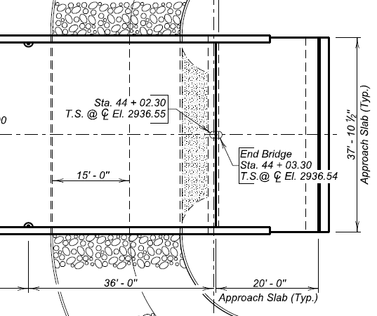
Approach Slabs

Slide 22
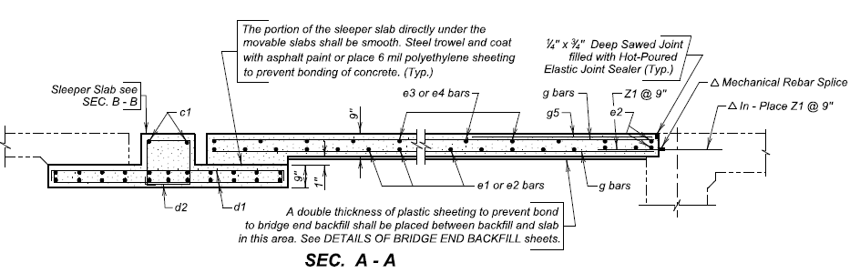
Standard Reinforcing

Slide 23
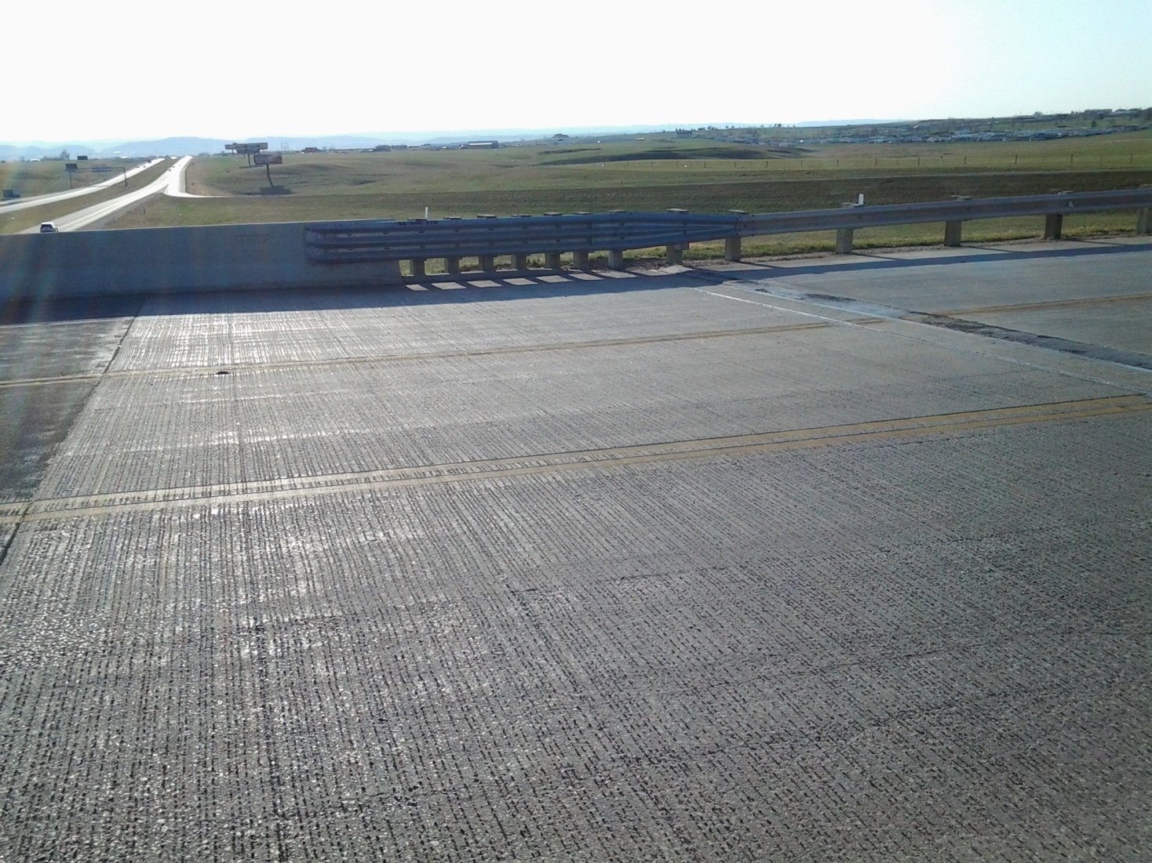
Approach Slab

Slide 24
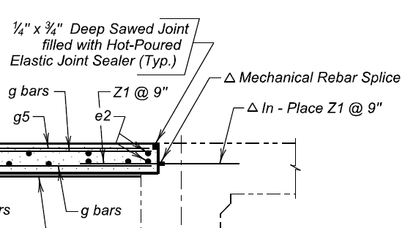
Connection Detail

Slide 25
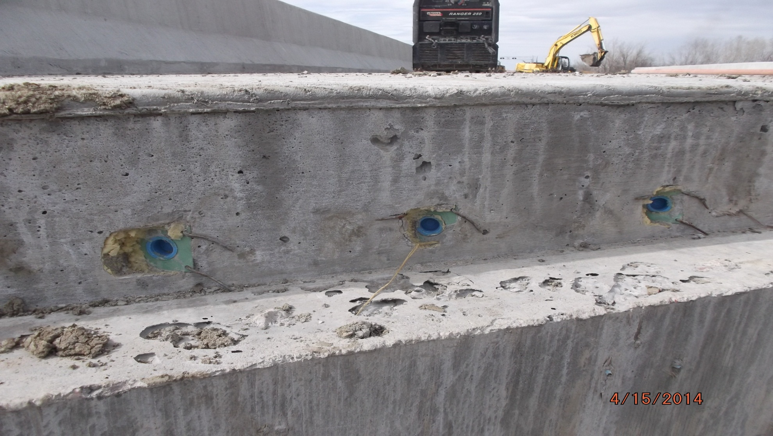
Z bar splice

Slide 26
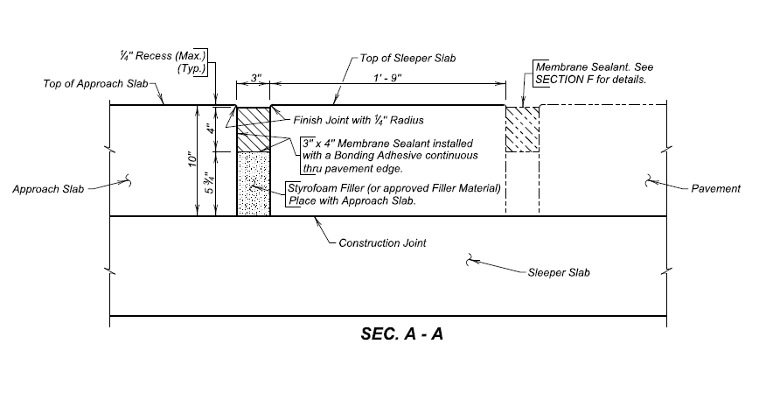
Expansion Joint

Slide 27
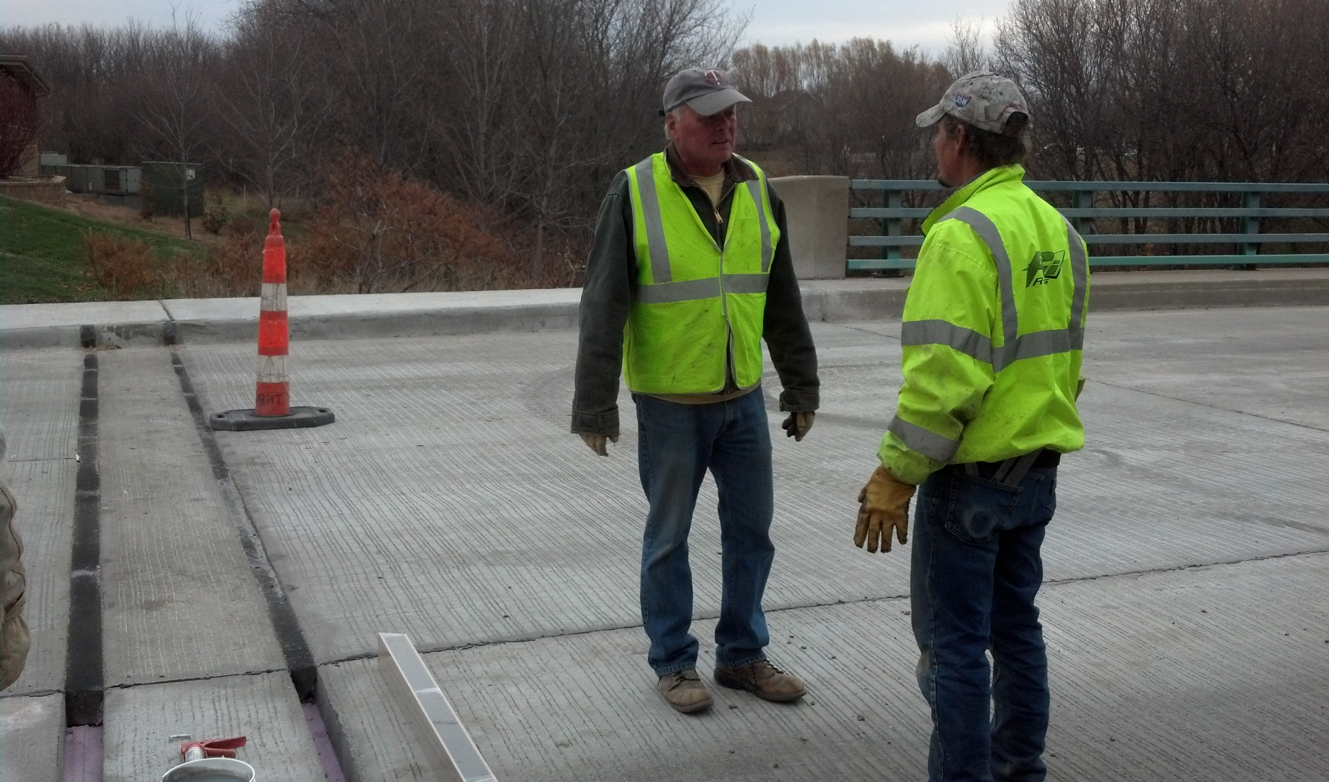
Joint Installation

Slide 28
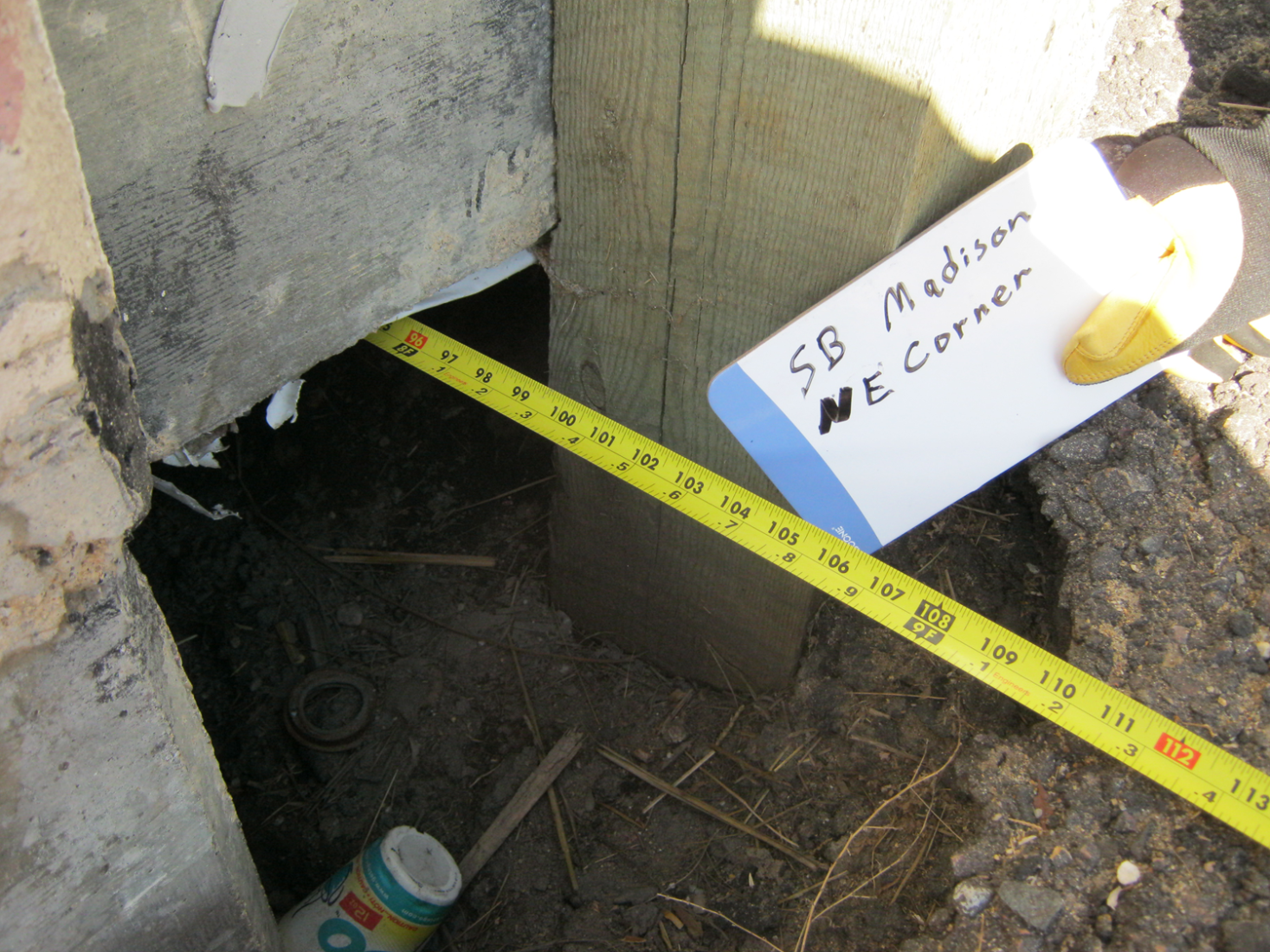
Settlement Issues

Slide 29
QUESTIONS?

