Slide 1
IA-92 over Little Silver Creek
ACCELERATED BRIDGE CONSTRUCTION CONCEPT REVIEW
Iowa ABC Workshop
May 1, 2014
Presented by Curtis J. Carter, PE

Slide 2
PRESENTATION OBJECTIVES
Discuss project concept
Share preliminary construction details (60% plans)
Solicit feedback from Workshop participants
Precursor to upcoming meeting with Iowa Association of General Contractors

Slide 3
PROJECT OVERVIEW
OBJECTIVE: In-House Design of ABC Bridge using PBES (Non-Slide)
SITE: IA-92 over Little Silver Creek
West of Treynor, IA (Rural)
GEOMETRY: 234’ x 44’ Bridge, 20° Skew, Sag Vertical Curve
SCHEDULE: Road Closure Limited to 21 Days
LETTING: December 16, 2014
CONSTRUCTION: Fall, 2015
EST. COST: $3.2M
STATUS: 60% Design Plans as of May 1, 2014

Slide 4
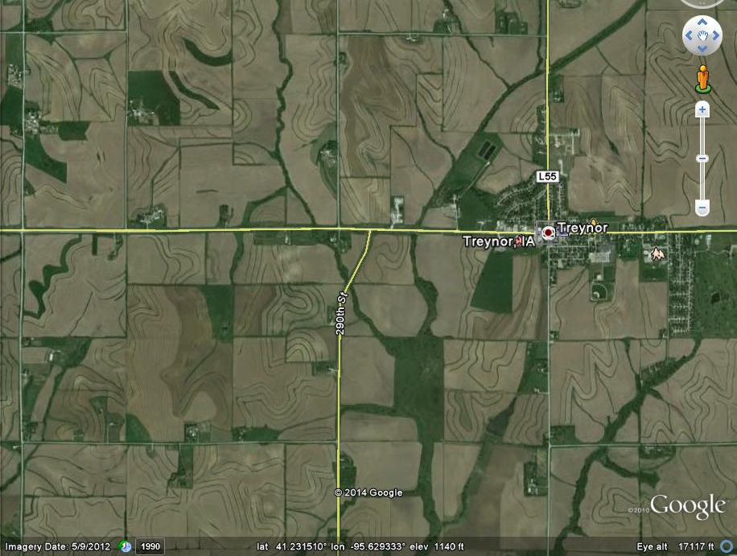
IA-92 over
Little Silver Creek

Slide 5
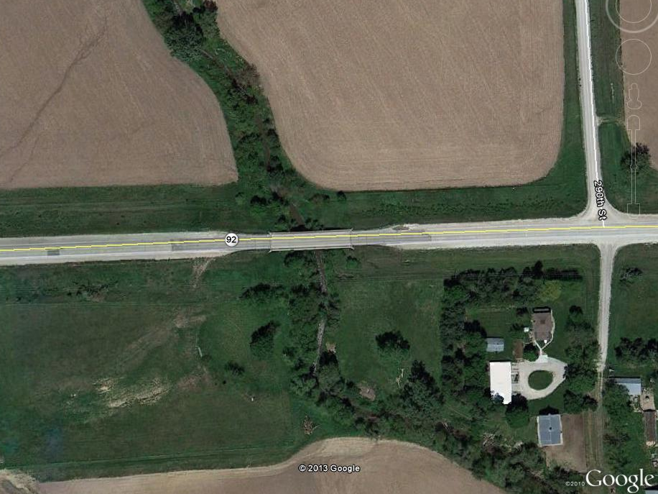
PROJECT SITE
Existing 150’-0 x 28’
Continuous Conc. Girder Bridge

Slide 6
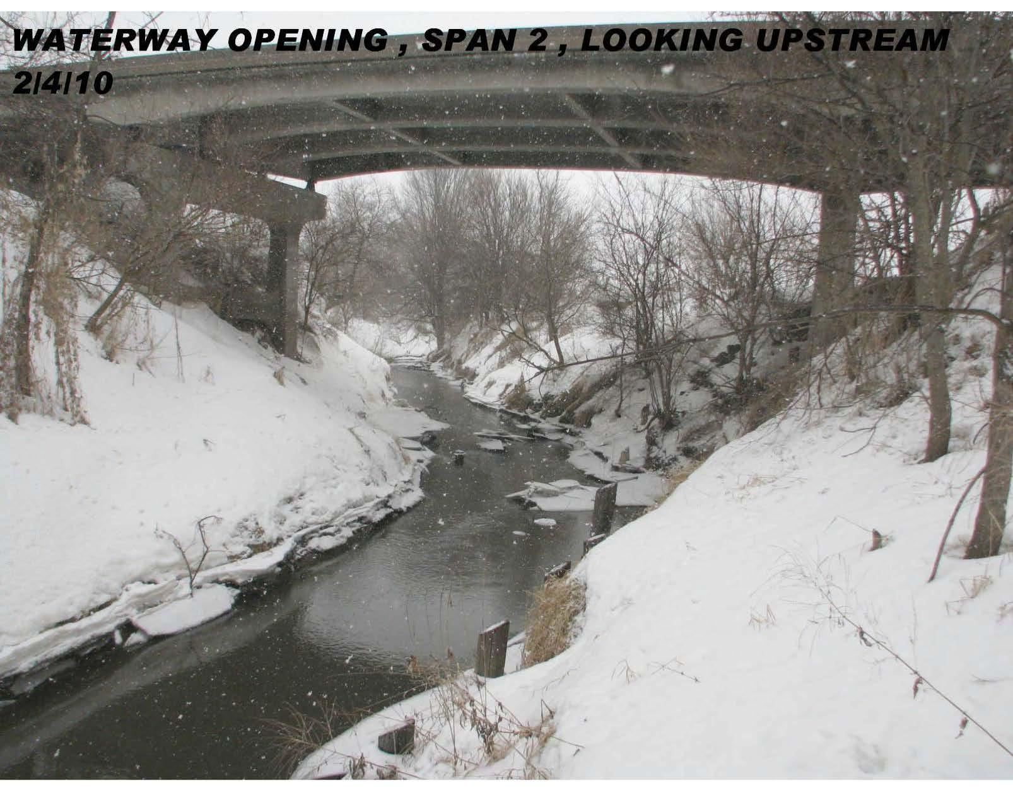
Looking North

Slide 7
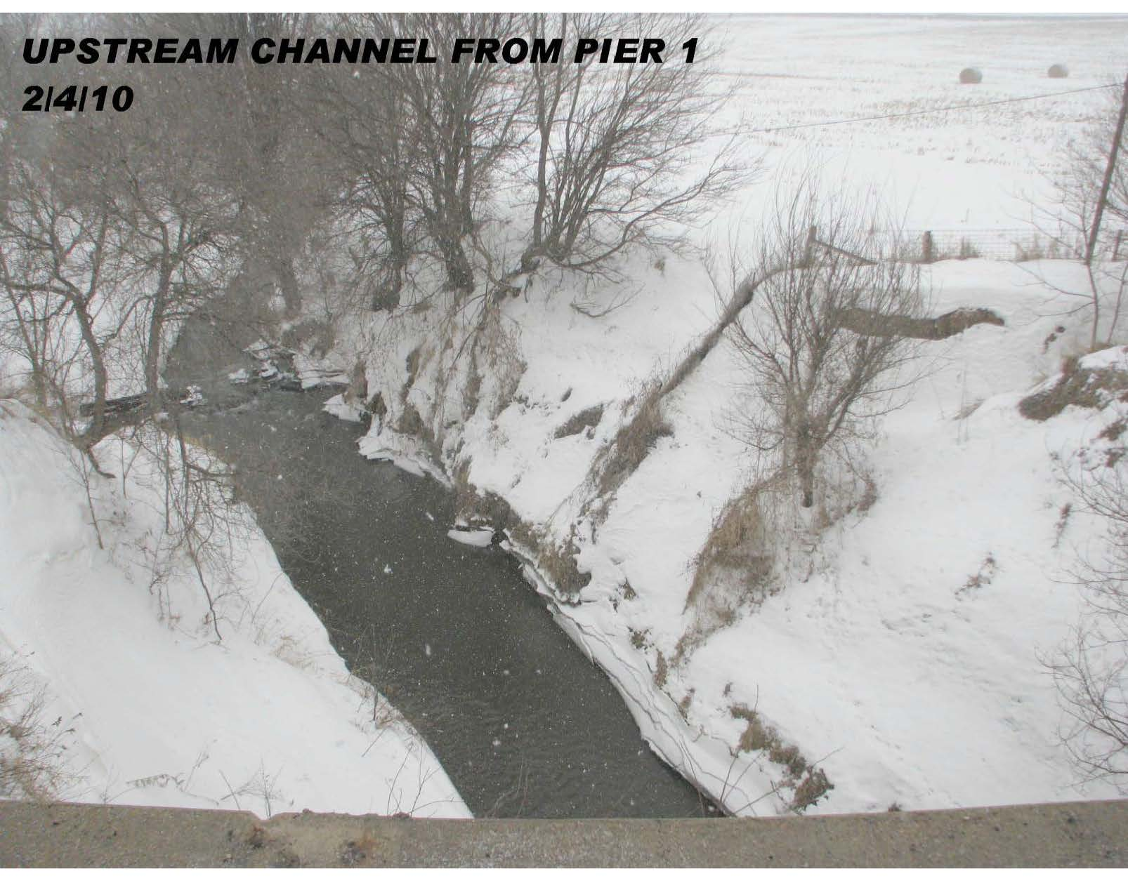
Looking North

Slide 8
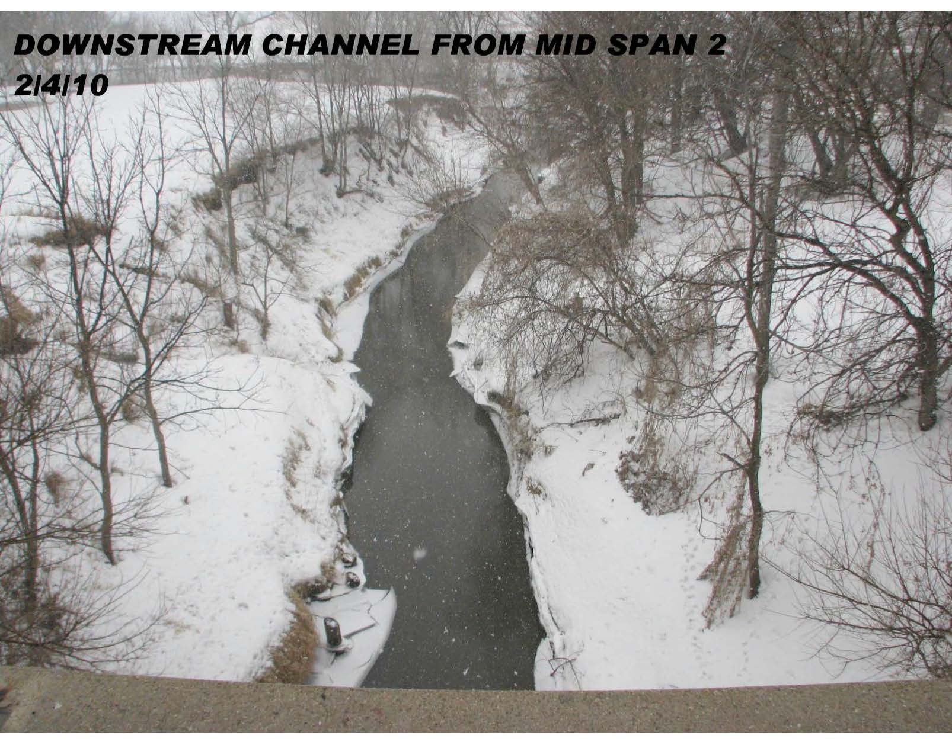
Looking South

Slide 9
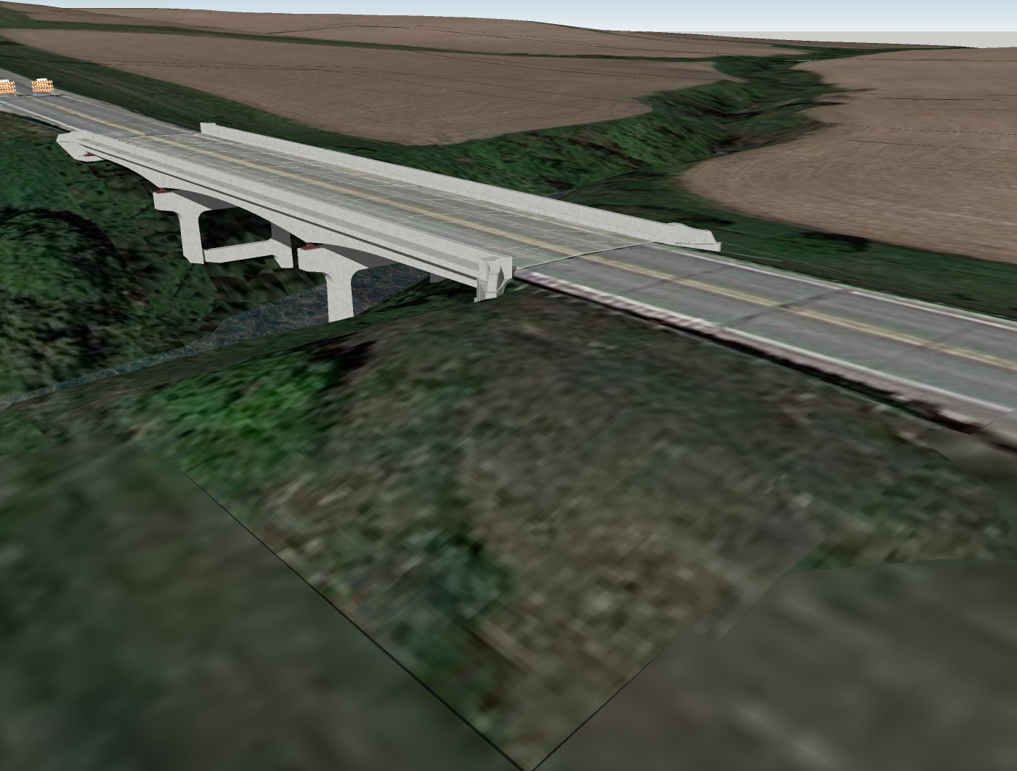
Existing 150’-0 x 28’
Continuous Conc. Girder Bridge

Slide 10
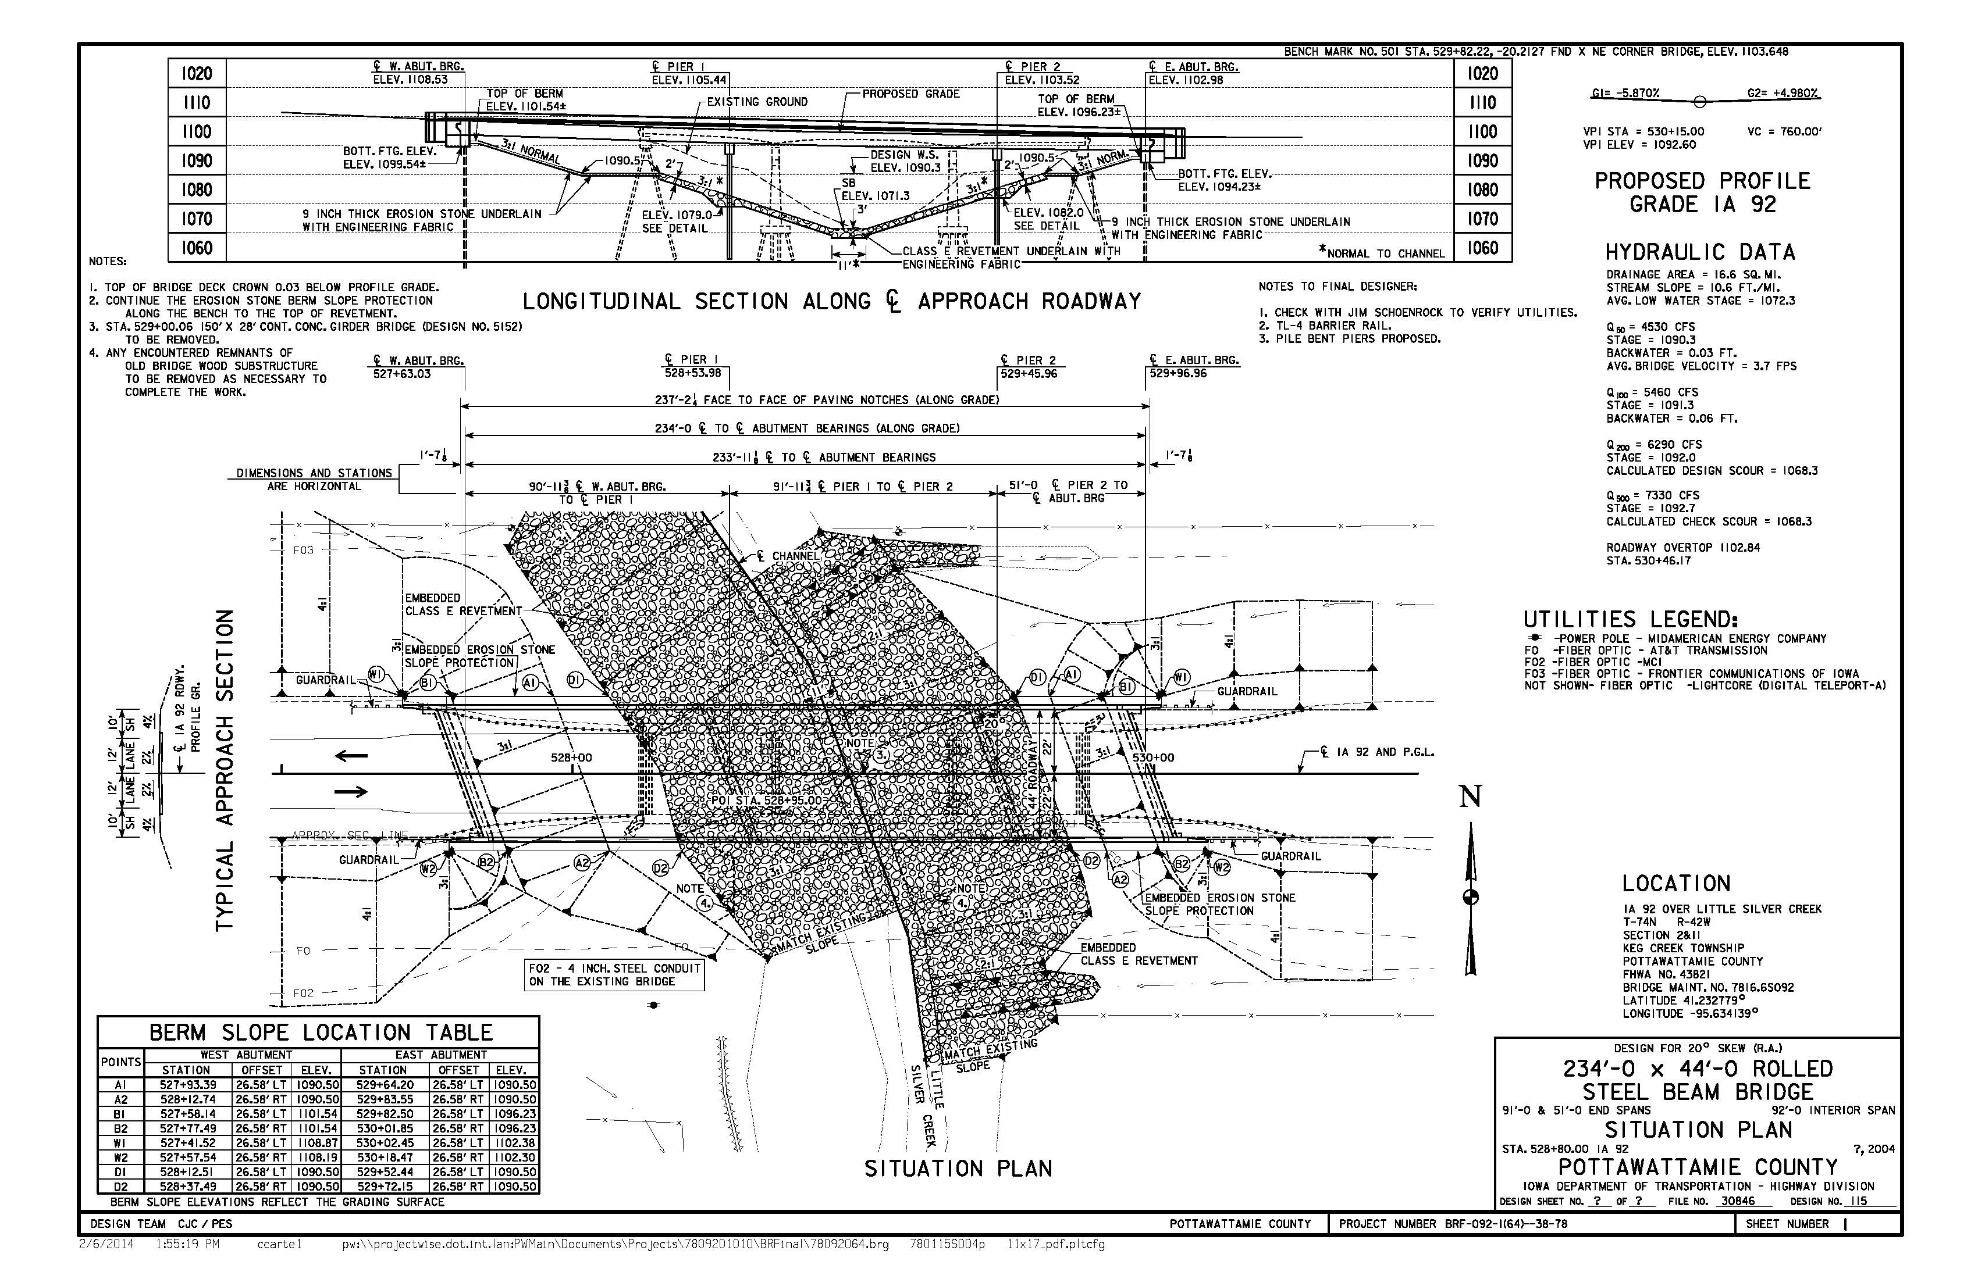

Slide 11
SITE OBSTACLES
Skew
  Iowa has not previously applied decked module concept to skewed bridge
Sag Vertical Curve
  4.0% deck grade at W. Abutment, 2.7% at Pier 1
  Sag curvature complicates fit-up, requires more accuracy during fabrication/prefabrication
Poor Soil Conditions
  Long pile lengths with 2 or 3 field splices per pile
Long Unbraced Length at Piers
  Degraded channel plus design scour
  Unsupported length exceeds Iowa design standards for pile bent piers

Slide 12
DESIGN STATUS
Design Team
  Curtis Carter
  Mike Nop
  Dean Bierwagen
Design/Details under development, 60% complete
Design concept may evolve based on:
  Feedback from ABC Workshop
  Feedback from Iowa Association of General Contractors
  Possible research opportunities

Slide 13
DESIGN HIGHLIGHTS

Slide 14
CONCEPT
Superstructure
  Modular Decked Beams
Substructure
  Integral Abutments
  Pile Bent Piers
Details intended to:
  Build on Proven Technology
  Improve Accelerated Constructability
  Ease Construction Tolerances
  Facilitate Rapid Field Adjustment
  Satisfy Performance Goals (Construction Schedule, Design Life)
  Promote Contractor Involvement and Innovation

Slide 15
ACCELERATED CONST. SCHEDULE
21-DAY ROAD CLOSURE
Pre-closure activities:
  Prefabricate superstructure modules
  Prefabricate substructure caps/footings (optional)
During closure:
  Demolition
  Grading and Revetment
  Substructure Construction
  Superstructure Construction
  Approach Construction
Post-closure activities (permissible single-lane closures as required):
  Shoulder Construction
  Guardrail
  Finish Grading and Seeding
  Miscellaneous Non-Structural Construction Activities

Slide 16
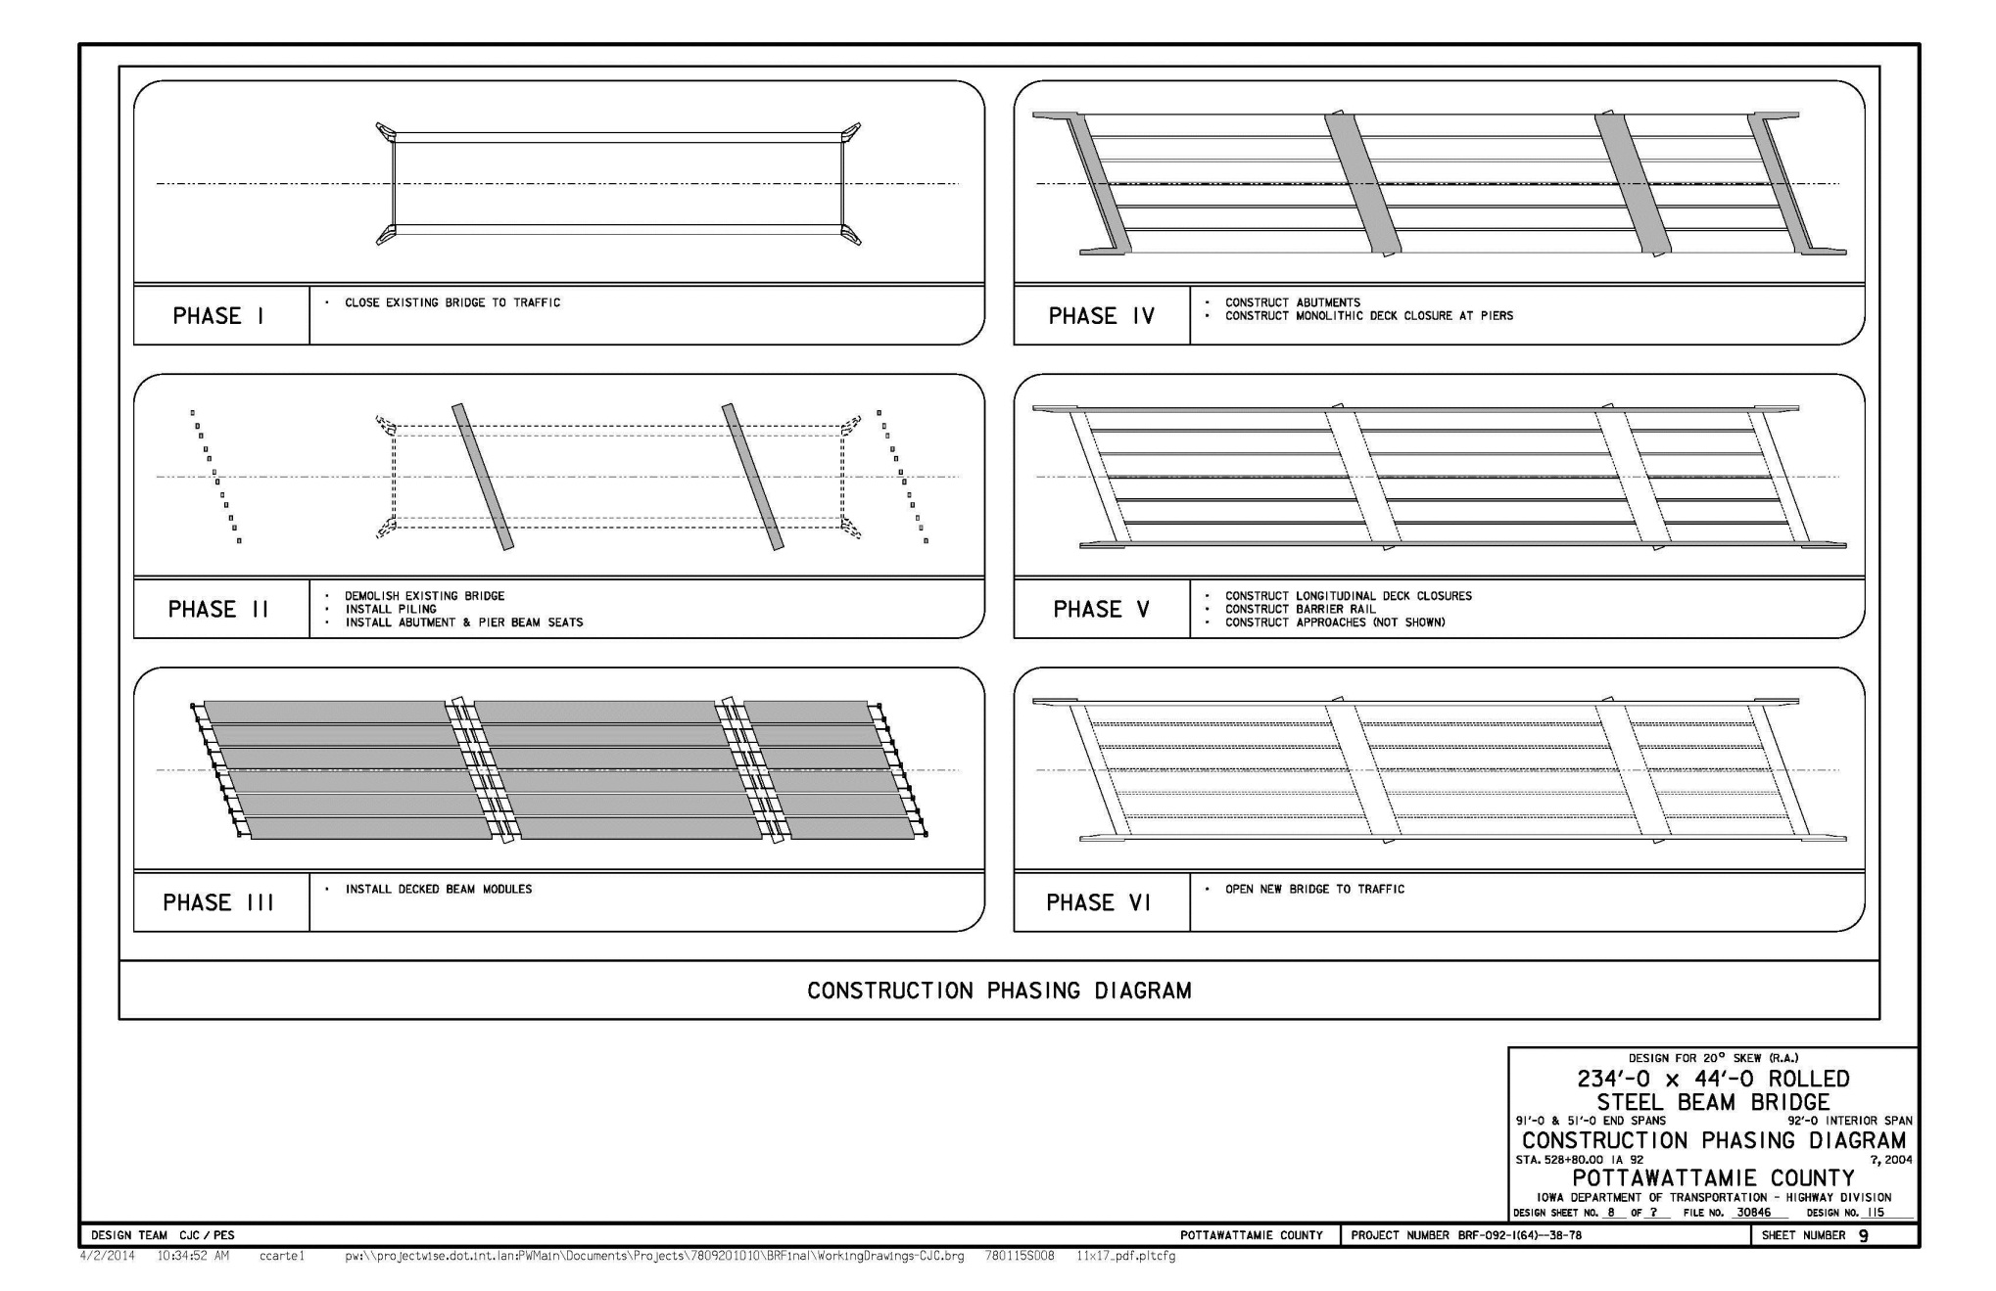
PROPOSED CONST. PHASING

Slide 17
PROPOSED SCHEDULE
21 Day ABC Timeline
 | CONSTRUCTION ACTIVITY |  |  |  |  | 21 DAY CLOSURE PERIOD
 |  |  |  |  |  | 1 | 2 | 3 | 4 | 5 | 6 | 7 | 8 | 9 | 10 | 11 | 12 | 13 | 14 | 15 | 16 | 17 | 18 | 19 | 20 | 21
 | CLOSE IA 92
 | BRIDGE DEMOLITION
 | GRADING & RIP-RAP PLACEMENT UNDER BRIDGE
 | DRIVE PIER PILING
 | PIER PILE ENCASEMENT CONSTRUCTION
 | DRIVE ABUTMENT PILING
 | CONSTRUCT PIER CAP
 | ABUTMENT PILE BRACING & BEAM SEATS
 | ERECT DECK MODULES
 | CONSTRUCT ABUTMENTS & WINGS
 | CONSTRUCT PIER CAP DIAPHRAGMS
 | PLACE UHPC LONGITUDINAL JOINTS
 | CONSTRUCT APPROACHES AND BARRIER RAIL
 | GRINDING & LONGITUDINAL GROOVING OF DECK
 | FINISH GRADING & WING ARMORING
 | GUARDRAIL & PAINT
 | OPEN IA 92

Slide 18
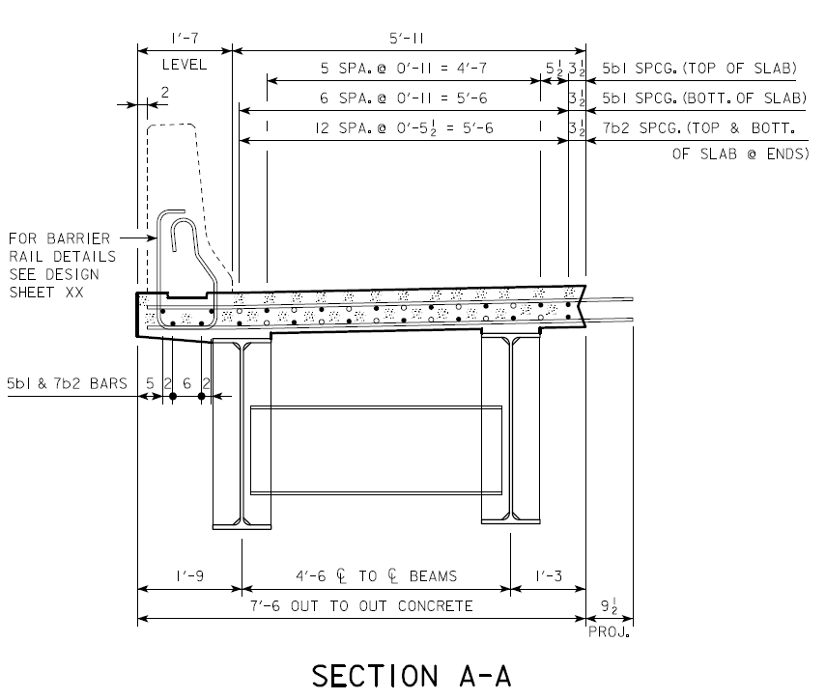
MODULAR DECKED BEAMS
2-BEAM MODULAR UNITS
Patterned after US-6 over Keg Creek
± 100,000 lbs Module Weight
W40x149 Beams (Simple Span)
  Prestressed concrete beams were considered but not implemented due to geometry complications (camber vs. grade) and heavier pick weights
4’-6 Beam Spacing, 7’-0 Deck Width
8¼” High Performance Concrete Deck
  Deck includes additional sacrificial thickness to allow grade/crown adjustment by grinding
Stainless Steel Deck Reinforcing
  Improved joint performance and greater service life
Transverse reinforcing will project from module for staggered lap with adjacent module
Typ. Module Detail
Bottom of beams will be set level; crown will be established using variable haunch thickness

Slide 19
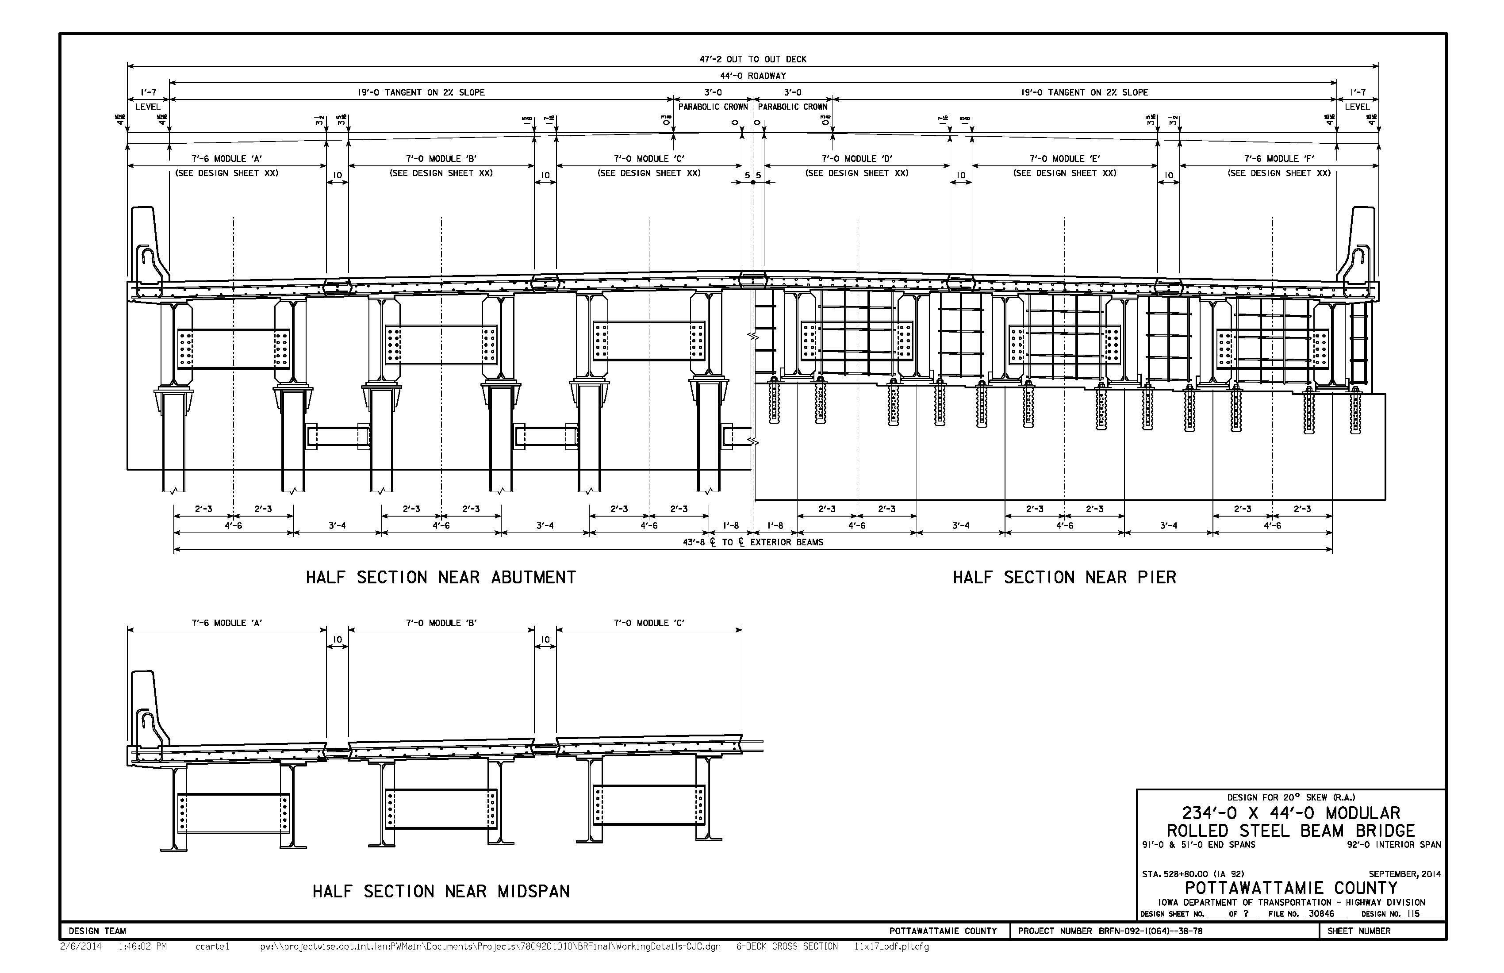
MODULAR DECKED BEAMS
Six-module cross section
10” joint between modules
Discontinuous steel diaphragms

Slide 20
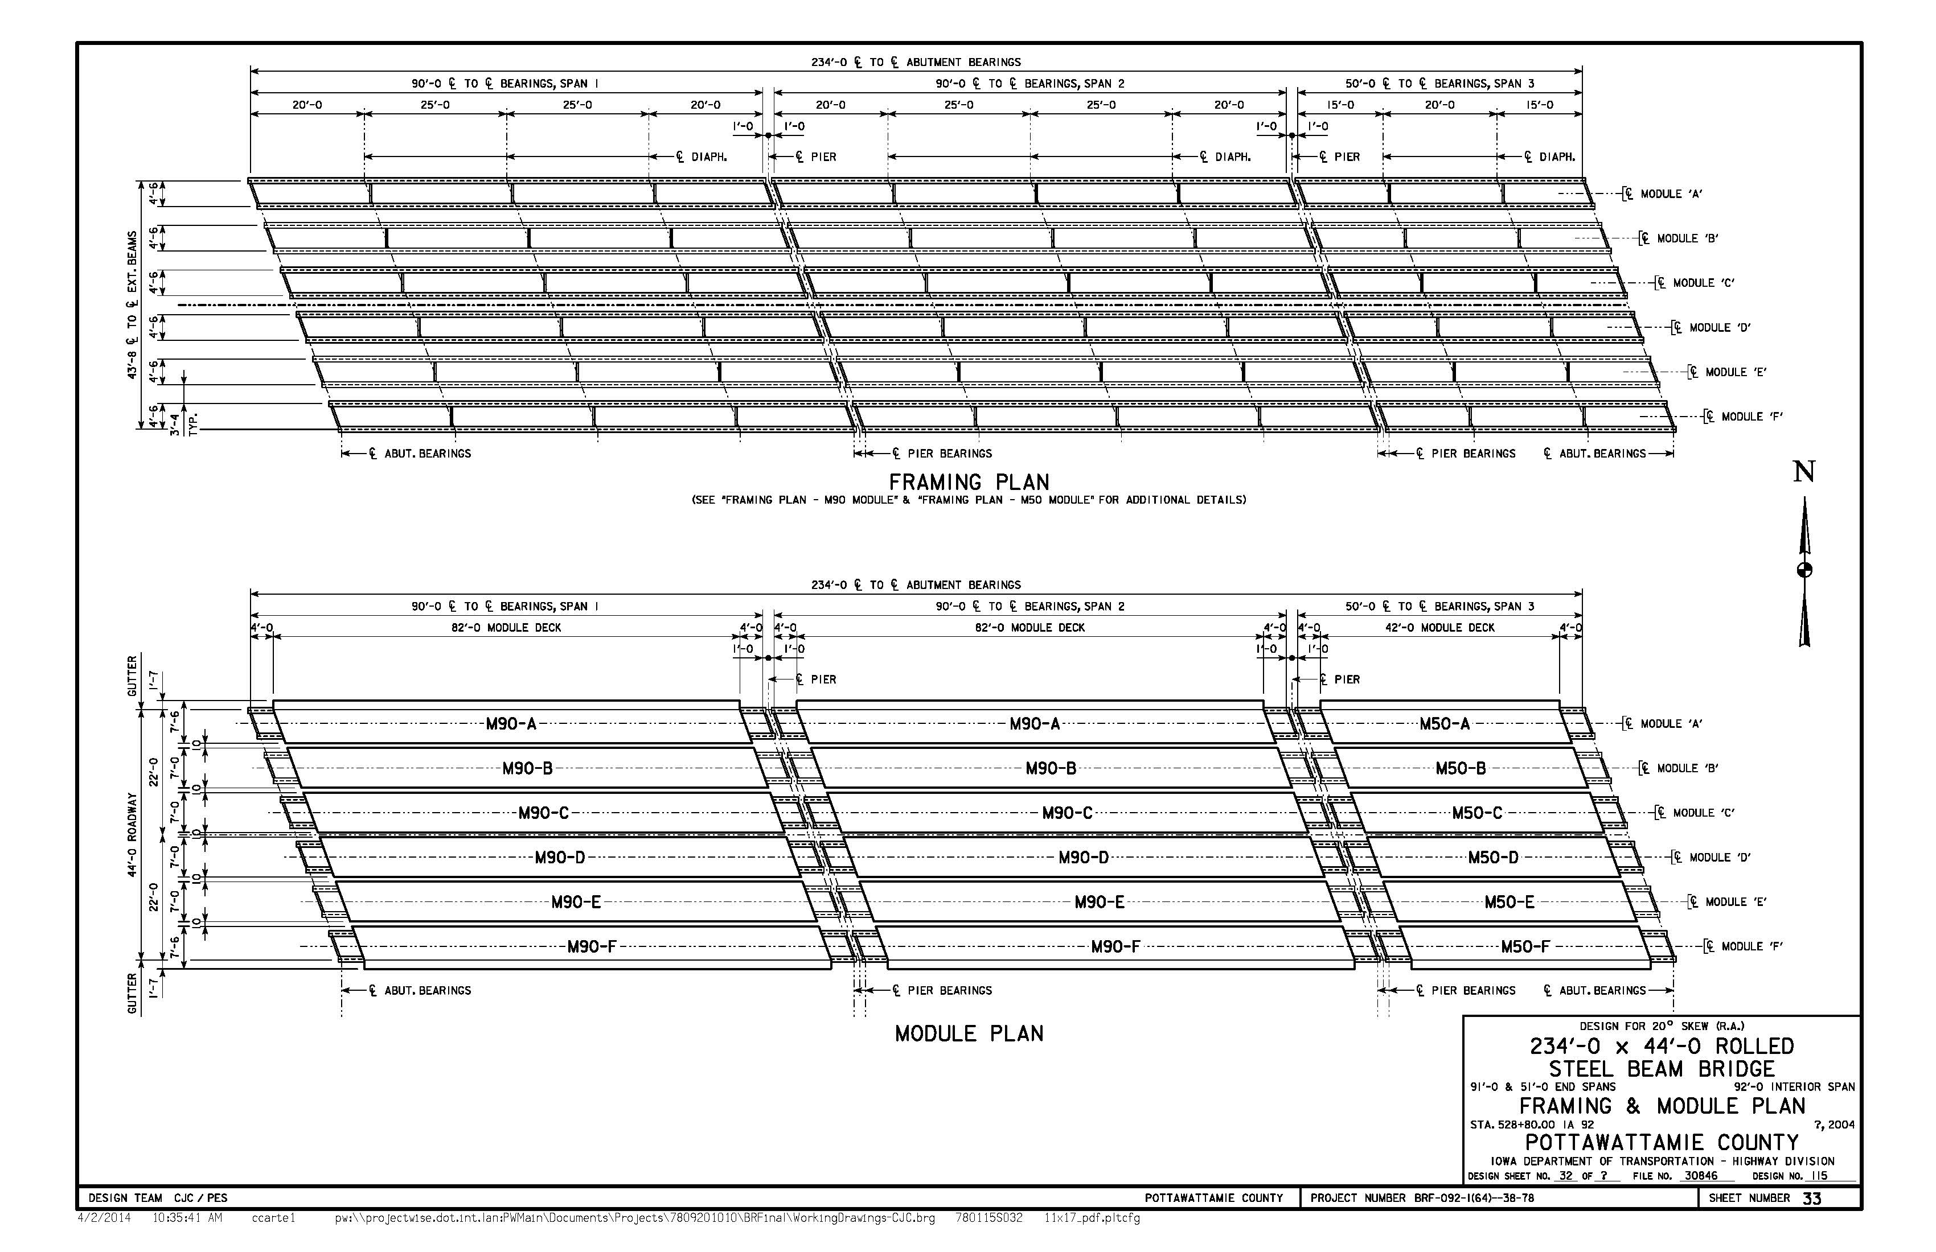
MODULAR DECKED BEAMS
18-module deck

Slide 21
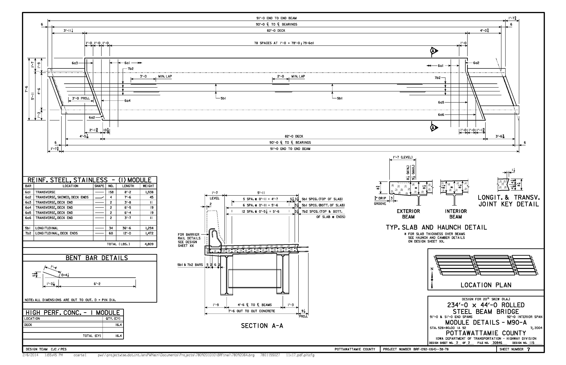
MODULAR DECKED BEAMS
Beam ends project from modular deck for lifting and securing to other modules

Slide 22
ALTERNATE SITE CASTING
Due to complex geometry, accurate prefabrication of single individual modules at a fabrication shop/casting yard will likely be difficult and expensive.
The recommended prefabrication procedure consists of using alternate site casting procedures to construct all modules simultaneously on temporary supports that match the relative location/elevation of the design bridge seats.
  Constructing modules simultaneously in the correct relative position facilitates accurate bar placement (optimized bar stagger at longitudinal joints).
  Minimizes post-assembly grinding/grade correction due to misaligned joint mating surfaces.
  Deck joint locations could be blocked out to allow for concrete placement using a conventional paving machine.
  Alternate site would be selected by the contractor and would be close to the project site, minimizing module transportation costs.

Slide 23
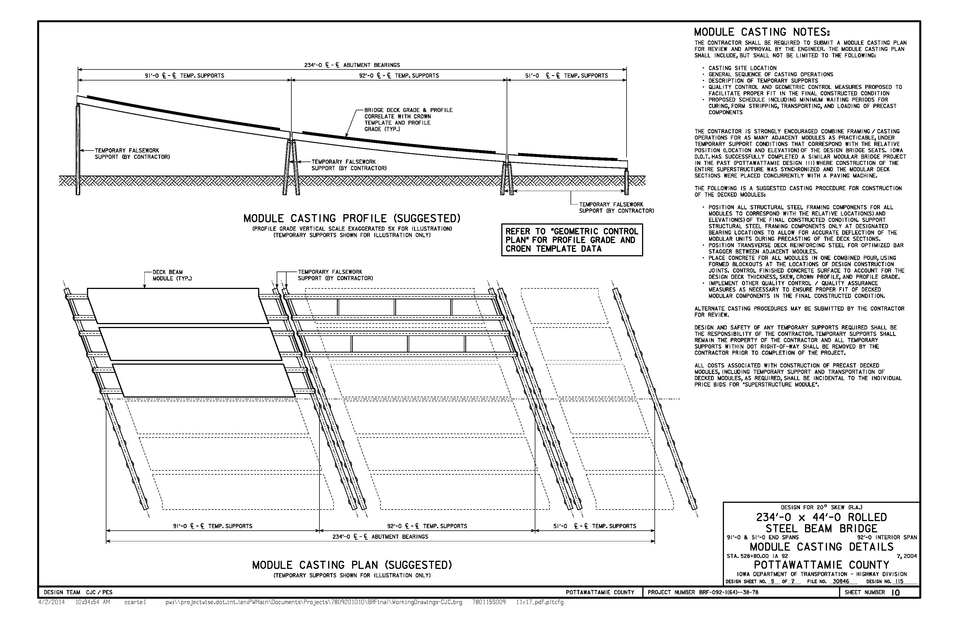
ALTERNATE SITE CASTING
Profile grade scale exaggerated 5X

Slide 24
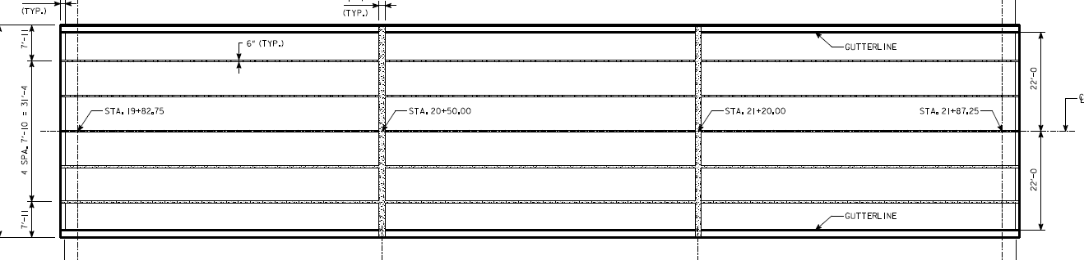
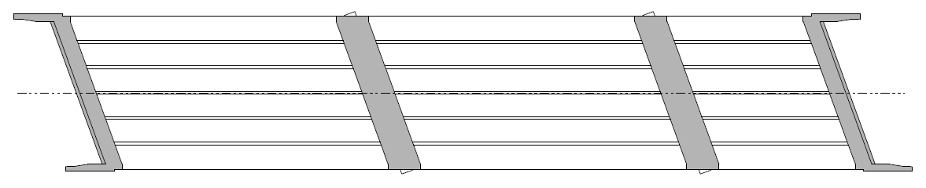
C.I.P. TRANSVERSE JOINTS
CONVENTIONAL CAST-IN-PLACE TRANSVERSE JOINTS
Wider joint for improved constructability
Allows joint(s) to be placed at lower-stress regions of deck
Deck closure concrete is monolithic with abutment/pier diaphragms
Conventional construction procedures with concrete maturity monitoring
Narrow UHPC joint
US-6 Over Keg Creek
Deck Plan
Wide C.I.P. joint
IA-92 Over L.S. Creek
Deck Plan

Slide 25
UHPC LONGITUDINAL JOINTS
ULTRA-HIGH-PERFORMANCE CONCRETE
Performance Advantages
  Better bond with precast module concrete
  Improved durability compared with conventional concrete
  Reduced development lengths for narrower joints
  Placed after C.I.P. transverse closures to minimize UHPC forming requirements
Design Considerations
  Limited contractor experience
  Special construction procedures
  On-site test pour will be required
  Contractor will be required to coordinate with manufacturer and follow recommended procedures
Version of this detail used for design
Example Deck Joint Options

Slide 26
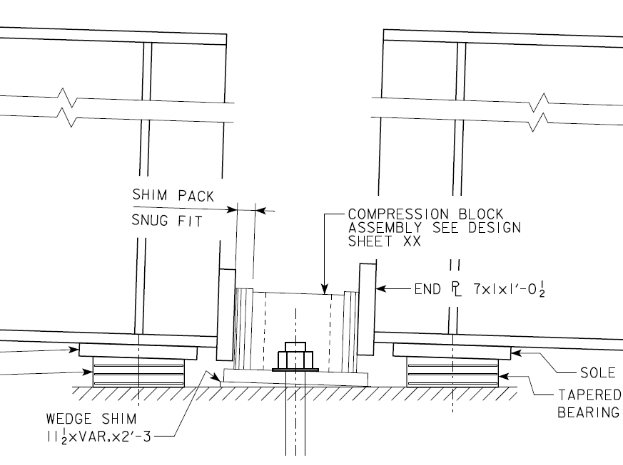
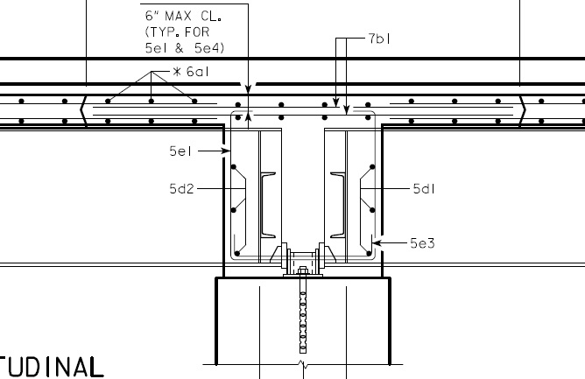
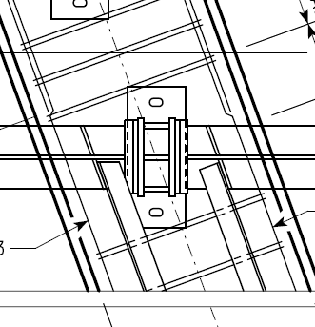
SIMPLE-MADE-CONTINUOUS
Designed to support dead load and live load for simple span conditions
Details will be implemented to allow structure to behave as continuous under live load
  Additional deck reinforcing in negative moment region
  Steel block used to transfer compressive forces between beam bottom flanges
Snug-fit acceptable for compression detail
Slotted holes and shim packs facilitate constructability and field adjustment
Monolithic diaphragm encases full moment reaction
Proposed Pier Continuity Details

Slide 27
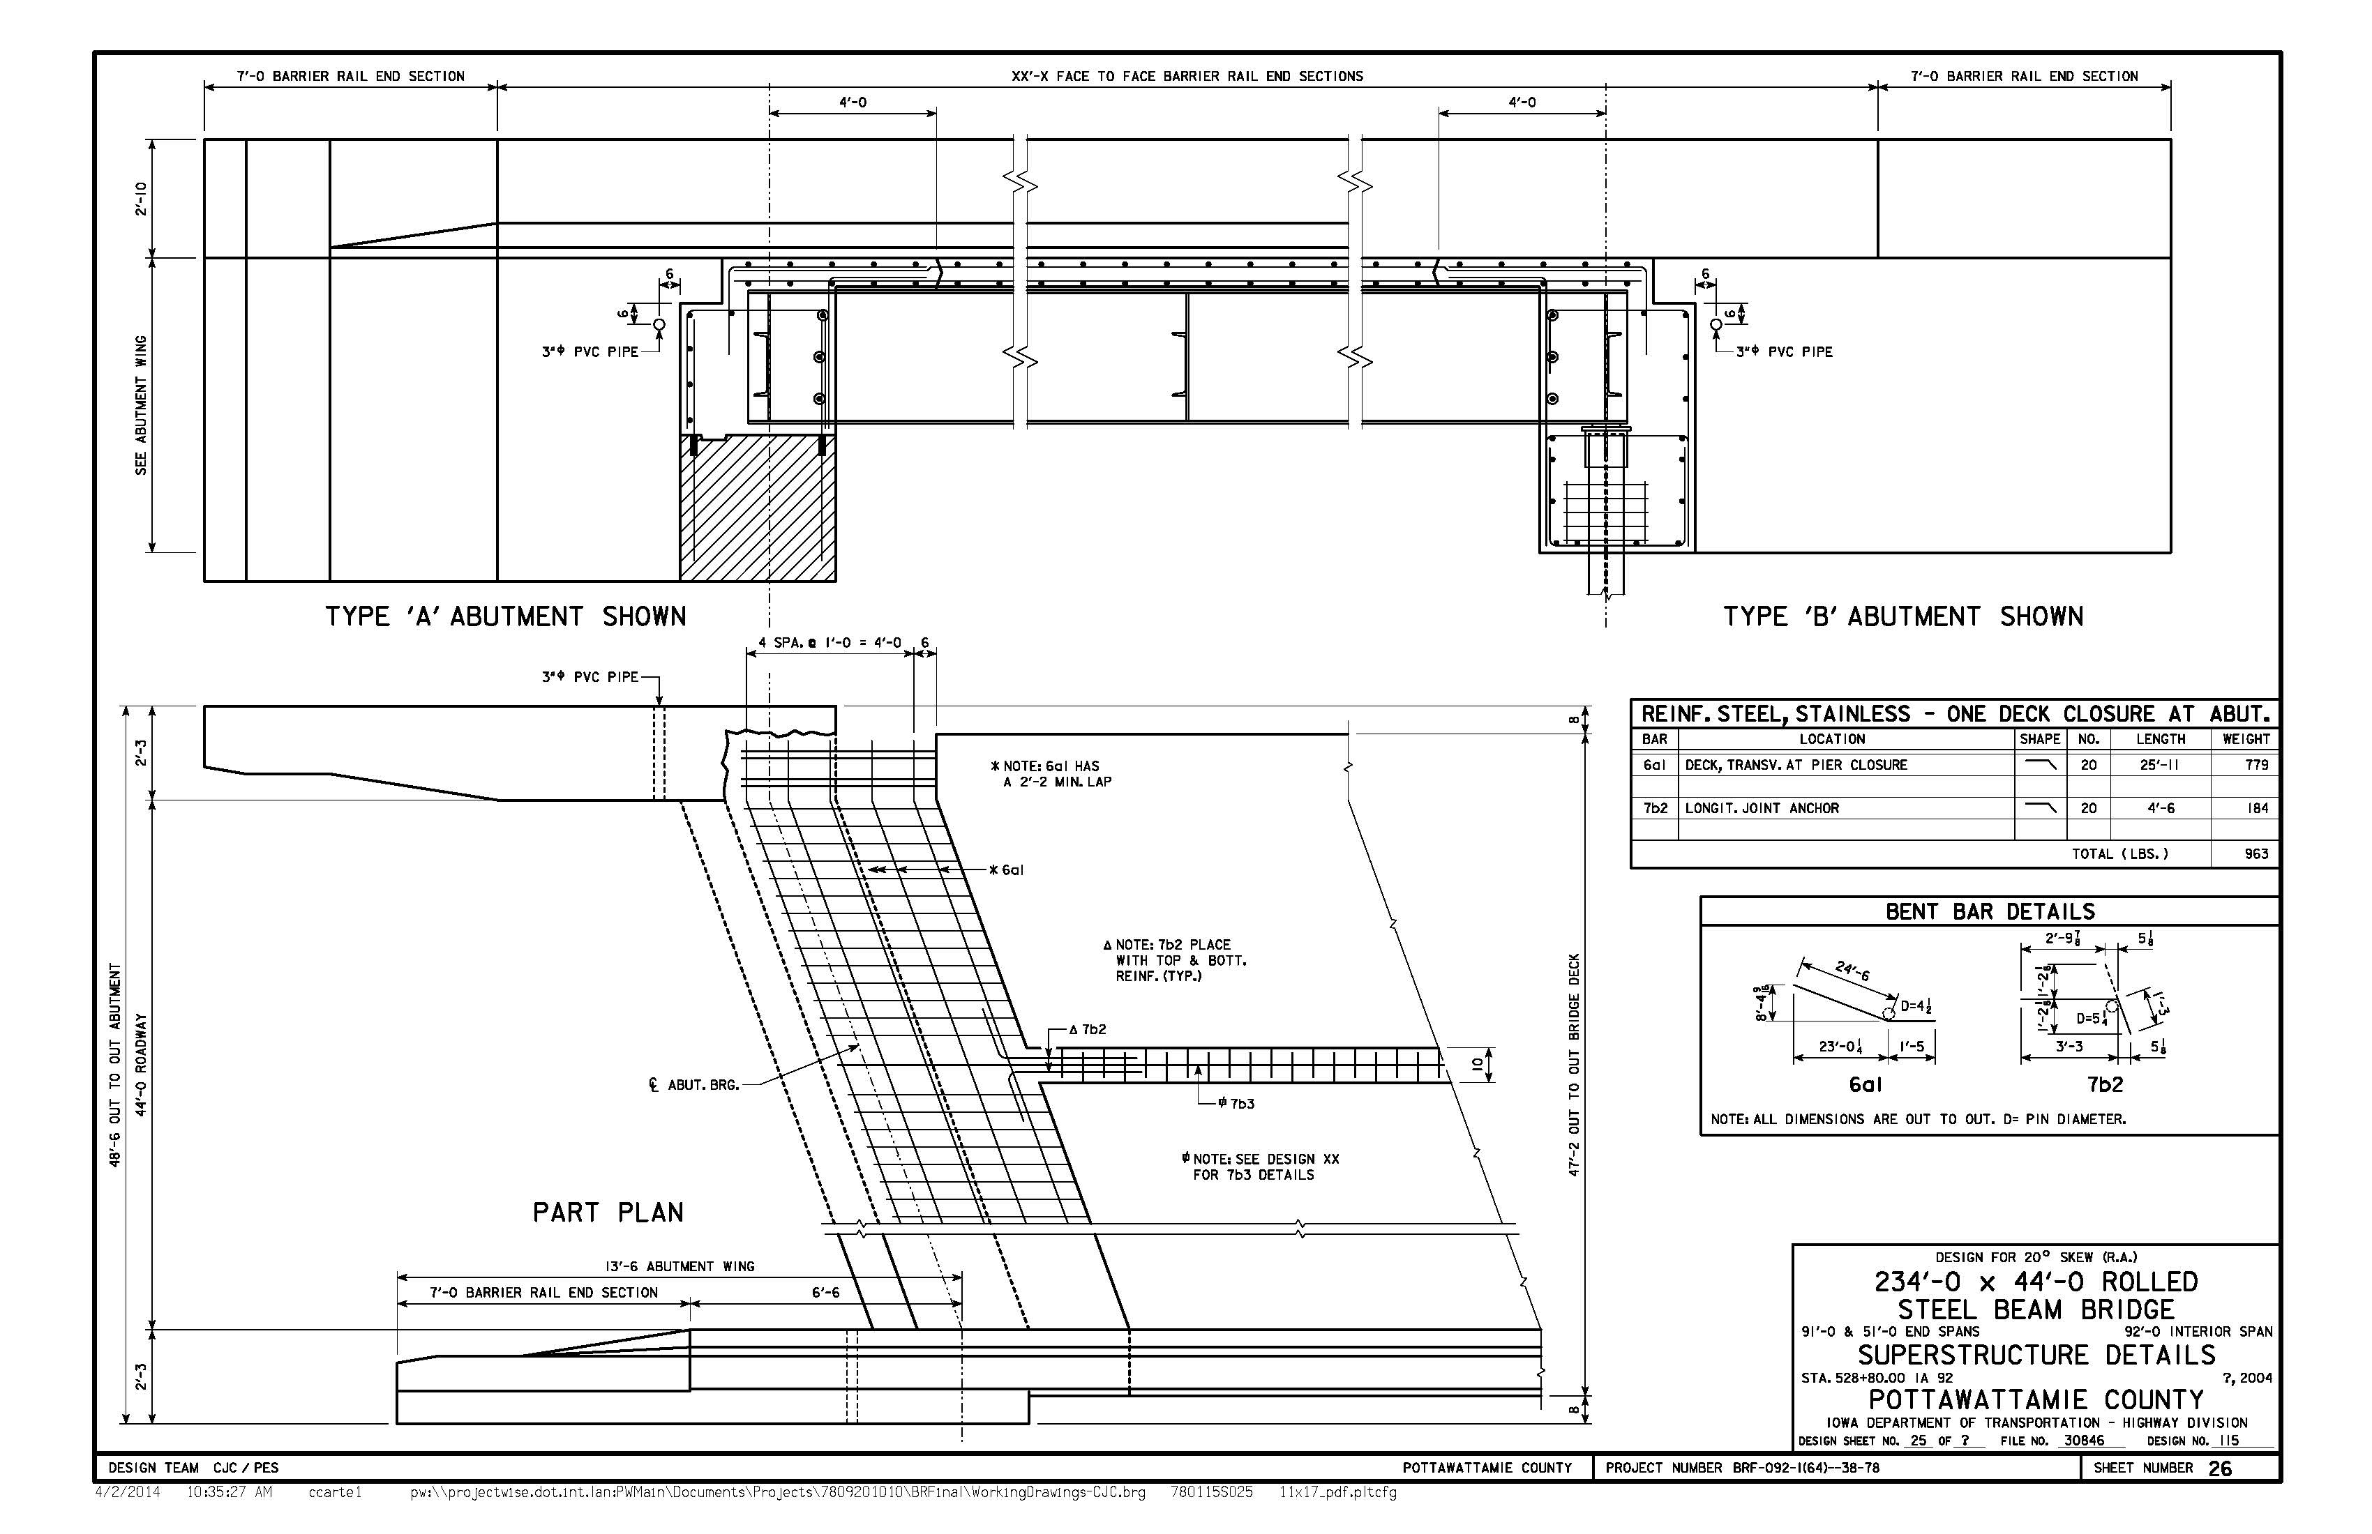
MODULAR SUPERSTRUCTURE
Staggered bar lap for transverse joints
Deck end section cast integrally with abutment diaphragm

Slide 28
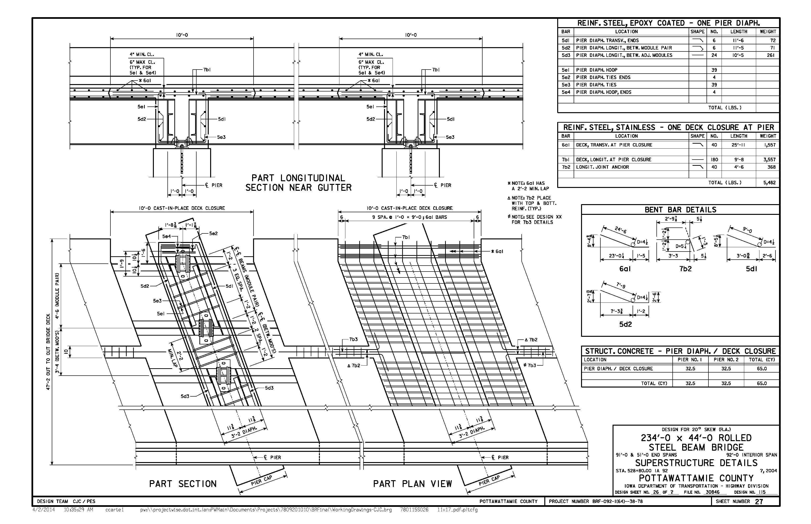
MODULAR SUPERSTRUCTURE
Wide transverse deck closure integral with pier diaphragms
Compression block assembly

Slide 29
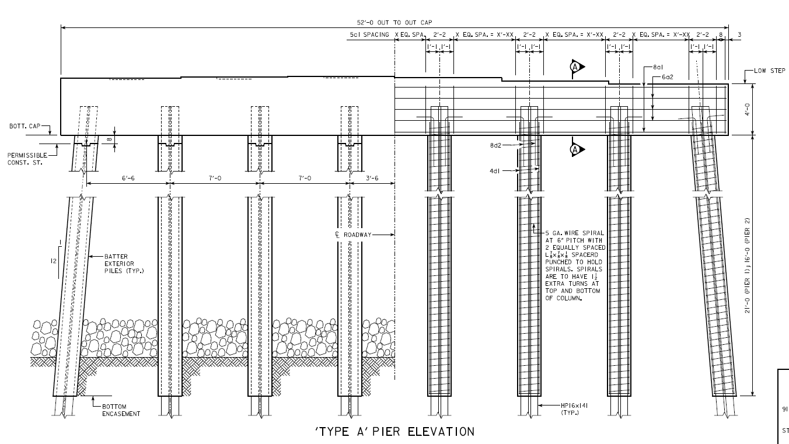
PILE BENT PIERS
Selected for economy/constructability
Design considerations include scour and unsupported length
  HP16x141 Piling (first use of HP16 section in Iowa)
  Piling oriented for strong-axis bending (non-standard detail in Iowa)
Design intent to include multiple construction options:
  Precast cap option
  Cast-in-place cap option
  Option to construct concrete pile encasement after critical road closure
C.I.P. diaphragm monolithic with deck
  Provides simple and durable connection of deck modules at pier
IA Modified Std.
Pile Bent Pier

Slide 30
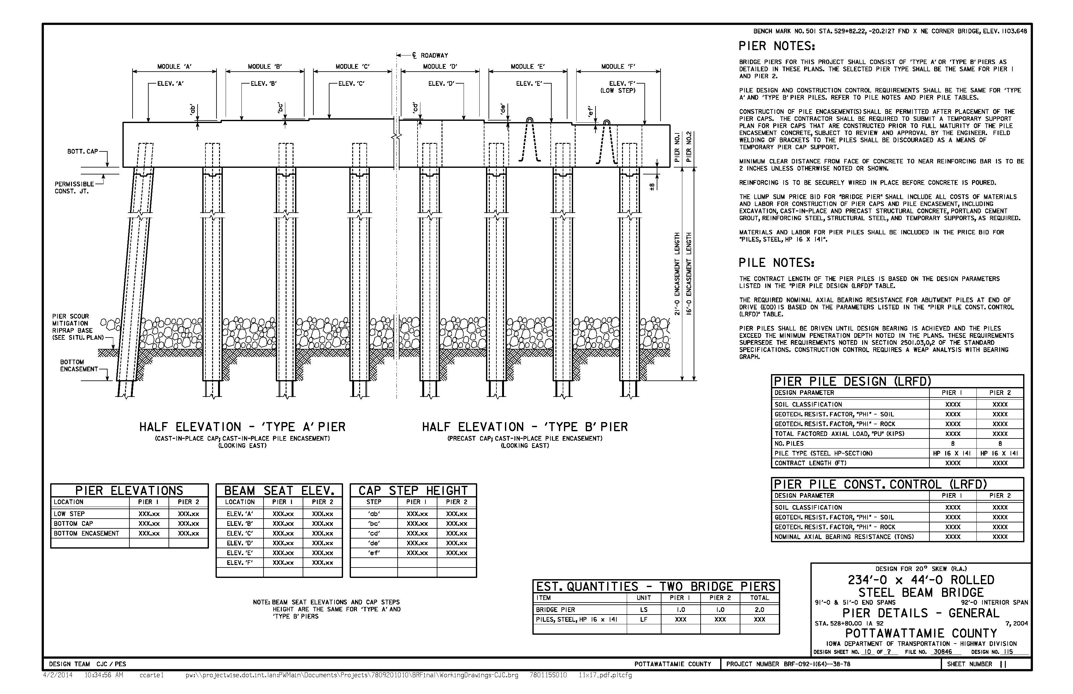
PILE BENT PIERS

Slide 31
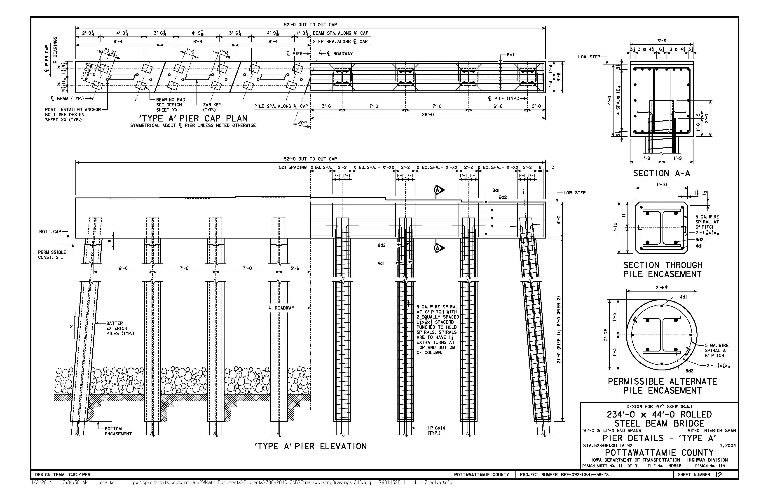
PILE BENT PIER (C.I.P. CAP)
Conventional construction; forms and reinforcing cage preassembled and dropped into place, concrete maturity after 24-36 hrs.
Pile encasement is non-structural for design; may be constructed after critical road closure.

Slide 32
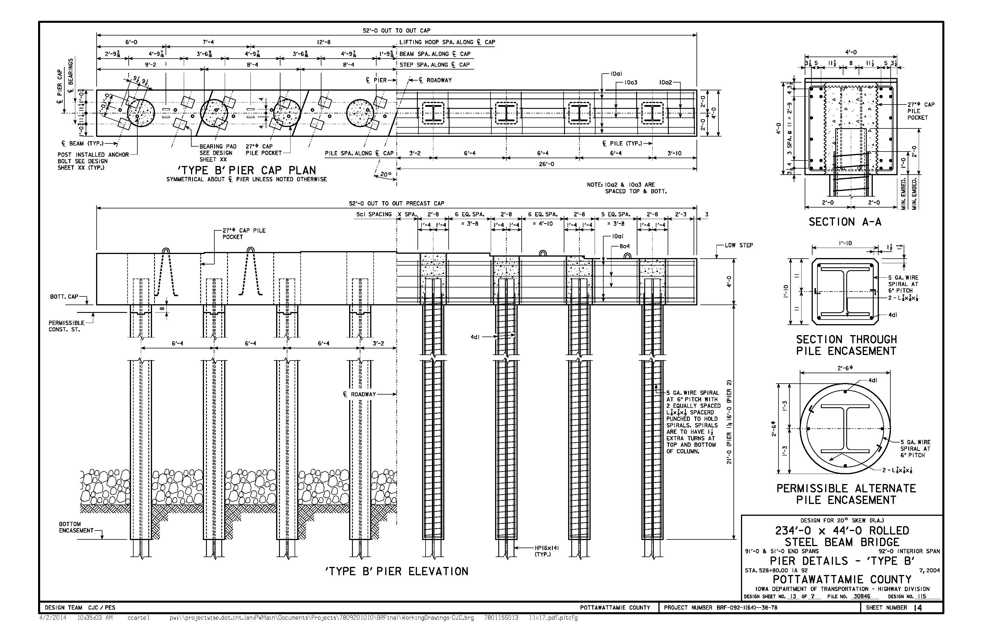
PILE BENT PIER (PRECAST CAP)
Lifting loops (± 125,000 lbs. pick weight
CMP pile pockets

Slide 33
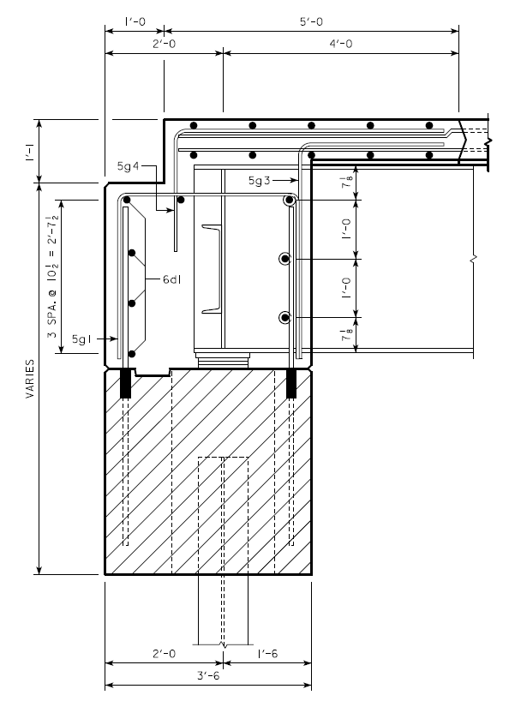
INTEGRAL ABUTMENTS
Selected for constructability/durability
Design considerations include stability during module placement
  Prebored piles oriented for weak axis bending
  Desire/need for piles to be braced during module placement
Design intent to include multiple construction options
  Precast cap option
  Cast-in-place cap option
  Capless option (beams supported directly on piling)
C.I.P. diaphragm monolithic with deck
  Provides simple and durable connection of deck modules at abutment
Integral Abutment
with Precast Cap

Slide 34
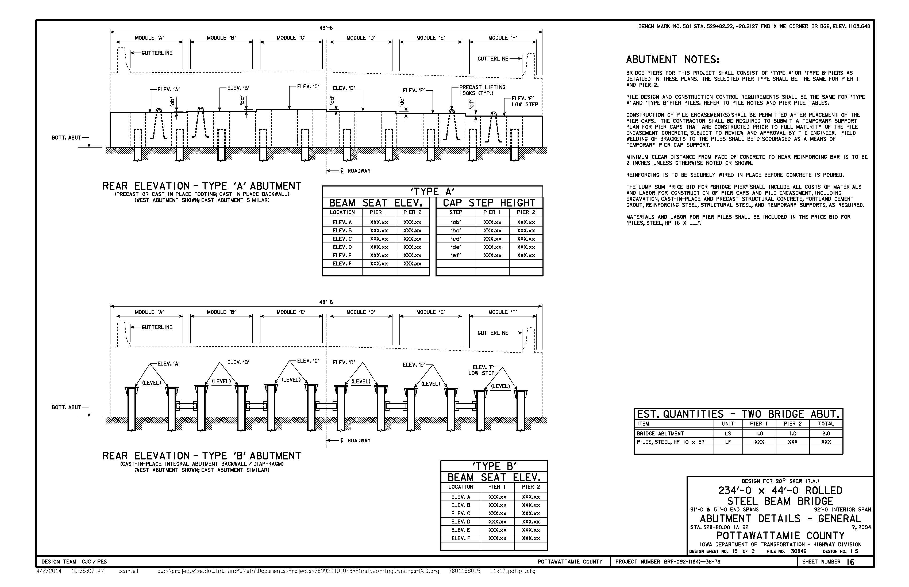
INTEGRAL ABUTMENTS

Slide 35
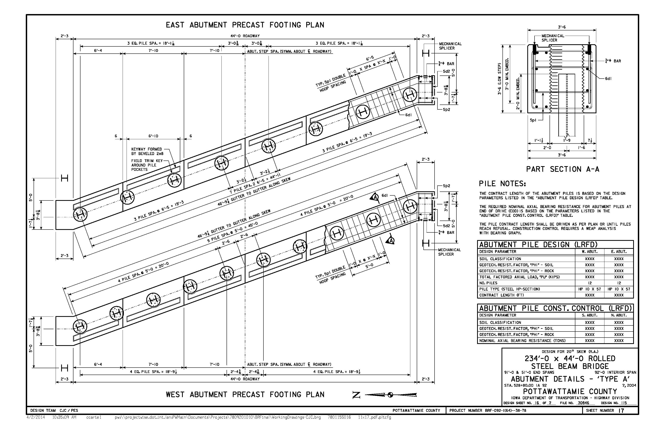
INTEGRAL ABUT. (PRECAST/C.I.P.)
± 95,000 lbs. pick weight
CMP pile pockets (omit for C.I.P. option)

Slide 36
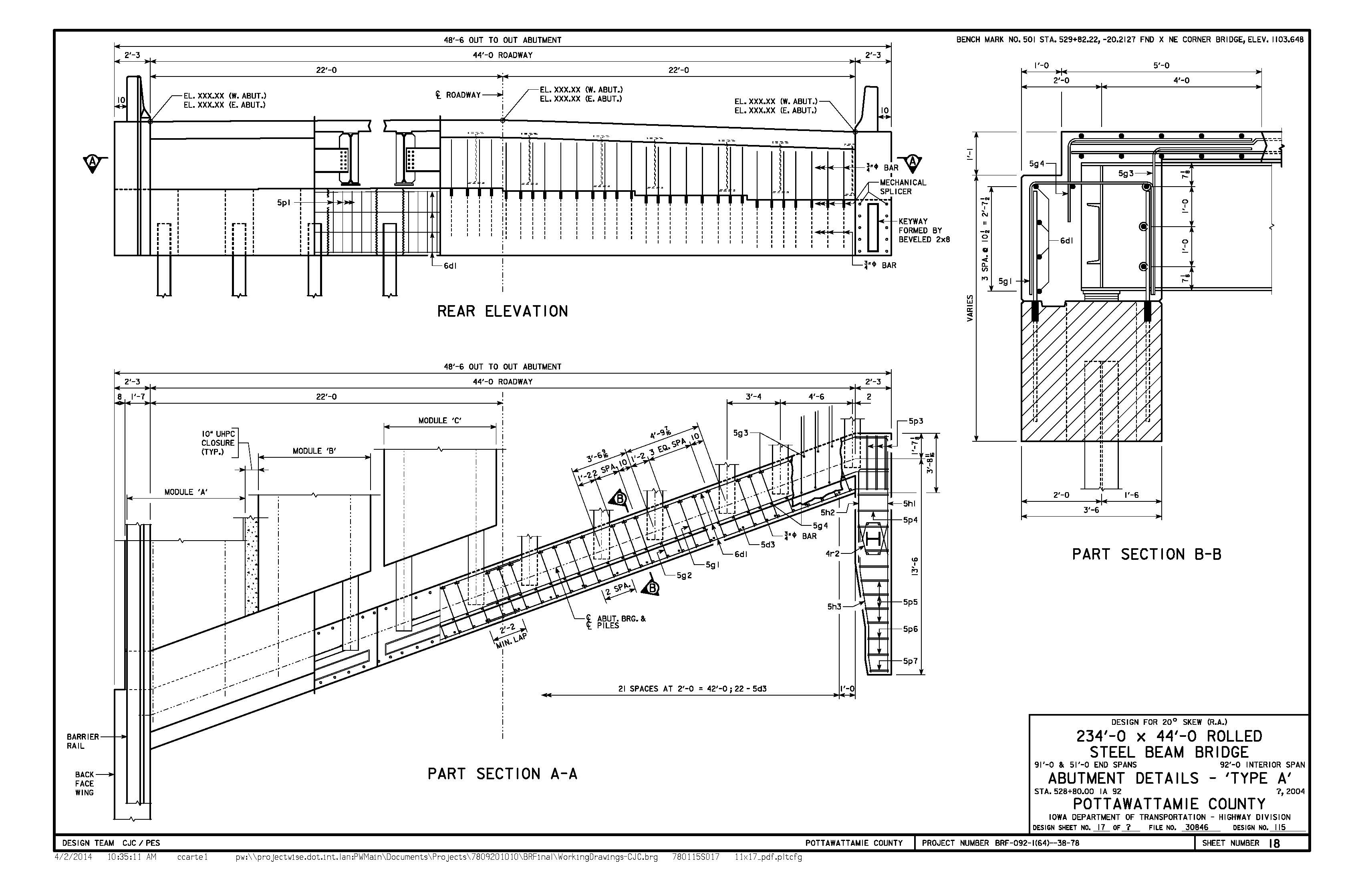
INTEGRAL ABUT. (PRECAST/C.I.P.)
Abutment backwall monolithic with end of deck
Mechanical splicers connect footing and backwall

Slide 37
BEAM-ON-PILE ABUT. CONCEPT
Concept has not been used on in-house IA DOT bridge designs, but other states have positive experience with this method.
Concept is being considered as an option for this project, although Iowa is soliciting input/feedback from contractors and other states.
Possible advantages for this project:
  Removes abutment footing construction from the critical path for deck module placement
  Could facilitate accurate placement of beam seats
  More conservative design, but not necessarily more expensive
Design considerations:
  Applicability to modular ABC concept?? Construction Tolerance?? Can these details be constructed quickly and accurately??
  Pile stability during module placement?? Module dead load reactions could exceed typical dead load reactions of single beams.
  Pile bracing details??
  Field welding concerns??

Slide 38
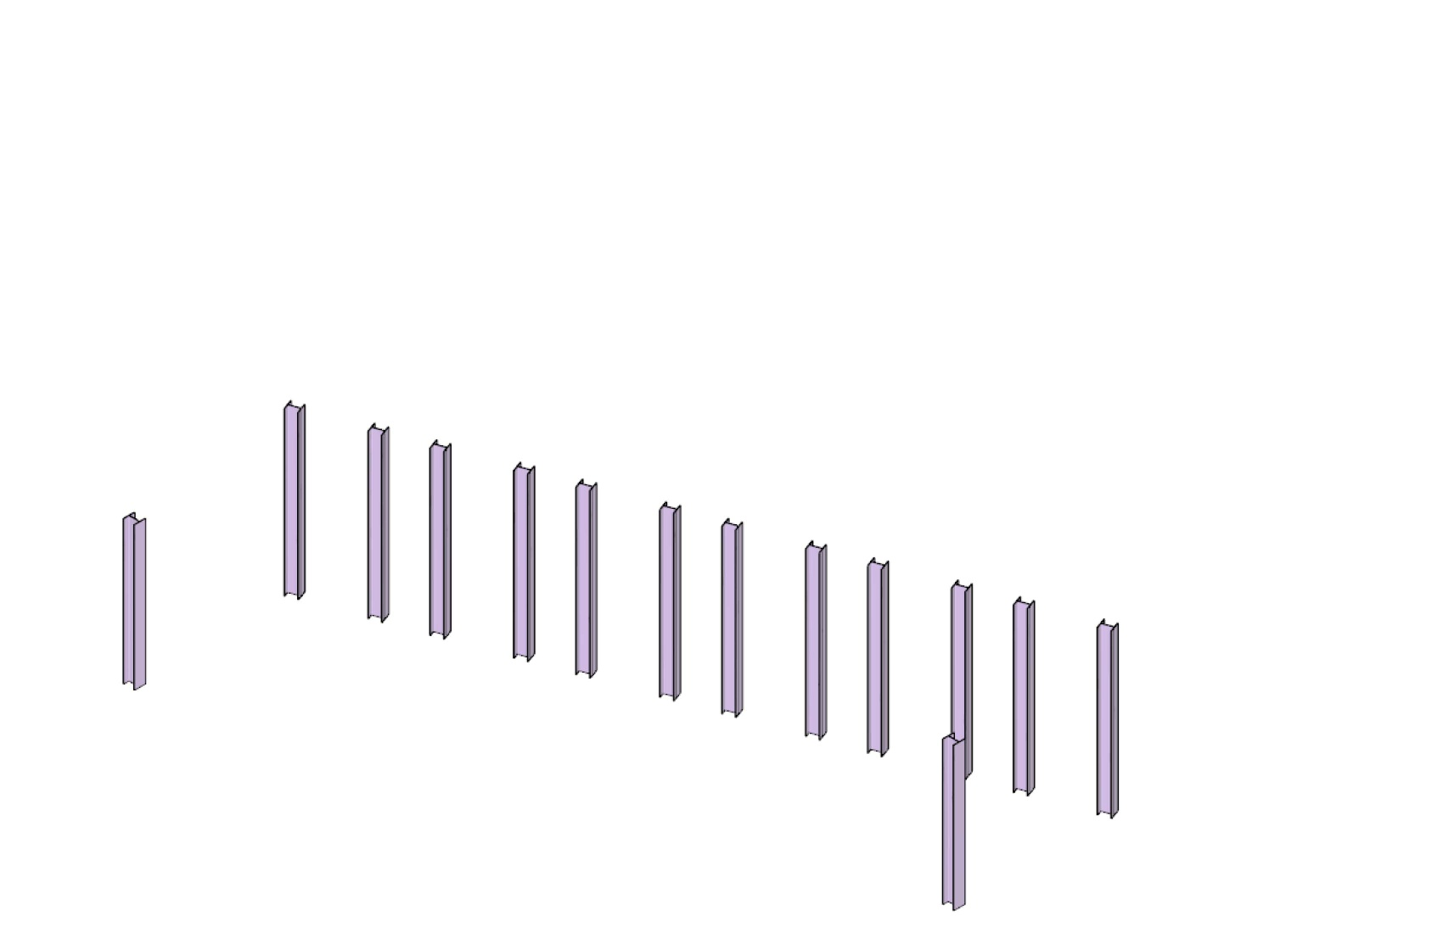
ABUTMENT CONCEPT: BEAM-ON-PILE
(1) INSTALL PILING

Slide 39
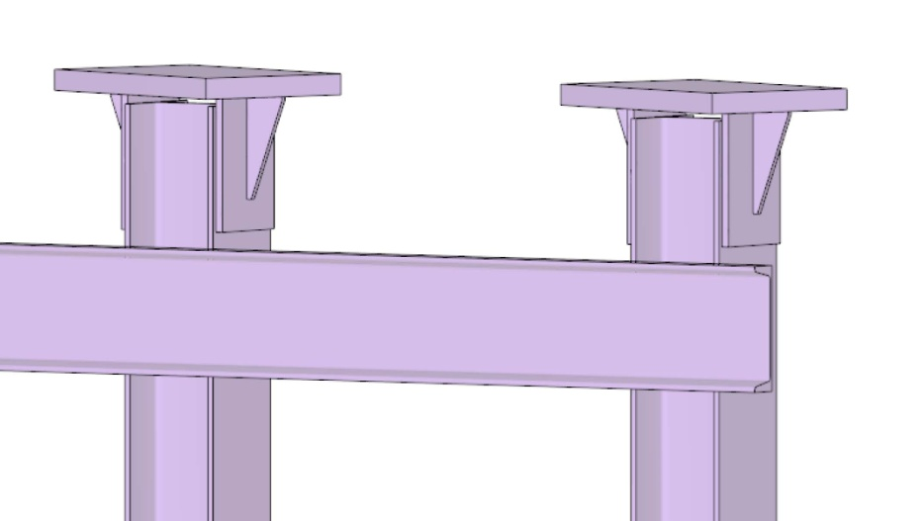
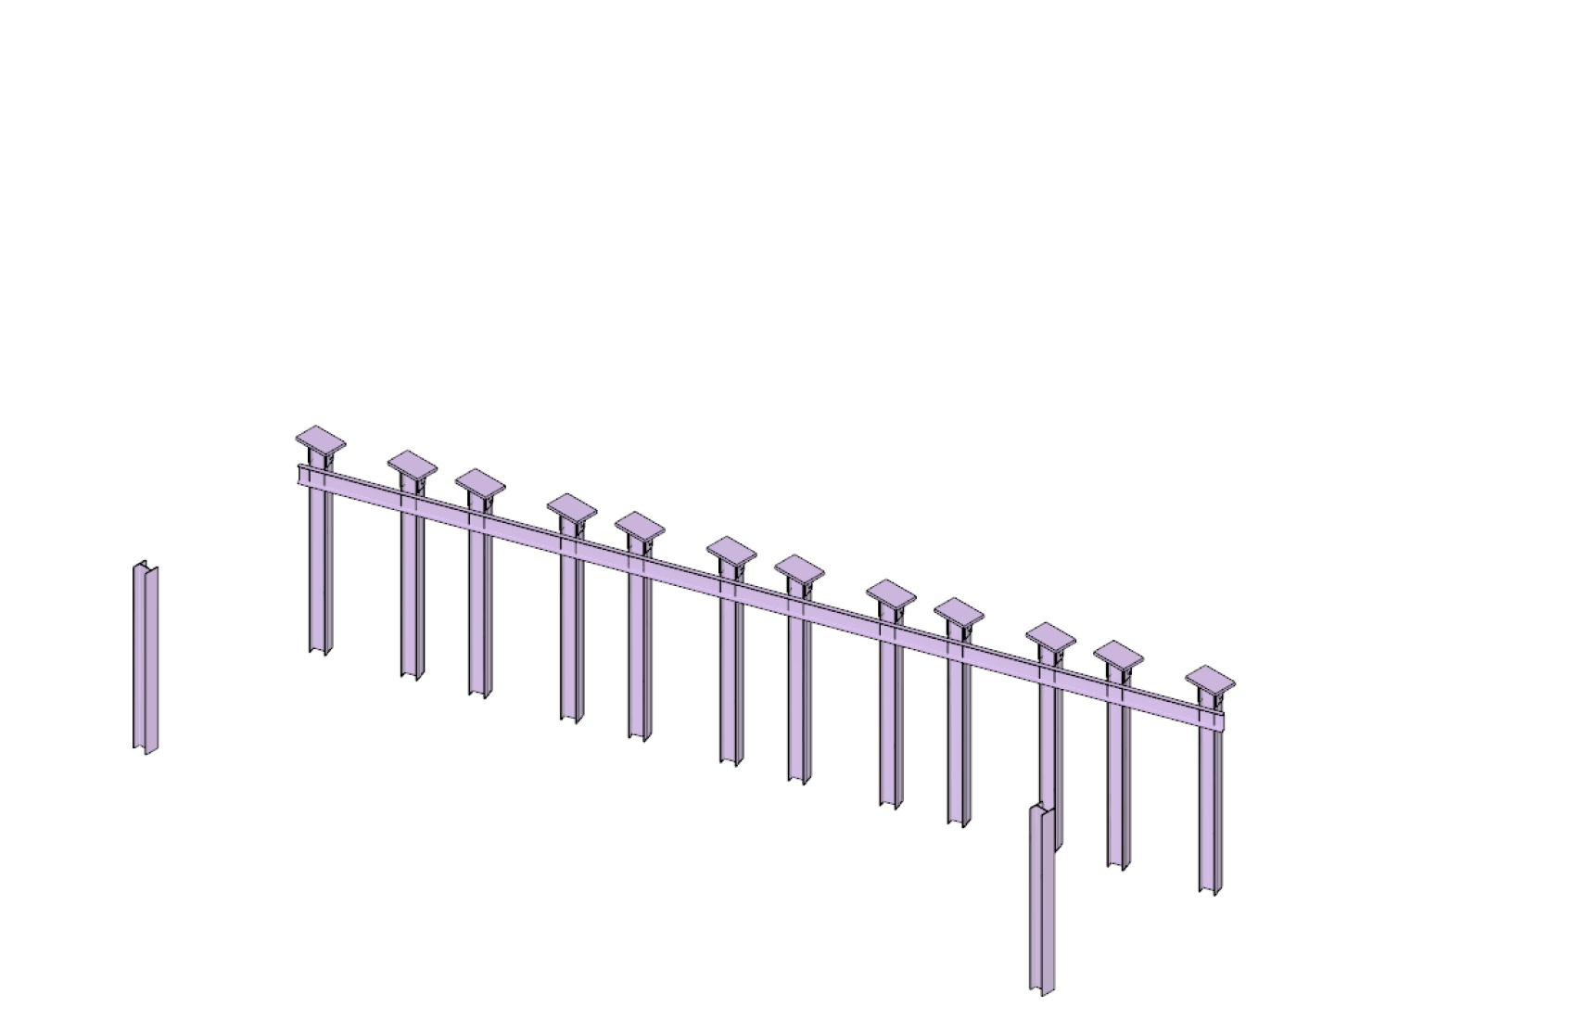
ABUTMENT CONCEPT: BEAM-ON-PILE
(2) INSTALL BRACING & BEAM SEATS

Slide 40
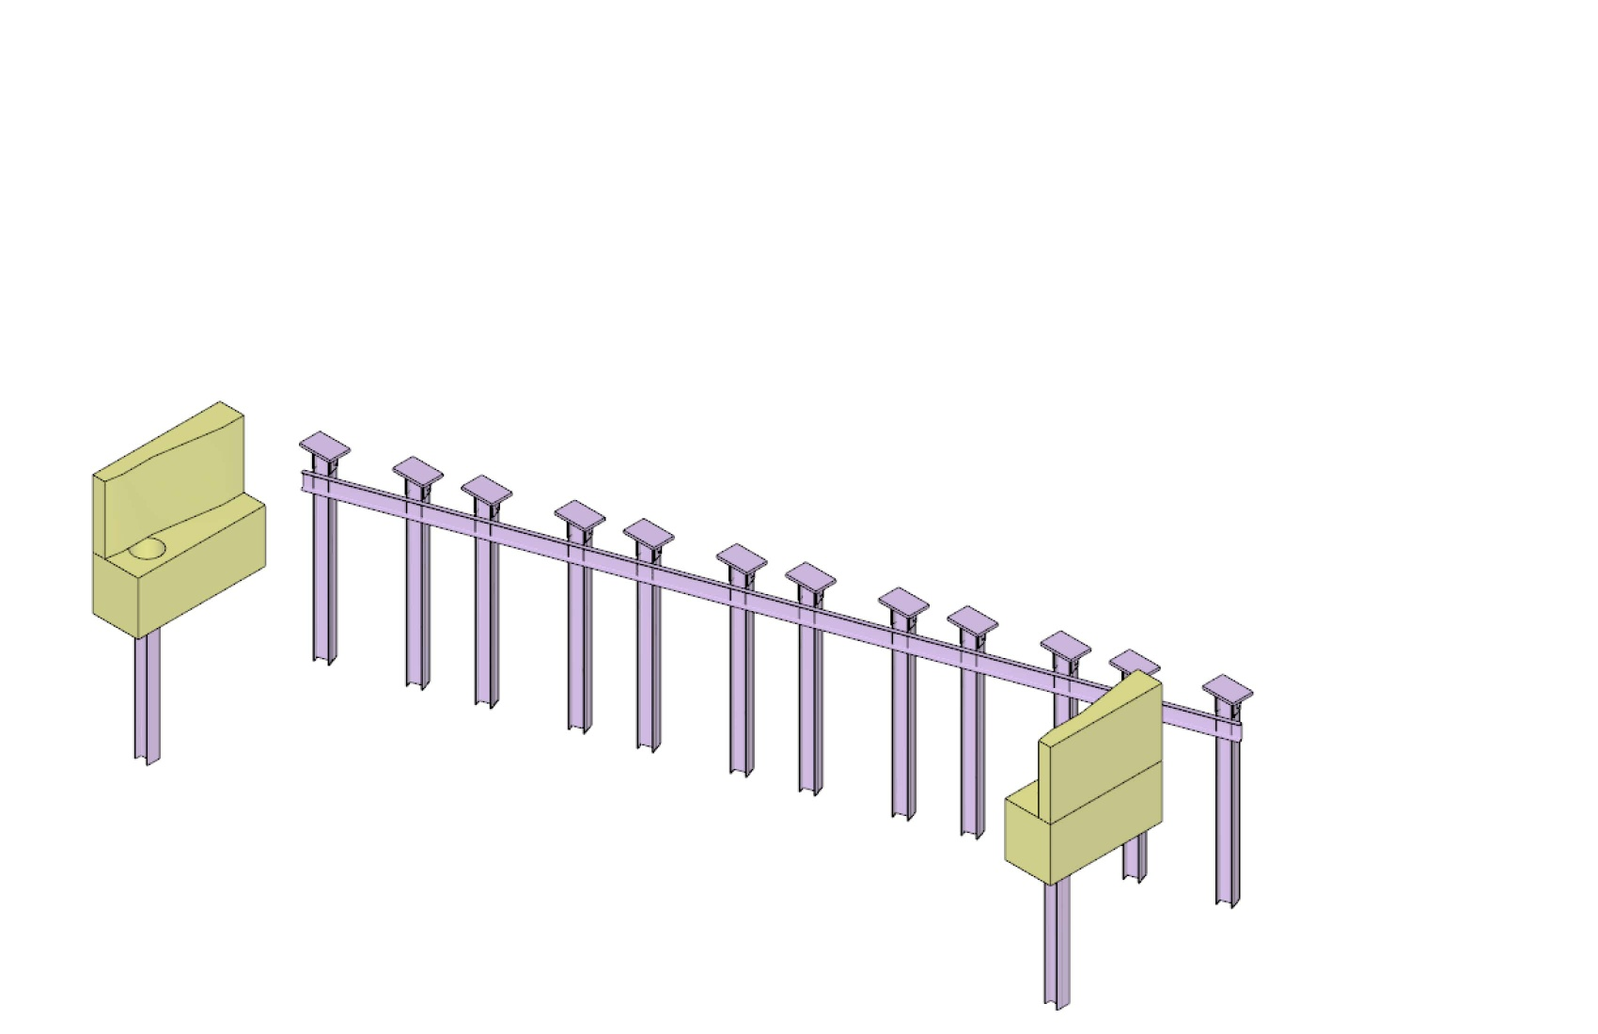
ABUTMENT CONCEPT: BEAM-ON-PILE
(3) INSTALL PRECAST WINGS

Slide 41
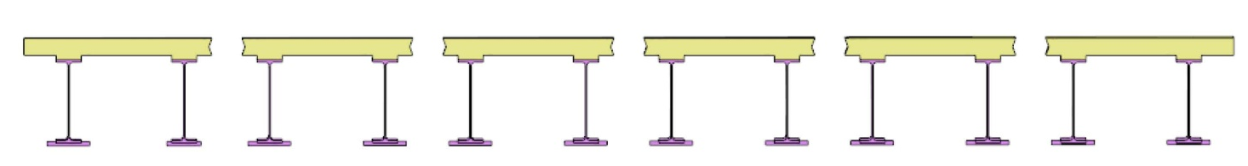
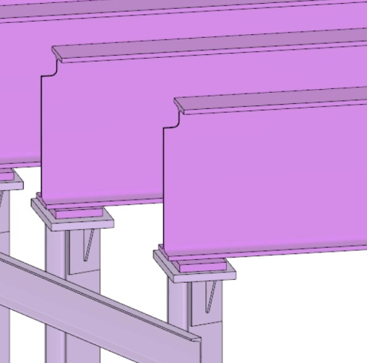
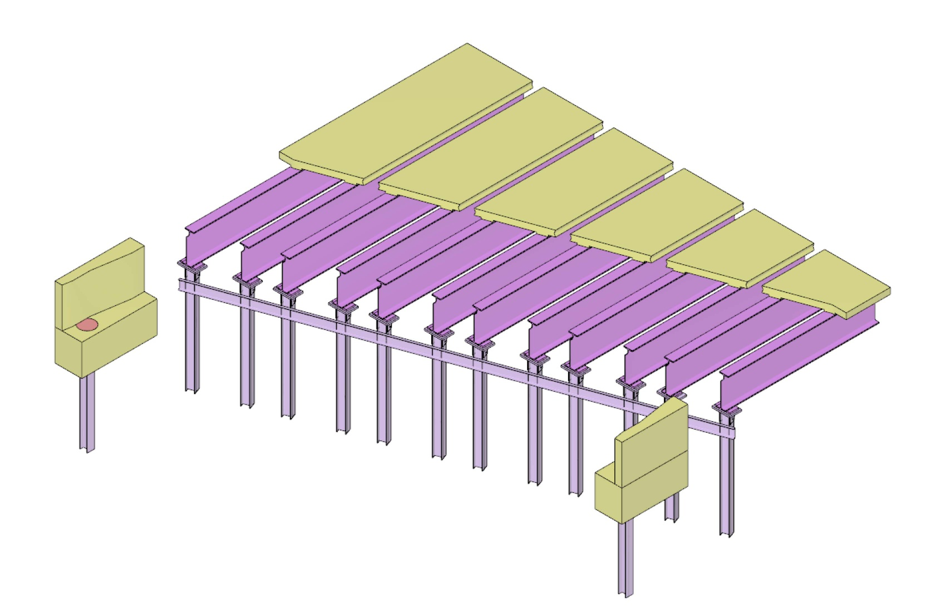
ABUTMENT CONCEPT: BEAM-ON-PILE
(4) INSTALL DECKED MODULES & WING POCKETS

Slide 42
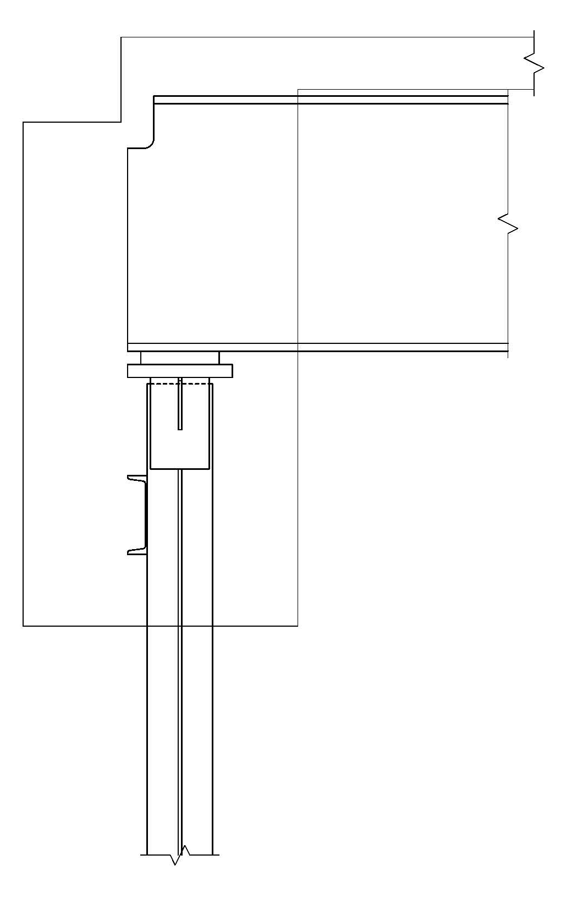
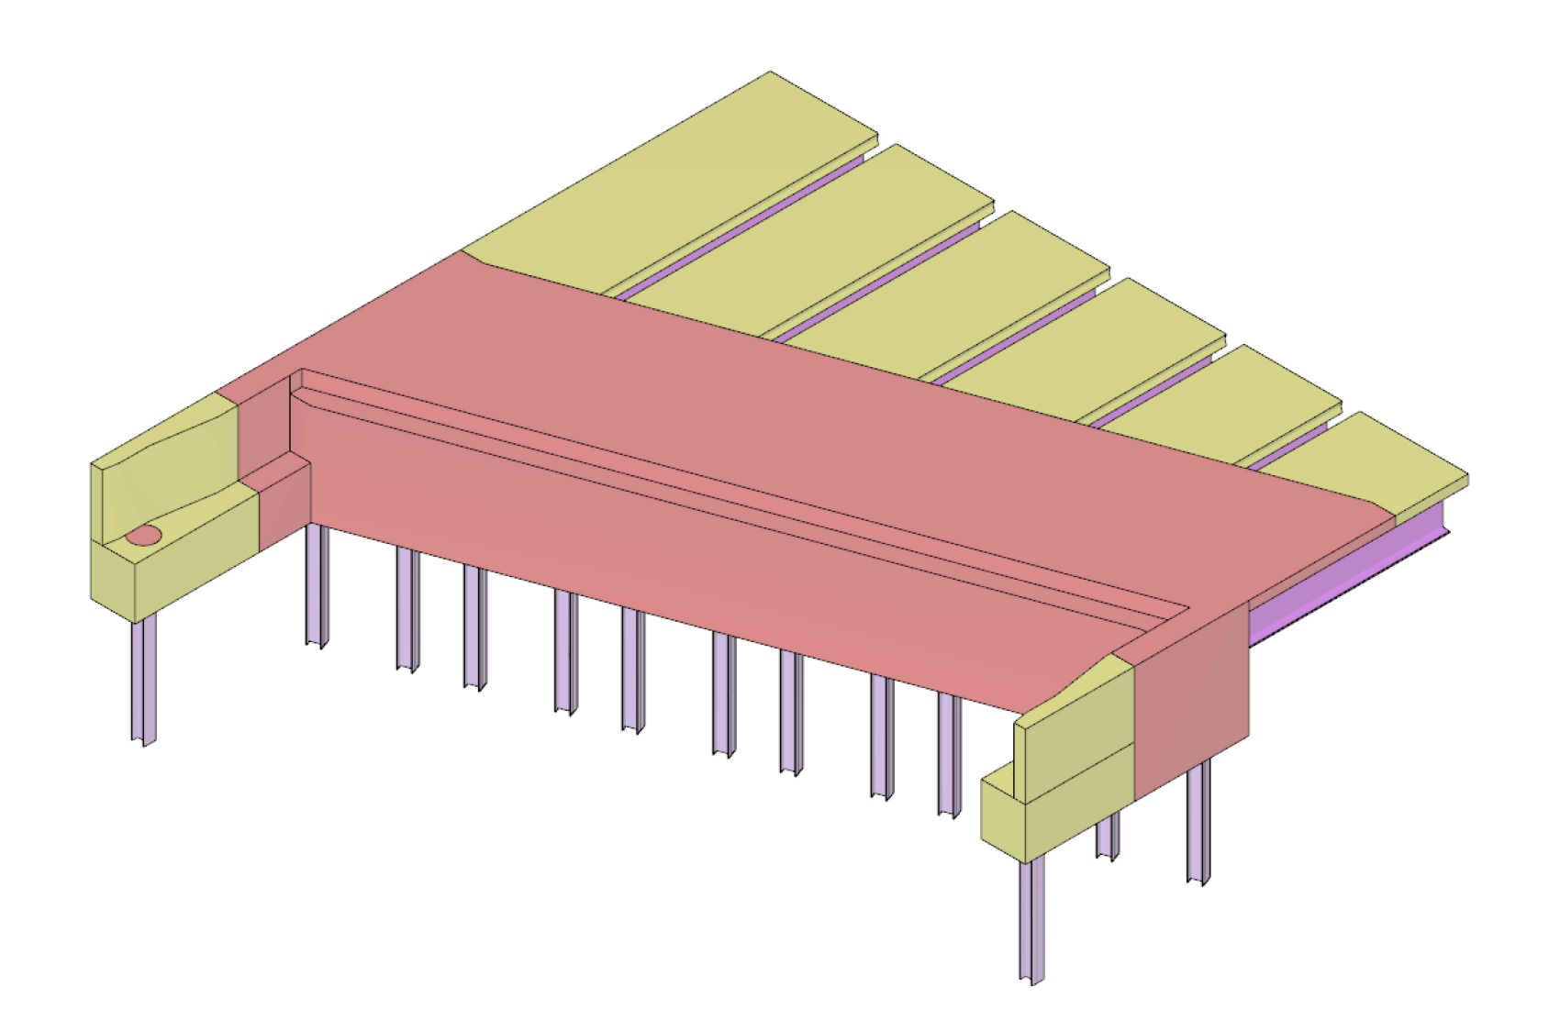
ABUTMENT CONCEPT: BEAM-ON-PILE
(5) PLACE ABUTMENT CONCRETE

Slide 43
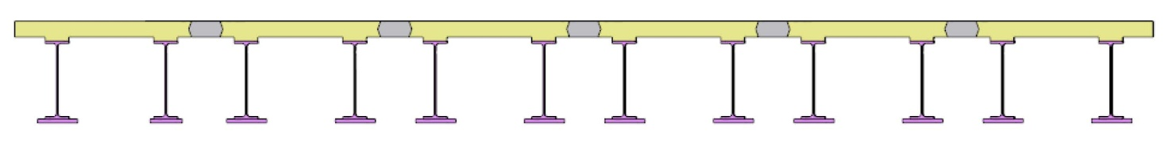

ABUTMENT CONCEPT: BEAM-ON-PILE
(6) PLACE UHPC LONGITUDINAL JOINTS

Slide 44
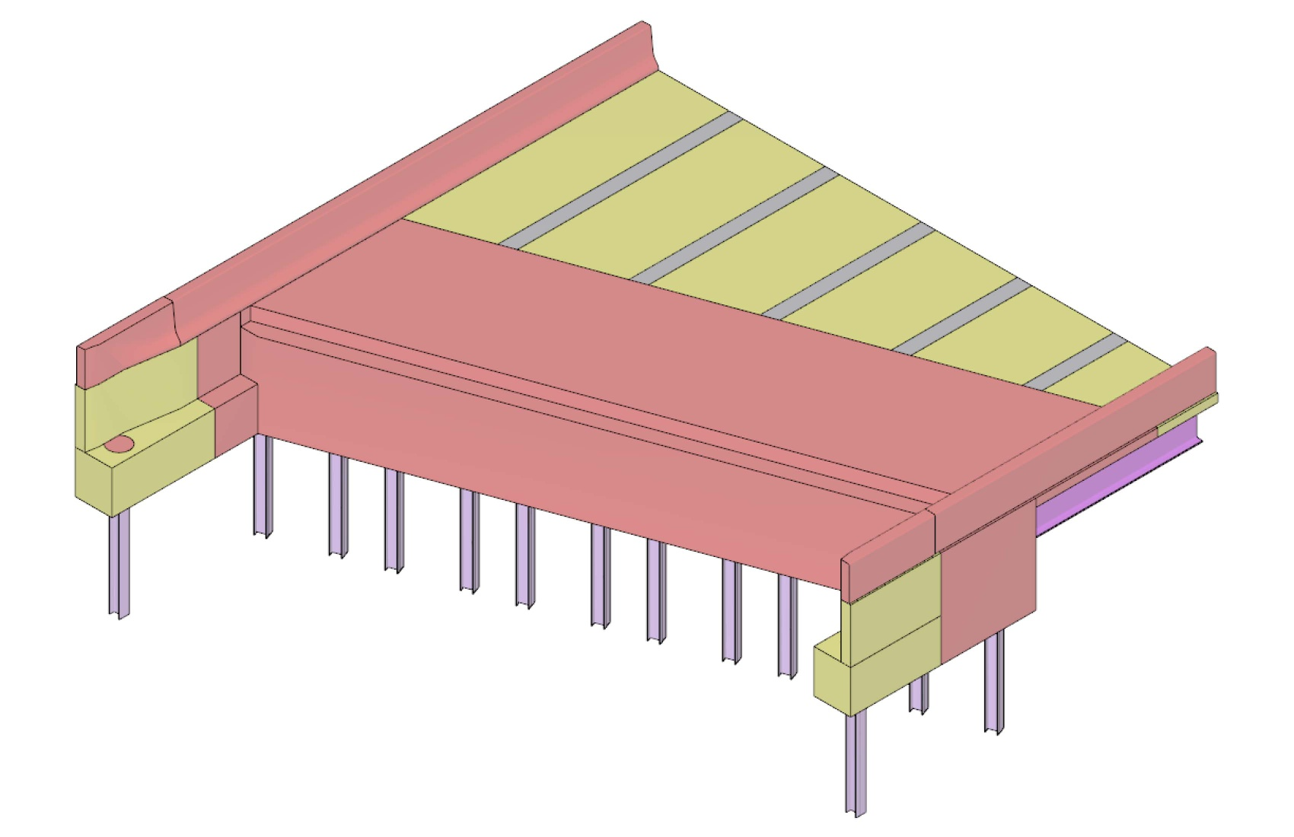
ABUTMENT CONCEPT: BEAM-ON-PILE
(7) INSTALL BARRIER RAIL

Slide 45
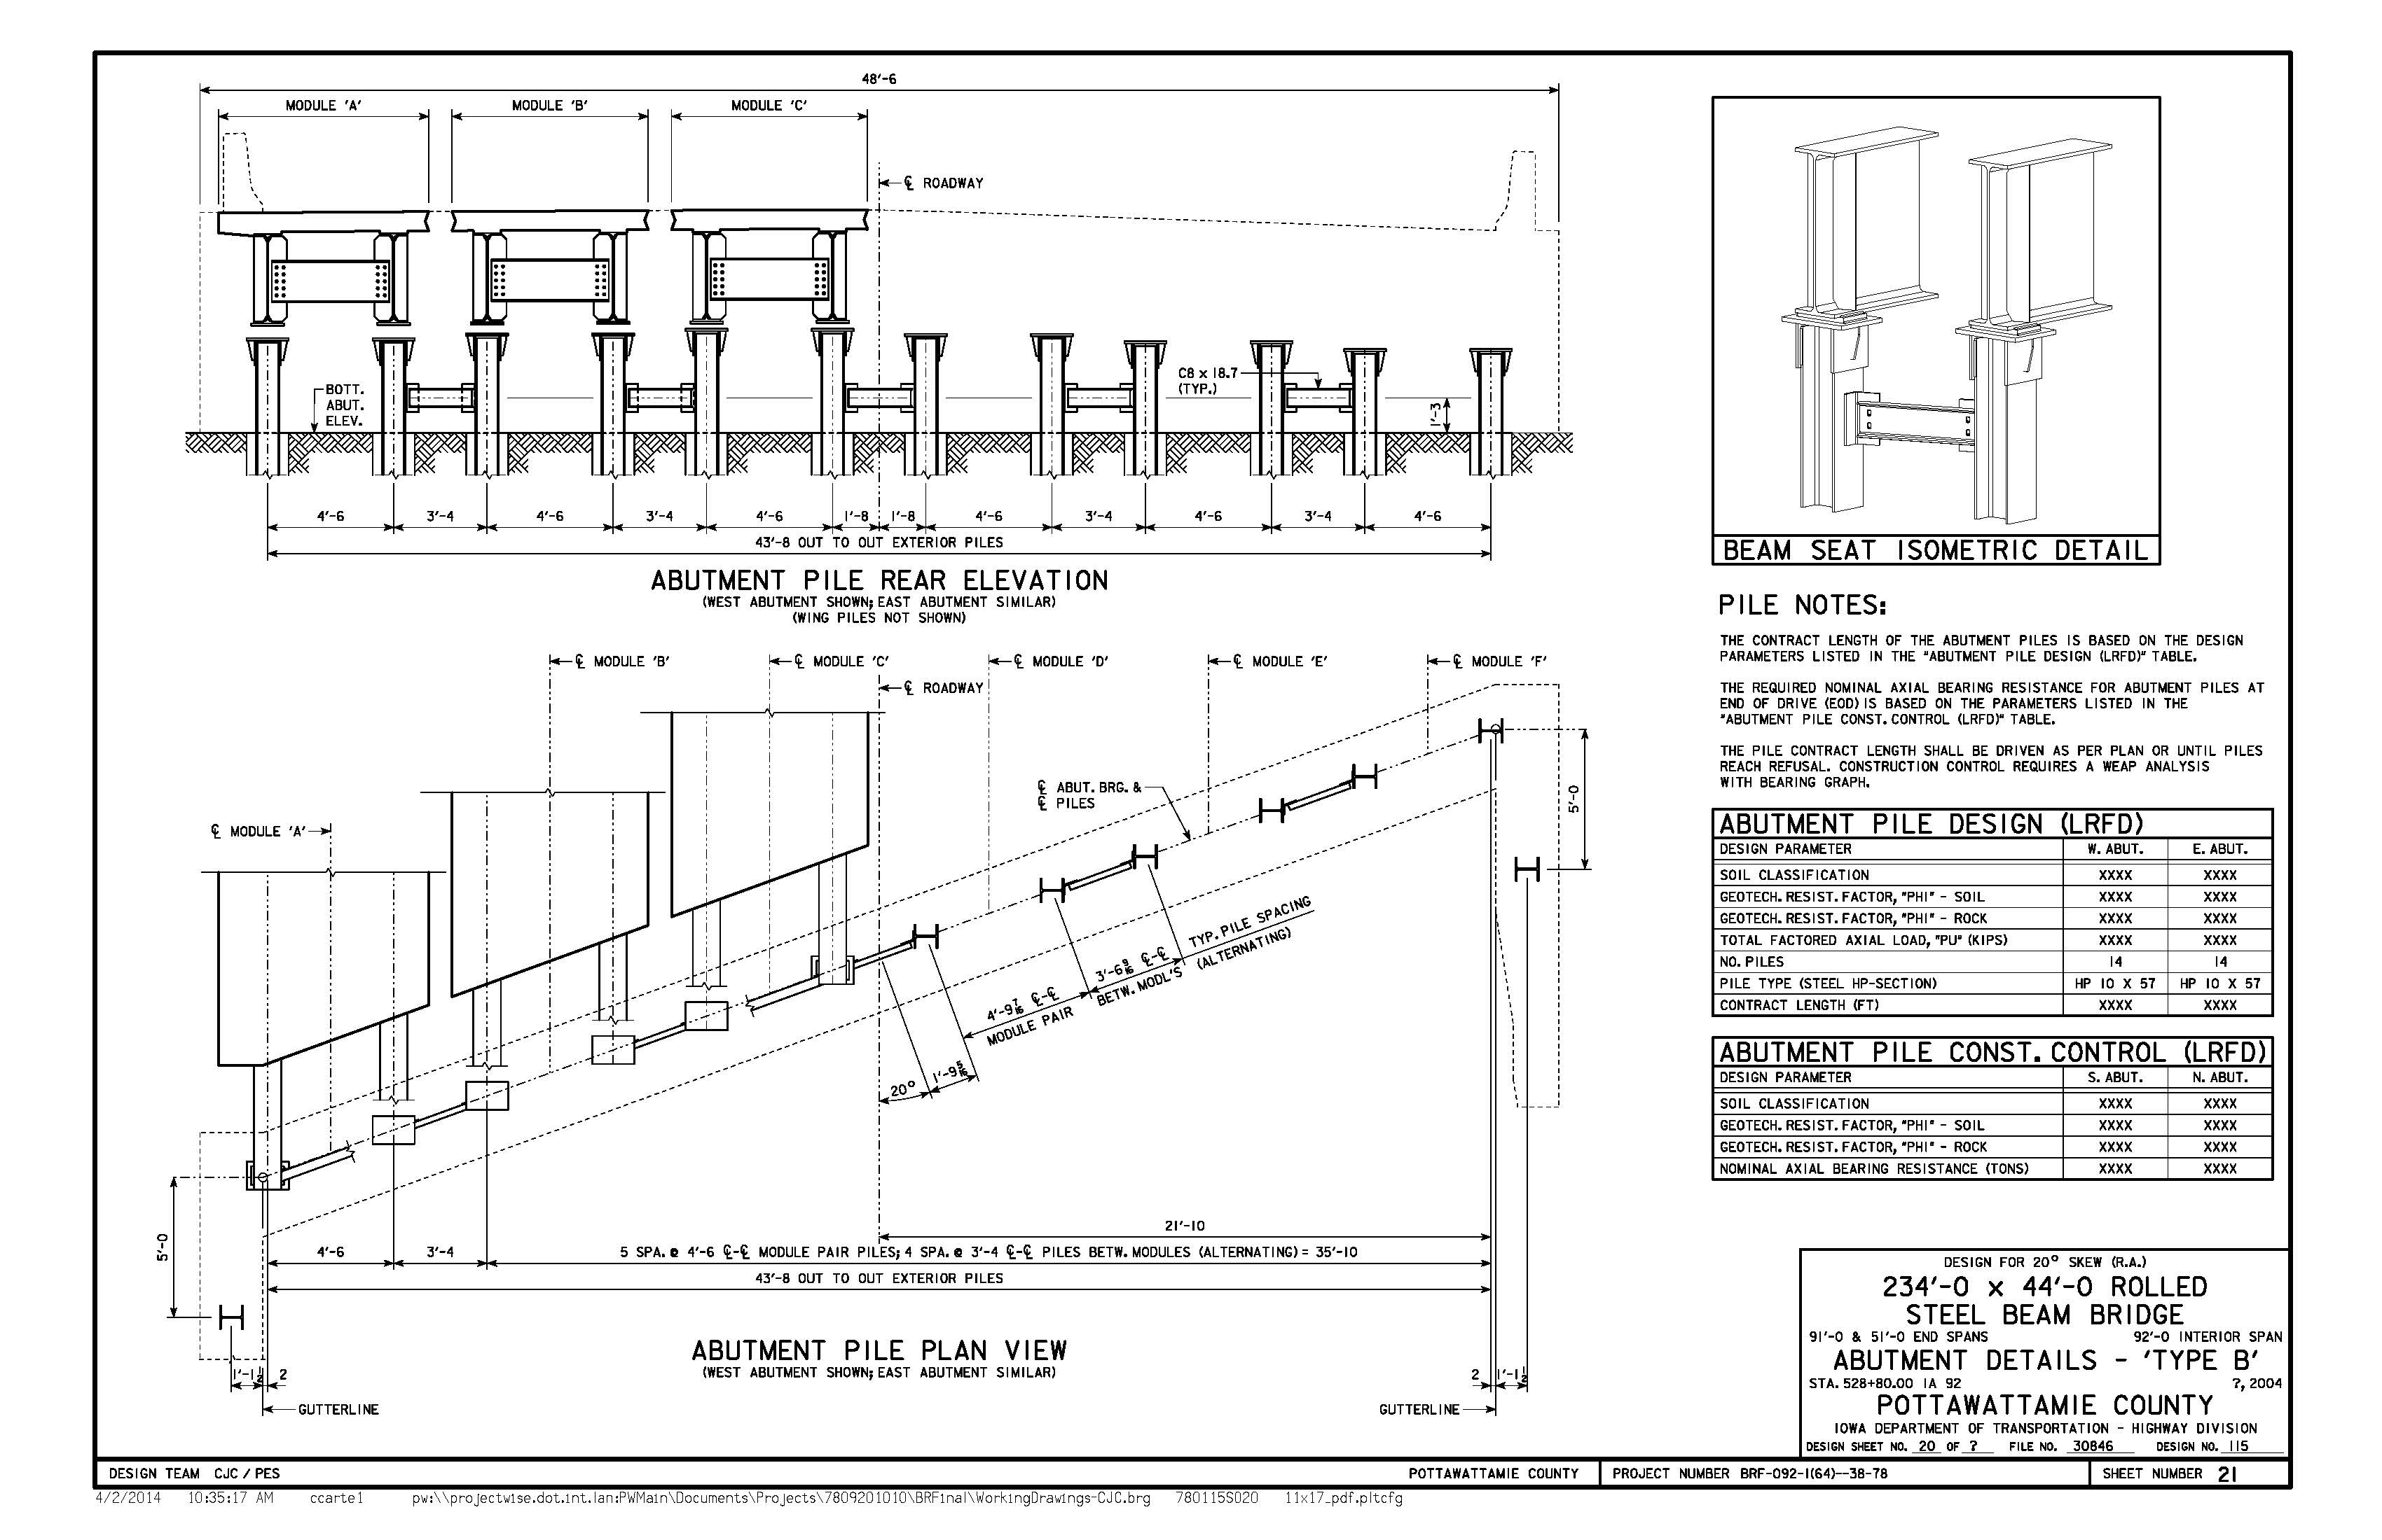
INTEGRAL ABUT. (BEAM-ON-PILE)
Pile bracing between modules
Requires more piles than Precast/CIP option, but shorter lengths

Slide 46
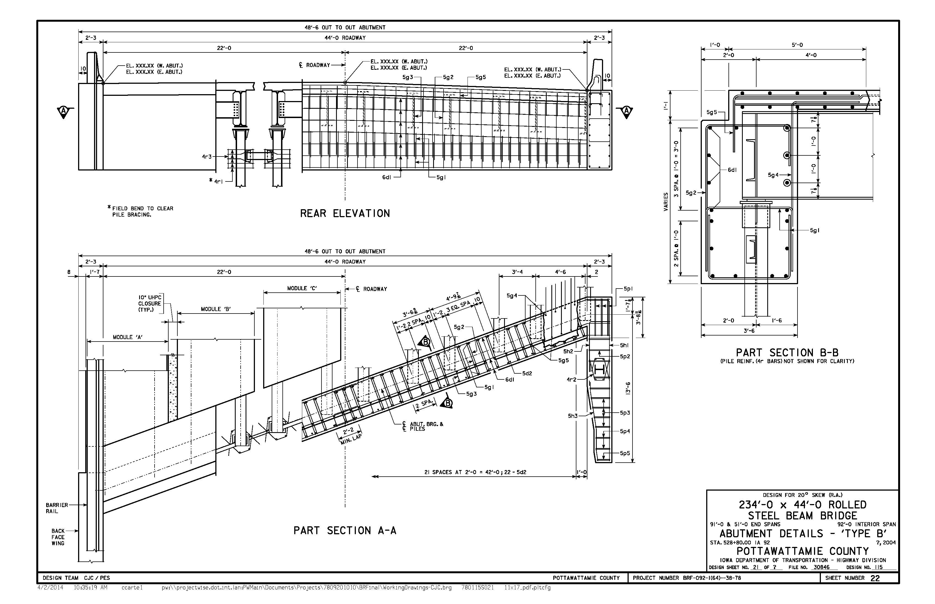
INTEGRAL ABUT. (BEAM-ON-PILE)
Abutment, wings and deck closure poured together

Slide 47
PROJECT SUMMARY

Slide 48
PROJECT OBJECTIVES
Safe structure (during construction and service) with long service life
Accelerated construction schedule
Demonstrate application of modular construction concept at a more challenging site
Demonstrate improvements upon previous experience with the modular construction concept
Provide in-house design experience
  Provides designers with a better understanding of the unique design/details/processes required for the modular construction concept, and for ABC projects in general.
  Experience will benefit in-house designers of similar projects, and reviewers of consultant-designed projects.
Expand agency experience
  When combined with experience from the Keg Creek project, IA DOT can develop a better understanding of the costs, benefits, and limitations of the modular construction concept.
  Experience with this project will assist the DOT in establishing policy and selecting the appropriate construction concept (modular construction, slide, etc.) for future ABC projects.

Slide 49
PROJECT INNOVATIONS (IOWA PERSPECTIVE)
Integral abutments
  Iowa’s preferred abutment type, but hasn’t previously been applied to ABC project
Transverse deck closures monolithic with beam end diaphragms
  Moves joint interface to lower-stress region of deck, provides secure connection of modules
Simplified UHPC joint details
  Wider joint, simpler bar lap, less bar congestion
  UHPC application to longitudinal joints only should simplify forming
Simplified continuity details
  Faster construction, more liberal construction tolerance

Slide 50
PROJECT INNOVATIONS (IOWA PERSPECTIVE)
Stainless steel deck reinforcing
  New to Iowa, expected to provide better joint performance and longer service life
Expanded application of pile bent piers
  Long unbraced length requires larger pile size
Fully detailed design alternates for substructure
  Facilitates contractor involvement in the final design solution
Greater opportunity/application of accelerated cast-in-place concrete
  Counter-intuitive to some ABC philosophy, cast-in-place concrete can be a good design option if it can be placed quickly and accurately
  Cast-in-place concrete is generally more forgiving than precast concrete with respect to construction tolerance

Slide 51
SCHEDULE, REVISITED
21 Day ABC Timeline
 | CONSTRUCTION ACTIVITY |  |  |  |  | 21 DAY CLOSURE PERIOD
 |  |  |  |  |  | 1 | 2 | 3 | 4 | 5 | 6 | 7 | 8 | 9 | 10 | 11 | 12 | 13 | 14 | 15 | 16 | 17 | 18 | 19 | 20 | 21
 | CLOSE IA 92
 | BRIDGE DEMOLITION
 | GRADING & RIP-RAP PLACEMENT UNDER BRIDGE
 | DRIVE PIER PILING
 | PIER PILE ENCASEMENT CONSTRUCTION
 | DRIVE ABUTMENT PILING
 | CONSTRUCT PIER CAP
 | ABUTMENT PILE BRACING & BEAM SEATS
 | ERECT DECK MODULES
 | CONSTRUCT ABUTMENTS & WINGS
 | CONSTRUCT PIER CAP DIAPHRAGMS
 | PLACE UHPC LONGITUDINAL JOINTS
 | CONSTRUCT APPROACHES AND BARRIER RAIL
 | GRINDING & LONGITUDINAL GROOVING OF DECK
 | FINISH GRADING & WING ARMORING
 | GUARDRAIL & PAINT
 | OPEN IA 92

Slide 52
SCHEDULE, REVISITED
DEMOLITION & GRADING – 4 DAYS
PIERS – 7 DAYS
ABUTMENT SEAT – 5 DAYS
MODULE PLACEMENT – 3 DAYS
TRANSVERSE CLOSURES – 3 DAYS
UHPC JOINTS – 1 DAY
APPROACHES – 3 DAYS
BARRIER RAIL – 2 DAYS
DECK GRINDING/GROOVING – 2 DAYS

Slide 53
WORKSHOP DISCUSSION OPPORTUNITIES
Opportunities for improvement??
  Schedule
  Decked module concept
  Transverse joint concept
  Longitudinal joint concept
  UHPC details
  Continuity details
  Pier details
  Abutment details
  General constructability

Slide 54
QUESTIONS??
THANK YOU!!

