Slide 1
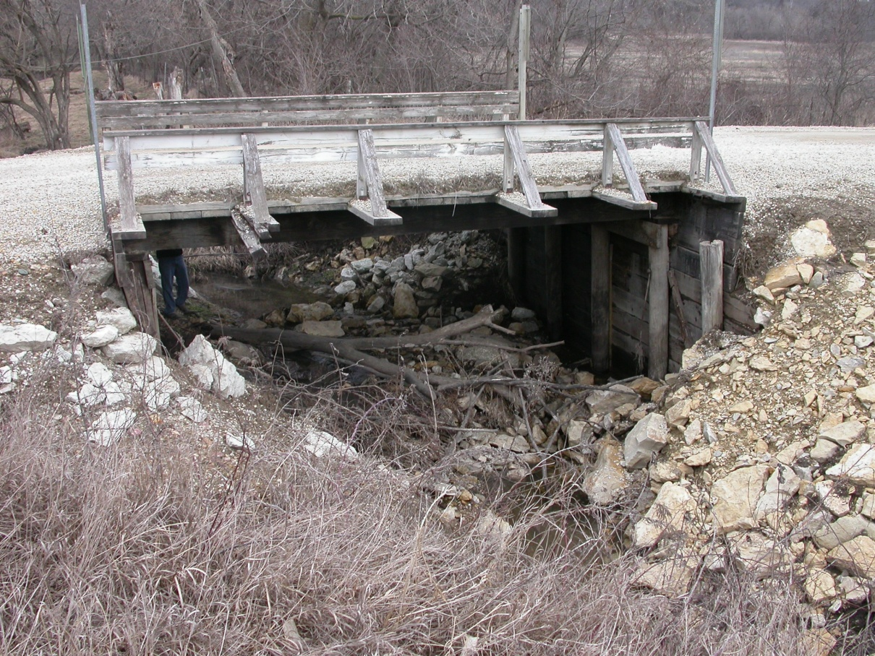
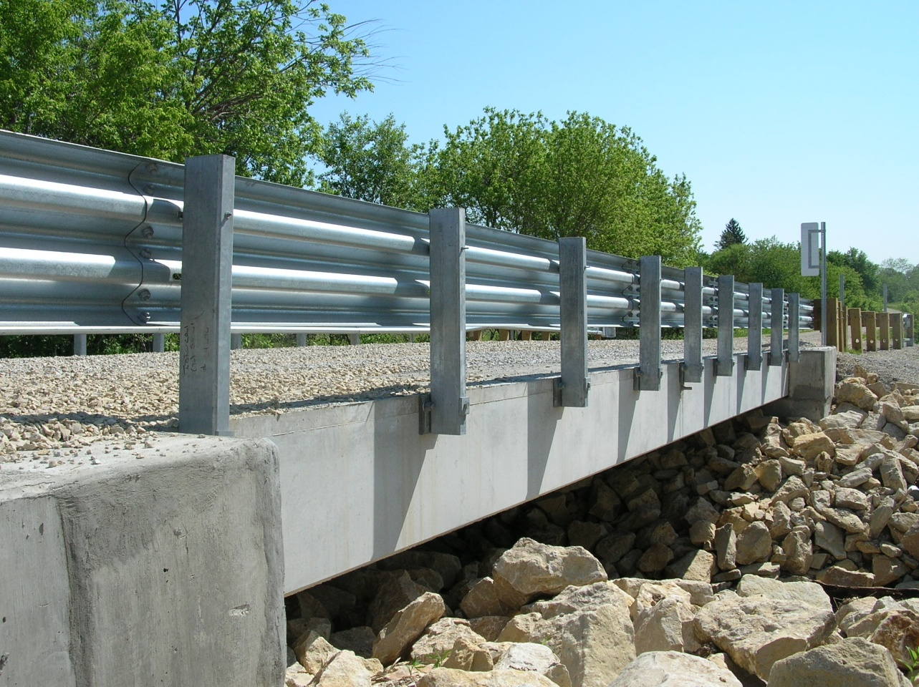
Madison County Bridge

Slide 2
Overview
Type:
  Box beam bridge
  Approach roadway surface – gravel
Size:
  Span: 46’-8
  Width: 24’-0
Cost:
  Winning Bid Total $159,937
  Bridge Bid $121,210
  Bridge Unit Cost $102/SF

Slide 3
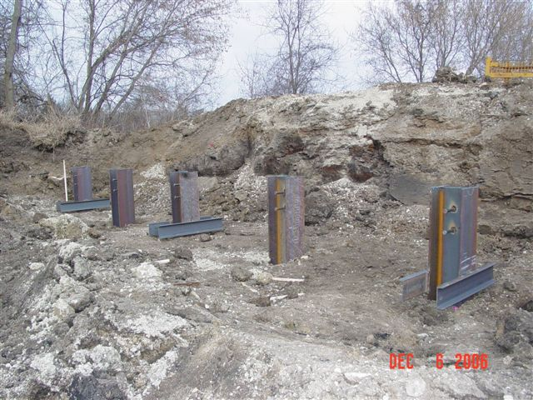
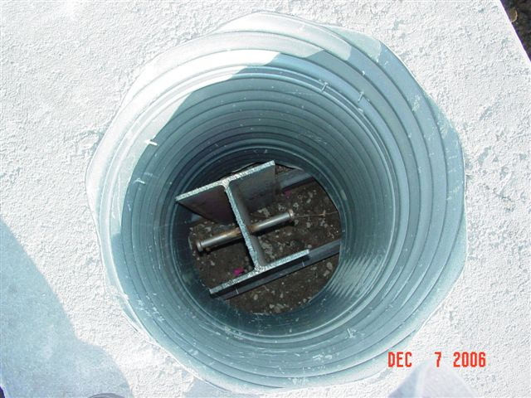
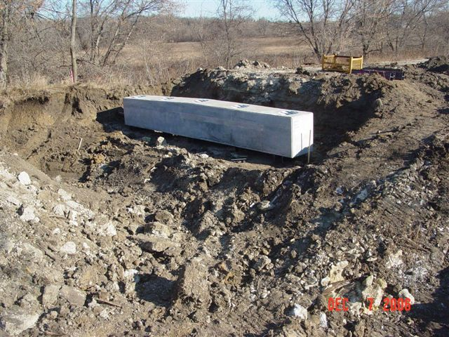
Substructure
  Precast abutment footing
  H-pile foundation

Slide 4
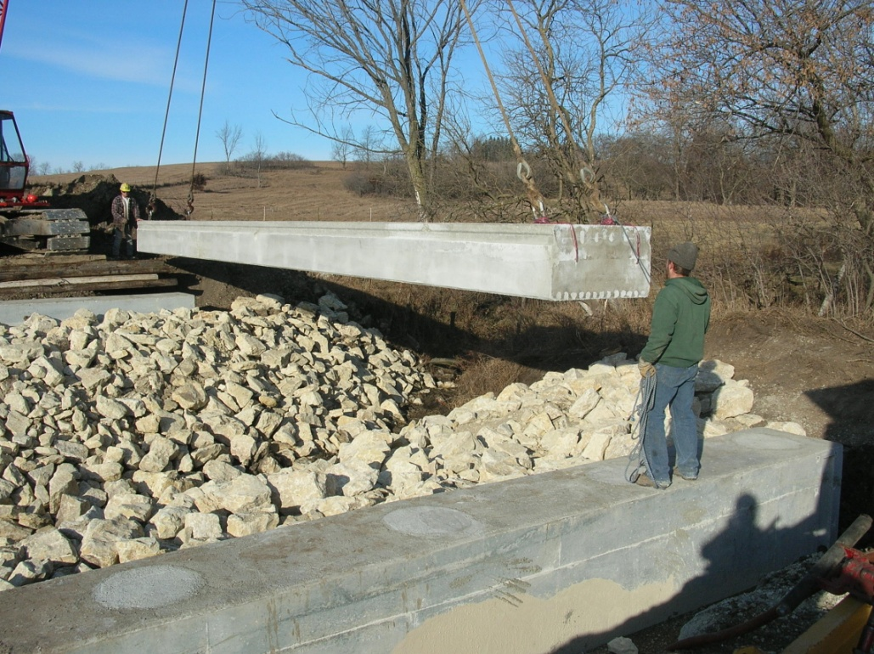
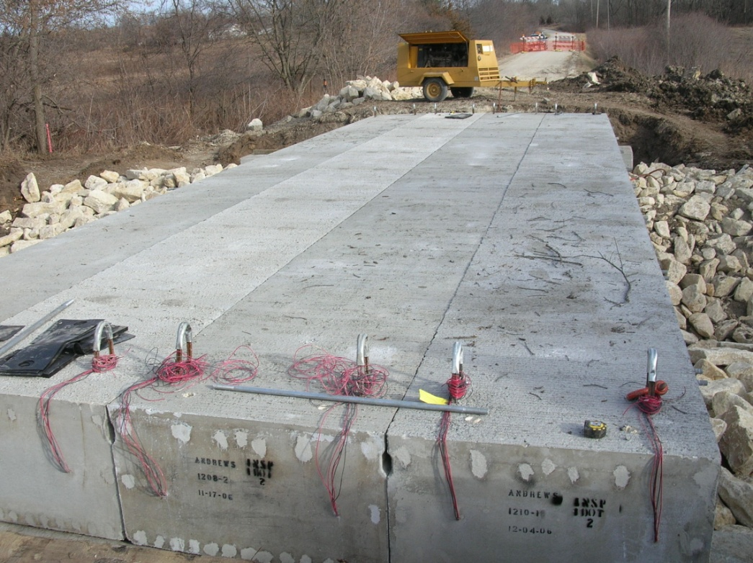
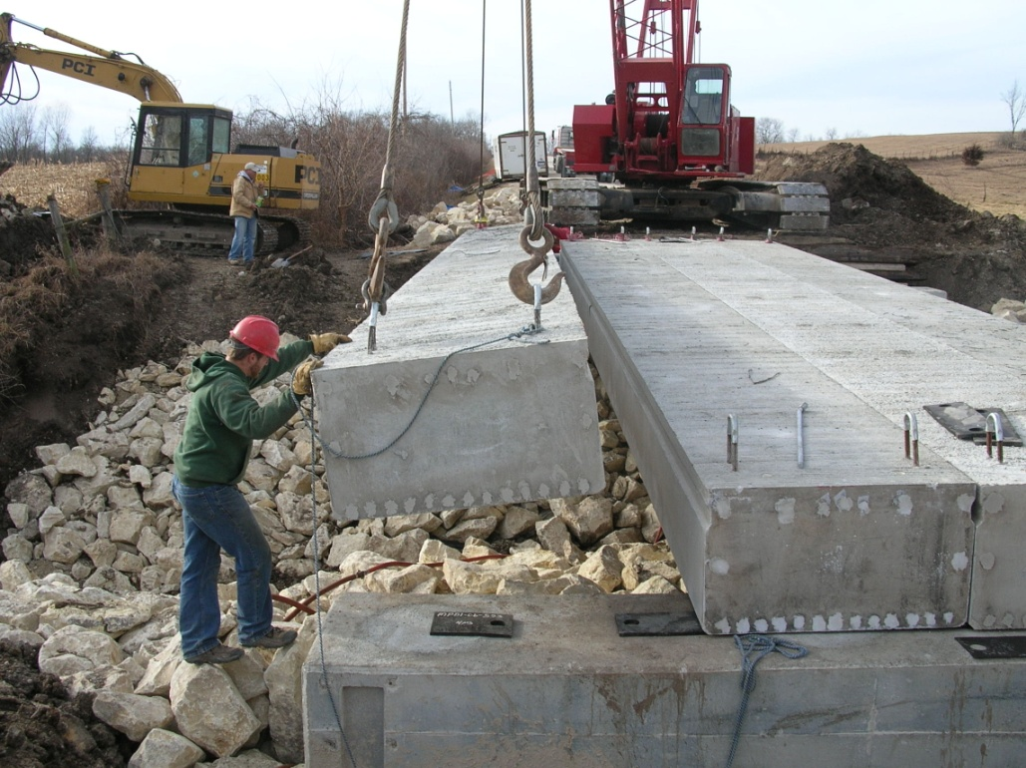
Superstructure
  Precast pretensioned box girders with integral deck
    Pre-stressed longitudinally
    Bolted transversely

