Slide 1
Iowa New Driver Education
(Name of DMV and/or County Treasurer)

Slide 2
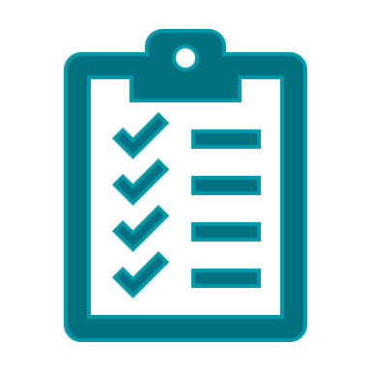
Welcome!
Thank you for joining us!
Agenda
Graduated Driver's License (GDL)
Special Minor Restricted License (School/Work Permit)
Moped
Parent-Taught Driver Education
Skip the Trip

Slide 3
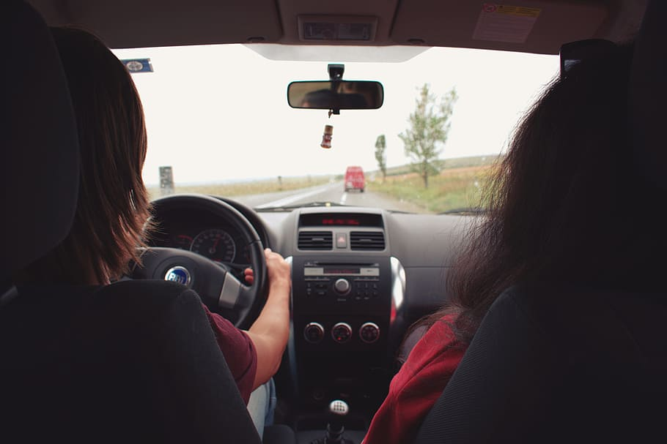
Graduated Driver's License System
3/2/2023

Slide 4
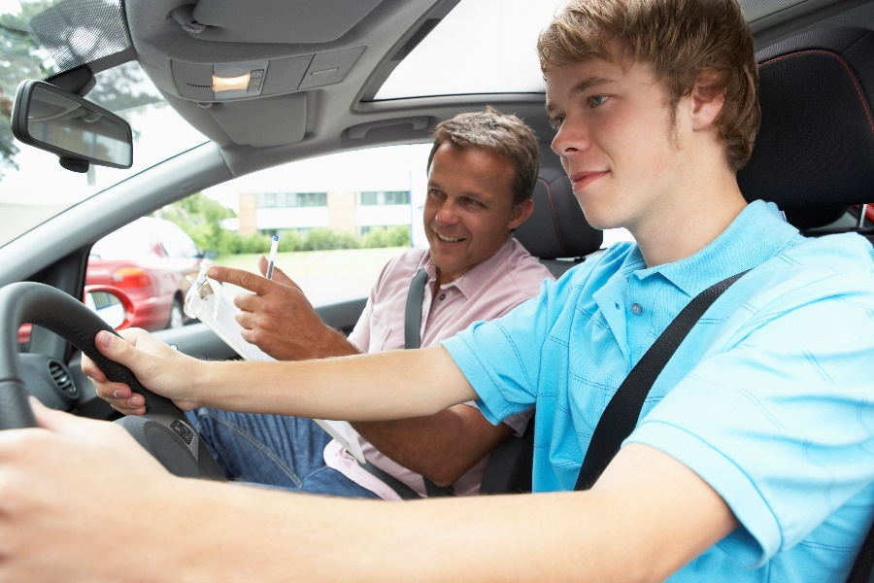
Get Ready to Drive!
Driving is an adult responsibility that must be taken seriously to keep you and others safe on the roadways and protect your privilege to drive.

Slide 5
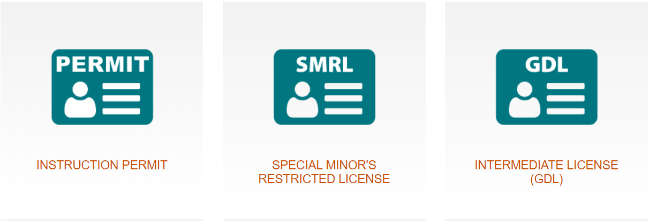
Graduated Driver's License
For drivers under the age of 18, Iowa has a graduated driver’s license (GDL) system. GDL includes three steps that provide experience to improve driving skills.
Notes:
For drivers under the age of 18, Iowa has a graduated driver’s license (GDL) system. GDL includes three steps that provide experience to improve driving skills. These steps include:

Slide 6
Instruction Permit
Must be 14 years old.
Your parent or guardian must provide written consent.
Pass written and vision tests.
Provide a primary form of identification, proof of residency, proof of social security number when you visit the DMV.
With the permit, you can drive at any time with adult supervision such as a family member over the age of 21 or another adult who is over the age of 25 with written permission from your parent or guardian.
Notes:
Instruction Permit
Must be 14 years old.
Your parent or guardian must provide written consent.
Pass the written and vision test.
Provide a primary form of identification, proof of residency, proof of social security number when you visit the DMV.
With the permit, you can drive at any time with adult supervision such as a family member over the age of 21 or another adult who is over the age of 25 with written permission from your parent or guardian.

Slide 7
1a. Special Minor Restricted License (School/Work Permit)
Be at least 14 ½ years old.
Complete an Iowa-approved driver education course.
Hold a valid instruction permit and maintain a clean driving record for a least six consecutive months immediately before applying for your minor school license.

Slide 8
WHAT CAN STUDENTS DO WITH THIS LICENSE?
Drive from their home to school(s) of enrollment for class or school sponsored activities using the most direct and accessible route. Public school students are limited to driving within the school district of enrollment and accredited nonpublic school students and students that are home-schooled are limited to driving within a 25-mile driving distance.
Drive to participate in school-sponsored extracurricular activities using the most direct and accessible route. Activities must be held at a location within a 25-mile driving distance.
Drive for work. The driving distance between the origin and destination must be 25 miles or less.
Drive to complete farm work to assist their parents, guardians, or employers in connection with any farm employment or farm-related work using the most direct and accessible route, if you live on or are employed by a farm in Iowa. The driving distance between the origin and destination must be 25 miles or less.
Stop for fuel while on route or at the closest filling station off route.

Slide 9
Special Minor Restricted License
How to apply:
Download and fill out Section 1 of the Affidavit for School License (form 430021) and sign with a live signature.
Have school superintendent, principal, or school board chair sign with a live signature.
Have a parent or guardian complete a Parental Consent for Special Minor’s Restricted License (form 430022). You must carry this completed form with you in the vehicle. Present it to law enforcement when requested.
This form is available at any driver’s license issuance site or online.

Slide 10
2. Intermediate License
Be at least 16 years old.
Complete an Iowa-approved driver education course.
Have had an instruction permit for a total of one year and a clear driving record for at least six consecutive months immediately before applying for your intermediate license.
Depending on your driver education instructor’s opinion, you may be required to complete a drive test at your local DMV.
Your parent or guardian must provide written consent.
With an intermediate license, you can drive without adult supervision between 12:30 a.m. and 5 a.m.
If your license says, “passenger restriction”, you cannot carry more than one minor passenger that is not a relative when driving without adult supervision.

Slide 11
3. Full License
Available at age 17.
Must meet all conditions of intermediate license:
Keep your intermediate license for at least 12 consecutive months immediately before applying for a full license.
Maintain a clean driving record for at least 12 consecutive months immediately before applying for a full license.
Complete 10 hours of supervised driving while holding your intermediate license.
If you are under the age of 18, you parent or guardian must provide written consent.
Full driving privileges with no restrictions.

Slide 12
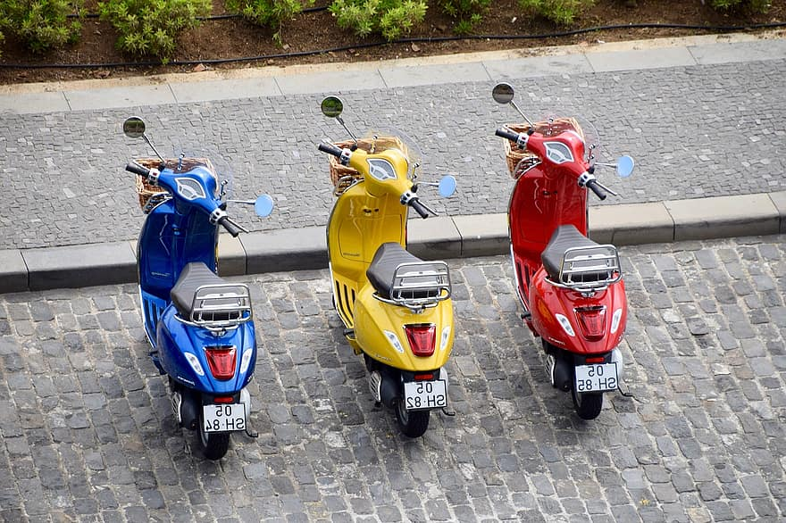
Moped
3/2/2023

Slide 13
Moped
You must be at least 14 years old to obtain a moped license.
If you are at least 14 but under 16, you must pass an approved moped education course and present your certificate of completion from the course when you apply for the moped license.
If you are at least 16, you do not have to complete a moped education course to obtain a moped license, but for your safety we encourage you to do so.
REMINDER: Passengers are not allowed on a moped.

Slide 14
Skip the Trip
Remote Knowledge Testing
3/2/2023

Slide 15
Overview
What is Skip the Trip?
Partnership between the DOT and participating schools to administer the operator’s knowledge test.
Who can give the test?
Participating agencies designate a proctor to administer the knowledge tests.
How does it work?
Applicants complete the knowledge test on-line through a web based “Remote Testing Portal”

Slide 16
Remote Testing vs. In-Person Testing
Differences
Similarities
Web-based delivery, instead of an application.
Remote portal suspends users’ test session if it is minimized (to prevent looking up answer on a browser).
Same content from the same bank of test questions.
Fulfills the same knowledge testing requirement needed to receive an instruction permit.

Slide 17
Onboarding Schools
Skip the Trip

Slide 18
Getting Started
1
CONTACT US:
Reach out to skipthetrip.support@iowadot.us
ACKNOWLEDGEMENT RECEIPT:
The School or Agency will receive an email containing a blank memorandum of understanding (MOU) and a program participant addendum.
2
3
AGREEMENTS:
An authorized representative of the school/agency is required to:
Review and sign the MOU
Determine your agencies proctor (program participant
Have each proctor complete the program participant addendum. (This form must also be signed by the authorized representative.

Slide 19
Getting Started - continued
4
SUBMIT AGREEMENTS:
Email the signed MOU and proctor agreement to skipthetrip.support@iowadot.us
AGREEMENT APPROVAL:
Once the agreements are properly executed the school will receive a signed copy.
5
6
TRAINING:
The proctors will receive an email with their user ID and password along with a link to the training.

Slide 20
For Questions
Contact skipthetrip.support@iowadot.us

Slide 21
Local Law Enforcement SLIDE

Slide 22
Organ Donor Rep. SLIDE

Slide 23
THANK YOU FOR YOUR TIME AND ATTENTION!

