Slide 1

UTILITY ACCOMODATION PERMITTING
For Utility owners, designers, and contractors.
Bryan Bradley, P.E. State Utility Engineer
800 Lincoln Way 515-239-1014
Ames, Iowa 50100 bryan.bradley@dot.iowa.gov
Notes:
Welcome to the Iowa DOT’s Utility Accommodation Permitting short course. This course has been designed specifically for utility owners, designers, and contractors as an aid to understanding the information contained in DOT utility accommodation permits.

Slide 2

When do I need to apply for a Utility Accommodation Permit?
When the installation will be within or crossing the DOT right-of-way
and
When the following conditions apply:
  A new installation
  An upgrade to an existing installation (e.g. upgrade from 34.5 kV to 161 kV)
  Change in installation location (e.g. above ground changed to underground)
  A new Accommodation Permit is not needed when:
The work is primarily maintenance in nature. Examples include:
  Same size and location as previous installation
  Pole replacement as long as the facility is not being upgraded and the pole is placed within 1’ of the original location
  Tree trimming/clearing
However, a “Work on Right-Of-Way” Permit is required if traffic is impacted.
Notes:
If the work is primarily maintenance in nature and traffic will be impacted, a Work on ROW permit is required.
Not as much information is required for a Work on ROW permit, though.

Slide 3
When do I need to submit multiple applications?
Multiple applications are needed when:
  An installation starts on one highway and continues onto another highway
    Each highway segment needs a separate permit
  Two different utilities occupy the same location and installation.
    Each utility needs an individual permit (e.g. telephone and fiber optic)
  An installation crosses a county line.
    A single permit can only cover work in one county
A single application will cover:
  An installation along only one highway
  An installation in only one county
  An installation of only one facility type and owner

Slide 4
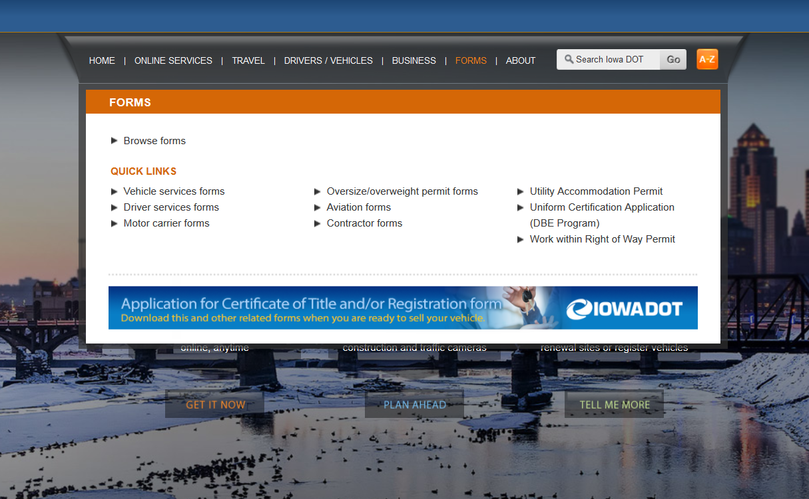
Where can I find the application?
https://www.iowadot.gov

Slide 5
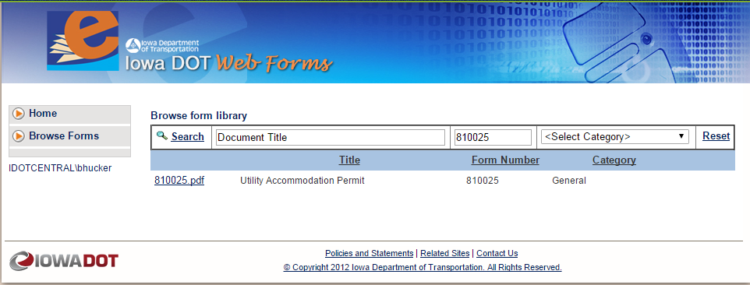
Where can I find the application?
https://forms.iowadot.gov/Default.aspx
SEARCH FOR FORM #: 810025
or the word “Utility.”
Notes:
If you can’t remember what the form number is

Slide 6
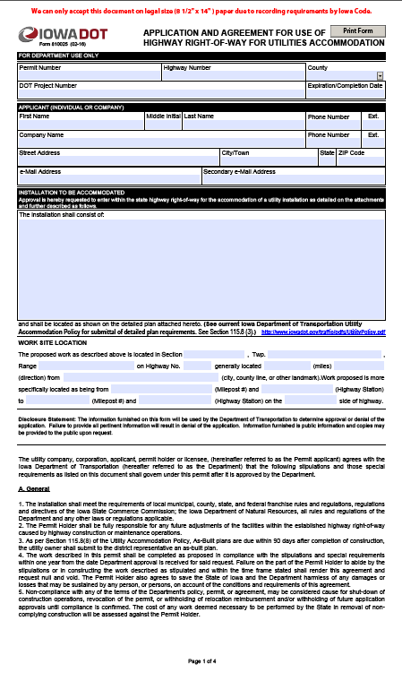
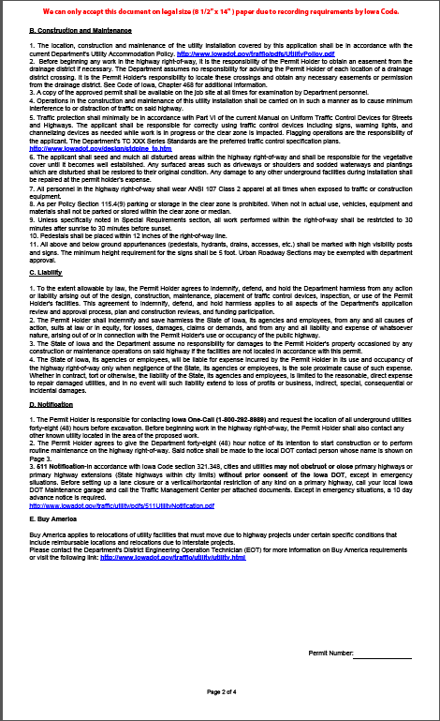
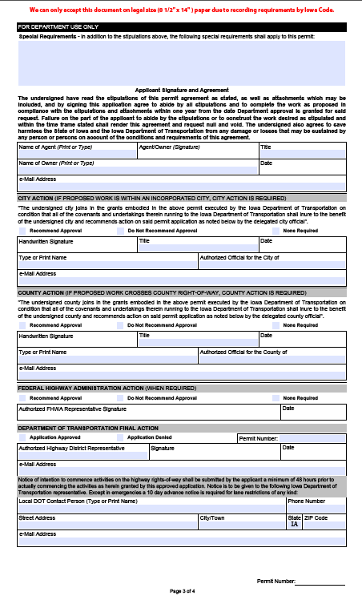
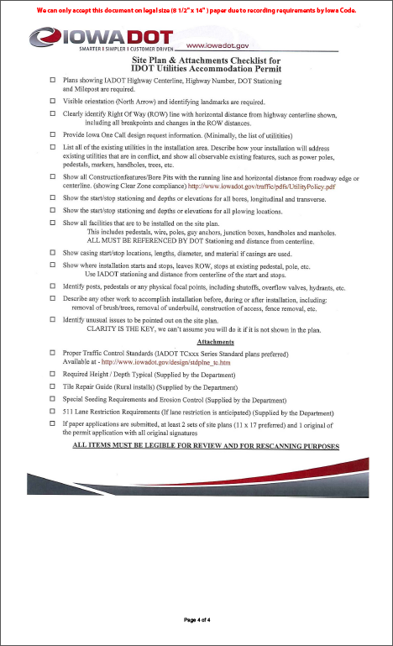
The Permit Application

Slide 7
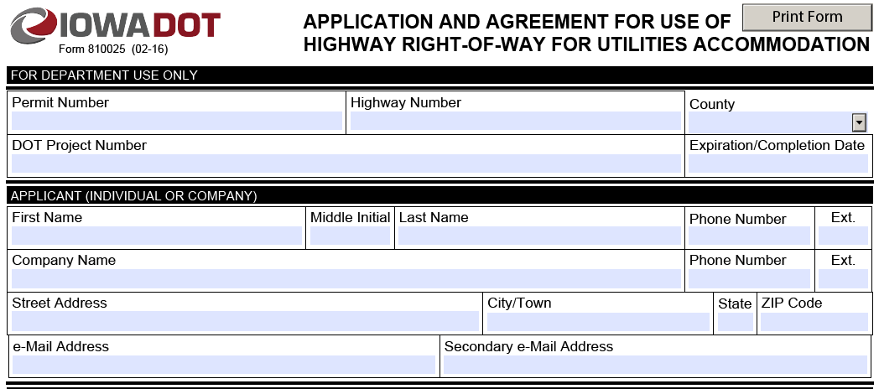
Filling out the application…
Applicant information must be filled out to completion with Utility facility owner’s information (no design consultant info).
Please make sure that the phone number listed is to someone that can answer questions that may arise from the permit.
Recently added email address and space for a second one.

Slide 8

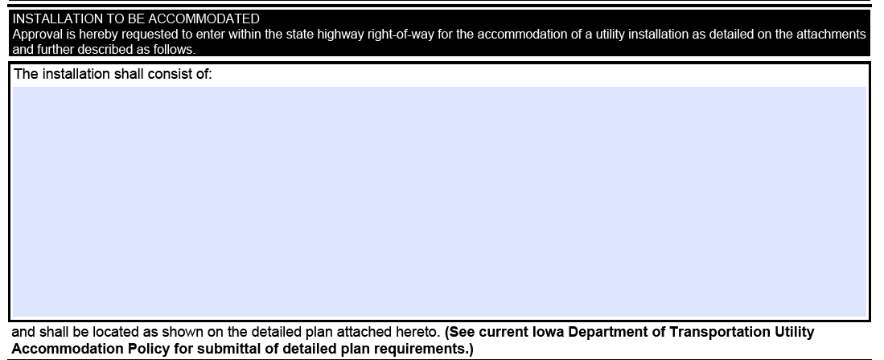
Installation to be Accommodated includes:
Method of construction:
  Boring, digging, open trenching, pole installation, etc.
Materials used in installation
Encasement materials and specifics on encasement
Vaults, pedestals, cabinets, footings, guy anchors, etc.

Slide 9
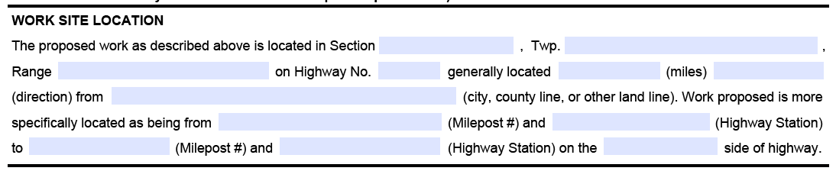
Work Site Location:
Section, Township, Range
  (Sec. 32, T76N, R13W)
Highway and general location information
  Stations, Mileposts, Side of Highway

Slide 10
Centerline Stationing
What is Stationing?
A station is a longitudinal measurement method used to provide location along highway and other longitudinal projects.
The measurement is taken horizontally (i.e. does not follow ground contour) along the highway project centerline.
1 STA. = 100 Feet
East-west roads, stationing typically begins on the west county line.
North-south roads, stationing typically begins on the south county line.
Stationing typically resets to 0+00 when crossing a county line.
STA. 445+00 = 44,500’ from station 0+00
Notes:
Longitudinal location – typically used on longitudinal-type projects (highways, railroads, pipelines, etc.)
One station is 100’ long
Stations are measured horizontally – they do not follow the contour (ups and downs) of the roadway

Slide 11
Centerline Stationing
How does stationing work?
Stationing
Example: This point is at
Sta. 451+00 - 50’ Lt.
(Left of centerline)
Labeled every 500’ on rural scales
Labeled every 100’ on urban scales
445
450
Left Side
Ahead
100’
Right Side
Back
500’
Example: This point is at
Sta. 451+25 - 100’ Rt.
(Right of centerline)

Slide 12
Where can I find Stationing for a Highway?
On 2-Lane Roads:
  The right side of the roadway when looking in the same direction as stationing.
On 4-Lane Roads:
  In similar locations as outlined previously on the outside edges in both directions.
DOT Project Plans:
  Obtain project plans from DOT Document Services in Ames: Desi.Asklof@dot.iowa.gov or (515) 239-1808

Slide 13
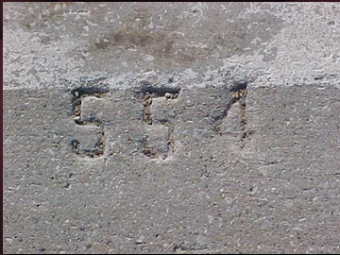
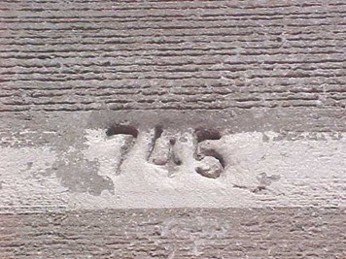
How do I find stationing in the field?
About 1 foot in from the outside edge of the road every 100 ft. stamped in the pavement on PCC (concrete) roadways.

Slide 14
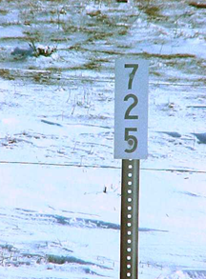
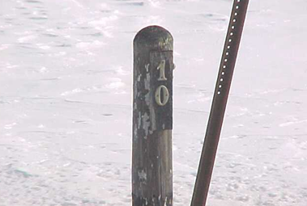
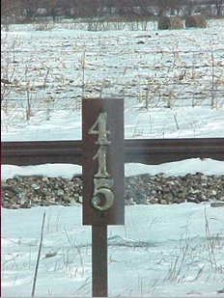
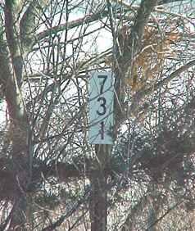
How do I find stationing in the field?
Every 500 ft. on HMA (Asphalt) surfaced roadways.

Slide 15
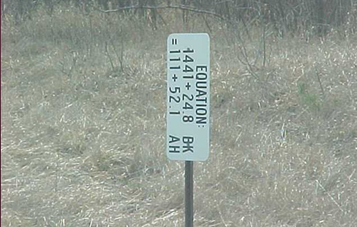
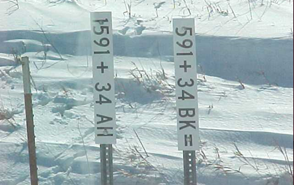
Station Equations
What happens when stationing changes along a road? A station equation is created.
Common reasons include:
shortening or lengthening of a highway line due to highway realignment
4-lane highway where one lane is longer than another due to alignment.
1410
1410
Ahead
115
Left Side
1411+24.8
111+52.1
Right Side
Back
Notes:
Drill down for the sign on the left.

Slide 16
Why do I encounter an Equation?
The end of one project to start of another
Construction of ramps
County or “corporate” separations (often a construction split at the corporation line)
Shortening or lengthening of a highway alignment due to highway realignment.
Alignment changes on a 4-lane facility where one lane is longer than another due to a differing alignment.

Slide 17
Other Stationing Anomalies
Metric Stationing on one set of lanes and English on another set in a 4-lane facility
  Particularly if one set of lanes was constructed years ago and the second set of lanes constructed between the mid-1990s and the mid-2000s.
Equations from English Stationing to Metric and back
  Again, occurs if road segment was constructed/reconstructed between the mid 1990s and mid-2000s.
Station numbers running in the opposite direction to Mileposts
Mileposts changing seemingly mid-stream
  May occur due to multi-plexing of two routes (i.e. if a US highway joins with a state highway, the US highway mileposts govern).
  Hierarchy for mileposts: Interstate Highways, then US Highways, then State Highways

Slide 18
What if I can’t find Stationing?
Contact the local EOT where the application will be submitted.
The EOT may ask you to:
  Flag or lathe out your proposed installation
  Note the lack of stationing/mileposts on a post-it or in a cover letter and leave those areas blank
  Measure from a known and identified point to the location(s) you are starting and stopping.
For best results, consider using one or more of the above methods to mark out your installation
It is ideal to field evaluate your intended location for anomalies
  Designing from your desk often results in many additional questions, etc.

Slide 19
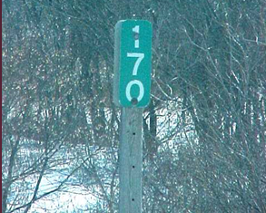
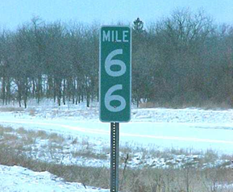
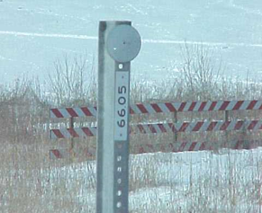
What Is A Milepost?
Mileage is measured along the centerline profile from the start of the highway.
NOTE: Mileposts may be up to 50’ ahead or back from their “correct” location when field conditions warrant, which is why they are called “reference posts.”
East-west roads, mileposts typically begin on the west end of the route in the state.
North-south roads, mileposts typically begin on the south end of the route in the state.
Mileposts are continuous throughout the length of the route across the state.
Notes:
Mileposts follow the contour, so a mile on anything other than a flat road will be less than 52+80 stations.

Slide 20
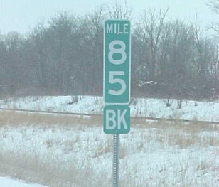
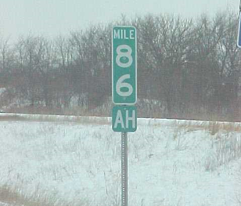
Milepost Equations
How are mile post adjustments accommodated?
Through “Ahead” and “Back” mile posts!
Back
Direction of Increasing
Milepost
Ahead
MILE 8
4
MILE 8
5
MILE 8
6
MILE 8
7
BK
AH
5,280’
Adjustment Distance*
5,280’
*Distance can vary from a few hundred feet to several miles.

Slide 21
Why do we need both Mileposts and Stations?
Mileposts follow the centerline profile (terrain) of the roadway (ground measurement).
Stations are in true horizontal distance as measured by survey equipment. This distance stays constant regardless of terrain.
Therefore, 1 mile (5280 ft.) does not always equal 52+80 stations.
Mileposts can be up to 50’ ahead or back from their “correct” location when field conditions warrant.
When measuring offsets from centerline, the measurement should be made horizontally (flat).
  Please do not use a wheel along the ground / terrain.
  Please use two people with a tape and pull it tight when taking the measurement.
GPS can be included for future references, but permit applications need to have traditional location information supplied.

Slide 22
Who submits the application?
The company that is permanently responsible for the utility facility.
  The utility owner is responsible for installation location and quality including when a contract-installer is used.
Permit applications must be submitted by a responsible utility company employee or authorized agent.
  To gain “Authorized Agent” status, the utility should submit a formal letter to the Department indicating their intent to allow a consultant to serve as their Authorized Agent and the extent of time they intend to allow that status for a particular consultant.
All permit applications competed by design contractors are to be reviewed and signed by utility company.
  A design contractor is allowed to serve as an authorized agent of a utility if the DOT has a letter on file from the utility granting authorized-agent status.

Slide 23
How soon should I submit the application?
As early as possible…
  It may take the DOT up to 30 days to process a permit application once all required information* has been submitted.
  *Required information includes:
    City, County, and/or Drainage District approval
    All information on the “Site Plan & Attachments Checklist for IDOT Utilities Accommodation Permit” (page 4 of permit application)
  For large projects, additional review time is appreciated due to the large amount of information to review.
  Note: Federal Highway Administration (FHWA) approvals may be required on a limited number of permit applications involving Interstate Highways. The DOT will secure FHWA approval prior to application approval, which could exceed the 30 day window.
Notes:
Breaking up the project into smaller segments may allow quicker processing.
Good feed back if doing it right have to redo less

Slide 24
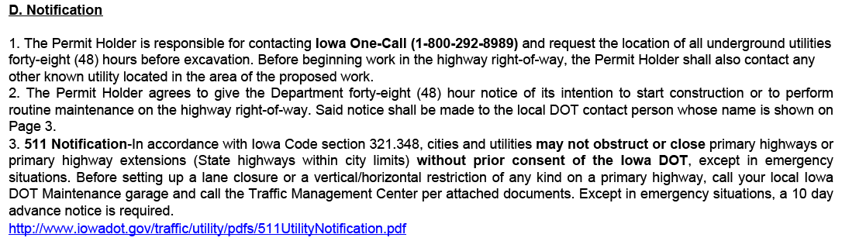
AGREEMENTS
Requirements provided on Pages 1 and 2 of the permit application should be reviewed prior to signing the permit application.
Such as…
Notes:
Several sections of legal requirements that tend to get ignored but are important
Review #2 as example of requirements

Slide 25
Who signs the permit application?
APPLICANT SIGNATURE
  The company that is permanently responsible for the utility facility.
  Permit applications must be signed by a responsible utility company employee or authorized agent.
  A design contractor is allowed to serve as an authorized agent of a utility if the DOT has a letter on file from the utility granting authorized-agent status.
CITY SIGNATURE
  Official from the city entity whenever an installation is within the corporate limits of a city.
COUNTY SIGNATURE
  Official from the county entity whenever the installation originates from, exits into or crosses a county road or county-owned property.
Notes:
For some cities, there is a 2-mile buffer for some facilities such as rural water facilities.

Slide 26
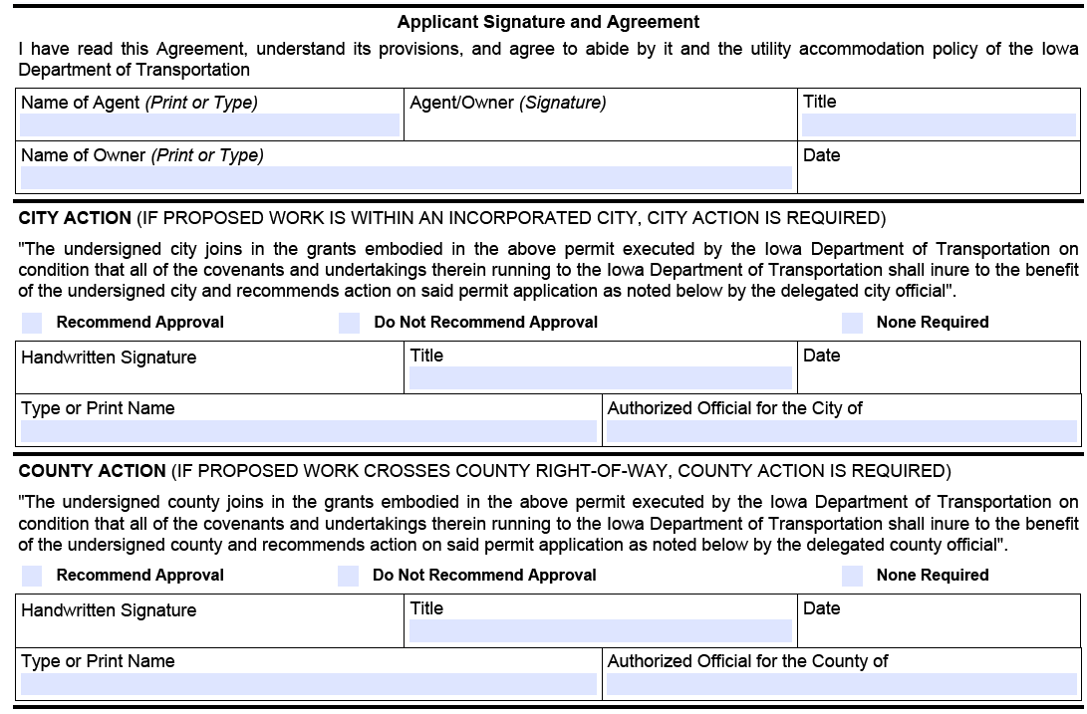
Notes:
An “Authorized Agent” of a utility company can fill out the “Applicant Signature and Agreement” portion on this page in their own name.

Slide 27
Other Possible Approvals
In the form of a signed letter of approval:
  US Army Corps of Engineers
  Other Military Entities
  Iowa Department of Natural Resources
  Railroads
  Others?
When to consider needing other approvals?
  Anywhere that you will potentially impact:
    Major Waterways
    Homeland Security
    Environmental, Historical, Ecological or other “protected areas”
      Regulatory restrictions apply to tree trimming/clearing to protect bats and migratory birds.

Slide 28
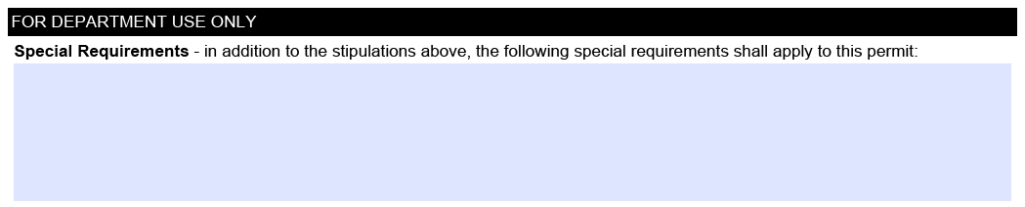
Special Requirements Section
Due to a steep backslope between STA. 123+45 and STA. 147+89, no open trenching or plowing will be allowed. Boring under this area is required.
Work within the ROW may only occur between one-half hour after sunrise to one-half hour before sunset per DOT policies.
Between MP 12 and MP 25, work may only occur between 9:00AM and 3:00PM due to high traffic volumes outside of those hours.
The E.O.T. will use this section for any special requirements:
  May contain restrictions or additional stipulations not outlined in standard permit wording
  Special construction methods
  Special Traffic Control
  Special notifications of other parties
  Work restrictions or hours or days

Slide 29
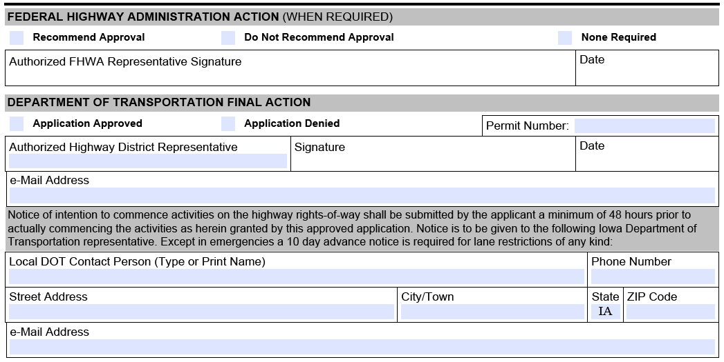
Final Permit Application Approval
FHWA Action
  Used for interstate impacts
  Acquired by the DOT staff
DOT Action
  Generally approved or not recommended for approval by the Engineering Operations Tech.
Contact Person
  Notifying this person allows us to know you will be working in the area
  Should be contacted at least 48 hours in advance
  Could be the E.O.T., Garage Supervisor, or RCE

Slide 30
Site Plan and Attachments Checklist
To avoid application approval delays, please be sure to address all checklist items prior to submitting the permit application!
This checklist is located on page 4 of the Application.
Keep in mind, the application may not be reviewed until sufficient background information is provided.
Notes:
This checklist is very valuable. Not everything will be needed every time, but if not needed, then check it off as complete.

Slide 31
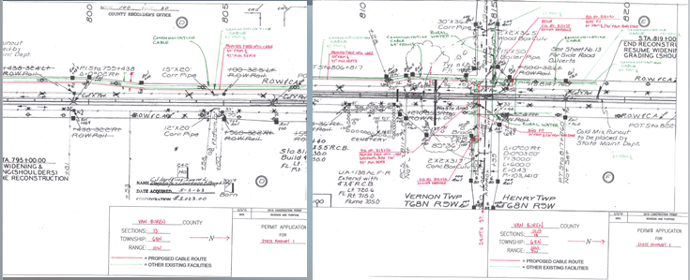
THE GOOD
Permit drawn on DOT as-built plans supplying both ROW information and Stationing
Existing utilities clearly given in contrast to what is proposed
Additional verbiage included showing intent of work proposed
Bore pits including distance from Centerline and edge of pavement included

Slide 32
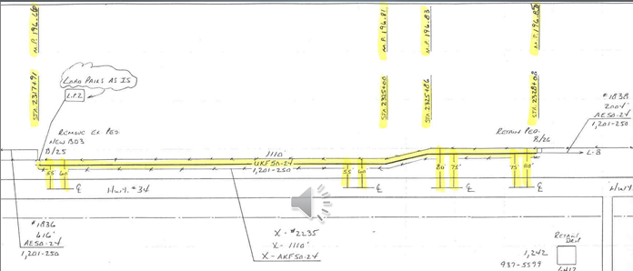
THE GOOD
Good detail with little unnecessary information
ROW & installation distance details including station breakpoints where ROW & installation changes from Centerline
Start & Stop at existing pedestals (includes ID labels for easy identification)

Slide 33
Ideal Site Plan Pointers
Color is Not always your best option
Make your site plan simple and direct
Make your site plan specific enough that anyone can take the plan and find the location in the field without much guidance
Remember to include all the necessary elements that are required
A few additional landmarks are always a good addition for ease of orientation

Slide 34
The Basics of Good Constructability
Can you actually install/construct as you are proposing?
Have you looked at the surroundings you are installing in?
Are Bushes, Trees, Plantings, signs, other utilities etc. In your way?
Never install in the foreslope or between a driveway culvert and the highway
As close to ROW as possible/practical
Transvers Crossing ideally installed perpendicular to the highway unless circumstances prevent it
Are you installing by open trench or boring?
Are you prepared to do the erosion control and seeding where it will be needed after installation?
Is the way you are proposing to install going to be feasible for your company?

Slide 35
Other Considerations for Site Plan Design
Other utilities I the area should be located and identified I your site plan if they are in the area of your proposed install
  Address how your contractor will address conflicting utilities not on your plan
    (relocating without prior approval in not an option)
Planned Tree/Bush Plantings or special grasses such as Wildflowers or Native Grasses
Other obstacles in ROW
  Signs, Poles, Archaeologic, Botanical or Historical obstacles
Private property owners “items”

Slide 36
Clear Zone
Clear zone is NOT just for overhead installation and poles
Clear zone involves bore pits
Clear zone involves equipment/material storage
What is Clear Zone?
  SEE CHARTS

Slide 37
Traffic Control Standards
TC-202, TC-212, TC-213, TC-214, TC-215 for 2-lane roadways
TC-1 is for duration of less than 1 hour
AMBER LIGHT ON THE VEHICLES IS A REQUIREMENT
TC-202 is for work that will be outside the clear zone of the roadway (this includes parked vehicles, trailers and idle equipment.)
TC-402, TC-418 (Divided Highway), TC-419 (Undivided Highway) are for 4-lne operations. TC-228 and TC-429 used in 3-lane sections with TWLTL.
TC-451 is for temporary full closure of a multi-lane facility requires law enforcement coordination and special notice to the District Traffic Tech.
Additional assistance for non-typical traffic control contact the District Traffic Technician

Slide 38
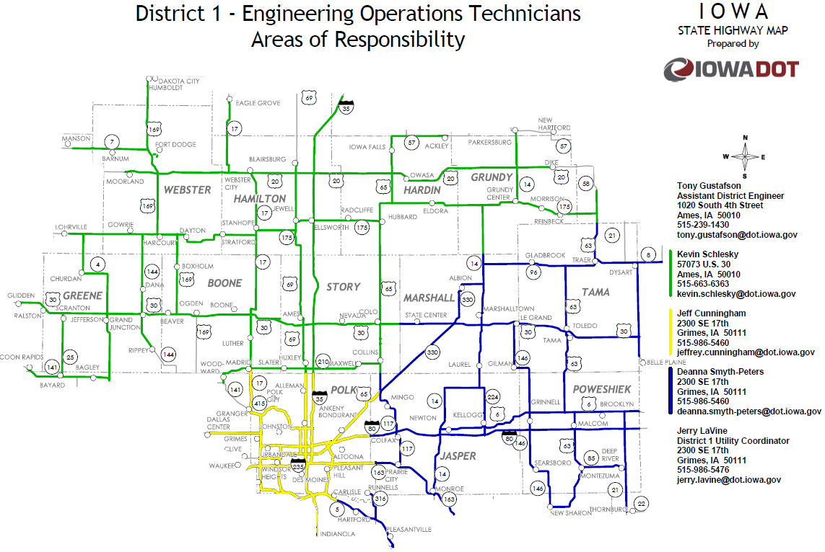
Where do I submit the completed application?
District 1
www.iowadot.gov/districts/permits.html

Slide 39
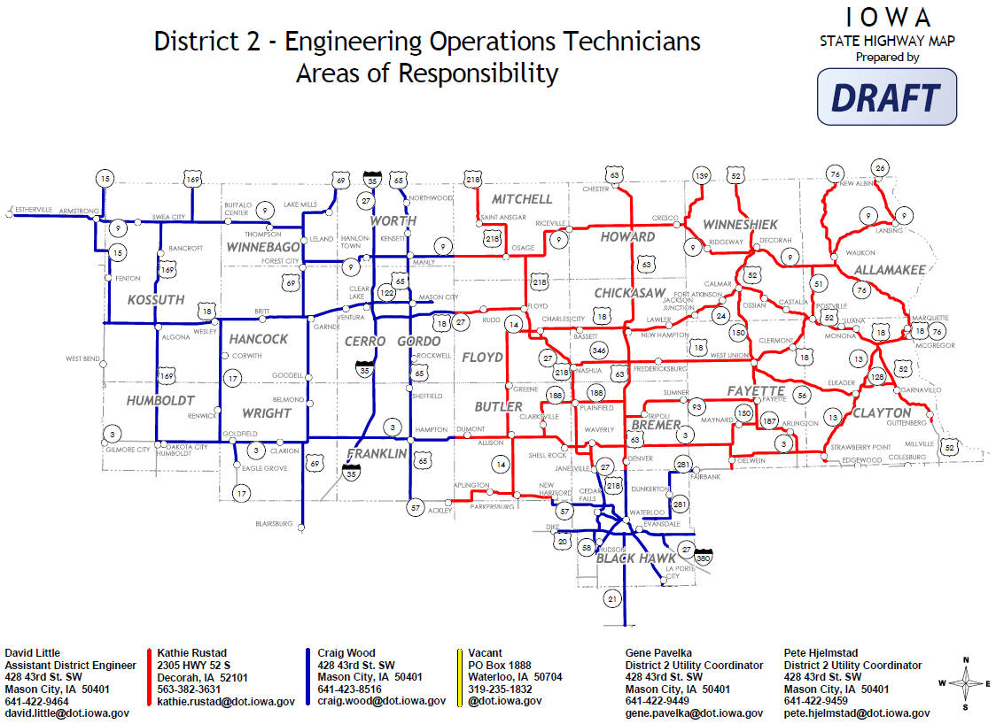
Where do I submit the completed application?
District 2
www.iowadot.gov/districts/permits.html

Slide 40
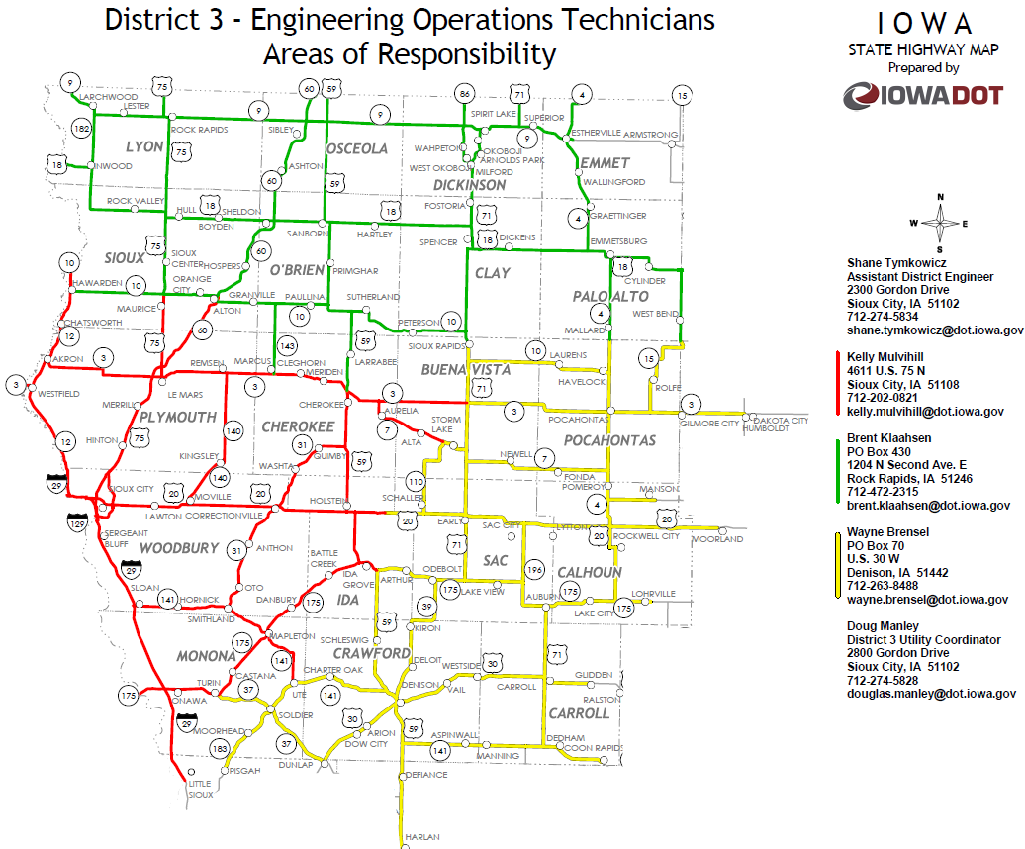
Where do I submit the completed application?
District 3
www.iowadot.gov/districts/permits.html

Slide 41
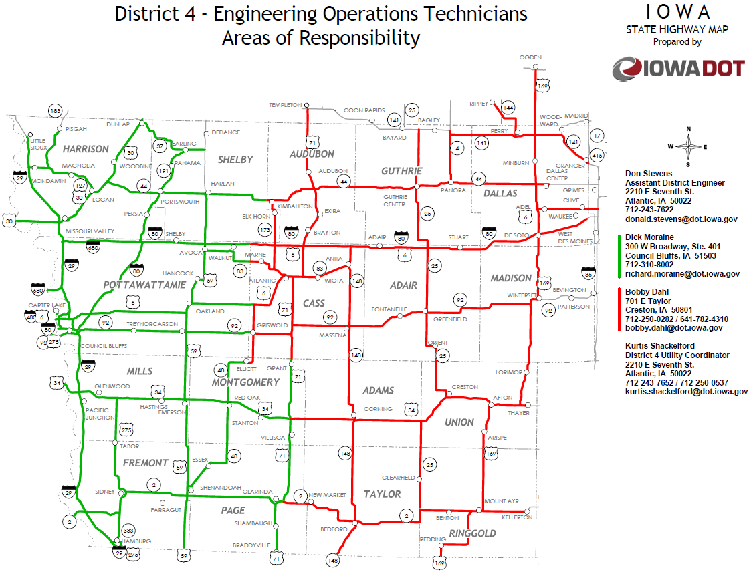
Where do I submit the completed application?
District 4
www.iowadot.gov/districts/permits.html

Slide 42
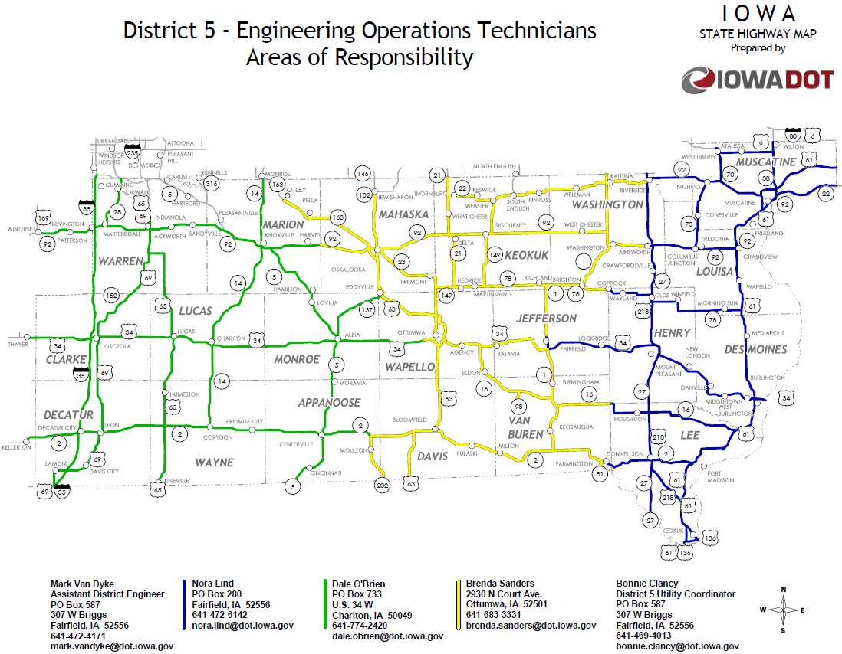
Where do I submit the completed application?
District 5
www.iowadot.gov/districts/permits.html

Slide 43
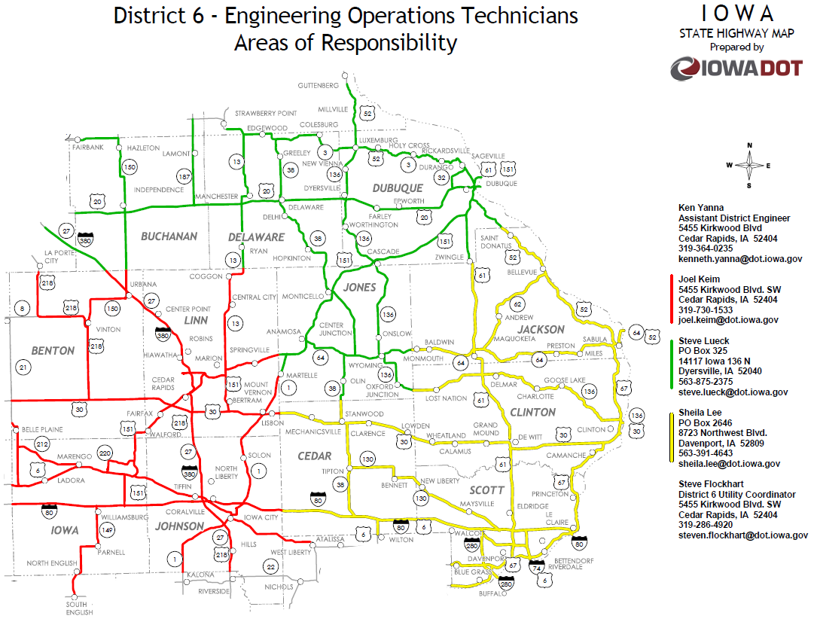
Where do I submit the completed application?
District 6
www.iowadot.gov/districts/permits.html

Slide 44
CARS 511 Utility Notification
Iowa DOT has a system to collect information on road closures and restrictions.
To make the system work, CARS 511 is to be notified 10 days prior to work commencement whenever you will be encroaching the normal roadway travel lanes
  i.e. lane closures, lane restrictions, temporary road closures or detours
This is designed to reroute any permitted, oversized loads that cannot proceed on route designated due to lane restrictions.
Notes:
Permits for oversized load are good for 10 days, which is why we need a 10-day notification for a lane restriction. We don’t want to get an oversized load stuck in a work zone because often they can’t back up, which would lead to traffic delays.
We understand emergency situations occur, so in those instances, you still need to notify the Traffic Management Center, but the 10-day wait will not apply.

Slide 45
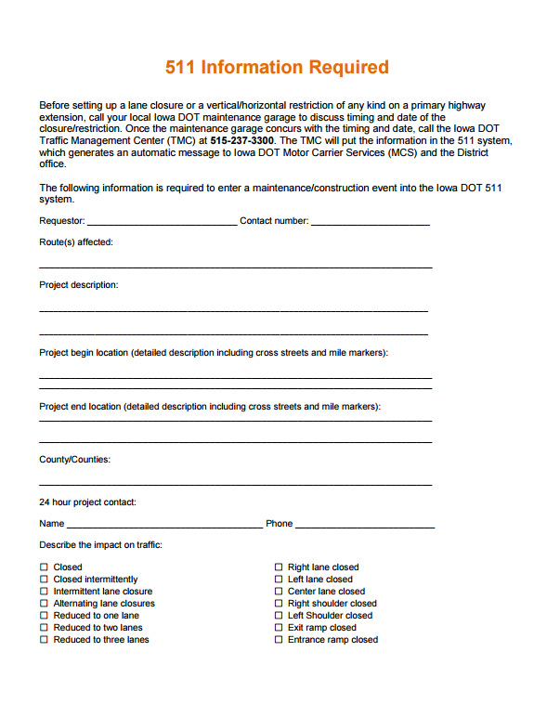
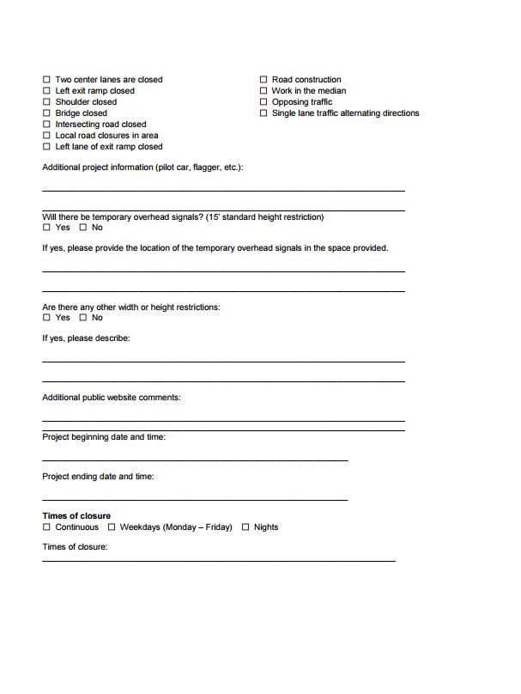

Slide 46
Permit Page Miscellaneous
Permit must be on legal-size paper
Permit must be typed or printed in ink
All areas of Applicant’s responsibility area must be filled out or an attached explanation why it is blank (N/A should not be used)
Signatures of all parties should be originals
All signatures (except FHWA) must be acquired before sending to Iowa DOT for approval.

Slide 47
Online Resources
Additional copies of the permits can be obtained in PDF format at: https://forms.iowadot.gov/BrowseForms.aspx
Utilities Accommodation Policy: http://www.iowadot.gov/traffic/utility/utility.html
Traffic Control Standards: http://www.iowadot.gov/design/stdplne_tc.htm
EOT Territory Maps: http://www.iowadot.gov/districts/permits.html
As-Built Plan Requests:
  Desi Asklof – desi.asklof@dot.iowa.gov or (515)-239-1808

Slide 48

Questions?
Bryan Bradley, P.E. State Utility Engineer
800 Lincoln Way 515-239-1014
Ames, Iowa 50100 bryan.bradley@dot.iowa.gov

