Slide 1
Iowa DOT Update
IPTA Annual Meeting
June 7, 2023

Slide 2
Iowa Public Transit Association
Today’s Topics
Public Transit Team Introductions and Staffing Updates
Compliance Reviews
Title VI Programs
Oral Fluid Drug Testing
Transit Manager Handbook Updates
Transit Manager Training Scheduled
Procurement Reminders
Upcoming Deadlines
Reporting Reminders
CALSTART Inc. Announcement
Fellowship Reminders and Updates
DBE Semi-Annual Report
UZA Boundaries
Shortfall Funding Contracts
Public Transit Infrastructure Grant
Vehicle Replacement List

Slide 3
Iowa Public Transit Association
Public Transit Team introductions and staffing updates
Tammy Nicholson, Modal Transportation Bureau Director
Kristin Haar, Public Transit Director
Brent Paulsen, Transit Programs Manager
Travis Estep, Grants Manager
Becky Law, Transit Programs Administrator
Emma Simmons, Transit Planner/Statewide Mobility Manager
Jamie Wingert, Compliance & Training Specialist
Amy Colwell, Fellowship & Contract Administration
Tesleem Ajisafe, Modal GIS Intern
Laura Lutz-Zimmerman, Transit Programs Administrator

Slide 4
Compliance Reviews 2022
Iowa Public Transit Association
Fort Dodge – Scheduled June 15
MIDAS, Region 5 – Scheduled June 15
SRTS, Region 4
CorridorRides, Region 10
10-15 Transit, Region 15
Ottumwa
Ames
Cambus
Iowa City

Slide 5
Compliance Reviews 2023
Iowa Public Transit Association
Rides, Region 3
PeopleRides, Region 6
INRTC, Region 7
Regional Transit Authority, Region 8
HIRTA, Region 11
Clinton
Muscatine
Dubuque
Waterloo

Slide 6
Title VI Programs
Iowa Public Transit Association
Title VI Programs for small urban and regional transit systems are due this year.
October 1, 2023, deadline
Template available
Contact Jamie at jamie.wingert@iowadot.us
Iowa DOT submitted its Title VI Program to FTA on June 1, 2023

Slide 7
Oral Fluid Drug Testing
Iowa Public Transit Association
49 CFR Part 40 updates were effective June 1, 2023
The final rule was published in the Federal Register, 88 FR 27596
https://www.govinfo.gov/content/pkg/FR-2023-05-02/pdf/2023-08041.pdf
For an employer to implement oral fluid testing under the Department's regulation, the U.S. Department of Health and Human Services (HHS) will need to certify at least two laboratories for oral fluid testing
There are no laboratories certified to conduct drug and specimen validity tests on oral fluid specimens at this time. HHS certified labs can be checked using this link: https://www.transportation.gov/odapc/labs

Slide 8
Oral Fluid Drug Testing – U.S. Department of Transportation Summary of Changes
Iowa Public Transit Association
https://www.transportation.gov/odapc/Notice_Summary_May_2023
This rule amends the FAA, FMCSA, FRA and FTA regulations to ensure consistency within the Department of Transportation and by removing or adjusting references to the word "urine" and /or add references to oral fluid.
Other definitions have been amended for conformity, and miscellaneous corrections.
Sections have been added, renumbered and reordered

Slide 9
Oral Fluid Drug Testing – Highlights for Employees
Iowa Public Transit Association
Could be subject to either an oral fluid collection or a urine collection for any DOT- regulated test
If there is a reason a second collection is needed, the test may be changed to the other type of collection to finish the testing
Substance Abuse Professional (SAP) evaluations may happen in person or remotely

Slide 10
Oral Fluid Drug Testing – For Employers
Iowa Public Transit Association
The choice to conduct an oral fluid or urine test is up to the employer
This additional method for drug testing will give employers a choice
Combat cheating on urine drug tests
Less intrusive
Work with your vendors to communicate you preferred approaches
It is a best practice to have a standing order in place with your collection sites
Designated Employee Representatives should be available to discuss standing orders and the type of test preferred if a problem collection occurs
Employer determines whether a refusal has occurred

Slide 11
Oral Fluid Drug Testing – Additional Considerations
Iowa Public Transit Association
If the same gender collector cannot be found for directly observed collections:
The collector will follow the standing order from the employer to allow oral fluid testing in such situations
If there is no standing order, the collector must contact the DER and arrange an oral fluid test at a site acceptable to the employer.
For direct observation collections involving transgender or nonbinary individuals, an oral fluid collection must be conducted.

Slide 12
Oral Fluid Drug Testing
Iowa Public Transit Association
Updates will be made to Chapter 14 in the Transit Manager’s Handbook to include this method of testing

Slide 13
Transit Manager Handbook Updates
Iowa Public Transit Association
Please submit any suggested corrections to Jamie Wingert by June 15th
jamie.wingert@iowadot.us

Slide 14
Save The Date
Iowa Public Transit Association
Transit Manager Training 2023
September 21, Noon – 5p.m.
September 22, 8:30a.m. – 1p.m.
Materials East/West Conference Room
Ames, IA

Slide 15
Iowa Public Transit Association
Procurement Reminders
Chapter 9 – Transit Manager Handbook
Will be reviewing and updating next few months
Per policy, our office is to verify that all federal certifications are being used in the solicitation and they are current and accurate
TPA’s need to provide concurrence/notice to proceed for all purchases made with FTA dollars, from vehicles to fuel to office supplies that total more than $10,000
If your agency is using funds under direct FTA grants, concurrence from our office is not required
Concurrence requirements are the same for STA and PTIG funds
Bid specifications for projects over $50,000 must be submitted to TPA for approval

Slide 16
Iowa Public Transit Association
Deadline Reminders
July 1st
Record Odometer Readings for each transit vehicle prior to start of service (Unless recorded after end of service on June 30)
August 15th
FINAL year-end stats due
All stats need to be accurate before submittal each quarter for the year end report to be accurate
Year-end odometer readings due
Iowa DOT’s accounting bureau sets a deadline of August 1 for submitting FY23 expenses
Transit agencies that are able to submit end of year reimbursement requests prior to this date are appreciated

Slide 17
Iowa Public Transit Association
Deadline Reminders Continued
October 1st
ICAAP applications due (for projects to begin the following October 1st)
Intercity Bus Grant applications due (for projects starting Jan 1)
State Transit Assistance Special Project applications due (for projects starting July 1)
Small Urban and Regional Transit Agency Title VI Programs due

Slide 18
Iowa Public Transit Association
NTD Reminders
National Transit Database (NTD)
We use data from your fiscal year-end statistical report
This report needs to be accurate
Year-end reviews will begin in August so we can input this data into the NTD system
Remember that your STA allocation needs to match what is shown on your stats
If your transit agency received training fellowships during the year, don’t forget to include those in the FTA or STA funding amounts – depending on system size
When you have contracted service, all ridership/mileage stats, operating costs and passenger revenue should match - work together to ensure this is accurate before submitting your quarterly report

Slide 19
Iowa Public Transit Association
NTD Reminders
National Transit Database (NTD), continued
If you still have stimulus monies, use those funds first when requesting operating expenses – talk to your assigned TPA if you have questions

Slide 20
Iowa Public Transit Association
Announcement
Low/No Emissions Grant
Jeremy Orr from CALSTART, Inc. will be available all-day Thursday and Friday morning for any transit agency that would like to meet and learn more about how CALSTART is assisting the Iowa DOT with the Low or No Emission Bus Program 5339C

Slide 21
Iowa Public Transit Association
Fellowship Application Reminders
Attach a brochure/agenda/itinerary for the training
If staying at a hotel/motel within the State of Iowa, you must attach a copy of the hotels/motels Human Trafficking Certification (it is not required if your stay is outside the state of Iowa)
Deadline for application submittal is TWO weeks before the event
If for any reasons something comes up and you are no longer able to attend the training that had been approved, please notify Amy Colwell by email that you need to cancel your request
Ineligible Items: Any application under $100, Tips, Room Service, Lodging or transportation costs within 60 miles of employee’s home office (not home address)

Slide 22
Iowa Public Transit Association
Fellowship Application Reminders, continued
All requests are to be submitted to Amy Colwell at amy.colwell@iowadot.us
Reimbursement Requests are to be submitted within 60 days of the training event
Updates to Chapter 12 of the Transit Manager’s Handbook will be coming within the next few months

Slide 23
DBE Semi-Annual Report
Iowa Public Transit Association
Iowa DOT submitted the semi-annual DBE report to the FTA on June 1
This report tallies up the reports submitted by the regional and small urban transit agencies plus the metropolitan planning organizations and regional planning affiliations
Our current three-year DBE goal is 0.14%
We topped the goal for this reporting period with 0.16% DBE participation
Please keep looking for DBE opportunities and encouraging potential DBEs to apply to the program
Transit agencies and MPOs/RPAs next semi-annual report is due to the Iowa DOT by November 1

Slide 24
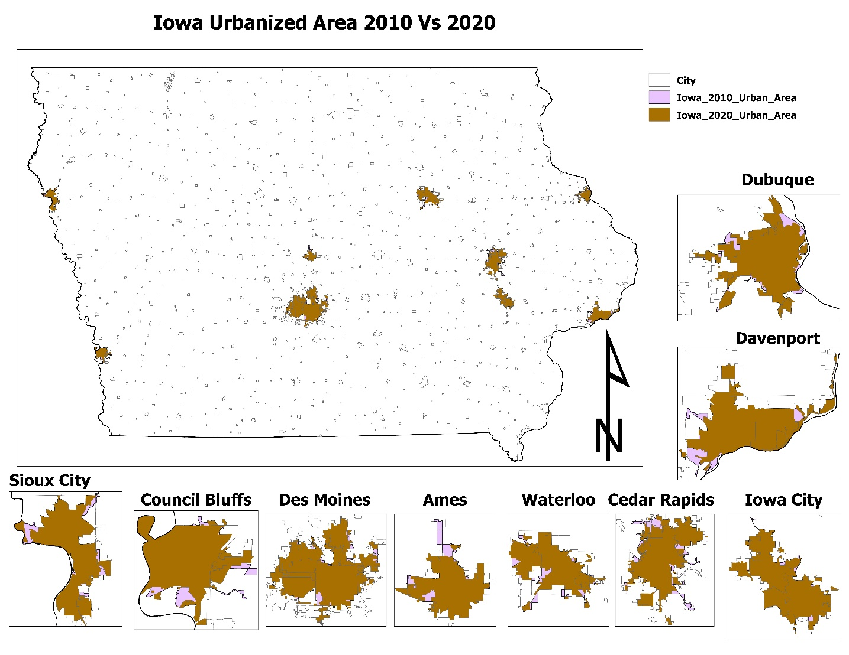
UZA Boundaries
Iowa Public Transit Association
With the finalization of the 2020 Census, new Urbanized Area (UZA) Boundaries were released in late 2022
UZAs are areas with populations of 50,000 or more

Slide 25
UZA Boundaries
Iowa Public Transit Association
Summarized from FTA Circular 9040.1G, the 5311 Circular:
FTA Section 5307 provides funding for capital assistance, planning, and operating assistance for public transportation in UZAs
The purpose of the FTA Section 5311 program is to support public transportation for people living in any area outside of a UZA as designated by the Bureau of the Census
Therefore, with the updated UZA boundaries, there may now be areas that regional transit agencies cannot provide trips in using 5311 funding – where both the origin and destination are now in the UZA
If any regional and large urban systems want to meet to discuss UZA boundaries and public transit services, Iowa DOT staff is available – please email Kristin, kristin.haar@iowadot.us

Slide 26
Shortfall Funding Contracts
Iowa Public Transit Association
In January 2023, the Iowa Transportation Commission approved providing shortfall funding from a combination of funding underruns in open FTA grants and unobligated CMAQ and Section 5339 formula dollars. These funds will go to open replacement vehicle contracts where the contract amount was not sufficient to cover the federal portion of higher vehicle prices
This shortfall funding will be provided to 24 transit systems for 189 vehicles

Slide 27
Shortfall Funding Contracts
Iowa Public Transit Association
Iowa DOT is identifying open FTA grants to amend in the vehicles needing shortfall funding
In working to add the vehicles to the grants, Iowa DOT staff discovered most of those vehicles to receive shortfall funding have not been amended into the current Transportation Improvement Program (TIP)
Projects must be in the TIP to receive federal funding
The vehicles receiving shortfall funding were listed on the spreadsheets sent to each transit agency on December 16, 2022
Transit agencies are asked to work with their MPO or RPA to amend their shortfall-funded vehicle(s) into the TIP ASAP

Slide 28
Public Transit Infrastructure Grant (PTIG)
Iowa Public Transit Association
Iowa DOT received eight FY24 PTIG applications
The total amount requested was $3,161,250
Total amount of PTIG funding available is $1,000,000
The maximum project award is 40% of the funding available or $400,000
Iowa DOT staff will score the applications and take funding recommendations to the Iowa Transportation Commission Workshop on July 11, 2023, with approval occurring at the Commission Meeting on August 8, 2023

Slide 29
Vehicle Replacement List
Iowa Public Transit Association
Iowa DOT staff expects to take the 2023 vehicle replacement list to the Iowa Transportation Commission this summer
FTA 5339 funding
Carbon Reduction Program funding in lieu of Congestion Mitigation Air Quality (CMAQ) funding
Transit agencies will not notice a difference in the type of funding as it will be transferred from FHWA to FTA becoming either Section 5307 or 5311 depending on the transit agencies awarded funds

Slide 30
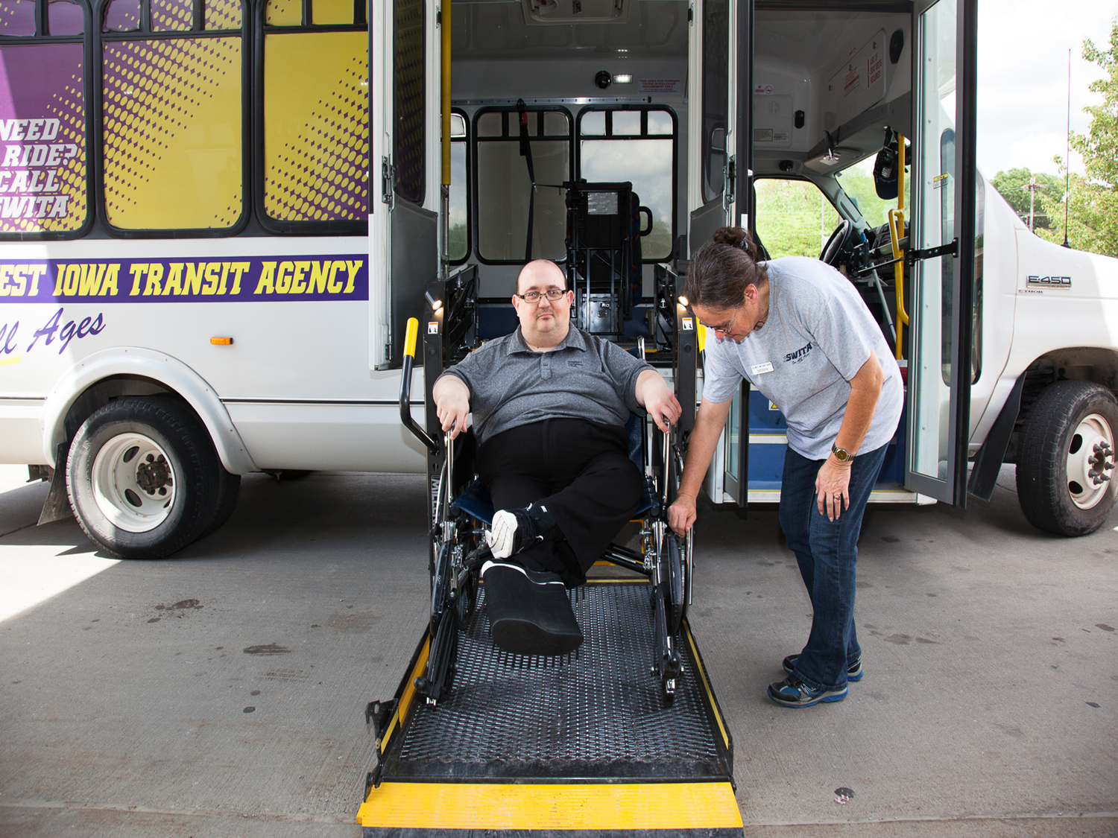
Thank
YOU!
iowadot.gov/transit

