Slide 1
Revitalize Iowa’s Sound Economy Program

Slide 2
Revitalize Iowa’s Sound Economy Program
Created in 1985
Purpose: To promote economic development through roadway improvements.
Eligible development shall have value-adding activities that feed new dollars into the economy
Available to cities and counties through an application program

Slide 3
Available Funding and Application Summary
Available Funding
Funded annually with dedicated state motor fuel and special fuel tax revenues
Application Summary for SFY2020
Total number of projects awarded: 11
Total project costs: $29,796,529
Total amount awarded: $16,032,197
 | CITY | COUNTY
Average funding generated monthly | $997,556 | $498,778
SFY 2020 current Road Use Tax Revenue (as of 3/02/2020) | $8,012,354.46 | $4,006,177.26
Current Unobligated Balance (as of 3/02/2020) | $9,807,345.33 | $1,894,090.68

Slide 4
Local Development Project Evaluation Criteria
Development Potential (35 points)
Economic impact and Cost Effectiveness (20 points)
Local Commitment and Initiative (33 points)
Transportation Need and Justification (4 points)
Local Economic Need (6 points)

Slide 5
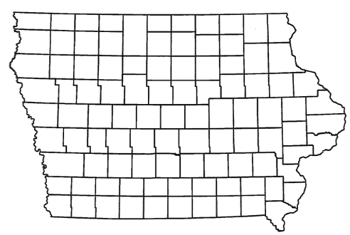
List of Local Development Applications Recommended
PROJECT NAME
SPONSOR
SCORE
TOTAL PROJECT COST
PERCENT PARTICIPATION
RECOMMENDED AMOUNT
Construction of a roundabout at Shaulis Road and Hess road, turn lanes at Lost Island Waterpark and new theme park entrance, culvert for Sink Creek, raising Shaulis Road, traffic signal at new theme park entrance, extension of Shaulis Road and traffic signal modifications along Shaulis Road. | Waterloo | 70 | $6,393,968 | 50% | $3,196,984

Slide 6
List of Local Development Applications Recommended
PROJECT NAME
SPONSOR
SCORE
TOTAL PROJECT COST
PERCENT PARTICIPATION
RECOMMENDED AMOUNT
Paving of approximately 2,400 feet of Applewood Road, construction of approximately 4,100 feet of 182nd Street, passing/turn lanes on County Road H-10 and Bunge Avenue and overlay of approximately 11,700 feet of Bunge Avenue | Mills County | 47 | $5,050,000 | 50% | $2,525,000

Slide 7
List of Local Development Applications Recommended
PROJECT NAME
SPONSOR
SCORE
TOTAL PROJECT COST
PERCENT PARTICIPATION
RECOMMENDED AMOUNT
Roadway improvements to relocate the main Des Moines International Airport commercial terminal entrance onto Cowles Drive including turn lanes on Fleur Drive | Des Moines | 70 | $2,912,003 | 50% | $1,456,002
Construction of approximately 1,225 feet of turn lanes on 6th Street SW | Cedar Rapids | 48 | $899,448 | 50% | $449,724

Slide 8
List of Local Development Applications Recommended
PROJECT NAME
SPONSOR
SCORE
TOTAL PROJECT COST
PERCENT PARTICIPATION
RECOMMENDED AMOUNT
Construction of approximately 1,000 feet of Beech Way SW. | Cedar Rapids | 50 | $895,375 | 50% | $447,688
Overlaying of approximately 2,050 feet of 192nd Street, and construction of approximately 926 feet of Portland Avenue and 687 feet of North 193rd Circle | Pottawattamie County | 38 | $1,161,339 | 50% | $580,670

Slide 9
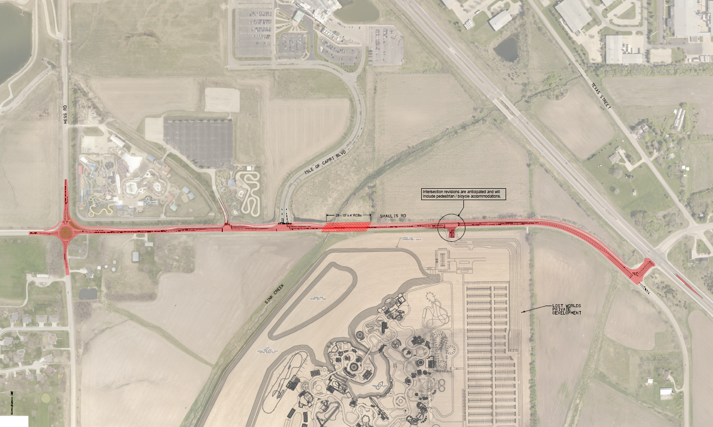
Waterloo
(Local Development)
Construction of a roundabout at Shaulis Road and Hess road, turn lanes at Lost Island Waterpark and new theme park entrance, culvert for Sink Creek, raising Shaulis Road, traffic signal at new theme park entrance, extension of Shaulis Road and traffic signal modifications along Shaulis Road all located on the southeast side of town. This project is necessary to support tourism by providing improved access to the proposed Lost Island Theme Park.
Total Cost: $6,393,968
Requested: $3,196,984 (50%)

Slide 10
Mills County
(Local Development)
Paving of approximately 2,400 feet of Applewood Road, construction of approximately 4,100 feet of 182nd Street, passing/turn lanes on County Road H-10 and Bunge Avenue and overlay of approximately 11,700 feet of Bunge Avenue located south of Council Bluffs. This project is necessary to provide improved access to seven lots totaling more than 680 acres for industrial purposes.
Total Cost: $5,050,000
Requested: $2,525,000 (50%)

Slide 11
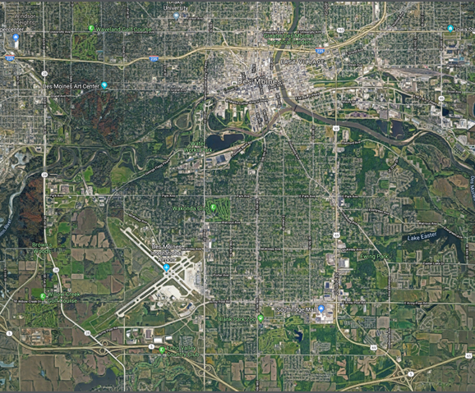
Des Moines
(Local Development)
Roadway improvements to relocate the main Des Moines International Airport commercial terminal entrance onto Cowles Drive including turn lanes on Fleur Drive. This project is necessary to provide improved access for an expanded Des Moines International Airport terminal for airport purposes.
Total Cost: $2,912,003
Requested: $1,456,002 (50%)

Slide 12
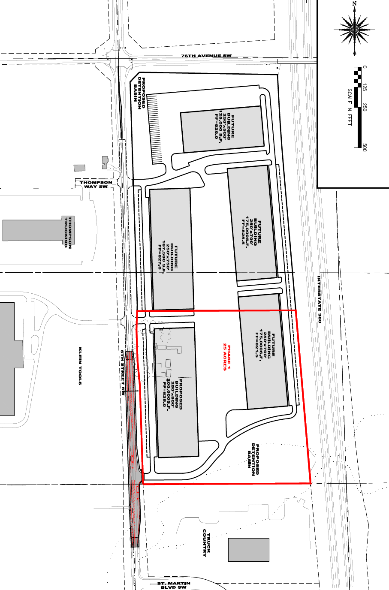
Cedar Rapids
(Local Development)
Construction of approximately 1,225 feet of turn lanes on 6th Street SW located on the southwest side of town. This project is necessary to provide improved access to more than 25 acres for warehousing and industrial purposes.
Total Cost: $899,448
Requested: $449,724 (50%)

Slide 13
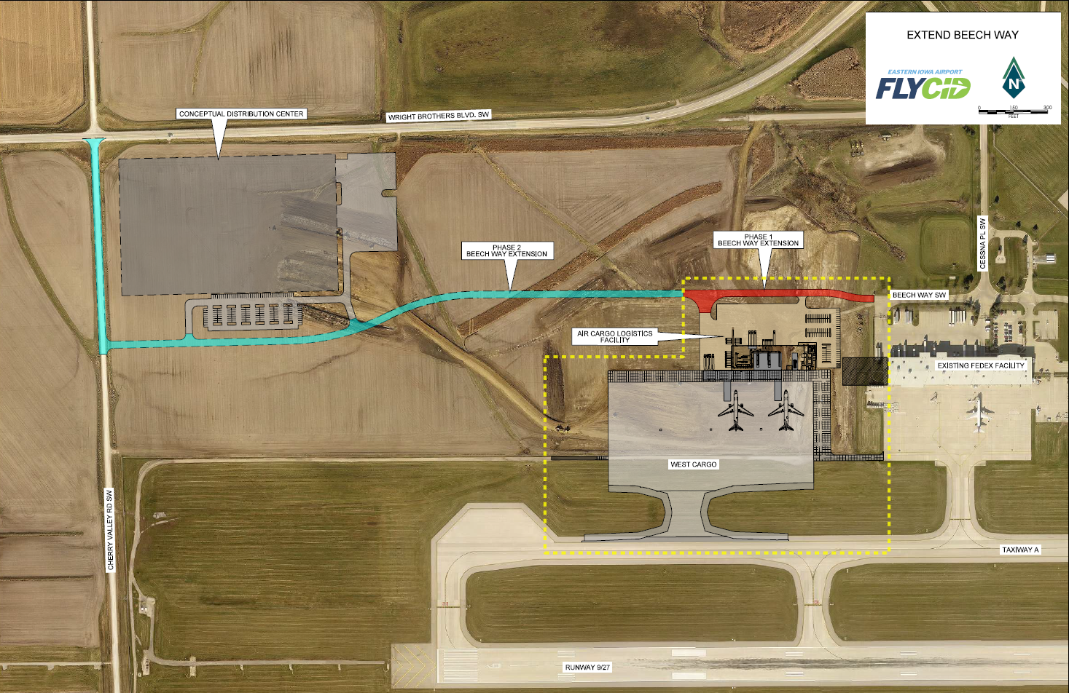
Cedar Rapids (Airport)
(Local Development)
Construction of approximately 1,000 feet of Beech Way SW located on the southwest side of town. This project is necessary to provide access to the West Cargo Expansion project at the Eastern Iowa Airport for airport purposes.
Total Cost: $895,375
Requested: $447,688 (50%)

Slide 14
Pottawattamie County
(Local Development)
Overlaying of approximately 2,050 feet of 192nd Street, and construction of approximately 926 feet of Portland Avenue and 687 feet of North 193rd Circle located south of Council Bluffs. This project is necessary to provide access to 14 lots totaling more than 28 acres for industrial and warehouse purposes.
Total Cost: $1,161,339
Requested: $580,670 (50%)

Slide 15
QUESTIONS?
Craig Markley, Systems Planning Bureau
craig.markley@iowadot.us
515-239-1027

