Slide 1
Des Moines Integrated Corridor Management - Update
April 13, 2020
Iowa Transportation Commission

Slide 2
What is Integrated Corridor Management (ICM)
Notes:
Framework for multi-modal, multi-jurisdictional coordination to deliver a safer, more reliable, and more convenient transportation system for all users
Based on proactive, integrated management and operation of a regional transportation system
Delivered in a cost-effective manner compared to traditional infrastructure capacity expansion projects

Slide 3
ICM Goals
Notes:
Some of our goals for the ICM project include improving:
-Safety - Reduce fatalities and serious injuries on public roads in the region
-Mobility - Provide options to travelers that minimize time spent traveling
-Travel Time Reliability - Improve efficiency and predictability of travel in the region
-Accessibility - Improve traveler’s overall ability to reach key destinations such as jobs, schools, libraries, health care, shopping, and entertainment
-Project delivery time – Be able to deliver identified strategies in a timely manner
-Improve public visibility and build support/momentum for the project

Slide 4
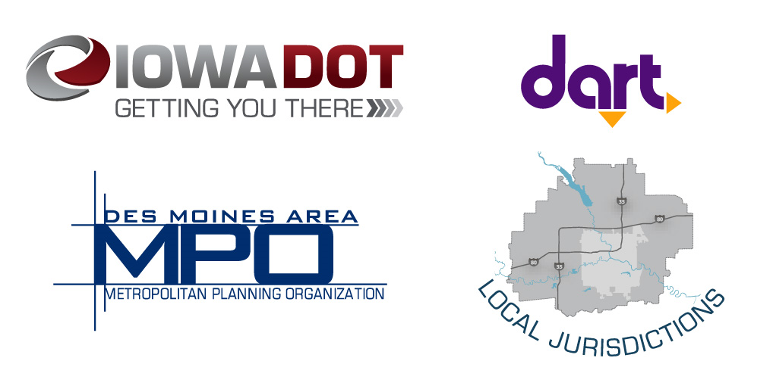
Partnerships
Notes:
We are taking a collaborative approach to this study with stakeholders from:
-DART
-Local Jurisdictions
-MPO
-Business groups
-Federal Highways
Collaboration really is the key to making this project a success.
Currently 11 Cities and 3 Counties are involved in the ICM effort.
Additional goals worth mentioning that require collaboration:
Regional Economic Vitality – Use the regional transportation system to foster a thriving, competitive regional economy.
Integration and Connectivity - Provide transportation that allows traveler to make efficient and seamless multi-modal trips throughout the region
Systems Management – Improve the efficiency of the surface transportation system
System Preservation -Maintain transportation infrastructure in a state of good repair

Slide 5
Why ICM for Des Moines Metropolitan Area?
Notes:
Traditional widening project focus too narrowly on recurring congestion.
When national research has show that non-recurring congestion makes up more than half of all congestion.
As we can see bad weather and traffic incidents, as part of non-recurring congestion, are larger culprits in Iowa than nationwide.
ICM strategies are more suited for dealing with this non-recurring congestion.
Furthermore:
The Des Moines Metro area is one of the fastest growing metros in the State
We can no longer afford to always build our way out of congestion
We need to find a more sustainable solution to handle the increased traffic demand

Slide 6
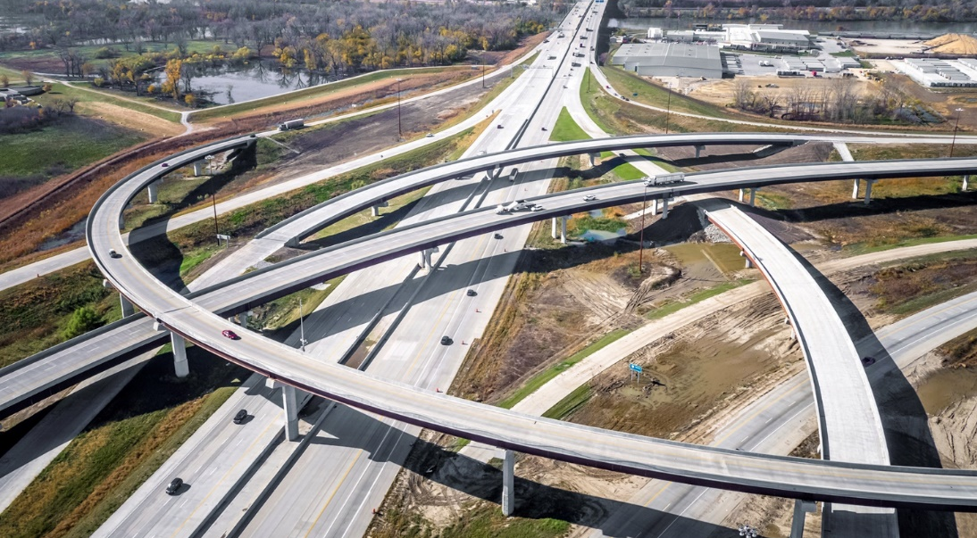
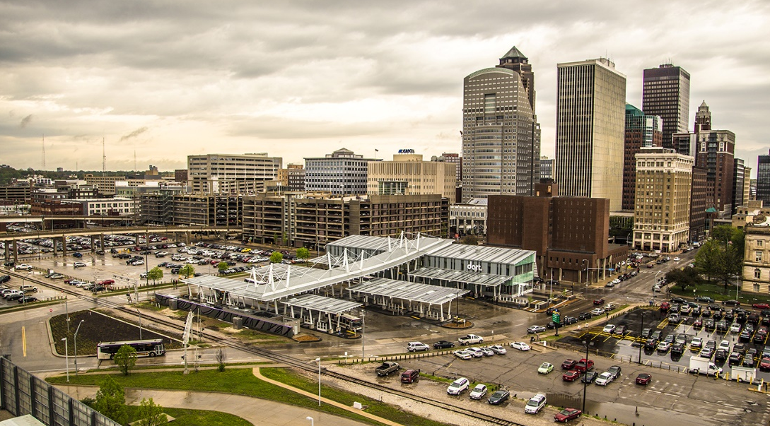
Balancing Funding Capacity Expansion Vs. Corridor Management
Council Bluffs Interstate System
Des Moines Metro Area
3 System Interchanges (3 more on IA-5)
41 Service Interchanges (7 more on IA-5/US-65)
56 Freeway Mainline Miles (Primary only; not on IA-5)
3 System Interchanges
12 Service Interchanges
18 Freeway Mainline Miles
Program Cost: $1.2 Billion
Program Cost: ???
Notes:
What are the ramifications if we don’t use ICM? Traditional capacity expansions like the CBIS are high in cost and take a lot of space to build. In Des Moines, building our way out of congestion is limited by the space available and cost prohibitive, since the cost of building many more lane miles of pavement would be expensive.

Slide 7
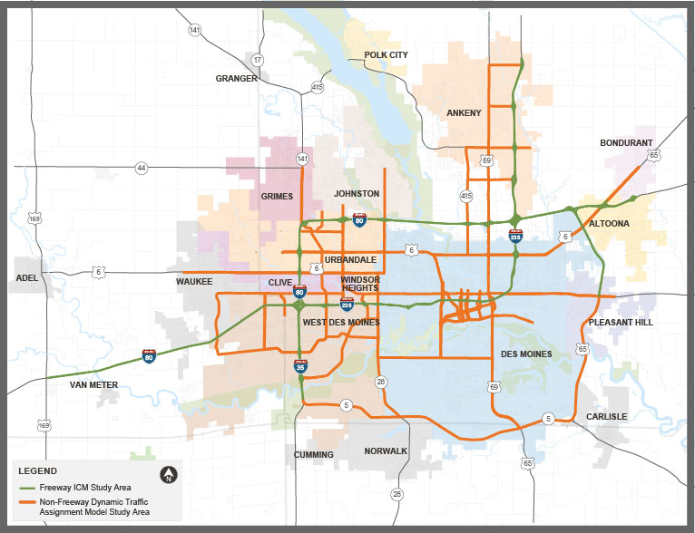
Project Boundaries
I-80
US Hwy 169 (Desoto)
1st Avenue (Altoona)
I-35
Iowa 5 (West Des Moines)
36th Street (Ankeny)
US 65 (I-80 to IA 163)
Selected parallel and connecting arterials
Notes:
Describe study area

Slide 8
Why ICM cont. - Identified Issues
Northwest
Weaving issues
Northeast
Southwest
Weather
Southeast
Infrastructure connectivity
Poor/outdated signal timing
Traffic impacts on arterials adjacent to interstate
Bottlenecks (drop lanes)
Arterial signal coordination
High speeds into congestion
High demand/limited capacity on Mix Master
Transit service/park-and-ride access
No access/limited access across median
Short merge segments
Bottlenecks
Queueing onto interstate
Heavy traffic
Lack of turn lanes
Pedestrian mobility improvements
Notes:
ICM fits the Des Moines metro area because it is a philosophy that allows many recurring and non-recurring issues to be addressed.
As we conducted needs assessments across the metro, the needs changed dramatically between the four different quadrants
List some diverse issues
Poor signal timing
Bottlenecks
Weather
Park and Ride access
Pedestrian Mobility
These issues were all identified by our stakeholders at previous workshops.

Slide 9
Schedule - Deployment
Notes:
The DOT has identified multiple stakeholders across the metro and will actively engage these groups and the general public throughout the ICM Development process through various:
-Workshops
- Public Meetings

Slide 10
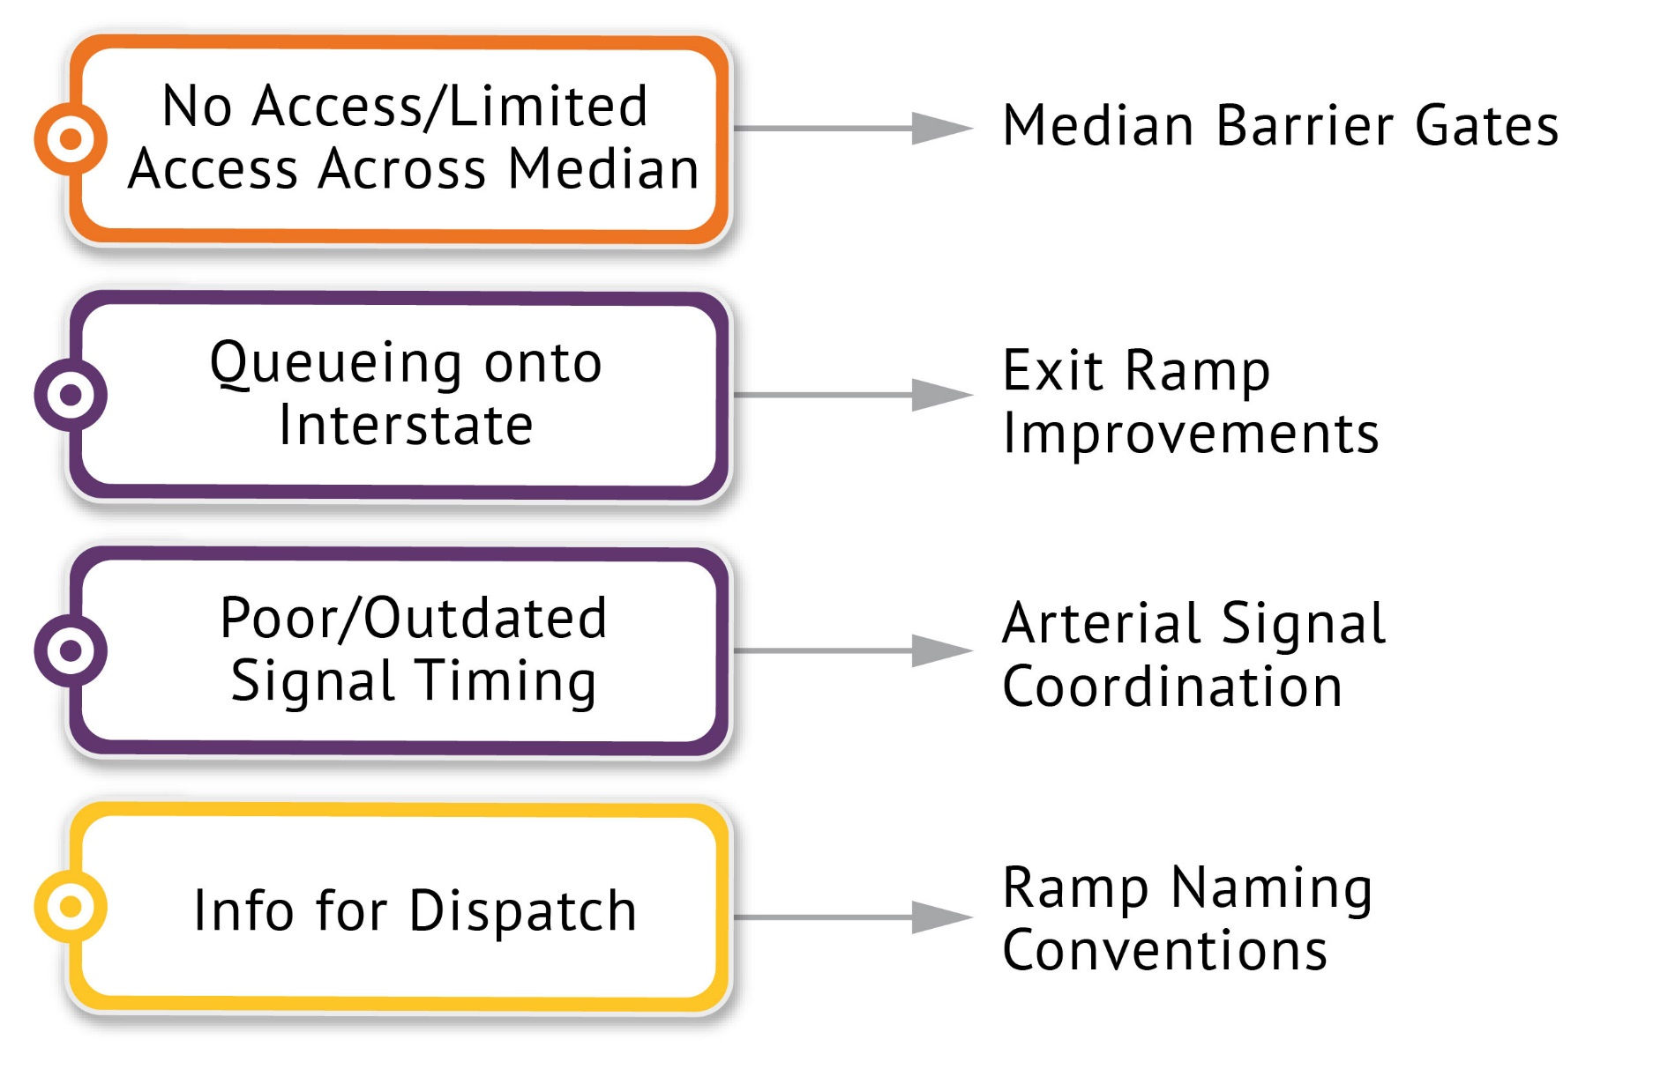
Near Term Strategies
Address identified issues
Quickly, cost effectively implementable
Notes:
Near Term Strategies have been developed. These strategies will
- Address identified issues
- Be quick and cost effective
- And easy implementable
The four strategies are:
Median barrier gates
Queue Spillback Mitigation
Traffic Signal Optimization
Oversized Freight Permitting

Slide 11
Median Barrier Gates
Objective: Improve responder access to incidents along the interstate system in areas with long distances between interchanges or adjacent to systems interchanges (e.g., NE mix) and high incident rates.
Construction Cost:
$400,000 to $450,000 per location
North
Notes:
Scope: Installation of median barrier gate(s) at pilot location(s) within the metro area.
Resources: Agency or consultant staff for detailed design, contracted installation.
Which location(s) would most directly benefit from improved access provided by median barrier gates?
Long distances between interchanges
Challenging roadway geometry (Northeast Mixmaster)
High incident rate- not a primary selection criteria (e.g., I-235)

Slide 12
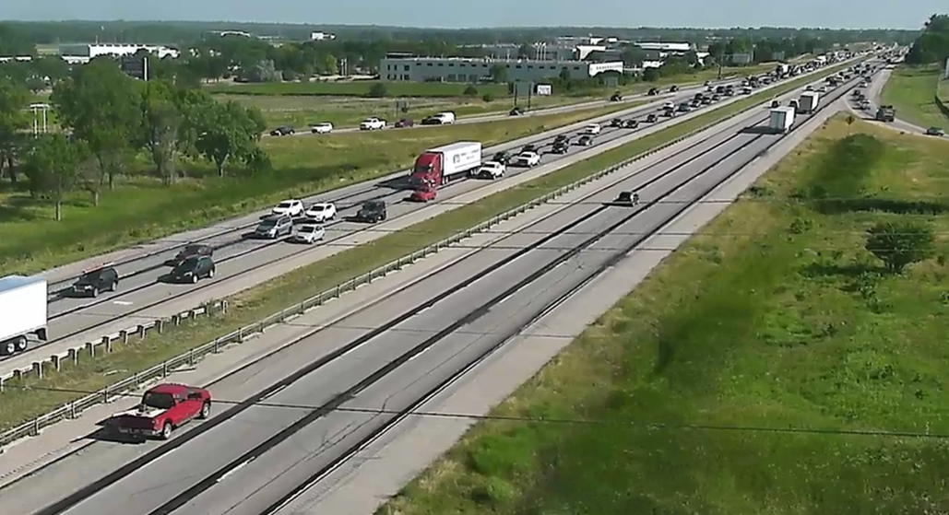
Queue Spillback Mitigation
Objective: Reduce instances of freeway off-ramp traffic impacting operations on the freeway mainline.
Construction Cost:
$40,000 to $50,000 per location
Notes:
Scope: Implement operational and/or geometric improvements on the ramp, at ramp/arterial terminals or along the arterial immediately adjacent to the ramp to reduce ramp delay.
Management: The technical committee will approve ramps to be studied and improved under the ICM program.
Resources: Agency or consultant staff on a case-by-case basis.
Candidate Ramps identified:
I-35 and Oralabor Road
I-80 and Jordan Creek Parkway
I-235 and MLK Parkway

Slide 13
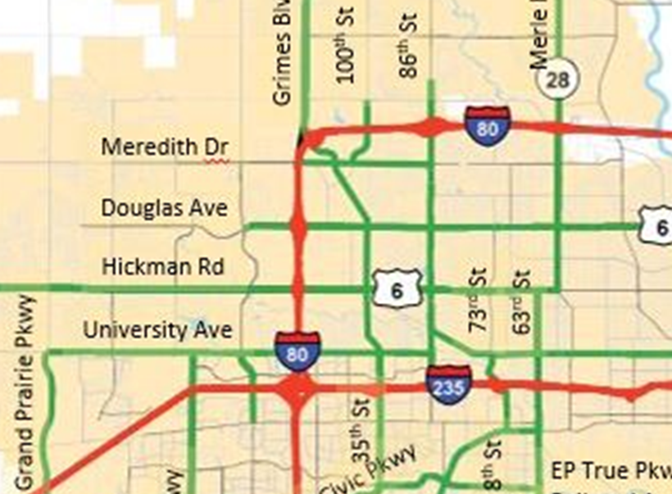
Regional Signal Optimization
Objective: Improve traffic signal operations along arterials key to the operation of the ICM corridor.
Construction Cost:
$25,000 to $105,000 pilot corridor
North
Notes:
Scope: Develop updated traffic signal timing plans for at-grade intersections that will improve corridor operations.
Management: The technical committee will approve arterials to be retimed under the ICM program.
The signal system subcommittee will oversee the process.
Resources: Agency or consultant staff on a case-by-case
Candidate Corridors identified:
Merle Hay Road, Hickman Rd north to 62nd Ave
Douglas Avenue, 128th Street to Merle Hay Road
Hickman Road, 128th Street to Merle Hay Road
University Avenue, Grand Prairie Pkwy to 86th St and 63rd to MLK Parkway

Slide 14
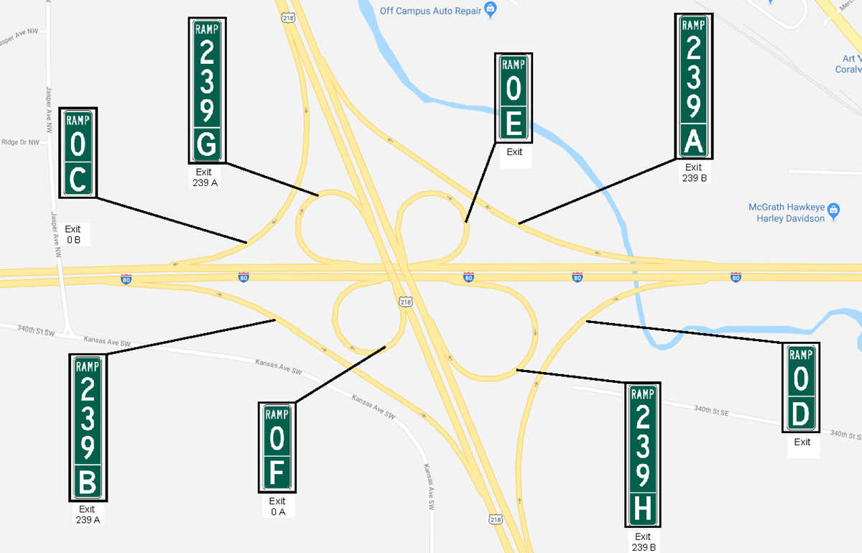
Ramp Naming Conventions
Objective: Decrease incident response time
Targeted Letting: June 2020
Notes:
Scope: Develop a clear and consistent naming convention for signage and dispatch on system interchange ramps
Management: Statewide Traffic Management Center and Emergency Dispatch
Resource: District 1 took lead with Traffic & Safety on this strategy
Candidate Locations: Both System Interchanges (NEMM & SWMM)
Currently this strategy is targeted for June 2020 Letting

Slide 15
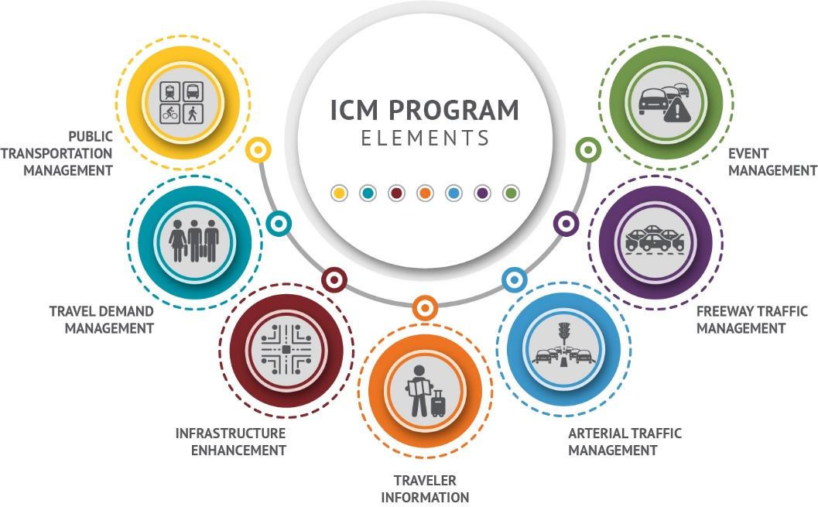
ICM Program Elements – Mid-to-Long Term
Notes:
ICM best operates as a system, but in order to understand what that entails we have to talk about the individual strategies first. The 7 elements that make up ICM include:
Event Management
Freeway Traffic Management
Over-dimensional freight permitting
Arterial Traffic Management
Traveler Information
Infrastructure Enhancements
Travel Demand Management
Public Transportation Management

Slide 16
Mid-to-Long Term Strategies
ICM strategies are in development to address year 2050 conditions and will be recommended for a phased implementation.
Future effort will focus on advancing strategies through the systems engineering process toward implementation
Key Outcomes
Analysis of ICM cost and cost effectiveness
Projects / Actions needed for ICM readiness
Stakeholder priorities for strategy deployments
Plans ready for implementation
Notes:
Summary
Future Conditions Report
Mid-to-Long Term Strategies Definitions
Future Program Level Concept of Operations Update
Future Project Level Concept of Operations Development
Future Implementation Plans

Slide 17
Questions
For Comments and Feedback:
Iowa DOT Project Manager: Neal Fobian
neal.fobian@iowadot.us
Notes:
Questions or Comments?

