Slide 1
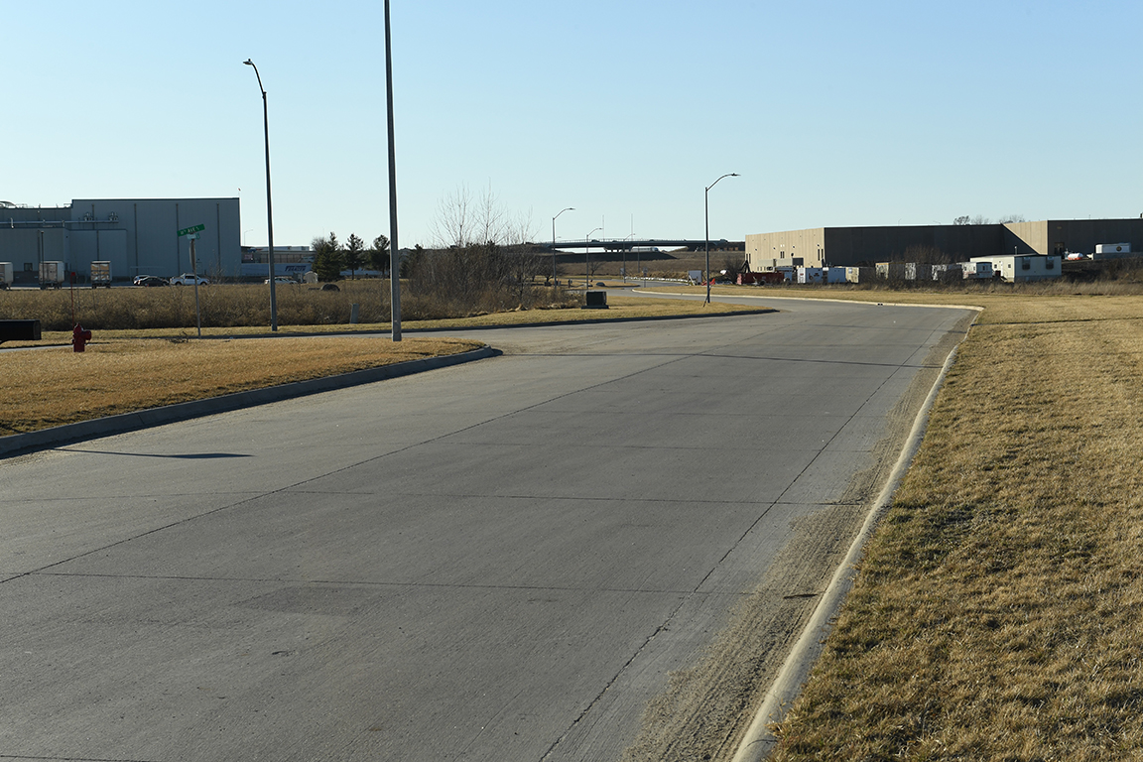

Revitalize Iowa’s Sound Economy Program
Iowa Transportation Commission Business Meeting
April 13, 2021

Slide 2

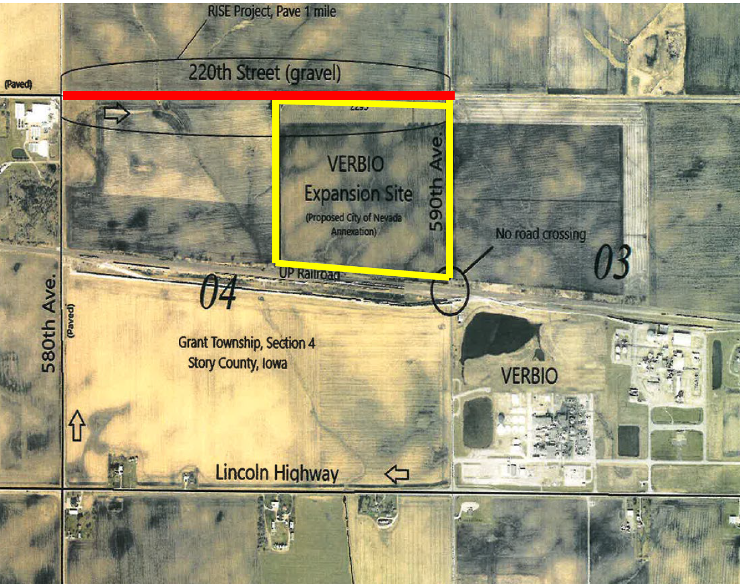
List of Local Development Applications Recommended
PROJECT NAME
SPONSOR
SCORE
TOTAL PROJECT COST
PERCENT PARTICIPATION
RECOMMENDED AMOUNT
Paving of approximately 5,238 feet of 220th Street. | Story County | 68 | $1,687,500 | 50% | $843,750

Slide 3
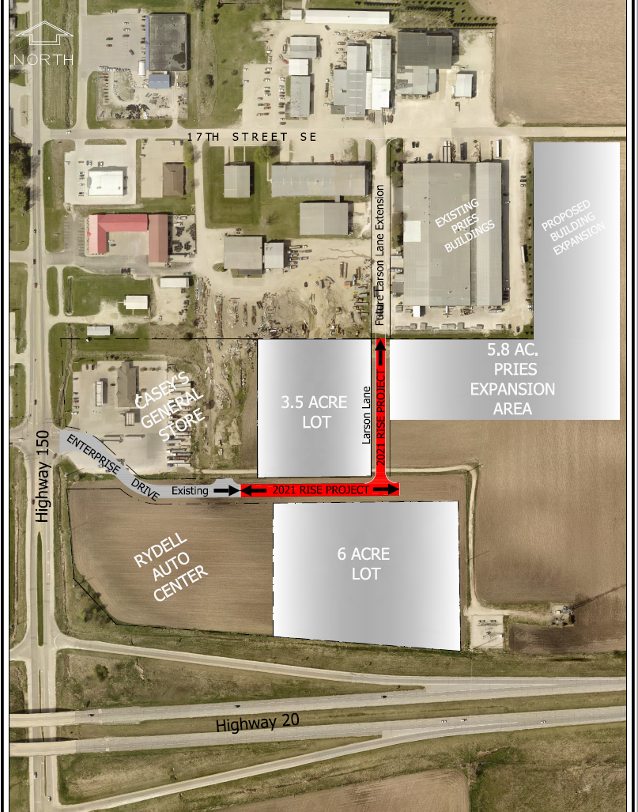
List of Local Development Applications Recommended
PROJECT NAME
SPONSOR
SCORE
TOTAL PROJECT COST
PERCENT PARTICIPATION
RECOMMENDED AMOUNT
Construction of approximately 700 feet of Enterprise Drive and 460 feet of Larson Lane. | Independence | 63 | $538,188 | 50% | $269,094

Slide 4
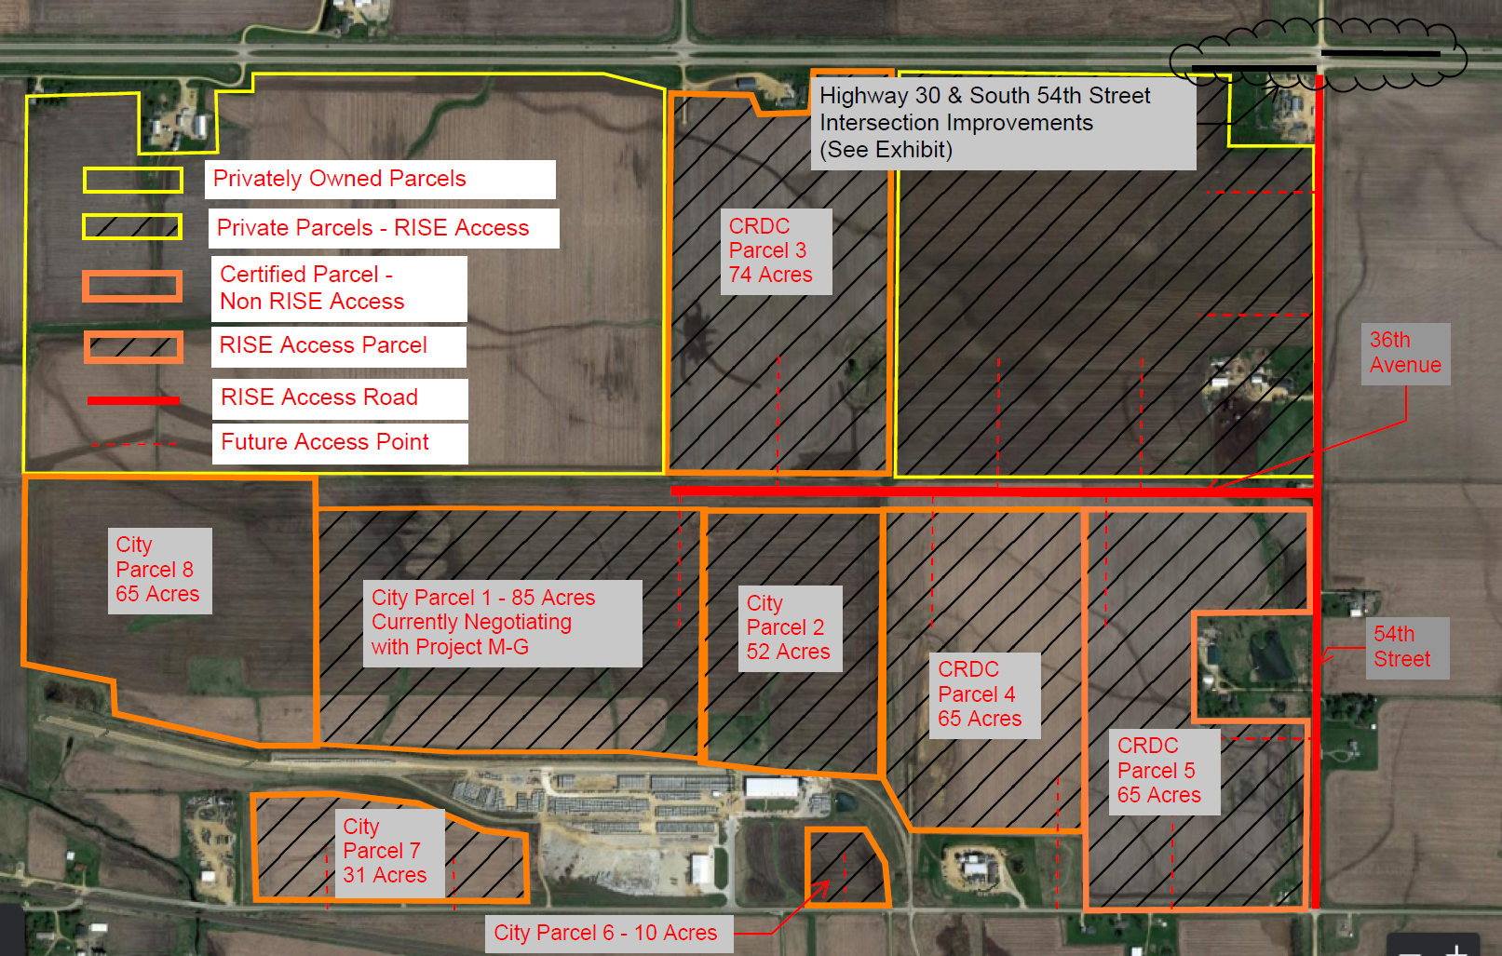
List of Local Development Applications Recommended
PROJECT NAME
SPONSOR
SCORE
TOTAL PROJECT COST
PERCENT PARTICIPATION
RECOMMENDED AMOUNT
Reconstruction of approximately 5,000 feet of South 54th Street, construction of approximately 4,000 feet of 36th Avenue South and turn lanes on U.S. 30. | Clinton | 61 | $4,787,500 | 60% | $2,872,500

