Slide 1
Revitalize Iowa’s Sound Economy Program
Iowa Transportation Commission Workshop
April 13, 2021

Slide 2
Revitalize Iowa’s Sound Economy Program
Created in 1985
Purpose: To promote economic development through roadway improvements.
Eligible development shall have value-adding activities that feed new dollars into the economy
Available to cities and counties through an application program

Slide 3
Available Funding and Application Summary
Available Funding
Funded annually with dedicated state motor fuel and special fuel tax revenues
Application Summary for SFY2021
Total number of projects awarded: 8
Total project costs: $12,681,237
Total amount awarded: $7,512,403
 | CITY | COUNTY
Average funding generated monthly | $970,179 | $485,089
SFY 2021 current Road Use Tax Revenue (as of 3/1/2021) | $7,297,266.90 | $3,648,633.45
Current Unobligated Balance (as of 3/1/2021) | $8,587,801.71 | $3,337,019.31

Slide 4
Local Development Project Evaluation Criteria
Development Potential (35 points)
Economic impact and Cost Effectiveness (20 points)
Local Commitment and Initiative (33 points)
Transportation Need and Justification (4 points)
Local Economic Need (6 points)

Slide 5
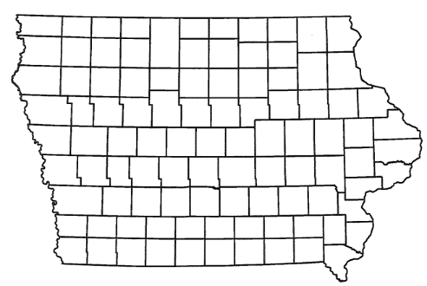
List of Local Development Applications Recommended
PROJECT NAME
SPONSOR
SCORE
TOTAL PROJECT COST
PERCENT PARTICIPATION
RECOMMENDED AMOUNT
Paving of approximately 5,238 feet of 220th Street. | Story County | 68 | $1,687,500 | 50% | $843,750
Construction of approximately 700 feet of Enterprise Drive and 460 feet of Larson Lane. | Independence | 63 | $538,188 | 50% | $269,094

Slide 6
List of Local Development Applications Recommended
PROJECT NAME
SPONSOR
SCORE
TOTAL PROJECT COST
PERCENT PARTICIPATION
RECOMMENDED AMOUNT
Reconstruction of approximately 5,000 feet of South 54th Street, construction of approximately 4,000 feet of 36th Avenue South and turn lanes on U.S. 30. | Clinton | 61 | $4,787,500 | 60% | $2,872,500

Slide 7
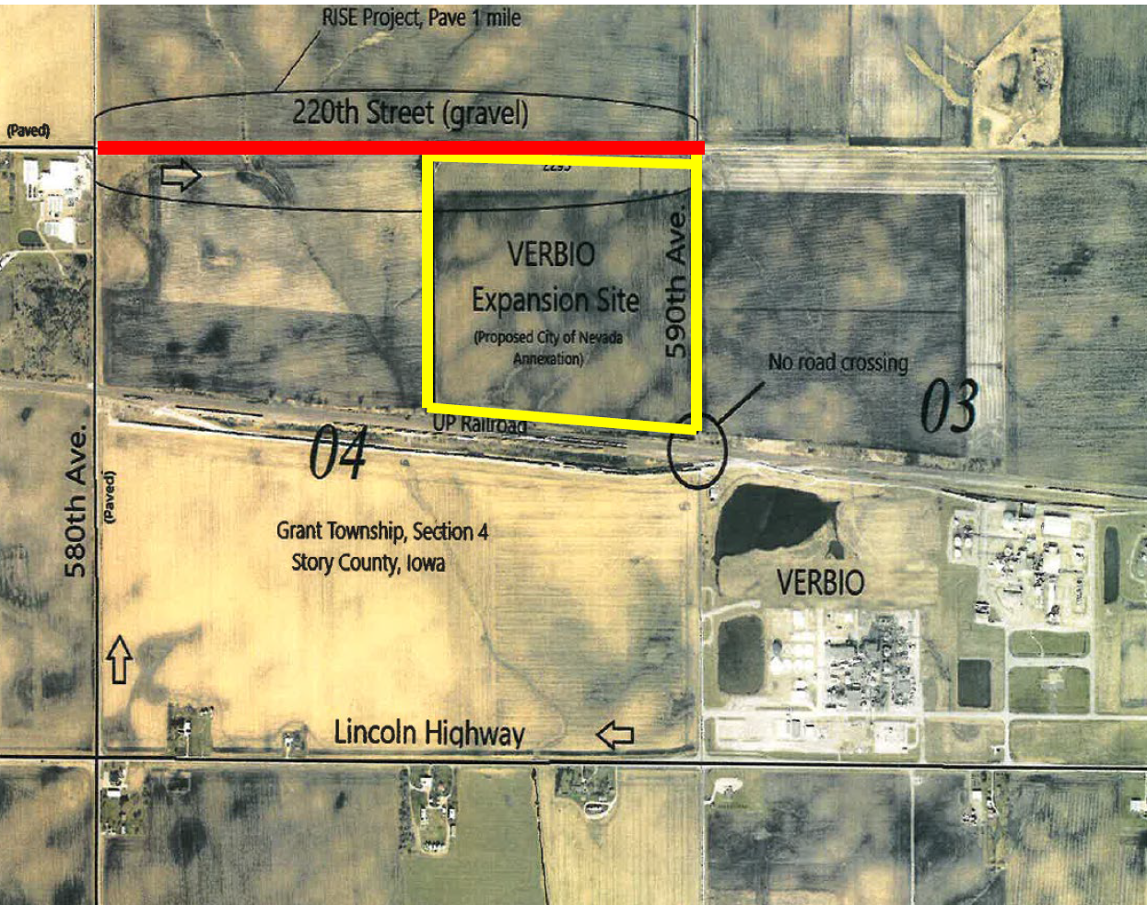
Story County
(Local Development)
Paving of approximately 5,238 feet of 220th Street located west of Nevada. This project will provide improved access to 103 acres for industrial purposes.
Total Cost: $1,687,500
Requested: $843,750 (50%)

Slide 8
Independence
(Local Development)
Construction of approximately 700 feet of Enterprise Drive and 460 feet of Larson Lane located on the southeast side of town. This project is necessary to provide improved access to three lots totaling more than 15 acres for industrial purposes.
Total Cost: $538,188
Requested: $269,094 (50%)

Slide 9
Clinton
(Local Development)
Reconstruction of approximately 5,000 feet of South 54th Street, construction of approximately 4,000 feet of 36th Avenue South and turn lanes on U.S. 30 located on the southwest side of town. This project is necessary to provide access to Lincolnway Industrial Rail and Air Park, an Iowa Economic Development Authority certified site of 345 acres.
Total Cost: $4,787,500
Requested: $2,872,500 (60%)

Slide 10
QUESTIONS?
Craig Markley, Systems Planning Bureau
craig.markley@iowadot.us
515-239-1027

