Slide 1
Commercial and Industrial Network Modification
Transportation Commission Workshop
Iowa Department of Transportation
April 12, 2021

Slide 2
Presentation Summary
Summary of Network Modification
History of Commercial & Industrial Network (CIN)
Description of Proposed Network Modification

Slide 3
CIN Network Modification Summary
Iowa Code stipulates the Iowa Transportation Commission is responsible for the designation of the CIN
Highway relocation and transfer of jurisdiction warrant change to the CIN
Southwest Arterial in the City of Dubuque, Dubuque county

Slide 4
CIN History
(1988) Transportation Commission directed by the Iowa Legislature to identify the CIN
Code Reference: Iowa Code Title VIII, Subtitle 1, Chapter 313.2A, specifies a maximum CIN mileage of 2,600
Current CIN mileage = 2,533
2,090 Rural
443 Urban
Comprised of Primary Highways to:
Enhance Iowa’s economic opportunities
Improve flow of commerce
Provide safe, efficient, and convenient travel
Better connect Iowa to regional, national and international markets

Slide 5
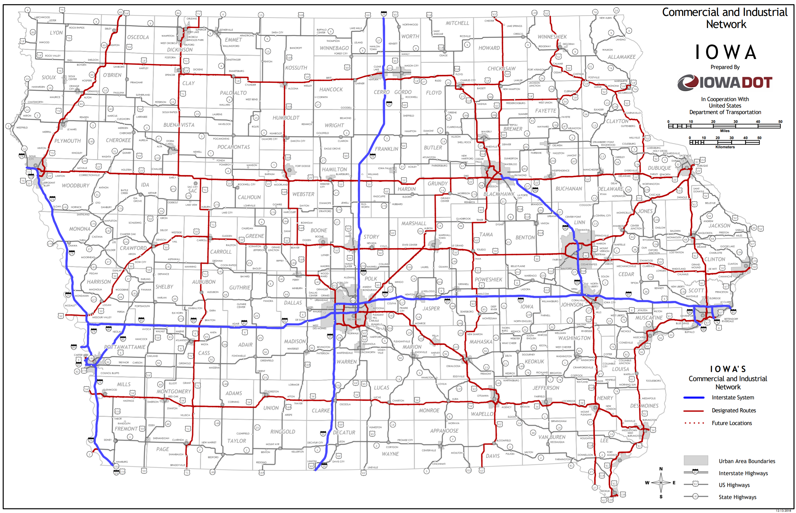
Current CIN Map

Slide 6
Proposed CIN Network Modification
Southwest Arterial in the City of Dubuque, Dubuque county

Slide 7
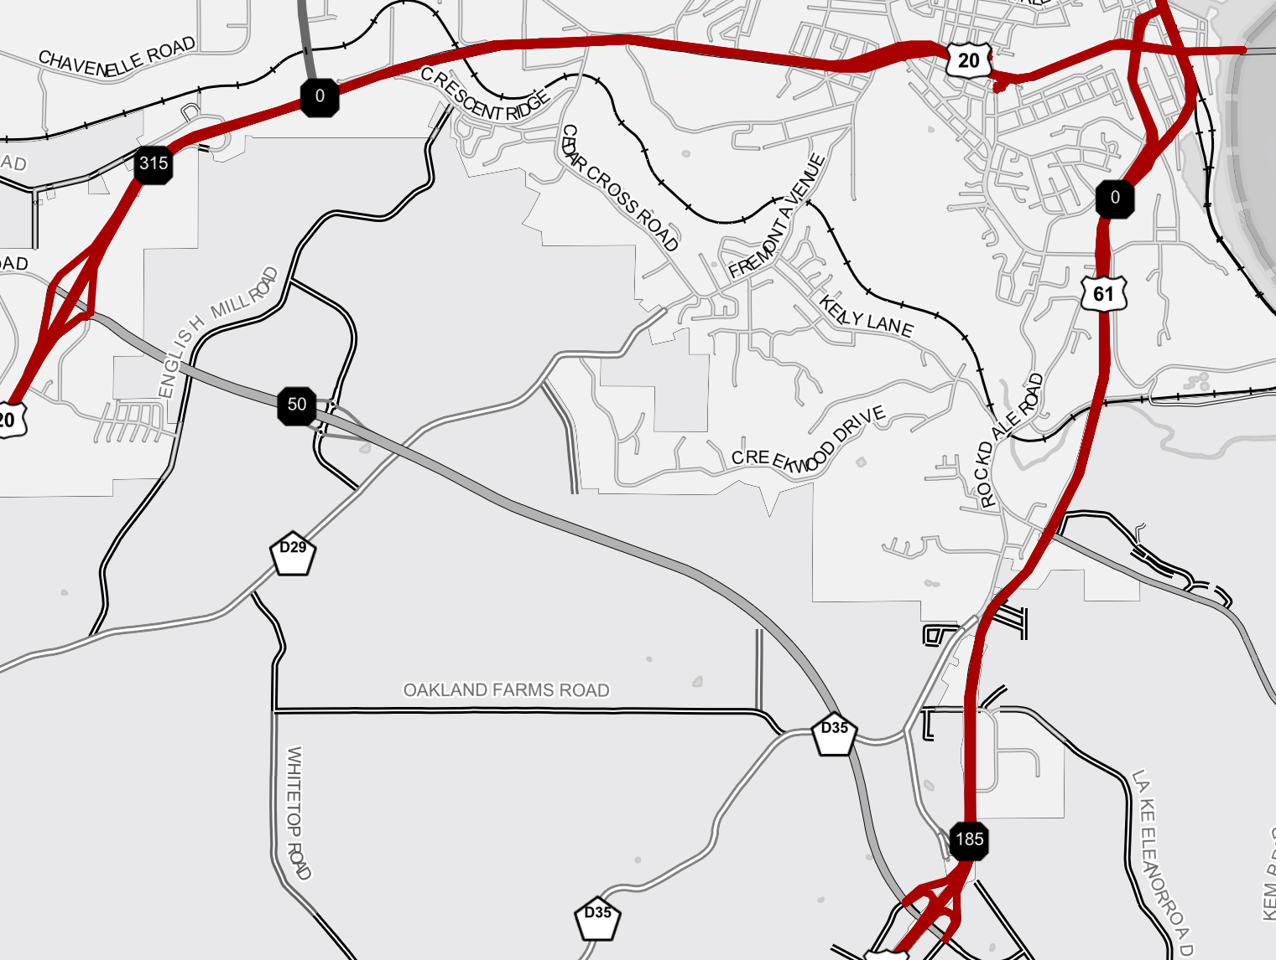
Southwest Arterial in the City of Dubuque, Dubuque county
Current CIN Designation
Proposed CIN Designation
Proposed CIN mileage to be added equals 5.4 miles
Proposed new CIN total equals 2,538.4 miles

Slide 8
Questions?
Jeff von Brown
Systems Planning Bureau
Jeff.vonbrown@iowadot.us
515-239-1554

