Slide 1
State Transportation Plan & State Freight Plan
2022 Updates
Commission Workshop
April 12, 2021

Slide 2
Agenda
Update timeline & status
System objectives development
Freight goals development
Wrap up

Slide 3
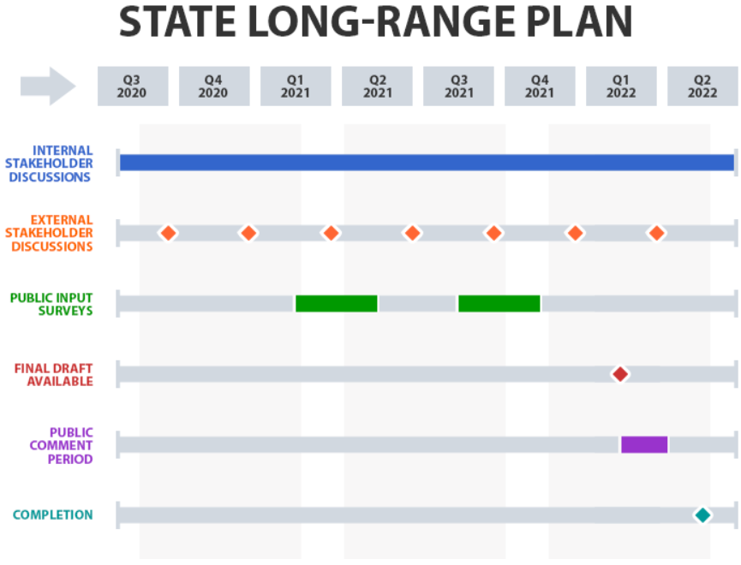
Timeline
Critical next step: public input survey
Working towards:
Early 2022 draft
May 2022 completion

Slide 4
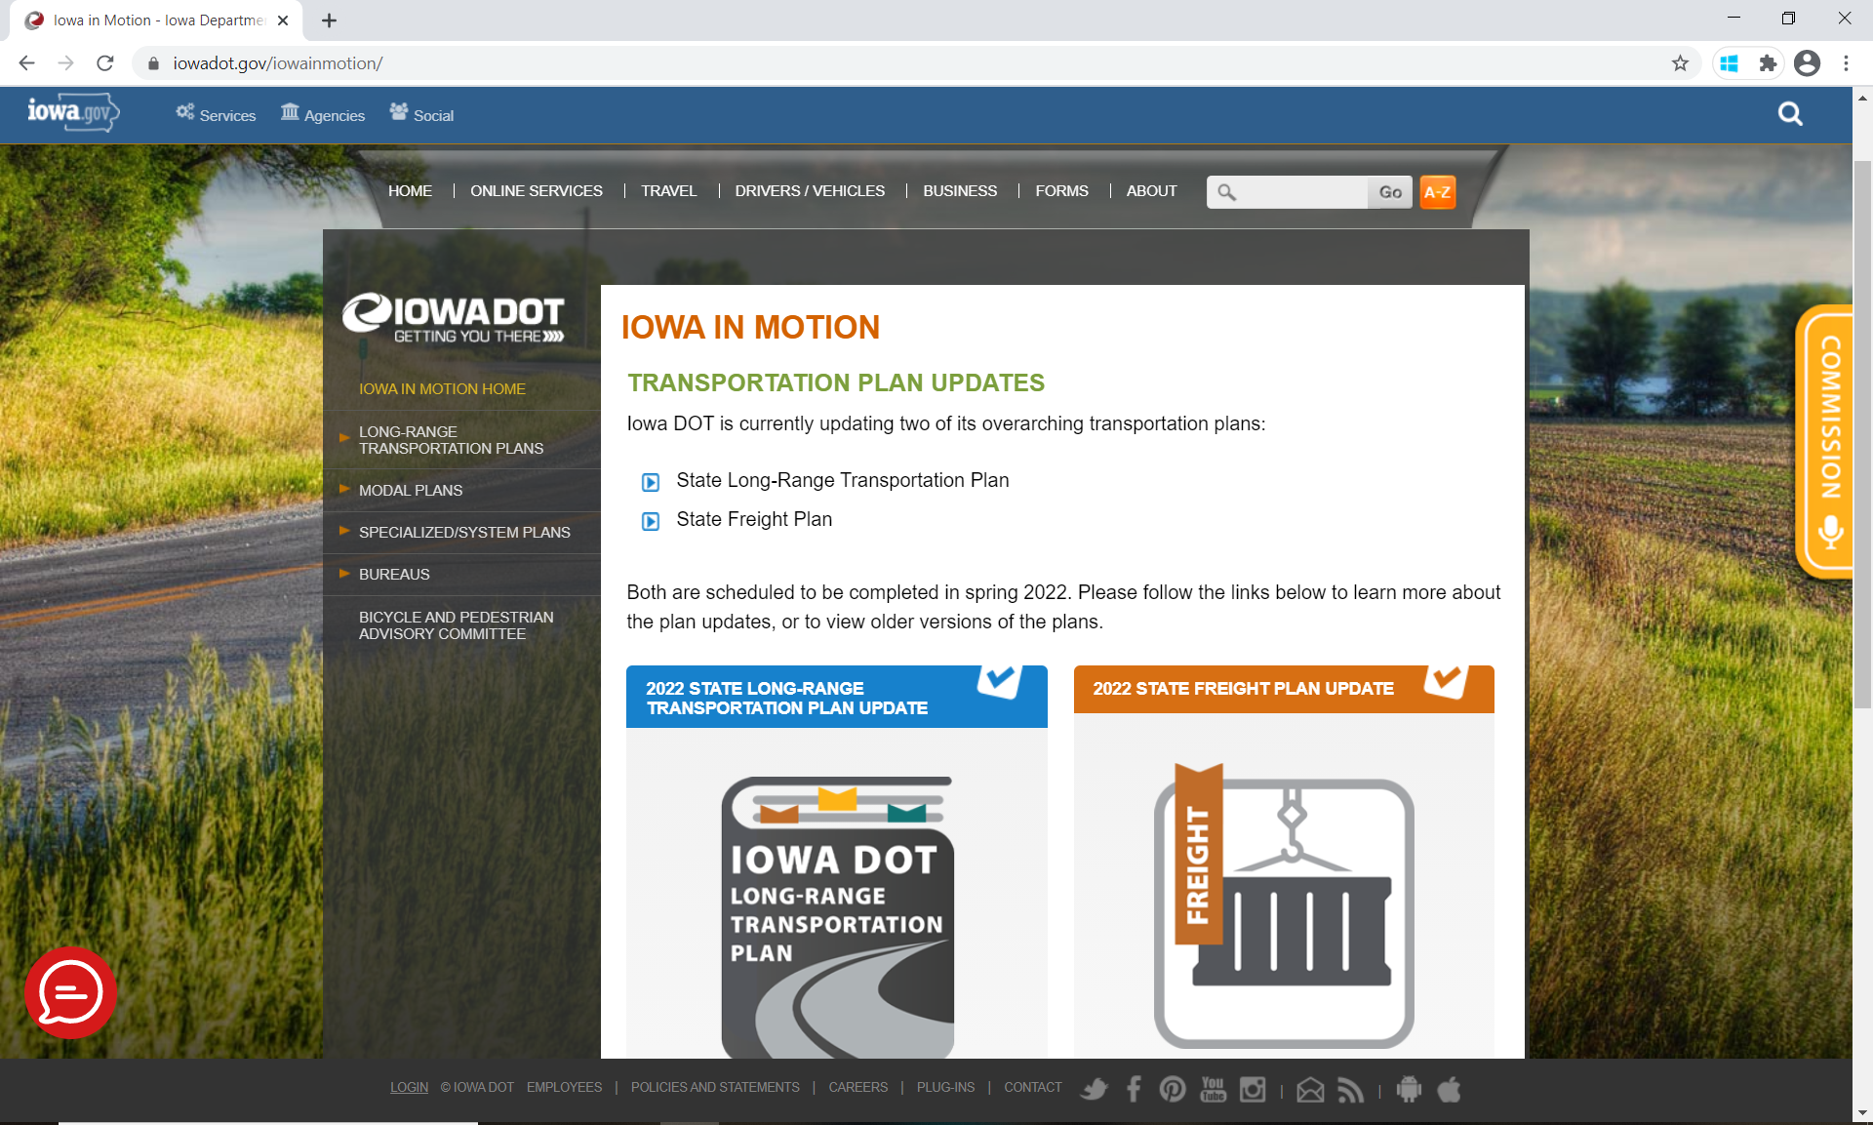
iowadot.gov/iowainmotion

Slide 5
System Objectives
Commission Workshop
April 12, 2021

Slide 6
Benefit of clear system objectives
Decision-support simplified:
Identify needs (in current SLRTP)
Prioritize among those needs (not in current SLRTP)
Needs identification in current SLRTP
Multi-modal analysis
Multi-factor analysis
Specific (e.g., corridor-level needs)
But priority lacks definition
Stewardship #1, otherwise need vs. no need

Slide 7
Benefit of clear system objectives
How to support prioritization
First, what are we trying to achieve on our system?
i.e., system objectives
Prior related work with mobility outcomes:
Safety, Flow, Sustainability, Accessibility
Outcomes synonymous with objectives, in this context
Internal steering committee supports this approach

Slide 8
Benefit of clear system objectives
Provides adaptable framework for measurement and prioritization across modes
Business units align to these objectives
Create measures/evaluation criteria for programs, applications, tools
Unifies and aligns:
Long-range planning
Performance management
Asset management
Project prioritization

Slide 9
WORKING DRAFT
Mobility
ULTIMATE OUTCOME (RESULT)
Tier 1
OUTCOMES
SAFETY
FLOW
SUSTAINABILITY
ACCESSIBILITY
Working Definitions
The transportation system is safe to use and minimizes incidents, crashes, injuries, and fatalities.
The transportation system reliably and efficiently moves people and goods while minimizing user delays and costs.
The transportation system is available and in good condition, meeting the needs of today and preparing for the future.
Users can readily access the transportation system and services without unnecessary barriers.
How will we monitor progress towards this outcome?
Incidents
Crashes
Injuries
Fatalities
Reliability
Efficiency
Usage
Condition
Cost
Benefit
Environmental Impact
Access to Systems Service Delivery
Equity
Performance Areas / Measures
TBD

Slide 10
Feedback?
Thoughts on adapting mobility outcomes to SLRTP system objectives?
Blind spots in Safety, Flow, Sustainability, Accessibility?
Other comments?

Slide 11
Freight Goals
Commission Workshop
April 12, 2021

Slide 12
Freight goals status
Guidance from FHWA
Determine goals to include
Input from Freight Advisory Council
Input from Internal Planning Steering Committee
Input from the Commission
Ultimately relate to SLRTP system objectives

Slide 13
Areas of focus
SAFETY
Improve the safety, security, and resilience of the national freight system.
INFRASTRUCTURE
Modernize freight infrastructure and operations to grow the economy, increase competitiveness, and improve quality of life.
INNOVATION
Prepare for the future by supporting the development of data, technologies, and workforce capabilities that improve freight system performance.

Slide 14
Industry perspective
SAFETY
INFRASTRUCTURE
INNOVATION
OTHER
Accidents (totals, severity, causes, claims)
Safety scores
Labor force (training, adherence to requirements)
Investment (totals, cost, upgrades)
Operations (mitigating impacts)
Condition (roads, tracks, locks)
Maintenance (inspections, plans)
Operations (mitigating impacts, congestion reporting, connections)
Investment (totals, cost)
Performance (total assets, costs of shipping, reliability)
Efficiency (time, fuel, reliability)
Productivity & profitability (automation, costs, competitiveness)
Labor force (training, satisfaction, jobs added)
Technologies (tracking, electronic HOS, PTC, automation)
Economics (jobs, global competitiveness, value of shipments)
Sustainability (funding, environmental)
Intermodal & multimodal (connections)

Slide 15
Any
additional feedback?
SAFETY
INFRASTRUCTURE
INNOVATION

Slide 16
Wrap Up
Critical next step:
Public input survey
Next Commission workshop discussion:
Possible summary of initial public input
System condition and needs analyses

Slide 17
QUESTIONS?
Garrett.Pedersen@iowadot.us
Samuel.Hiscocks@iowadot.us
Andrea.White@iowadot.us

