Slide 1
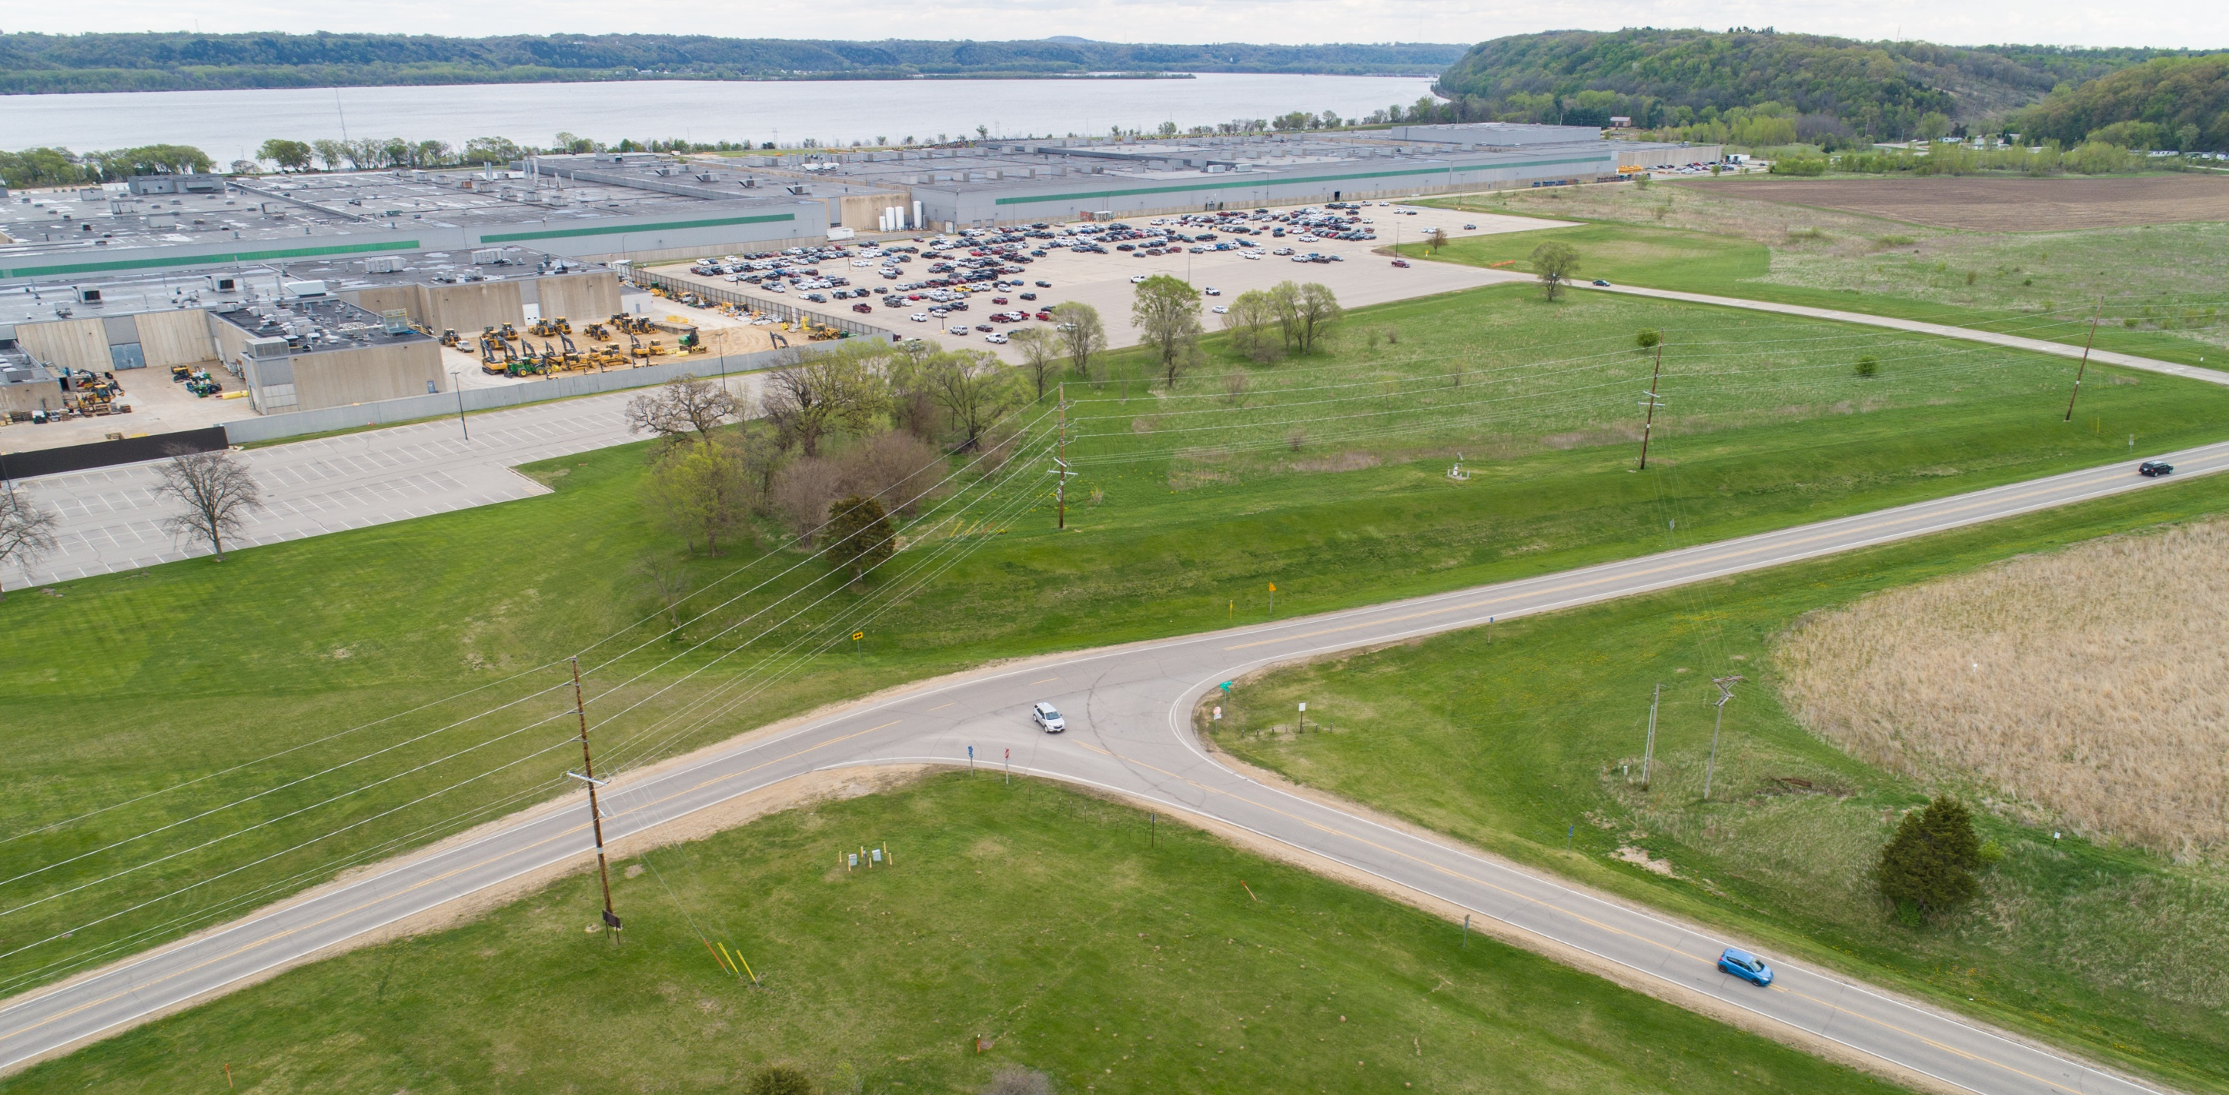
CORRIDOR PROJECT
JOHN DEERE ROAD
Iowa DOT Commission Meeting – April 13, 2021

Slide 2
Project Development Review
Planned Improvements
ROW
Update on Decoupling Process & Schedule
Construction
Budget
DISCUSSION
FOR TODAY

Slide 3
PROJECT
GOALS
Address safety and operational challenges
affecting traffic at John Deere.
Safety
Traffic Flow
Stakeholders
Reduce accidents
Reduce travel delays
Boost freight mobility
Support John Deere Expansion

Slide 4
Stakeholder Engagement
Meetings with John Deere (9/16/20, 11/2/20) and DuTrac (11/18/20)
Update to Dubuque County Board of Supervisors
11/9/20, 2/22/21 (Public Outreach Meeting)
Preliminary Plans Submitted & Cleared
1/12/21
Environmental Concurrence
John Deere Road work complete; efforts focused on NW Arterial portion
ROW Acquisition
in progress
Private Utility Coordination
in progress
PROJECT
DEVELOPMENT
REVIEW

Slide 5
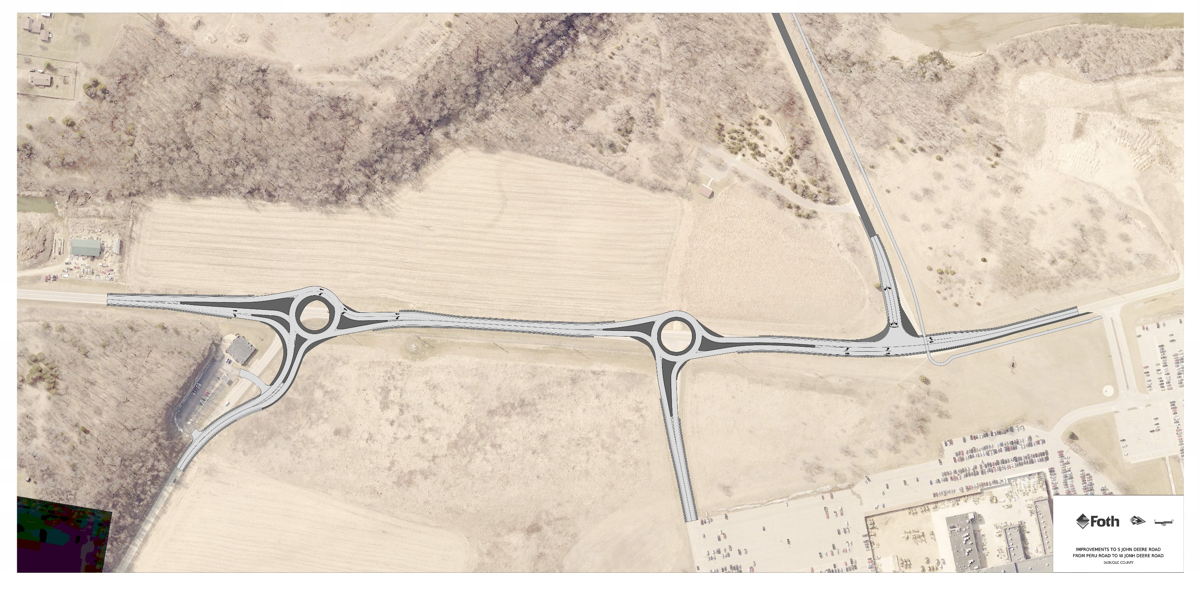
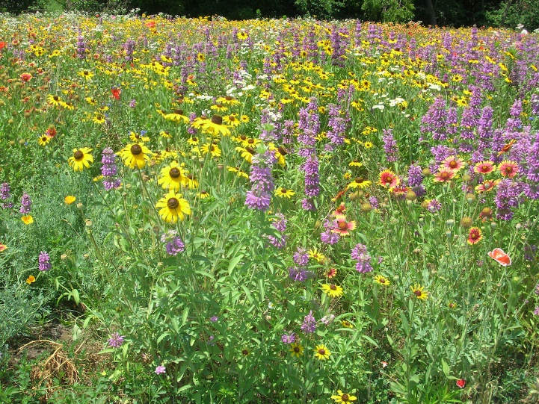
W John Deere Road
Roundabout
Trail
Roundabout
S John Deere Road
Peru Road
PROPOSED
IMPROVEMENTS

Slide 6
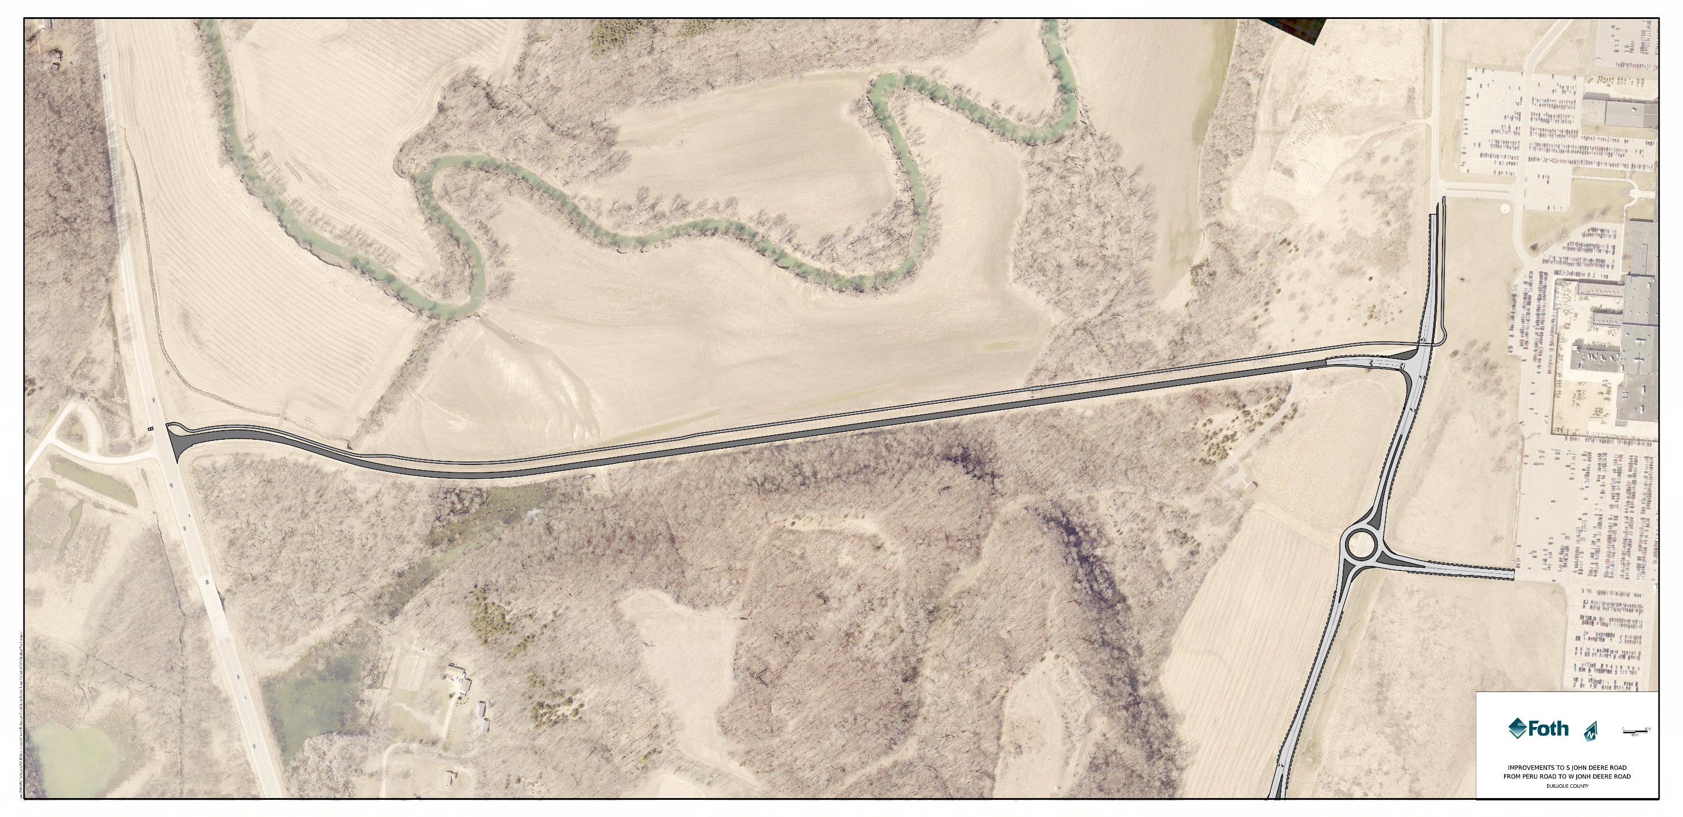
W John Deere Road
Trail
S John Deere Road
Overlay
PROPOSED
IMPROVEMENTS

Slide 7
Appraisals
Under Review
Right-of-Way Public Hearing
3/1/21
Send Appraisals to Property Owners/Offers
June/July 2021
ROW
UPDATE

Slide 8
W John Deere Road
S John Deere Road
John Deere
DuTrac
Peru Road
Dubuque County
ROW
UPDATE

Slide 9
Environmental Concurrence
John Deere Road work complete; efforts focused on NW Arterial portion
June/July 2021
Final Design/Check Plans
10/12/21l
Letting
Late 2021/Early 2022
SCHEDULE

Slide 10
When will it start?
Spring 2022
Traffic During Construction
When will it end?
Spring/Early Summer 2023
CONSTRUCTION

Slide 11
$6.8M
Project Budget
Preliminary Estimate within budget
Planned improvements
Includes contingency
ROW acquisition costs
Utility relocation costs
BUDGET
UPDATE

Slide 12
W John Deere Road
S John Deere Road
Peru Road
QUESTIONS

