Slide 1
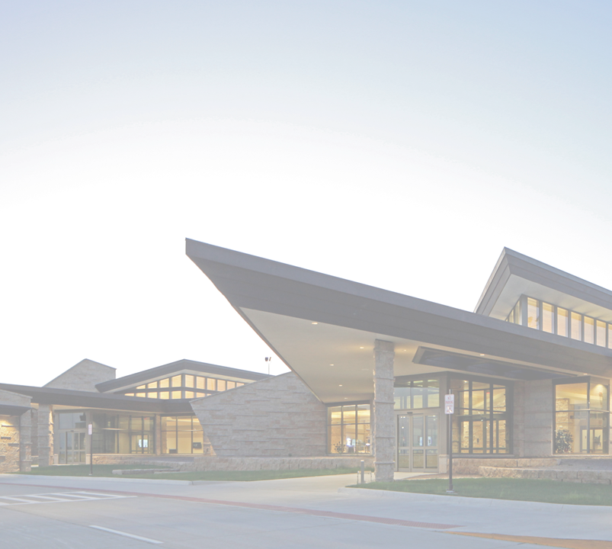
IOWA DOT COMMISSION PRESENTATION
DUBUQUE REGIONAL AIRPORT
Captain Robert L. Martin
Terminal
Notes:
Good Morning, Todd Dalsing, Dubuque Regional Airport
This morning I would like to give a quick overview from a year of covid impact on DBQ one of Iowa’s commercial airports, including budget, an update on state DOT projects and program and DBQ Statistics.

Slide 2
COVID TIMELINE
COVID Impact
March 2020
Covid declared U.S. National Emergency.
Congress signs Cares Act – Airports & Airline relief funding through September 30, 2020
December 2020
Congress signs Corona Virus Response and Recovery Supplemental Act (CRSSA)
Airports/Airlines relief funding through March 31, 2021
January 2021
AA resumes daily flights DBQ to ORD, evaluating demand on month-to-month basis.
October 2020
Cares Act expires
Airlines began reduction of flights at all airports. Some airports receive suspensions including DBQ (3 months)
March 2021 Congress signs American Rescue Plan Act (ARPA) Airports and Airlines relief funding through September 2021
Notes:
Covid impacted FY 20 and carried over to FY 21.
Early March 2020 DBQ Airport and Chamber were in Phoenix meeting with airlines to expand westbound service to Denver when covid was growing concern and soon after declared a national emergency.
Late March….

Slide 3
Federal Airport Relief
COVID Federal
Budget
Impact
Coronavirus Aid, Relief, and Economic Security (CARES) Act
March 27, 2020, First round of federal support included $10 billion in funds for airport economic relief. DBQ received $1,159,773
Coronavirus Response and Relief Supplemental Appropriation Act, (CRRSA). December 27, 2020, Second round of federal support included $2 billion in economic relief to airports. DBQ received $ 1,021,068
DBQ Total to Date $ 2,180,841
Third round of relief, America Rescue Plan includes $8 billion for airports.
Currently standing by for DBQ funding announcement by FAA.
Over the next four years funds may be used for annual debt service, local match for FAA AIP projects and operating costs for DBQ Airport.
Notes:
Airports including DBQ have received two rounds of federal relief to date.
1st round:

Slide 4
COVID
Passenger Impact
National Passenger Throughput
(TSA Screening)
Passenger numbers from first of month for comparison purposes only
Notes:
Passenger that have gone through TSA screening checkpoint. Numbers represent one day, the first of each month.
Top blue line 2019 pre covid numbers.
Orange line shows 2 months FY 20 pre covid numbers then March to April worst month of pandemic for aviation, a 96% decrease in passenger demand over 2019.
Yellow line shows FY 2021, as you can see, slow recovery, currently at about 50% decrease in passenger demand over 2019.

Slide 5
COVID Air Carrier
Budget Impact
Air Carrier Budget Impact
American Airlines posted a loss of:
Full year 2020 of $8.9 billion
Fourth quarter net loss of $2.2 billion
Southwest posted a loss of:
Full year 2020 of $3.1 billion
Fourth quarter net loss of $761 million
Delta Airlines posted a loss of:
Full year 2020 of $9 billion
Fourth quarter net loss of $2.1 billion
United Airlines posted a loss of:
Full year 2020 of $7 billion
Fourth quarter net loss of $1.9 billion
JetBlue posted a loss of:
Full year 2020 of $1.4 billion
Fourth quarter net loss of $381 million
Notes:
American is DBQ primary carrier.
As you can see all legacy and other carriers showing loss.

Slide 6
Airport Budget Revenue Impact
COVID
DBQ Airport Budget Impact
Notes:
Airport Budget Revenue Impact
Graphs show FY19 and FY 20 Actual and FY 21 forecasted for next 2 months.
Top left graph - PFC = Passenger Facility Charge, $4.50 fee on each airline ticket sold out of DBQ.
PFC are used to offset debt service on FAA AIP projects.
Top right graph - CFC = Customer Facility Charge, $3.00 on each vehicle per day rented out of DBQ.
CFC are used to make improvements to rental car associated infrastructure at terminal.
Bottom graph -Fuel includes all fuel sold at airport Jet A, 100LL, Diesel, autogas.
Revenues are down but expenses are also down because we are not purchasing as much fuel.

Slide 7
Dubuque Regional Airport
FY 22 CAPITAL IMPROVEMENT PROJECTS
Project | FY 22 Project Cost |  |  | Total Project Cost
Reconstruct Taxiway Alpha | $ | 350,000 |  | $ | 12,050,000
Asphalt Pavement Repair | $ | 150,000 |  | $ | 325,000
Relocate Existing Emergency Generator | $ | 189,000 |  | $ | 189,000
Additional AV Gas Fuel Tank | $ | 242,000 |  | $ | 242,000
Corporate Hangar Facilities Maintenance | $ | 20,000 |  | $ | 80,000
Perimeter Fence Improvements | $ | 10,000 |  | $ | 25,000
Notes:
City FY 22 Capital Improvement include 2 IDOT CSVI Projects highlighted in yellow

Slide 8
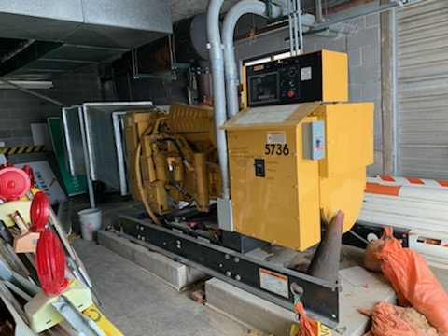
Relocate Emergency Generator
IDOT Funds = $164,000
Local Funds = $ 25,000
TOTAL FY22 = $189,000
Existing emergency generator relocated to provide back-up power to Joint Use facility and Dubuque Jet Center
Notes:
1st IDOT CSVI Project Relocate Emergency Generator
Generator that DBQ is currently using for airfield lighting backup will be relocated.
Provide back up power for JUF that include Airport operations and maintenance to include ARFF
And DJC that provides all aircraft ground handling, fueling, concierge service and
Administrative offices.

Slide 9
Avgas Fuel
Tank
IDOT Funds = $215,443
Local Funds = $ 26,557
TOTAL FY22 = $242,000
Installation of 20,000-gallon avgas aviation fuel tank
Notes:
IDOT CSVI Project
To meet increased demand in fuel gallons sold.

Slide 10
IDOT AVIATION BUREAU AIR SERVICE DEVELOPMENT PROGRAM DBQ has participated for 10 years
Air Service Development –
Air service consulting and data studies directed at specific air service enhancements. Air service data.
Leveraging federal funds through the U.S. DOT’s Small Community Air Service Development Grant program.
Marketing Air Service
Marketing efforts using print, radio, digital, billboard, social media and video advertising.
Notes:
DBQ budget is $60,000 split 80% state / 10% local. Or $48,000 state, $12,000 local.
Use funds for:
Air service development,
Marketing Commercial Air Service.

Slide 11
DBQ Air Traffic Control Tower (ATCT) Operations
2019 2020
DBQ 64,603 64,415
DSM 78,869 58,355
CID 53,111 42,030
ORD 921,408 539,615
Notes:
An operation is defined as a take off or landing of aircraft.
Thanks to DBQ strong general aviation the University of Dubuque Flight training school with 30 aircraft and over 300 students, instructors and staff, other local tenants and corporate traffic DBQ was the busiest airport in Iowa 2020. In the past DBQ has always been 2nd behind DSM.
You can see the impact Covid has had on other Iowa airport DSM, CID and even Chicago Ohara.
2019 2020
DSM 78,869 DSM 58,355
DBQ 64,603 DBQ 64,415
CID 53,111 CID 42,030
SUX 18,500 SUX 15,351 ALO 21,316 ALO 17,972
ORD 921,408 ORD 539,615

Slide 12
DBQ American Airlines Statistics
American
Airlines
Enplanements
2019
36,582
2020
11,050
DBQ Ave. Enplanement Load Factors
2019
74.62%
2020
45.86%
Total Flight Completion Rate
2020 97.72%
Notes:
2020 Covid impact on enplanements, went from 36K to 11K
2020 load factors decrease from 74% to 45%. 45% was around the national average at that time
2021 with one flight a day enplanements are slowly rising and currently seeing around %53 load factors as of April 1,
DBQ continues to have an excellent air carriers completion rate.

Slide 13
THANK YOU
www.flydbq.com
1-844-IFLYDBQ
(1-844-435-9327)
Notes:
I would like to recognize and thank your staff
Stu Anderson- Director, Transportation Development Division
Tim McClung- Aviation Planning Manager
Shane Wright- Aviation Program Manager
Michael Marr- Airport Inspector
Brian Kuennen- Aviation Program Specialist
Thank you Commissioners, for your support,
happy to answer any questions you may have.

