Slide 1
Collins Road
Remaining Need
$25 M
Next Phase
$40 M
Completed
Continues to be one of the highest volume corridors; high crash rate
Pursuing best value, long-term impacts

Slide 2
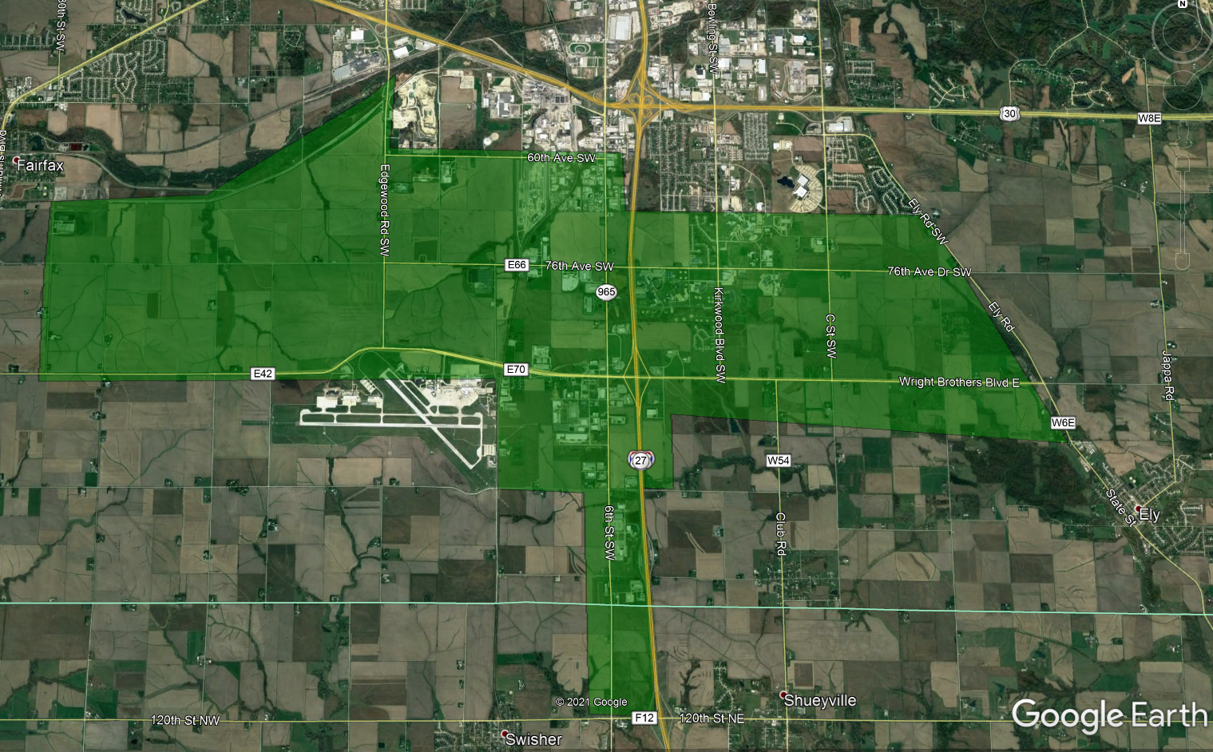
Wright Brothers Boulevard

Slide 3
Wright Brothers Boulevard
30
Legend
Commercial/Industrial
Residential
Institutional
RISE Funded Projects
Wright Brothers Boulevard Interchange
Continues to be one of the highest volume corridors; high crash rate
Continue to pursue best value, long-term impacts

Slide 4
Thank You

