Slide 1
Corridor Preservation
RENEWAL
I-80 from West of Co Rd R16 to Grand Prairie Parkway
Transportation Commission Workshop
April 12-13, 2021

Slide 2
What is corridor preservation?
Corridor preservation is not a legal encumbrance on the property or an exercise of eminent domain, but is instead a right of notice.
Corridor preservation avoids inconsistent development of property needed for highway right-of-way, by allowing DOT to receive notice of intended development of property within the proposed right-of-way and giving us the opportunity to take action to acquire it before the development occurs.

Slide 3
CPZ Renewal for I-80 in Dallas County
Today only addressing the RENEWAL of the I-80 CPZ in Dallas County. The other CPZs that were discussed in March will be brought back to the commission in June for consideration for approval after gathering public comment.
Gary Harris presented the proposed CPZ renewal at the March workshop for initial guidance. Initial guidance is the opportunity to informally determine whether the Commission has interest in considering the renewal of CPZ.

Slide 4
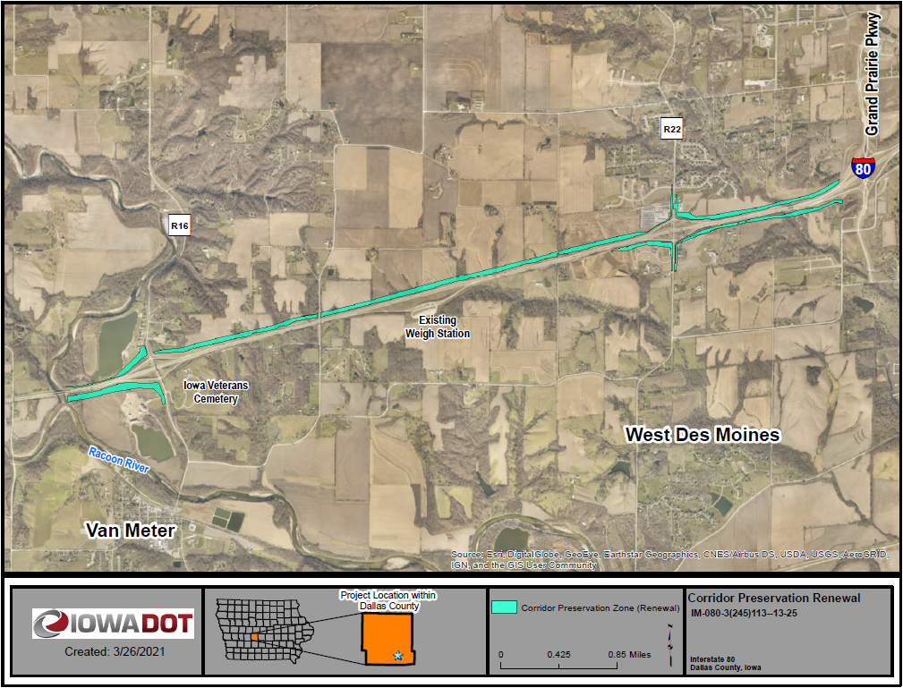
CPZ Renewal for I-80 in Dallas County
I-80 from West of Co Rd R16 to Grand Prairie Parkway

Slide 5
CPZ Renewal for I-80 in Dallas County
The Commission did show interest in renewing the use of CPZ in this location
CPZ will be presented for formal action during the April business meeting
If approved, we follow the usual and required process for formal notice established by section 306.19(5),
Written notice to the affected city or county
Published notice in the newspaper.
Notice to all affected property owners.

Slide 6
CPZ Renewal for I-80 in Dallas County
Once established, a CPZ is valid for three years, and we may re-establish it every three years.
Any questions?
Thank You
Bryan Bradley
Location and Environment Bureau
bryan.bradley@iowadot.us
(515) 239-1787

