Slide 2
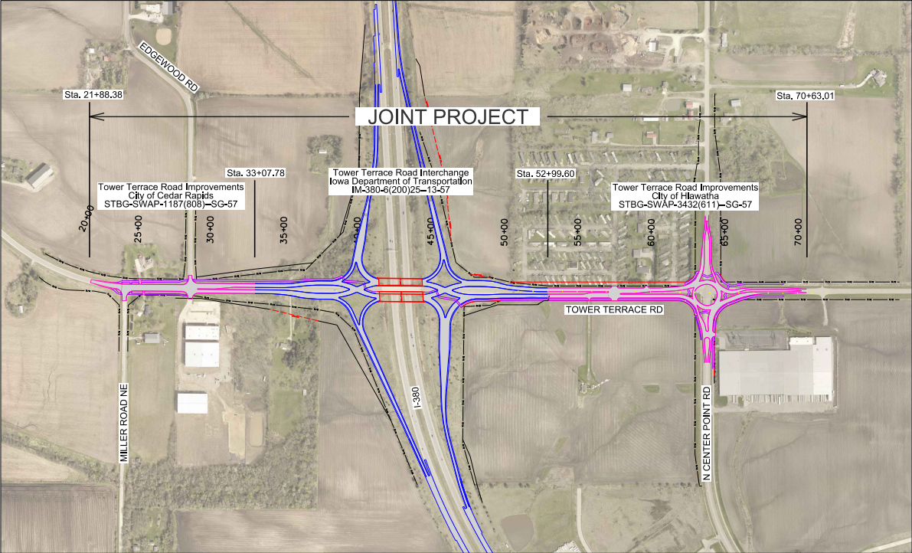
Tower Terrace Road Interchange

Slide 3
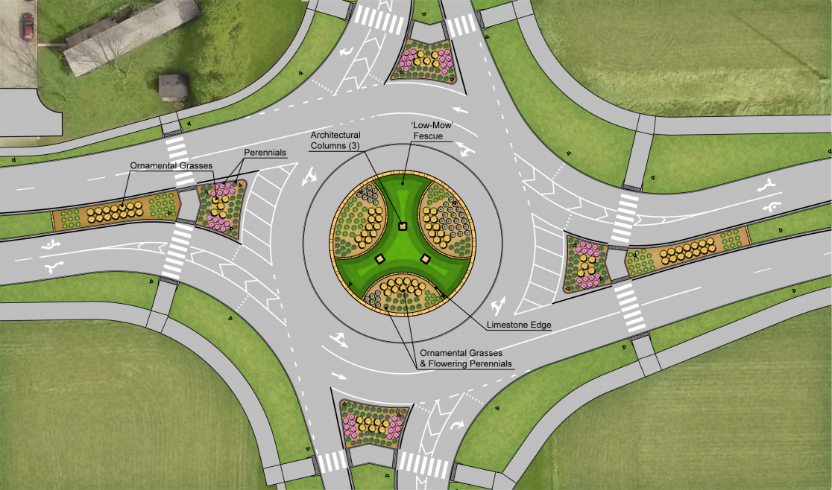

Slide 4
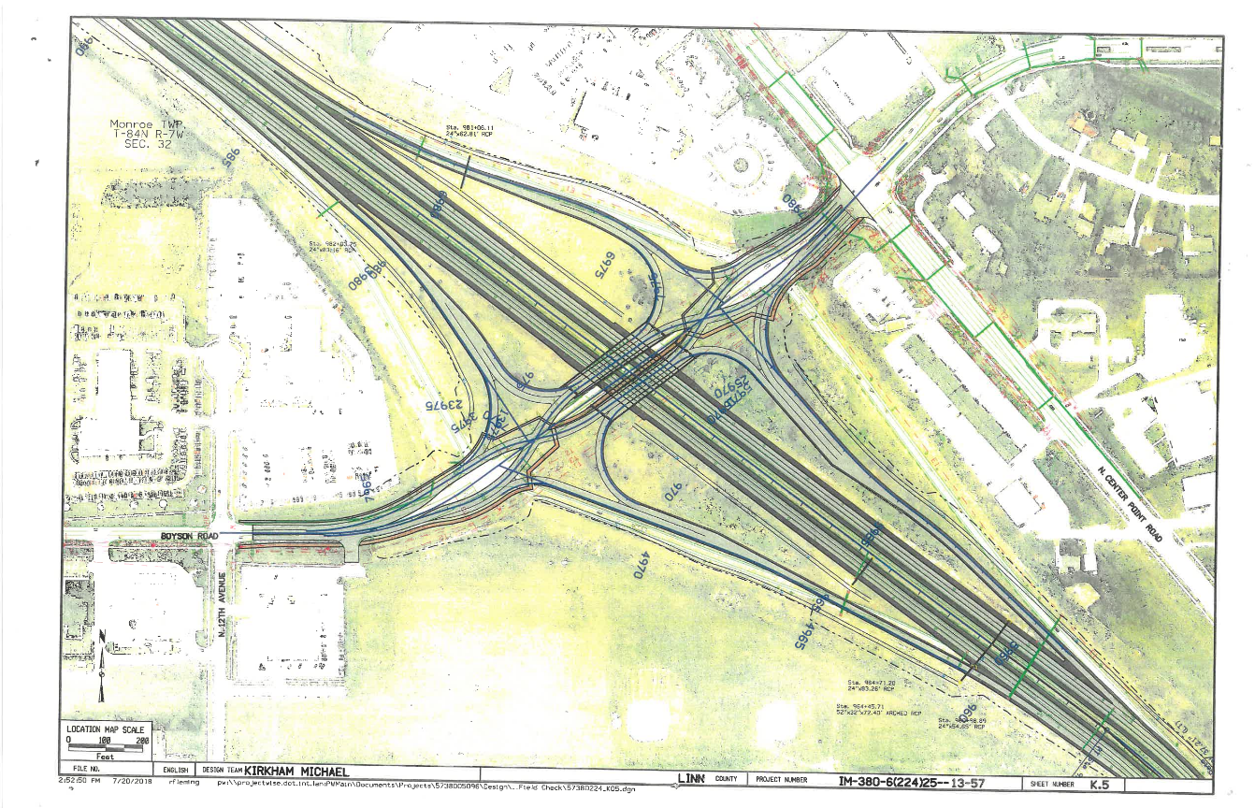
Boyson Road Interchange

Slide 5
Tower Terrace Corridor

Slide 6
