Slide 1
2022-2026 Highway Program Development
April 12, 2021

Slide 2
April 12, 2021
April Workshop Agenda
Revisit previously discussed Decision Points
Review 2022-2026 Highway Program Balances
Summarize 2022-2026 Highway Program Objectives
Discuss detailed project lists

Slide 3
April 12, 2021
Commission Program Development Schedule (2022-2026)
April 2021
Develop the Draft 2022-2026 Highway Program
Action Item: 2022-2026 Highway Program Objectives
May 2021
Present the Draft 2022-2026 Iowa Transportation Improvement Program to the public
(including all previous program approvals and draft 2022–2026 Highway Program)
June 2021
Action Item: Approve the 2022–2026 Iowa Transportation Improvement Program

Slide 4
Decision Points
April 12, 2021
At what levels should the line item targets be programmed?
Should projects in the 2022-2025 program continue to be programmed with cost/schedule updates?
How should the Program be balanced and what projects should be added to the Program?

Slide 5
Revisiting Decision Points
April 12, 2021
1. At what levels should the line item targets be programmed?
Commission direction based on February 9 discussion and March 9 action:
Increase the following line item targets
Cooperative City/County/State Highway Research increase by $250,000 each year until it reaches $2.5 million in 2025
Statewide Contract Maintenance increase by $500,000 each year
Continue to fund all other line items at previously approved target levels.

Slide 6
Revisiting Decision Points
April 12, 2021
2. Should projects in the 2022-2025 program continue to be
programmed with cost/schedule updates?
Commission direction based on March 9 and 25 discussion:
Yes, there is program capacity to do so with some rebalancing.
In many cases, local jurisdictions have made commitments and project scheduling decisions based on current program schedules.

Slide 7
Revisiting Decision Points
April 12, 2021
3. How should the Program be balanced and what projects should be added to the Program?
Commission discussion on March 9 and 25:
There is program capacity to continue the incremental increases to the stewardship targets in the later years of the Program based on asset management discussions.
Increase safety funding target by $5 million in 2022 and then increase by $1 million each following year
Add $30 million of non-Interstate pavement modernization work in 2022.
Continue to program in FY 2026 previously programmed multi-year projects.
Delay the I-80/Madison Avenue project to begin in 2025 and phase over four years
Add last phase of Iowa 2 resiliency project in Fremont County
Add additional Super-2 projects on US 30, US 18, and US 63
Add several smaller projects to address safety and operational needs that cannot otherwise be met with the stewardship category.

Slide 8
April 12, 2021
as presented March 25, 2021
Project Reschedule/Addition Scenario
For Highway Planning Purposes Only (x $1,000,000)
 | 2022 | 2023 | 2024 | 2025 | 2026 | 2027 | Beyond
Interstate Stewardship
I-80 Polk University Ave to North of Douglas |  |  |  | 1.8
I-80 Polk University Ave to North of Douglas (advance ROW) |  |  | 1.8
I-235 Polk Ramp Metering (not currently in the program) |  | 5.2
I-235 Polk Ramp Metering |  |  | 5.2
I-80 Western Iowa ITS | 1.5 | 1.0 | 1.0
Major Interstate Capacity/System Enhancement
CBIS: I-80 and Madison Avenue | 115.9
CBIS: I-80 and Madison Avenue | 5.0 |  |  | 37.8 | 22.7 | 20.7 | 24.8
I-380 Johnson: N of Forevergreen Rd to N of Penn St |  |  | 9.7 | 29.8 | 18.0

Slide 9
April 12, 2021
as presented March 25, 2021
Project Reschedule/Addition Scenario
For Highway Planning Purposes Only (x $1,000,000)
 | 2022 | 2023 | 2024 | 2025 | 2026 | 2027 | Beyond
Non-Interstate Capacity/System Enhancement
Stewardship
US 71 Dickinson Okoboji Rd in Arnolds Park to East View Ave | 5.3 | 12.9
US 71 Dickinson Okoboji Rd in Arnolds Park to East View Ave | 12.9
Iowa 2 Fremont: Resiliency improvements (Phase II) | 3.6
Iowa 3 Cherokee: 1.3 miles E of US 59 to 1.8 miles E of US 59 |  |  |  |  | 4.4
Iowa 7 Buena Vista: IA 110 Intersection in Storm Lake | 0.9
US 75 Plymouth: Hinton |  |  |  |  | 3.5 | 6.1
Iowa 76 Clayton: McGregor | 4.8
US 20 Black Hawk: Iowa 21 to E Jct I-380 Interchange (ITS) |  |  |  |  | 1.7
Culverts/Slide Repairs (multiple locations statewide) | 2.9 | 0.8 | 1.0 | 0.2
Capacity
US 30 Cedar: ECL Lisbon to WCL Mechanicsville |  |  |  |  | 3.5
US 30 Cedar: ECL Lisbon to WCL Mechanicsville |  |  |  | 3.5
US 18 Kossuth/Hancock: 1.65 miles East of Co Rd P64 to Hutchins (Super-2) | 4.8
US 30 Cedar: WCL Mechanicsville to WCL Stanwood (Super-2) |  |  |  | 0.4 | 10.1
US 63 Tama: Toledo to Co Rd E29 (Super-2) |  |  | 0.1 | 8.1
Non-Interstate Pavement Modernization
Stewardship | 30.0

Slide 10
2022-2031 Highway Program Analysis
For Highway Planning Purposes Only (x $1,000,000)
Changes to Projected Funds
FY 2021 Projects Rescheduled
Rescheduling and cost changes of projects programmed in years 2022 to 2025, add 2026
Added highlighted projects
Additional project schedule changes
April 12, 2021
as presented March 25, 2021
Proposed Highway Program Extended Highway Program
2022 2023 2024 2025 2026 2027 2028 2029 2030 2031
Projected Funds as of March 2021 754.7 687.0 715.5 707.5 701.4 701.4 701.4 701.4 701.4 701.4
Highway Program Components
Interstate Stewardship 199.1 157.9 151.5 149.9 149.0 175.0 180.0 185.0 190.0 195.0
Non-Interstate Pavement Modernization 147.7 140.0 145.0 150.0 155.0 165.0 175.0 185.0 190.0 195.0
Non-Interstate Bridge Modernization 64.5 101.7 110.6 125.8 140.3 155.0 170.0 185.0 190.0 195.0
Safety Specific 31.9 31.0 32.0 33.0 34.0 35.0 36.0 37.0 38.0 39.0
Non-Interstate Capacity/System Enhancement 158.3 178.4 267.4 141.2 156.1
US 61 Des Moines N of Mediapolis to N of IA 78 0.4
US 30 Missouri Valley bypass 21.6 6.7
US 61 1 mi N of IA 78 to 2 mi S of IA 92 49.2
US 63 NW Oskaloosa bypass 0.2
US 75 Plymouth: Hinton 6.1
Major Interstate Capacity/System Enhancement 177.1 90.0 80.2 177.2 117.2
I-35 Polk/Story 1.2
I-80 Scott Mississippi River Bridge 50.0 50.0
I-80 Pottawattamie Madison Avenue 20.7 24.8
Highway Program Balance (23.9) (12.0) (71.2) (69.6) (50.2) 22.0 58.9 109.4 93.4 77.4
Black: Previous discussion
( ): Indicates Highway Program is over-programmed
Green: Changes since previous discussion

Slide 11
2022-2031 Highway Program Analysis
For Highway Planning Purposes Only (x $1,000,000)
Changes to Projected Funds
FY 2021 Projects Rescheduled
Rescheduling and cost changes of projects programmed in years 2022 to 2025, add 2026
Added highlighted projects
Additional project schedule changes
Adjustment for final non-Interstate pavement modernization costs
April 12, 2021
Proposed Highway Program Extended Highway Program
2022 2023 2024 2025 2026 2027 2028 2029 2030 2031
Projected Funds as of March 2021 754.7 687.0 715.5 707.5 701.4 701.4 701.4 701.4 701.4 701.4
Highway Program Components
Interstate Stewardship 199.1 157.9 151.5 149.9 149.0 175.0 180.0 185.0 190.0 195.0
Non-Interstate Pavement Modernization 147.7 140.0 145.0 150.0 155.0 165.0 175.0 185.0 190.0 195.0
Non-Interstate Pavement Modernization 0.4
Non-Interstate Bridge Modernization 64.5 101.7 110.6 125.8 140.3 155.0 170.0 185.0 190.0 195.0
Safety Specific 31.9 31.0 32.0 33.0 34.0 35.0 36.0 37.0 38.0 39.0
Non-Interstate Capacity/System Enhancement 158.3 178.4 267.4 141.2 156.1
US 61 Des Moines N of Mediapolis to N of IA 78 0.4
US 30 Missouri Valley bypass 21.6 6.7
US 61 1 mi N of IA 78 to 2 mi S of IA 92 49.2
US 63 NW Oskaloosa bypass 0.2
US 75 Plymouth: Hinton 6.1
Major Interstate Capacity/System Enhancement 177.1 90.0 80.2 177.2 117.2
I-35 Polk/Story 1.2
I-80 Scott Mississippi River Bridge 50.0 50.0
I-80 Pottawattamie Madison Avenue 20.7 24.8
Highway Program Balance (24.3) (12.0) (71.2) (69.6) (50.2) 22.0 58.9 109.4 93.4 77.4
Black: Previous discussion
( ): Indicates Highway Program is over-programmed
Green: Changes since previous discussion

Slide 12
2022-2031 Highway Program Analysis
For Highway Planning Purposes Only (x $1,000,000)
Changes to Projected Funds
FY 2021 Projects Rescheduled
Rescheduling and cost changes of projects programmed in years 2022 to 2025, add 2026
Added highlighted projects
Additional project schedule changes
Adjustment for final non-Interstate pavement modernization costs
April 12, 2021
Proposed Highway Program Extended Highway Program
2022 2023 2024 2025 2026 2027 2028 2029 2030 2031
Projected Funds as of March 2021 754.7 687.0 715.5 707.5 701.4 701.4 701.4 701.4 701.4 701.4
Highway Program Components
Interstate Stewardship 199.1 157.9 151.5 149.9 149.0 175.0 180.0 185.0 190.0 195.0
Non-Interstate Pavement Modernization 148.1 140.0 145.0 150.0 155.0 165.0 175.0 185.0 190.0 195.0
Non-Interstate Bridge Modernization 64.5 101.7 110.6 125.8 140.3 155.0 170.0 185.0 190.0 195.0
Safety Specific 31.9 31.0 32.0 33.0 34.0 35.0 36.0 37.0 38.0 39.0
Non-Interstate Capacity/System Enhancement 158.3 178.4 267.4 141.2 156.1
US 61 Des Moines N of Mediapolis to N of IA 78 0.4
US 30 Missouri Valley bypass 21.6 6.7
US 61 1 mi N of IA 78 to 2 mi S of IA 92 49.2
US 63 NW Oskaloosa bypass 0.2
US 75 Plymouth: Hinton 6.1
Major Interstate Capacity/System Enhancement 177.1 90.0 80.2 177.2 117.2
I-35 Polk/Story 1.2
I-80 Scott Mississippi River Bridge 50.0 50.0
I-80 Pottawattamie Madison Avenue 20.7 24.8
Highway Program Balance (24.3) (12.0) (71.2) (69.6) (50.2) 22.0 58.9 109.4 93.4 77.4
Black: Previous discussion
( ): Indicates Highway Program is over-programmed
Green: Changes since previous discussion

Slide 13
April 13, 2020

Slide 14
April 12, 2021
FY 2022-2026 Highway Program Objectives
Projects in the 2022-2025 Highway Program will continue to be programmed with cost and schedule updates
Investment Area: Stewardship through maintaining a state of good repair
Maintain increasing funding levels for safety
Maintain increasing Interstate funding levels for pavement reconstruction, modernization, bridges, pavement patching/maintenance, rest areas, and other miscellaneous projects
Maintain increasing funding levels for non-interstate pavement modernization
Maintain increasing funding levels for non-interstate bridge modernization
Invest in additional stewardship projects
Investment Area: Modification through rightsizing the system
Transfer of jurisdiction for portions of primary roadways to cities and counties
Investment Area: Optimization through improving operational efficiency and resiliency
Invest in intelligent transportation systems infrastructure
Invest in Super-2 improvements
Investment Area: Transformation through increasing mobility and travel choices
Invest in corridor improvements

Slide 15
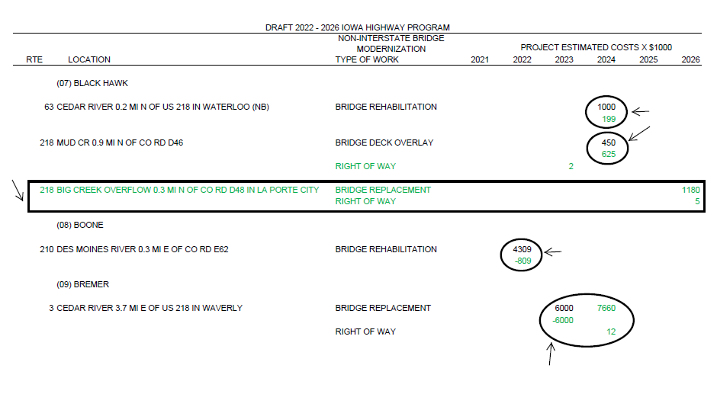
April 12, 2021
Explanation of Highway Program Changes
Project costs increased
New project added to year 2026
Project costs decreased
Project moved from year 2023 to 2024 and costs increased

Slide 16
Next Steps
April 12, 2021
April
Action Item: Approve 2022-2026 Highway Program Objectives
May
Present the Draft 2022-2026 Iowa Transportation Improvement Program to the public (including all previous program approvals and draft 2022–2026 Highway Program)
June
Action Item: Approve 2022-2026 Iowa Transportation Improvement Program

