Slide 1
Revitalize Iowa’s Sound Economy Program
Iowa Transportation Commission Business Meeting
April 12, 2022

Slide 2
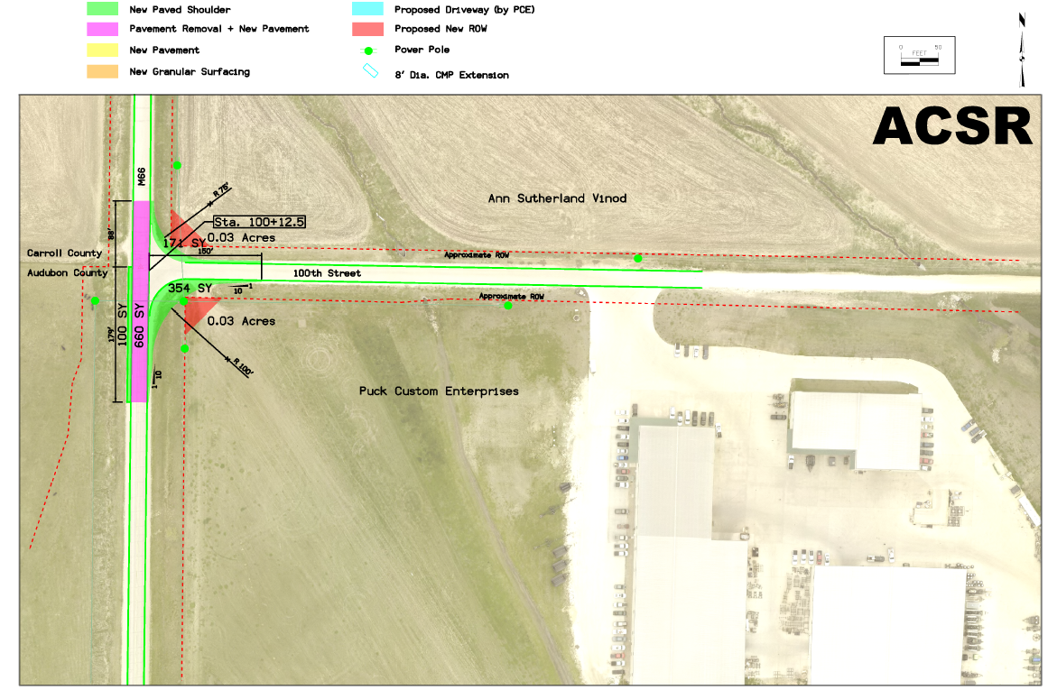
List of Immediate Opportunity Applications Recommended
PROJECT NAME
SPONSOR
SCORE
TOTAL PROJECT COST
PERCENT PARTICIPATION
RECOMMENDED AMOUNT
Amendment: Reduce the grant, remove 100th Street improvements and construct additional intersection improvements to County Road M-66 and 100th Street. | Audubon County | N/A | $297,525 | 80% | $238,020

Slide 3
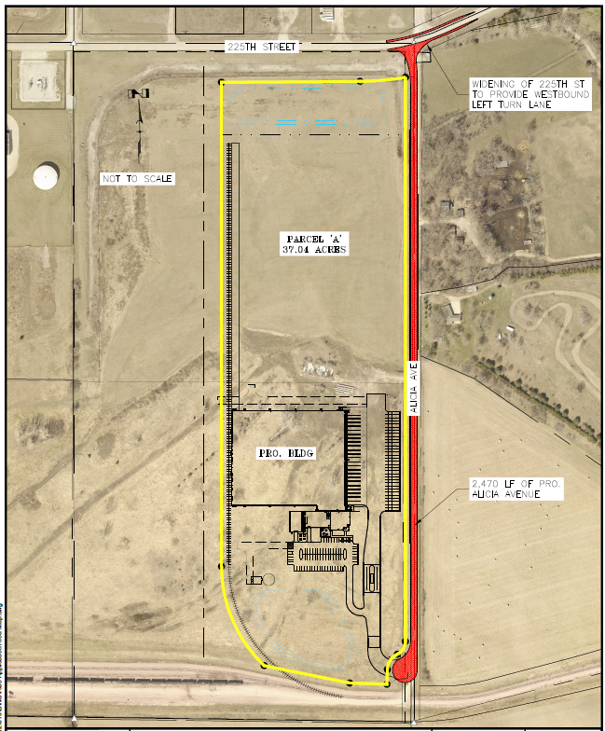
List of Local Development Applications Recommended
PROJECT NAME
SPONSOR
SCORE
TOTAL PROJECT COST
PERCENT PARTICIPATION
RECOMMENDED AMOUNT
Paving approximately 2,470 feet of Alicia Avenue and construction of a left-turn lane on 225th Street. | Sioux City | 66 | $2,661,056 | 50% | $1,330,528

Slide 4
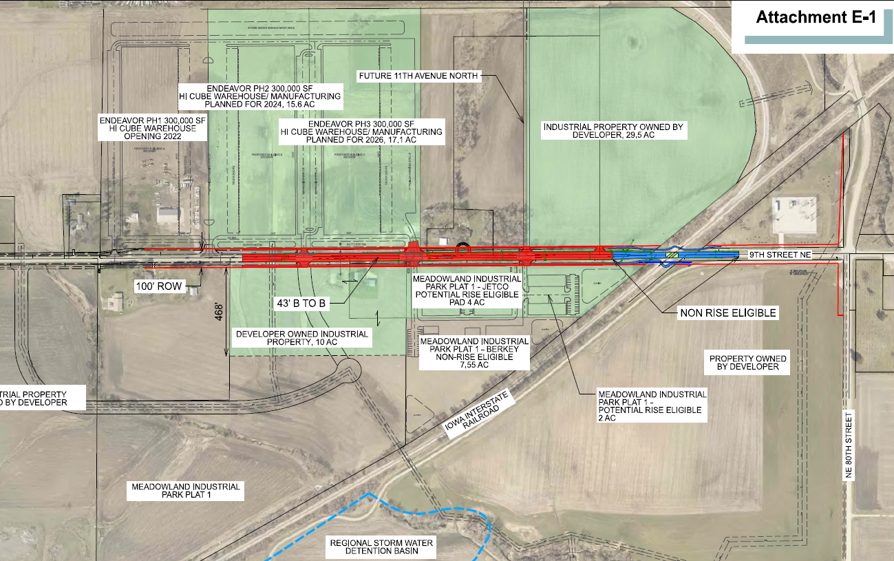
List of Local Development Applications Recommended
PROJECT NAME
SPONSOR
SCORE
TOTAL PROJECT COST
PERCENT PARTICIPATION
RECOMMENDED AMOUNT
Reconstruction of approximately 1,960 feet of 9th Street NE. | Altoona | 45 | $3,018,414 | 50% | $1,509,207

