Slide 1
REGION 13 SWITA TRANSIT SWIPCO PLANNING

Slide 2
OUR TRANSIT CAPABILITES
74 Drivers
63 Light duty buses (seat between 16-20)
28 Mini-Vans
4 Sedans
3 medium duty buses (seat between 33-40)
2 SUV’s
4 STS Light duty buses(seat 14-18)
Facilities in Atlantic, IA and Council Bluffs, IA

Slide 3
SWITA ABOUT US
State designated public transit provider for Harrison, Shelby, Pottawattamie, Cass, Mills, Montgomery, Fremont and Page counties in Southwest Iowa.
Provide over 375,000 rides and travel over 1.8 million miles in FY21. Projected to provide over 425,000 rides and run over 2 million miles in FY22.
Services include but are not limited to transportation for elderly and disabled individuals, work routes, van pools, taxi service and student transportation.

Slide 4
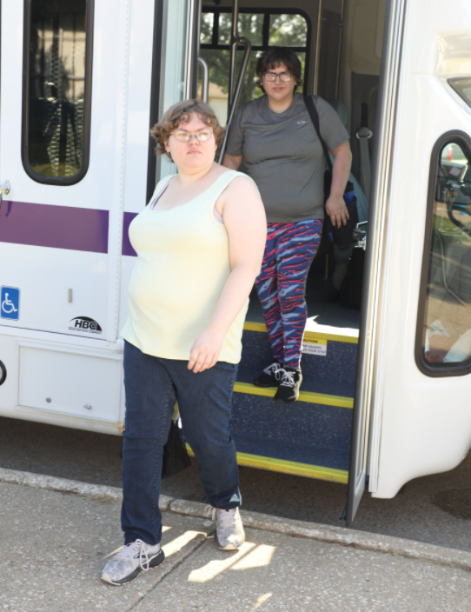
WORKROUTE RIDERSHIP BY YEAR
FY17 | FY18 | FY19 | FY20 | FY21 | **FY22 PROJ**
25,963 | 39,953 | 57,128 | 43,363 | 57,128 | 80,000

Slide 5
CURRENT WORKROUTES
MENARDS---COUNCIL BLUFFS TO SHELBY (SEASONAL)
UPTOWN STAFFING(OAKLAND FOODS ROUTES)
PSSI (OSI) ****Started 6/18****
PSSI (MONOGRAM)****Started 7/18****
MONOGRAM FOODS---HARLAN, IA****Started 8/18****
OSI—ATLANTIC TO OAKLAND 1ST AND 2ND SHIFT*Started 11/19*
TRANSITION ALLIANCE ROUTE (CBCSD)****Started 09/19***

Slide 6
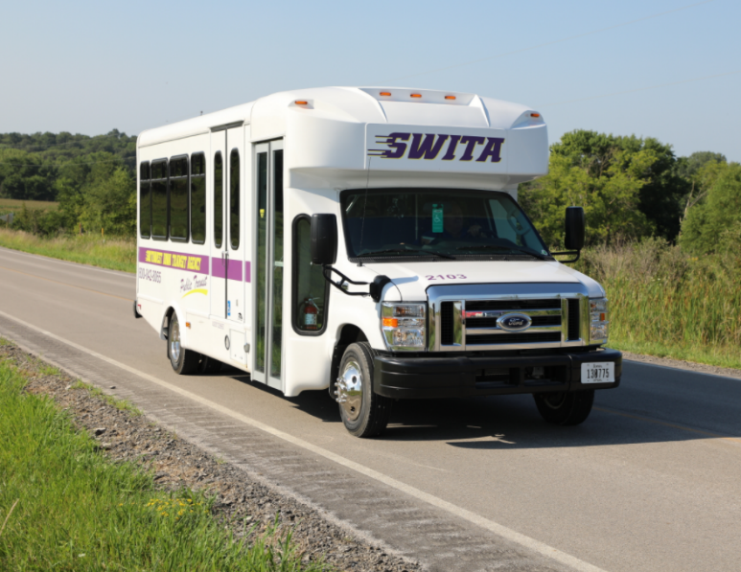
IN DEVELOPMENT
OSI---CB/OMA to Oakland both shifts expansion***Pending driver***
PSSI/Costco Poultry—CB Metro to Fremont, NE***Pending driver***

Slide 7
CURRENT STRUGGLES
System wide we are around 10 drivers short for current needs and 18 drivers short if factoring in routes that are ready to run but waiting on drivers.
DMV’s in our area are currently over a month out on testing and the DMV in Council Bluffs has been given a waiver from the state allowing them to refuse testing in our vehicles.
ELDT training has added a considerable amount of time to our driver on boarding process. The theory portion of this training has added 8 hours and BTW training has added another 8-10 hours depending on the trainee.

Slide 8
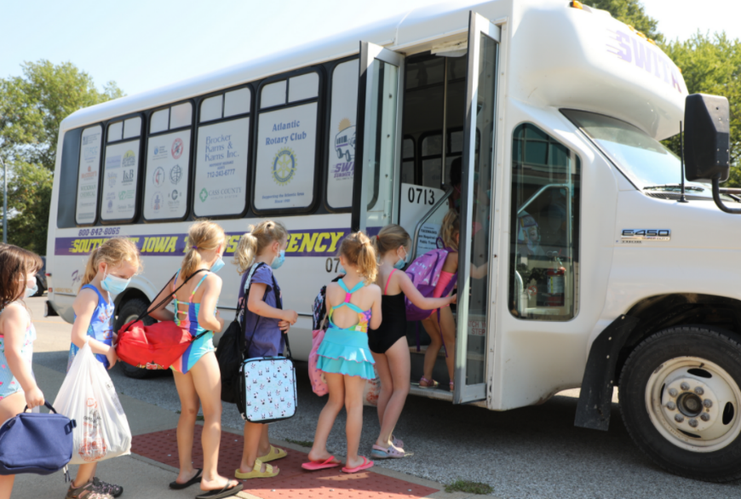
REQUESTED SUPPORT AREAS
3RD PARTY TESTING LOCATIONS
FLEXIBILITY ON BUS PURCHASES

Slide 9
SWIPCO- RPA 13
Transportation Planning and Projects
Cass, Fremont, Montgomery, and Page Counties

Slide 10
RPA-13 Programming
RPA-13 Sub-allocates funding for road improvement projects to each of the four counties and the four largest cities (Atlantic, Clarinda, Red Oak, and Shenandoah) based on a formula like Road Use Tax Fund.
About $5,000,000 allocated per year
Bridge projects are selected on a county-wide basis and ranked based on inspection reports, traffic data, classification of type and level of service, proximity to proposed construction projects, new or relocating business needs, and public input.
Transportation Alternatives Program partially funds the region’s trail and safe routes to school projects on a competitive basis.

Slide 11
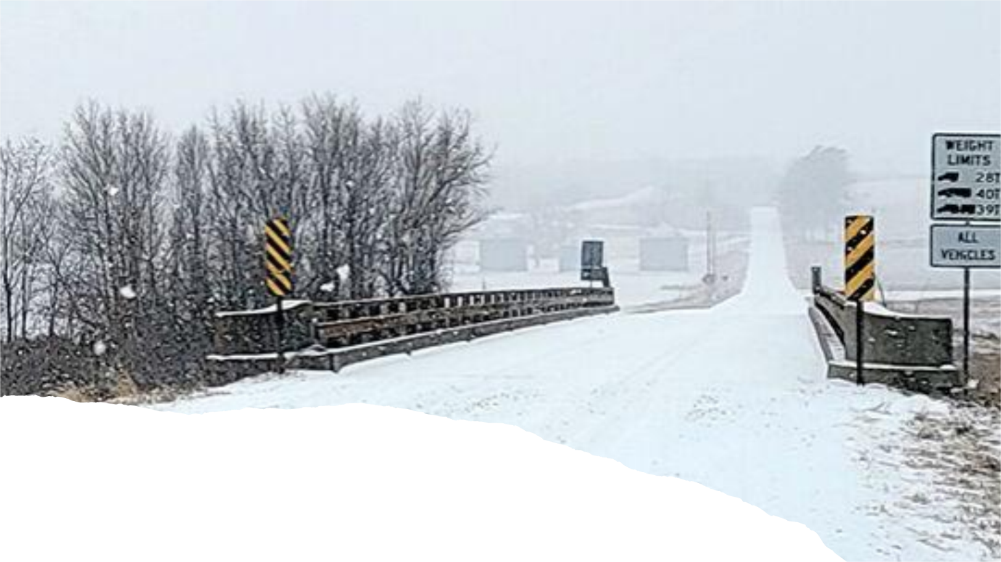
STBG Project Highlight- Essex Bridge Replacement
$2,800,000 total funding between RPA-13 and DOT for 150th St Bridge Replacement
The bridge crosses the East Nishnabotna River and is shared with Page County
The project is scheduled to be started in fall 2022 and will widen and lengthen the original 1937 bridge
Page County Newspapers photo by Heidi Hertensen

Slide 12
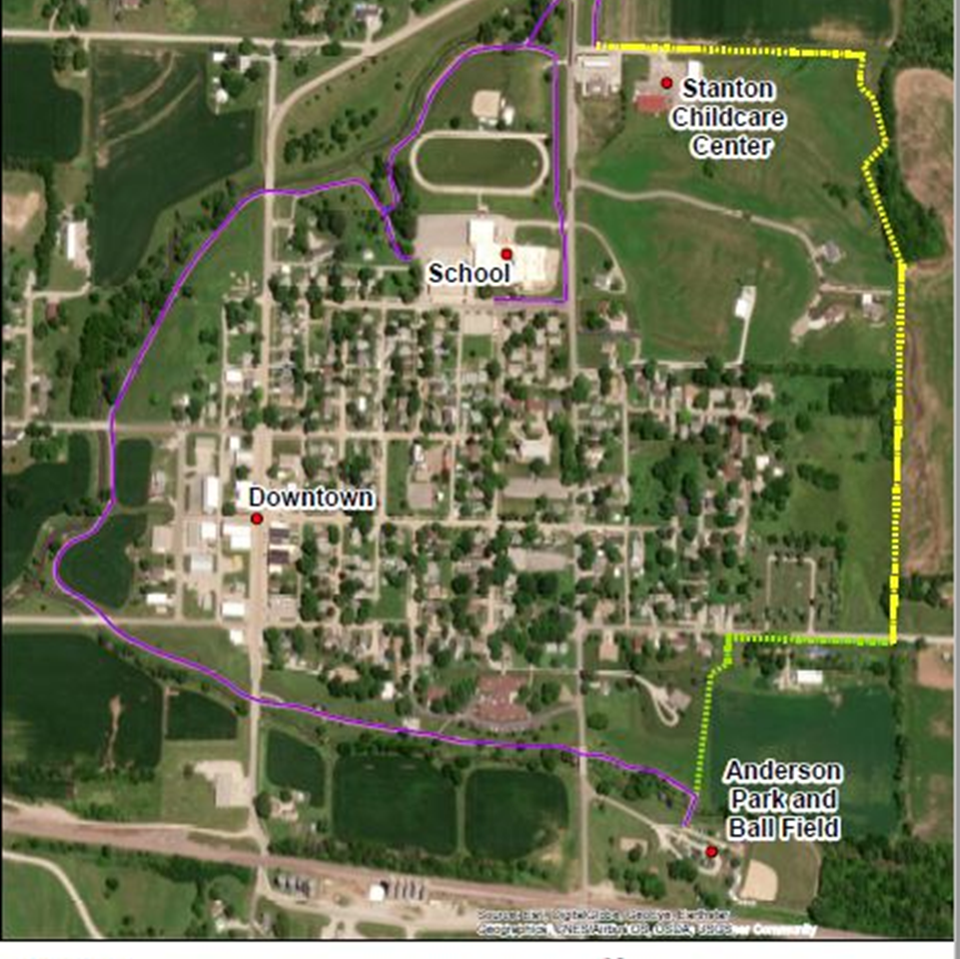
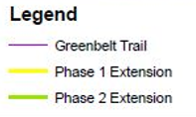
TAP Project Highlight- Stanton
Stanton
$100,000 TAP grant
$244,000 project budget
To complete the greenbelt loop around the city

Slide 13
2019 Flood Recovery Work
Hamburg Levee
$6,800,000 EDA Grant for the local match
USACE and DOT partnership and coordination to build a 3-mile levee to protect Hamburg from future flood events in addition to raising 2 roads to the levee height.
A second levee is planned southwest of Interstate 29
Photo Credit: US Army Corps of Engineers

Slide 14
Thank you for your support!
John McCurdy, AICP Executive Director
Mark Lander, Transit Director
Alexsis Fleener, Community Development Director

