Slide 1
Transportation Trends Update
Transportation Commission Workshop
April 11, 2022

Slide 2
Overview
Economic Recovery Index
Travel trends
US total rail carloads
Commercial air service passenger counts
Vehicular traffic

Slide 3
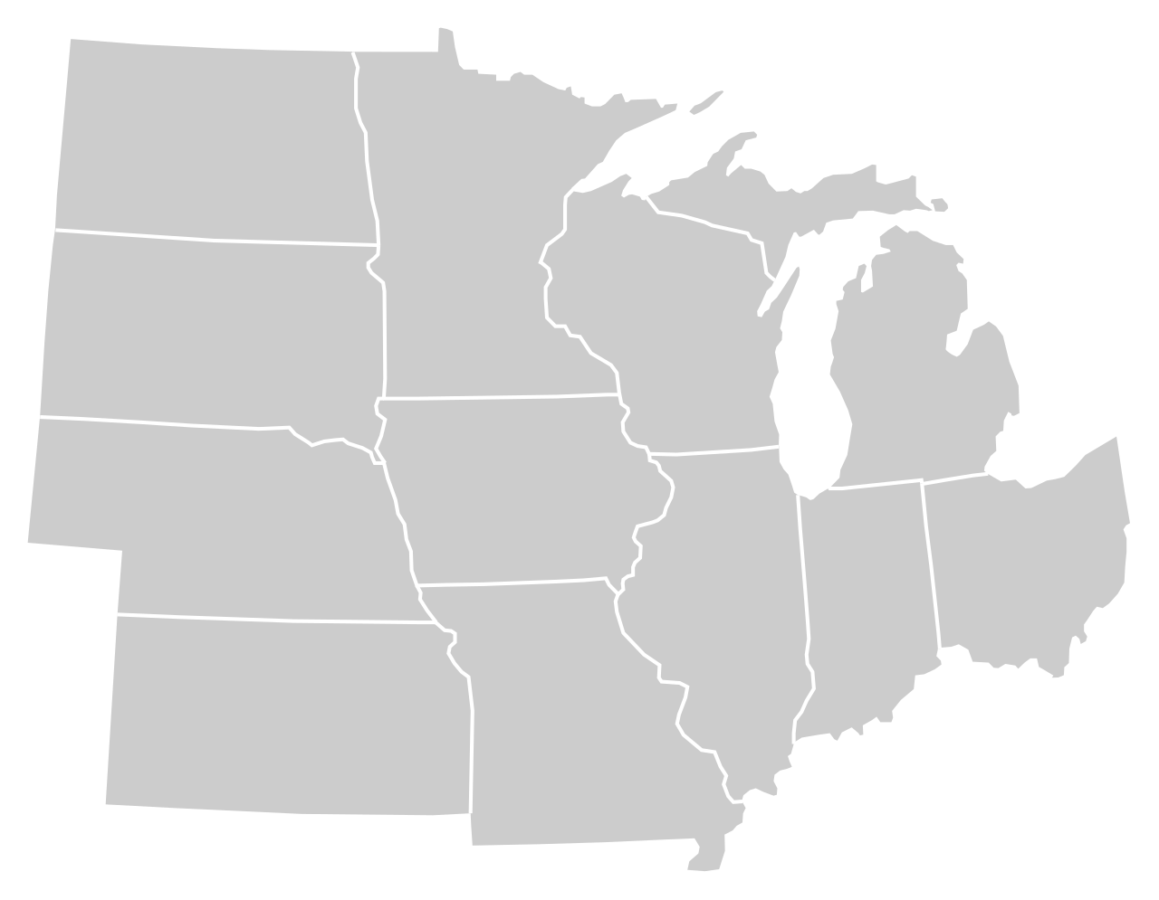
Moody’s/CNN Recovery Index - Midwest (Pre-Pandemic = 100) As of 4/1/2022
96%
91%
105%
95%
95%
98%
(94% last month)
101%
97%
89%
99%
94%
93%
Nation is at 95% (92% last month)

Slide 5
Monthly Passenger Counts at Iowa’s Eight Commercial Service Airports
(through February 2022)

Slide 6
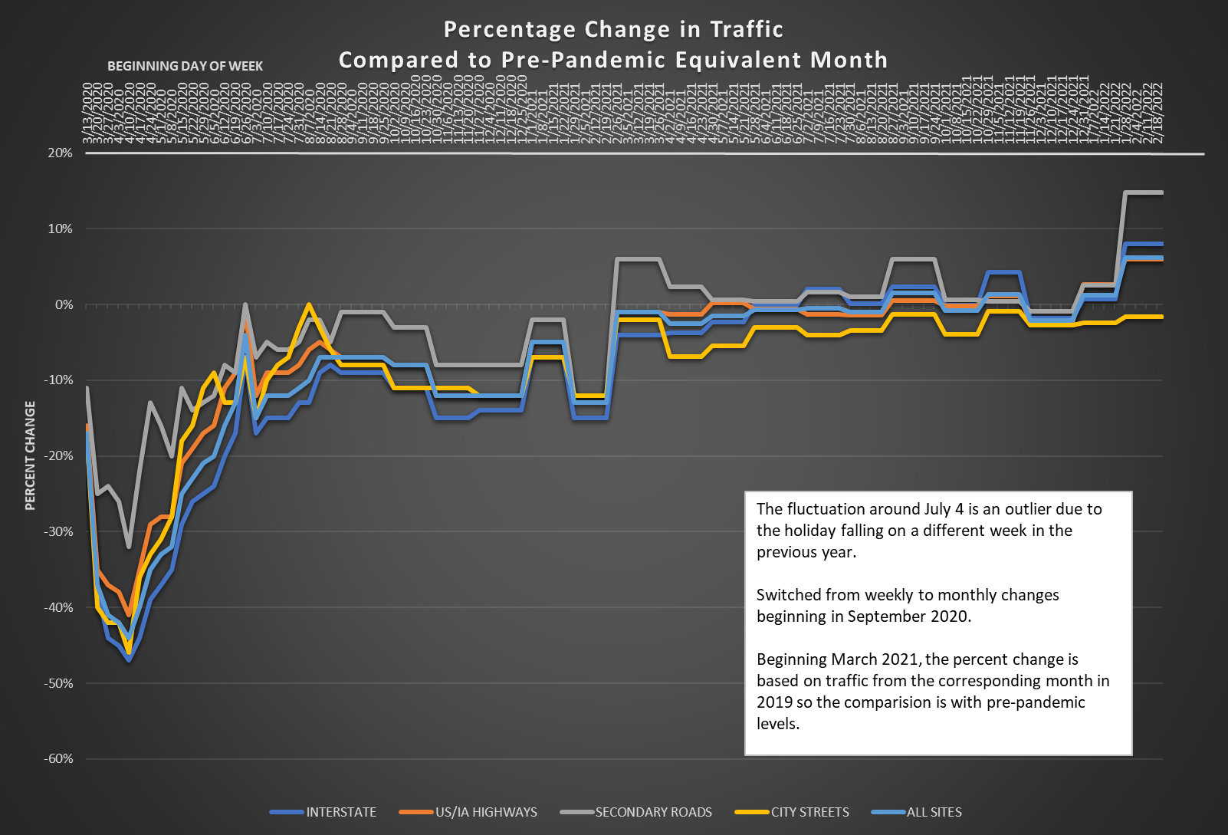

Slide 7
Questions?

